Slide 1
America in World War One

Slide 2
Good Morning Students, silently read “When Would You Go To War?” in the activities and sources packet

Slide 3
World War I Prior Knowledge
At the top of your notes, write some things you know (or think of) about World War I.

Slide 4
World War One-At a Glance (Contextualization)
Nicknamed the “Great War”
Largest conflict the world had seen up that point
Lasted four years-1914-1918
Extremely deadly
16 million deaths, 20 million wounded
First major conflict after the Second Industrial Revolution-technology much improved

Slide 5
Crime of the Ages

Slide 6
Participating Countries in World War I

Slide 7
Long Term Causes of World War I
Militarism
Alliances
Imperialism
Nationalism

Slide 8
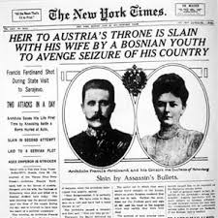
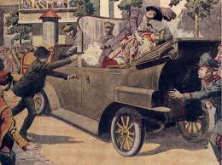
The Spark
The assassination of Archduke Franz Ferdinand and his wife in June 1914.
By August, all major European nations were at war with each other.

Slide 9
U.S. Neutrality
In August 1914, President Wilson issued a Proclamation of Neutrality after the war in Europe broke out.
Encouraged Americans to remain neutral in “thought as well as in action”
Notes:
J.P. Morgan & other Wall Street bankers lent
the Allies over $3 billion
British blockade of German coast mostly prevented American trade with Germany.

Slide 10
U.S. Neutrality?
Value of US Exports for 1914:
Allies:$824.8Million
Central Powers: $169.3 Million
Value of US Exports for 1916:
Allies: $3.2 Billion
Central Powers: $1.2 Million
Value of US loans for 1917
Allies: $2.5 Billion
Central Powers: $27 Million

Slide 11
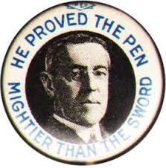
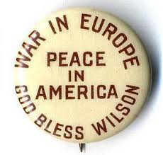
U.S. Election of 1916

Slide 12
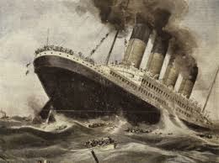
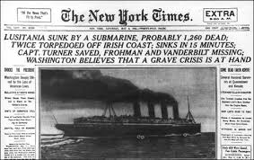

Slide 13
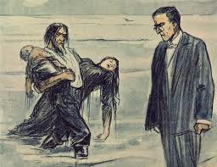

Slide 14
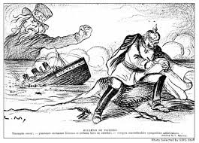

Slide 15
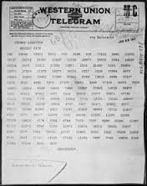
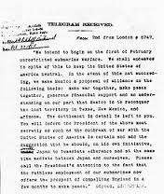

Slide 16
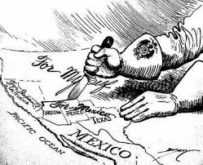

Slide 17
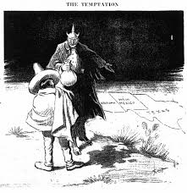

Slide 18
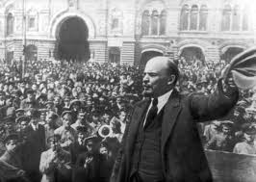
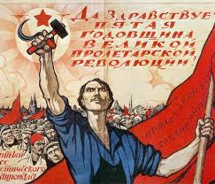

Slide 19
Main Reasons U.S. Enters War
Sinking of Lusitania/unrestricted submarine warfare
Zimmerman Note
Communists take over Russia

Slide 20
Woodrow Wilson, April 12, 1917
“The world must be made safe for democracy.”
Woodrow Wilson

Slide 21
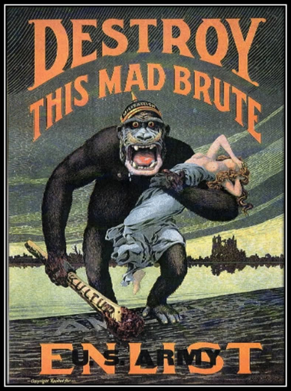
Read Wilson’s War Message to Congress, 1917 and answer the questions. Be prepared to discuss.

Slide 22
Read Diverging Interpretations of Why the U.S. went to War. Organize “answers” in most convincing and least convincing.

Slide 23
America Tips the Balance
Selective Service Act
May 1917
Military Draft
24 million registered, 3 million called into duty, 2 million serve in Europe
Soldiers enter Europe fresh and idealized compared to their European counterparts
Soldiers are nicknamed “doughboys”-white belts

Slide 24
Over There

Slide 25
What does the song Over There reveal about American identity during wartime?

Slide 26
Essential Question-Day3
How did World War One affect American society & the U.S. economy?

Slide 27
Mobilizing Industry
U.S. economy not ready for war – had to mobilize.
President Wilson ordered nationalization of all railroads under the Railroad Administration
Temporary – ended after the war
War Industries Board
Controlled raw materials, production, prices, & labor relations
Notes:
– not very powerful, met with resistance, quickly disbanded after the war.

Slide 28
Mobilizing Labor
Slogan - “Labor Will Win the War.”
More than 1 million women joined the workforce after the U.S. declared war
19th Amendment ratified just after the war in 1920
Many African Americans migrated north to work in war factories.
War Dept. issued a “work or fight” rule in 1918 – drafted if unemployed

Slide 29
Mobilizing Labor
National War Labor Board, 1918 created to mediate labor disputes.
▪Discouraged strikes ▪Encouraged higher wages, 8-hour work day, & unionization.
Union membership in U.S. doubled during the war.
Wages in unionized sectors increased 20%
BUT, inflation increased – prices more than doubled
▪Strikes still plagued U.S. – no federal recognition of labor unions

Slide 30
Mobilizing the Economy
Food Administration established in 1917
▪Headed by Herbert Hoover
▪Relied on voluntary compliance
“Meatless Mondays” & “Wheatless Wednesdays
▪Encouraged “Victory Gardens” & rationing
18th Amendment ratified in 1919 – prohibited manufacture of alcohol (conserve grain)

Slide 31
Mobilizing Public Opinion
Congress established the Committee of Public Information in 1917.
▪Encouraged public support for the war ▪Voluntary press censorship, propaganda (films, posters), community volunteer organizations
▪Encouraged citizens to report “suspicious” actions or speech

Slide 32
Essential Question (Day 2)
Should citizens’ rights be restricted in wartime as a means of protection?

Slide 33
Restricting Civil Liberties in Wartime-Review
1798 – Alien & Sedition Acts Prohibited public criticism of U.S. government
1861 – Lincoln suspends writ of Habeaus Corpus
Notes:
Federalist-controlled Congress targeted French-sympathizers in Democratic-Republican party
\ Raised residency requirement for citizenship, increased presidential power to arrest/jail/deport immigrants
Targeted Confederate spies
Allowed prisoners to be held indefinitely – declared unconstitutional by Supreme Court, Lincoln ignores ruling

Slide 34
Restrictions on Civil Liberties
Anti-German hysteria swept the US – fueled by CPI propaganda.
Resulted in rampant rumor of spying & sabotage
German courses discontinued in many schools
Orchestras stopped playing Wagner & Beethoven
▪German foods renamed
▪Frankfurters→hot dogs
▪Hamburgers→liberty sandwiches
▪Sauerkraut→liberty cabbage

Slide 35
Restrictions on Civil Liberties
Espionage Act of 1917
Provided fines & imprisonment for persons making false statements, aiding the enemy, inciting military rebellion, or obstructing Selective Service
Sedition Act of 1918
Forbade any criticism of the government, flag, or uniform. Targeted Socialists & members/leaders of the IWW - Eugene Debs

Slide 36
Restrictions on Civil Liberties
Schenck v. United States
▪Upheld the constitutionality of the Espionage Act
Ruling limited free speech when words represented “a clear & present danger.”
Notes:
Justice Oliver Wendell Holmes’ example: Yelling fire in a crowded theater is not protected speech

Slide 37
Go to website-Period 7-WWI and Imperialism and download Sedition in WWI Lesson Plan
HIPP Documents A & B
Historical Context
Intended Audience
Purpose
Point of View
Answer the following for Document C
When was this law passed? Why did the U.S. gov. pass this law?
In your own words, summarize this law.
Do you think this law was necessary? Why or why not? Use evidence to support your answer.

Slide 38
ROLES
PRESENTER-4
LEADER-3
TIME KEEPER- 2-15 MINUTES
RECORDER-1

