Slide 1
Capitalism vs. Socialism & Communism

Slide 2
Capitalism

Slide 3
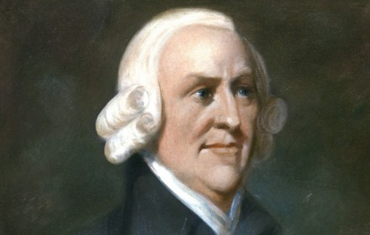
Adam Smith

Slide 4
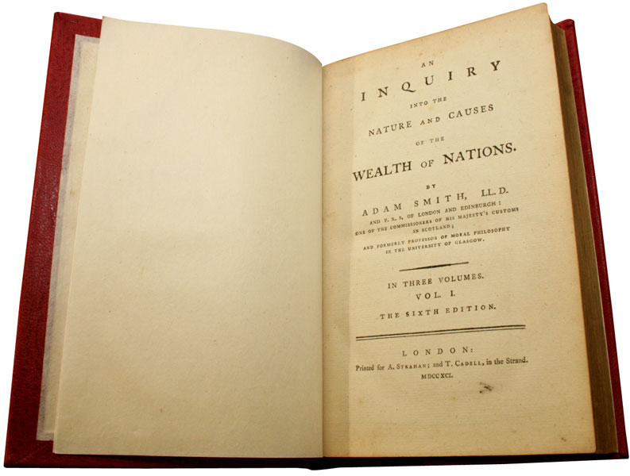
The Wealth of Nations, 1776

Slide 5
Quotes
“Every individual… intends only his own gain, and he is in this… cases… led by an invisible hand to promote… the public good.”

Slide 6
Economics
Private ownership of property
Profit motive
Free market competition

Slide 7
Role of Government
Laissez-faire (“let it be”)
Break apart monopolies

Slide 8
Pros
Innovation, efficiency & freedom of choice
Increased standard of living for most people (middle class)

Slide 9
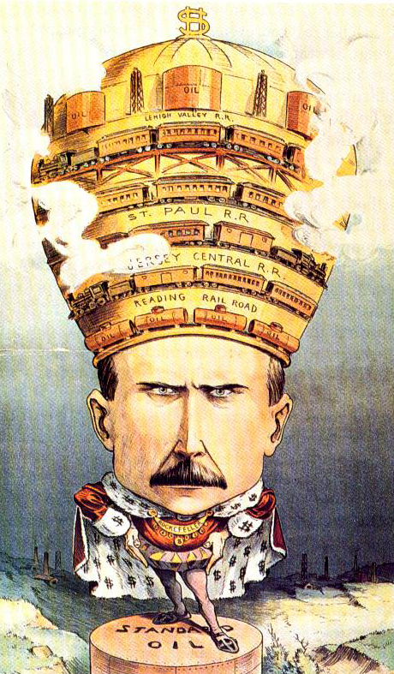
Cons
Unequal distribution of wealth & exploitation of workers
Cycles of boom & bust
Monopolies can develop, eliminating competition

Slide 10
Key Figures

Slide 11
Key Figures

Slide 12
Countries

Slide 13
Socialism & Communism

Slide 14
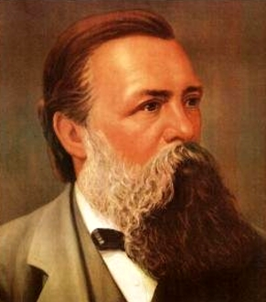
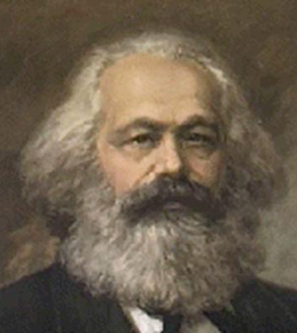
Friedrich Engels & Karl Marx

Slide 15
The Communist Manifesto, 1848

Slide 16
Das Kapital, 1867

Slide 17
Quotes
“Workers of the world, unite! You have nothing to lose but your chains.”
“From each according to his ability, to each according to his need.”

Slide 18
Economics
Response to the injustices of capitalism
Class struggle: Bourgeosie vs. Proletariat
Redistribution of wealth

Slide 19
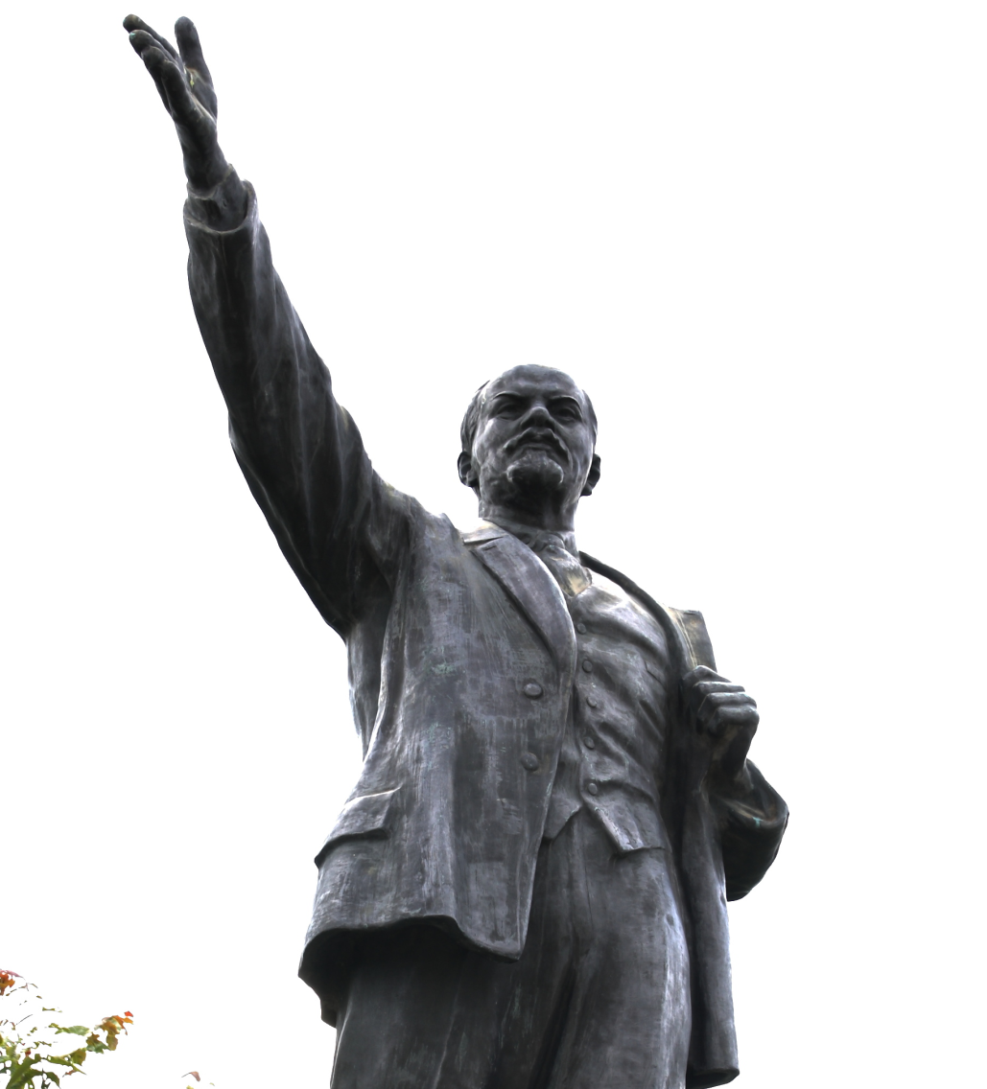
Role of Government
Government control of all economic activity
“Dictatorship of the proletariat”

Slide 20
Pros
Basic needs like employment, food, clothing & shelter are guaranteed by the government
Industrial production & unity help fight wars

Slide 21
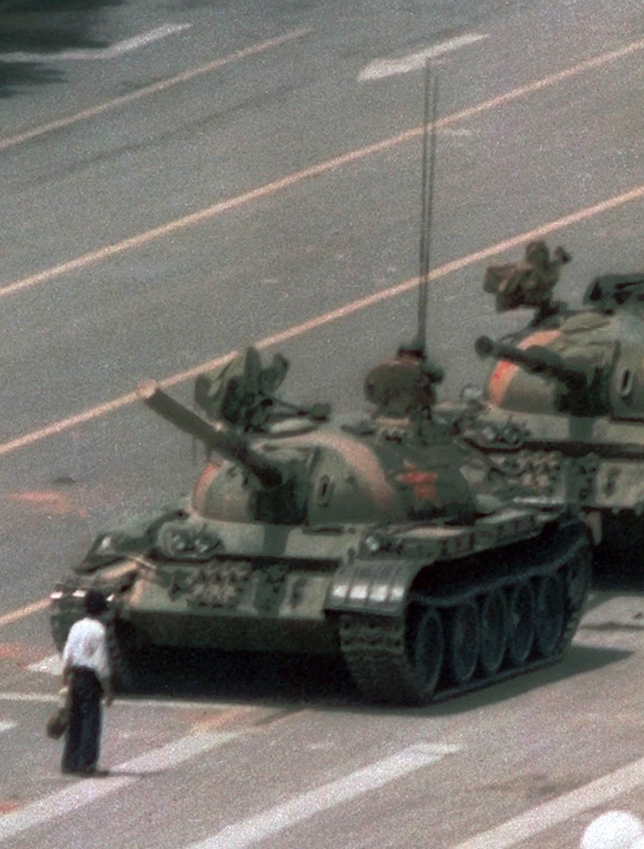
Cons
Tendency to become a totalitarian dictatorship
Consumer goods & comforts are often scarce
Slow or no economic growth

Slide 22
Key Figures

Slide 23
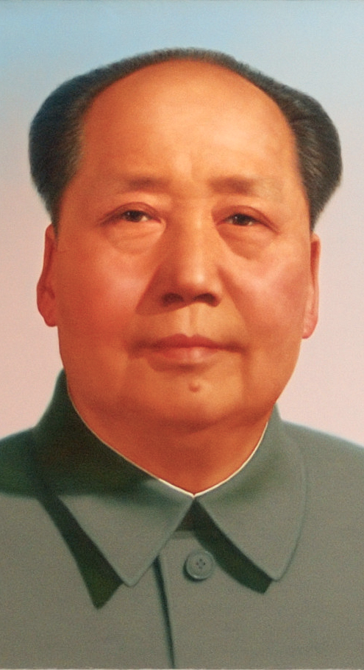
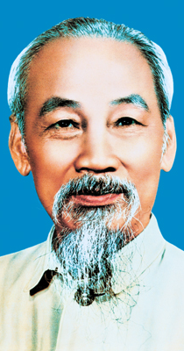
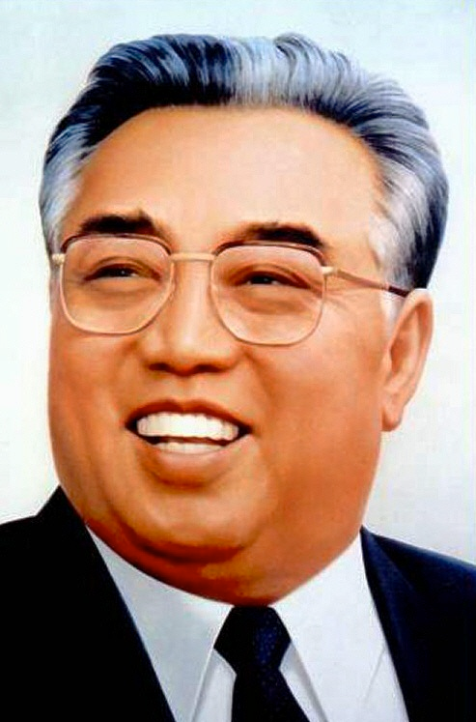
Key Figures

Slide 24
Countries

Slide 25
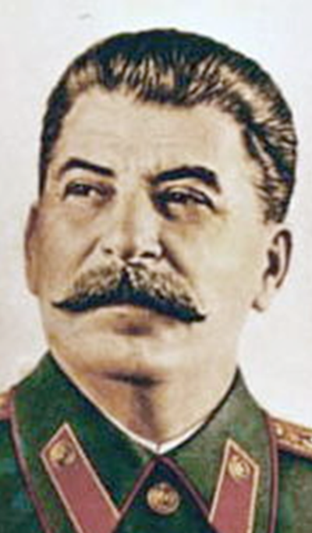
Communism vs. Socialism

Slide 26
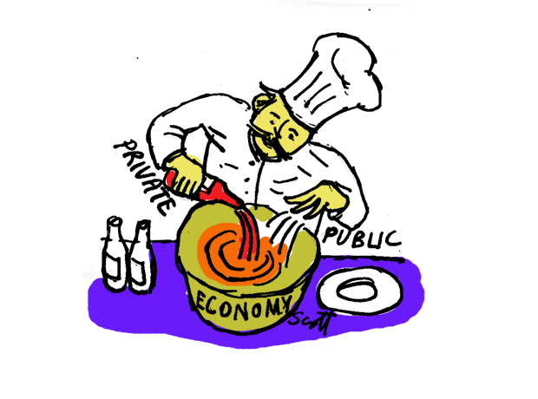
Mixed Economy

