Slide 1
Industrialization, Urbanization and Immigration….oh my.

Slide 2
A Nation of Immigrants
In the last half of the 19th century, the U.S. Population more than tripled. From 23.2 million in 1850 to 76.2 million in 1900.
16.2 million of those were immigrants.
8.8 million more will arrive from 1900-1910

Slide 3
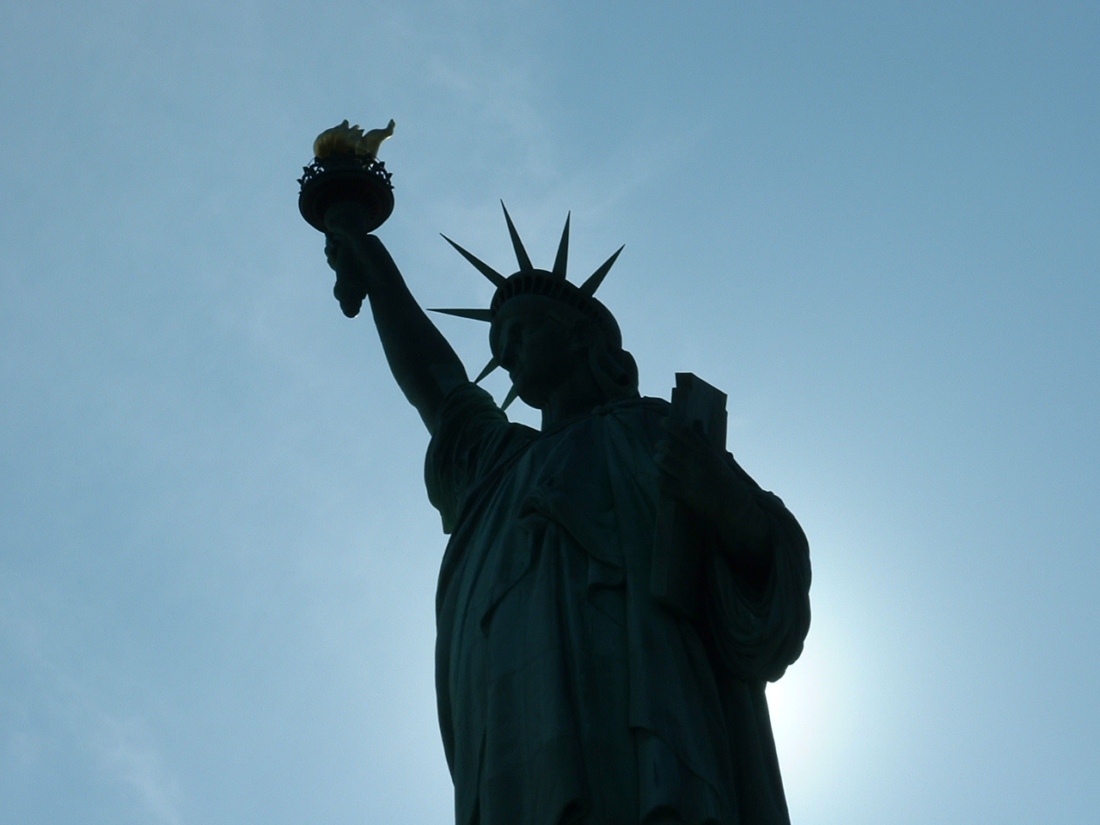
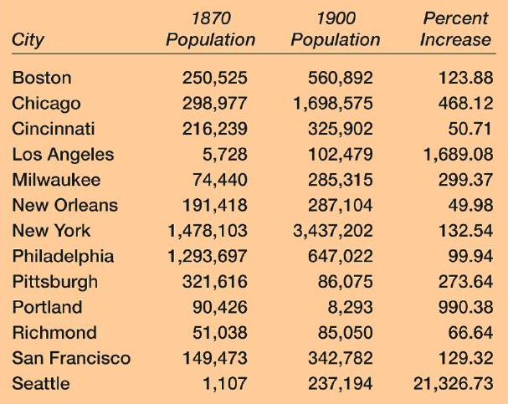
Immigration & Urbanization

Slide 4
Reasons for Immigration to U.S.
Push Factors (negative)
Pull Factors (positive)
Poverty of displaced farmworkers
Overcrowding and joblessness
Religious persecution especially Jews in eastern Europe
American reputation for political and religious freedom
Economic opportunities
Abundance of industrial jobs in American cities

Slide 5
Old Immigrants vs. New Immigrants
OLD
New
British, German, Irish and Scandinavian
Protestant
Mostly English speaking
Southern and Eastern Europe: Italians, Greeks, Croats, Slovaks, Poles and Russians.
Poor and illiterate
Roman Catholic, Greek Orthodox, Russian Orthodox and Jewish
Many languages
Crowded into poor ethnic neighborhoods in New York, Chicago, and other large cities

Slide 6
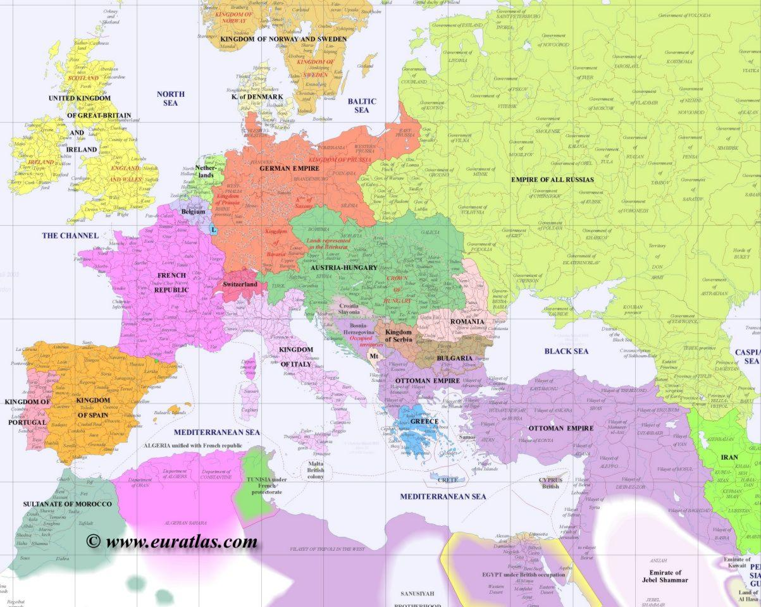
Old Immigration

Slide 7
New Immigration

Slide 8
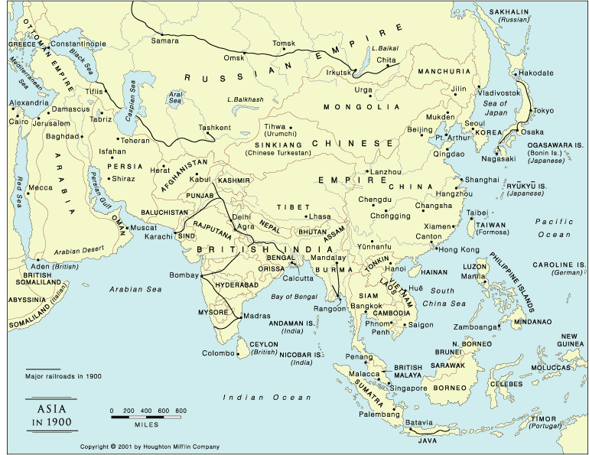
New Immigration

Slide 9
ARRIVAL
Physical Exams
Quarantine
Name Changes
Culture Shock
Video – Edison Motion Pictures

Slide 10
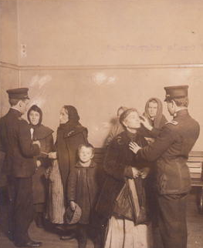
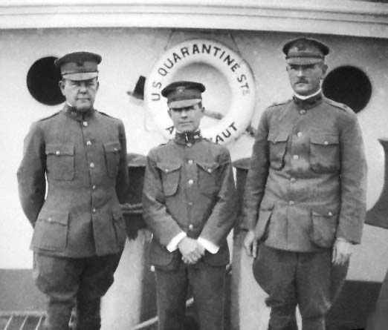
Medical Exams & Quarantine

Slide 11
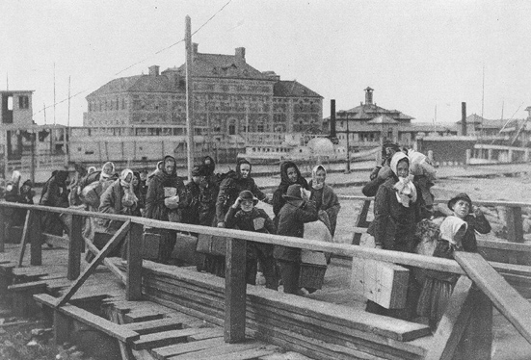
Ellis Island, NY

Slide 12

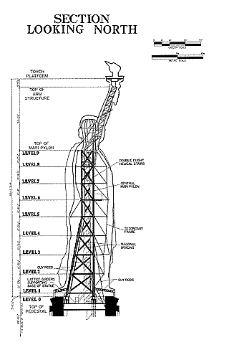
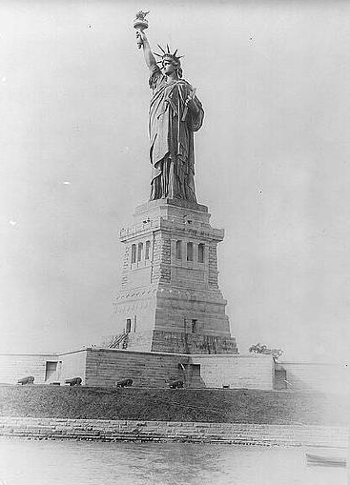
Statue of Liberty, 1886

Slide 13
The New Colossus
Not like the brazen giant of Greek fame,
With conquering limbs astride from land to land;
Here at our sea-washed, sunset gates shall stand
A mighty woman with a torch, whose flame
Is the imprisoned lightning, and her name
Mother of Exiles. From her beacon-hand
Glows world-wide welcome; her mild eyes command
The air-bridged harbor that twin cities frame.
"Keep ancient lands, your storied pomp!" cries she
With silent lips. "Give me your tired, your poor,
Your huddled masses yearning to breathe free,
The wretched refuse of your teeming shore.
Send these, the homeless, tempest-tost to me,
I lift my lamp beside the golden door!"
—Emma Lazarus, 1883

Slide 14
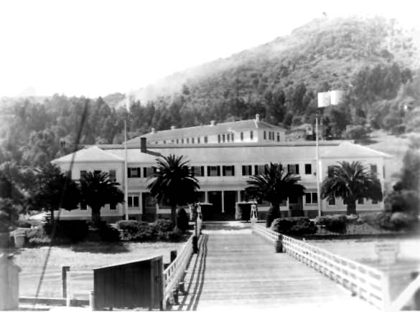
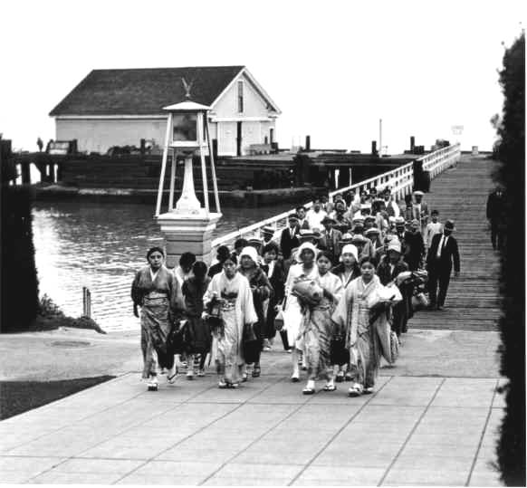
Angel Island, San Francisco

Slide 15
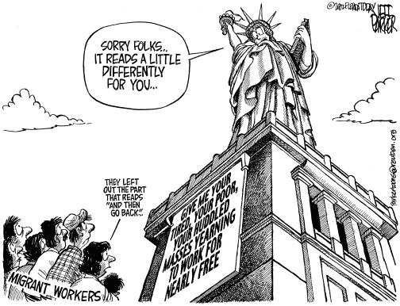
Immigration Today

Slide 16
Restricting Immigration
Chinese Exclusion Act of 1882-placed a ban on all immigrants from China
1882 restriction on “undesirable” immigrants (criminals & mentally ill).
Contract Labor Law-restricted temporary workers to protect American workers
Literacy test passed in 1917
By 1892 immigrants had to pass more rigorous medical examinations and pay a tax

Slide 17
Supporters Immigration restrictions
Labor Unions- feared immigrants would depress wages and break strikes
Nativist societies such as American Protective Association prejudice against Roman Catholics
Social Darwinists- saw new immigrants as biologically inferior

Slide 18
Urbanization
Urbanization and industrialization developed simultaneously.
Cities provided both laborers and a market for factory made goods.
By 1900 almost 40 percent of Americans lived in towns or cities.
By 1920 most Americans lived in Urban areas than in rural areas

Slide 19
Urban residents
Both immigrants and internal migrants from rural areas moved to cities
Migrants left farms in search of factory jobs
African-Americans joined the movement from farms to cities. Between 1897-1930, nearly 1 million southern Blacks settled northern and western cities

Slide 20
Changes in nature of cities
Streetcars for transportation
Skyscrapers
Ethnic neighborhoods

Slide 21

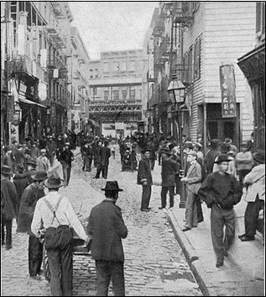
Chinatown
San Francisco
Los Angeles
New York City

Slide 22

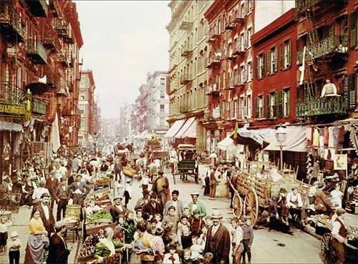
“Little Italy”

Slide 23
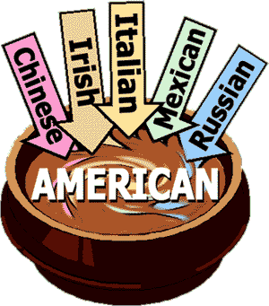
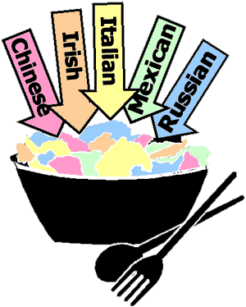
Theories of Culture
Melting Pot Assimilation
Salad Bowl Pluralism

Slide 24
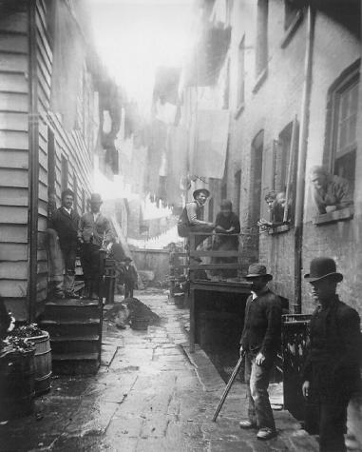
Tenements
One or more families living in a small apartment
Poor sanitation & ventilation

Slide 25
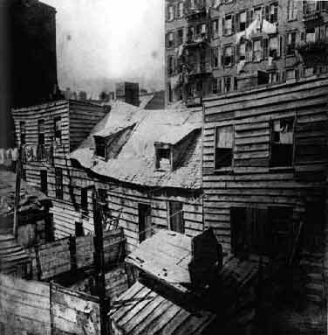
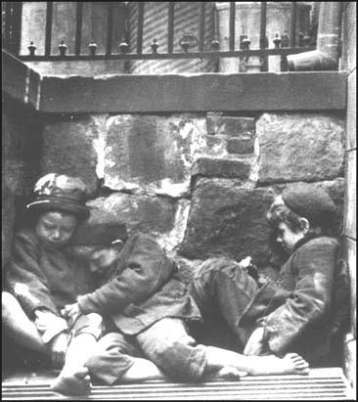
Tenements

Slide 26
Tenements

Slide 27
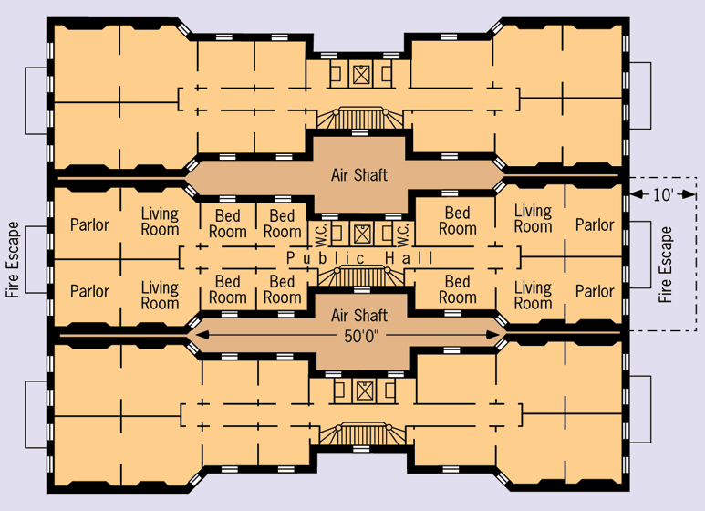
Dumbbell Tenement

Slide 28
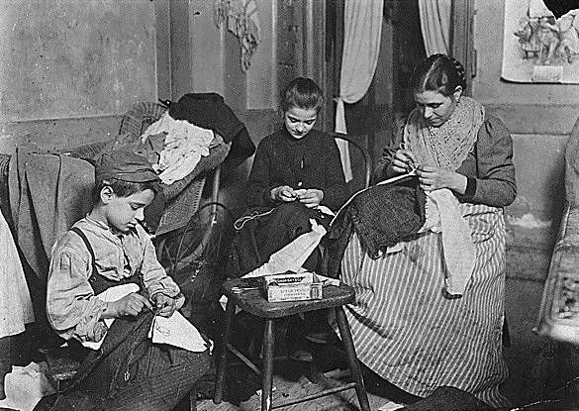
Immigrant Families

Slide 29
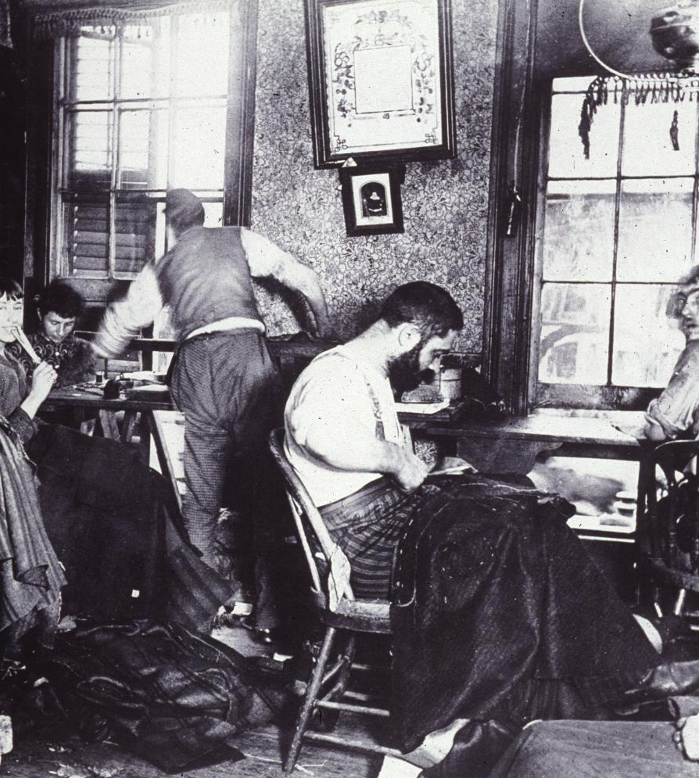
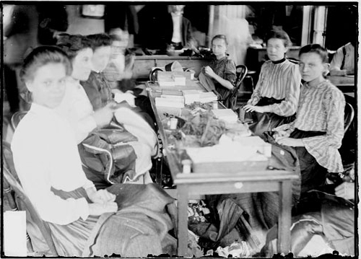
Sweatshops
Urban factories with poor wages & working conditions

Slide 30
Birth of the suburbs
Wealthy moved outside of the cities for various reasons:
  1. abundant land at low cost
  2. inexpensive transportation by rail
  3. low-cost construction homes
  4. ethnic and racial prejudice
  5. privacy

Slide 31
City Needs
By the end of the 1900s the need for water purification, sewage systems, waste disposal, street lighting, police departments and zoning laws were implemented

Slide 32
Boss and Machine Politics
Cities came under control of tightly organized groups of politicians know as political machines.
Boss gave orders to to give government jobs to loyal supporters
Tammany Hall in NYC coordinated to meet the needs of businesses, immigrants and the underprivileged. In return the machines ask for people’s votes on election day.

Slide 33
Reform
Books on social criticisms: Progress and Poverty, Looking Backward both promoted greater government regulation
Settlement Houses: provided social services for underpriviledged. Taught English to immigrants, early childhood education, industrial arts, established neighborhood theatres and music schools
Example: Hull House in Chicago.

Slide 34
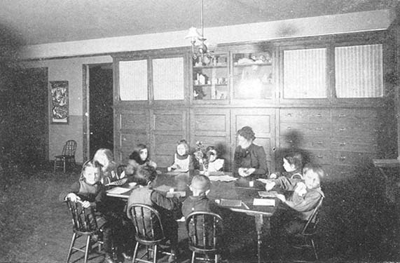
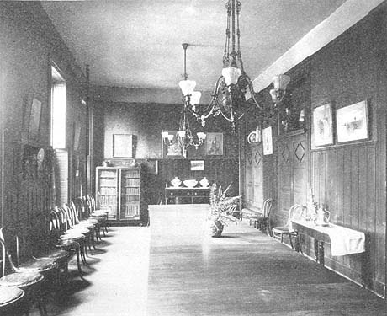
Hull House

Slide 35
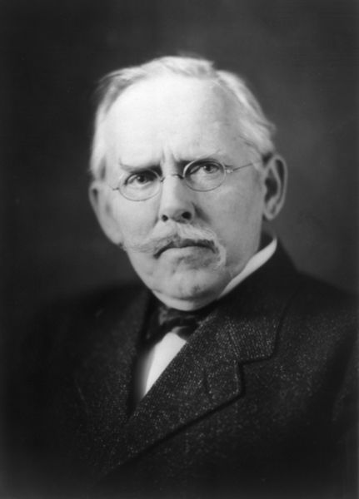
Jacob Riis
How the Other Half Lives (1890)
Described the working and living conditions of immigrants
First “muckraker”

Slide 36
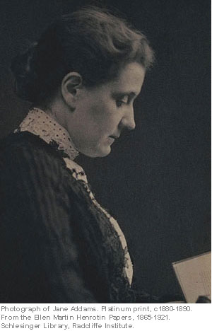
Jane Addams
Settlement houses
  Educated, trained Americans
  Living in poor immigrant communities
  Art, education, economic development
Hull House, Chicago

Slide 37
Social Gospel
Protestant Clergy preached the importance of applying Christian principles to help with social problems such as poverty

Slide 38
Intellectual and Cultural Movements
Changes in Education
Literature and Arts
Public Schools: New compulsory education laws
Higher Education
Social Sciences
Professions: doctors, educators, social workers and lawyers
Realism and Naturalism
Painting
Architecture
Music
Popular Press
Amusements
Spectator Sports
Amateur Sports

Slide 39
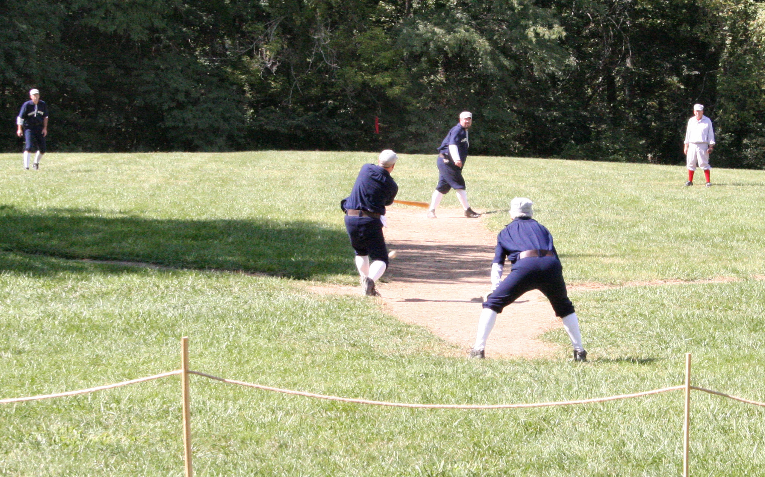
The National Pastime

Slide 40
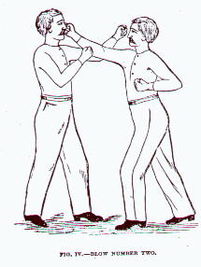
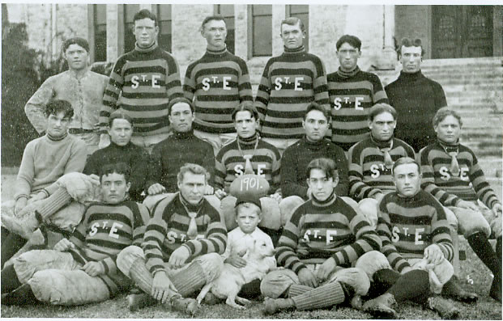
Boxing & College Football

Slide 41
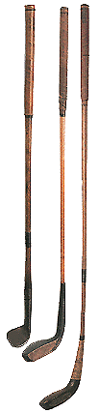
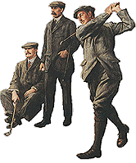

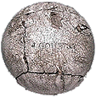
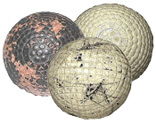
Country Clubs

Slide 42
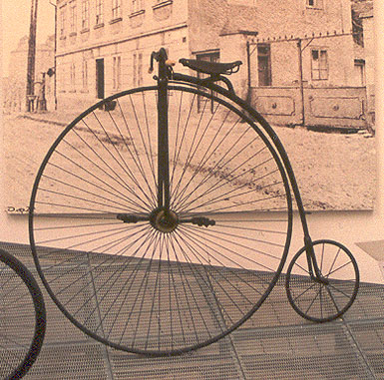
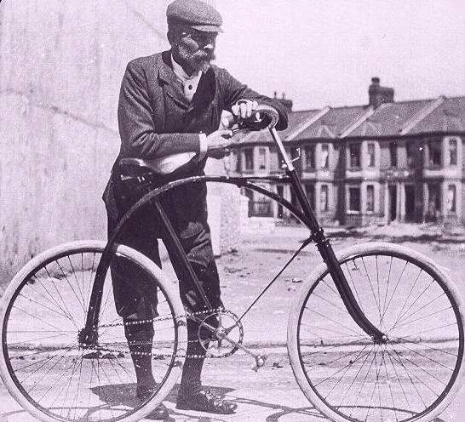
Bicycles

Slide 43
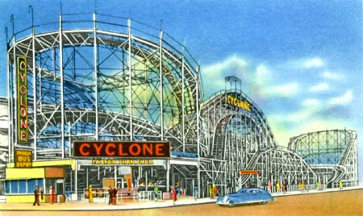
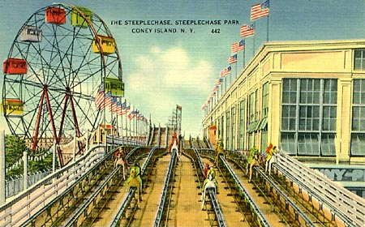
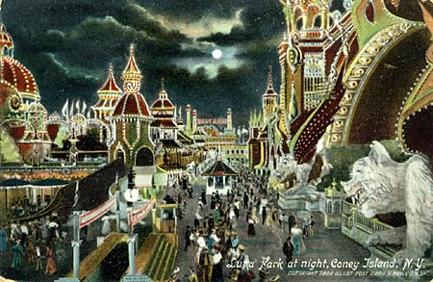
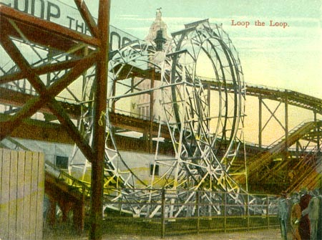
Coney Island, NY

Slide 44





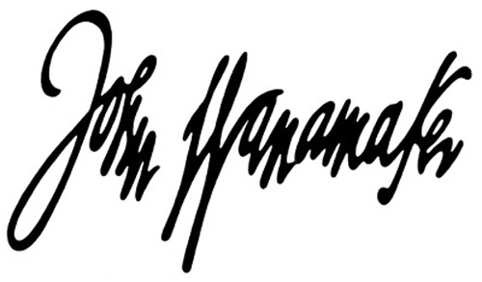
Department Stores

Slide 45
Main Ideas
Immigration
Push & pull factors
Ellis & Angel Island
Ethnic neighborhoods
“Melting Pot” vs. “Salad Bowl”
Backlash against immigration
Urbanization
Population explosion
Growth in city size
New opportunities for both men & women
Tenement slums
Mass transit
Skyscrapers

