Slide 1
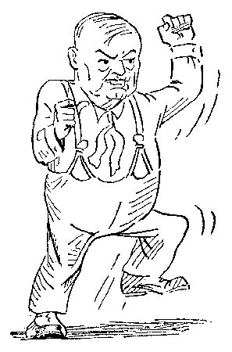
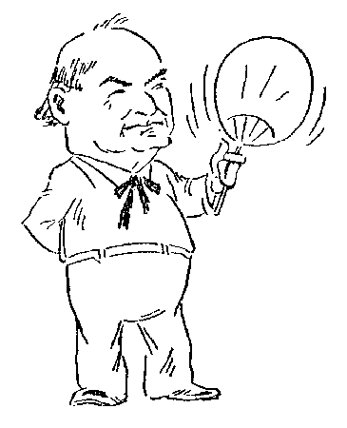
Scopes Trial
Clarence Darrow
William J. Bryan

Slide 2
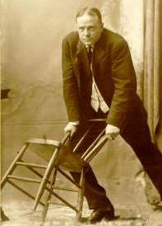
Modern vs. Traditional
Fundamentalist Preachers
Flappers

Slide 3
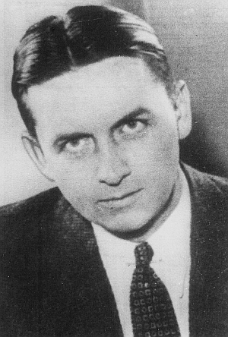
Prohibition
Eliot Ness
Al Capone

Slide 4
Literature & Culture
Lost Generation Writers
Upper- and Middle-Class America

Slide 5
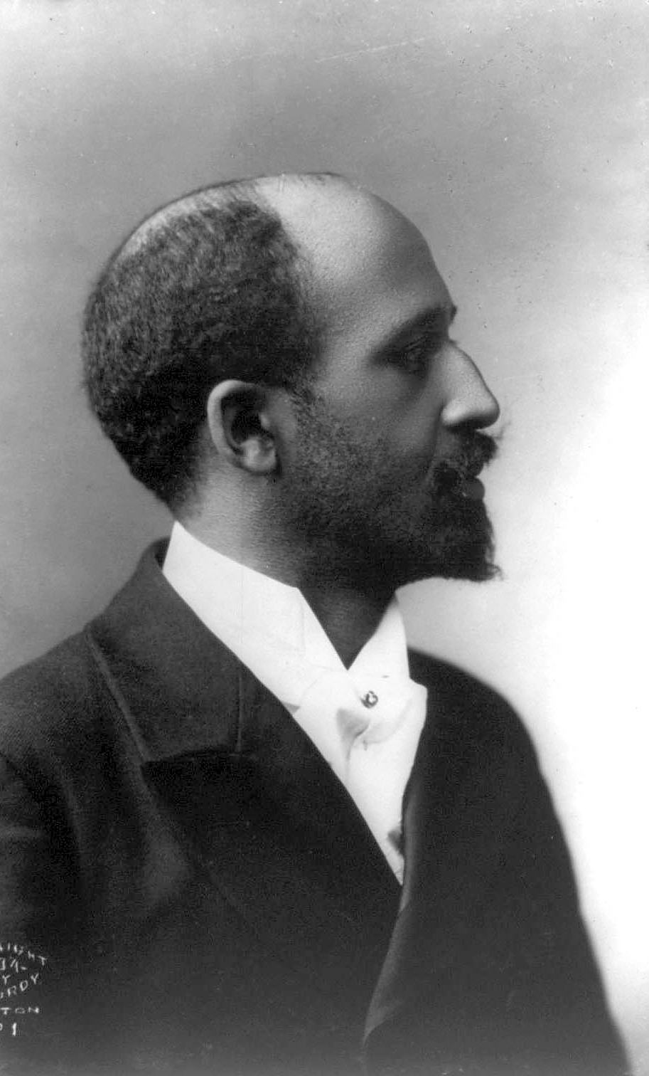
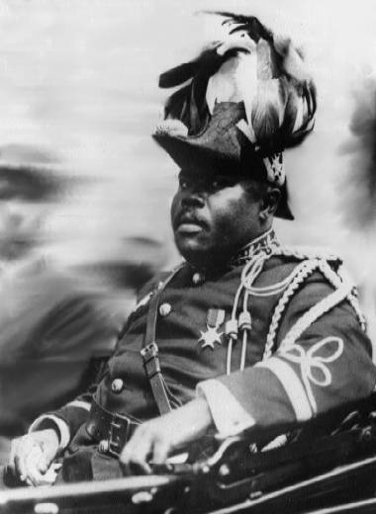
African Americans
W.E.B. DuBois
Marcus Garvey

Slide 6
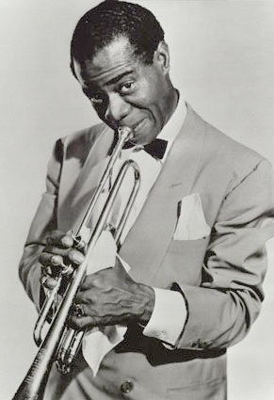
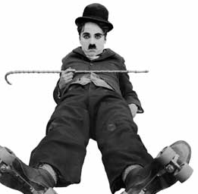
Entertainers
Charlie Chaplin
Louis Armstrong

Slide 7
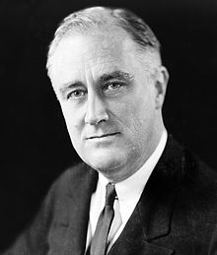
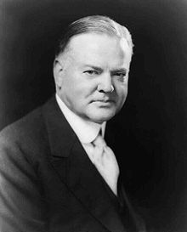
Politicians
FDR
Hoover

Slide 8
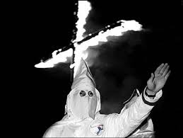
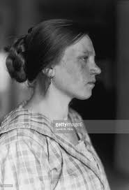
Immigration/Nativism
KKK
EE Immigrant

Slide 9
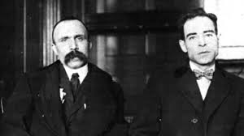
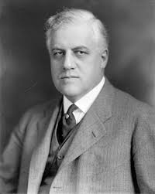
Red Scare
Sacco & Vanzetti
A. Mitchell Palmer

