Slide 1
The Vietnam War 1965-1975

Slide 2
The Wars Before the War

Slide 3
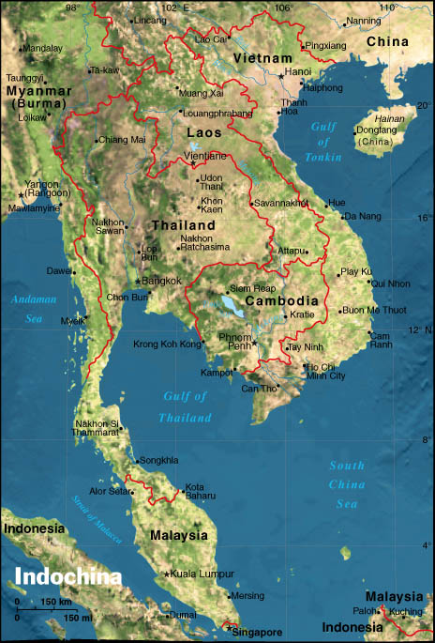
“Indochina”

Slide 4
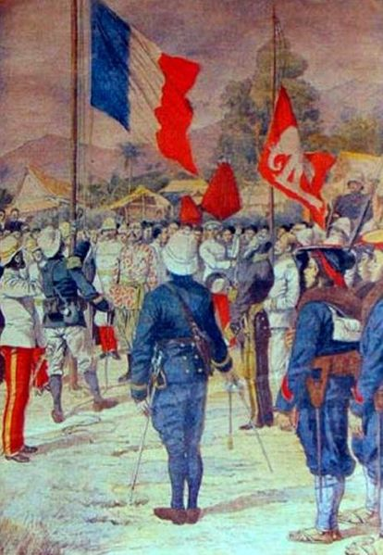
Colonization of Vietnam
Chinese…
1800s-1940 – French
1940-1945 – Japanese
1945-1954 – French
1954-1973 – USA?

Slide 5
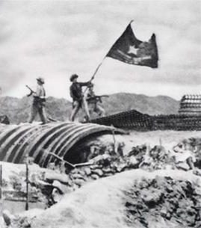
Battle of Dien Bien Phu
US financed French war effort
1954 – Vietnam gains independence from France

Slide 6
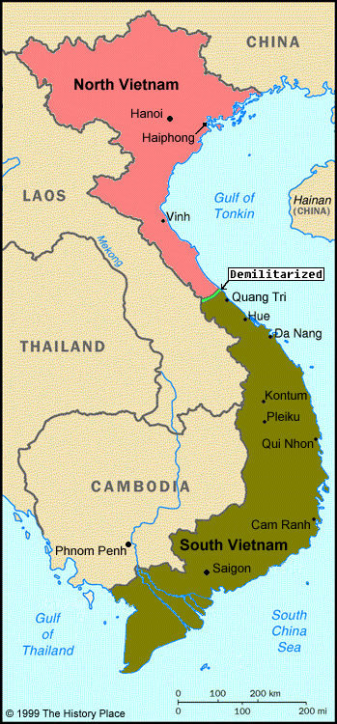
Vietnam Divided
17th parallel
North – Communist
South – “Nationalist”

Slide 7
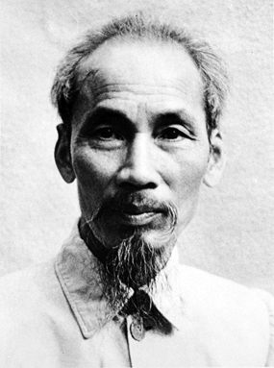
Ho Chi Minh
President of Communist North Vietnam

Slide 8
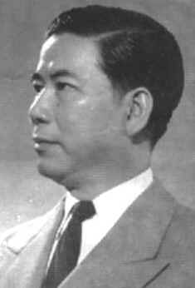
Ngo Dinh Diem
US puppet in South Vietnam

Slide 9
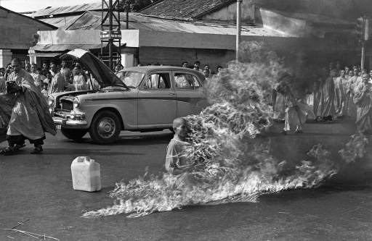
Protests Against Diem

Slide 10
American Involvement Increases

Slide 11
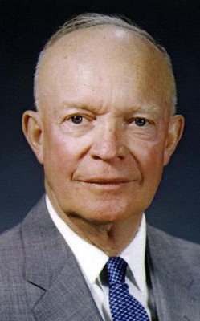
Eisenhower
Sent 675 military advisors to South Vietnam
“Domino Theory”

Slide 12
Domino Theory

Slide 13
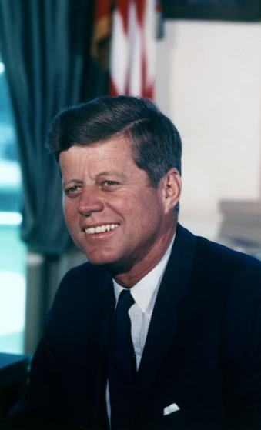
Kennedy
Increased military advisors to 16,000
Supported coup against Diem
Planned withdrawal of troops?

Slide 14
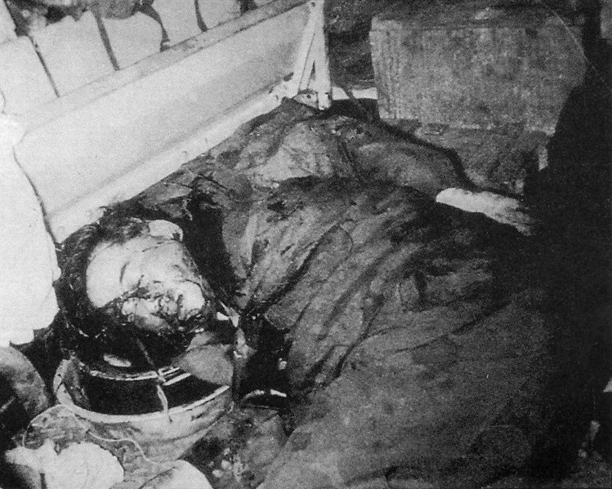
Coup Against Diem

Slide 15
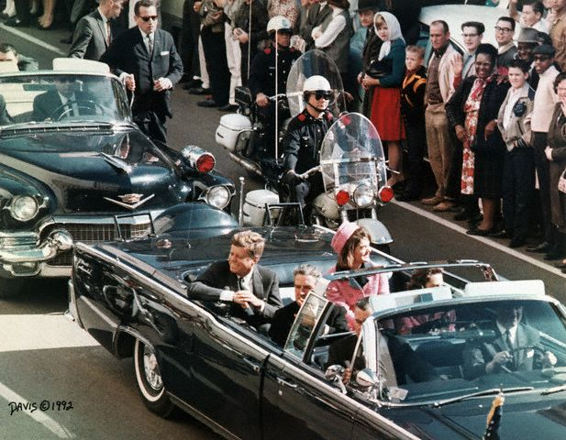
Kennedy Assassination

Slide 16
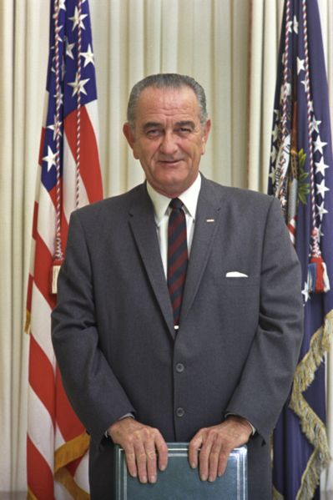
Johnson
1964 Tonkin Gulf incident
War begins
Escalation of troop levels

Slide 17
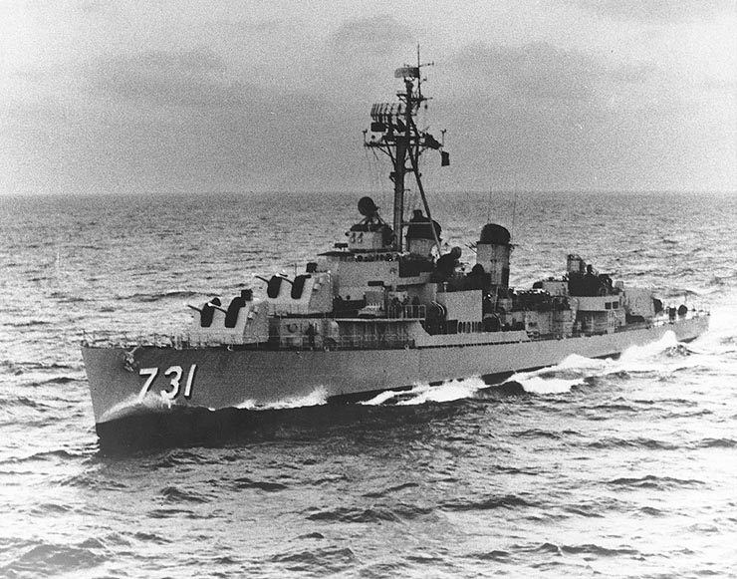
Tonkin Gulf Incident
1964
USS Maddox attacked off coast of North Vietnam
2nd alleged incident

Slide 18
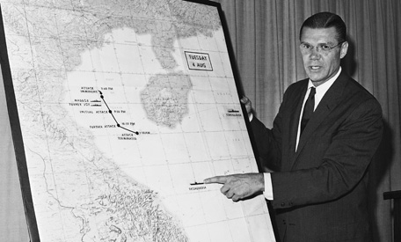
Robert McNamara

Slide 19
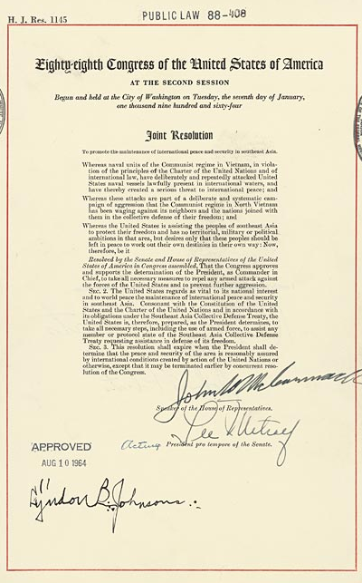
Tonkin Gulf Resolution
Congress gave President Johnson a “blank check”…
…not an official declaration of war

Slide 20
The War on the Ground

Slide 21
Combatants
vs.
Army of the Republic of South Vietnam (ARVN)
United States (US)
North Vietnamese Army (NVA)
Viet Cong (VC)

Slide 22
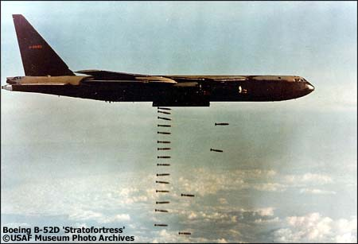
Operation Rolling Thunder

Slide 23
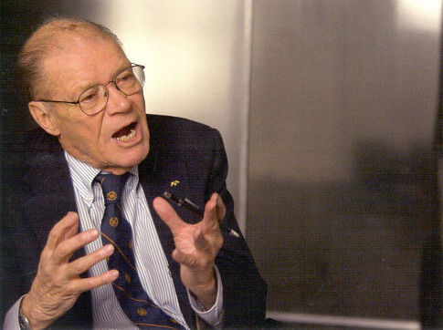
“The Fog of War”
Secretary of Defense Robert McNamara
Video Clip
1:10:31-1:16:58

Slide 24
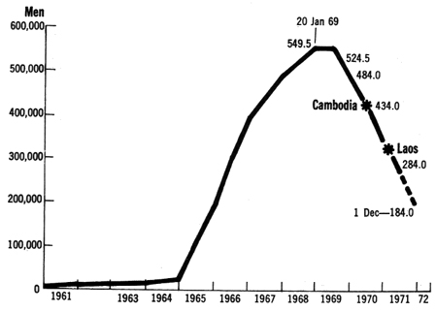
Escalation

Slide 25
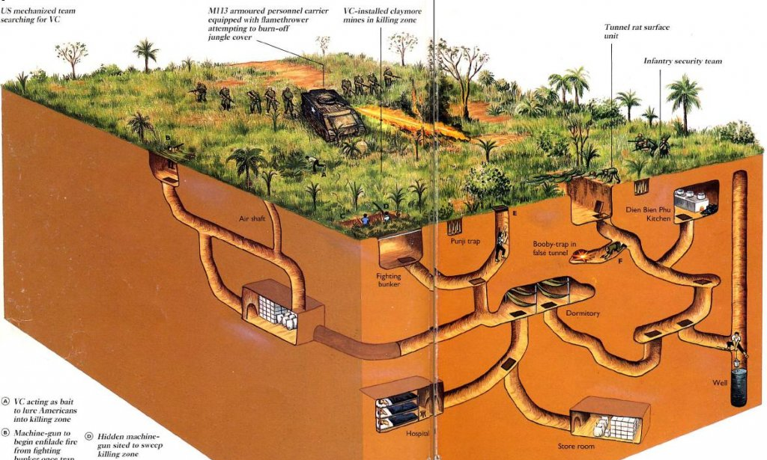
Guerilla Warfare

Slide 26
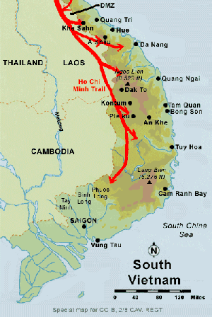
Ho Chi Minh Trail

Slide 27
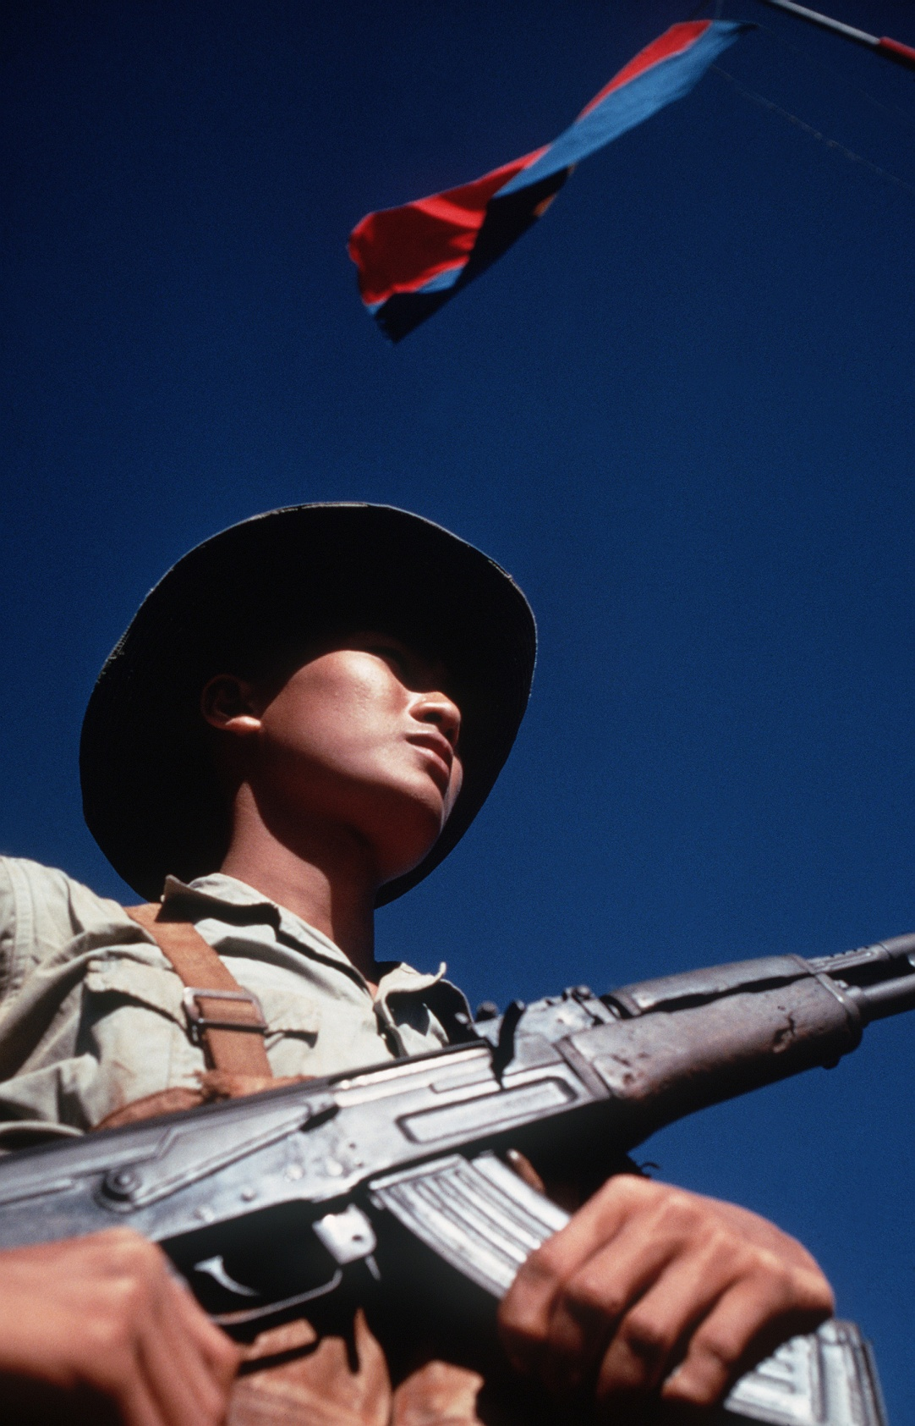
Vietcong

Slide 28
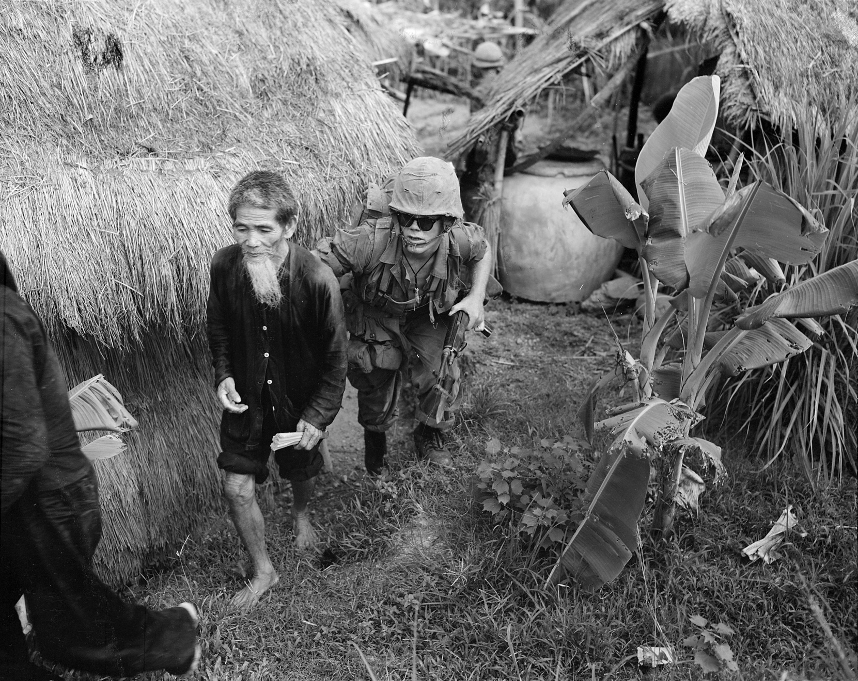
Counter-Insurgency Warfare

Slide 29
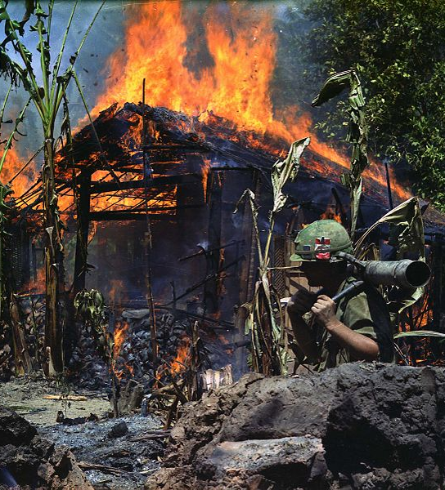
Counter-Insurgency Warfare
“It became necessary to destroy the village in order to save it.”

Slide 30
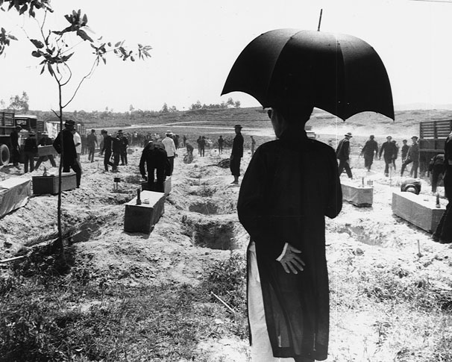
VC/NVA Atrocities

Slide 31
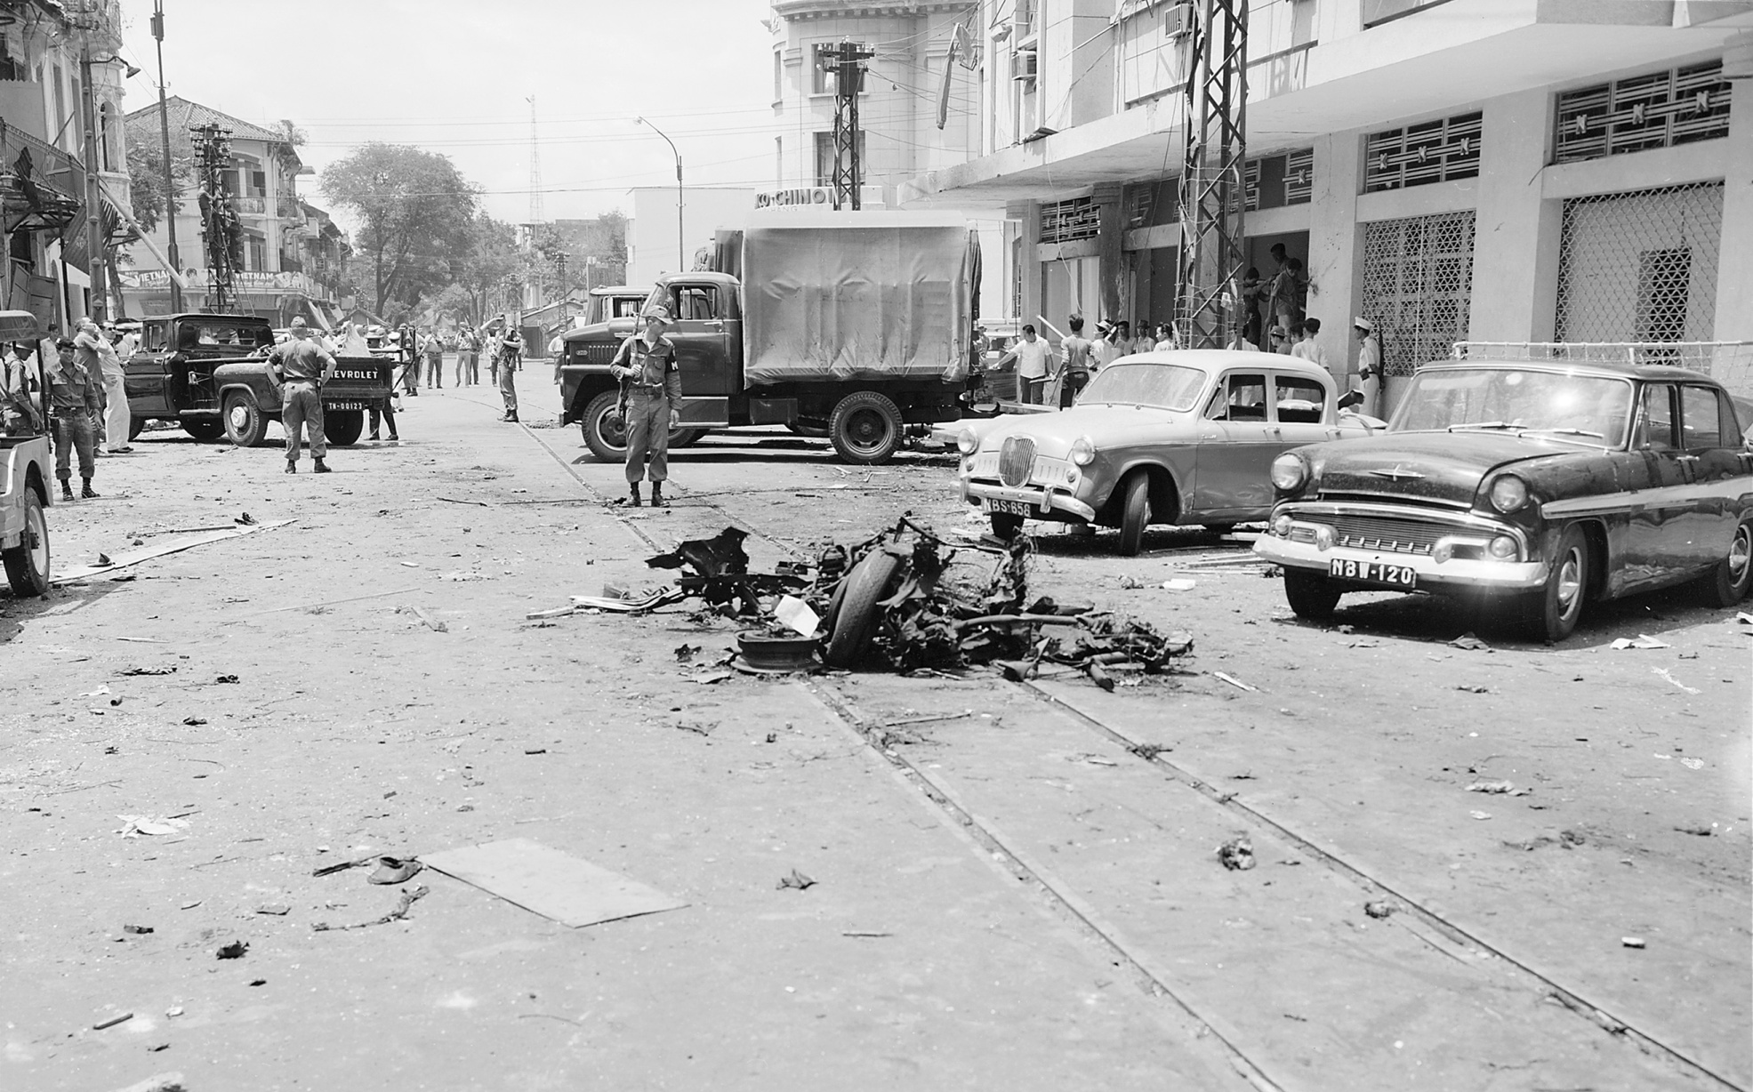
VC/NVA Atrocities

Slide 32
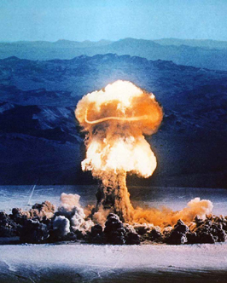
“Limited War”

Slide 33
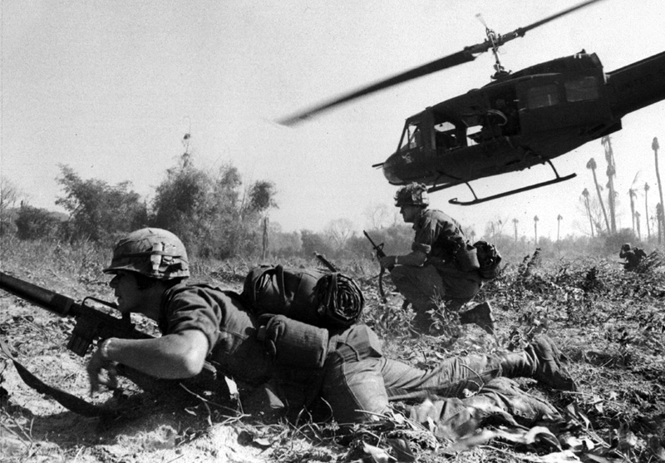
Helicopters

Slide 34
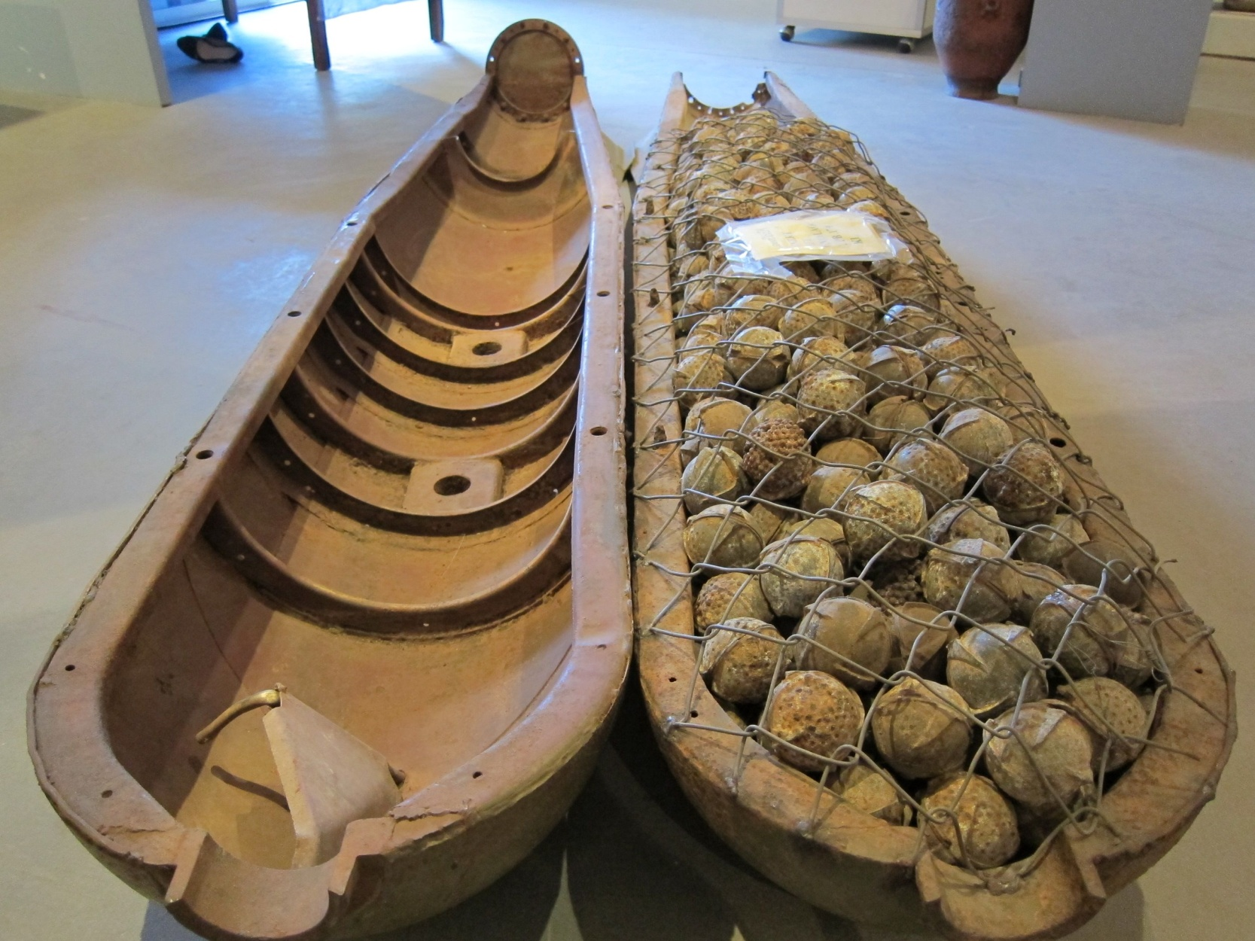
Cluster Bombs

Slide 35
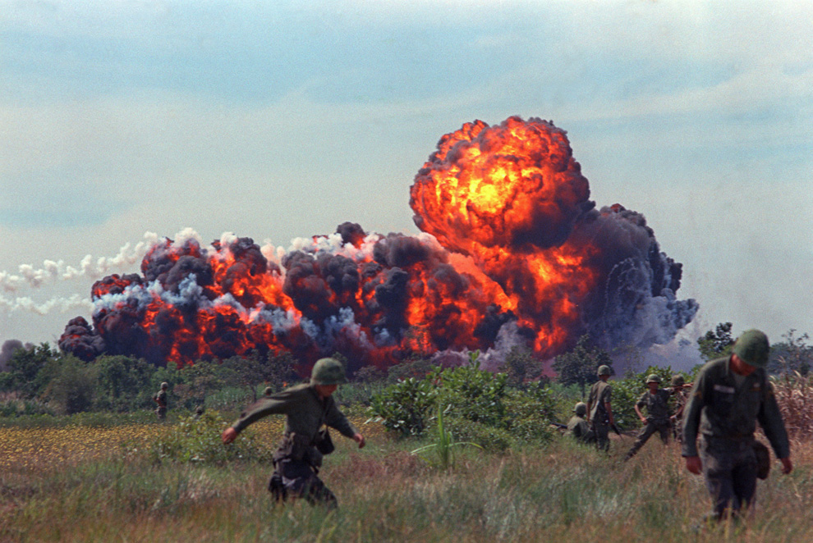
Napalm

Slide 36
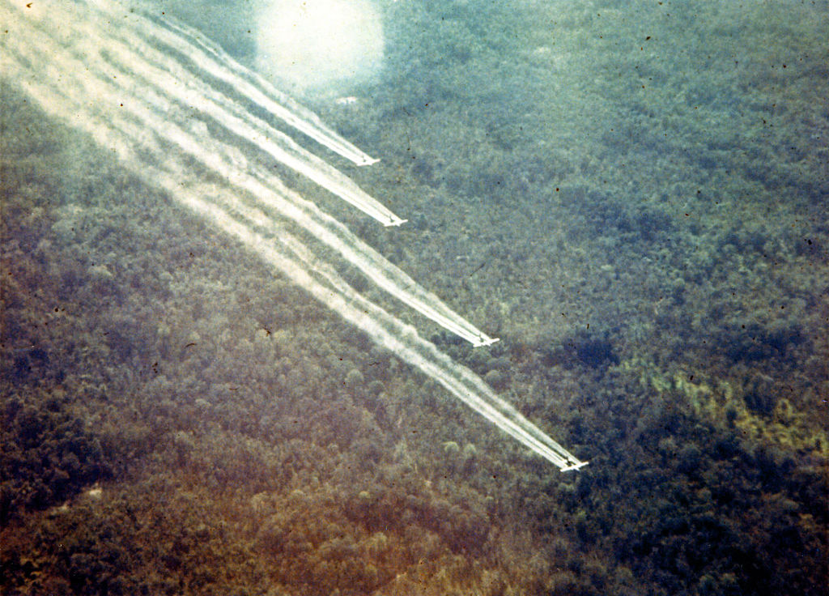
Agent Orange

Slide 37
1968: The Turning Point

Slide 38
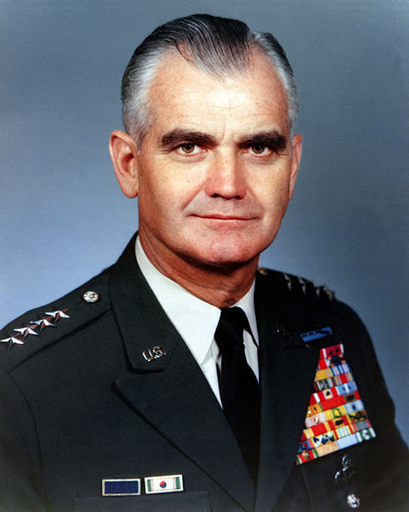
Gen. William Westmoreland
“Light at the end of the tunnel”

Slide 39
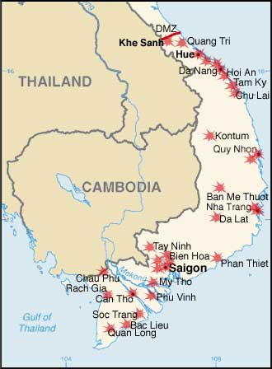
Tet Offensive
New Year 1968
Surprise NVA/VC attacks in South Vietnam

Slide 40
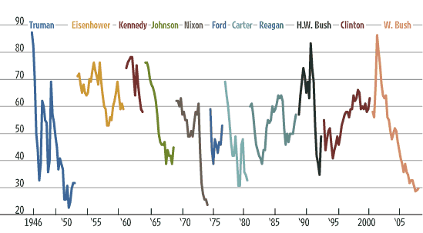
LBJ’s Approval Rating

Slide 41
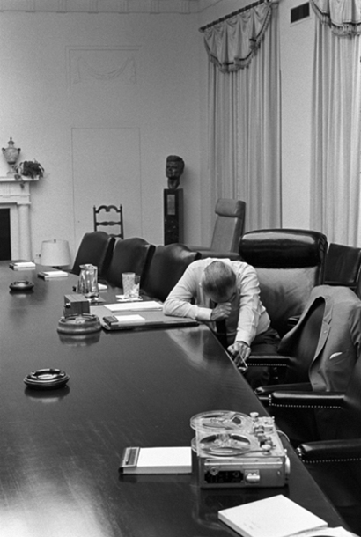
LBJ Steps Aside

Slide 42
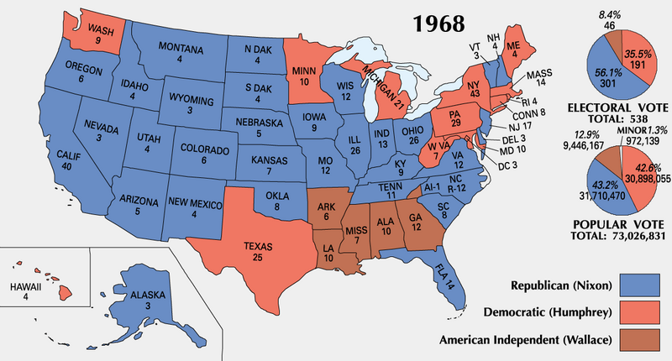
1968 Election

Slide 43
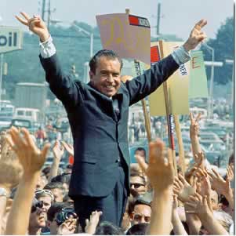
Richard Nixon: “Silent Majority”

Slide 44
The War at Home

Slide 45
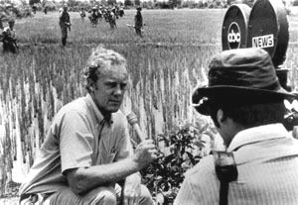
“The Living Room War”

Slide 46
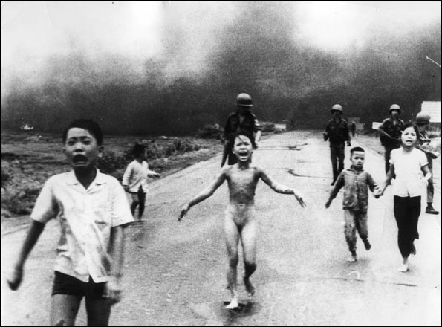
“The Living Room War”

Slide 47
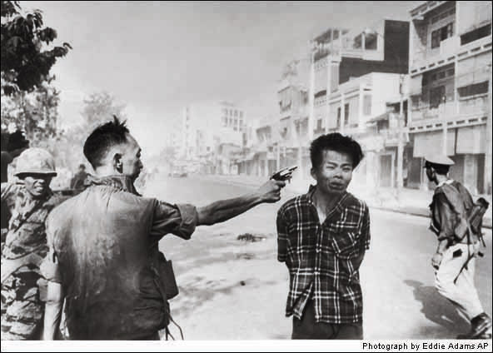
“The Living Room War”

Slide 48
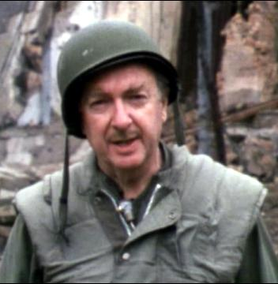
Walter Cronkite
Cronkite:
“The bloody experience of Vietnam is to end in a stalemate”
LBJ:
“If I’ve lost Cronkite, I’ve lost middle America”

Slide 49
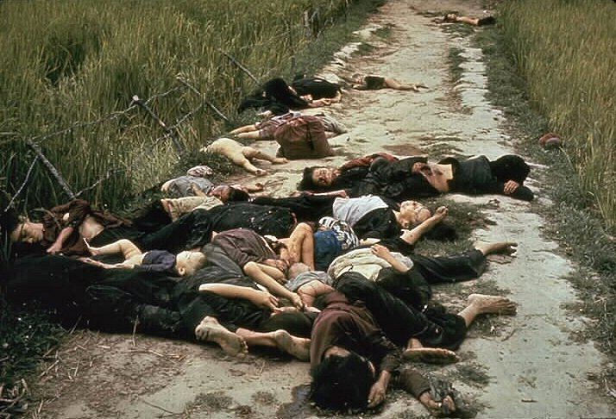
My Lai Massacre

Slide 50
Daniel Ellsberg
Whistleblower, leaker of the “Pentagon Papers”
New York Times v. U.S.
No “prior restraint” on publication
1st Amendment freedom of the press

Slide 51
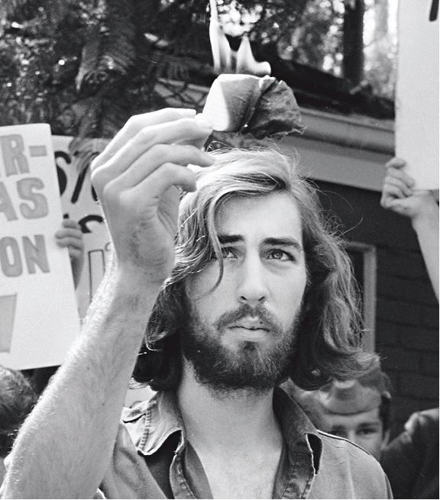
Draft Resistance

Slide 52
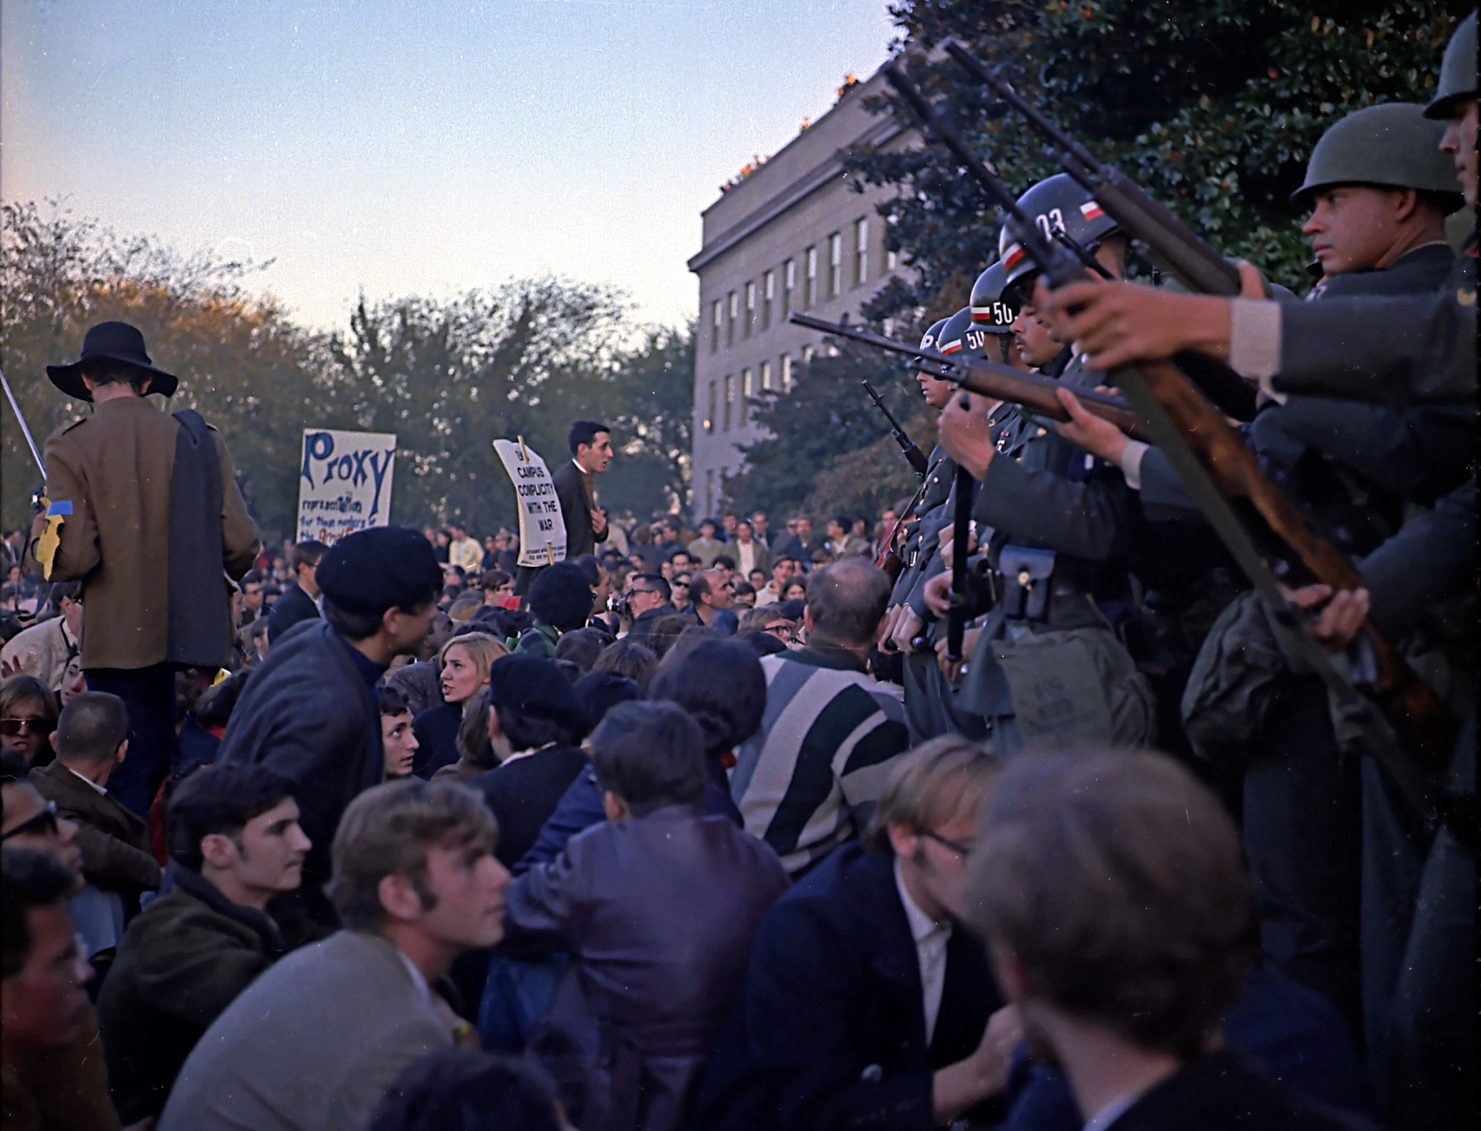
Anti-War Movement

Slide 53
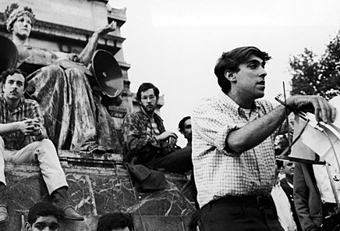
Students for a Democratic Society (SDS)

Slide 54
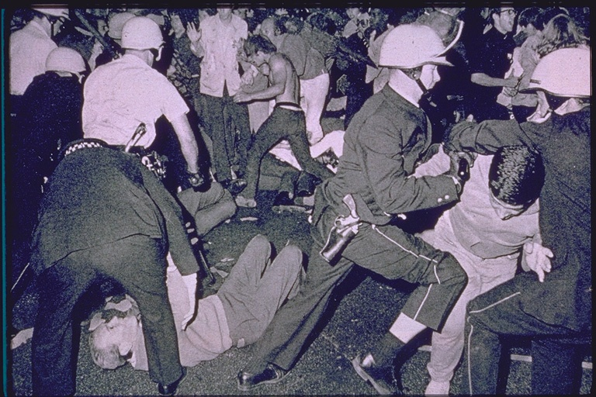
Democratic Convention Riots

Slide 55
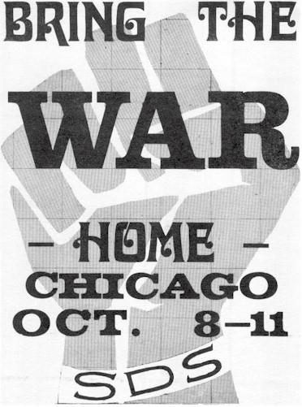
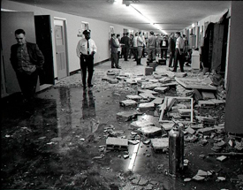
SDS Splinter Group: Weather Underground

Slide 56
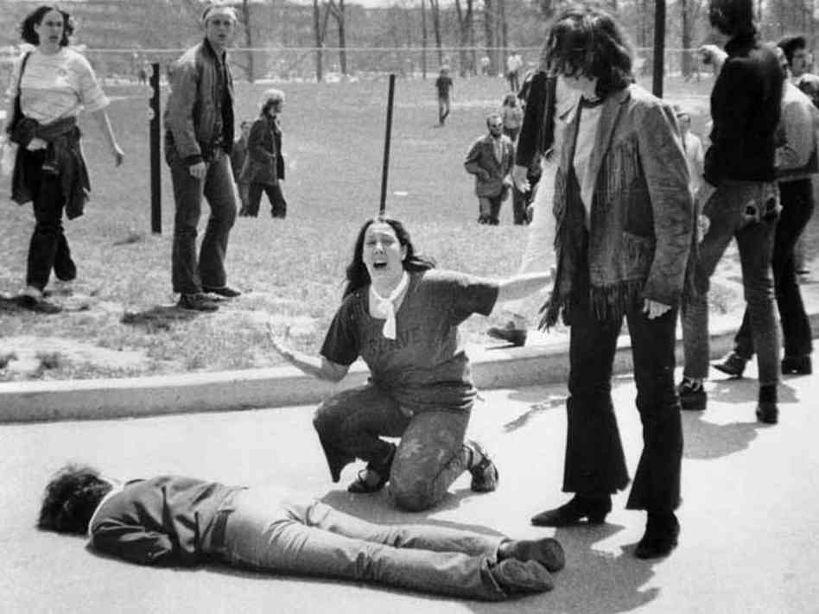
Kent State & Jackson State Shootings

Slide 57
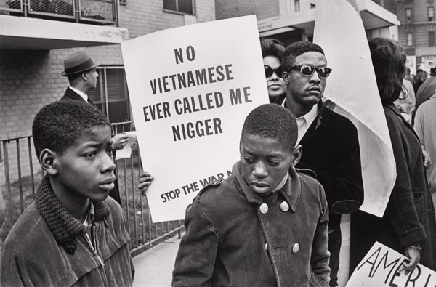
Civil Rights Movement

Slide 58
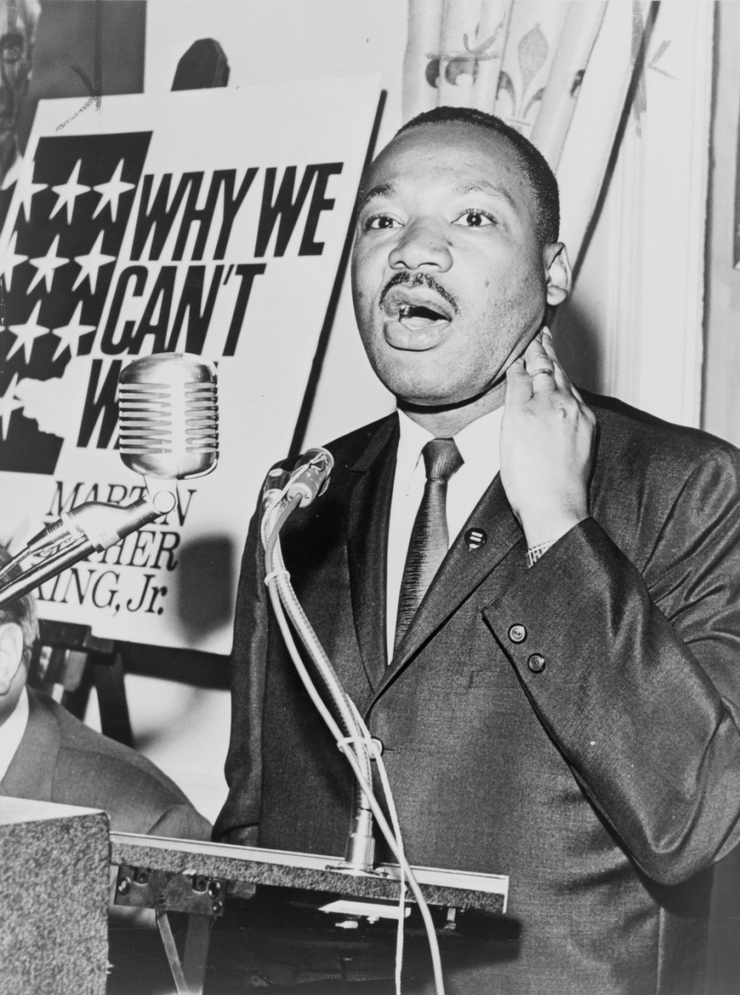
Martin Luther King, Jr.
“If America's soul becomes totally poisoned, part of the autopsy must read: Vietnam. It can never be saved so long as it destroys the deepest hopes of men the world over.”

Slide 59
Muhammad Ali

Slide 60
Declining Morale

Slide 61
Ho Chi Minh
“You will kill ten of our men and we will kill one of yours, and in the end it will be you who tires of it.”

Slide 62
The War Continues

Slide 63
Richard Nixon
“Peace with honor”
Increased bombing raids
North Vietnam
Laos & Cambodia
“Vietnamization”

Slide 64
Secret Bombing of Laos & Cambodia

Slide 65
“Vietnamization”

Slide 66
“Vietnamization”

Slide 67
Paris Peace Accords
Henry Kissinger
U.S. withdrawal from South Vietnam
Détente

Slide 68
The War Ends

Slide 69
Last U.S. Troops Leave, 1973

Slide 70
Fall of Saigon, 1975

Slide 71
Vietnamese Immigration to U.S.

Slide 72
The War Ends, 1975

Slide 73
Vietnam Unified

Slide 74
Legacy of the War

Slide 75
U.S. Deaths by Year

Slide 76
Total Deaths
U.S. Military | ARVN | South Vietnamese Civilians | NVA & Viet Cong | North Vietnamese Civilians
58,286 | 220,000- 313,000 | 195,000-430,000 | 400,000- 1,100,000 | 50,000-65,000
Total |  |  | Total
480,000-807,000 |  |  | 455,000-1,170,000

Slide 77
Khmer Rouge: Cambodian Genocide

Slide 78
Health Effects of Agent Orange

Slide 79
Undermining of the Great Society

Slide 80
War Powers Act

Slide 81
26th Amendment

Slide 82
Prisoners of War

Slide 83
Veterans Issues

Slide 84
All-Volunteer Army

Slide 85
“Embedded” Reporters

Slide 86
Plumbers… Watergate Scandal

Slide 87
Apathy & Distrust

Slide 88
Vietnam Veterans Memorial

Slide 89
Vietnam Veterans Memorial

