Slide 1
The Ratification Debate
Mr. Johnson
APUSH
Hopewell High School

Slide 2
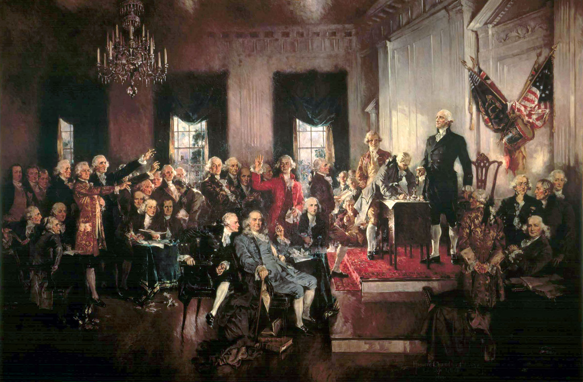
Constitutional Convention, 1787

Slide 3
Key Questions
Can democracy/republicanism govern a large area?
Ancient democracies were small city-states
The Roman Republic was destroyed by imperialism & Julius Caesar
Will the executive and judicial branches supplant the power of the legislative branch?
Legislature was seen as most direct expression of the people’s will
How will the rights of the states and people be safeguarded against the national government?
The Constitution drafted at the convention did not include a bill of rights, unlike many of the new state constitutions
Other Questions
How can we pay off our war debt?
Where will the nation’s capital be located?

Slide 4
The Ratification Debate
Federalists
Antifederalists
Supported ratification
Strong central government
Opposed ratification
States’ rights & local control
James Madison
Patrick Henry

Slide 5
Arguing the Constitution
The Federalist
The Antifederalist
a.k.a. The Federalist Papers
James Madison, Alexander Hamilton, John Jay
Organized effort
Pseudonym: “Publius”
a.k.a. The Antifederalist Papers
George Clinton, Robert Yates, Samuel Bryan
Ad hoc opposition
Pseudonyms: “Brutus,” “Cato,” “Federal Farmer”
Why?

Slide 6
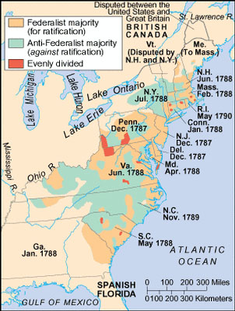
Ratification by State and Region

Slide 7
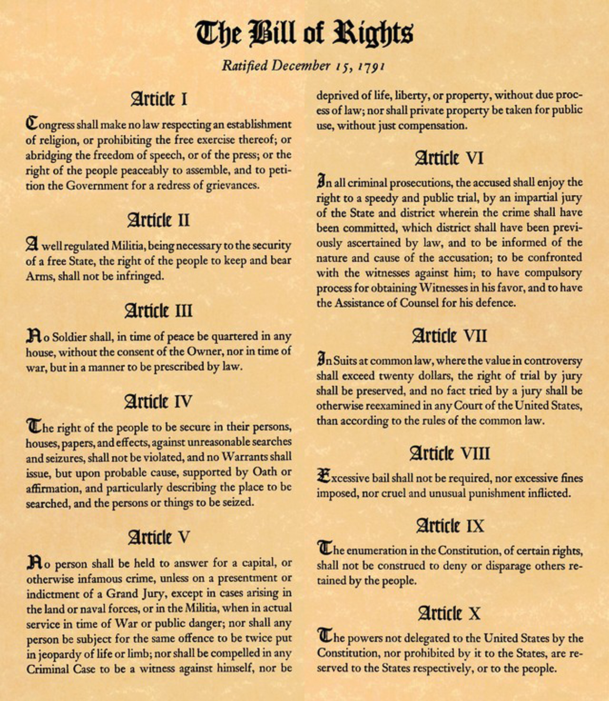

Slide 8
Analyzing the Federalist & Antifederalist Papers
 | Doc. A | Doc. B | Doc. C | Doc. D | Doc. E | Doc. F
Federalist or Antifederalist?
Number
Pseudonym
Author Name
Argument
Your Comments

Slide 9
Analyzing the Federalist & Antifederalist Papers
 | Doc. A | Doc. B | Doc. C | Doc. D | Doc. E | Doc. F
Federalist or Antifederalist? | Antifederalist | Federalist | Federalist | Antifederalist | Antifederalist | Federalist
Number | AF #10 | F #13 | F #51 | AF #16 | AF #17 | F #10
Pseudonym | Brutus | Publius | Publius | Brutus | Brutus | Publius
Author Name | Robert Yates (likely) | Alexander Hamilton | James Madison | Robert Yates (likely) | Robert Yates (likely) | James Madison
Argument | Standing armies are a threat to civil liberties; militias should be used instead; talks about how Roman Republic was overthrown & how Cromwell became dictator | One national government is more efficient than 13 state governments or 3 regional governments; “well organized” govt can “diffuse” its power | Separation of powers … each branch should have will of its own; checks & balances… each branch should limit the authority of the other branch | Senate has too much power to block House; Senators are unelected; 6 year term is too long | National supremacy clause will annihilate state sovereignty; Supreme Court vs. state courts; Legislative power to tax people | Factions: groups work for their own interests contrary to good of the nation (poor vs. rich, religious); Republic can guard against factions better than democracy
Your Comments | Disagree b/c foreign threats endanger US; army doesn’t threaten civil liberties | Agree b/c working together had helped win the war | Agree b/c it still works today (well, sort of) | Agree b/c common people will have no power; approve of the 17th Amendment | Disagree b/c checks & balances; added 10th amendment which reserves powers to states | Disagree, b/c it’s not fair for rich to have all the power

Slide 10
Web Resources
http://teachingamericanhistory.org/ratification/

