Slide 1
The Marshall Court

Slide 2
Who Interprets the Constitution?
John Marshall
Judicial review
Thomas Jefferson
Nullification by states

Slide 3
John Marshall
Federalist
National supremacy
Economic growth
Independence and power of judicial branch
Chief Justice from 1801-1835

Slide 4
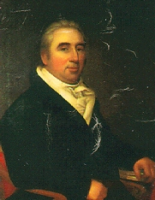
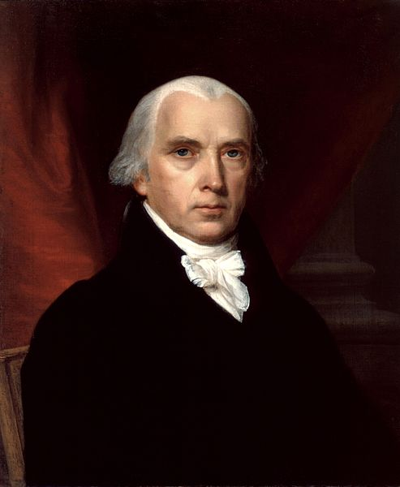
Marbury v. Madison, 1803
“Midnight Judges”
Outgoing Federalists vs. incoming Democratic-Republicans
Supreme Court’s power of judicial review

Slide 5
Cohens v. Virginia, 1821
Cohens was convicted in Virginia for selling illegal lottery tickets
Supreme Court asserts its power to review state court decisions

Slide 6
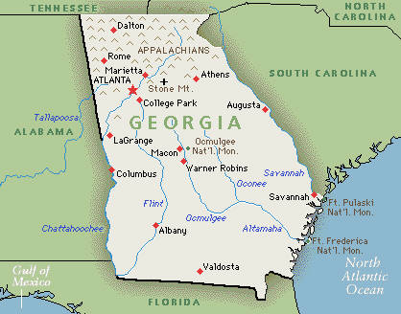
Fletcher v. Peck, 1810
Georgia legislature granted land to speculators in exchange for bribes
After election, new Georgia legislature canceled the deal
Decision
Sanctity of contracts
Victory of “wealth over mob”

Slide 7
Dartmouth College v. Woodward, 1819
Royal charter from King George III
New Hampshire tried to place college under state control
Decision
Charter stands
Sanctity of contracts
Laissez-faire

Slide 8
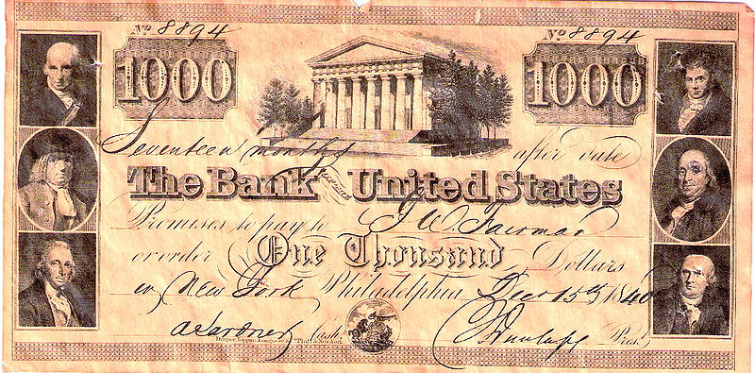
McCulloch v. Maryland, 1819
National bank vs. Maryland state tax
Decision
Bank is constitutional under the necessary & proper (“elastic”) clause
“The power to tax is the power to destroy”
National supremacy

Slide 9
Gibbons v. Ogden, 1824
Steamboats
State monopoly license vs. federal license
Decision
Only the federal government may regulate interstate commerce
National supremacy

