Slide 1
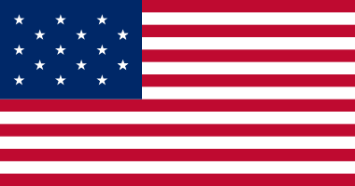
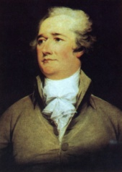
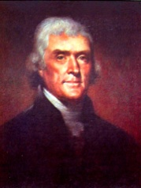
The First Two-Party System
Issue
National or Local Government?
Strict or Loose Interpretation of the Constitution?
Tariffs & Business or Agriculture?
National bank or state bank
Militia or standing army?
Foreign Policy: Britain or France?
Regions of Support: N,S,E,W
Nullification? Y,N
“Order” or “Liberty”?
Leaders & Presidents
Federalists Democratic-Republicans
Questions
Why does the Electoral College encourage a two-party system rather than a multiparty system?
Why was Thomas Jefferson’s election in 1800 considered a “revolution”?

