Slide 1
Welcome Back!! This week’s homework .
Mon: Finish Reading and HIPPing Docs/Assigned Civil Rights Groups Reading Pages & Primary Documents
Tuesday: Read Pgs. 902-908 & LBJ Article (Bring books to Class this day)
Wednesday: Read Pgs. 910-922, 926-933 (quiz today on previous reading), LBJ Article & Beyond Vietnam by MLK
Thursday: 947-950, 957-964, 974-995 & Edpuzzle: Conservatism & Reagan Revolution
Friday: CH. 31 & Take Home Practice Test (Quiz today on previous day readings)

Slide 2
Lessons of the Week 4/24
Monday: 1950s short lecture, DBQ Practice, Quiz on Ch. 26
Tuesday: Other Civil Rights Groups Presentation Time
Wednesday: Liberalism, Johnson & Great Society
Thursday: Vietnam & Antiwar Movement
Friday: Conservatism, Reagan & New Right

Slide 3
Lessons of the Week 5/1
Monday: Practice Exam #2: Multiple Choice & Short Response (AP Chem & AP Environmental)
Tuesday: Practice Exam #2: Multiple Choice & Short Response (AP Spanish Language)
Wednesday: DBQ
Thursday: DBQ Scoring & Any Last Questions?
Friday: THE BIG DAY APUSH EXAM: 8-12PM

Slide 4
—1950s Cause, context, and effect of post-war prosperity

Slide 5
Based on your understanding of CH. 26, docs and Crash Course, what were the 1950s like in America?
The 1950s were most similar to what other time period?
The 1950s were most different than what other time period?
What continuities continued in the 1950s?
What changed in the 1950s from other time periods?

Slide 6
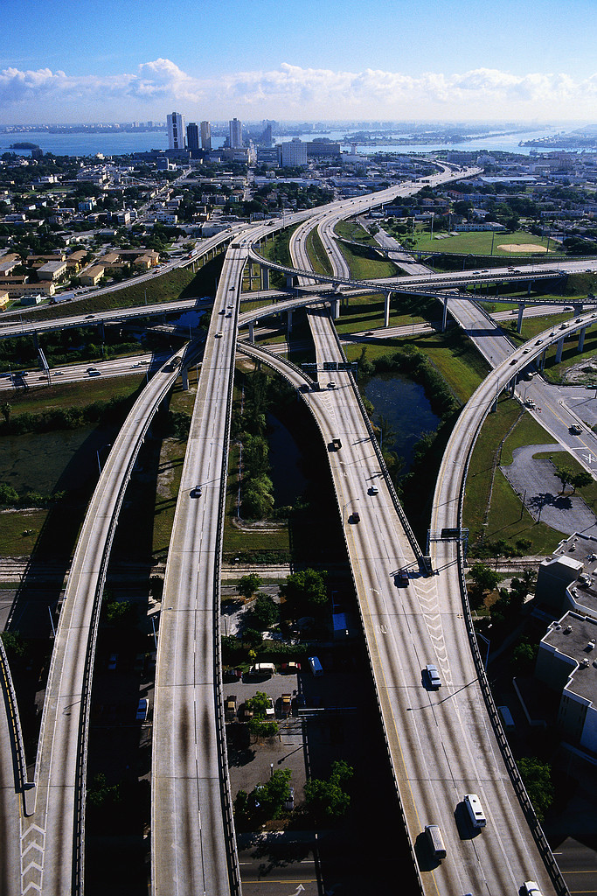
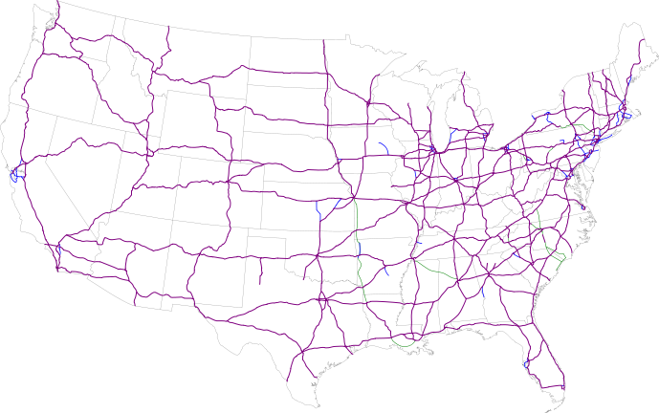
National Highway Act

Slide 7
“Under God” added to the pledge

Slide 13
Said no women ever…

Slide 15
EQ:

Slide 16
Conformity
Tremendous economic growth in the 1950s raised the standard of living for most Americans.
The 1950s is also known as a time in which the culture was homogenous (the same) and a time of conformity.

Slide 17
Causes of the Economic Boom of the 1950s
1. Military Industrial Complex
2. Corporate expansion
3. G.I. Bill
4. Domestic Consumer Market
5. Trade Unions
Collective bargaining

Slide 18
What did people buy?
Televisions
Houses
Cars
Clothing

Slide 19
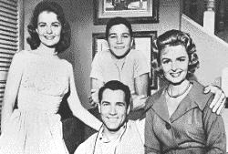
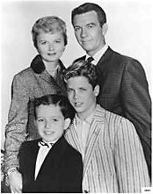
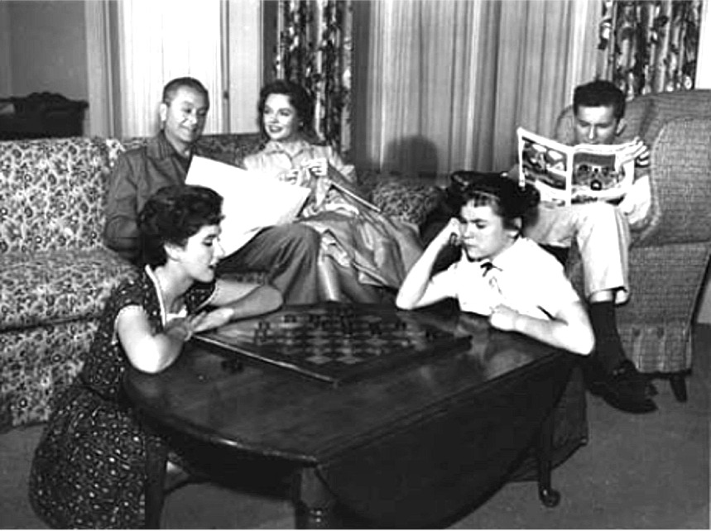
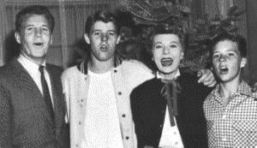
Suburban Living: The Typical TV Suburban Families
The Donna Reed Show 1958-1966
Leave It to Beaver 1957-1963
Father Knows Best 1954-1958
The Ozzie & Harriet Show 1952-1966

Slide 20
Where did people live? Suburbia
Suburbs
“white flight”
“Levittown”
Rules of conformity
70,000 residents
Largest community in the US w/out a single African American

Slide 21
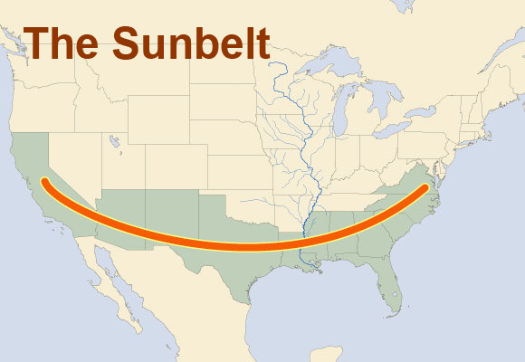
Sunbelt

Slide 22
Religion
1940 less than half of adult population belonged to a church
1960 over 65% were official members
Bible sales soared
Cold War context
“under God” –1954

Slide 23
The American Family
Baby Boom-increase in the American birthrate. Peaked by 1957
Stable, young marriages
Women expected to be stay-at-home moms but married women continued to be half of all women workers.

Slide 24
“teenagers” and delinquency
Mobility
Affluence
Rock and Roll
Chuck Berry
Elvis Presley
Crossed racial lines
“unfocused rebelliousness”
Tools of Communism

Slide 25
Not all was rosy…
Urban Crisis
Flight to the suburbs left cities less prosperous
Gentrification
To keep people in the cities, 1.4 million people were displaced
Segregation & discrimination
Housing restrictions for African-Americans
AAs not welcomed in suburbs

Slide 26
Describe 1950s culture in one word
Share & Discuss

Slide 27
Women’s “Place”
DBQ Essay #2!!!!
Betty Freidan
NOW
Redstockings Manifesto
The Case for the ERA
Phyllis Schlafly
Jerry Falwell
1951 Advertisement
“Analyze the impact that post WWII culture had on the development of the American women’s identity”
Read and analyze each document
Complete a DBQ analysis
Write full DBQ
Peer/self edit
Revise

