Slide 1
Road to Civil War
Part One
Henretta Chapter 13 (pages 428-440)
Pageant Chapter 19
AMSCO Ch. 13

Slide 2
Free Soil Movement
Following the Mexican American War issue of slavery in the territories becomes the key cause of sectional tension
• Free Soil Party formed in 1848:“free soil, free labor, and free men”
– Wanted no slavery in new land to the west
– Keep West an opportunity for whites only – Not against slavery in the south
• Many southerners saw any attempt to restrict the expansion of slavery as a violation of their constitutional rights.

Slide 3
Presidential Candidates
• Whigs took no position on slavery in the election
• Cass supports popular sovereignty:
• People in the territory should decide whether or not to allow slavery
• Free Soil Party opposed extension of slavery in the territories (Wilmot proviso position)

Slide 4
California Gold Rush, 1849
Sectional tension between the North and South.
California creates a constitution banning slavery and asks Congress for admission as free state.

Slide 5
Crisis Over Mexican Cession
Until California tried to become a free state, equal balance of power in the Senate
– 15 free states
– 15 slave state
• Southerners increasingly defensive over the institution of slavery
– Tallmadge Amendment (1819)
– Wilmot Proviso (1846)
– Underground Railroad

Slide 6
Threats of Secession..And then Compromise
Radical southerners “Fire- eaters” talk openly of
secession
• Could there be another compromise?
– Missouri Compromise (1820)
– Nullification crisis (1828-1833)
• Force Bill and Compromise Tariff of 1833
• Henry Clay and Stephen Douglas favor compromise

Slide 7
Compromise of 1850
CA admitted as free state
• Mexican Cession land Utah and New Mexico setup as territories
– Slavery determined by Popular sovereignty
• Ban slave trade in Washington D.C.
• New Fugitive Slave Law for the South
• Settled border dispute between NM and TX in NM favor

Slide 8
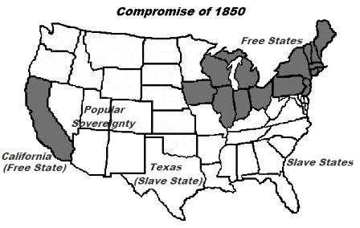

Slide 9
Fugitive Slave Act of 1850
Huge increase in sectional tension in the 1850s as a result of the Fugitive Slave Act
Ø➢ Fugitive Slave Act turned the north into a hunting ground for fugitive slaves
Ø➢ Northerners who assisted runaways could be arrested
Ø➢ Slaves could not testify in court, denied a jury trial

Slide 10
Northern Resistance
Moderate northerners are suddenly sympathetic to the abolitionist movement
• Growth in the abolitionist movement
– Underground Railroad:helped escaped slaves reach the north or to Canada
• Personal Liberty laws: Did not allow use of local jails for housing fugitive slave
• Vigilance Committees: goal to protect fugitive slaves from the slave catchers
• Anthony Burns:1853 escaped from slavery
Notes:
The 1850’s saw the nation becoming more
and more polarized.

Slide 11
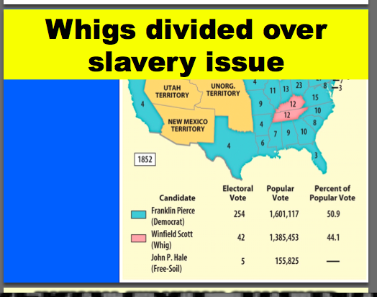
Whigs divided over slavery issue

Slide 12
National expansion Challenged
Debate over slavery slowed any attempts at national expansion (Manifest Destiny)
Free Soil supporters had suspicion of any expansion attempts under President Pierce
• Ostend Manifesto: planforthe U.S. to buy Cuba from Spain
• Free Soilers denounced this plan
• Northerners increasingly fear that the south was attempting to create a slave empire or “slaveocracy”

Slide 13
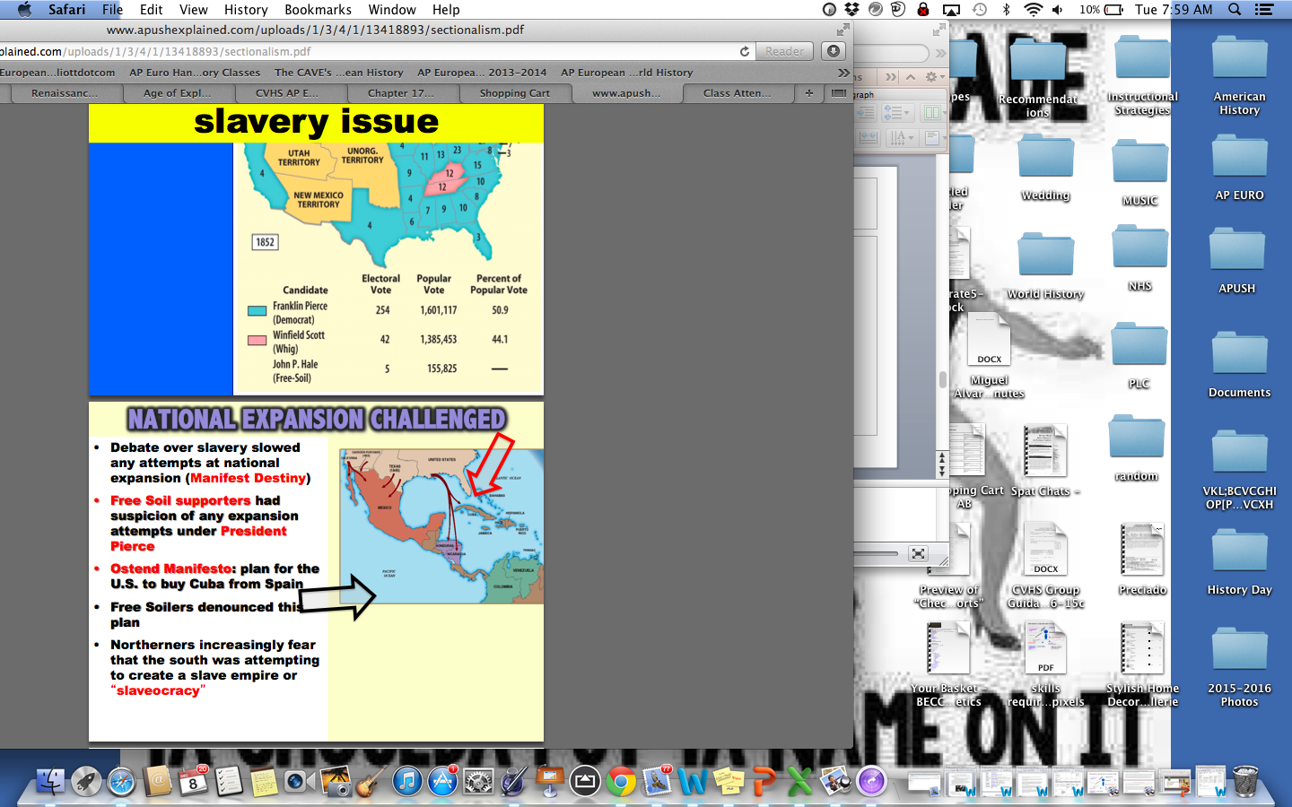

Slide 14
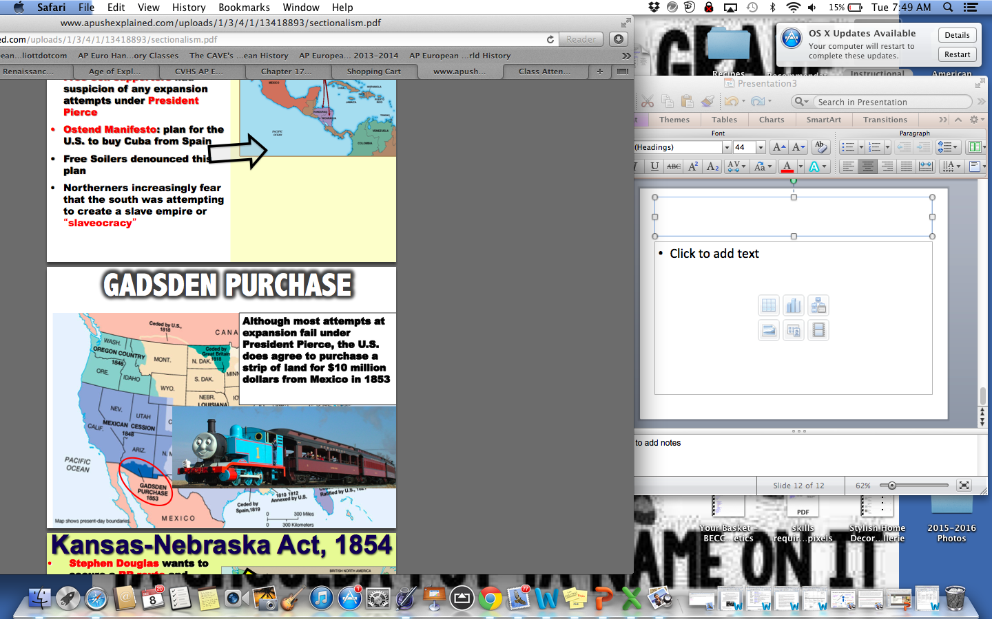

Slide 15
Kansas-Nebraska Act
Stephen Douglas wants to secure a RR route and encourage western settlement
• To win southern approval: Set up two territories 1) Kansas 2) Nebraska
• Slavery would be decided by popular sovereignty
• Repeal’s the Missouri Compromise of 1820
• Slavery can go north of 36°30′
• Huge opposition in the north – Republican party formed
• Gave south an opportunity to expand slavery

Slide 16
