Slide 1
Road to Civil War Part II
This is still 19&20
Henretta 13B
AMSCO 12

Slide 2
Northern Resistance
Uncle Tom’s Cabin” by Harriett Beecher Stowe (1852)
Inspire many northerners to resist the Fugitive Slave Act
Brought morality argument to the slavery debate
Exposed the horrors of slavery to a Northern & European audiences
Lincoln: “So you’re the little woman who wrote the book that made this great war.

Slide 3
Result of the Kansas-Nebraska Act
It was assumed that Kansas would become a slave state and Nebraska would be a free state
• Pro slavery and anti- slavery flood into Kansas
Company: sent free soil settlers to the area
From Missouri pro slavery “border ruffians” come into Kansas
Two rival governments set-up
• Topeka- free soil • Lecompton- slave govt.

Slide 4
Republican Party is formed as a response to the Kansas-Nebraska Act

Slide 5
BLEEDING KANSAS
Sack of Lawrence 1856- Free Soil town attacked by pro- slavery forces
• Pottawatomie Creek- John Brown and his homies attack pro slavery forces
• By 1856 Civil war in Kansas between pro slavery and anti slavery forces

Slide 6
The Beat Down!
Charles Sumner (Senator from Mass.) gives a speech condemning events in “Bleeding Kansas”
– Insults Senator from South Carolina Andrew Butler
• Congressman Preston Brooks of South Carolina enters Congress and beats Sumner with a cane.
• Violence over slavery in Kansas had spread to Congress

Slide 8
Election of 1856
1st time Republican party runs a candidate for the Presidency
• John C. Fremont ➢ Democrats pick James Buchanan
• Picked because he had nothing to do with Kansas-Nebraska Act
➢ Know Nothing Party picked Millard Fillmore
• Anti-immigrant and Anti Catholic

Slide 9
LECOMPTON CONSTITUTION
1st challenge for President Buchanan
• Lecompton Constitution
– Pro-slavery – Free Soilers boycott the election • Supported by President Buchanan
– Rejected by Congress

Slide 10
DRED SCOTT CASE
Dred Scott was a slave who sued for his freedom
• Dred Scott case goes to Supreme Court in 1857
• Roger Taney was the Chief Justice (a Southern Democrat)
– African Americans are not citizens of the United States
Could not sue
– Since slaves are property, they could not be taken away (Constitution)
– Congress could not makes laws regarding slavery in the territories
• Missouri Compromise unconstitutional

Slide 11
LINCOLN-DOUGLAS DEBATES
Abe Lincoln (Republican) debates Stephen Douglas (Democrat) for the Illinois Senate in 1858
➢ 7 debates held ➢ Lincoln challenges Douglas on Dred Scott decision: Could
slavery be prevented in the territories
➢ Dred Scott decision said no ➢ Douglas takes the position (Freeport Doctrine)
that territories could limit slavery Ø➢ Southerners are pissed
Results ➢ Douglas keeps Senate seat Ø➢ Lincoln becomes national figure Ø➢ Southerners are angry-
➢Democrats will be split in 1860

Slide 12
JOHN BROWN AT HARPERS FERRY
John Brown hopes to spark a slave revolt in 1859
• Attempts to seize the federal arsenal at Harper’s Ferry
It does not go well – Charged with treason and hung
• Impact
– South is outraged
– Brown becomes a martyr to abolitionist
– Immediate cause of secession

Slide 13
DEMOCRATS SPLIT
The issue of slavery had divided the Democrats
– Northern Democrats favor Stephen Douglas
• Popular sovereignty & enforce Fugitive Slave Act
– Southern Democrats favor John C. Breckinridge
• Allow slavery in the territories
• Annex Cuba

Slide 14
REPUBLICAN PARTY
Lincoln and the Republican party platform
– For the free-soilers: no extension of slavery in territories
– For the northern manufacturers: a protective tariff
– For the Northwest: a Pacific railroad
– For the farmers: free homesteads (land)
• Southern secessionist threaten to leave Union if Lincoln wins

Slide 15
ELECTION OF 1860 RESULTS
• Republican party wins the Presidency for the 1st time
• But Lincoln is a “minority” President
– Southerners see him as a sectional President
• Not on ballot in 10 southern states

Slide 16
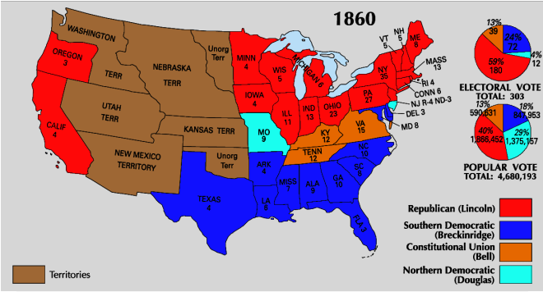
THE ELECTION OF 1860

Slide 17
SECESSION
South Carolina votes to secede in December 1860
• Eventually 7 southern states leave the union before Lincoln even takes office
– See him as a sectional President hostile to slavery
• Confederate States of America is formed – Jefferson Davis chosen as President
• Lame Duck President Buchanan does nothing to stop secession
– From November 1860 to March 1861 – Does not believe secession is legal

Slide 18
Crittenden Compromise
Last ditch attempt to avoid a major crisis • Hope to calm southern fears:
– The return of the Missouri Compromise idea Slavery prohibited in territories north of 36°30′ • Slavery allowed in territories south of 36°30′
– Lincoln rejects this • Position of Republican party was no extension of slavery in the territories
• Before Lincoln even takes office 7 southern states have left the union!

