Slide 1
Reform in the Antebellum Era

Slide 2
The Second Great Awakening
“Spiritual Reform From Within” [Religious Revivalism]
Social Reforms & Redefining the Ideal of Equality
Temperance
Abolitionism
Education
Asylum & Penal Reform
Women’s Rights

Slide 3
Reform
Second Great Awakening – religious movement that encouraged people to improve themselves and society.
Charles G. Finney – “father of modern revivalism”

Slide 4
Reform Movements

Slide 5
Temperance Movement
Temperance Movement — undertook to eliminate social problems by curbing drinking
Led largely by clergy, the movement at first focused on drunkenness and did not oppose moderate drinking
In 1826 the American Temperance Society was founded, taking voluntary abstinence as its goal.

Slide 6
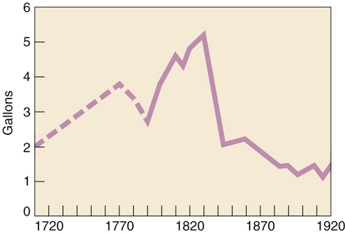
The Temperance Movement
During the next decade approximately 5000 local temperance societies were founded
As the movement gained momentum, annual per capita consumption of alcohol dropped sharply

Slide 7
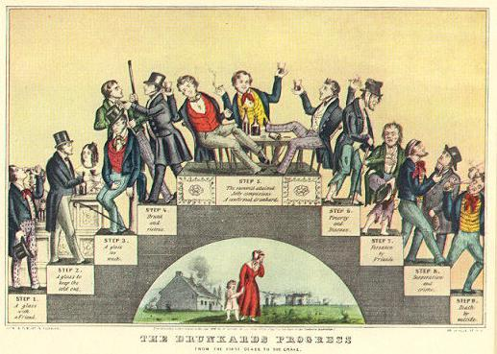
The Drunkard’s Progress
From the first glass to the grave, 1846

Slide 8
Education Reform
Horace Mann believed schools created good citizens.
Created tax-supported public schools

Slide 9
Asylum/Prison Reform
Dorothea Dix discovered that many prisons held mentally ill patients.
Emphasized rehabilitation to help people get better!!!
Established public hospitals for the mentally ill!!!

Slide 10
Asylum/Prison Reform

Slide 11
Women’s Rights Reform

Slide 12
“Separate Spheres” Concept
Republican Motherhood evolved into the “Cult of Domesticity”
A woman’s “sphere” was in the home (it was a refuge from the cruel world outside).
Her role was to “civilize” her husband and family.
An 1830s MA minister:
The power of woman is her dependence. A woman who gives up that dependence on man to become a reformer yields the power God has given her for her protection, and her character becomes unnatural!

Slide 13
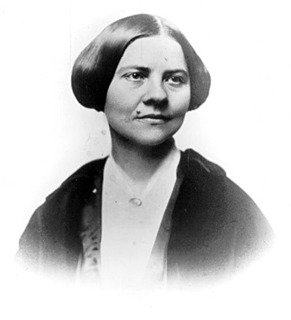
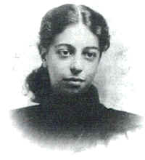
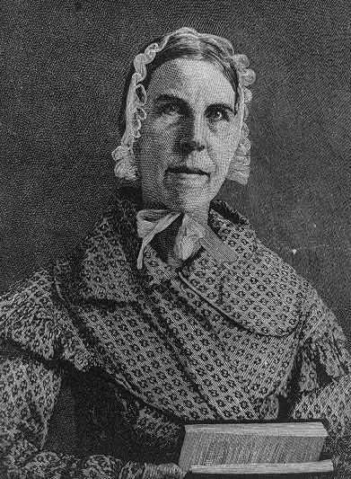
Cult of Domesticity = Slavery
The 2nd Great Awakening inspired women to improve society.
Lucy Stone
Angelina Grimké
Sarah Grimké
American Women’s Suffrage Assoc.
edited Woman’s Journal
Southern Abolitionists
R2-9

Slide 14
Elizabeth Cady Stanton and Lucretia Mott fought for women’s rights
Held Seneca Falls Convention
“All men and women are created equal”

Slide 15
Reform
Sarah and Angelina Grimke were daughters of a SC slave owner but also abolitionists.
HOT???

Slide 16
Reform
Sojourner Truth had been a slave for nearly 30 years but became a famous abolitionist.

Slide 17
Reform
Some young, unmarried women began working in the factories.
Treated poorly and not paid well
Lowell Mill (Mass)

Slide 18
Slavery and Abolition

Slide 19
“Cotton Is King!”

Slide 20
Growth of slavery
GROWTH OF SLAVERY

Slide 21
Growth of slavery
GROWTH OF SLAVERY

Slide 22
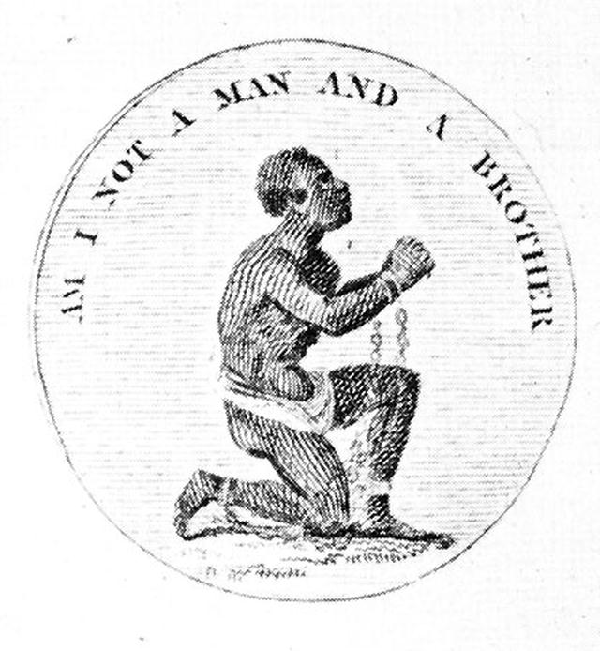
Abolitionist Movement
1816 --> American Colonization Society created (gradual, voluntary emancipation.
CV Create a free state in Liberia
British Colonization Society symbol

Slide 23
Reform
Many southerners considered slavery to be a “necessary evil.”
Abolition movement to outlaw slavery.
“Necessary evil”

Slide 24
Reform
William Lloyd Garrison – white abolitionist who started a newspaper called
The Liberator.
American Anti-Slavery Society was founded in 1833.

Slide 25
Reform
Frederick Douglass was born into slavery
Taught to read and write by his master’s wife.
Became the most famous abolitionist!!!

Slide 26
Black Abolitionists
David Walker (1785-1830)
1829 --> Appeal to the Colored Citizens of the World
Fight for freedom rather than wait to be set free by whites.

Slide 27
Reform
Harriet Beecher Stowe wrote Uncle Tom’s Cabin to show the inhumanity of slavery.
Caused strong feelings in the North and South.

Slide 28
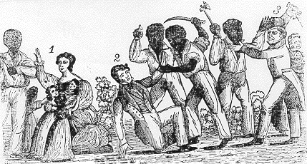
Reform
In 1831, Nat Turner’s Rebellion led to nearly 60 white people killed on plantations.
Spread fear throughout the South and harsh treatment for slaves.

Slide 29
Reform
Slave codes were laws that limited rights of slaves.
Considered property
Couldn’t vote
Couldn’t own guns or testify in court
Couldn’t legally marry

Slide 30
Reform
Transcendentalism – philosophical movement that emphasized living a simple life, the inner self, and nature.
Led by Ralph Waldo Emerson and Henry David Thoreau
Thoreau wrote Civil Disobedience to protest the Mexican War.

Slide 31
Reform

Slide 32
Reform
Utopian communities tried to create a perfect place.
Brook Farm
New Harmony
Oneida

Slide 33
American Art & Literature

Slide 34
Art
Hudson River School – painters that celebrated the beauty of the American landscape.

Slide 35
Lewis and Clark

Slide 37
Literature
James Fenimore Cooper wrote The Last of the Mohicans.
Washington Irving wrote the Legend of Sleepy Hollow.
Noah Webster created the Dictionary to standardize the English language.

Slide 38
SENECA FALLS
The first Woman’s rights movement was in Seneca Falls, New York in 1849……
Educational and professional opportunities
Property rights
Legal equality
repeal of laws awarding the father custody of the children in divorce.
Suffrage rights

Slide 39
Turn to Period 4 on the website and open up the Declaration of Sentiments. Read the document and write down 2 demands that are still relevant today.

Slide 40
What did you learn today??

