Slide 1
Reconstruction begins
Mr. Johnson
APUSH
Hopewell High School

Slide 2
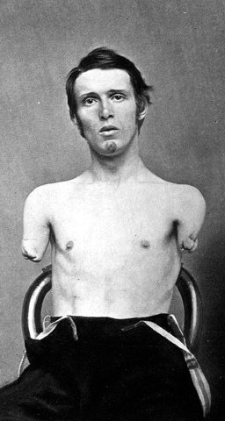
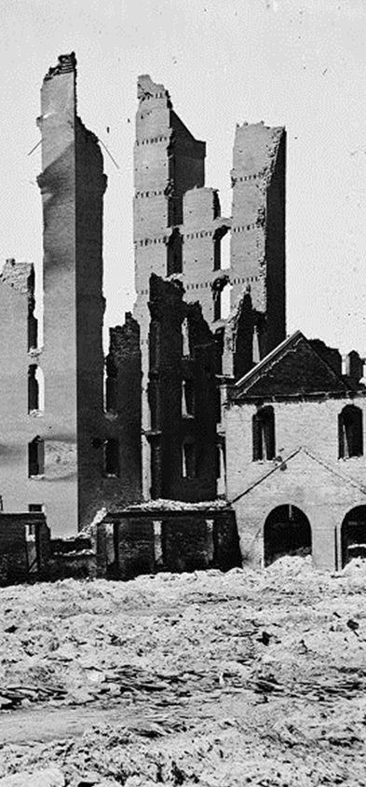
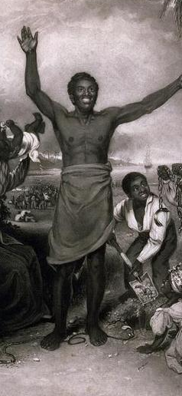
Reconstruction
Deaths, Injuries &
Lingering Resentment
Economic Devastation
Readmission of Southern States
Legal Status of Freedmen

Slide 3
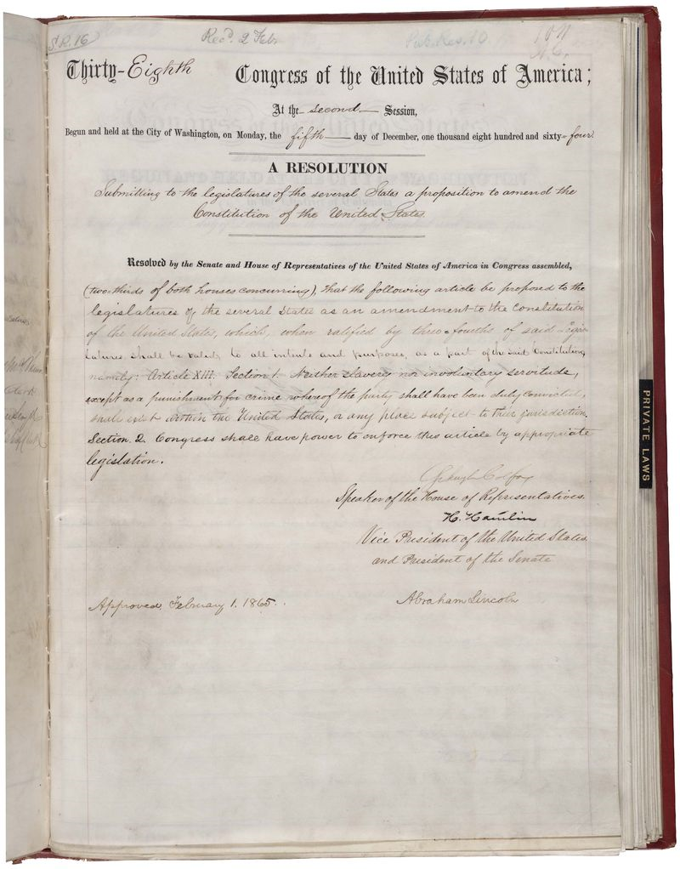
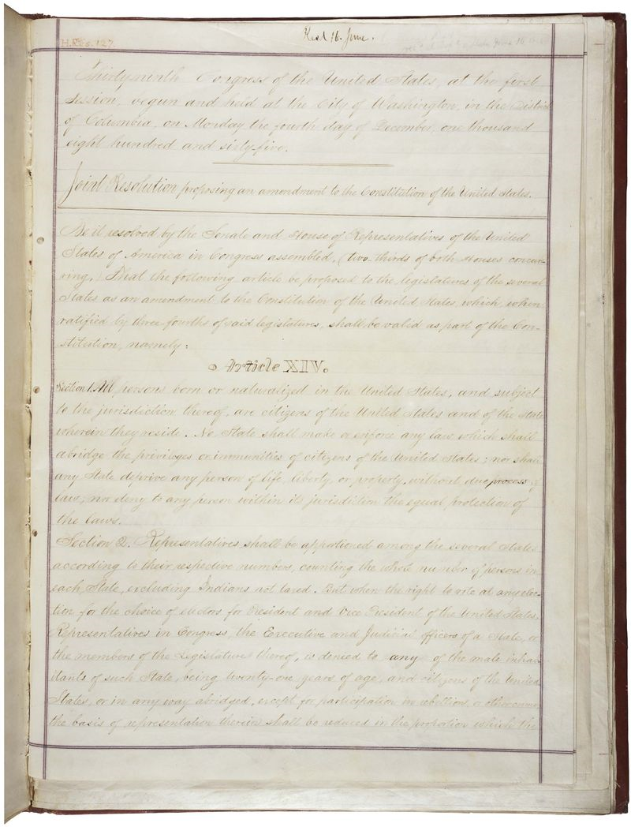
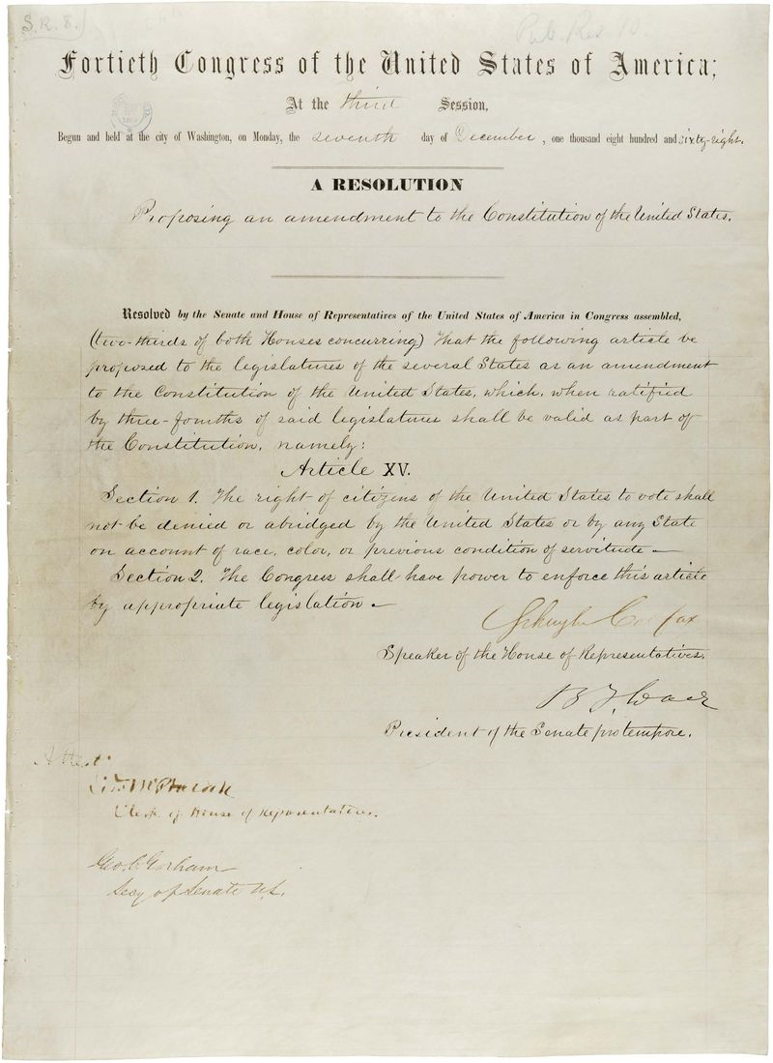
Reconstruction Amendments
13th
14th
15th

Slide 4
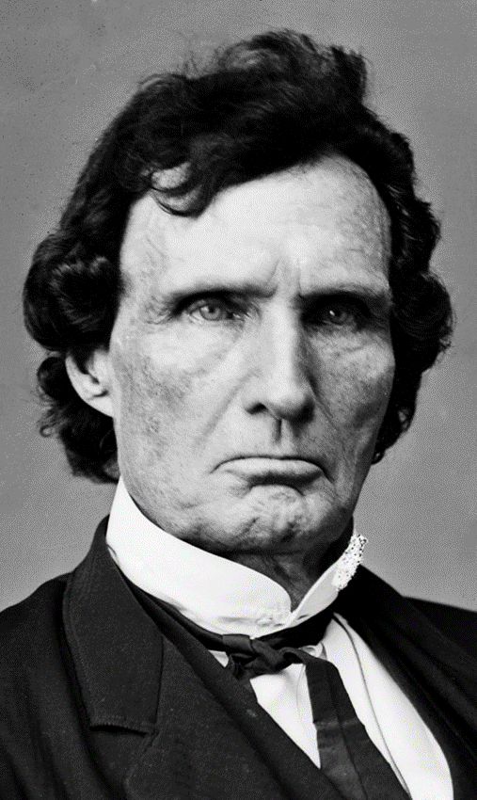
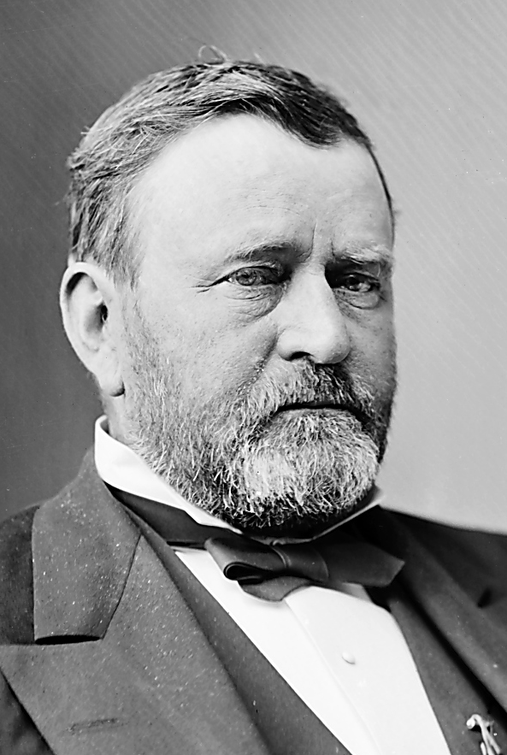
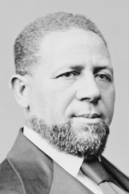
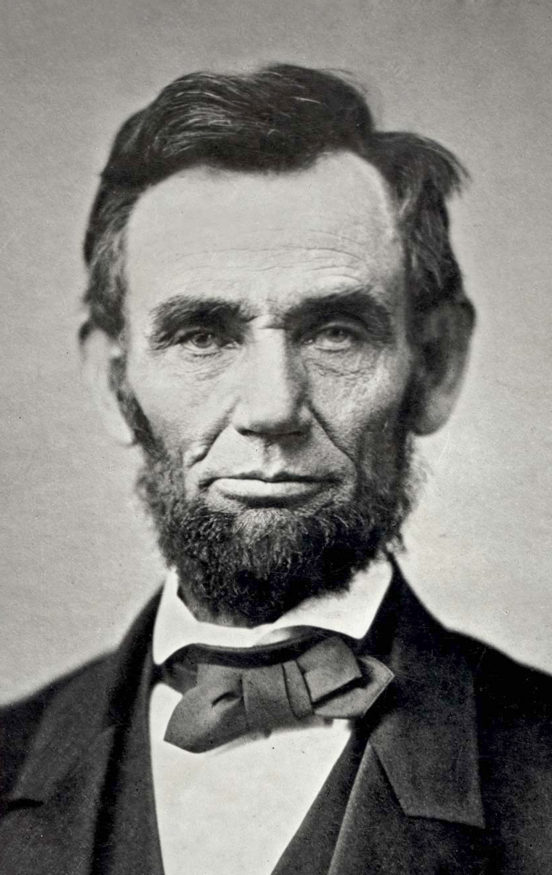
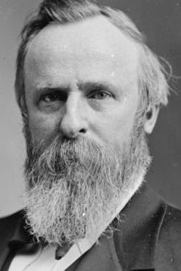
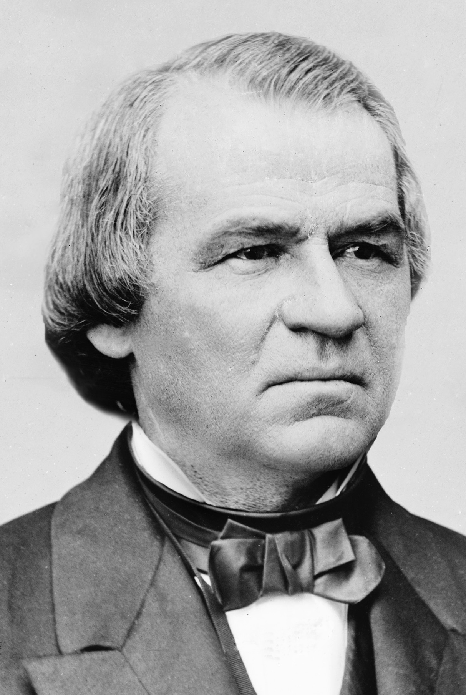
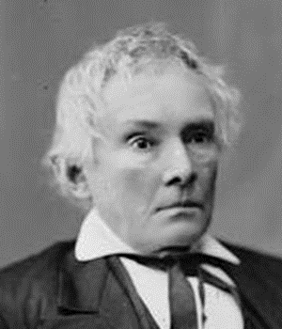
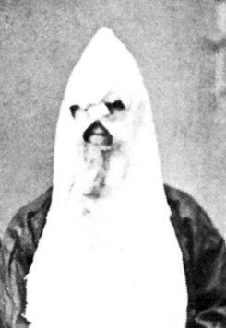


Political Spectrum of Reconstruction
Radicals
Moderates
Unionists
Redeemers
KKK
Federal Supremacy
Black Civil Rights
Military Occupation
States’ Rights
Blacks as Second-Class Citizens
Home Rule

Slide 5
Wartime Reconstruction
Military Occupation

Slide 6
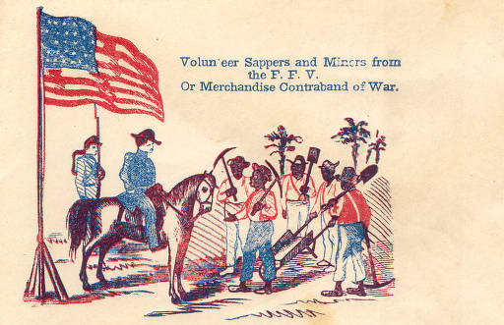
Slaves as “Contraband” Enemy Property

Slide 7
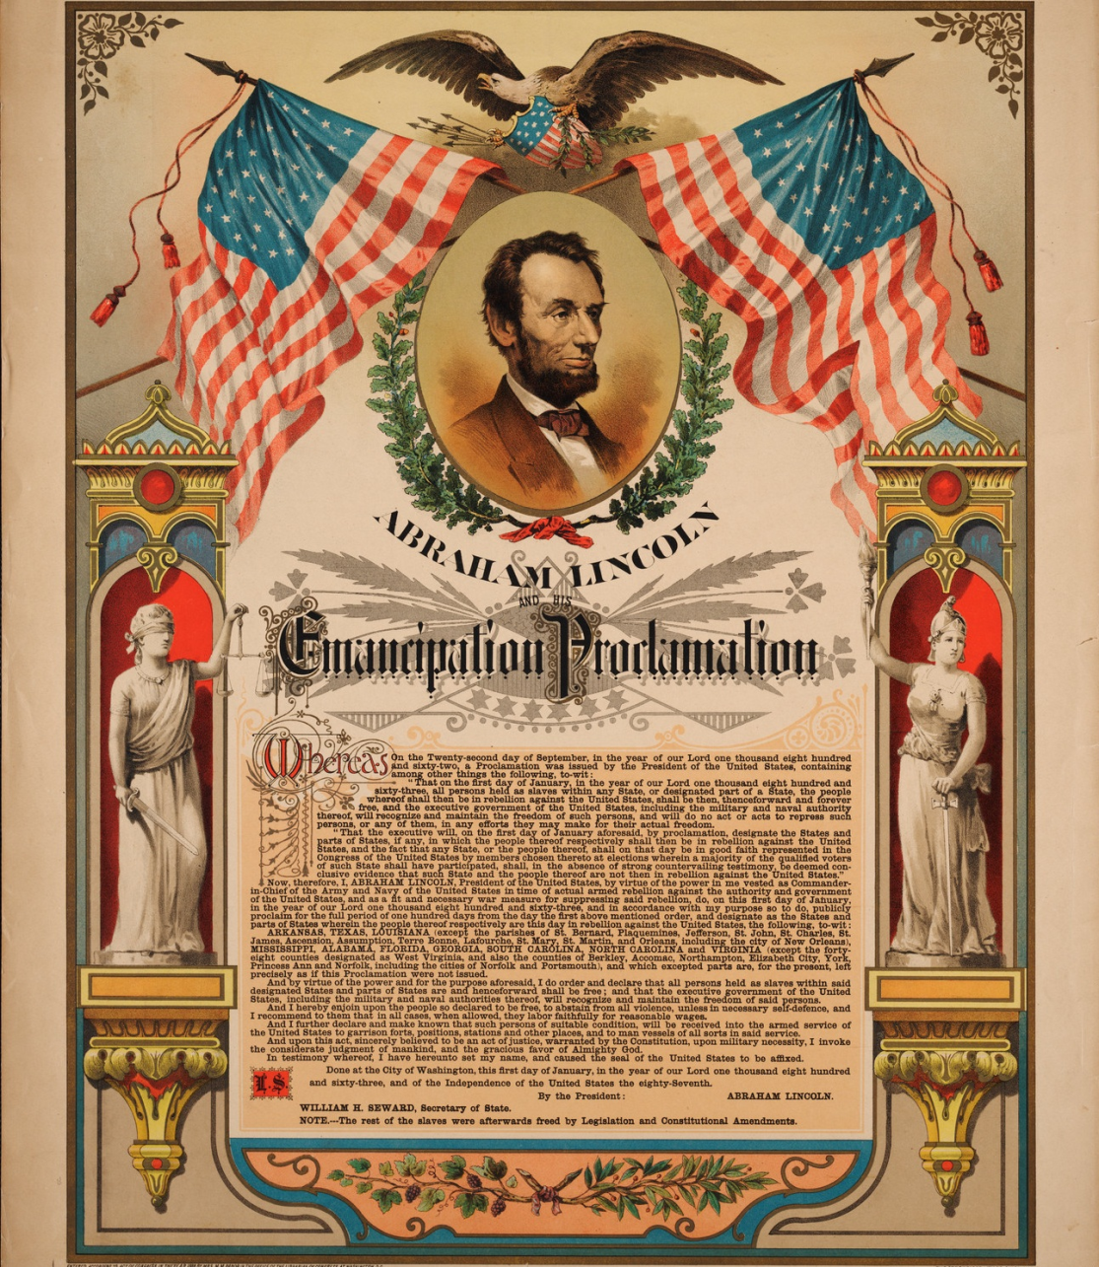
Emancipation Proclamation

Slide 8
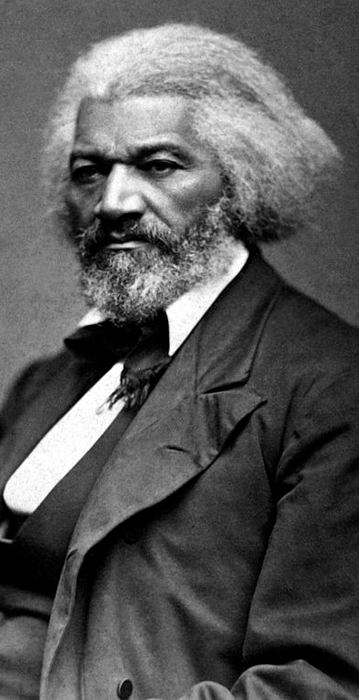
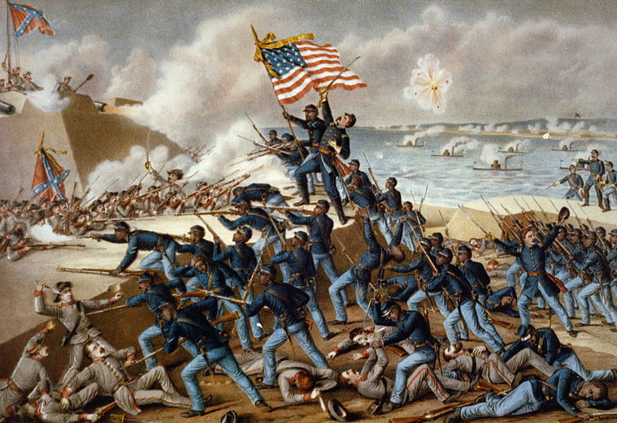
Frederick Douglass & Black Regiments

Slide 9
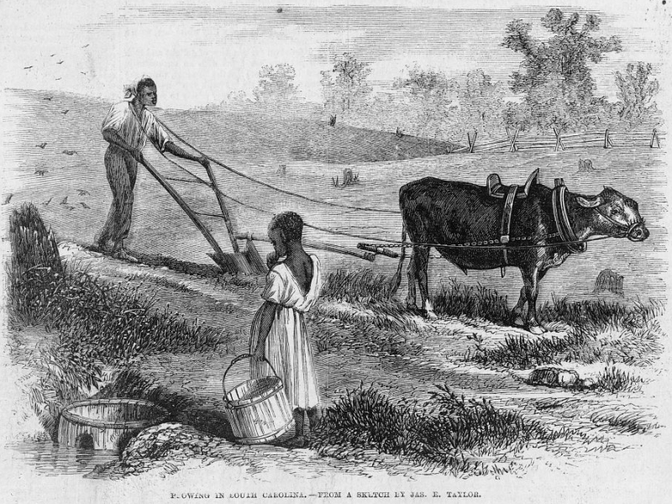
Land Reform: 40 Acres and a Mule?

Slide 10
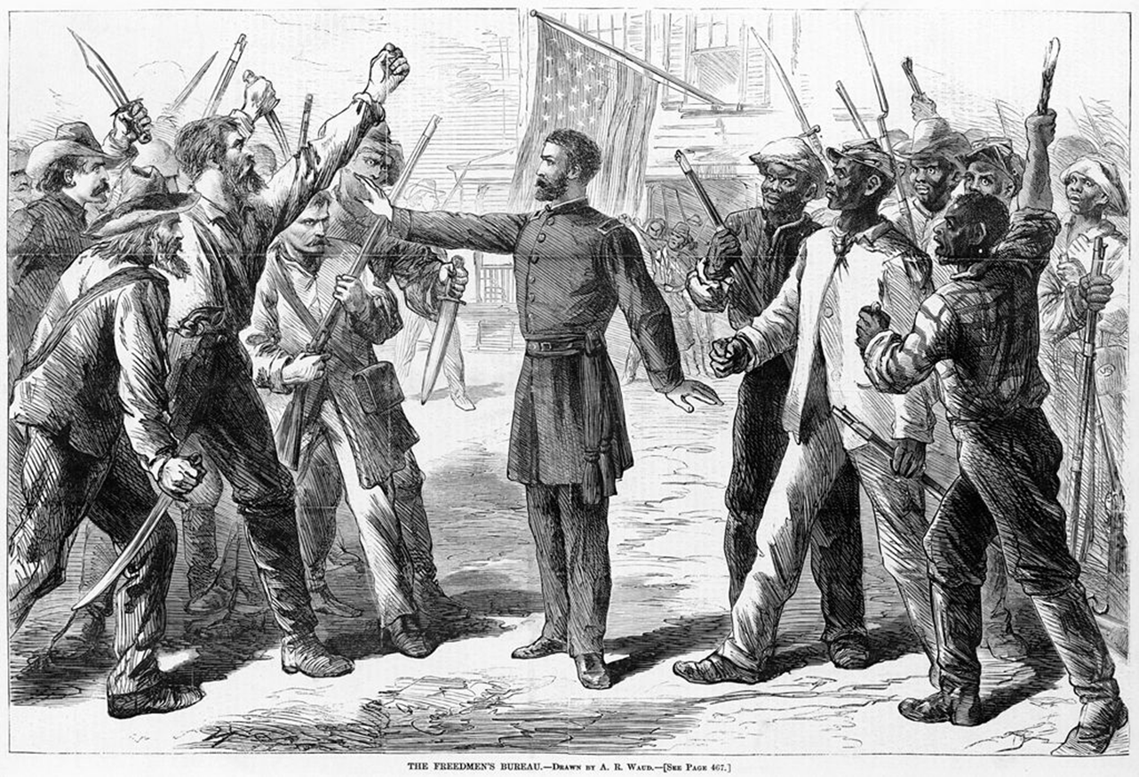
Military Occupation of the South

Slide 11
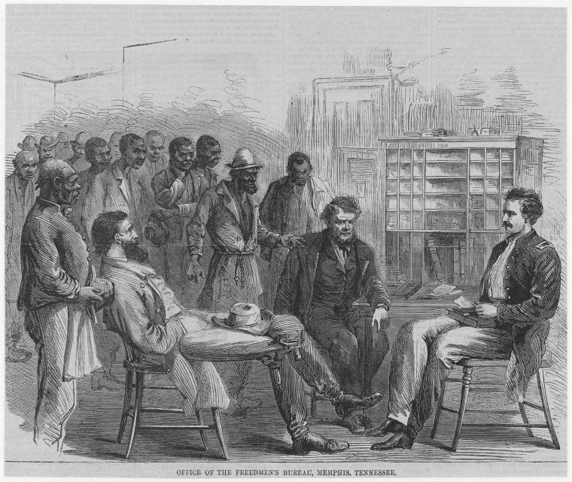
Freedmen’s Bureau Established, 1865

Slide 12
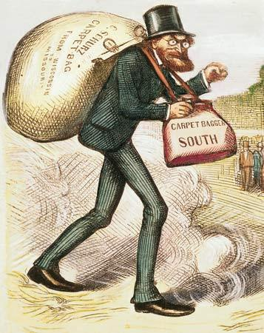

Carpetbaggers Travel South

Slide 13
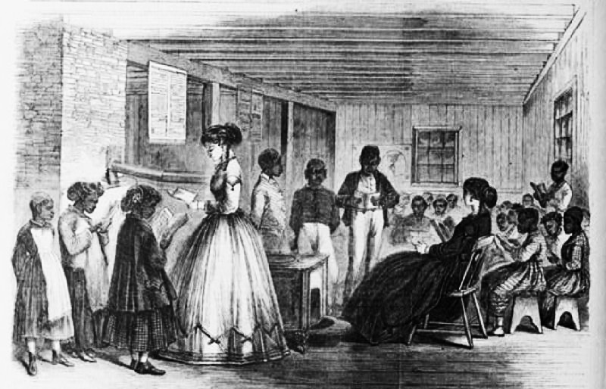
Carpetbaggers at Freedmen’s Bureau

Slide 14
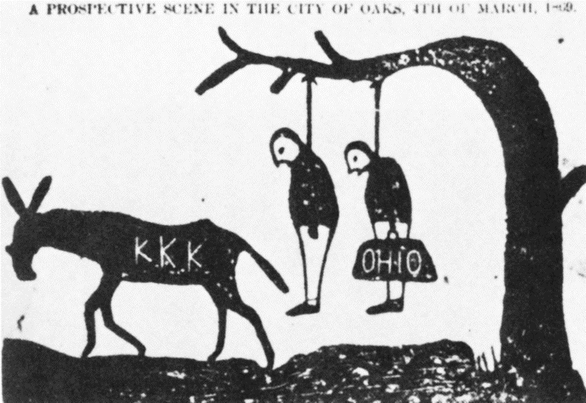
Death Threats Against Carpetbaggers

Slide 15
Wartime Reconstruction:
Military Occupation
Abolishing Slavery
  “Contraband”: Union army sheltered and refused to return fugitive slaves
  Emancipation Proclamation freed slaves in Confederacy
  Abolitionists, including Frederick Douglass, successfully lobbied for black Union Army regiments
  “40 acres and a mule” land redistribution was proposed, but not realized
Reshaping Southern Society
  South was placed under occupation by Union Army
  Freedmen’s Bureau provided education, legal protection and temporary economic aid to former slaves
  Northern carpetbaggers came to the south to aid freedmen and for new business opportunities
  Southern Democrats resented and resisted military occupation and social change

Slide 16
Presidential Reconstruction
Abraham Lincoln

Slide 17
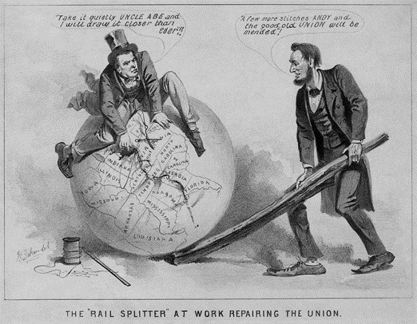
Lincoln & Reconstruction

Slide 18
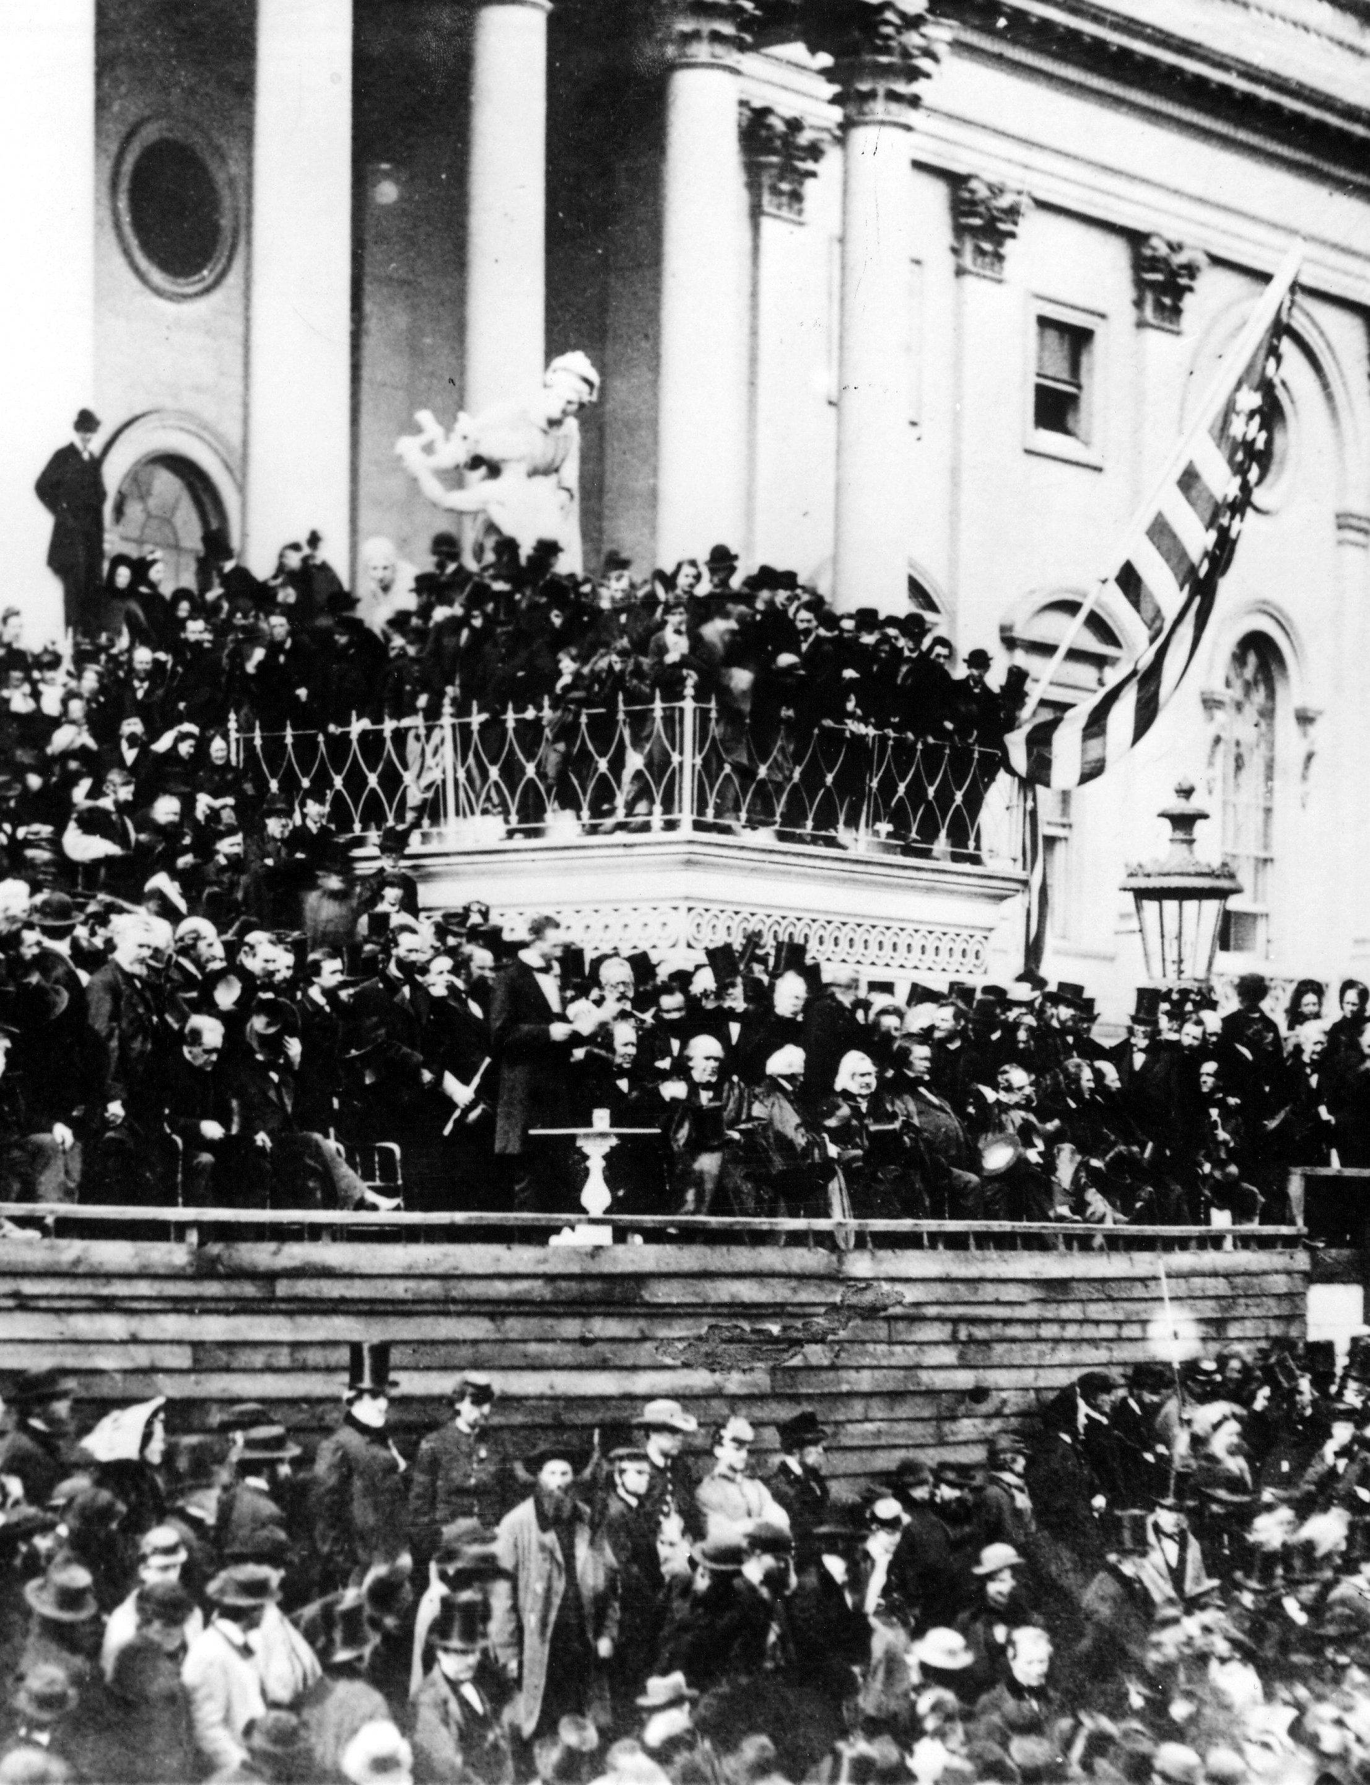
Lincoln’s Second Inaugural Address
“With malice toward none; with charity for all; with firmness in the right, as God gives us to see the right, let us strive on to finish the work we are in; to bind up the nation's wounds; to care for him who shall have borne the battle, and for his widow, and his orphan--to do all which may achieve and cherish a just and lasting peace, among ourselves, and with all nations.”
March 4, 1865

Slide 19
Lincoln’s 10% Plan

Slide 20
New State Constitutions:
Unionist “Lincoln Governments”

Slide 21
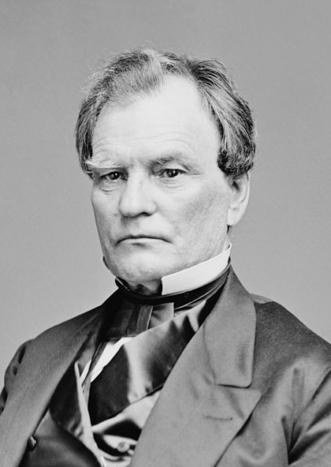
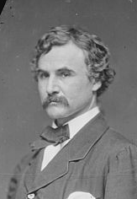
Radical Republicans: Wade-Davis Bill
50%
Benjamin Wade
(R-OH)
Henry W. Davis
(R-MD)

Slide 22
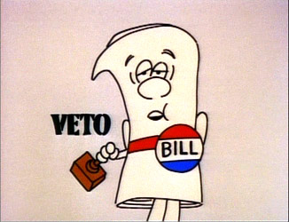
Lincoln’s Pocket Veto of Wade-Davis Bill

Slide 23
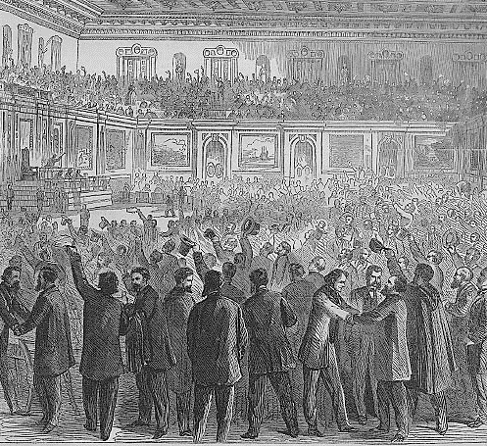
Lobbying for the 13th Amendment

Slide 24
13th Amendment
Ratified in 1865
“Neither slavery nor involuntary servitude, except as punishment for crime whereof the party shall have been duly convicted, shall exist within the United States or any place subject to their jurisdiction”

Slide 25
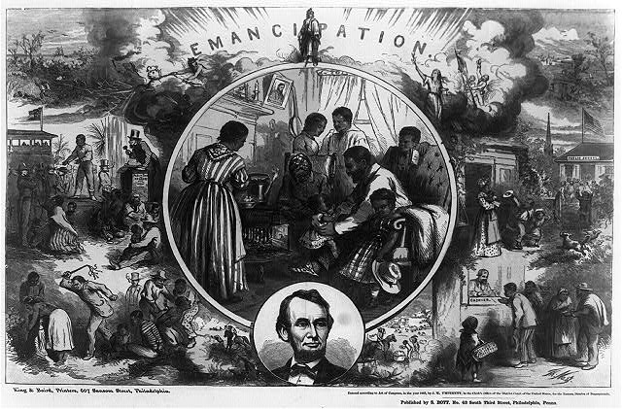
13th Amendment

Slide 26
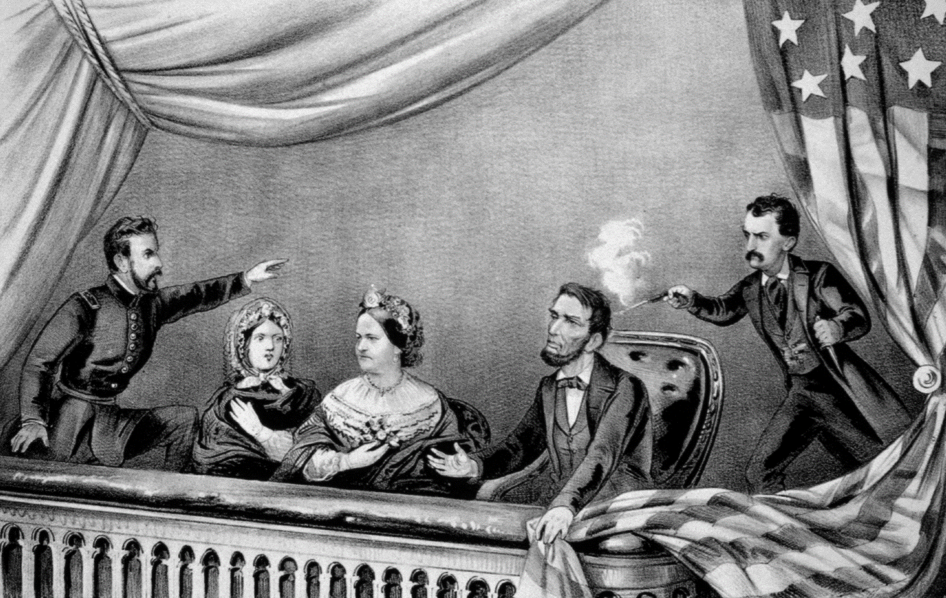
Assassination of Lincoln

Slide 27
Presidential Reconstruction:
Abraham Lincoln
Lincoln’s Views
  National union is “indivisible” and “perpetual,” therefore secession was always illegal
  National reconciliation and swift restoration of southern states to the Union after new state governments (“Lincoln governments”) had been formed
  “With malice toward none, with charity for all… to bind up the nation’s wounds”
  Opposed Radical Republicans’ harsher, punitive stance
Lincoln’s Policies
  10% Loyalty Plan
  Pocket veto of Radical Republicans’ Wade-Davis Bill (50% Plan)
  Successfully lobbied for passage of 13th Amendment, which abolished slavery in all states
Assassination of Lincoln, 1865
  John Wilkes Booth
  Led to power struggle between President Andrew Johnson (D) & Congressional Radical Republicans

Slide 28
Presidential Reconstruction
Andrew Johnson

Slide 29
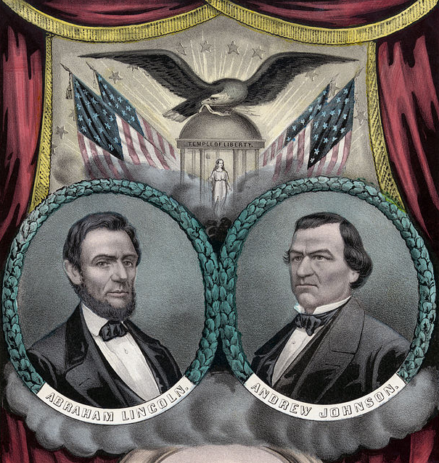


1864 Election: Lincoln & Johnson

Slide 30
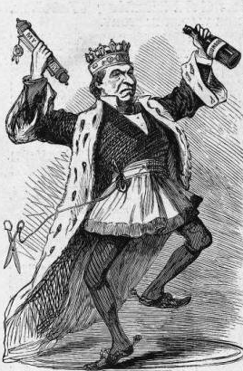
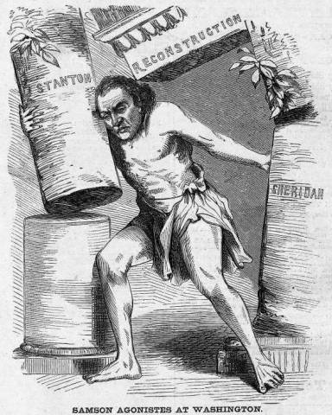
Worst President Ever?

Slide 31
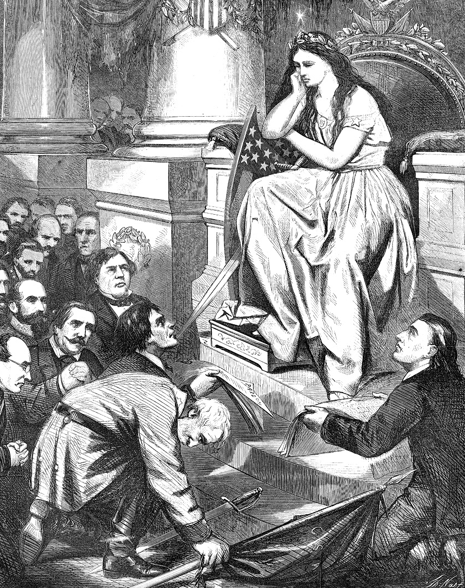
Pardons for Confederate Leaders

Slide 32
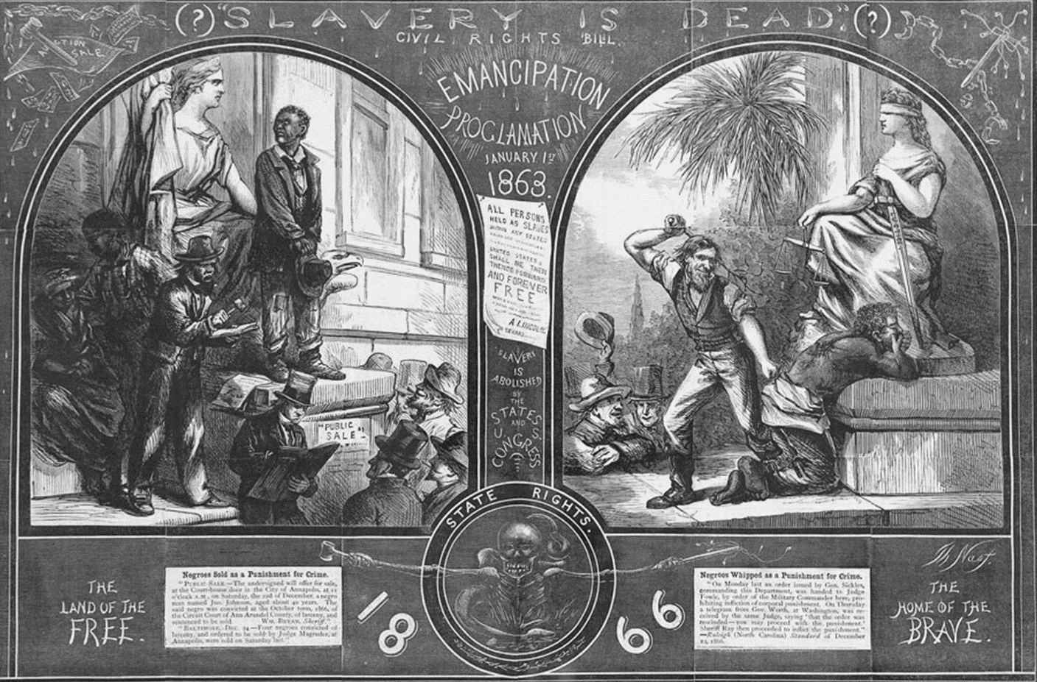
New State Constitutions & Black Codes

Slide 33
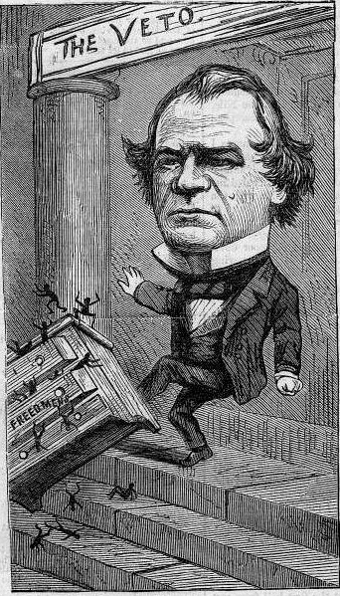
Johnson’s Vetoes
Extension of Freedmen’s Bureau
Civil Rights Act

Slide 34
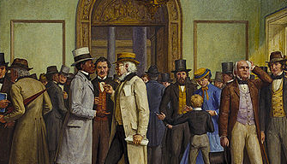
Radical Republicans Override Johnson’s Vetoes

Slide 35
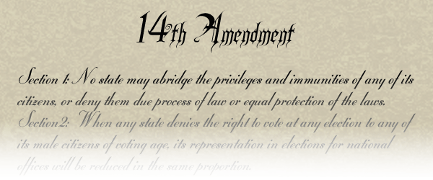
Johnson Opposes 14th Amendment

Slide 36
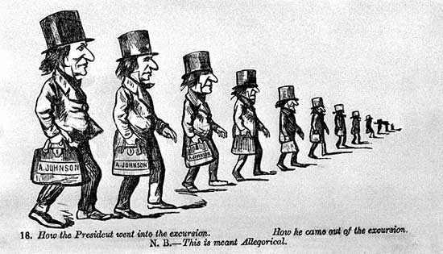
Johnson’s “Swing Around the Circle”

Slide 37


Republican Gains in 1866 Election
40th U.S. Congress (in 1867)
Senate | 45 (86% of Senate seats) | 8 (14% of Senate seats)
House (plus 1 Conservative Party congressman) | 142 (79% of Senate seats) | 45 (21% of Senate seats)

Slide 38
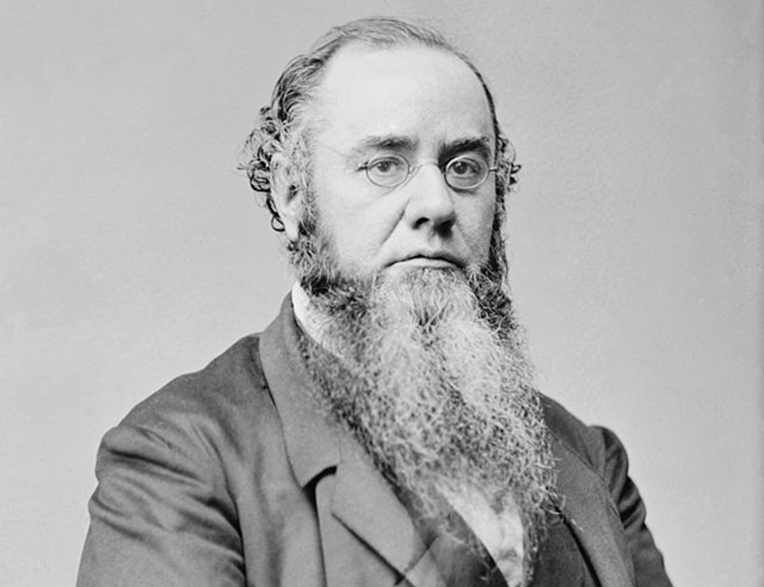
Tenure of Office Act & Edwin Stanton

Slide 39
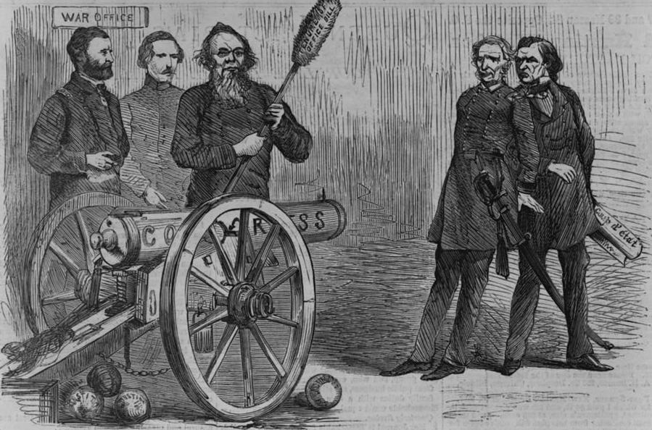
Stanton’s Revenge on Johnson

Slide 40
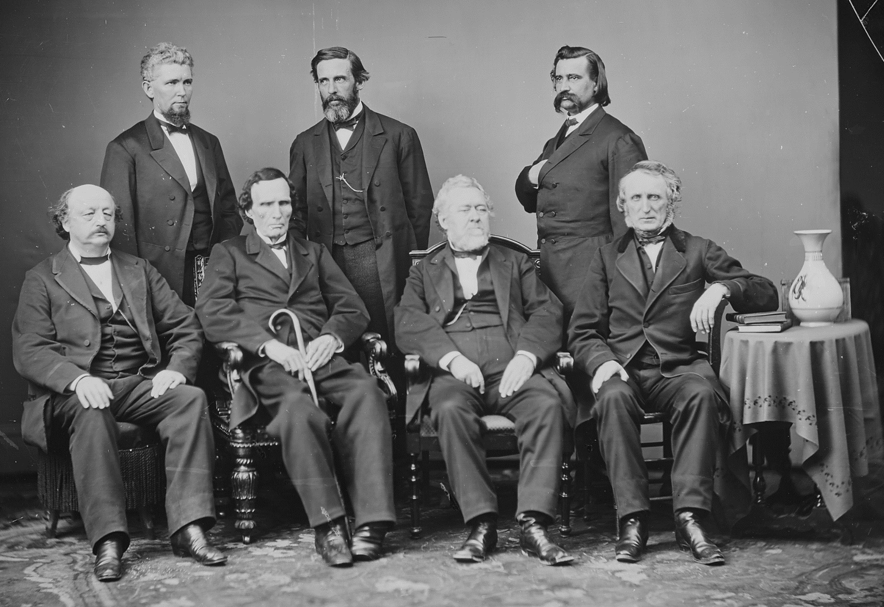
House Impeachment Committee

Slide 41
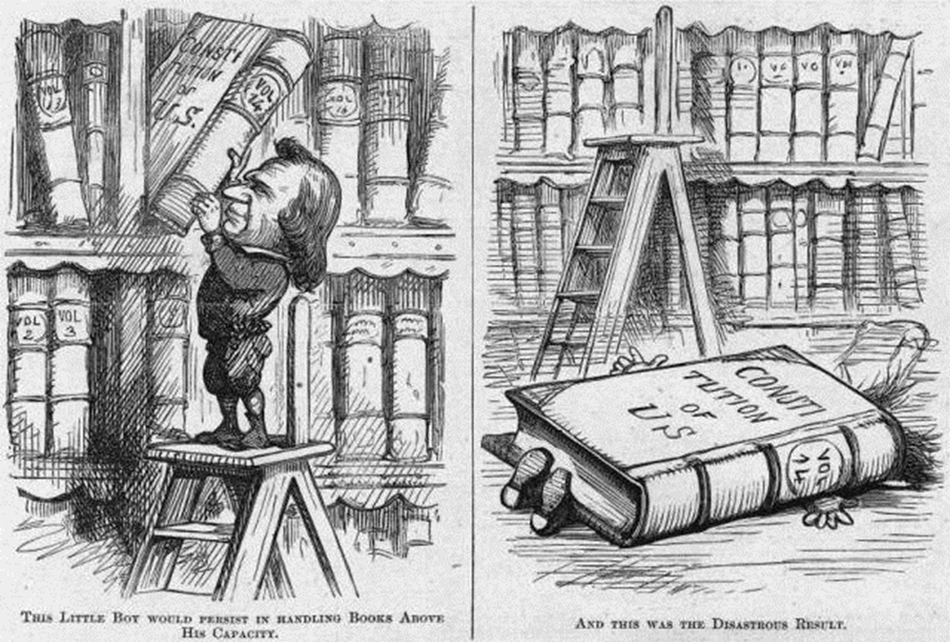
House Impeachment Charges

Slide 42
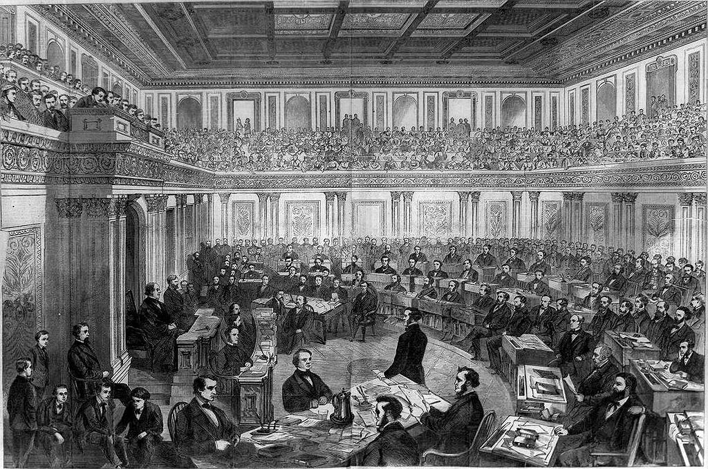
Senate Impeachment Trial, 1868

Slide 43
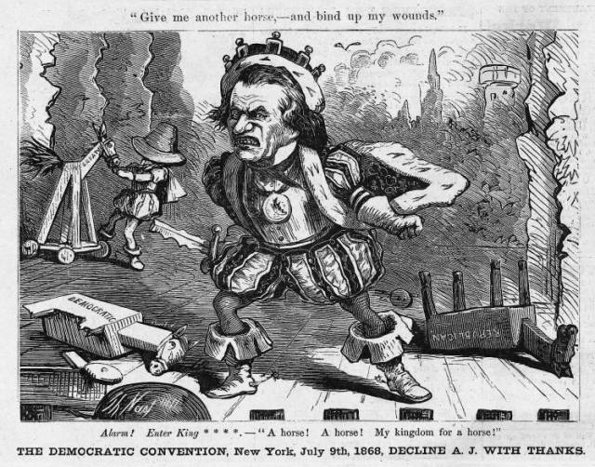
Johnson’s Pyrrhic Victory

Slide 44
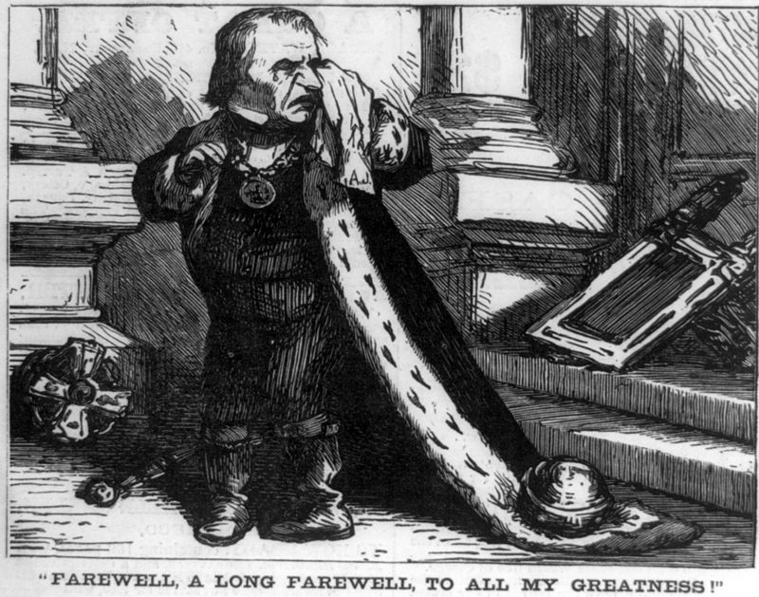
Johnson Leaves Office, 1869

Slide 45
Presidential Reconstruction:
Andrew Johnson
Johnson’s Views
  “War Democrat” who was hated by many southerners and distrusted by Radical Republicans
  Was a Jacksonian white supremacist… but also anti-aristocrat
  Swift restoration of southern states with only minimal protections for freedmen
Johnson vs. Southern States
  Pardoned ex-Confederates and wealthy planters
  Confederate elite came back into power
  Southern states passed Black Codes
Johnson vs. African Americans
  Vetoed Freedmen’s Bureau
  Vetoed Civil Rights Act
  Opposed 14th Amendment
Johnson vs. Congress
  Congress overrode many of Johnson’s vetoes
  Republicans won a supermajority in 1866 Congressional election
  Congress passed Tenure of Office Act, 1867
  Johnson fired Secretary of War Edwin Stanton and replaced radical generals, 1867
  Johnson was impeached but kept his job by only one vote, 1868

Slide 46
Congressional Reconstruction
The Radical Republicans

Slide 47
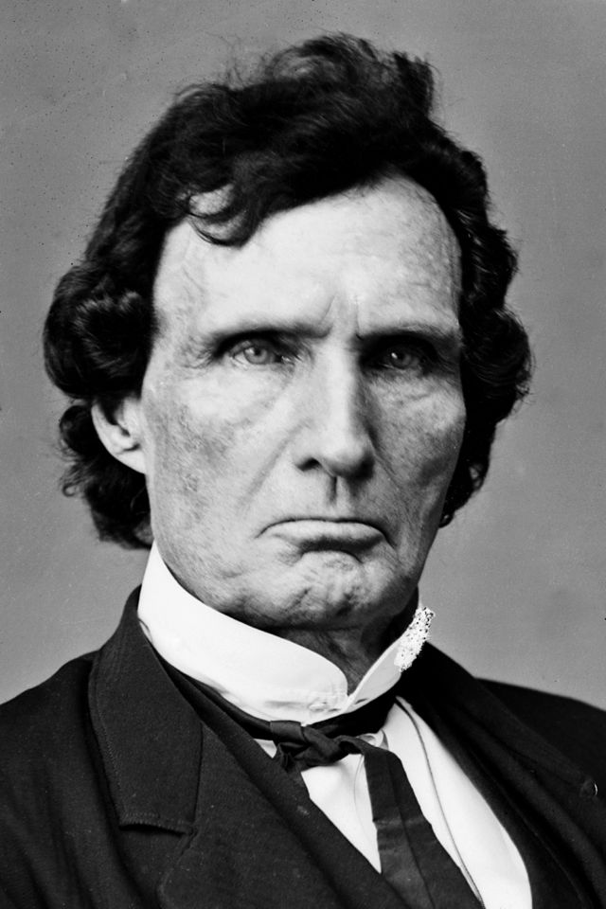
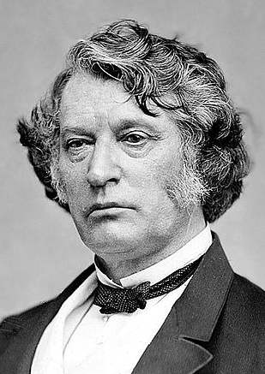
Congressional Radical Republicans
House
Thaddeus Stevens
Senate
Charles Sumner

Slide 48

Views of the Radical Republicans
South is a conquered province subject to military occupation
Full equality of freedmen must be guaranteed
Congress & federal government must enforce these conditions on southern states before they rejoin the Union

Slide 49

Civil Rights Acts of 1866 & 1875

Slide 50

Military Reconstruction Act, 1867

Slide 51
Reconstruction Amendments
13th
14th
15th

Slide 52

14th Amendment
Ratified in 1868
Guarantees
  Citizenship by birth
  Equal protection under the law
  Privileges and immunities
“No state shall...”
  Federal supremacy
  Incorporation doctrine

Slide 53


Suffragettes & the 14th Amendment?

Slide 54

Votes for Freedmen?

Slide 55

15th Amendment
Ratified in 1870
Universal male suffrage

Slide 56

Suffragettes & the 15th Amendment?

Slide 57
Congressional Reconstruction:
The Radical Republicans
Leaders
  House: Thaddeus Stevens (PA)
  Senate: Charles Sumner (MA)
Views of Radical Republicans
  Military occupation & federal supremacy over south
  Full equality for freedmen
Radical Republican Legislation
  Civil Rights Act of 1866
  Military Reconstruction Act
  13th Amendment abolished slavery
  14th Amendment guaranteed citizenship & equal protection
  15th Amendment guaranteed universal male suffrage
  Civil Rights Act of 1875
Women were both emboldened and frustrated by Reconstruction Amendments

