Slide 1
Capitalism & Industrial Revolution

Slide 2
Background : Industrial Revolution
Gilded Age – or, Age of Big Business, or, Rise of Capital
IR and production increase = rich, very rich industrialists (bourgeoisie) called Robber Barons-unethical, manipulative business leaders
Bourgeoisie showed off their wealth: mansions, clothes, cars, jewels, etc. --- new kings of the land
Gilded Age: wasteful, show-off luxury
Causes: C.W. & new production; MR and westward expansion = increased markets; new inventions and mechanization; gov’t policies – (tariffs, tax-free, courts); cheap immigrant labor
Effects: rise of cities (urbanization) and increased immigration; move westward and NA dislocation; exploitation and labor unions; new work patterns (8-5 pm); double work for women (increased rights?)

Slide 3
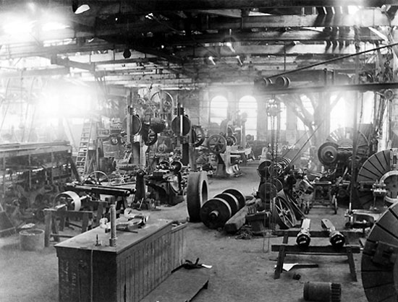
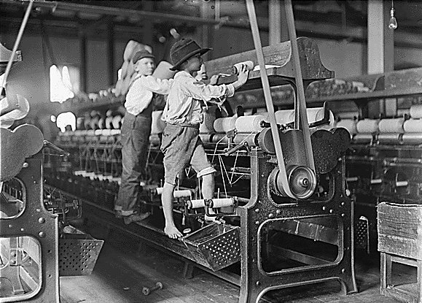
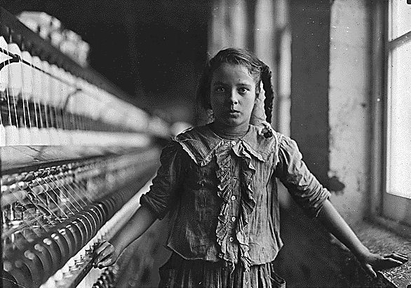

Slide 4
Capitalism
Def: type of economy in which industries are privately owned, and the prices, production and distribution of goods are determined by competition in a free market for the purpose of profit
Own private property, owner creates company; make a product for $3, sell for $5 = $2 Profit
Owners of property = bourgeoisie
Workers = proletariat (most are not owners)

Slide 5
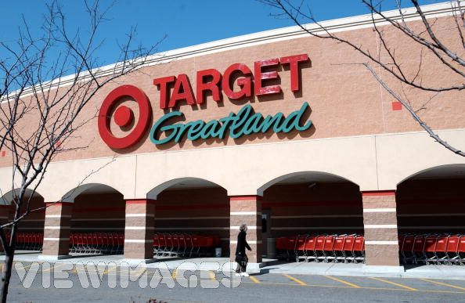
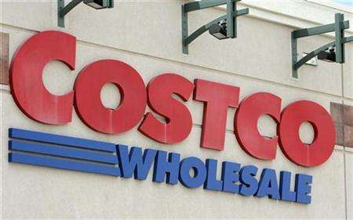

Slide 6
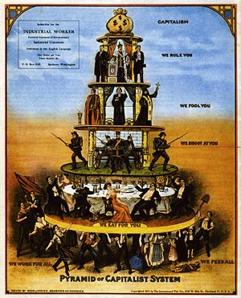

Slide 7
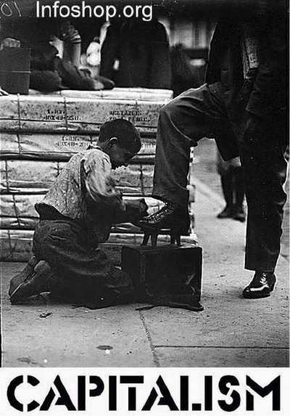

Slide 9
Economic Transformation: 1860s to 1900s
Business Organization
Corporation = investors buy company stocks; company uses money to create goods; distributes profits to investors
Corporations often work with competing corporation to control prices = horizontal integration
Corporations control every level of production – such as oil, the drilling, transportation, refining and selling = vertical integration
Notes:
Global Industrial Leader
In 1860s, US was top 5 industrial producer – behind UK, Germany and Frace
By 1890s/1900s, US produces more than all three combined → leads in steel, minerals, etc & consumer goods, textiles
New South
New development of RR in south – attempt to industrialize with cigarette and textile factories.
Generally, still behind North and Midwest and pre-CW industrial South
+ traits: low wages, weak political power for labor

Slide 11
Social & Political Discontent
Railroad Trusts and Other Monopolies
Trusts = competing companies work together to set high prices; Monopoly = 1 company controls 1 part of market
Railroad trusts most famous; demanded high RR rates, hurt farmers; trusts in sugar, tools, grain depot industries
Standard Oil most famous monopoly; controlled all aspects of oil manufacturing and sales

Slide 12
Industrial Robber Barons (owners)
John D. Rockefeller: OIL --- controlled everything w/ oil: crude, refining, transport
Andrew Carnegie: STEEL --- very important for I.R, (railroads, machines); $480 mil, 1901
Cornelius Vanderbilt: RAILROAD --- transportation of goods; also gain land
Many gave to charities while paying very little to workers (philantrophy)

Slide 14
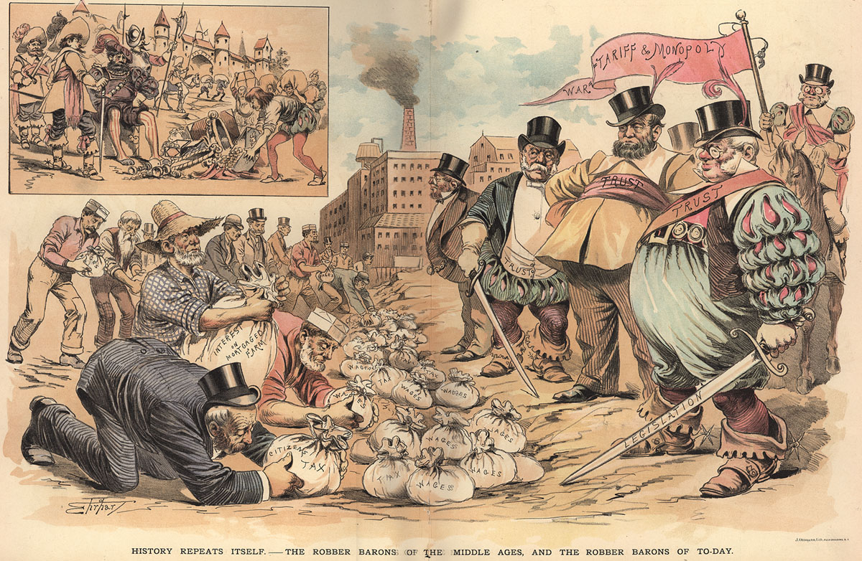

Slide 15
IDEAS during Industrial Revolution
Laissez Faire: “leave alone” --- no government interference in economy; no government regulations; so, no minimum wage, unsafe working conditions
Social Darwinism: poor are “naturally” poor and rich are “naturally” rich; it’s part of “survival of the fittest”
If the poor die in factories or ghettoes, then it helps humanity; less slow, stupid people.

Slide 16
Living Conditions
People lived in tiny, cramped apartments--- very close to other people.
Little privacy or space; no green parks
Unclean water, diseases (people infected each other) and little heating.
From very hard work, people came home to poor, depressing homes.

Slide 17
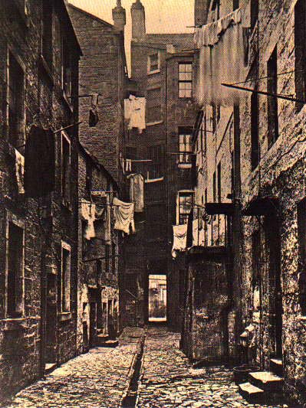
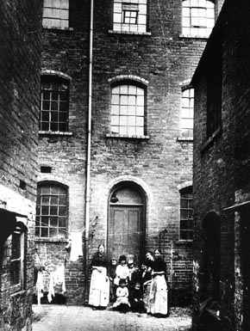

Slide 18
