Slide 1
Presidential Elections

Slide 2
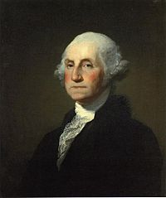
Election of 1789
George Washington
Independent

Slide 3
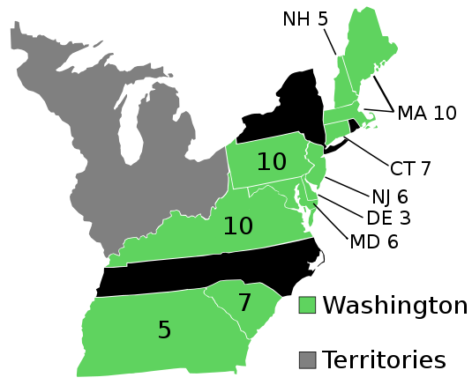
Election of 1789

Slide 4
Election of 1792
George Washington
Independent

Slide 5
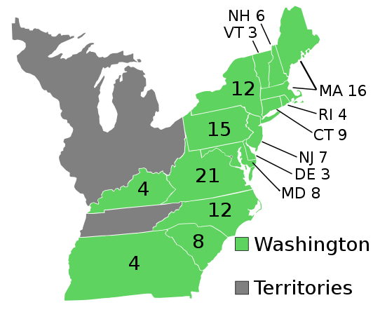
Election of 1792

Slide 6
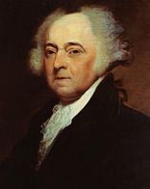
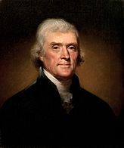
Election of 1796
John Adams
Federalist
Thomas Jefferson
Democratic-Republican

Slide 7
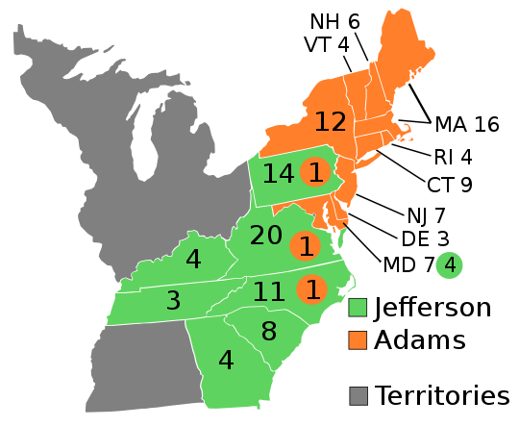
Election of 1796

Slide 8
Election of 1800
Thomas Jefferson
Democratic-Republican
John Adams
Federalist

Slide 9
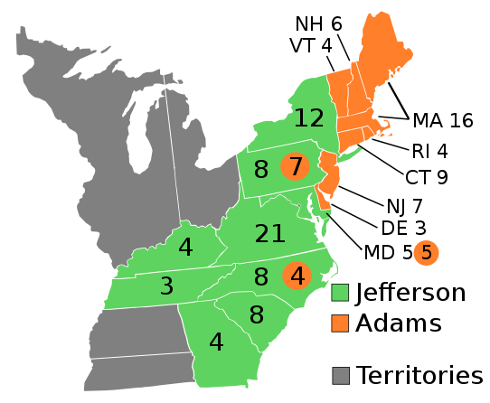
Election of 1800

Slide 10
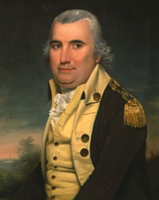
Election of 1804
Thomas Jefferson
Democratic-Republican
Charles C. Pinckney
Federalist

Slide 11
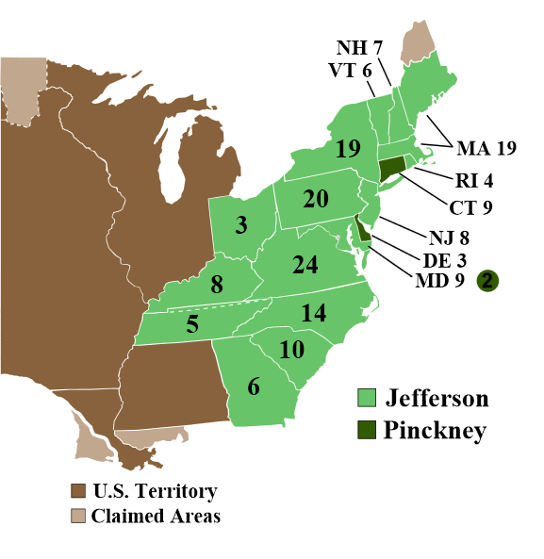
Election of 1804

Slide 12
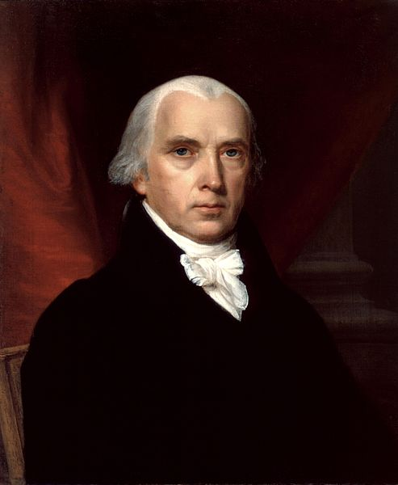
Election of 1808
James Madison
Democratic-Republican
Charles C. Pinckney
Federalist

Slide 13
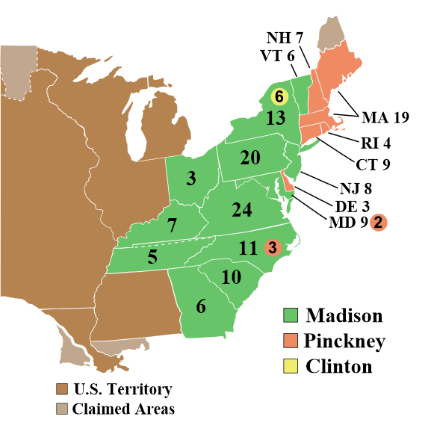
Election of 1808

Slide 14
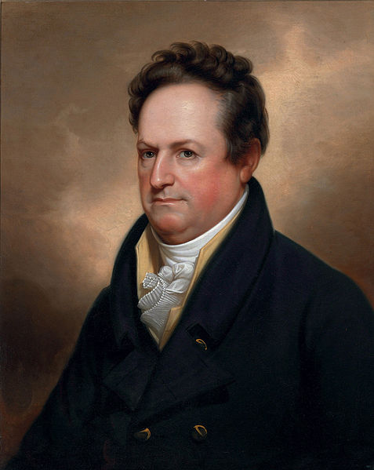
Election of 1812
James Madison
Democratic-Republican
Dewitt Clinton
Federalist

Slide 15
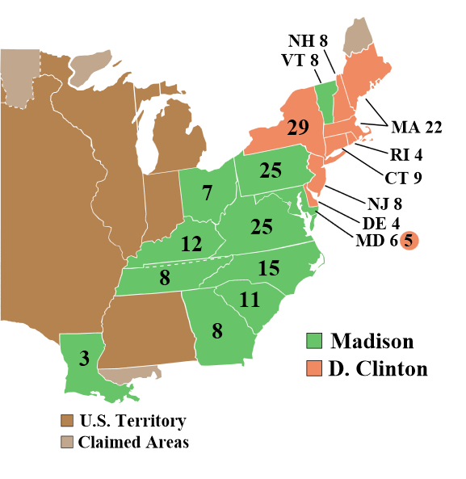
Election of 1812

Slide 16
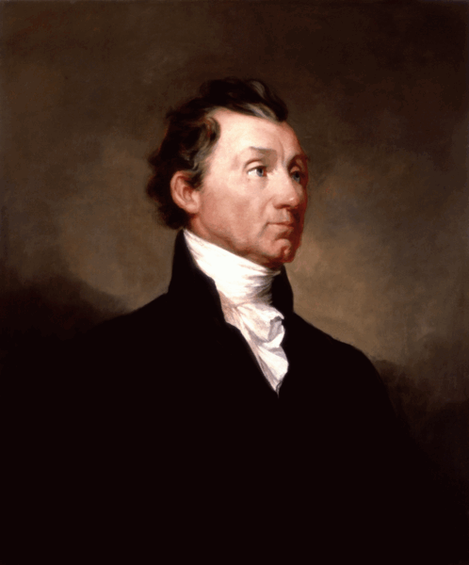
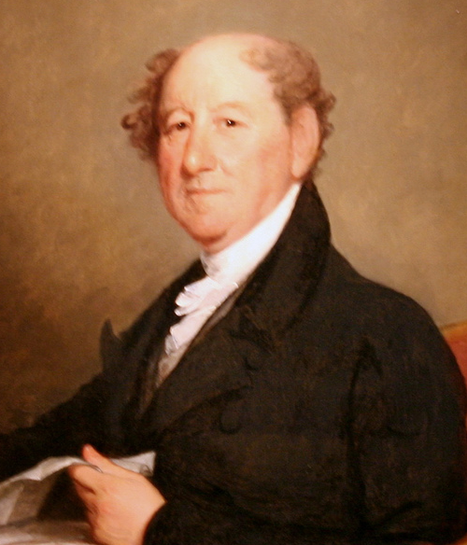
Election of 1816
James Monroe
Democratic-Republican
Rufus King
Federalist

Slide 17
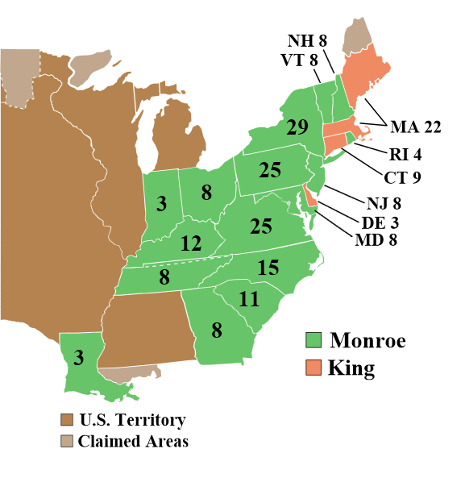
Election of 1816

Slide 18
Election of 1820
James Monroe
Democratic-Republican

Slide 19
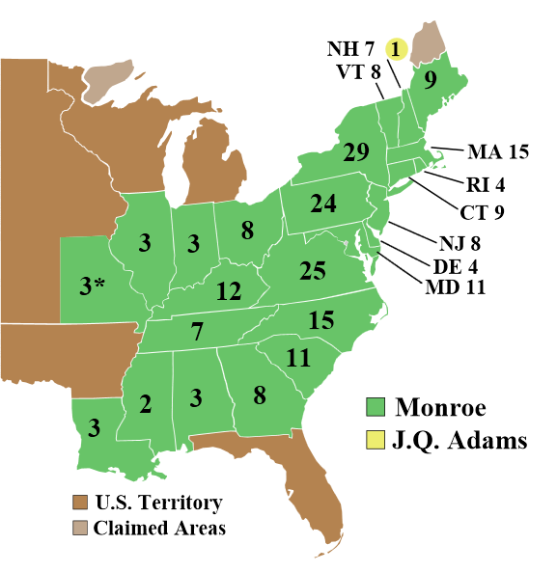
Election of 1820

Slide 20
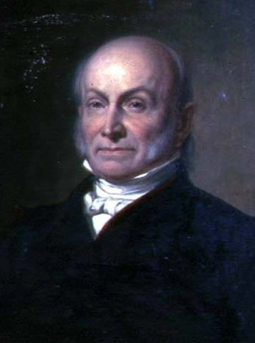
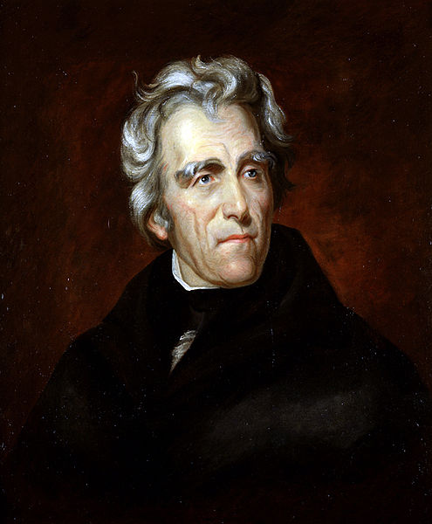
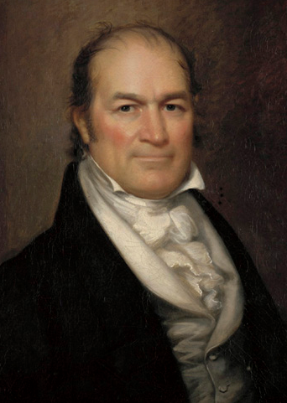
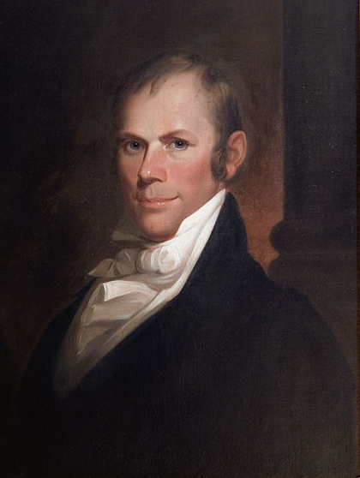
Election of 1824
John Quincy Adams
Democratic-Republican
Andrew Jackson
Democratic- Republican
William Crawford
Democratic- Republican
Henry Clay
Democratic- Republican

Slide 21
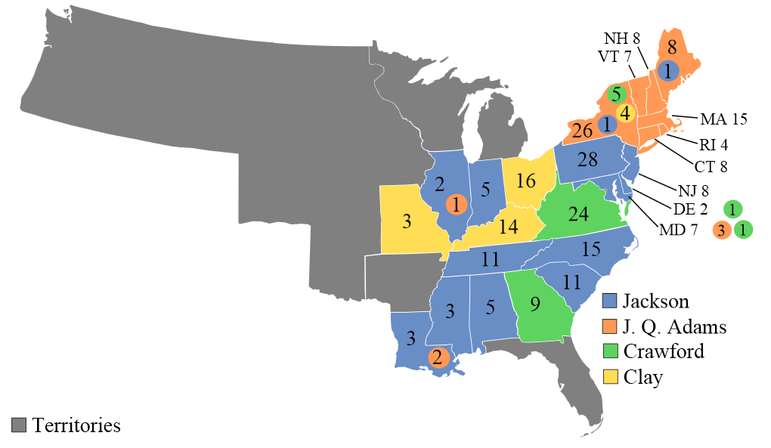
Election of 1824

Slide 22
Election of 1828
Andrew Jackson
Democrat
John Quincy Adams
National Republican

Slide 23
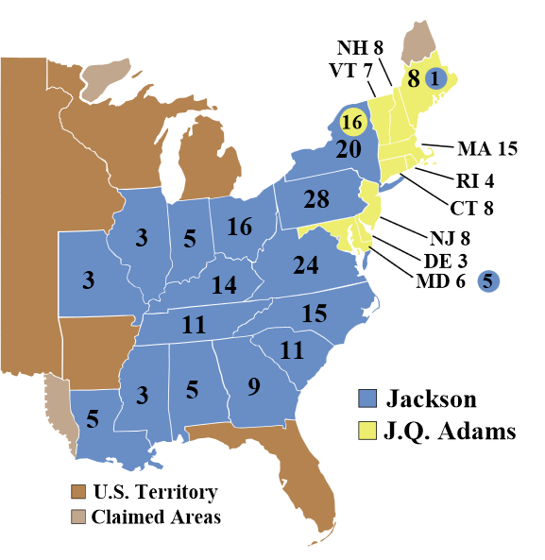
Election of 1828

Slide 24
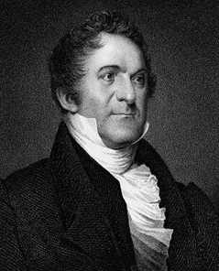
Election of 1832
Andrew Jackson
Democrat
Henry Clay
National Republican
William Wirt
Anti-Masons

Slide 25
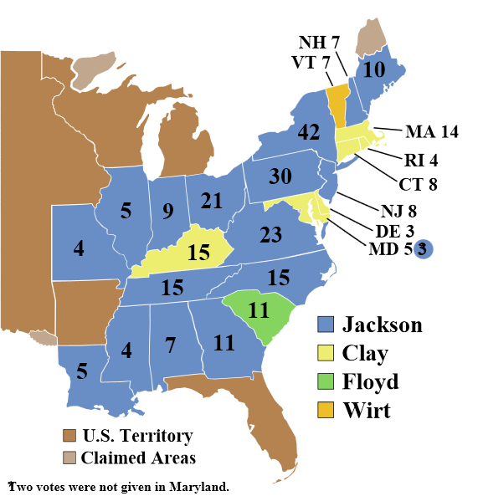
Election of 1832

Slide 26
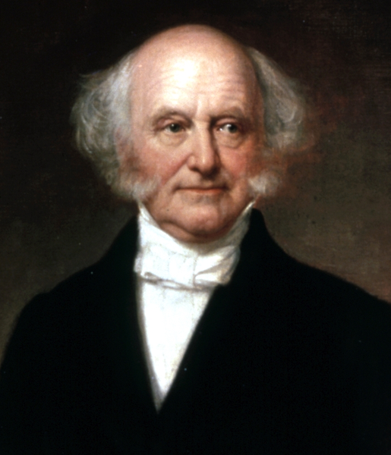
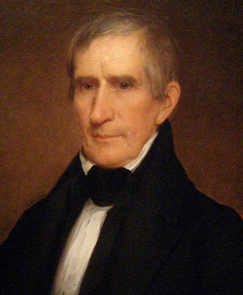
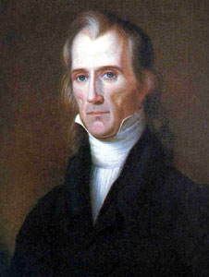
Election of 1836
Martin Van Buren
Democrat
William H. Harrison
Whig
Hugh White
Whig

Slide 27
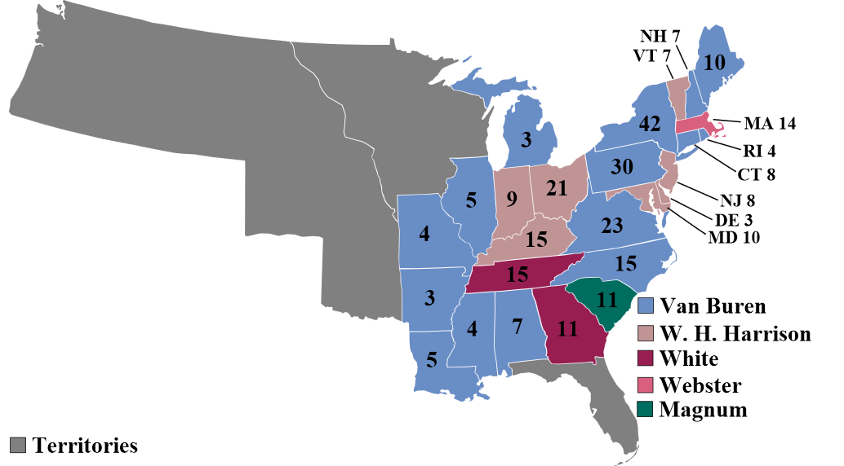
Election of 1836

Slide 28
Election of 1840
William H. Harrison
Whig
Martin Van Buren
Democrat

Slide 29
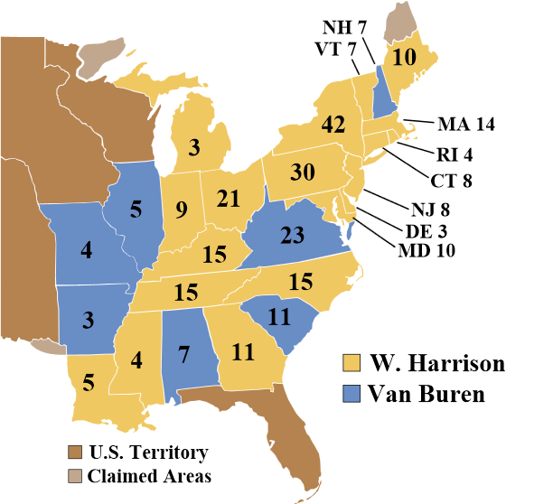
Election of 1840

Slide 30
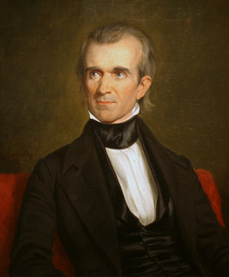
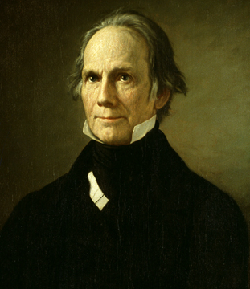
Election of 1844
James K. Polk
Democrat
Henry Clay
Whig

Slide 31
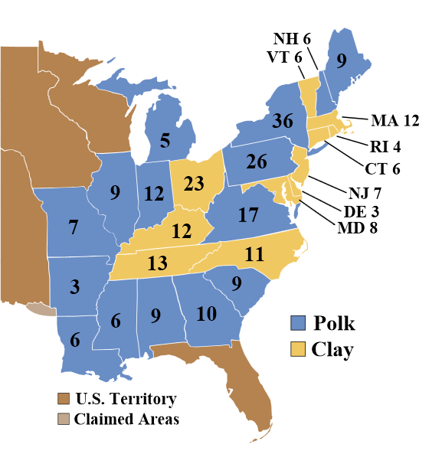
Election of 1844

Slide 32
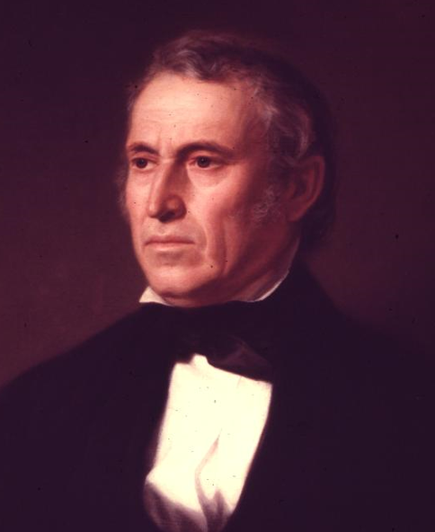
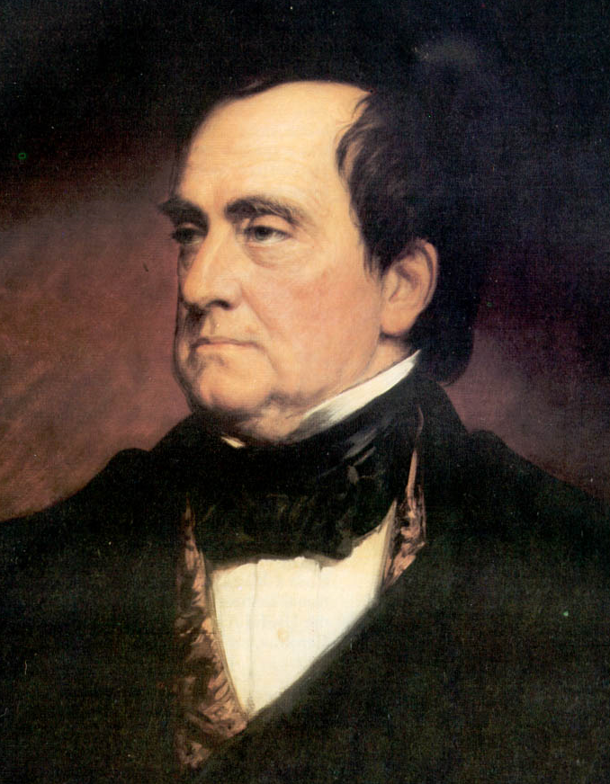
Election of 1848
Zachary Taylor
Whig
Lewis Cass
Whig
Martin Van Buren
Free Soil

Slide 33
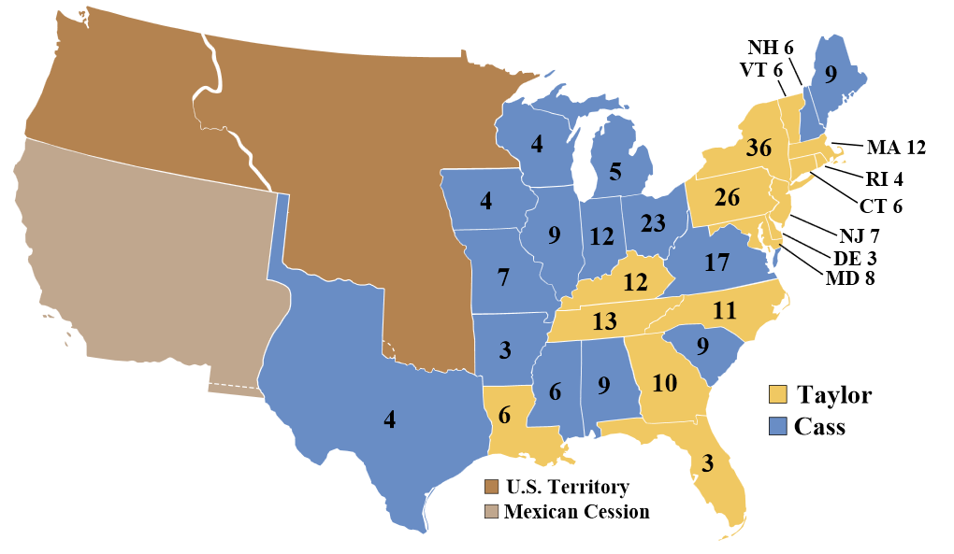
Election of 1848

Slide 34
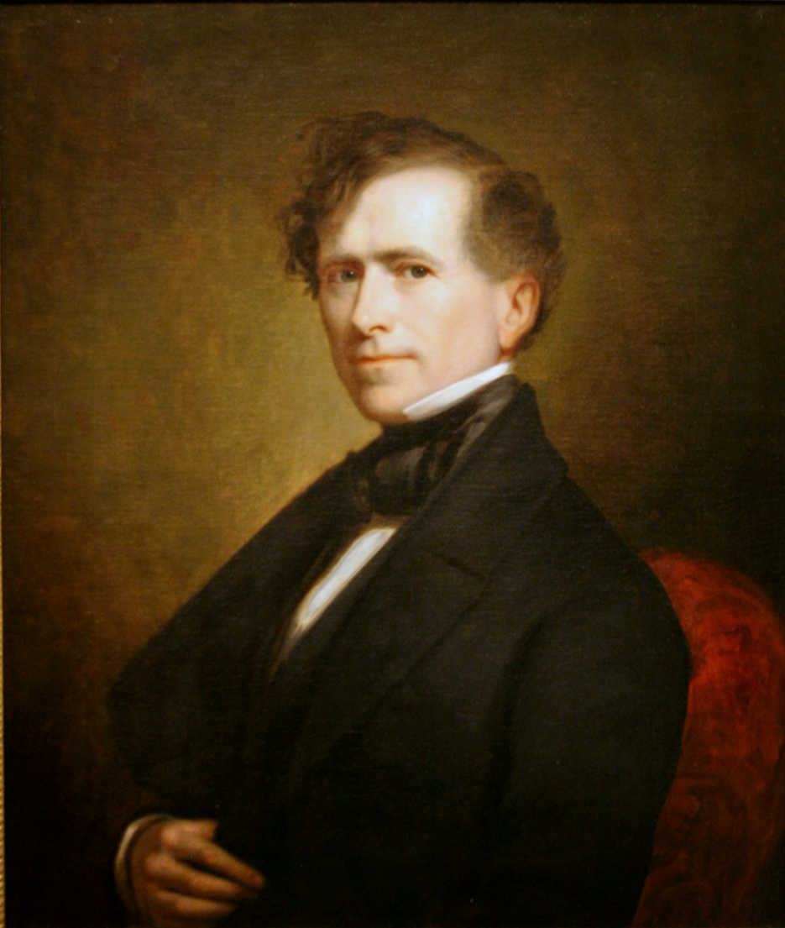
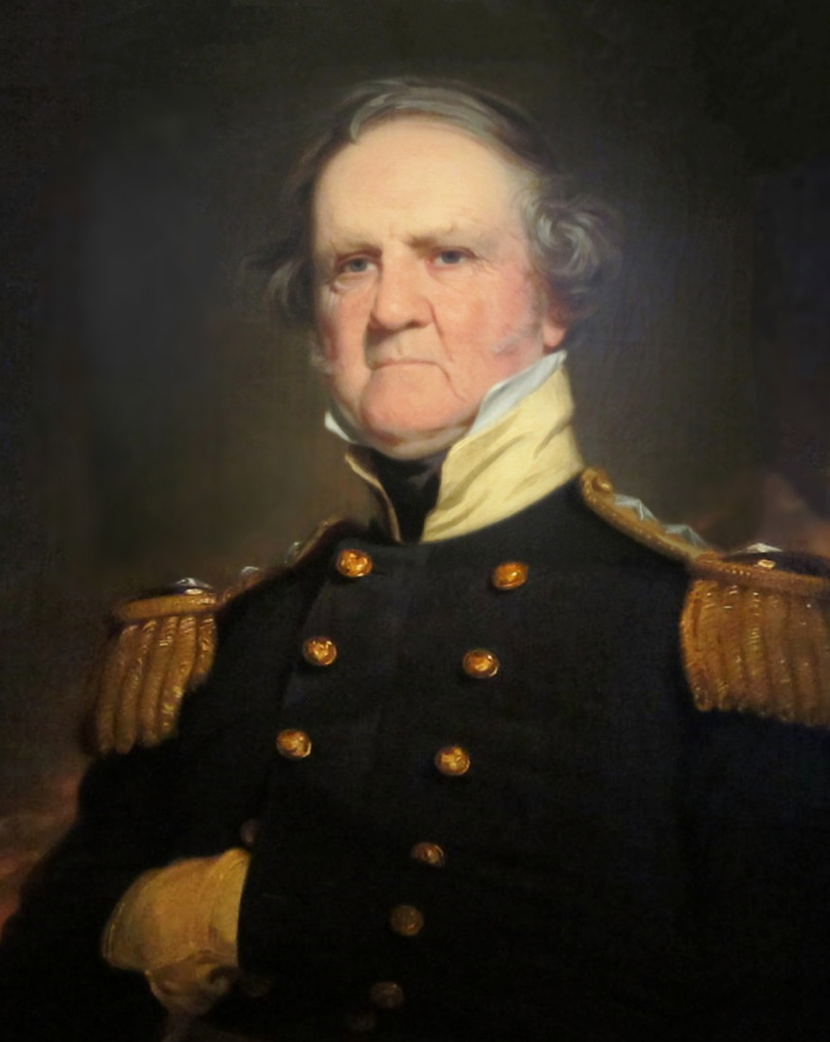
Election of 1852
Franklin Pierce
Democrat
Winfield Scott
Whig

Slide 35
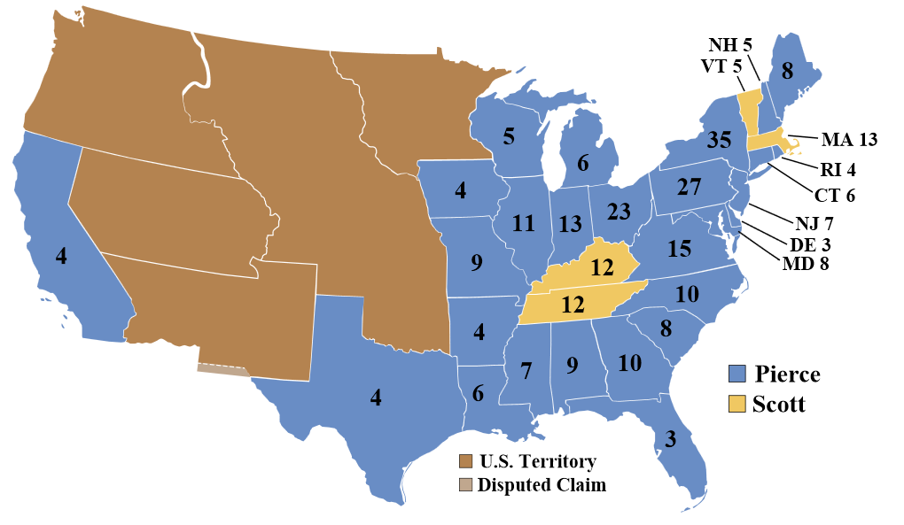
Election of 1852

Slide 36
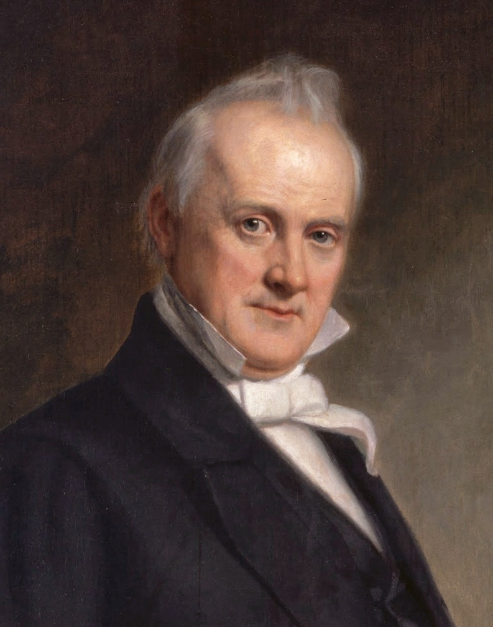
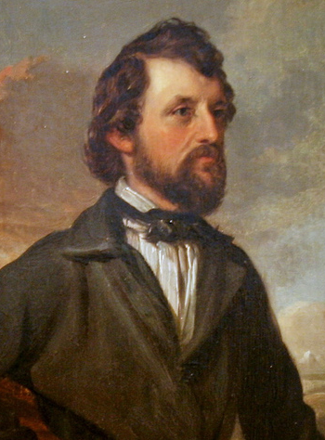
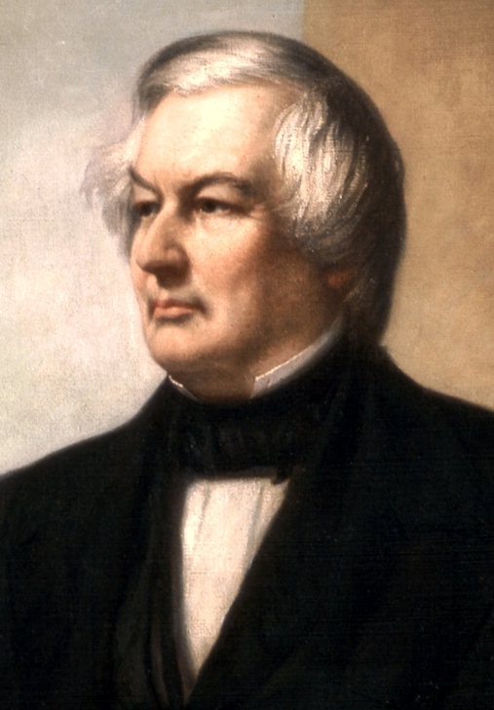
Election of 1856
James Buchanan
Democrat
John C. Fremont
Republican
Millard Fillmore
American/Know-Nothing

Slide 37
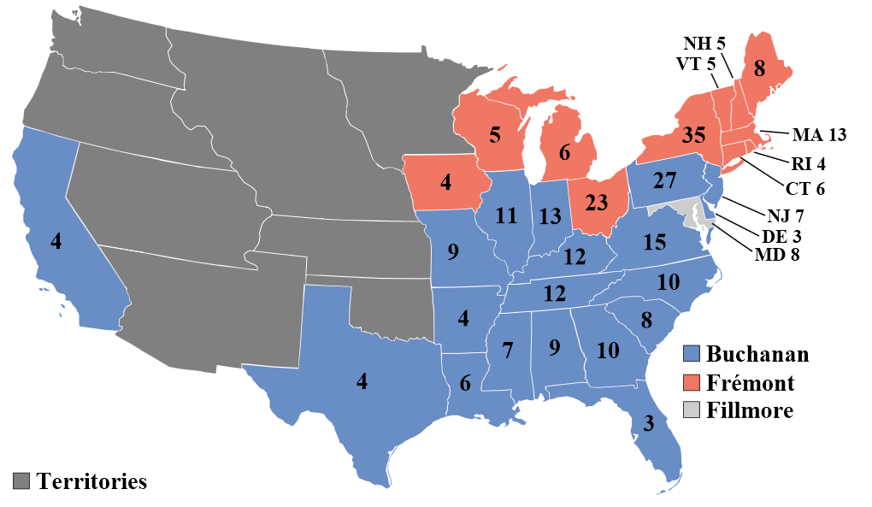
Election of 1856

Slide 38
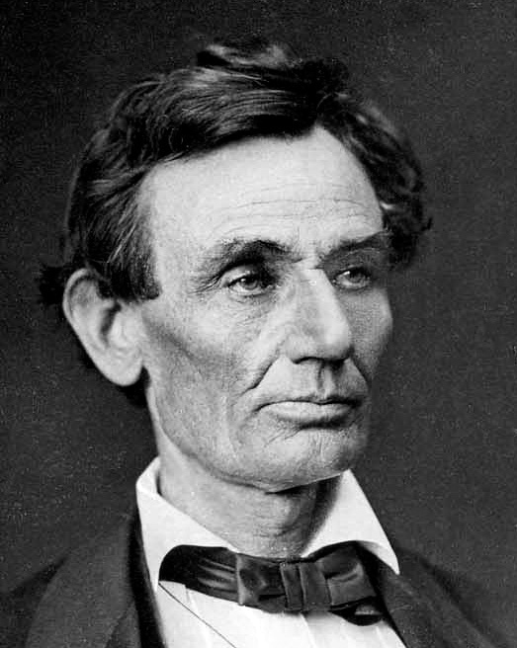
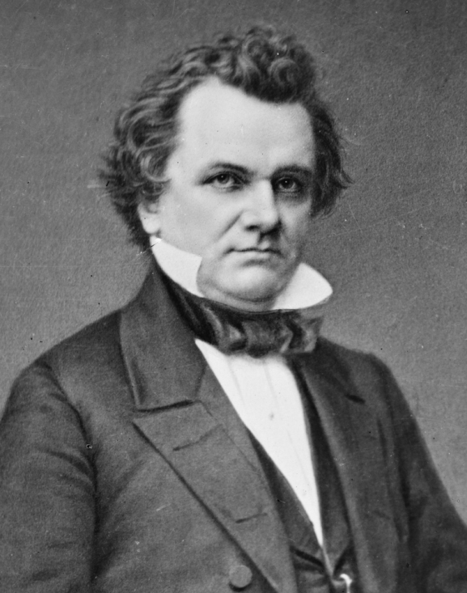
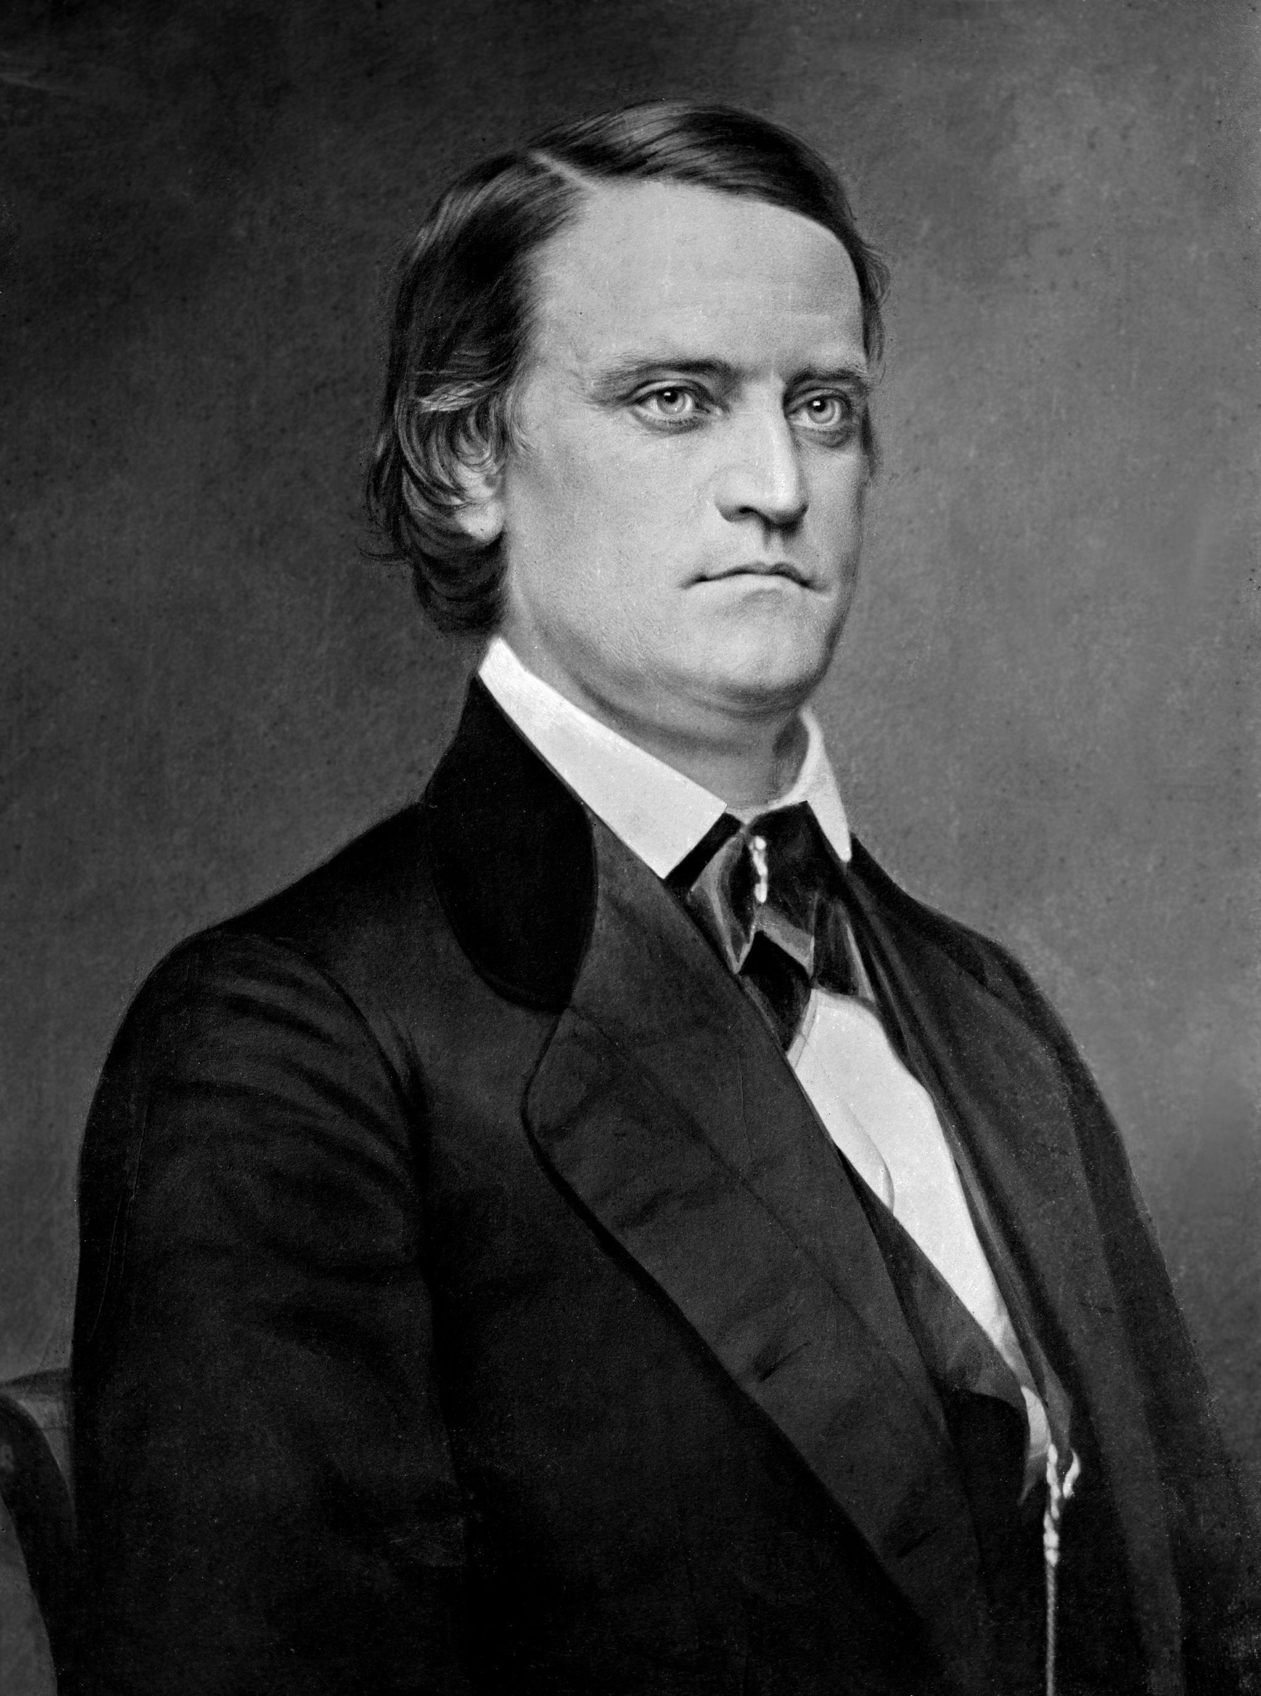
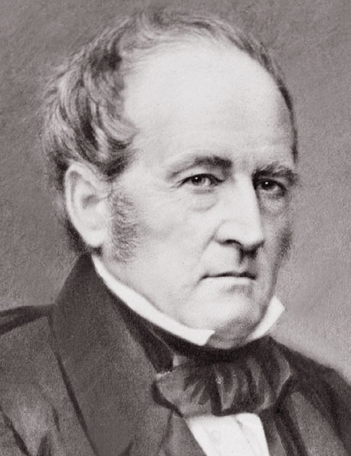
Election of 1860
Abraham Lincoln
Republican
Stephen Douglas
Northern Democrat
John C. Breckenridge
Southern Democrat
John Bell
Constitutional Union

Slide 39
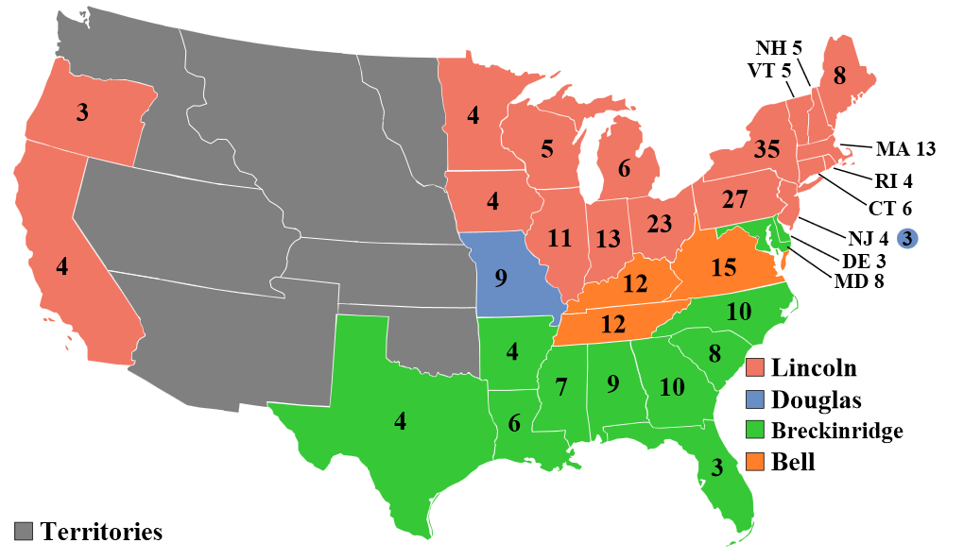
Election of 1860

Slide 40
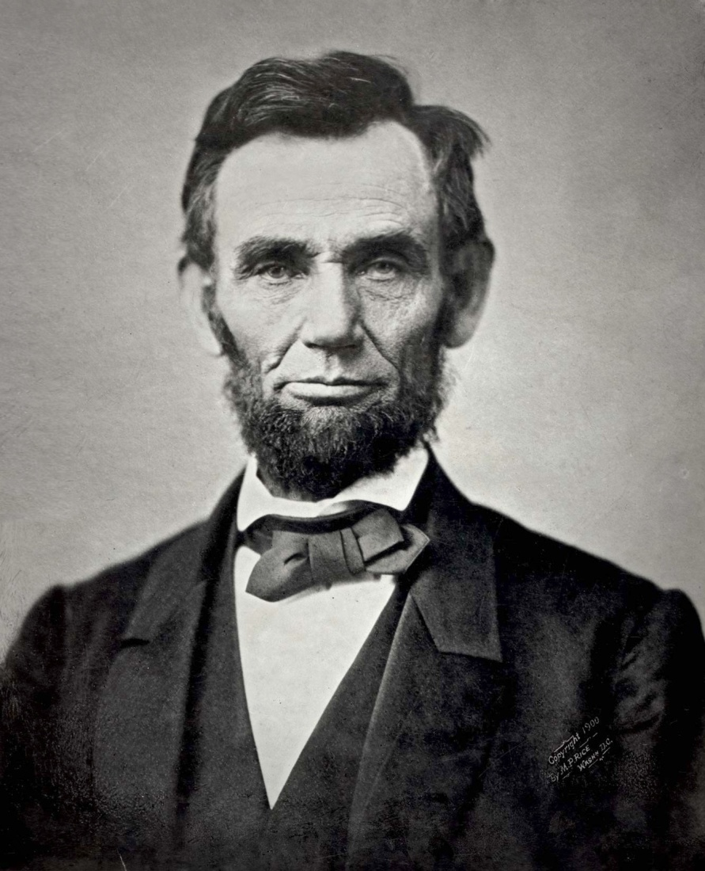
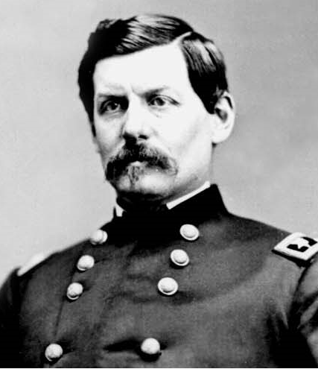
Election of 1864
Abraham Lincoln
Republican
George McClellan
Democrat/Copperhead

Slide 41
Election of 1864

Slide 42
Election of 1868
Ulysses S Grant
Republican
Horatio Seymour
Democrat

Slide 43
Election of 1868

Slide 44
Election of 1872
Ulysses S Grant
Republican
Horace Greeley
Liberal Republican

Slide 45
Election of 1872

Slide 46
Election of 1876
Rutherford Hayes
Republican
Samuel Tilden
Democrat

Slide 47
Election of 1876

Slide 48
Election of 1880
James Garfield
Republican
Winfield Hancock
Democrat

Slide 49
Election of 1880

Slide 50
Election of 1884
Grover Cleveland
Democrat
James G. Blaine
Republican

Slide 51
Election of 1884

Slide 52
Election of 1888
Benjamin Harrison
Republican
Grover Cleveland
Democrat

Slide 53
Election of 1888

Slide 54
Election of 1892
Grover Cleveland
Democrat
Benjamin Harrison
Republican
James B. Weaver
Populist

Slide 55
Election of 1892

Slide 56
Election of 1896
William McKinley
Republican
William Jennings Bryan
Democrat/Populist

Slide 57
Election of 1896

Slide 58
Election of 1900
William McKinley
Republican
William Jennings Bryan
Democrat/Populist

Slide 59
Election of 1900

Slide 60
Election of 1904
Theodore Roosevelt
Republican
Alton B. Parker
Democrat

Slide 61
Election of 1904

Slide 62
Election of 1908
William H. Taft
Republican
William Jennings Bryan
Democrat

Slide 63
Election of 1908

Slide 64
Election of 1912
Woodrow Wilson
Democrat
Theodore Roosevelt
Progressive (“Bull Moose”)
William H. Taft
Republican
Eugene V. Debs
Socialist

Slide 65
Election of 1912

Slide 66
Election of 1916
Woodrow Wilson
Democrat
Charles Evans Hughes
Democrat

Slide 67
Election of 1916

Slide 68
Election of 1920
Warren G. Harding
Republican
James M. Cox
Democrat

Slide 69
Election of 1920

Slide 70
Election of 1924
Calvin Coolidge
Republican
John W. Davis
Democrat
Robert LaFollette
Progressive

Slide 71
Election of 1924

Slide 72
Election of 1928
Herbert Hoover
Republican
Al Smith
Democrat

Slide 73
Election of 1928

Slide 74
Election of 1932
Franklin D. Roosevelt
Democrat
Herbert Hoover
Republican

Slide 75
Election of 1932

Slide 76
Election of 1936
Franklin D. Roosevelt
Democrat
Alf Landon
Republican

Slide 77
Election of 1936

Slide 78
Election of 1940
Franklin D. Roosevelt
Democrat
Wendell Willkie
Republican

Slide 79
Election of 1940

Slide 80
Election of 1944
Franklin D. Roosevelt
Democrat
Thomas Dewey
Republican

Slide 81
Election of 1944

Slide 82
Election of 1948
Harry S. Truman
Democrat
Thomas Dewey
Republican
Strom Thurmond
Dixiecrat

Slide 83
Election of 1948

Slide 84
Election of 1952
Dwight Eisenhower
Republican
Adlai Stevenson
Democrat

Slide 85
Election of 1952

Slide 86
Election of 1956
Dwight Eisenhower
Republican
Adlai Stevenson
Democrat

Slide 87
Election of 1956

Slide 88
Election of 1960
John F. Kennedy
Democrat
Richard Nixon
Republican

Slide 89
Election of 1960

Slide 90
Election of 1964
Lyndon Johnson
Democrat
Barry Goldwater
Republican

Slide 91
Election of 1964

Slide 92
Election of 1968
Richard Nixon
Republican
Hubert Humphrey
Democrat
George Wallace
American Independent

Slide 93
Election of 1968

Slide 94
Election of 1972
Richard Nixon
Republican
George McGovern
Democrat

Slide 95
Election of 1972

Slide 96
Election of 1976
Jimmy Carter
Democrat
Gerald Ford
Republican

Slide 97
Election of 1976

Slide 98
Election of 1980
Ronald Reagan
Republican
Jimmy Carter
Democrat

Slide 99
Election of 1980

Slide 100
Election of 1984
Ronald Reagan
Republican
Walter Mondale
Democrat

Slide 101
Election of 1984

Slide 102
Election of 1988
George H.W. Bush
Republican
Michael Dukakis
Democrat

Slide 103
Election of 1988

Slide 104
Election of 1992
Bill Clinton
Democrat
George H.W. Bush
Republican
Ross Perot
Reform

Slide 105
Election of 1992

Slide 106
Election of 1996
Bill Clinton
Democrat
Bob Dole
Republican
Ross Perot
Reform

Slide 107
Election of 1996

Slide 108
Election of 2000
George W. Bush
Republican
Al Gore
Democrat
Ralph Nader
Green

Slide 109
Election of 2000

Slide 110
Election of 2004
George W. Bush
Republican
John Kerry
Democrat

Slide 111
Election of 2004

Slide 112
Election of 2008
Barack Obama
Democrat
John McCain
Republican

Slide 113
Election of 2008

Slide 114
Election of 2012
Barack Obama
Democrat
Mitt Romney
Republican

Slide 115
Election of 2012

