Slide 1
1491-1607
NATIVE AMERICAN LIFE
EARLY COLONIZATION

Slide 2
Native Americans
Pre-Contact (Prior to 1492)
Over 10,000 years before Columbus, people came to the Americas via the Bering Strait
• Native Americans developed a wide variety of social, political, and economic structures based upon interactions with each other and the environment.
• Native American religion was very often connected to their relationship with nature
– Animism: belief that non- human things (plants, animals) possess a spiritual essence

Slide 3
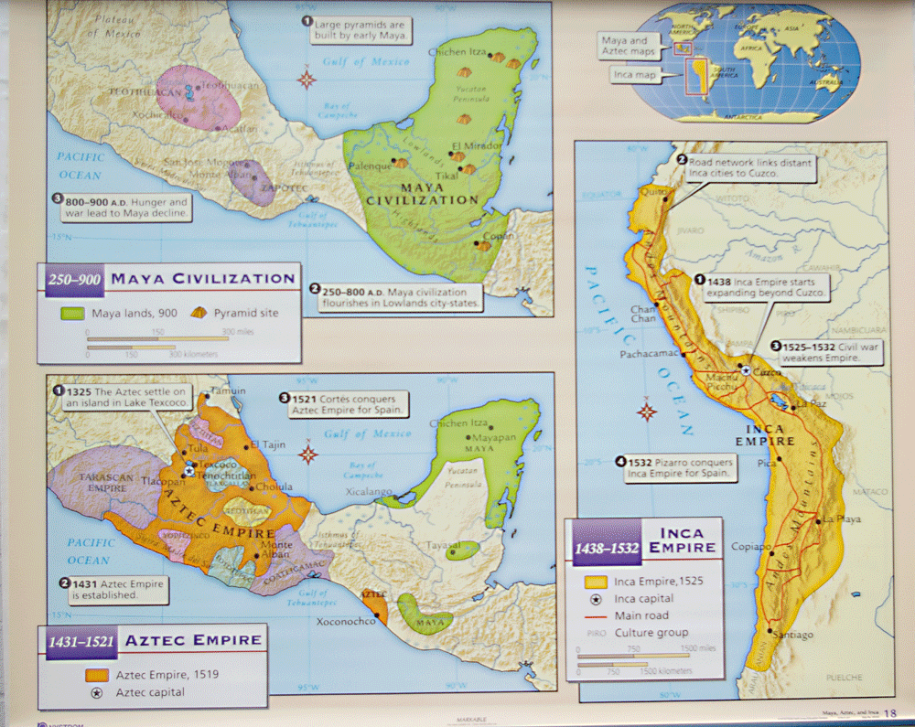

Slide 4
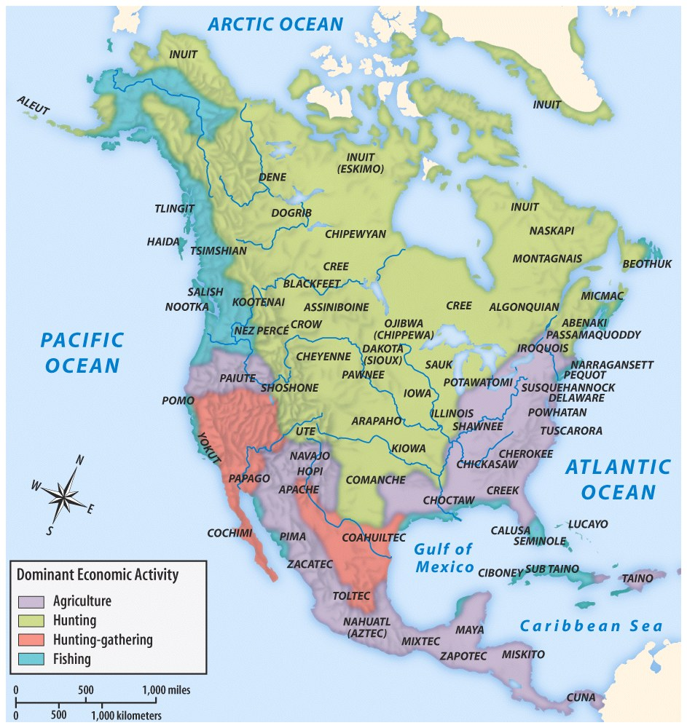
Class Discussion:
What caused these different regions ?
Are there any intervening obstacles that caused these different regions.

Slide 5
How did landscape, climate and resources influence the development of Native Americans society.
W-T-P-S

Slide 6
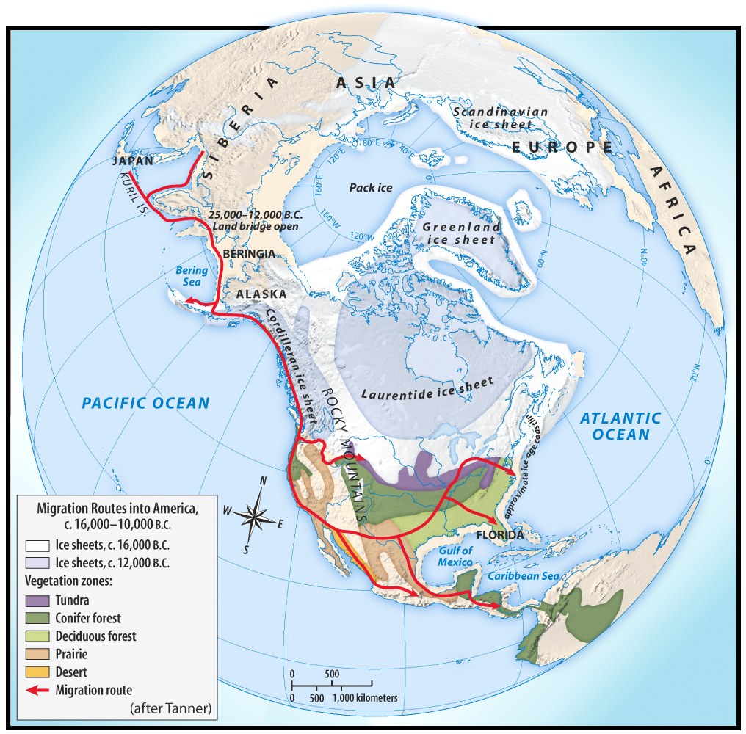
Pre-Columbian time period.
First Americans came from Asia
Crossed the Bering Strait during the Ice Age
Following a food source
Gradual migration

Slide 7
Native American Culture
They developed different and complex societies that both transformed and adapted to their diverse environments
• Examples:
• Southwest (Pueblo): lived in arid land and relied on irrigation to grow maize & other agricultural products
• Great Basin & Great Plains (Lakota Sioux): lack of natural resources led to growth of nomadic lifestyle & the importance of hunting buffalo
• Atlantic coast & Northeast (Iroquois): mix of agricultural & hunter-gatherer society. Established permanent villages
– Iroquois Confederation

Slide 8
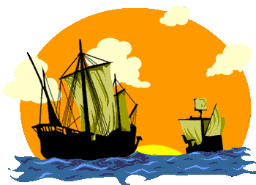
Colonization of the New World
3 G’s: Gold, Glory, God
– Economic: Gold: New sources of
wealth (trade with Asia)
– Political: Glory: ^ power & status
– Religious: God: convert the native population to Christianity
The arrival of Columbus in 1492 (& other Europeans after) led to massive demographic and social changes on both sides of the Atlantic
• Columbian Exchange:Trans-Atlantic exchange of people, diseases, food, trade, ideas, etc. between the Western Hemisphere, Africa, and Europe
– Horses (from Europe) dramatically change Native life
– Disease such as smallpox (from Europe) lead to massive
population decline as deadly epidemics spread
– Maize/corn (from America) fueled population increase in Europe

Slide 9
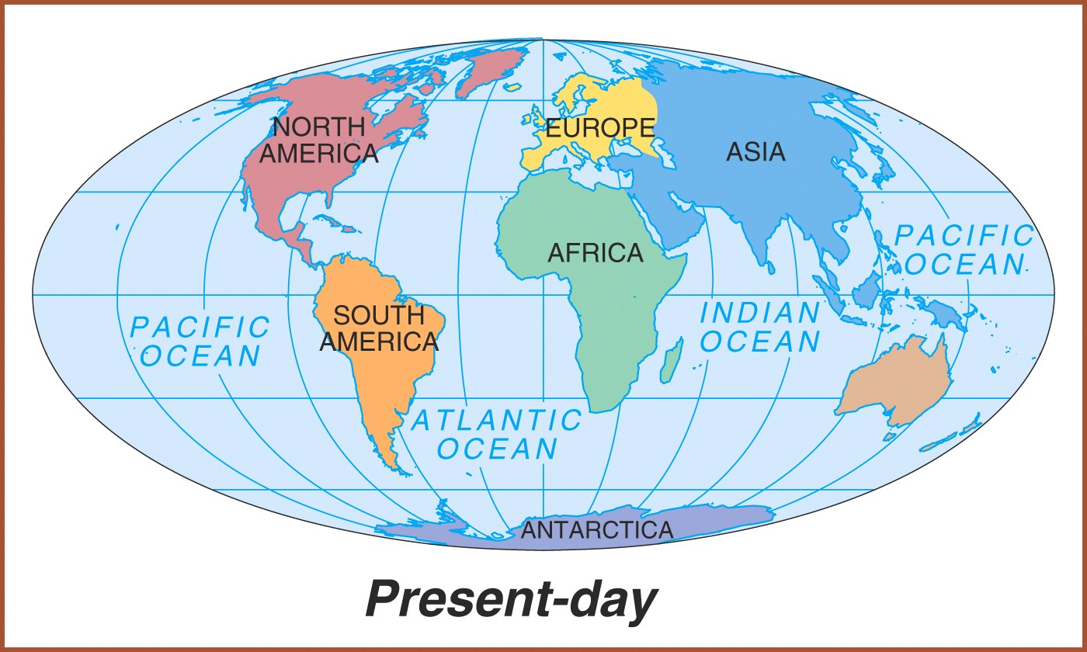
NEW WORLD
OLD WORLD

Slide 10
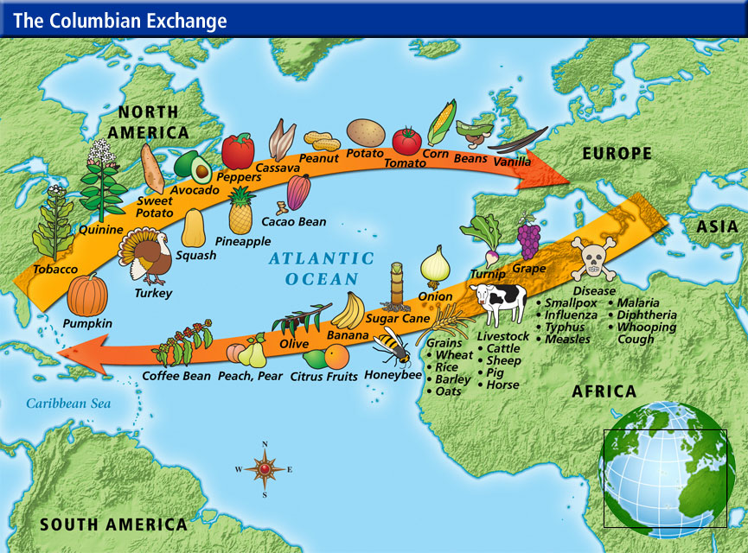

Slide 11
EARLY COLONIZATION: SPAIN & PORTUGAL
Treaty of Tordesillas Spain & Portugal agree to divide up the Western Hemisphere
• Spain was the earliest to colonize North America (St. Augustine, 1565)
• Encomienda System: Spanish colonists received land with native people
– Native slave labor in mining (silver) or agriculture (sugar)
– Spanish sought to convert Native people to Catholicism
• Racially mixed populations of European, Native, and African people
– Mestizo: people of mixed Indian and European heritage
– Mulatto: people of mixed white and black ancestry

Slide 12
Pueblo Revolt 1680
Attempts to change Native American beliefs led to resistance and conflict
Popé's Rebellion in 1680 leads to the death of hundreds of Spanish colonists and the destruction of Catholic churches in the area
“Native people strove to maintain their political and cultural autonomy”

Slide 13
^{Debating Spanish Colonization}
“Debates occurred over how Native Americans should be treated and how “civilized” they were compared to European standards”
• Juan de Sepúlveda wrote “Just Causes for War Against the Indians” that justified Spanish colonization of the Americas
• Bartolomé de las Casas published in 1552 “A Short
Account of the Destruction of the Indies” that criticized Spanish treatment of the indigenous people

Slide 14
Comparing European Colonization
Protestant England will soon challenge Spanish colonization of North America
• Unlike the English colonist, the Spanish, French, and Dutch are going to attempt to exploit new world resources AND form more complex relationships with indigenous people
  – Spain and Portugal formed colonies that used Native American and African slave labor in agriculture and mining
  – France, Holland, Spain will trade, intermarry with natives
  Reasons for colonization
• Mercantilism: colonies exist to enrich the Mother country
– Access to raw materials – Provide gold and silver

Slide 15
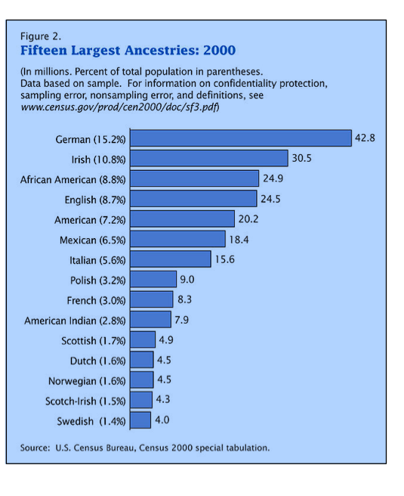

Slide 16
Period 1 begins with 1491. If the American Indian population in what is now the United States was nearly 10 million before 1492, why is the United States population in modern times only 2 to 3% American Indian?

Slide 17
Period 1 ends with the establishment of Jamestown, the first permanent British settlement in North America. Explain why 1607 is a major turning point in United States history.

Slide 18
