Slide 1
the Rise & Fall of Populism
Mr. Johnson
APUSH

Slide 2
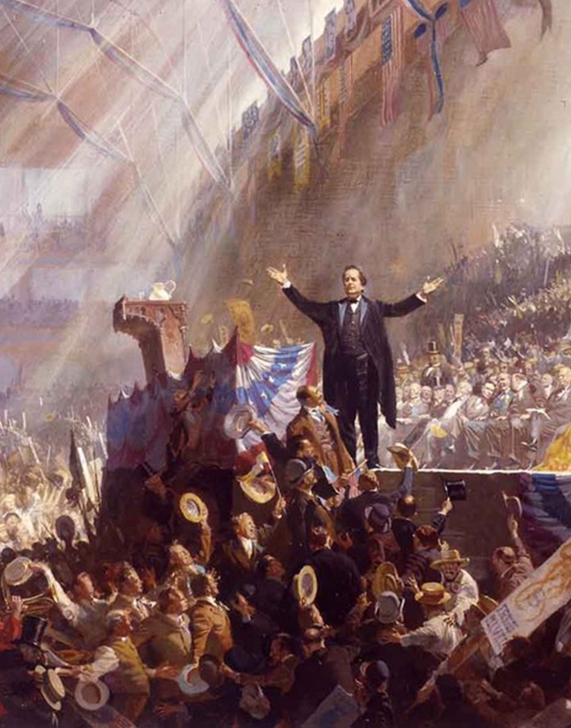
What is Populism?
An appeal to the hopes and fears of common people…
…especially in opposition to the political, social, intellectual or economic elite

Slide 3
The Farm Becomes a Factory
Cast steel ____
John Deere
“___ buster” for tough prairie topsoil
Mechanized ______
Cyrus McCormick
Quick _________ of large fields
______ wire
Joseph Glidden
Cattle ranching
Ended open _____
___________ in Midwest
Slaughterhouses
Chicago
St. Louis
Railroads & ___________ cars
Gustavus Swift
Ended long ______ drives
Transportation of _________ from slaughterhouses
Over the next century, farms became
____efficient
______in acreage
_____ in number
and were held by _____ people

Slide 4
Trouble for Farmers
Ecological Trouble
______ swarms
Drought
Overfarming… ________ of soil
Economic Trouble
Overfarming… _____________… falling prices
Bank _____ for tools
High cost of _________: Long distances and railroad rebates meant that western farmers were charged more than eastern farmers corporate customers
Government Trouble
Land ___________ got much of the Homestead Act land
High _______ helped industry but hurt agriculture
_____ of 1873
_______ Act of 1873 (“_____ of ‘73”) demonetized silver
_________ helped creditors (banks) but hurt debtors (farmers)
Farmers ended up in ____

Slide 5
Farmers Organize
The Grange
“_______”
Founded in 1867 by ______ H. ______
Organized social gatherings and farmer education
Created __________ to control supply of crops and buy supplies in bulk
Granger laws passed in western states attempted to regulate __________
Greenback Labor Party
Founded in 1874 in response to _____ of 1873
Led by Peter Cooper and ____ B. ______
Advocated _________ through increased circulation of ________ (fiat) paper money
Farmers Alliances
Endorsed candidates running for state offices (__ – Midwest, __ – South)
Northern, Southern & Colored Alliances: ___________ and ______ limited its effectiveness

Slide 6
Regulating the Railroads
Granger & Farmers’ Alliance Laws
Munn v. Illinois, 1877
States may regulate __________ commerce
Wabash v. Illinois, 1886
States may not regulate __________ commerce
Interstate Commerce Act, 1887
_______ regulation of trade
Interstate Commerce Commission was “_______” by railroad interests and was ineffectual
Railroads as monopolies
Due to enormous _______ investment required, railroad routes were often under monopoly control
Sherman ____-_____ Act, 1890
U.S. v. E.C. Knight (1893) _______ impact of law
Law was used against ______ more than against trusts (e.g. _______ Strike of 1894)
Regulation of big business would be ineffective until “__________” presidents

Slide 7
Formation of the Populist Party
Formed from
______
_________ Labor
_______ Alliances
Some _________
____ Elizabeth _____, organizer and agitator
_____ B. ______, presidential nominee in 1892
Populism shattered __________ Party’s base in the west
_____ Platform of 1892
Economic Reform
Abolition of the _______ Bank
Re-monetization of ______
_______________ of RRs, telephone & telegraph companies
__-hour work day for government employees
Political Reform
Direct election of ________
Australian (______) ballot
___-term limit for president & vice president
Restriction of ___________

Slide 8
Election of 1896
_____ of 1893 reinvigorated bimetallism movement
William ________ _____ (D)
Nominated by Populists & Democrats
_____ of Gold speech: rural, evangelical economic populism
Supported _________ (coinage of silver) to accomplish ______
Railcar “__________” campaign covered 18,000 miles
William McKinley (R)
Nominated by Republicans
Mark Hanna, campaign advisor
Vastly outspent Bryan campaign and painted him as an irresponsible radical
Front-porch campaign
Election Outcome
Bryan failed to gain support of eastern working class
McKinley won
Dingley Tariff raised rates
Yukon Gold Rush led to Gold Standard Act of 1900
Imperialism
McKinley defeated Bryan again in 1900

Slide 9
Legacy of Populism
Failures
1896 election is seen as triumph of _____, __________ America over ____, _________ America
______ and nativism divided Populists
Populists failed to break ___-party system
__________ Party dominance, which lasted from Civil War to Great Depression, continued
Successes
_________ absorbed Populist Party
___________ movement (both Democratic & Republican) would later achieve many Populist goals set forth in _____ Platform of 1892

Slide 10
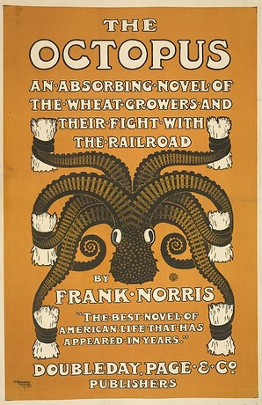
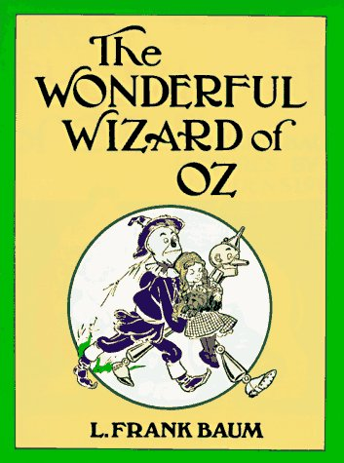
Populism in Literature

