Slide 1
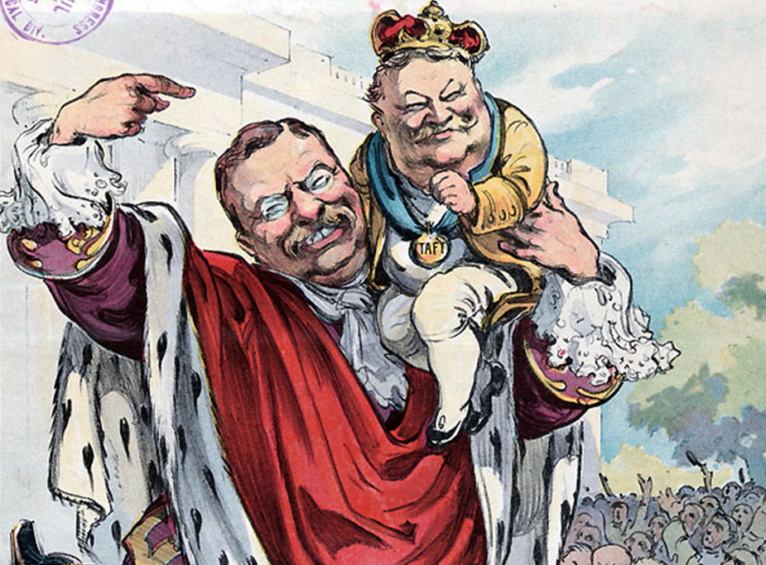
The Progressive Presidents Mr. Johnson Hopewell High School

Slide 2
Main Ideas
The federal government responded to grassroots reform efforts by enacting progressive policies.
Progressive reforms sought to established a greater degree of democratic participation and strengthening the power of the federal government to regulate the economy.
Presidents Roosevelt, Taft and Wilson all instituted progressive policies, though they were bitter rivals.

Slide 3
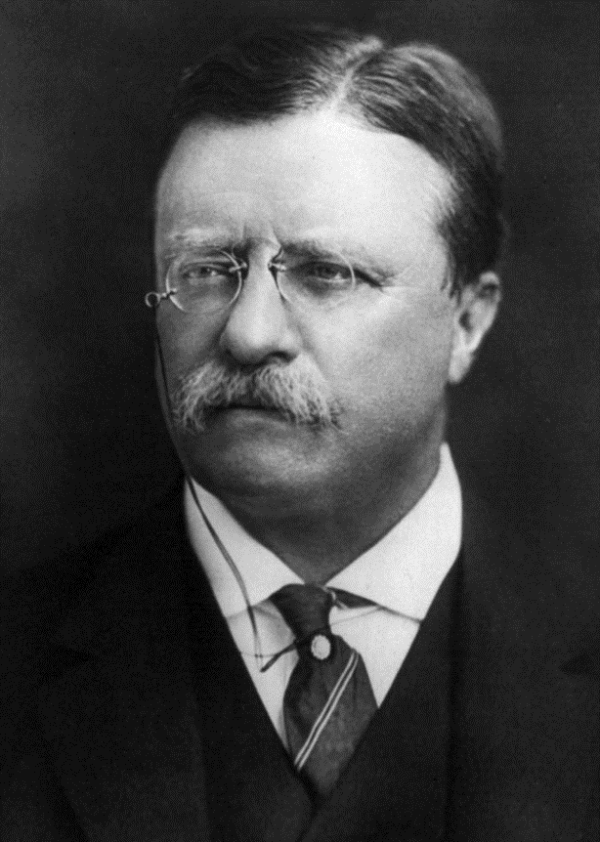
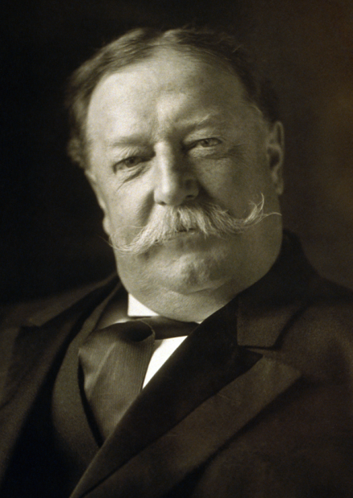
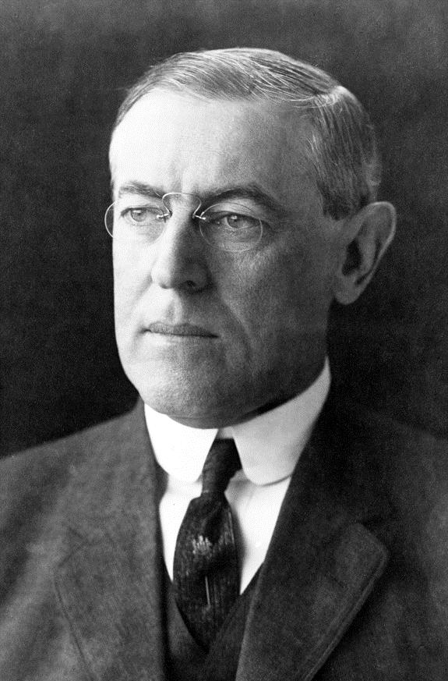
What is Progressivism?
Broad-Based Reforms
Regulation of big business
Labor protection
Consumer protection
Direct democracy
Pragmatism & efficiency
Education
Women’s rights
Prohibition
Environmentalism
…Civil rights?
Roosevelt (R)
Taft (R)
Wilson (D)

Slide 4
Theodore Roosevelt, 1901-1909
T.R.’s Personality
“_______ Rider” in the Spanish-American War, 1898
“Speak softly and carry a big ________”
White House as a “______ Pulpit” to pass and enforce laws
Economic Policy
“________ Deal”: equality of opportunity for all
Anthracite ______ Strike: T.R. arbitrated, marking the first time the government didn’t automatically side with ________________
Trust-__________: T.R. was first president to enforce the ________ Anti-Trust Act to break apart monopolies (ex: Northern Securities v. U.S.)
Hepburn Act increased regulation of ____________ by ICC
Consumer Protection
Upton Sinclair’s The Jungle led to the passage of the _____ Inspection Act and ______ Food & Drug Act
Conservation Policy
John Muir (_____ preservation) vs. Gifford Pinchot (__________ use)
Newlands ___________ Act
U.S. ________ Service
New ___________ Parks
Other Policies
Consulted Booker T. ____________ on civil rights
“______________’s Agreement” with Japan cut off immigration but guaranteed education to immigrants already here
________________ Foreign Policy
Roosevelt Corollary
Panama Canal

Slide 5
William H. Taft, 1909-1913
Taft Tackles the Rich
16th Amendment created the __________ tax
Progressive (____________) taxation
“The more you ______, the more they ______”
Mann-Elkins Act allowed greater regulation of ___________ & _________ rates by ICC
Taft actually initiated more anti-________ suits than Theodore Roosevelt
Roosevelt-Taft Split
In U.S. v. U.S. Steel, Taft tried to prosecute one of Roosevelt’s “______” trusts
Payne-Aldrich Tariff lowered some import ________ but raised others
Ballinger-Pinchot Affair split the _____________ movement
Taft’s Foreign Policy
Dollar Diplomacy
Investment in Latin America & Asia

Slide 6
The Election of 1912
Republican Party
Mainstream Republicans remained loyal to __________ _______
Progressive Republican (Bull __________) Party
___________ __________ defeated _______ “Fighting Bob” _________ for the Progressive Party nomination
T.R.’s “New ____________” campaign
Democratic Party
Democrats nominated __________ ____________
W.W.’s “New _________” campaign
Third Parties
Eugene ______, Socialist Party
Eugene _______, Prohibition Party
Election Results
Taft and Roosevelt split the _____________ Party
____________ (D) won the election

Slide 7
Woodrow Wilson, 1913-1921
Triple Wall of Privilege
Tariffs
Underwood Tariff lowered ________ duties and an amendment added a ________________ income tax
Trusts
Clayton Antitrust Act banned _______ discrimination and ______________ directorates, protected labor unions from ___________ actions, and gave “teeth” to the _____________ Antitrust Act
Federal ________ Commission enforced regulations and busted ____________
Banks
Federal __________ Act reformed banking system
Monetary policy controls ________ rates and inflation
Other Policies
New laws banned ______ labor
Adamson Act required 8-hour day for ___________ employees (with extra pay for ________)
17th Amendment: Direct election of _____________
18th Amendment: _________ of alcohol
19th Amendment: _________’s suffrage
Wilson appointed the 1st _____ justice to Supreme Court but, as a Southern Democrat, he _________ federal employment
Foreign Policy
Missionary (Moral) Diplomacy
WWI, Treaty of Versailles & League of Nations

