Slide 1
Reconstruction begins
Mr. Johnson
APUSH
Hopewell High School

Slide 2
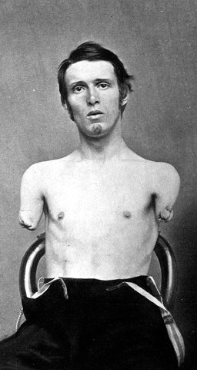
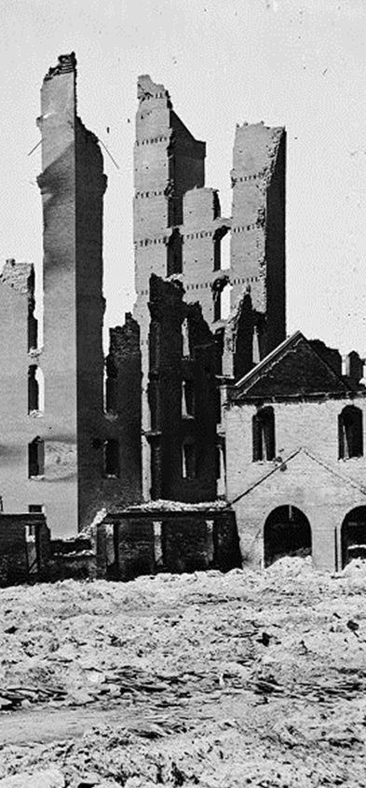
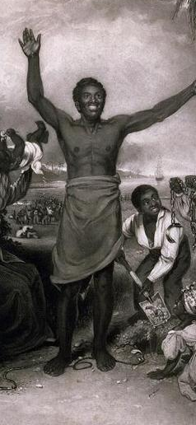
Reconstruction
Deaths, Injuries &
Lingering Resentment
Economic Devastation
Readmission of Southern States
Legal Status of Freedmen

Slide 3
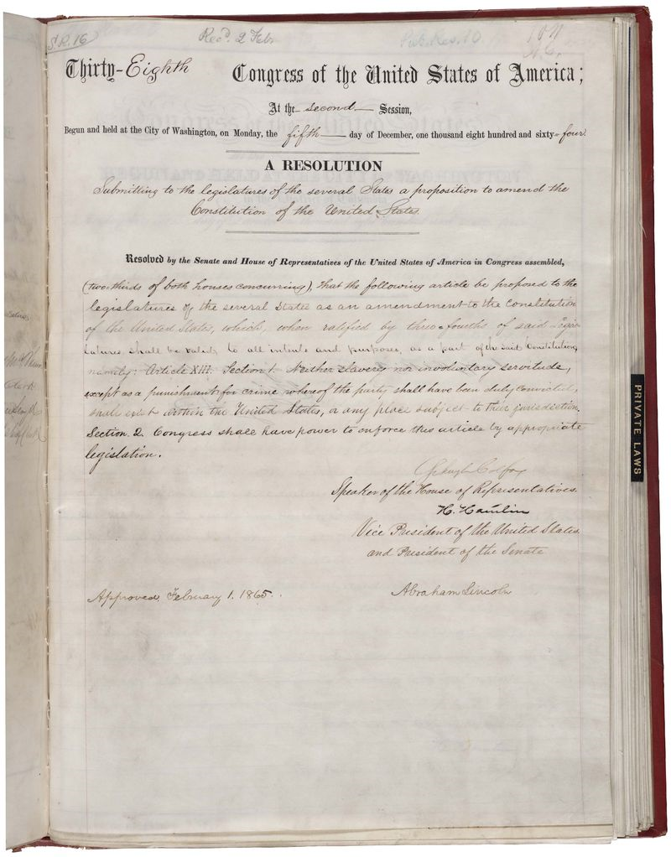
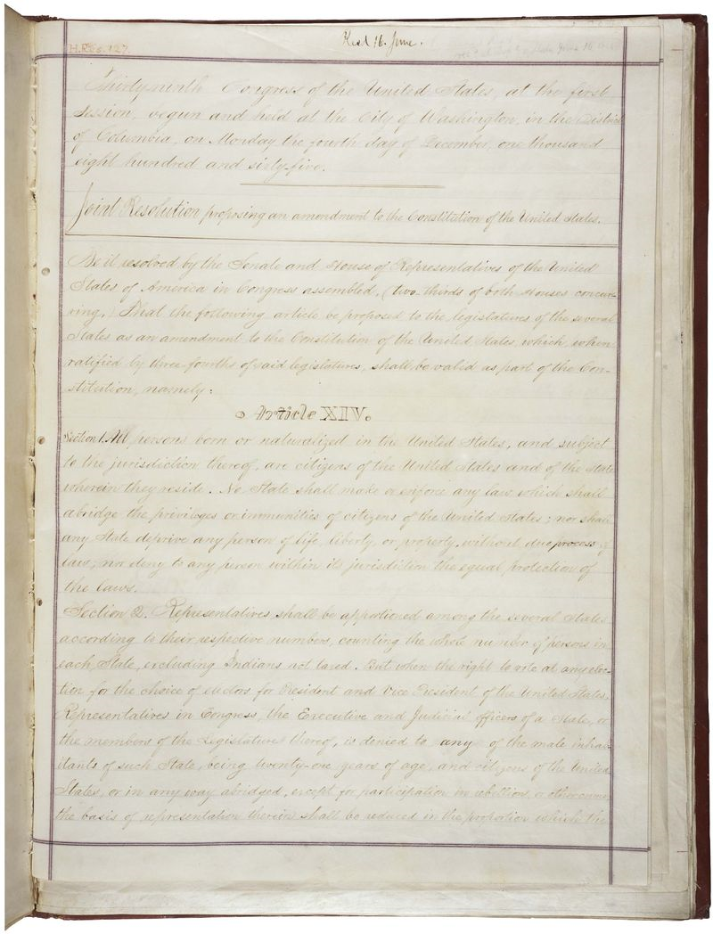
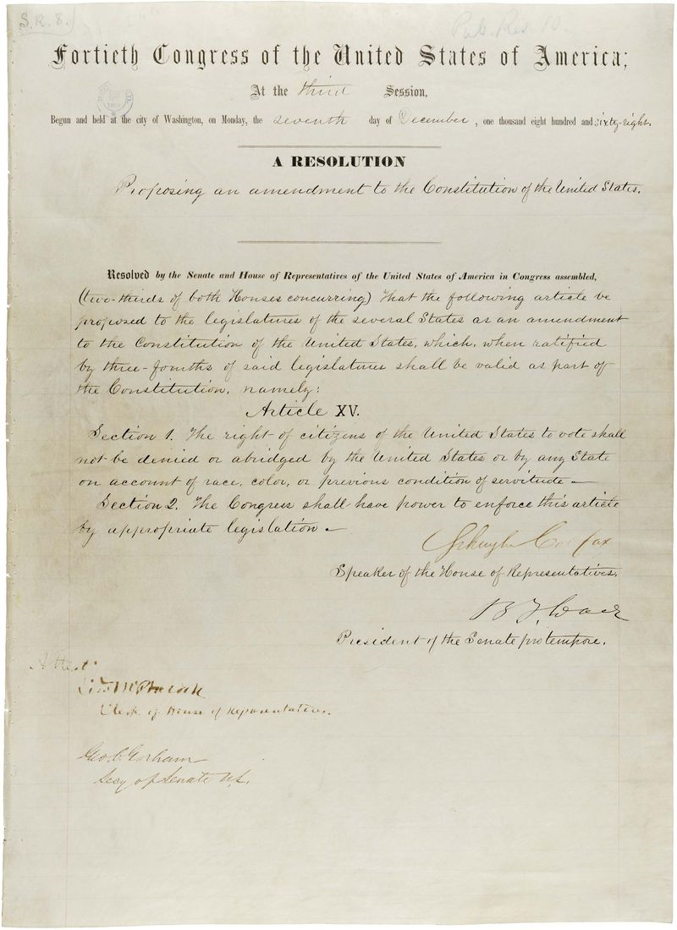
Reconstruction Amendments
13th
14th
15th

Slide 4
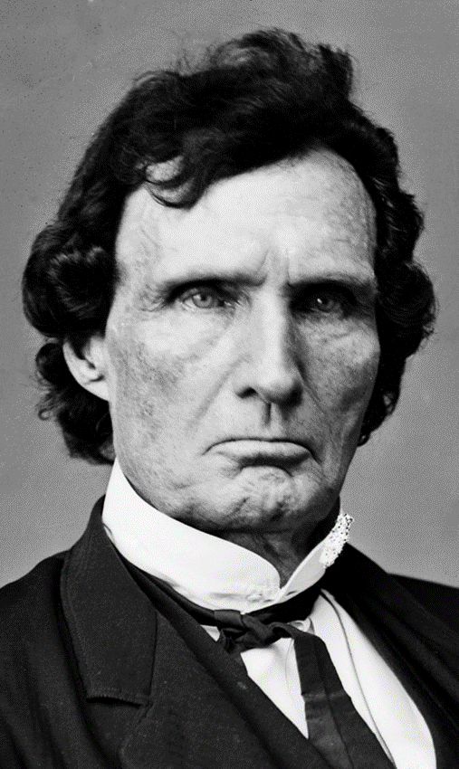
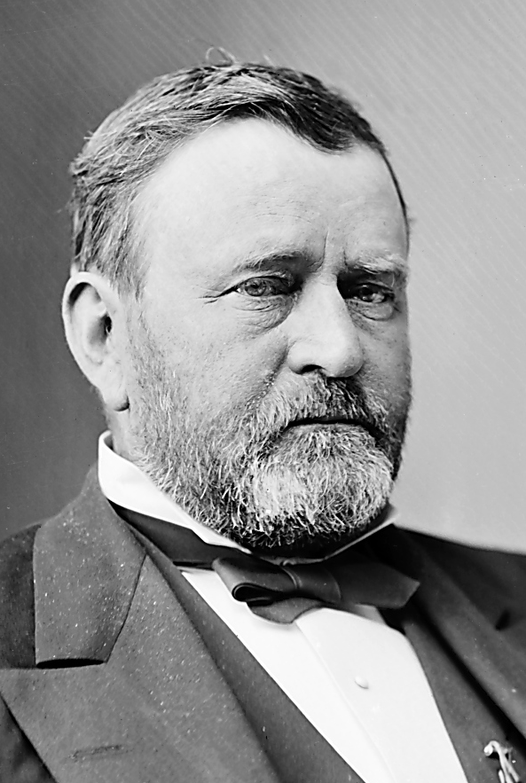
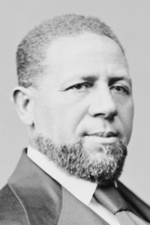
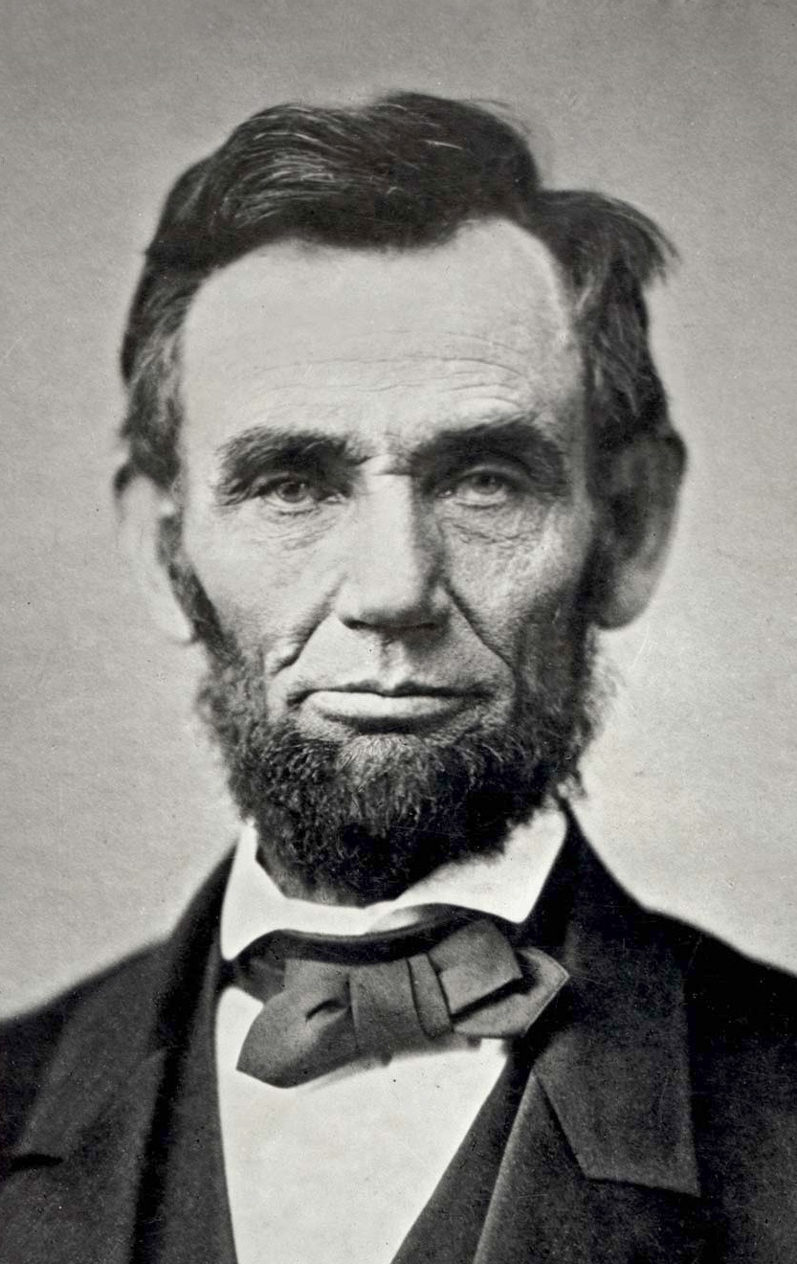
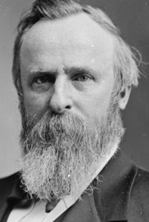
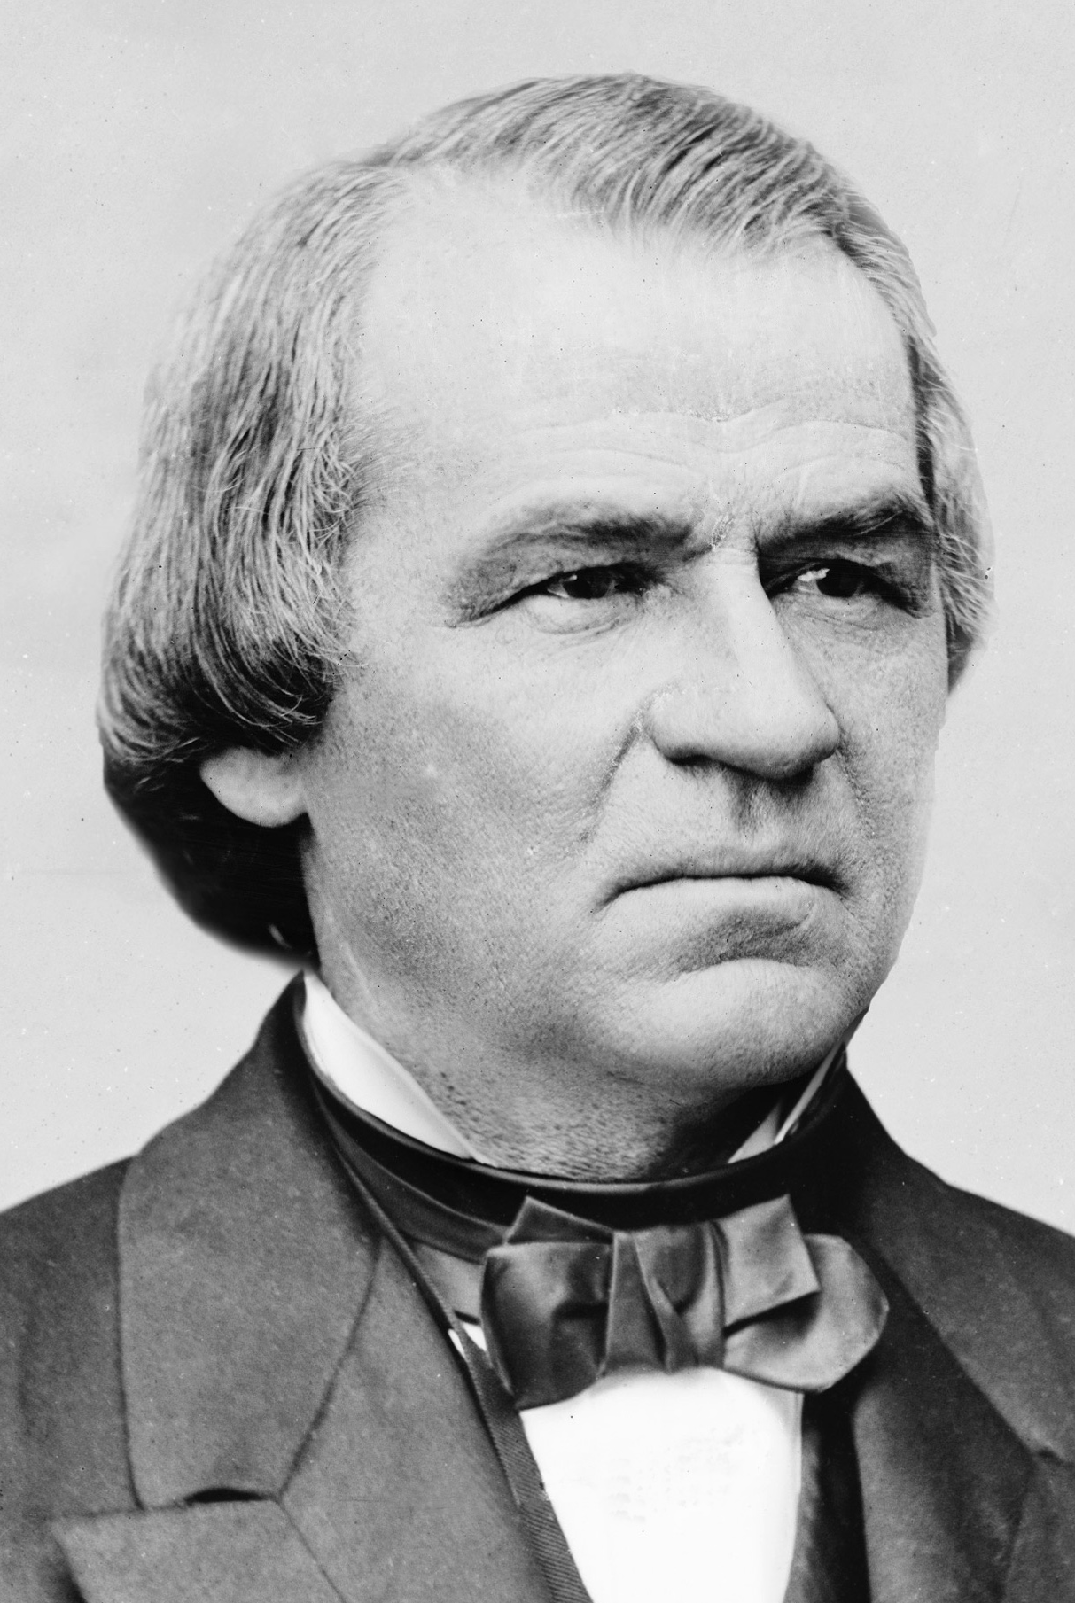
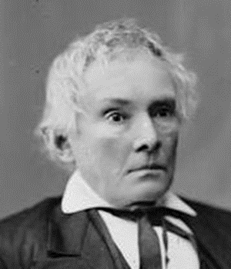
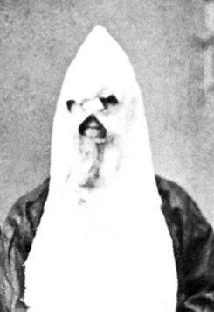

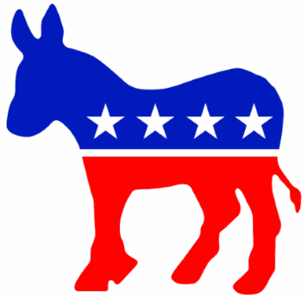
Political Spectrum of Reconstruction
Radicals
Moderates
Unionists
Redeemers
KKK
Federal Supremacy
Black Civil Rights
Military Occupation
States’ Rights
Blacks as Second-Class Citizens
Home Rule

Slide 5
Wartime Reconstruction:
Military Occupation
Abolishing Slavery
  “__________”: Union army sheltered and refused to return fugitive slaves
  ___________ Proclamation freed slaves in Confederacy
  Abolitionists including Frederick ____________, successfully lobbied for black Union Army ______________
  “40 ____ and a ____” land redistribution was proposed, but not realized
Reshaping Southern Society
  South was placed under _________ by Union Army
  __________’s Bureau provided education, legal protection and temporary economic aid to former slaves
  Northern ____________ came to the south to aid freedmen and for new business opportunities
  Southern _____________ resented and resisted military occupation and social change

Slide 6
Presidential Reconstruction:
Abraham Lincoln
Lincoln’s Views
  National union is “________” and “__________,” therefore secession was always ________
  National _____________ and swift __________ of southern states to the Union after new state ____________ (“Lincoln governments”) had been formed
  “With _______ toward none, with ________ for all… to bind up the nation’s _______”
  Opposed ______ Republicans’ harsher, punitive stance
Lincoln’s Policies
  ___% Loyalty Plan
  Pocket _____ of Radical Republicans’ Wade-Davis Bill (50% Plan)
  Successfully lobbied for passage of ___th Amendment, which abolished slavery in all states
Assassination of Lincoln, 1865
  John Wilkes _________
  Led to power struggle between President Andrew ______ (D) & Congressional __________ Republicans

Slide 7
Presidential Reconstruction:
Andrew Johnson
Johnson’s Views
  “War ________” who was hated by many southerners and distrusted by Radical Republicans
  Was a Jacksonian white _____________… but also anti-_____________
  Swift ___________ of southern states with only ___________ protections for freedmen
Johnson vs. Southern States
  Pardoned ex-_____________ and wealthy _________
  Confederate ______ came back into power
  Southern states passed _______ Codes
Johnson vs. African Americans
  ________ Freedmen’s Bureau
  ________ Civil Rights Act
  ___________ 14th Amendment
Johnson vs. Congress
  Congress __________ many of Johnson’s vetoes
  Republicans won a __________ in 1866 Congressional election
  Congress passed _________ of Office Act, 1867
  Johnson fired Secretary of War Edwin _________ and replaced _________ generals, 1867
  Johnson was ________ but kept his job by only one vote, 1868

Slide 8
Congressional Reconstruction:
The Radical Republicans
Leaders
  House: Thaddeus _______ (PA)
  Senate: Charles ________ (MA)
Views of Radical Republicans
  Military ___________ & federal _____________ over south
  Full __________ for freedmen
Radical Republican Legislation
  _______ Rights Act of 1866
  ________ Reconstruction Act
  ___^{th} Amendment abolished slavery
  ___^{th} Amendment guaranteed citizenship & equal protection
  ___^{th} Amendment guaranteed universal male suffrage
  _______ Rights Act of 1875
____ were both emboldened and frustrated by Reconstruction Amendments

