Slide 1
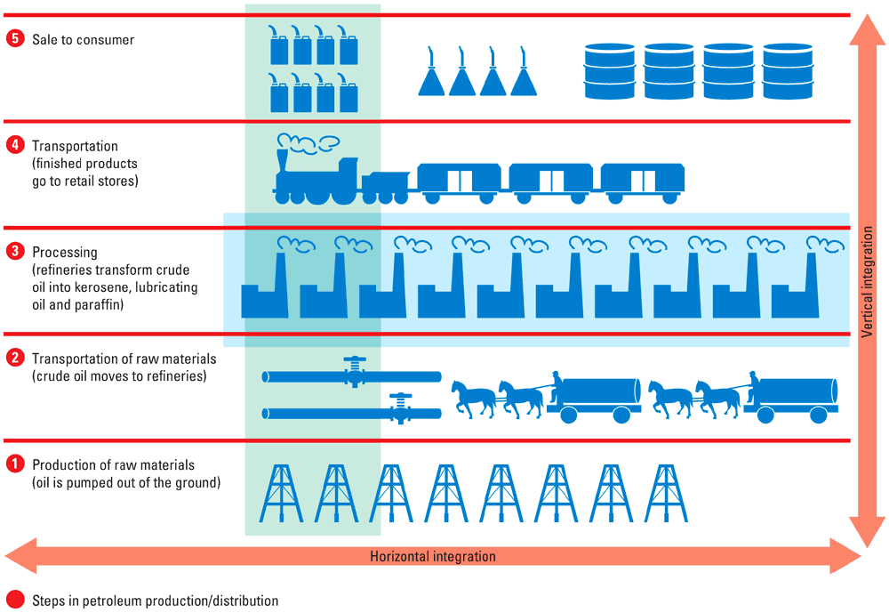
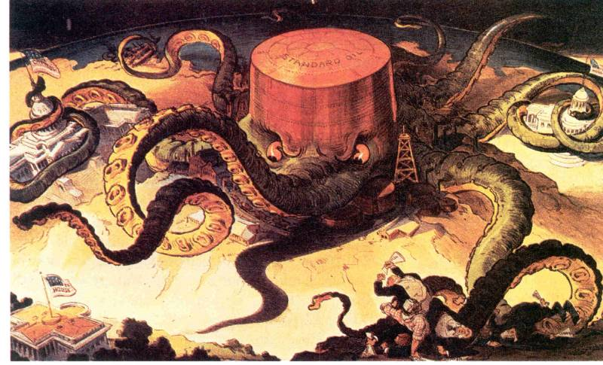
My Business Empire
Show me that you, too, could be a robber baron or captain of industry! Create your own business empire on the next page:
Start by creating “My Business” in the bottom left corner
Expand your business both vertically and horizontally (see the Rockefeller/Standard Oil example below for help) by filling in the small boxes extending in both directions.
3. Treatment of Workers: Would you slash wages and crush unions to make big profits? Or would you treat workers well to create a stable but less profitable business?
4. Government Legislation: What laws would help your business grow and become more profitable?
5. Spending on Myself: Would you be frugal? Or an extravagant and conspicuous consumer?
6. Philanthropy: How would you use your wealth for the benefit of society as a whole?

Slide 2
My Business Empire
Treatment of Employees
Government Legislation
Vertical Integration
Spending on Myself
Philanthropy
My Business:
Horizontal Integration

