Slide 1
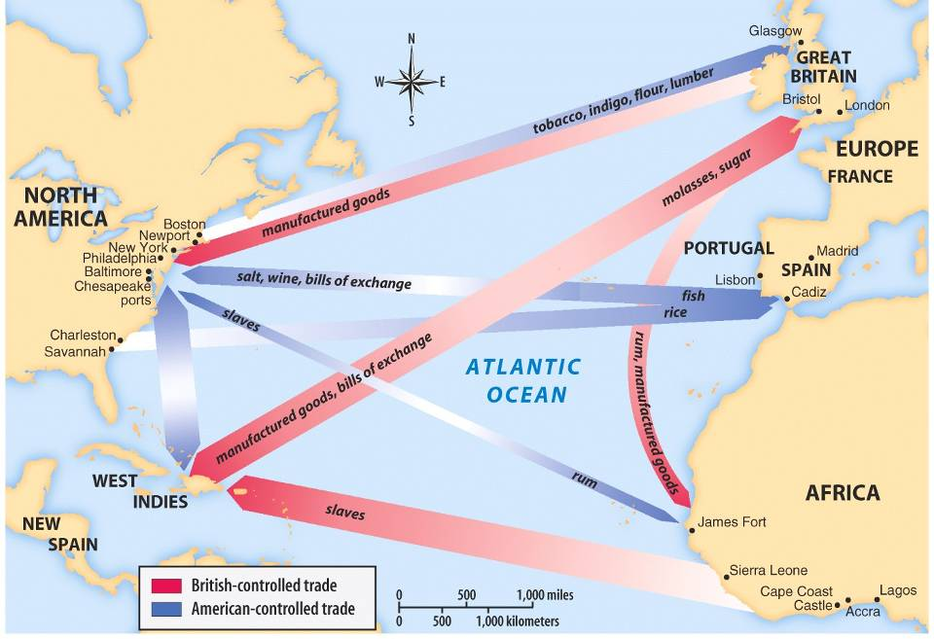
The American colonies were an important part of the
trans-Atlantic trade network
Economics in the Colonies
The colonies produced profitable raw materials, such as tobacco, wheat, fish, indigo, & whale oil
Britain sold manufactured goods back to the colonists, like clothing, tea, guns, & tableware

Slide 2
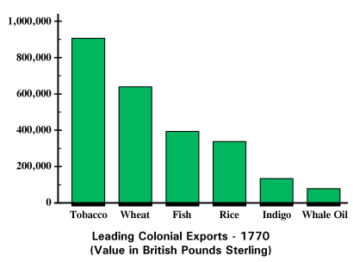
What were the top 3 colonial exports?
South
South
Middle
South
New England
New England

Slide 3
Increased demand for colonial raw materials, increased the demand for African slaves
Economics in the Colonies
This network created a series of triangular trades among America, Europe, & Africa

Slide 4
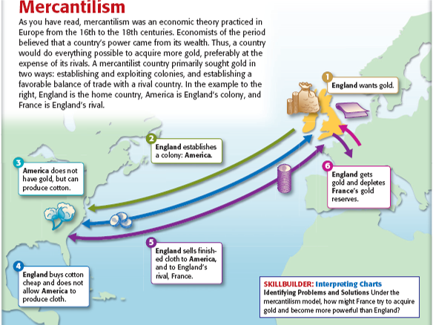
Mercantilism
  By the 1650s, Britain began
  to embrace the economic
  policy of mercantilism based
  on the idea that the colonies
  exist to generate wealth for
  the mother country
  Mercantilism is
  based on the idea of
  a balance of trade in which a nation exports more than it imports

Slide 5
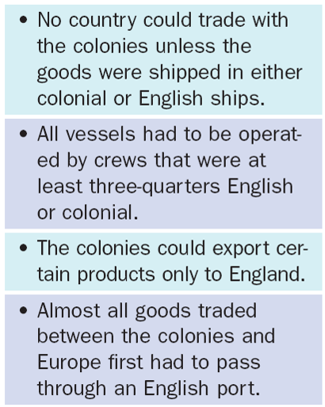
The Navigation Acts
Mercantilism meant that Britain began to control & regulate colonial trade
In 1660, Britain began the first of a series of Navigation Acts designed to restrict colonial trade & increase British wealth
The Navigation Acts required the colonists to trade only with Britain

Slide 6
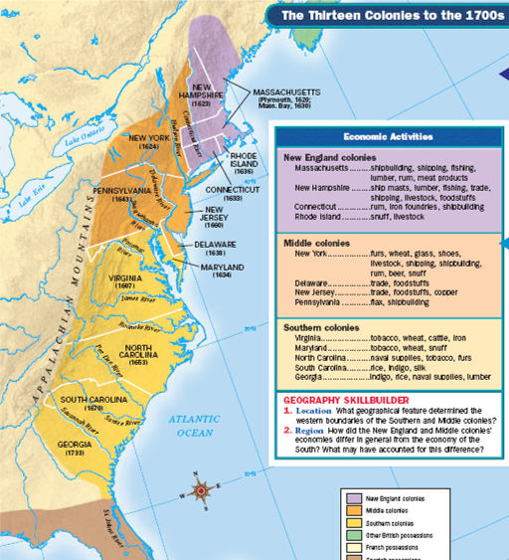
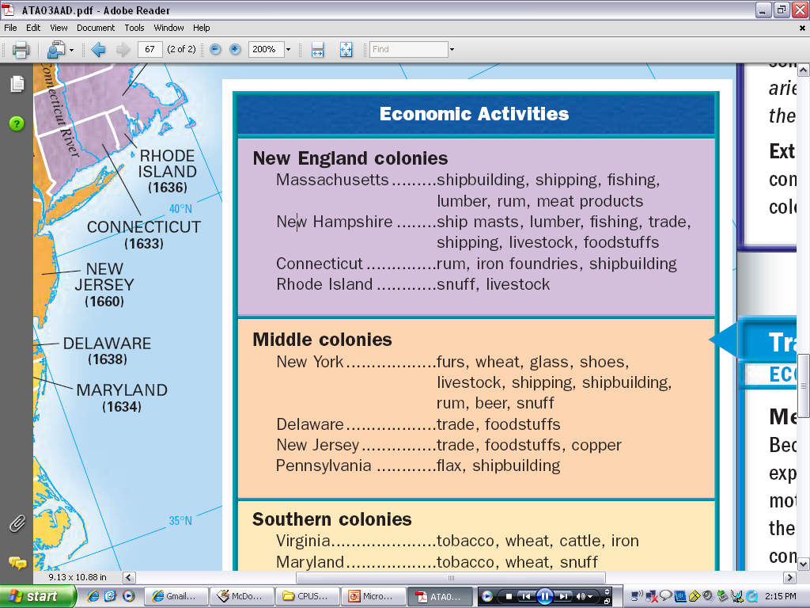
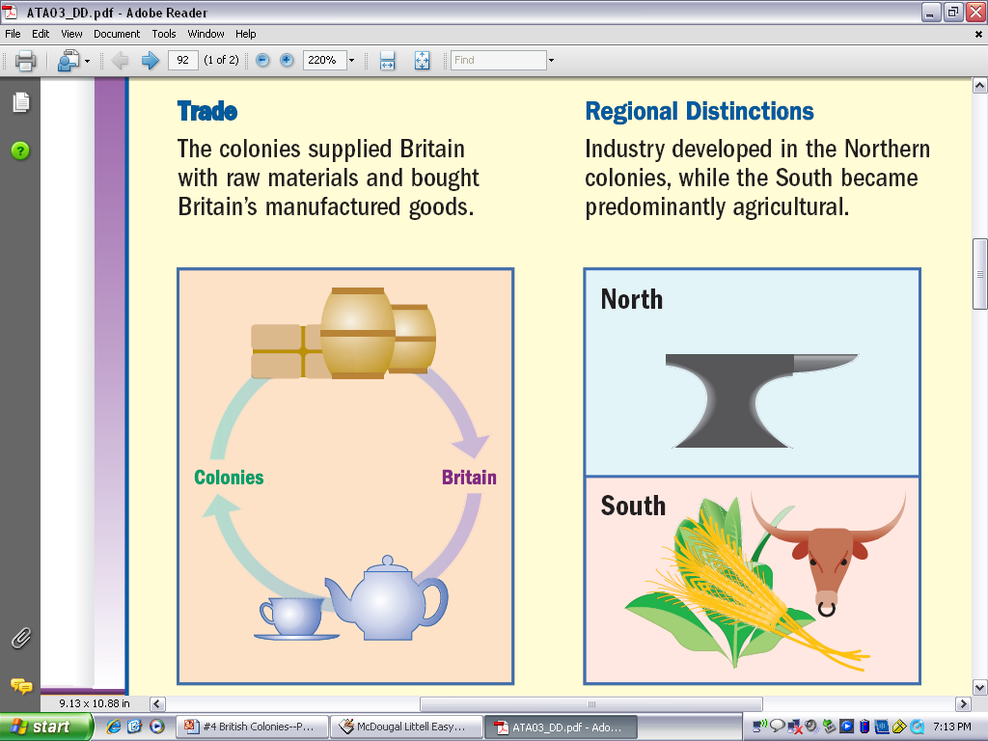
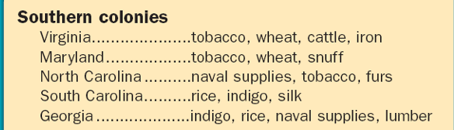
All 13 of the British colonies participated in
the trans-Atlantic trade…
“Northern” Colonies
“Southern” Colonies
…But regional differences led to a long-term division between the “Southern” & “Northern” colonies

Slide 7
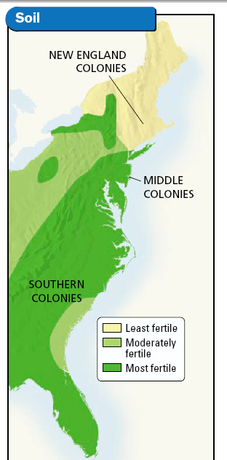
Southern economies were dominated by cash-crop agriculture, plantations rather than cities, large gaps between rich & poor, and slaves & indentured servants

Slide 8
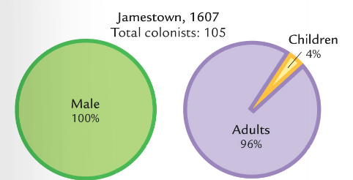
Social Hierarchy in the Chesapeake
Owners of tobacco plantations were at the top of society
Poor, small-scale farmers were the largest class; Most were former indentured servants
There were few women in Virginia, which made it difficult for colonists to marry or to have families
Indentured servants were often mistreated
African slaves were at the bottom of society

Slide 9
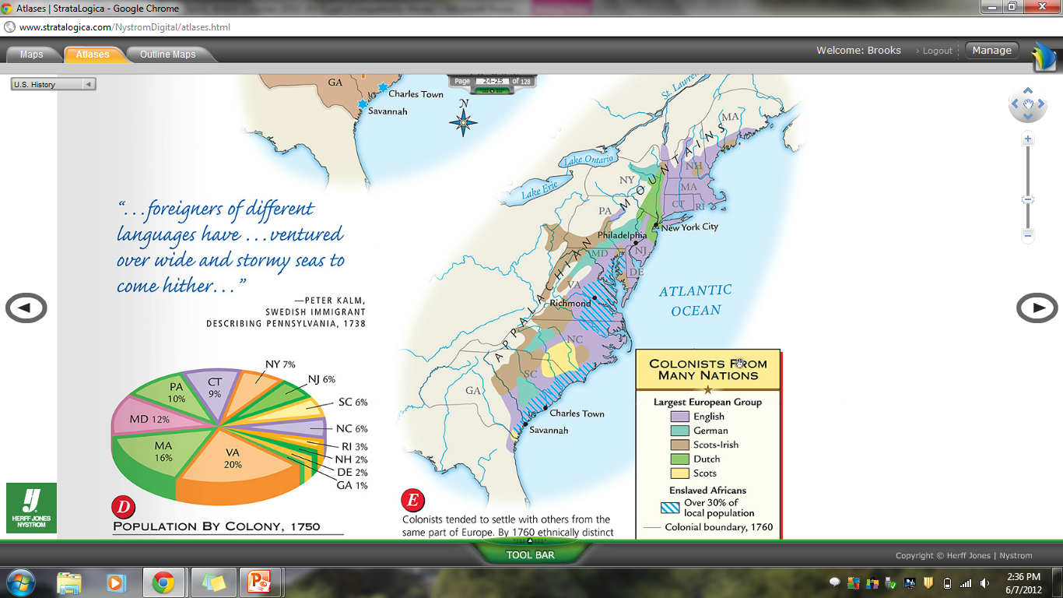
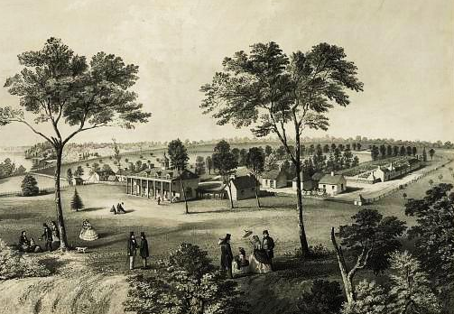
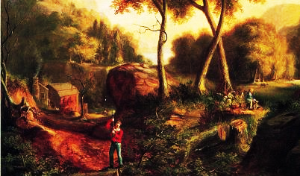
English colonists typically made up the plantation owners in the nutrient-rich lands in the east
Former English indentured servants, Irish, & German immigrants moved to the “backcountry” with
poor soil, near Indians,
& lived in poverty

Slide 10
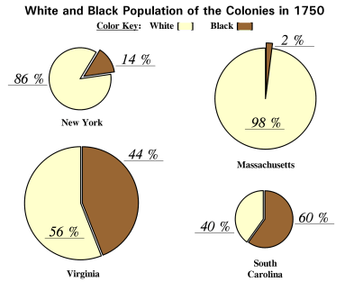
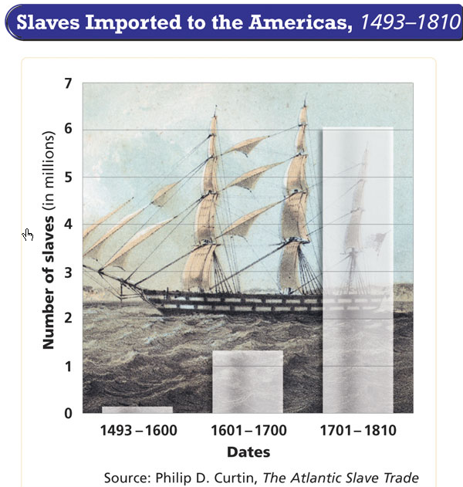
Slavery in the South was far more common than
in the Northern colonies
  80-90% of Southern slaves were field workers, most on plantations

Slide 11
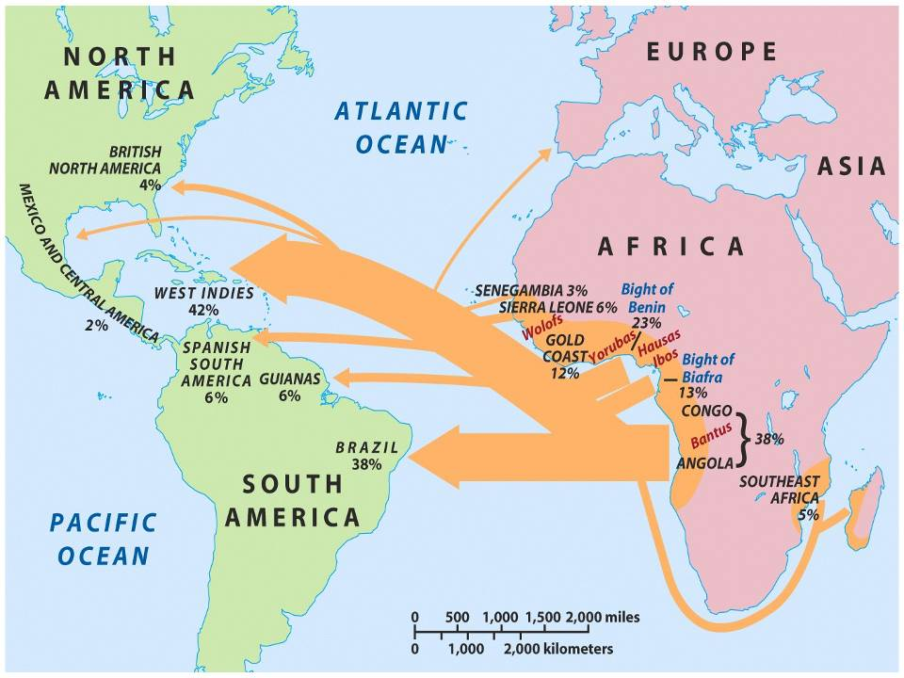
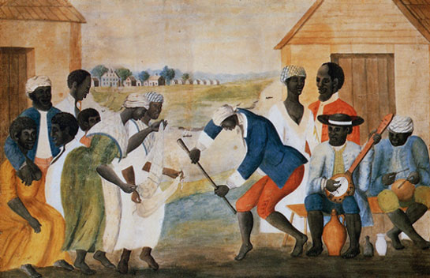
Slaves came from a variety of places in West Africa & had a variety of languages & cultures
Slaves used music
& dance to maintain their African culture
Slave families were common, but marriages were not recognized
Slave religion often blended African rituals with Christianity

Slide 12
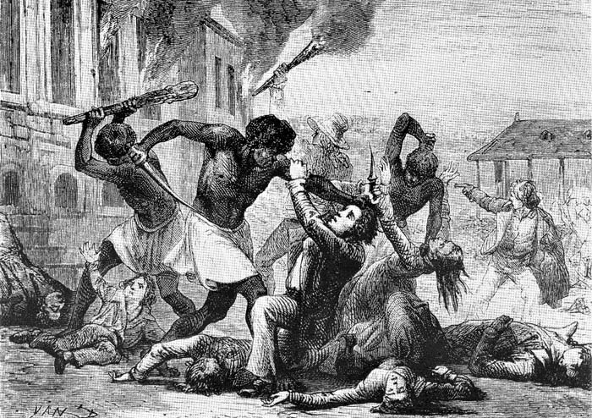
Slaves resisted by running away, slowing down work,
or sabotaging equipment
In the Stono Rebellion 150 slaves attacked & killed over 20 whites

Slide 13
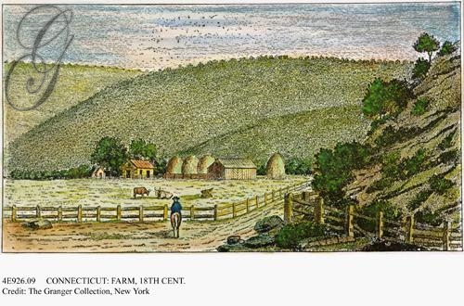
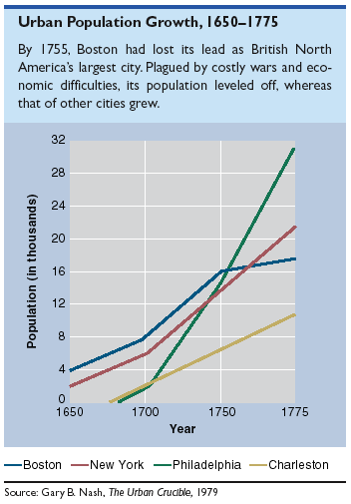
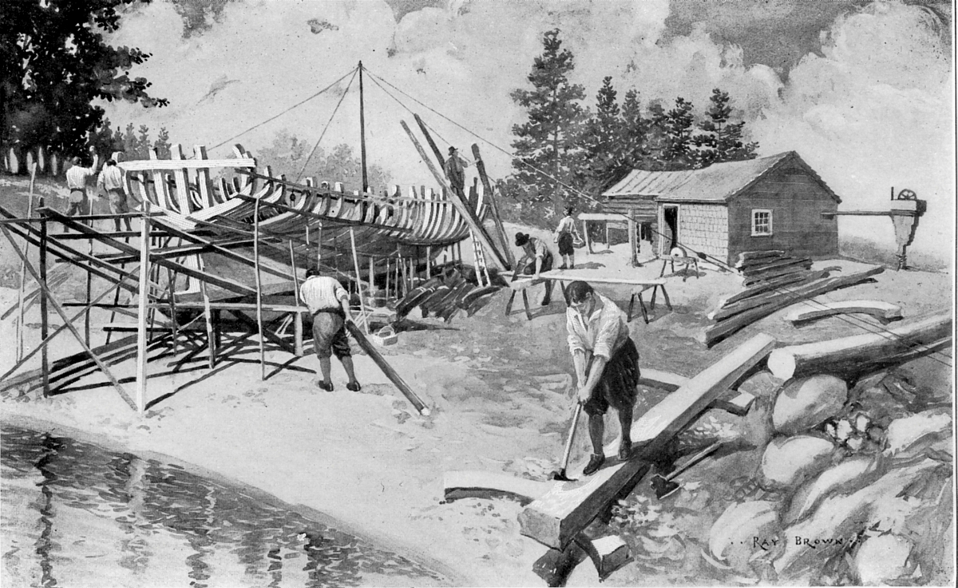
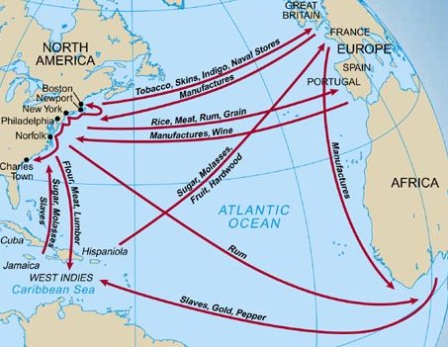
The Northern economy was more diverse than the South
In addition to farms, the Northern economy focused on lumber, shipbuilding, fishing, iron works
Northern farms typically were small & grew multiple crops like wheat, corn, & livestock
Northern cities like Boston, Philadelphia, & New York were important ports for international trade
Northern cities
gave people more professional & trade opportunities
than anywhere
in the colonies

Slide 14
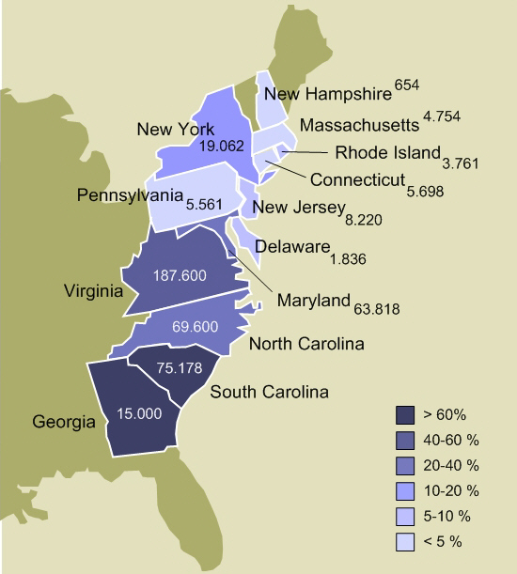
Slavery existed in Northern colonies where most slaves worked on small-scale farms or as domestic servants
Like in the South, English, Germans, & Irish immigrants lived in the backcountry as small-scale farmers

