Slide 1
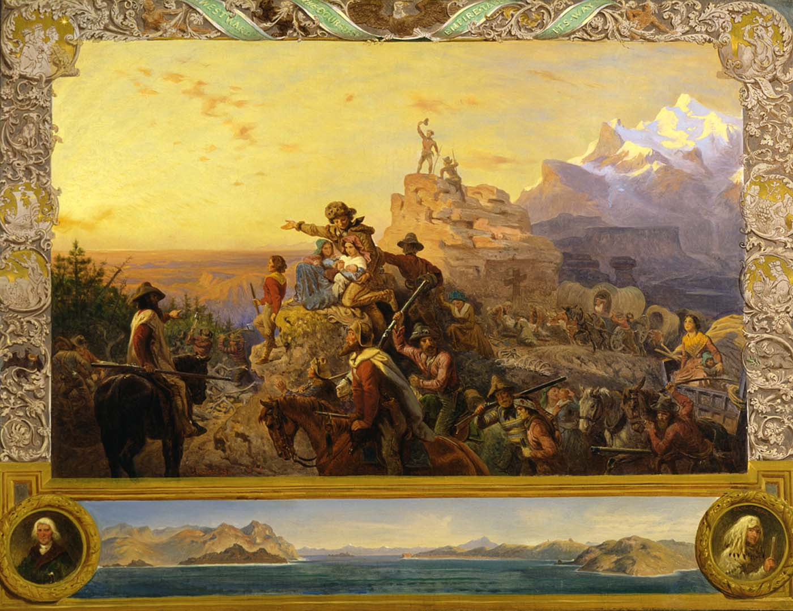
Manifest Destiny American Territorial Expansion 1803-1853
Mr. Johnson
APUSH

Slide 2
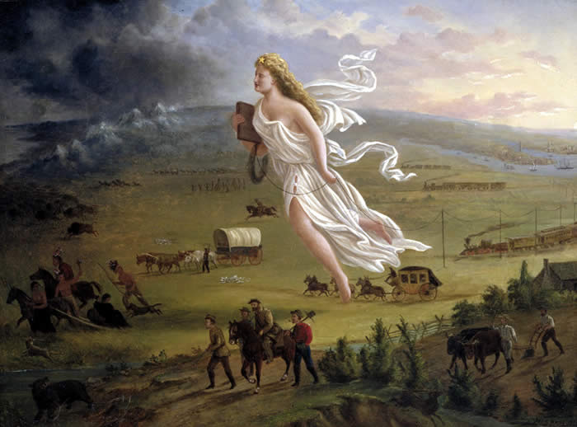
Manifest Destiny

Slide 3
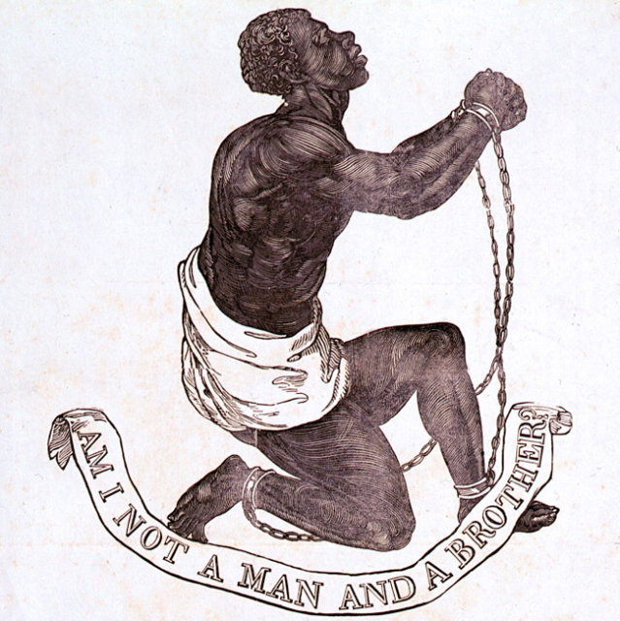
The Slavery Controversy

Slide 4
Essential Question
Did fulfilling our “Manifest Destiny” strengthen American nationalism or divide the country along sectional lines?

Slide 5
Your Chart
Manifest Destiny American Territorial Expansion 1803-1853
Territory (Year) | How Added | Nationalism | Sectionalism

Slide 6
Louisiana Purchase
1803

Slide 7
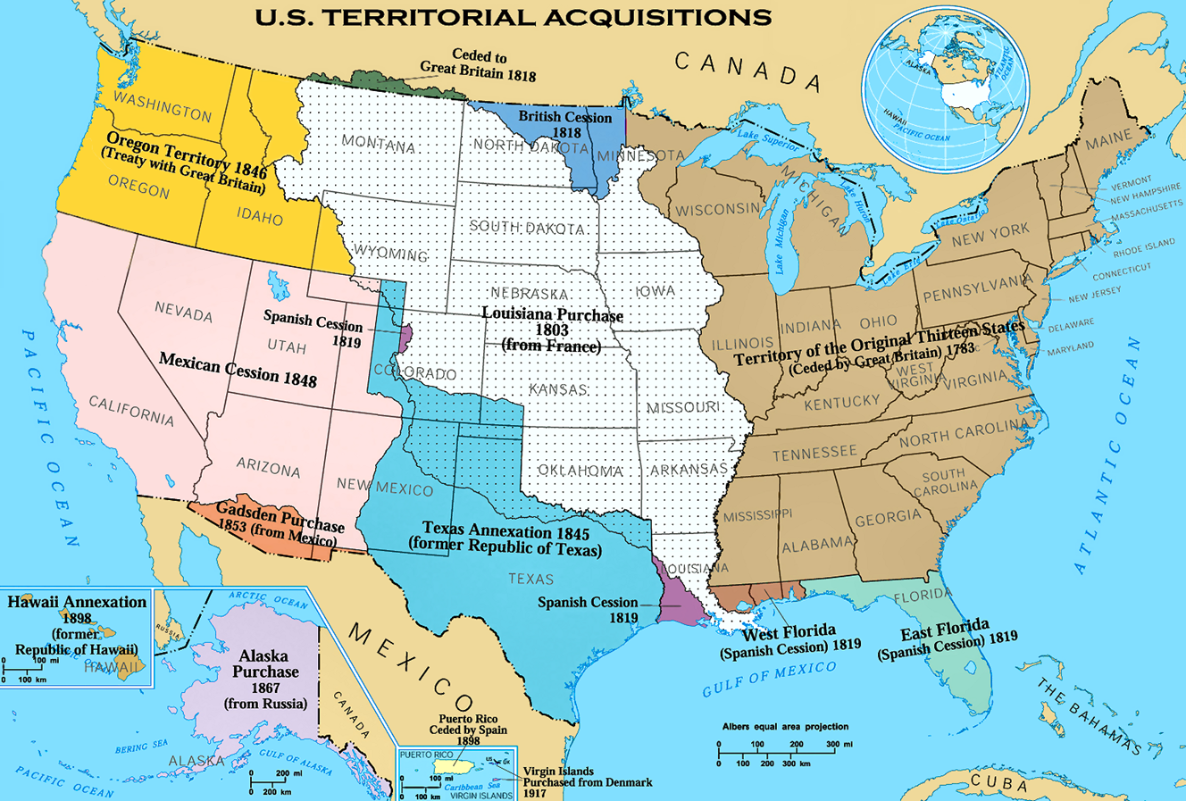
Louisiana Purchase (1803)

Slide 8
How Added
Thomas Jefferson
Purchased from France
Challenged Jefferson’s strict interpretation
Lewis & Clark Expedition
Thomas Jefferson

Slide 9
Nationalism
New land for farming… Jefferson’s agrarian “empire of liberty”
Free use of the Mississippi River & New Orleans port

Slide 10
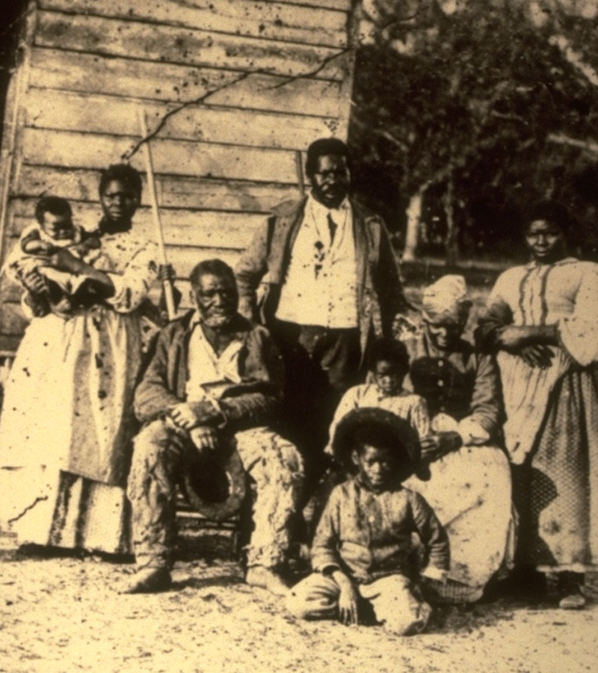
Sectionalism
Henry Clay’s Missouri Compromise
Missouri – slave state
Maine – free state
36-30 line – above free, below slave
Jefferson: “Firebell in the night”

Slide 11
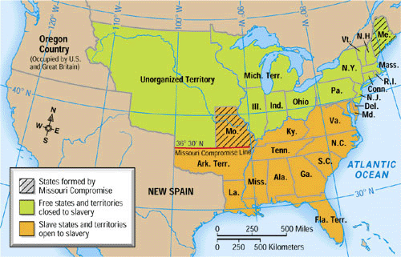
Missouri Compromise
Henry Clay

Slide 12
Your Chart
Territory (Year) | How Added | Nationalism | Sectionalism
Louisiana Purchase (1803) | Thomas Jefferson Purchased from France Challenged Jefferson’s strict interpreta-tion Lewis & Clark Expedition | New land for farming… Jefferson’s agrarian “empire of liberty” Free use of the Mississippi River/New Orleans | Henry Clay’s Missouri Compromise Missouri – slave state Maine – free state 36-30 line – above free, below slave Jefferson: “Firebell in the night”

Slide 13
Florida
1819

Slide 14
Florida (1819)

Slide 15
How Added
Purchased from Spain
Adams-Onis Treaty
Secretary of State John Q. Adams
John Quincy Adams

Slide 16
Nationalism
New land for farming
Distanced Spanish threat from U.S. homeland
James Monroe’s “Era of Good Feelings”
James Monroe

Slide 17
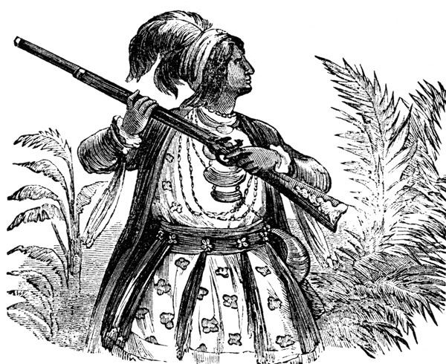
Sectionalism
New slave state
Fugitive slaves… “Black Seminoles”
Seminole Wars

Slide 18
Your Chart
Territory (Year) | How Added | Nationalism | Sectionalism
Florida (1819) | Purchased from Spain Adams-Onis Treaty Sec. of State John Q. Adams | New land for farming Distanced Spainish threat from U.S. homeland James Monroe’s “Era of Good Feelings” | New slave state Fugitive slaves… “Black Seminoles” Seminole Wars

Slide 19
Texas
1845

Slide 20
Texas (1845)

Slide 21
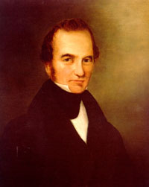
How Added
Stephen Austin’s Missourians colonized Texas
Texas War for Independence (1836-1837)
“Lone Star” Republic of Texas
Stephen Austin

Slide 22
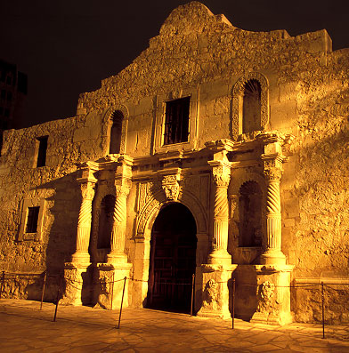
Nationalism
“Remember the Alamo”
James K. Polk: “Manifest Destiny” president

Slide 23
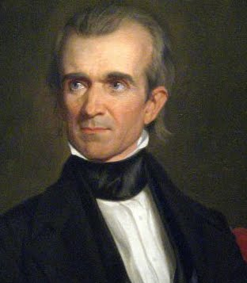
Sectionalism
Annexation?
North vs. South
Polk supports annexation
Annexed as a slave state
James K. Polk

Slide 24
Your Chart
Territory (Year) | How Added | Nationalism | Sectionalism
Texas (1845) | Stephen Austin’s Missourians colonize Texas Texas War for Inde-pendence (1836-1838) “Lone Star” Republic of Texas | “Remember the Alamo” James K. Polk: “Manifest Destiny” president | Annexation? North vs. South Polk supports annexation Annexed as a slave state

Slide 25
Mexican Cession
1848

Slide 26
Mexican Cession (1848)

Slide 27
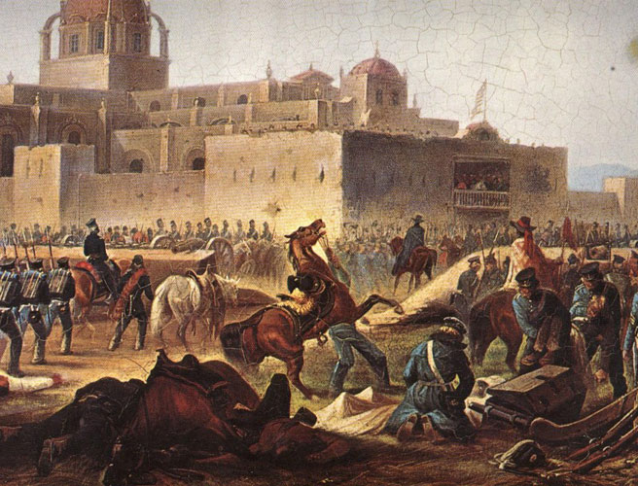
How Added
Mexican War (1846-1848)
US wins
Treaty of Guadalupe-Hidalgo (1848)
Mexico surrenders 2/5 of its land

Slide 28
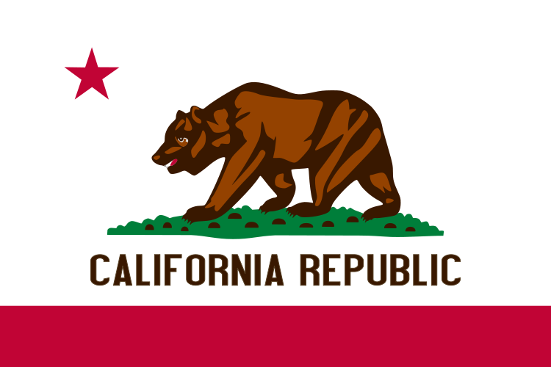
Nationalism
“Manifest Destiny” accomplished
“From sea to shining sea”
1849 California gold rush: “49ers”
Clipper ships & trade with Asia

Slide 29
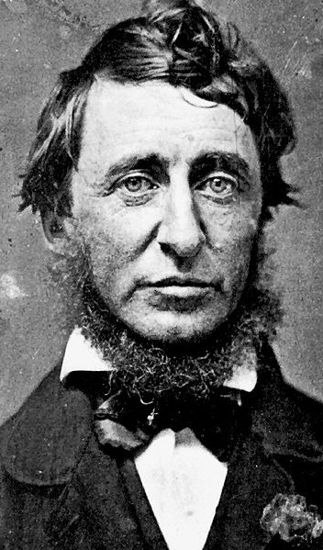
Sectionalism
Thoreau: Civil Disobedience
Emerson: “Mexico will poison us.”
Lincoln: “Spot Resolutions”
Wilmot Proviso
Land should be free from slavery
Henry Clay’s Compromise of 1850
California – free state
New Mexico/Arizona – popular sovereignty
Washington, D.C. – slave trade abolished
Fugitive Slave Act of 1850
Henry David Thoreau

Slide 30
Your Chart
Territory (Year) | How Added | Nationalism | Sectionalism
Mexican Cession (1848) | Mexican War (1846-1848) US wins Treaty of Guadalupe-Hidalgo (1848) Mexico surrenders 2/5 of its land | “Manifest Destiny” accomplished “From sea to shining sea” 1849 California gold rush: “49ers” Clipper ships & trade with Asia | Thoreau, Civil Disobedience Emerson: “Mexico will poison us.” Lincoln: “Spot Resolutions” Wilmot Proviso Land should be free from slavery Henry Clay’s Compromise of 1850 California – free state New Mexico/Arizona – popular sovereignty Washington, D.C. – slave trade abolished Fugitive Slave Act of 1850

Slide 31
Gadsden Purchase
1853

Slide 32
Gadsden Purchase (1853)

Slide 33
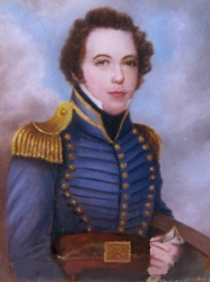
How Added
Purchased from Mexico
James Gadsden

Slide 34
Nationalism
Construction of the Southern Pacific railroad line

Slide 35
Your Chart
Territory (Year) | How Added | Nationalism | Sectionalism
Gadsden Purchase (1853) | Purchased from Mexico | Construction of Southern Pacific railroad line

Slide 36
Oregon Country
1845

Slide 37
Oregon Country (1845)

Slide 38
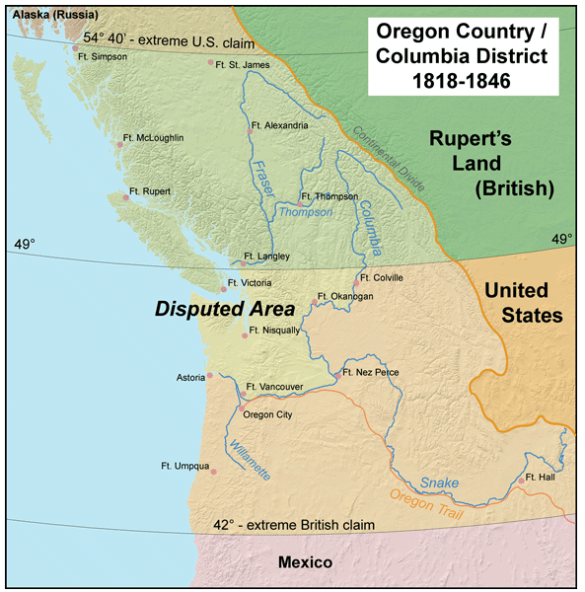
How Added
Border dispute with British Canada
49th parallel?
“54° 40’ or Fight!”
Border settled peacefully at 49°

Slide 39
Nationalism
“From sea to shining sea”
“Manifest Destiny” accomplished
Oregon gold rush

Slide 40
Sectionalism
Free states

Slide 41
Your Chart
Territory (Year) | How Added | Nationalism | Sectionalism
Oregon Country (1845) | Border dispute with British Canada 49th parallel “54° 40’ or Fight!” Border settled peacefully at 49° | “From sea to shining sea” “Manifest Destiny” accomplished Oregon gold rush | Free states

Slide 42
Cuba: Ostend Manifesto
1854

Slide 43
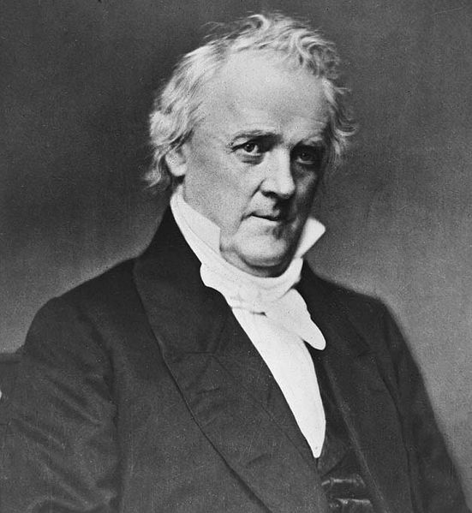
Ostend Manifesto (1854)
Failed proposal to purchase Cuba from Spain
Democratic diplomat James Buchanan

Slide 44
Nationalism
Manifest Destiny… imperialism
Monroe Doctrine

Slide 45
Sectionalism
North opposed addition of another slave state

Slide 46
Your Chart
Territory (Year) | … | Nationalism | Sectionalism
Ostend Manifesto(1854) | Failed proposal to purchase Cuba from Spain Democratic diplomat James Buchanan | Manifest Destiny… imperialism Monroe Doctrine | North opposed addition of another slave state

Slide 47
Nicaragua: William Walker
1856-1857

Slide 48
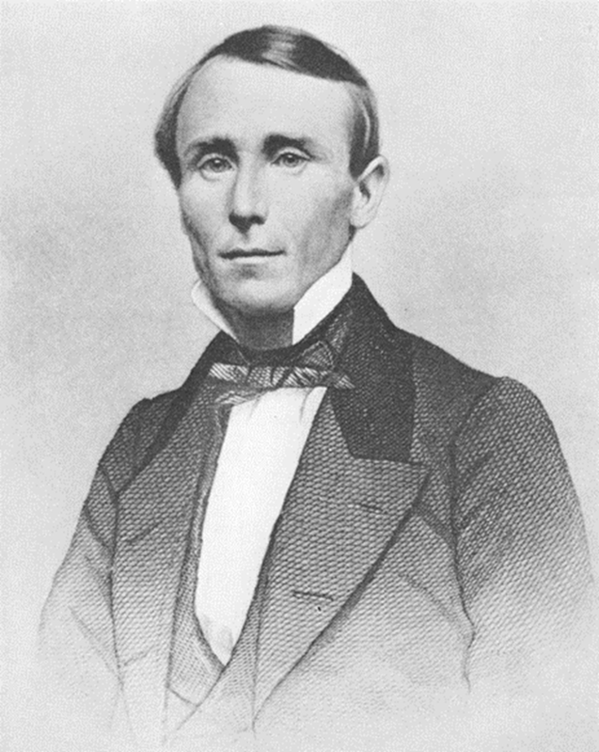
William Walker in Nicaragua
Possible location for a Central American canal
William Walker declared himself president in 1856
Deposed in 1857, executed in 1860

Slide 49
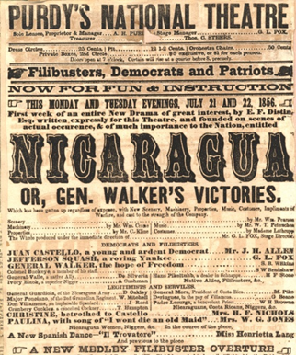
Nationalism
Manifest Destiny… imperialism
Monroe Doctrine

Slide 50
Sectionalism
North opposed addition of another slave state

Slide 51
Your Chart
Territory (Year) | … | Nationalism | Sectionalism
William Walker in Nicar-agua (1857) | Possible location for a Central American canal William Walker declared himself president in 1856… …Executed in 1857 | Manifest Destiny… imperialism Monroe Doctrine | North opposed addition of another slave state

Slide 52
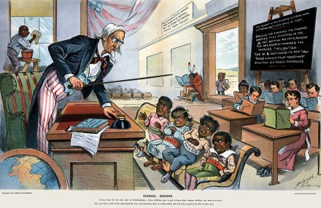
Age of Imperialism

Slide 53
Whose Destiny?
Native Americans, African Americans & Mexicans

Slide 54
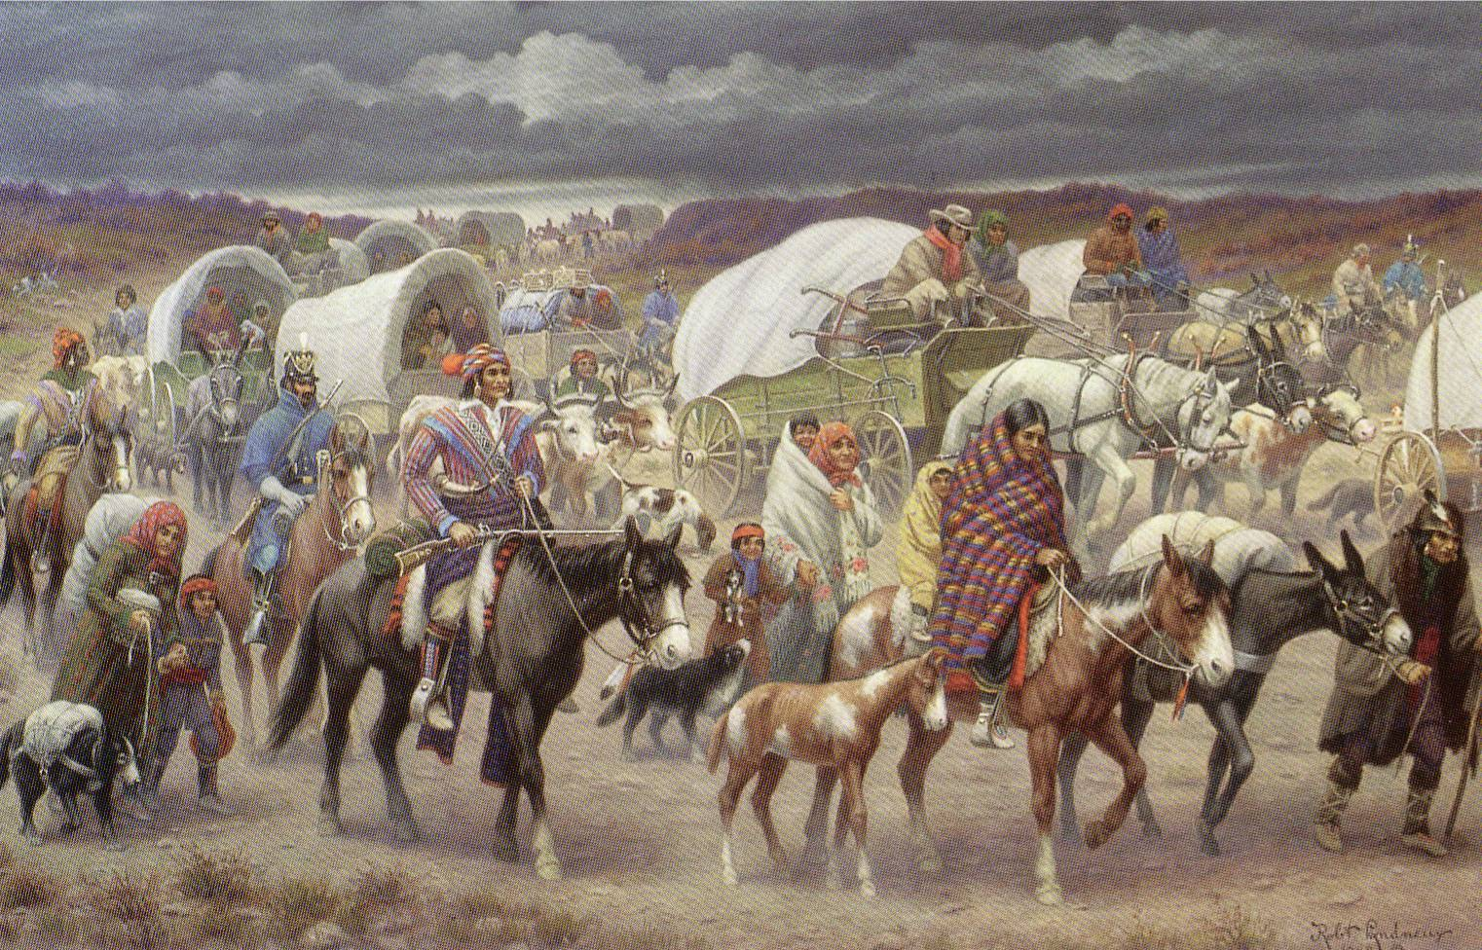
Trail of Tears

Slide 56
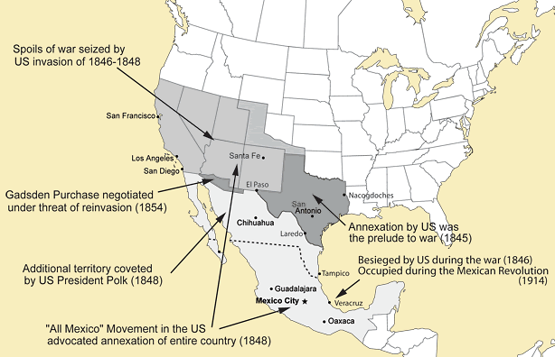
Mexican Lands

Slide 57
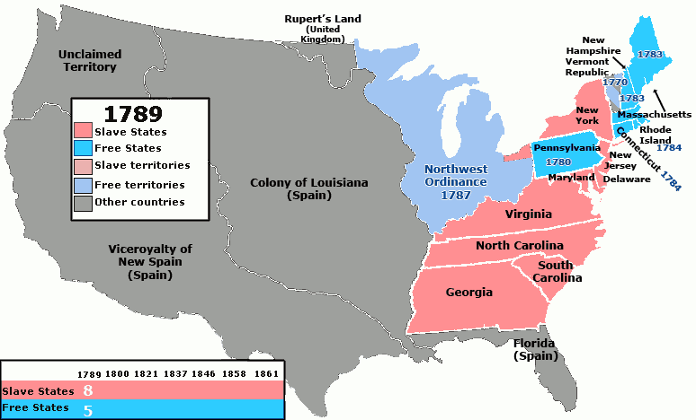
Expansion of Slavery

Slide 58
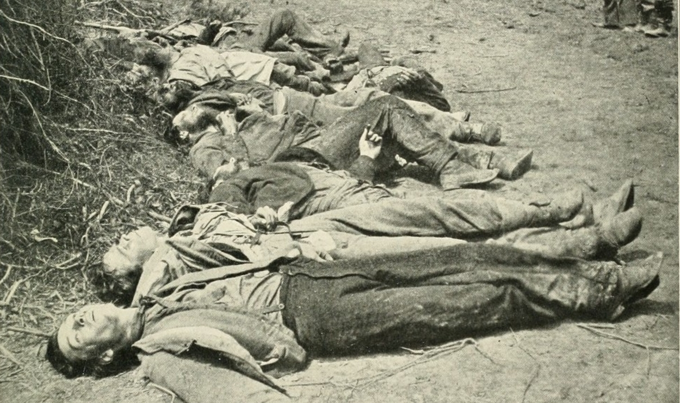
Civil War

