Slide 1
EQ: What were the changes in the political and voting process during the early-mid 1800s?

Slide 2
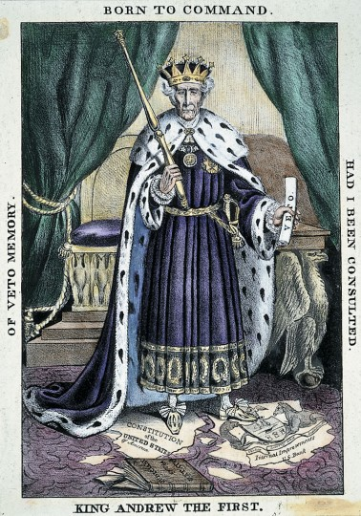

Slide 3
Changes in the Franchise
Franchise: Right to vote
Read & annotate the “Changes in the Franchise” handout. Note the voting qualifications regarding: – Citizenship status, sex, age, race, residence, property, wealth, taxpayer status
1. What was happening to the right to vote in the first half of the 19th-century?
2. What was changing in regard to this right?

Slide 4
Changes in the Franchise
Description | Enfranchised BEFORE 1800? | Enfranchised AFTER 1800?
1) New Jersey widow whose husband left her a small fortune and a successful shipbuilding business

Slide 5
Assignment
Primary Source Analysis
  Voting qualifications by state, 1780-1844
  Election Data – 1824,1828, 1832 & 1836 Presidential Elections

Slide 6
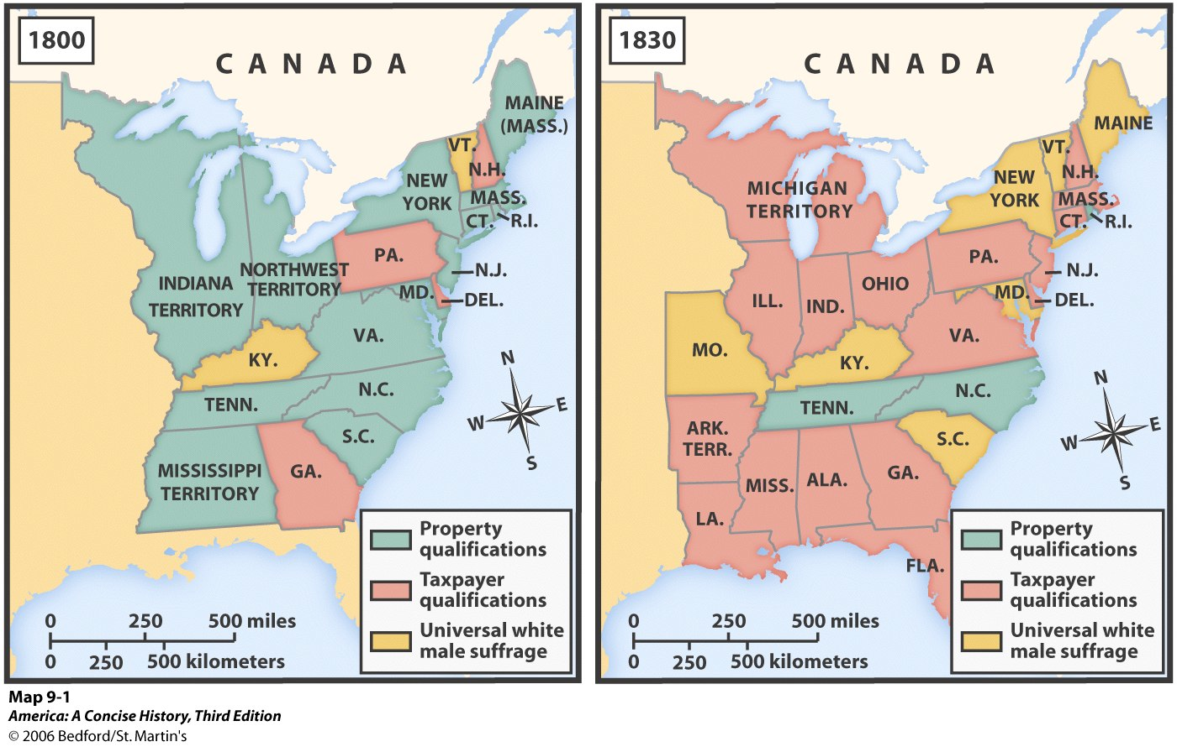
Qualifications for Voting

Slide 7
Did the increased right to vote among white males translate into increased voting?

Slide 8
Voter Participation
Did the increased right to vote among white males translate into increased voting?
Use 3 Charts
1. Voter Participation in Presidential Elections by State: 1824-1836.
2. 1824 Presidential Election Data
3. 1828 Presidential Election Data
4. 1832 Presidential Election Data
5. 1836 Presidential Election Data

Slide 9
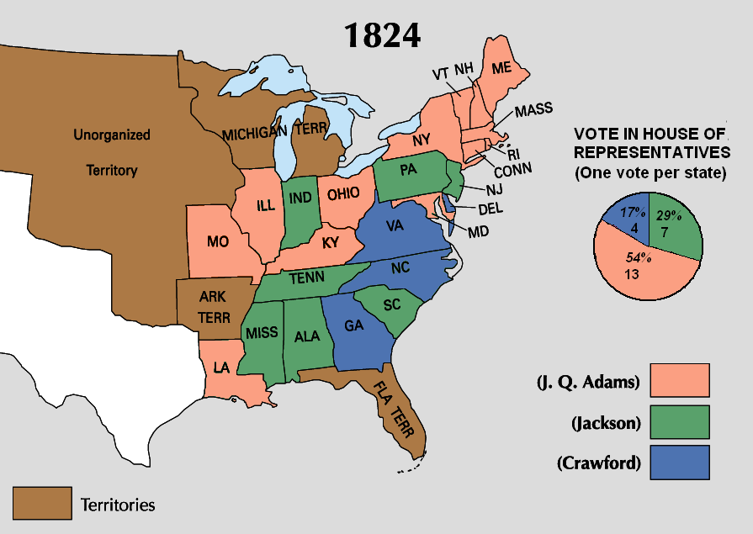

Slide 10
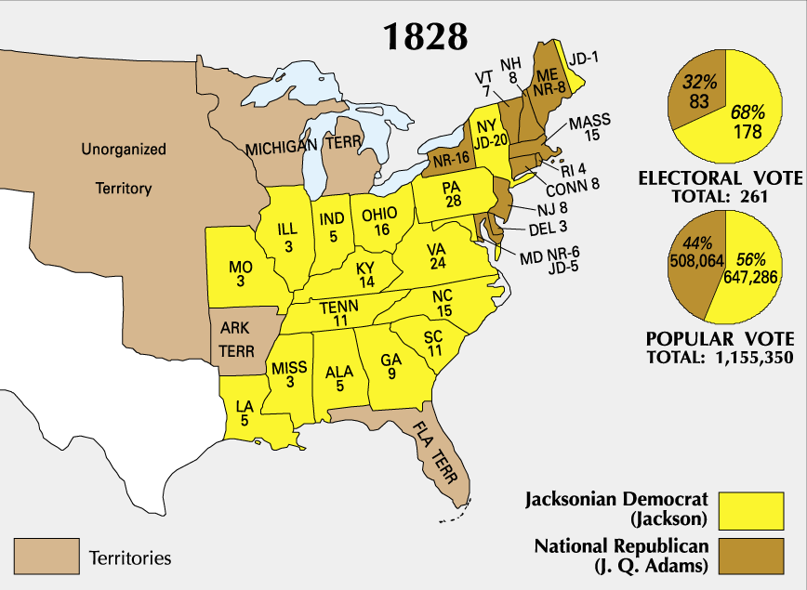

Slide 11
Did the increased right to vote among white males translate into increased voting?
**Cite evidence from documents to support your answer**
Respond on a separate sheet of paper. One paragraph.

Slide 12
Conclusion
In general, voting participation tended to be much higher in states that voted solidly for Andrew Jackson than those states that went solidly for John Quincy Adams. In Massachusetts, Connecticut, and Rhode Island, which Adams won handily, voting participation was less than 30 percent, with only a small increase in participation over 1824. In more closely contested states won by Adams, such as New Jersey and Maryland, voting participation was high and had greatly increased over 1824. In general, states with very large percentage increases in voting participation tended to be closely contested or to vote solidly for Jackson. In the election of 1832, with Jackson's re-election virtually assured, voting participation tended to drop. In 1836, voting participation tended to increase again. The data indicate that Jackson's popularity was an important factor in the increase in voter participation and that first-time voters—represented by the percentage increase in voter participation—tended to vote for Jackson. There is also an indication that the increase in voter participation due to the expansion of the base and, at least in part, to Jackson's popularity, led to an extended period of higher voter participation after Jackson's presidency ended.

Slide 13
Synthesis
Read: Disenfranchised: Report Looks at How Voter ID Laws Set Up Roadblocks to Voting (on the website)
1. How many states have voter ID laws?
2. Who is disproportionately affected by Voter ID laws?
3. To what extent to voter ID laws affect the franchise?

