Slide 1
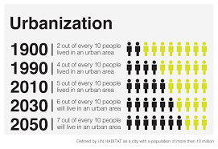
Urbanization & Immigration

Slide 2
True or False
America has always warmly welcomed immigrants
America has never passed laws restricting immigration.
The Chinese contributed to the construction of the transcontinental railroad.
The Chinese came to America to take American jobs from White Americans.

Slide 3
Urbanization and Immigration: 1880s to 1920s
Urbanization (the growth of cities) and Living Conditions
Population: 40 million (1870) → 80 million (1900); 50+% in cities –by 1920, country more urban than rural
People lived in tiny, cramped apartments (Tenements)--- very close to other people --little privacy or space; no green parks; unclean water, diseases (people infected each other) and little
Segregation: different districts for ethnicities (Enclaves) – poor closer to factories; ghettos--- wealthy away from downtown
Nativism, Labor and Immigration
Old Immigration (1850-80): German & Irish
New Immigration (1880-1920): 27 mil immigrants (S.E. Euro)
S.E. Europe not “white”; blamed for crime, radicalism/instability, low wages, corruption – often excluded from unions
Chinese Immigration: 1850s CA places miner tax on Chinese immigrants; attacked for taking “white” jobs & lowering wages (Irish vs. Chinese)
Chinese Exclusion Act: prohibited Chinese immigration in 1887; 1st focused anti immigration act; more in 1920s

Slide 4
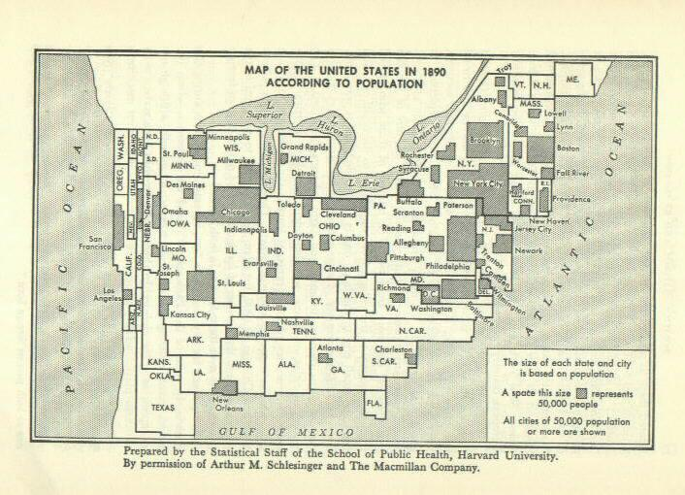
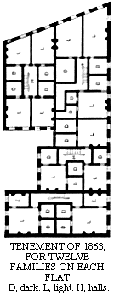
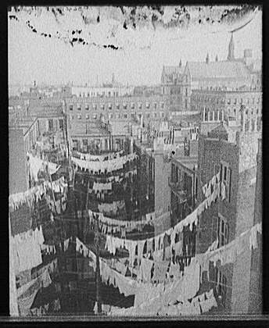

Slide 5
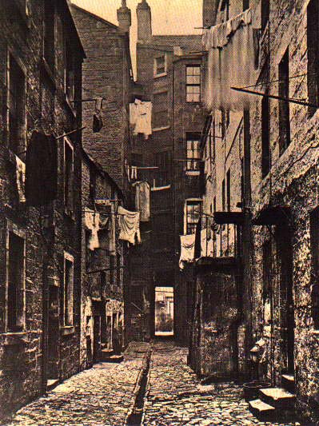
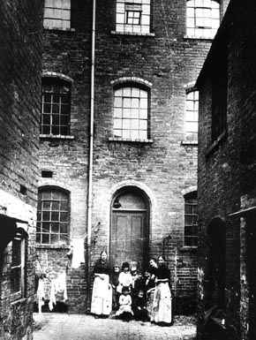

Slide 6
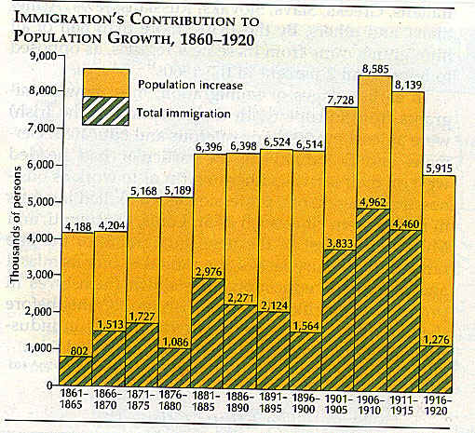
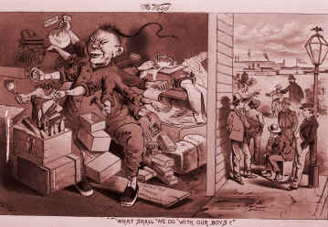
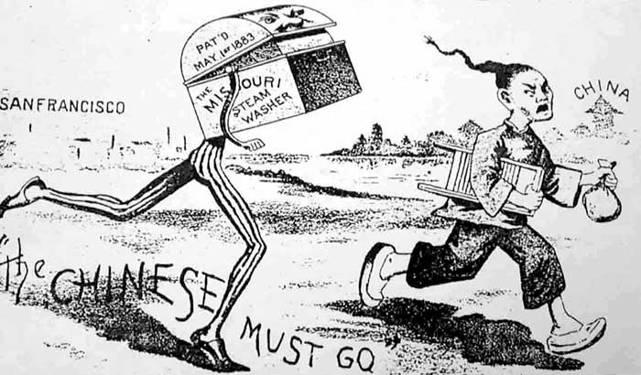
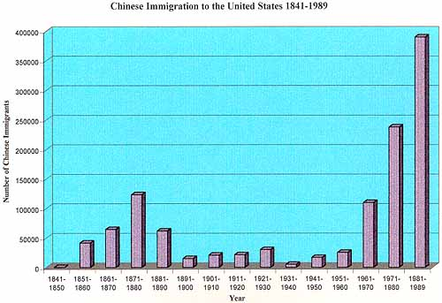

Slide 7
Can Laws Hurt People?

Slide 8
“The Magic Washer”
What is the author’s opinion on Uncle Sam?
What is the author’s opinion on washer men (Chinese immigrants)?
How do Nativists feel about the Chinese?
Overall, what is the cartoon trying to say?

Slide 9
Chinese Immigration & Exclusion
Take three minutes to read about Chinese Exclusion and be prepared to explain.
Why do you think the law might have been put in place?
What were the intended consequences of the law?
How would Americans be likely to respond?

Slide 10
Rocks Spring Massacre/Tacoma Expulsion
Students facing the Steelers banner read about the Rocks Spring Massacre
Students facing the TV read the Tacoma expulsion
What happened during the Rocks Spring Massacre?
What happened at the Tacoma Expulsion?
How are these two events similar? How are they different?

Slide 11
Notes:
In the 1950s asian/black couples could only get their pictures taken together in the secrecy of photo booths to avoid taunting and bullying.

Slide 12
Writing Prompt
Chinese immigrants and their families were not simply “excluded” as the legislation wording implies-they were victims of violence. To what extent was the Chinese Exclusion Act responsible for these violent acts against the Chinese? Would these incidents have occurred without the legislation? Respond in a single paragraph beginning with a thesis statement. Use as many details as you can in your evidence.

Slide 13
When Chinese People Were Banned From the U.S., a Mexican City Came to the Rescue
Article posted on the website under Period Six-> Immigration & Urbanization
Please read

