Slide 1
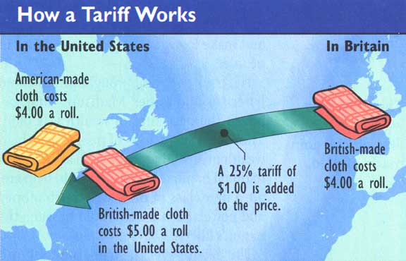
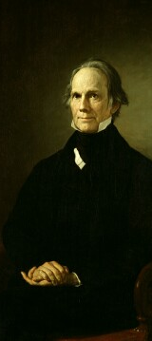
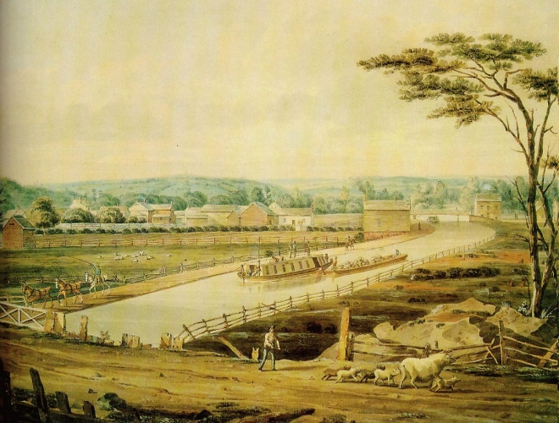
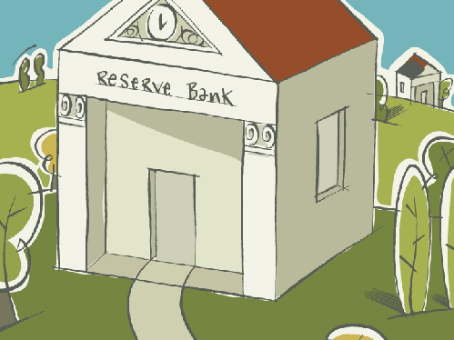
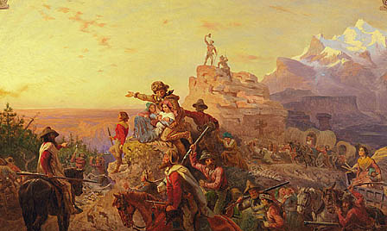
The American System
Protective Tariff
Internal Improvements
Henry Clay
Sale of public lands
National Bank

Slide 2
Protective Tariff

Slide 3
National Bank

Slide 4
Sale of Public Lands… high prices

Slide 5
Internal Improvements… roads & canals

