Slide 1
HAMILTON VS. JEFFERSON

Slide 2
EQ:
Agenda
Complete Bill of Rights Assignment
Notes/Context- Where We Stand April 1789
Comparison –Hamilton & Jefferson
Hamilton song-Cabinet Battle #1

Slide 3
Where We Stand- April 1789
Recent events:
  – 8 years ago (1781), fought final battle of Revolutionary War &
  established the Articles of Confederation.
  – 6 years ago (1783), Treaty of Paris established national boundaries of United States.
    East of the Mississippi
    Canada→Florida border
  – 10 months ago (June 1788), Constitution ratified, replaced the Articles of Confederation.
April 30, 1789 – George Washington took the Oath of Office in New York City to become the nation’s first President.

Slide 4
Washington’s First Cabinet
Washington did not campaign for himself – chosen by the electoral college to be country’s first president.
– John Adams (runner-up) became Vice President
• Washington coined the idea of the president’s
“cabinet.”
– Department of State – Thomas Jefferson (VA)
– Department of the Treasury – Alexander Hamilton (NY)
– Department of War – Henry Knox (MA)
– Attorney General – Edmund Randolph (VA)

Slide 5
Hamilton’s Economic Vision
As Secretary of the Treasury, Hamilton developed an economic plan for the new U.S.:
1. Federal government assumption of state debts
  Most northern states still owed significant sums, southern states had paid most of their debt
  Compromise of 1790 – capital of US would be moved from NYC to Washington, D.C. if southern states agreed to help pay
2. Establishment of a National Bank
• Issue paper money, handle government finances,
issue loans
3. Establish tariffs to protect industry & provide federal revenue
• Would provide vast majority of gov’t revenue for the new nation

Slide 6
Divisions in the New Nation
Despite their seats in Washington’s cabinet, Hamilton & Jefferson disagreed sharply in their views and philosophies on government.
– Hamilton = led the Federalist Party
• Supported by Northerners, primarily upper class merchants & bankers
– Jefferson = led the Democratic-Republican Party
• Supported by Southerners, primarily lower/ middle class farmers

Slide 7
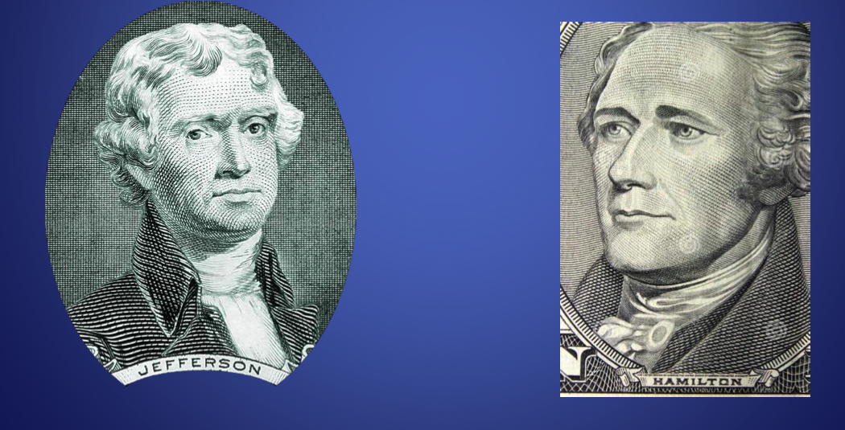
Comparing Hamilton & Jefferson
Chart

Slide 8
Background
Thomas Jefferson
– Grew up as member of elite in society
– Elected to Virginia’s state legislature at age 26.
– Served as governor of Virginia, minister to France, and Secretary of State
Alexander Hamilton
– Born into poverty in the British West Indies
– Joined Continental Army during the Revolution - became an aide to General Washington.
– Worked his way up through society.

Slide 9

HAMILTON RAP!

Slide 10

Rap Battle #1

Slide 11

HAMILTON COMMERCIAL (90s)

Slide 12
SEE, HISTORY IS COOL!

