Slide 1
Era of Good Feelings? 1816-1824
EQ: Which was the most powerful force during the Era of Good Feelings? Nationalism or Sectionalism?

Slide 2
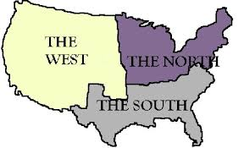
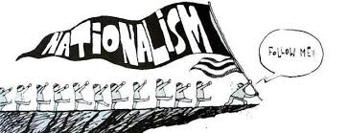
BIG Vocab Words
Nationalism: Pride in one’s country
Ex: War of 1812
Ex: Monroe Doctrine
Sectionalism: a devotion to the interests of one geographic region over the interests of the country as a whole, ultimately led to the Union's worst crisis: civil war between the North and the South in the early 1860s
Ex: Slavery
Ex: Tariffs

Slide 3
What caused Nationalism?
Which of the following can be considered a major cause of a growth of nationalism that happened in the period after the War of 1812?
1. Victory at the Battle of New Orleans
2. Francis Scott Key’s Star Spangled Banner
3. Manufacturing grows in response to embargo during war
4.Earning of respect by standing up to England

Slide 4
What caused Sectionalism?
1. Loyalty to region
2. Social & Cultural differences
3. Economic Differences
4. Fedreral vs. States’ Rights

Slide 5
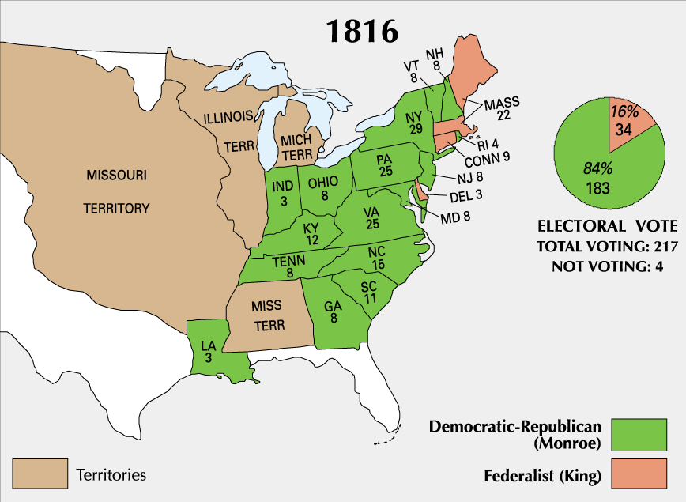
Election of 1816
Notes:
The demise of the federalist party.

Slide 6
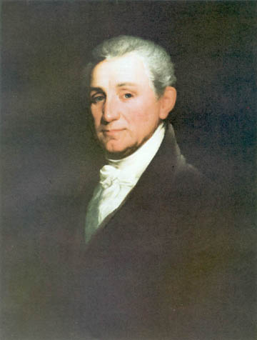
James Monroe

Slide 7
Geographic Growth
Illinois
Indiana
Alabama
Mississippi

Slide 8
Recognizing Cause: Why did so many people migrate west?
Which of the following can be considered a major cause of a growth of to the West that happened in the period after the War of 1812?
1. Lots of cheap land while land in the east became more expensive
2. Embargo pushed people West looking for money
3. Victories over Indians

Slide 9
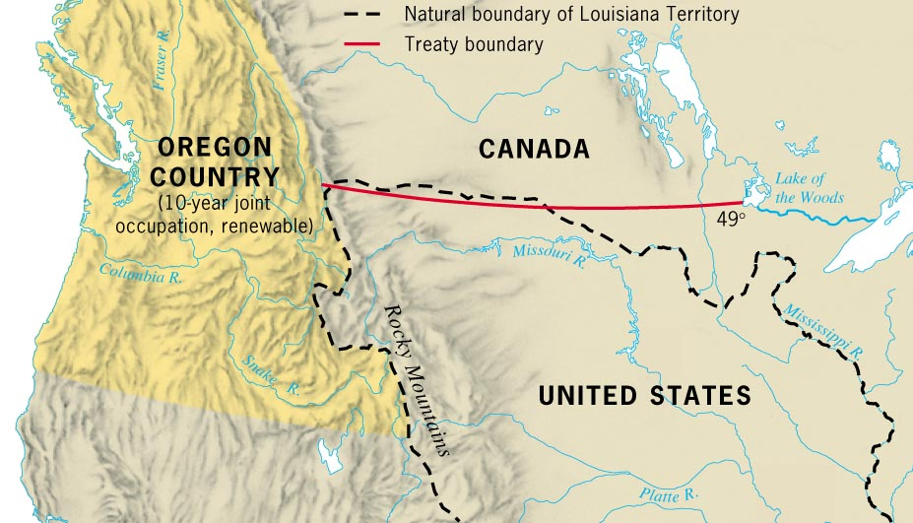
Setting a Border with British Canada

Slide 10
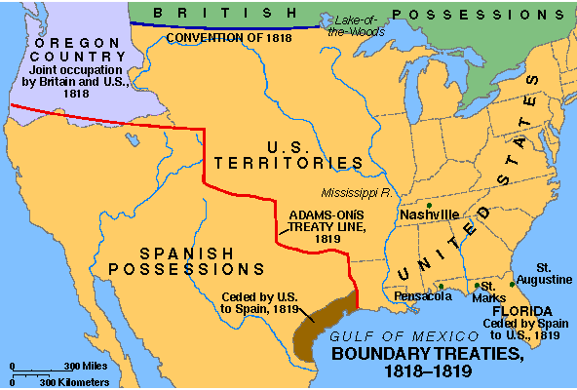
Adams Onis Treaty 1819

Slide 11
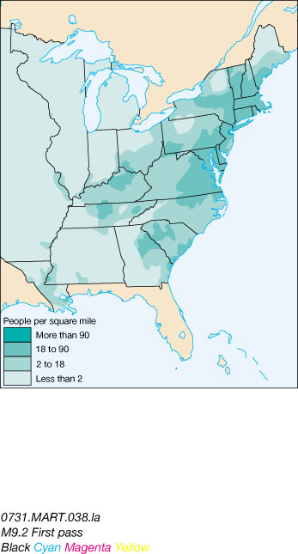
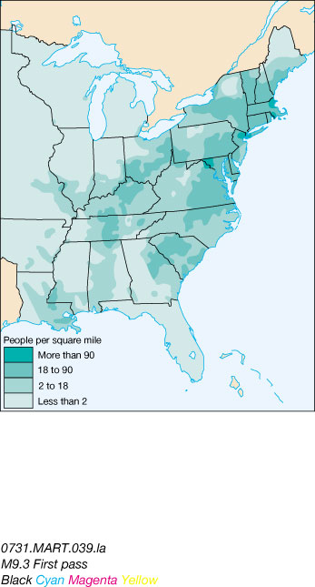
Population Density
1810
1820

Slide 12
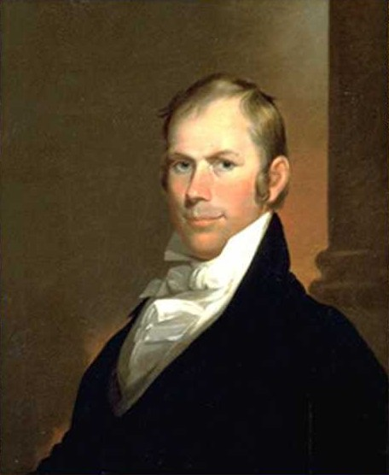
Henry Clay
This guy will be around forever!

Slide 13
Role of Government: Should the government help pay for the development of internal improvements (infrastructure) in the country?
Costs
Benefits

Slide 14
The American System
Tariff of 1816
Chartering of the Second Bank of the United States [BUS].
Internal improvements at federal expense. - National Road

Slide 15
Memory Aid for Henry Clay’s American System: “BIT”
B ank of the U.S. (BUS)
I nternal Improvements
T ariff of 1816

Slide 16
Transportation Revolution
“Let us bind the Republic together with a perfect system of roads and canals. Let us conquer space.”

Slide 17
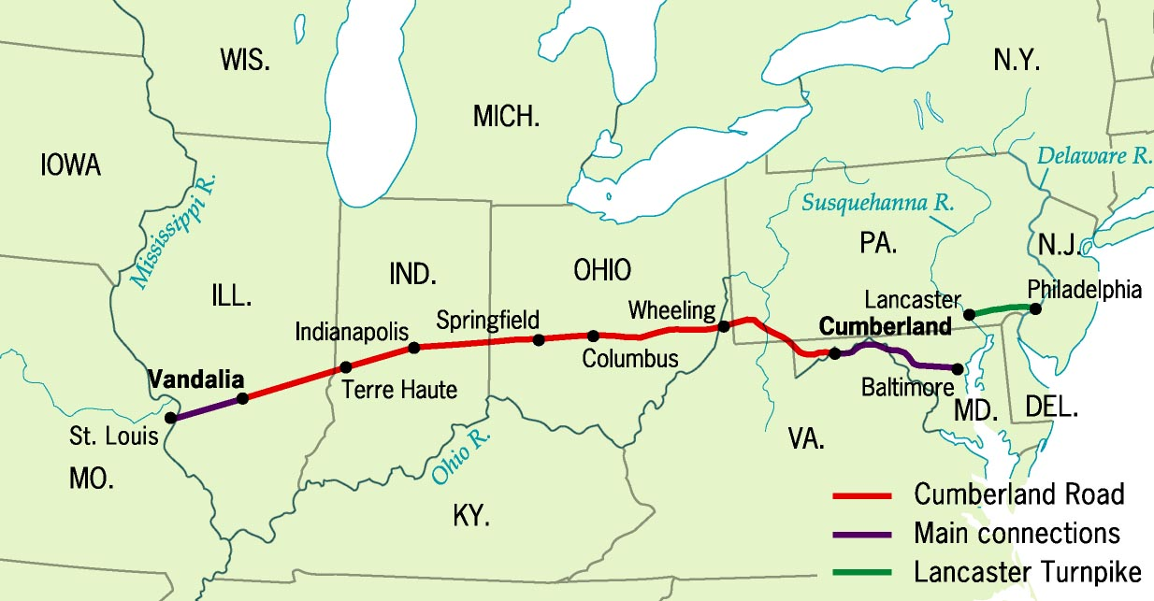
Cumberland Road

Slide 18
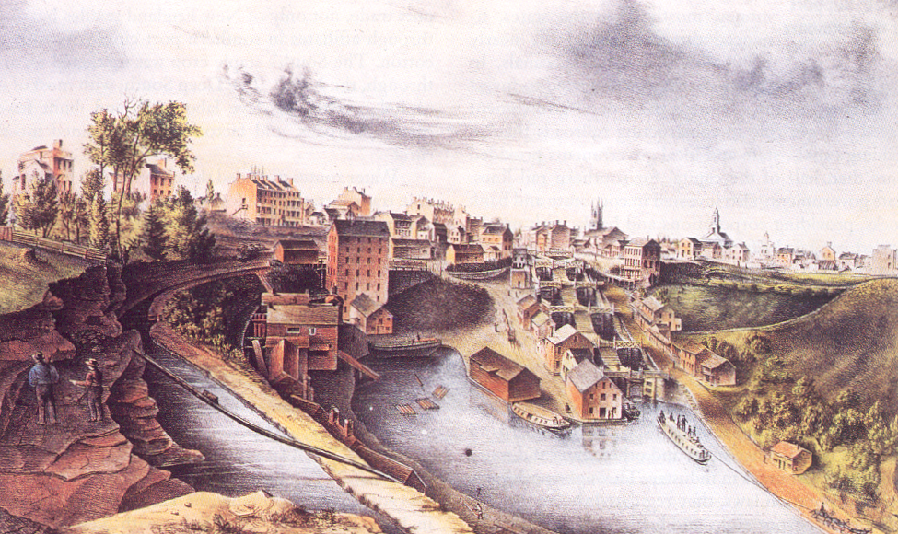
The Erie Canal

Slide 19
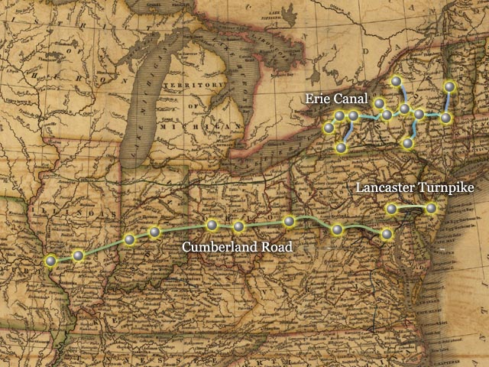
What does “The Canal Song” indicate about the mood of Americans toward the new forms of transportation that were being developed in the 1800s?

Slide 20
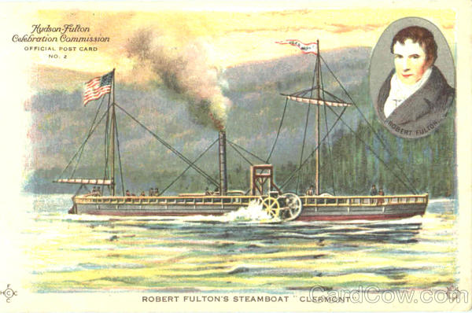
Robert Fulton & the Steamboat

Slide 21
Role of Government: Who should pay for these improvements?
The American System
Protective Tariffs
Internal Improve-ments:
Roads and Canals
National Bank
Public Land Policies

Slide 22
Bonus Bill
GOAL: to set aside money (1.5 million to states) made on stock sales from the Bank of the United States for internal improvements. March, 1817
Madison vetoed the bill because he believed in strict interpretation, and using federal money for internal improvements is not a power granted to the federal government in the Constitution, nor is it necessary and proper
the General Welfare Clause of the Constitution was never intended to become a Pandora’s box for special-interest legislation

Slide 23
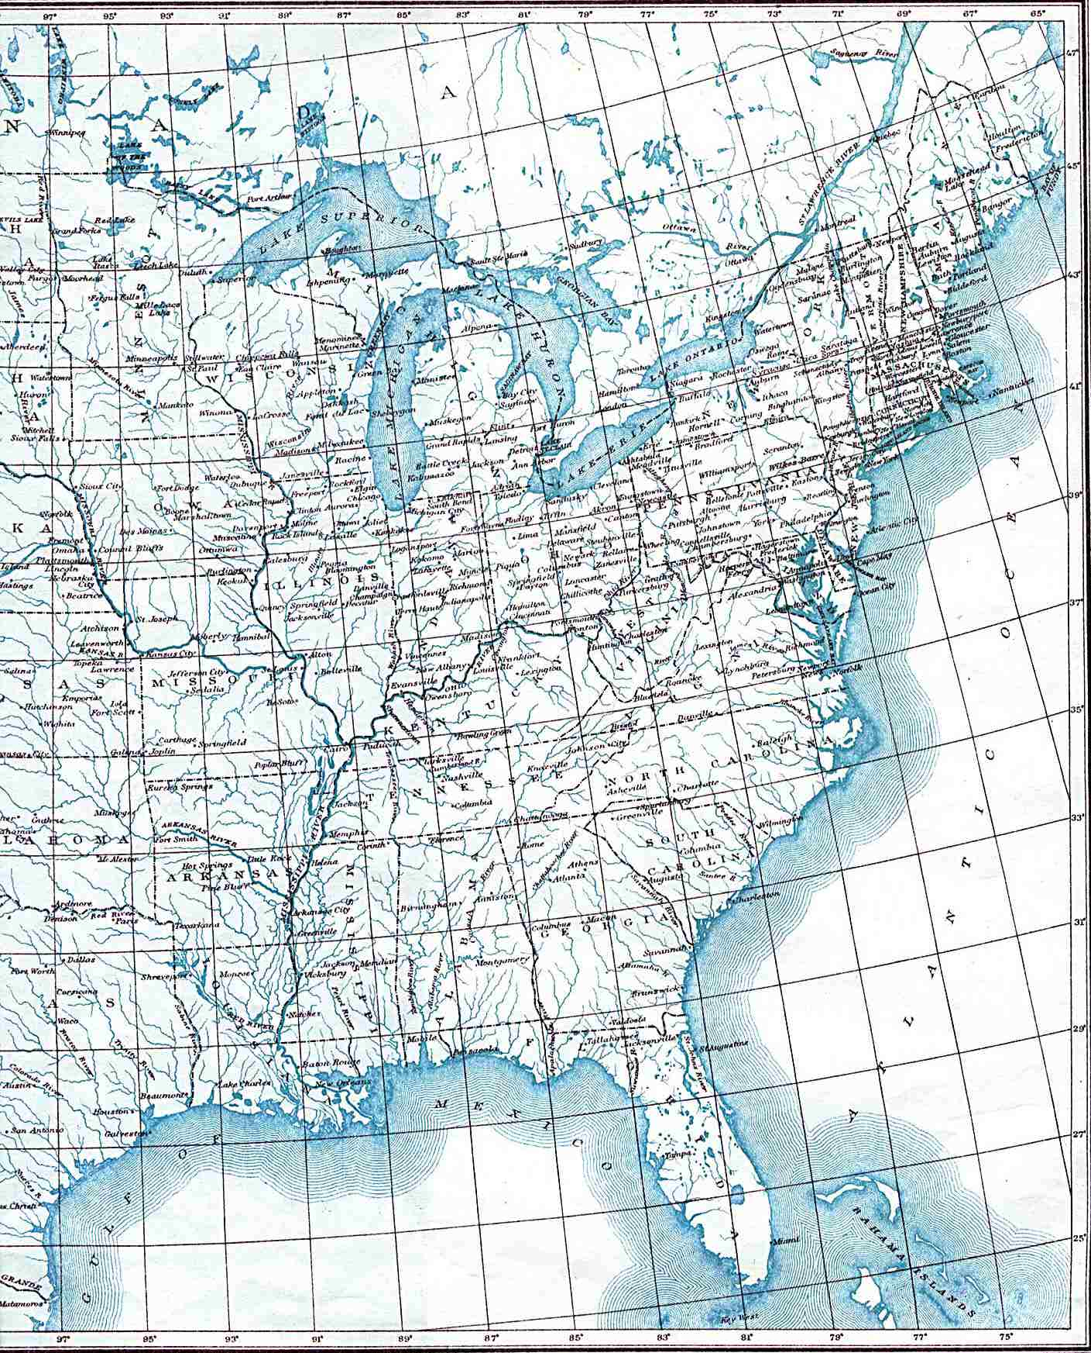

Slide 24
Tariff of 1816
Calhoun’s Tariff of 1816 The South believed that the development of a home market would help the U.S. economy which would benefit everyone
But
Protested that the tariff, which was disproportionately paid by trade-dependent southerners, would be primarily used to finance road and canal projects in the northern states.

Slide 25
Role of Government: How did the tariff lead to the growth of manufacturing?
Textile industry – led to the beginning of the factory system. This was made possible thanks to two developments:
#1 system of interchangeable parts – Eli Whitney
#2 system of all the work done in one building was developed by Lowell

Slide 26
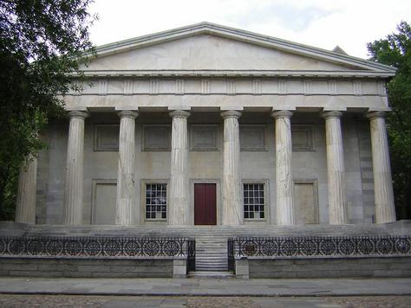
Bank of the United States Renewed
FIRST BUS: In 1811 – the original charter for the Bank of the United States ended and wasn’t renewed by James Madison and the Republican Congress
PROBLEM The number of state banks then increased, but in most states there was little banking control. Credit was easily given to many people who couldn’t pay back loans. The financial situation wasn’t good (Sound familiar???)
SOLUTION 1816 – the Second Bank of the United States was chartered. Henry Clay and John C Calhoun had led the move in Congress.

Slide 27
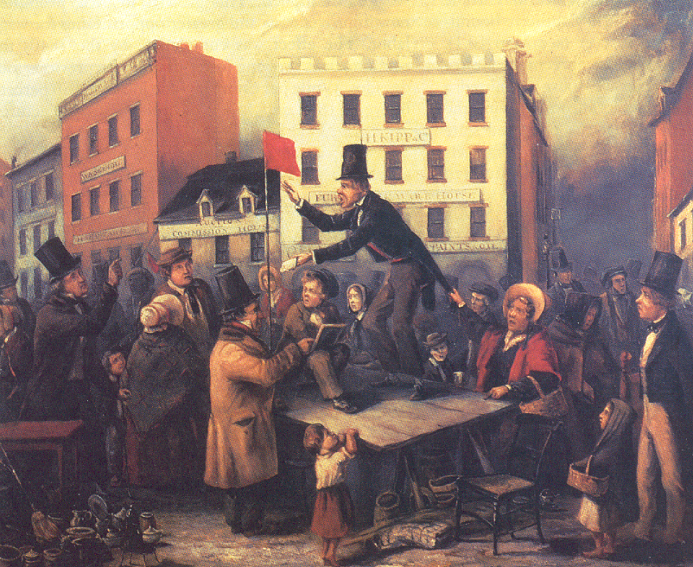
Panic of 1819
First financial panic since the “Critical Period (1780’s)
under the Articles of
Confederation – Cyclic
panics and depressions
will occur every 20 years
CAUSES
#1 Over speculation of frontier lands by Banks (especially BUS)
#2 Inflation from war of 1812 + economic drop-off = vulnerable economy
#3 Deficit trade in balance with Britain
#4 BUS forced wildcat western banks to foreclose on western farms

Slide 28
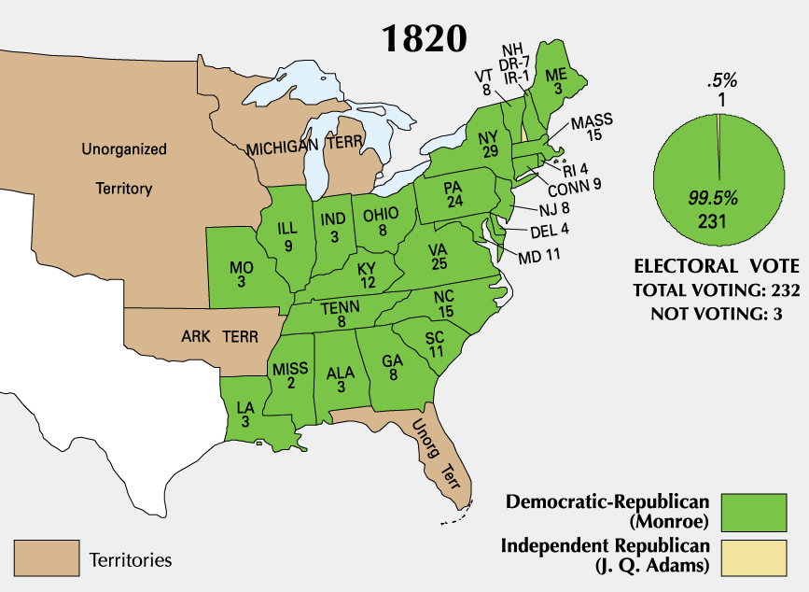
Election of 1820

Slide 29
Document Scramble
Historians have traditionally labeled the period after the War of 1812 the “Era of Good Feelings.” Evaluate the accuracy of this label, considering the emergence of nationalism and sectionalism.
Use the documents and your knowledge of the period 1815-1825 to construct your answer.

Slide 30
Directions for Document Scramble
1. Each table group will be assigned one document.
2. HIPP the document
3. Does the document deal with Nationalism or Sectionalism? Explain
3. Using evidence from your document, is the label “Era of Good Feelings” accurate? Explain

Slide 31
Table One: Document A
Table Two: Document B
Table Three: Document C
Table Four: Document D
Table Five: Document F
Table Six: Document G
Table Seven: Document H
Table Eight: Document I (first period will do this together)

