Slide 1
Economic Weaknesses in US, 1920s
Causes of Great Depression

Slide 2
Know
Stock
Stock Market
Buying on Margin
Recession
Depression
Inequality

Slide 3
Essential Questions
What caused the stock market crash of 1929?
What were consequences of the stock market crash of 1929?

Slide 4
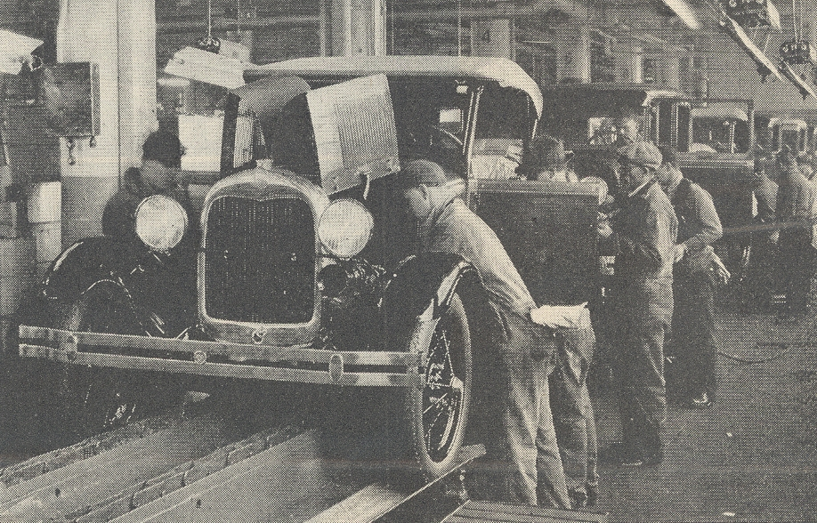
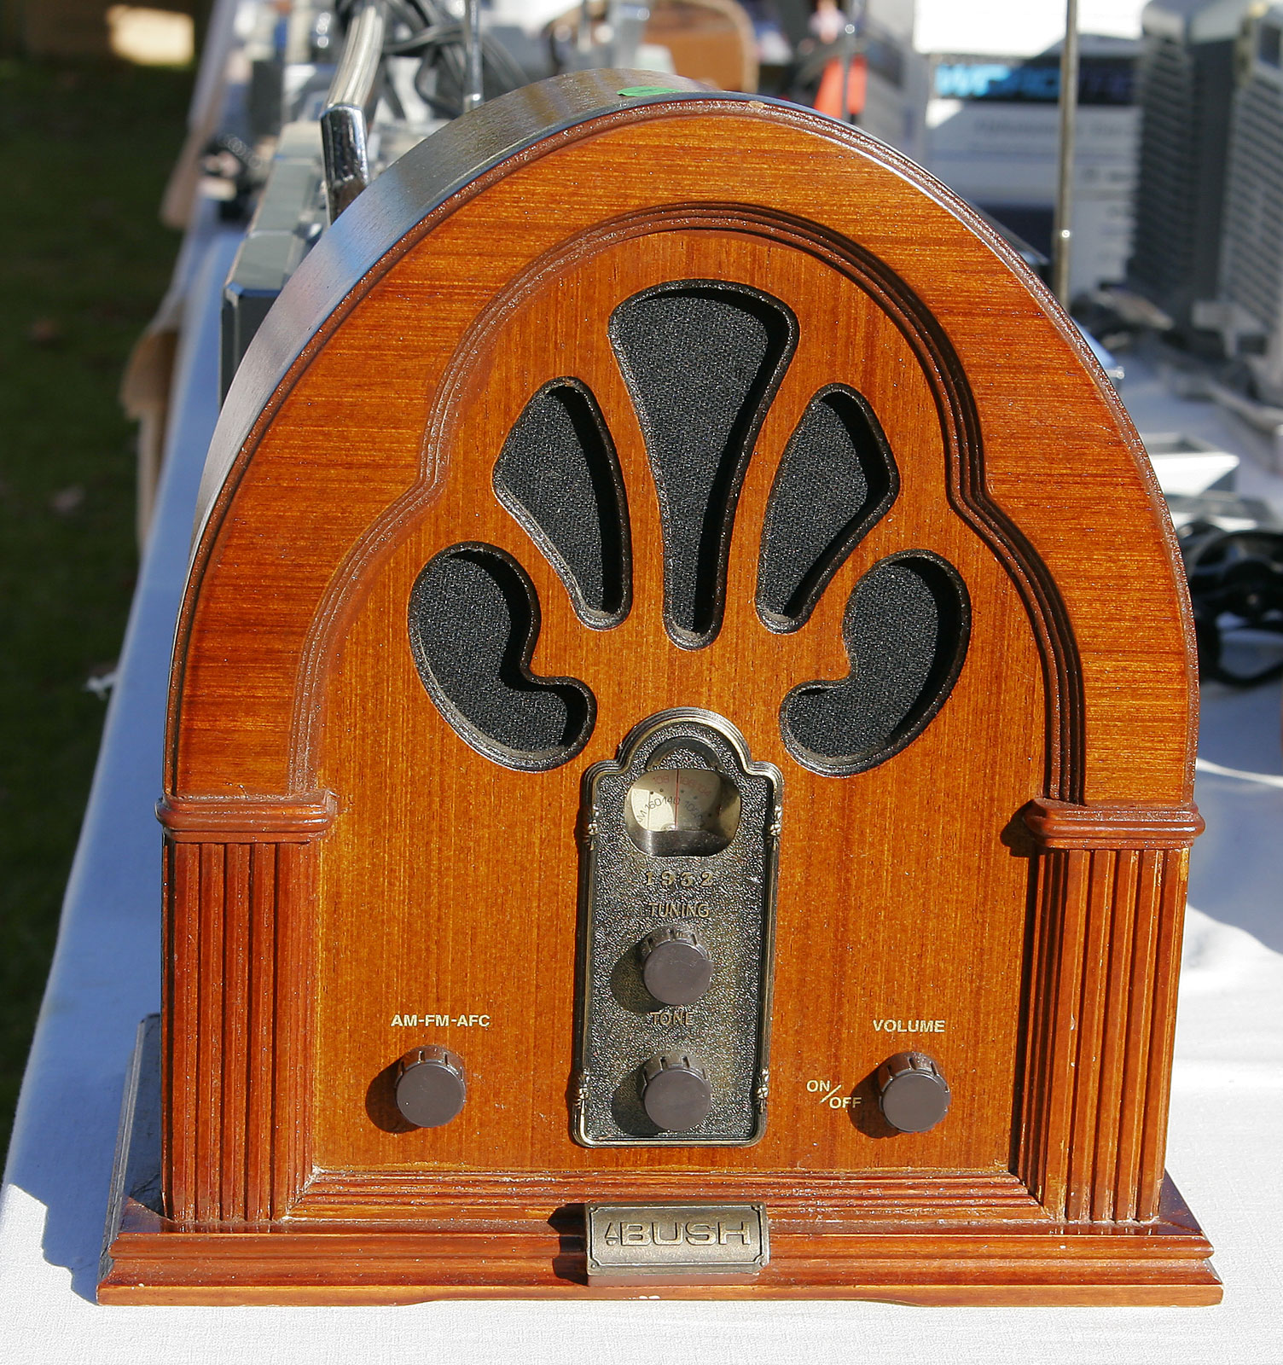
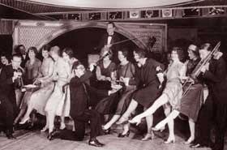
1920s Economic Changes: Ford & Conservatives in Economic Boom
Economic Boom: widespread construction jobs; new technologies; high demand
2ND Industrial Revolution
New Products & Technology
Radio, refrigerators, vacuums, cars
Assembly Line + Henry Ford
NOT inventor of automobile but of assembly line – makes production easier = more, cheaper cars
Wealthier, in-debt Americans
Installment Payments (credit)
Farming Bankruptcies + Income Inequality
Conservative Presidents & Laissez Fair Capitalism
Warren G. Harding (1920-23)
Calvin Coolidge (1923;1924-8)

Slide 5
1920 Election: Pres. Warren Harding
Warren G. Harding of Ohio: returning America to "Normalcy"
Americans eager to turn inward and evade international issues.; tired of the idealism/sacrifice of Progressive Reforms.
Harding’s conservative economic philosophy (carried out by Coolidge & Hoover)
Conservatives believed role of gov’t was to make business more profitable.
Government’s role should be limited; stay out of business (laissez faire)
Businessmen should run the government as they had experience in management
Rejected federal gov’t programs to help citizens; local communities/charity should be responsible
Less Taxes: for corporations and the wealthy
Premise: high taxes forced investors to invest in tax-exempt securities rather than in factories that provided economic growth. "trickle down" economics”
Smaller net return to the Treasury than moderate taxes. Tax burden shifted to middle-class
High Tariffs: Fordney-McCumber Tariff (1922)
Businessmen feared cheap goods coming from a recovering Europe. Tariff rates pushed from 27% (Underwood Tariff) to about 38.5% (almost as high as the Payne-Aldrich Tariff of 19
Less Regulation:
Harding appointed people to regulate agencies that didn't like regulation
Interstate Commerce Commission dominated by men sympathetic to the managers of railroads.

Slide 6
1. Unequal Income Distribution + Large Debt
Wealthiest 1% of pop owned 60% of national wealth (1920-9)
1929, 70% of families below “good standard of living”
Many workers often earning LESS than before WWI
Families buying goods on credit; by late 20s, credit is running dry = less consuming

Slide 7
2. Farmers and ‘Appearance’ of Prosperity.
Farm bankruptcies in 1920s; 1k in 1920, 5.5k in 1928
Farming Overproduction =lower prices = less profit for farmers which leads to debt which leads to bankruptcies
“Appearance of Prosperity” made people believe economy was strong and would always increase
People made risky economic choices; by late 20s economy was in danger

Slide 8
3. Risky Economic Behavior
1. Banks participated in the stock market
2. Buying on Margin-borrowing money from a broker/bank in order to purchase stock

Slide 9
Stock Market Crashes in 1929

Slide 10
Great Depression is Global

Slide 11
A Bad Economy Means Less Jobs

Slide 12
Families Are Impoverished

Slide 13
Definition of Great Depression
Stock Market, backbone of U.S. Economy, crashed in 1929.
The economic crash depressed (brought down) U.S. economy: companies bankrupted, banks closed, jobs lost, families become poor
Time Span: 1929 to 1939, start of WWII
The Great Depression was an economic depression that eliminated jobs, family incomes and sense of hope.
Most people did not see it coming, though there were a few warning signs

Slide 14
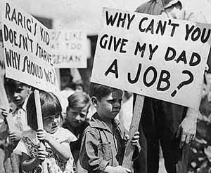

Slide 15
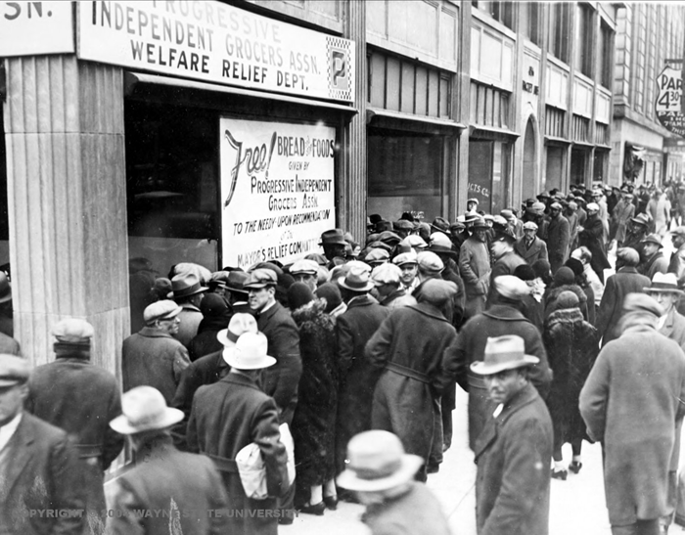

Slide 16
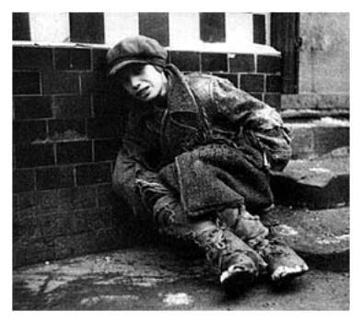

Slide 17
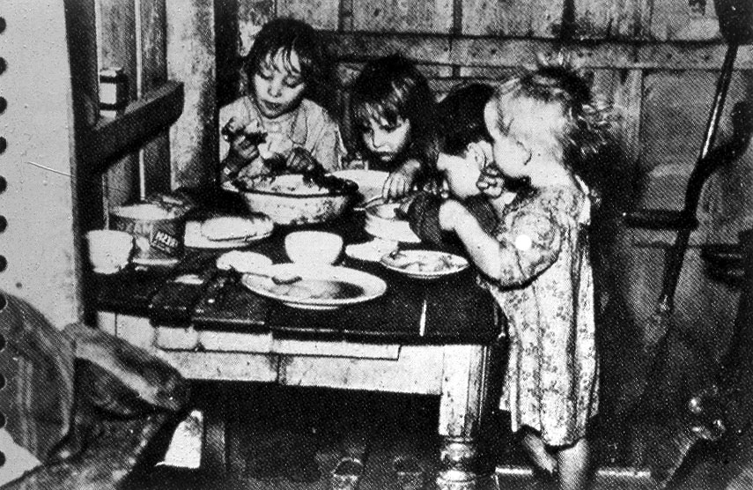

Slide 18
Stock Market on Black Tuesday (October 29, 1929)
Nervous investors began selling stocks because of fear that stocks prices would drop
Collapse of the stock market strained the financial resources of many banks
Banks didn’t have money to lend to industries
Consumers spent less=companies laid off workers=unemployed had less $ to spend
People lost their savings = less consumption = more unemployment
Farmers began to lose money on their products = Farmers unable to pay loans on their property (bankrupt or foreclosure)
Following the Stock Market
1) increase in unemployment
2) drop in economic activity (less buying) = another round of lay-offs/bankruptcies
3) bank runs = lost savings
4) poverty/hunger/starvation (soup kitchens)
5) families lost their homes
6) Hoovervilles= neighborhoods of shacks to house the homeless

Slide 19
Development of the GD: 1929 -30s
Bankruptcies & Bank Runs
In 1920s, US banks lent money for “buying on the margin”
With Black Tuesday, many people’s savings were lost
Bank Runs: People rushed to banks to take out their savings – banks never have ALL savings
By mid-thirties, hundreds of banks “failing” – closing doors and savings lost
In Dec. 1930, 350 went out of business because of Bank Runs
More people lose their savings, and consume less = more economic depression
Without savings and an economic depression, more jobs are cut, which = higher unemployment, etc.
Unemployment & Hoovervilles
Lost capital = bankrupt business = increasing unemployment rate
Under 5% in 1929; 9% in 1930; 25% in 1933 → no work = no buying = more economic depression
People couldn’t pay debt/rent; kicked out of homes; many created shanty-towns called Hoovervilles, for the pres

Slide 20
A Bad Economy Means Less Jobs

Slide 21
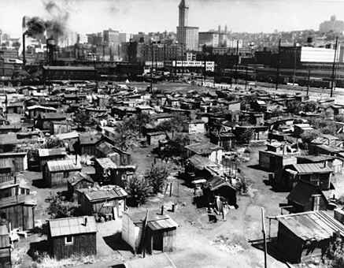

Slide 22
Mexican Americans during GD
Mexicans used for cheap labor in early 1900s.
Once the great depression hit, accused of stealing jobs/depressing wages
Many denied gov’t relief or jobs; some attacked
More than 300,000-1 million Mexicans were Repatriated (“voluntarily” deported to Mexico)
Many deported for being labor organizers

Slide 23
Migrant Farmers from Great Plains
Great Plains (CO, OK, NM, KS) enter severe drought in 1931, lasted for several years
Farmers had been careless – land was bare; previously covered with grasses.
DUST BOWL: When wind storms hit area, the soil was lifted and caused dust storms – destroyed land, crops and houses
Farmers migrated to CA and competed with Mexicans for agricultural jobs; White Californians called migrants “Okies” – subject of Grapes of Wrath

Slide 24
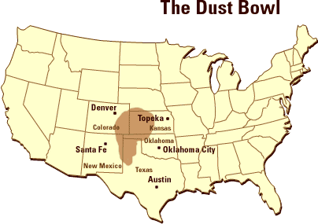

Slide 25
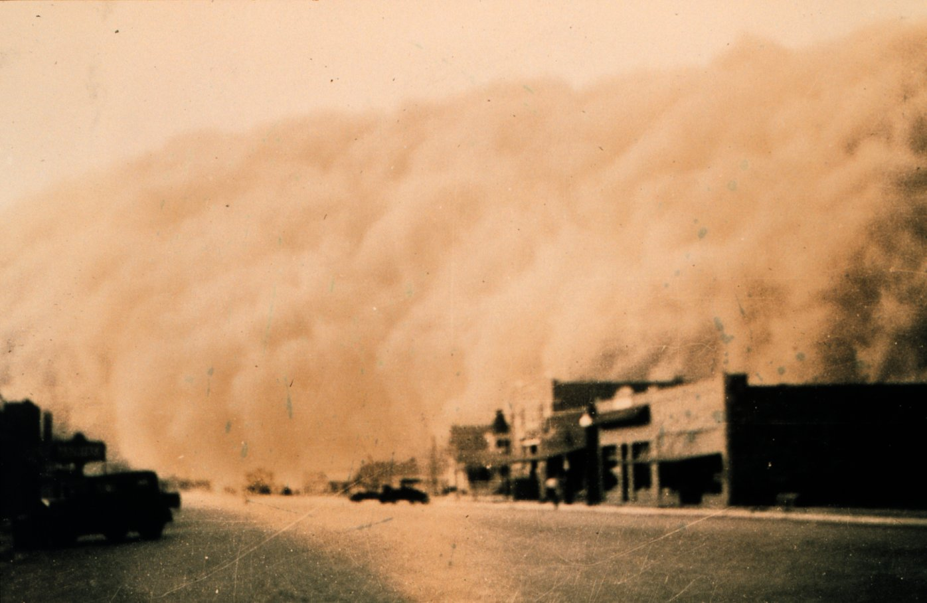

Slide 26
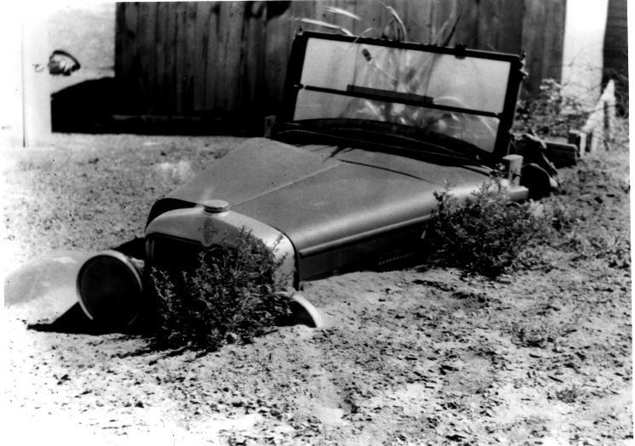
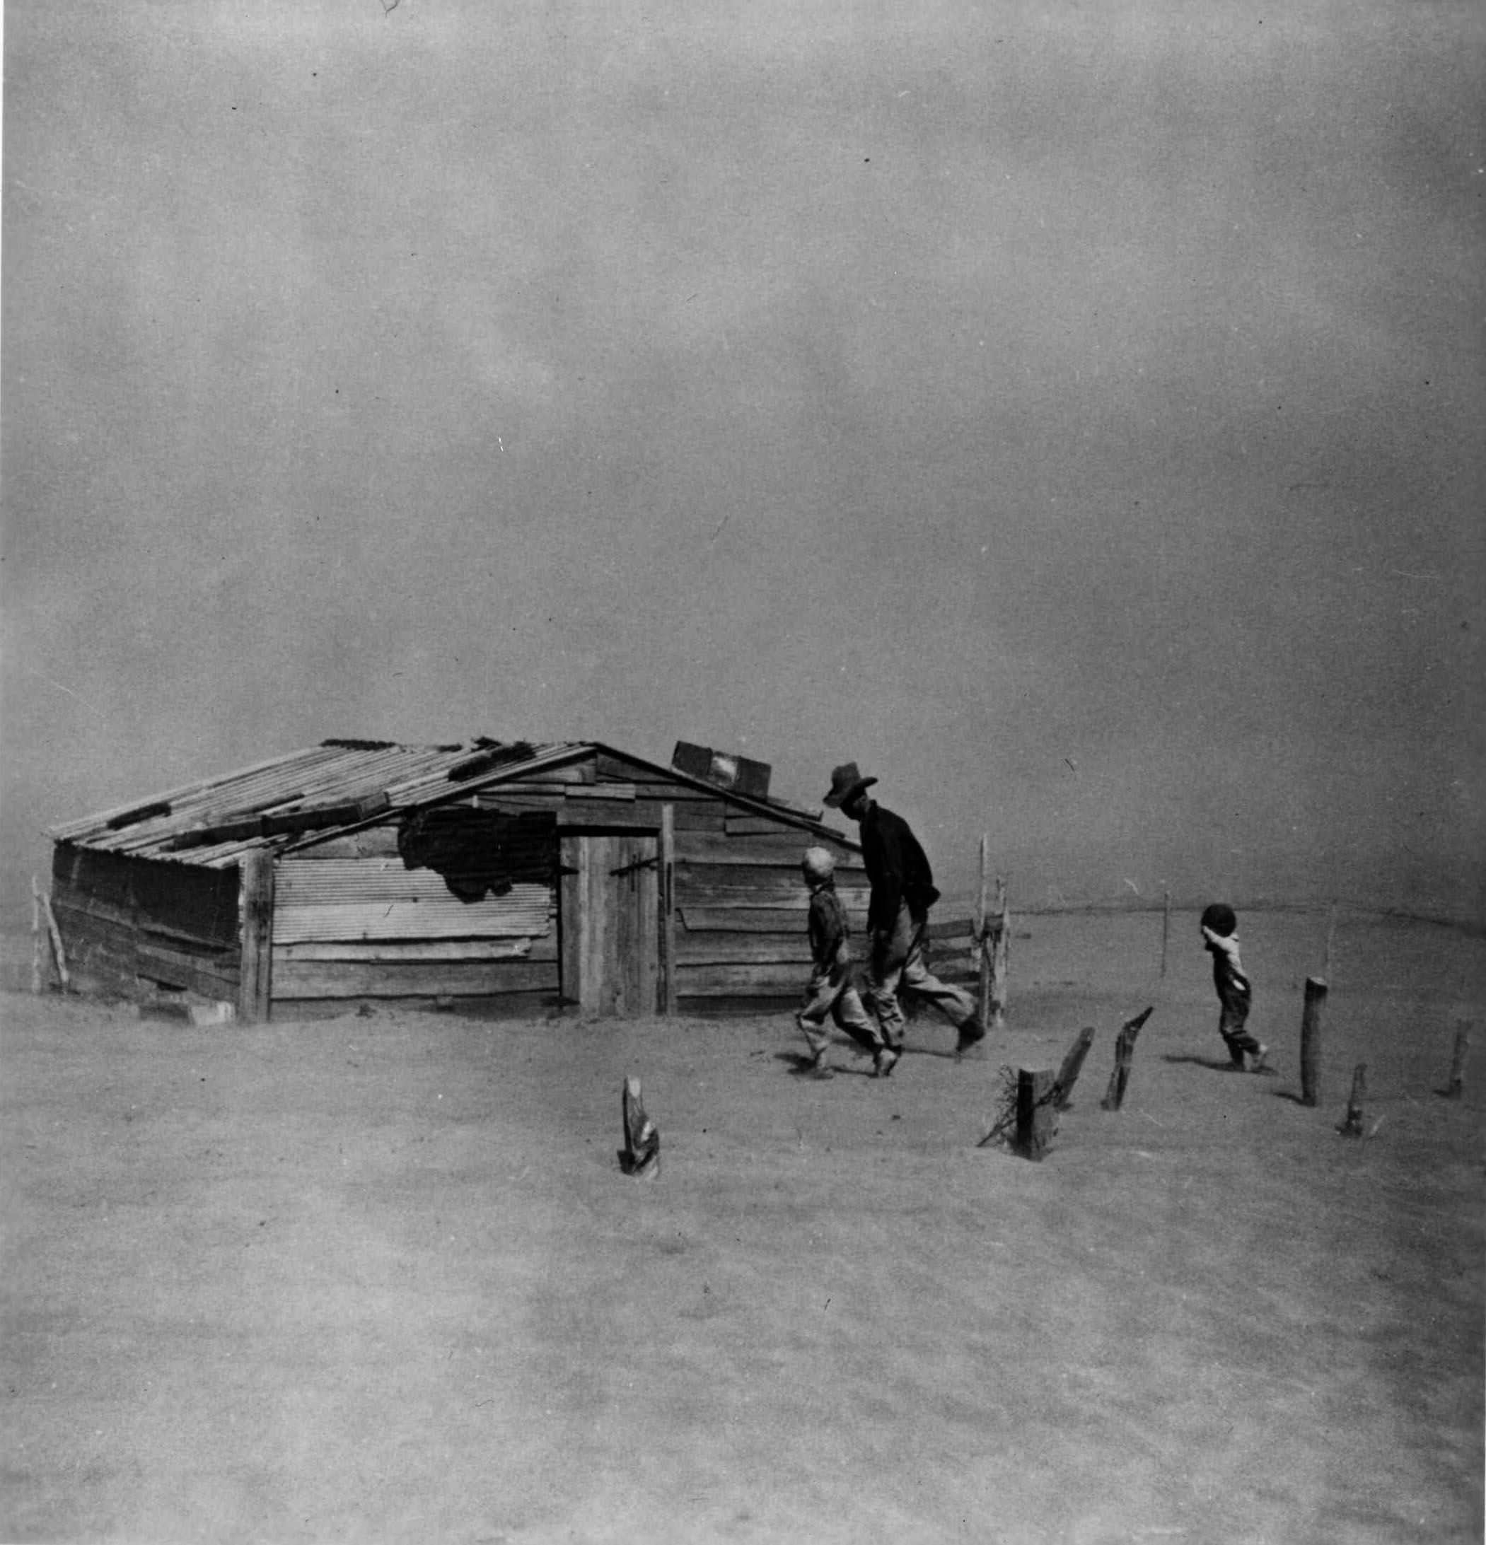

Slide 27
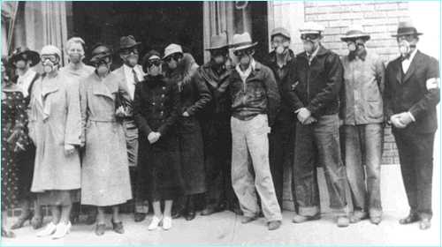
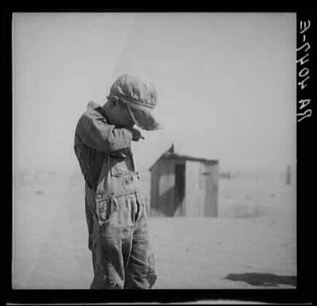
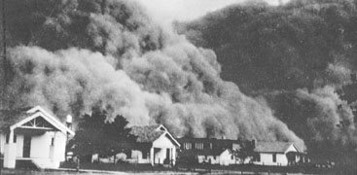

Slide 28
STOCK MARKET SIMULATION
Every investor has $100 in the Stock Market.
Each company share costs (initially) $5.
So, every investor has 20 shares in their first company (your group table).
The idea behind investment is to BUY when prices are LOW and SELL when prices are HIGH.

Slide 29
Scenario 1
Computer Chip Company creates the fastest computer chip available and will start selling it to computer companies soon.
A war breaks out between two countries, and both countries buy weapons from the Military Weapons Company.
A newspaper writes several articles on a major problem in several cars produced by the Car Company.

Slide 30
Scenario 1 Prices
Computer Chip Stock UP to $9
Military Co. Stock UP to $11
Car Co. Stock DOWN to $4

Slide 31
Scenario 2
Other companies develop computer chips as quickly as those produced by the Computer Chip Company
The war continues, and the countries keep buying weapons from the Military Weapons Company.
The Car Company redesigns the faulty cars with much better cars

Slide 32
Scenario 2 Prices
Computer Chip Stock DOWN to $7
Military Co. Stock UP to $14
Car Co. Stock UP to $6

Slide 33
Scenario 3
The Computer Chip Company creates another, faster chip. But people are not buying computers.
The war ends and both countries sign an treaty that says they will stop buying weapons from the Military Weapons Co.
The Car Company gets an award for best car of the year.

Slide 34
Scenario 3 Prices
Computer Chip Stock DOWN to $6
Military Co. Stock DOWN to $8
Car Co. Stock UP to $8.50

Slide 35
Review Causes
Economic Weaknesses
Unequal Distribution of Wealth
Consumption on Credit, which runs out in late 1920s
Farm overproduction/bankruptcies
Factory overproduction
Risky Economic Behavior – Appearance of Prosperity
Buying on the Margin
Banks Participating in Stock Market
Stock Market Crash (Black Tuesday)-drop in value by $16 billion

