Slide 1
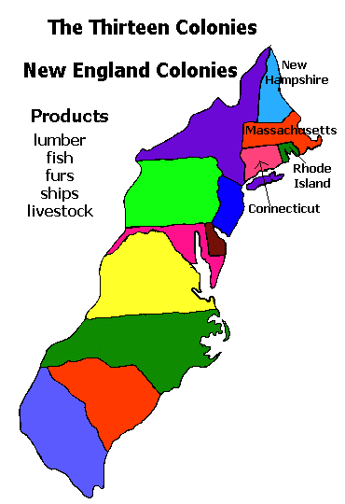
NEW ENGLAND COLONIES

Slide 2
Essential Questions
Describe the economic, social and political characteristics of the New England colonies.

Slide 3
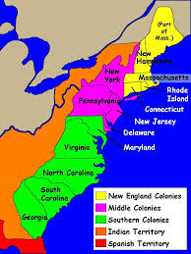
Religious Motives for colonization, male & female settlers, tight knit communities, mixed economy
Compare & contrast with Chesapeake region

Slide 4
Plymouth Colony
Protestant Reformation sparked dramatic changes in Europe and lead to rise of Puritanism
Puritans wanted to purify the church
Pilgrims: Separatists who wanted to break away from the Anglican church
Pilgrim’s sough to establish a colony: Land at Plymouth
Mayflower Compact signed prior to arrival : agreement established a basic government based upon majority rule
Established basis for self government
Governor William Bradford
Local native leader Squanto helped the colony survive in its early years

Slide 5
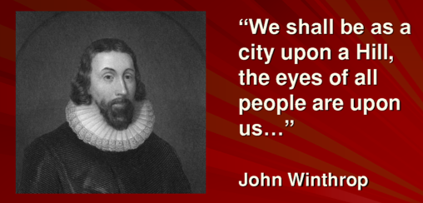
Massachusetts Bay Colony
In 1629 Puritan John Winthrop received a charter to est. the Massachusetts Bay Colony
Goal: Wanted to be as a “City Upon a Hill”
Religion was extremely important in the New England colonies-education (Harvard)
Religious freedom was reserved ONLY for Puritans
Church membership was a requirement for participation in politics
Town Hall Meeting became an important part of direct democracy in colonial America (all church going males could participate)
Economy: mixed economy

Slide 6
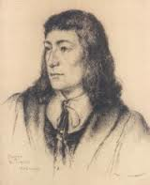
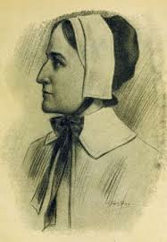
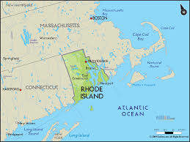
Religious Dissent
Roger Williams questioned Puritan Leadership
Called for complete separation of church and state and criticized the colonies treatment of Native Americans
Banished from the colony
Founded Providence, Rhode Island
1st colony with complete religious freedom
Anne Hutchinson challenged the accept role of women within the church by openly speaking out against church leaders

Slide 7
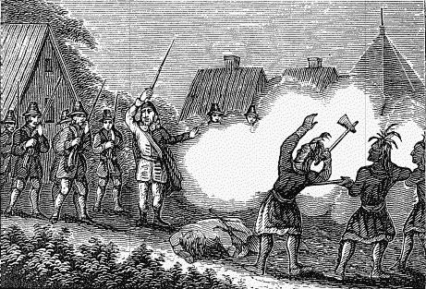
Conflict with Native Americans
Pequot War (1630s): New England colonist wipe out Pequot tribe
New England Confederation (1643): military alliance intended to defend the NE colonies against potential threaths
King Philip’s/Metacom’s War (1675-76): leader of the Wampanoags defeated by colonists
End of major Native resistance to the New England colonies.

Slide 8
Middle Colonies: Breadbasket
New York was originally a Dutch colony called New Amsterdam
Charles II sends a military expedition and grants area to his brother James the Duke of York (1664)
Pennsylvania (1681) founded by William Penn as refuge for Quakers (“Holy Experiment”)
Very liberal colony-representative assembly
Treated Native Americans fairly
Religious toleration & freedom
Extended rights to women
Demographically, religiously, & ethnically diverse
Economics: wheat, corn (“breakbasket”), trade, etc.

Slide 9
Colonial Policy
Mercantilism: colonies to enrich the mother country
Salutary neglect
Navigations Acts: 1) trade carried only in English or colonial ships 2) trade had to pass through English ports 3) certain enumerated goods from the colonies could be exported only to England (tobacco, etc.)
Smuggling was a problem
Dominion of New England (1686): implemented to increase royal control over the colonies
Sir Edmund Andros appointed by the king
Very unpopular: enforced the Navigation Acts, limited town meeting, etc.
Ends with Glorious Revolution in 1688

Slide 10
Essential Questions
Describe the economic, social and political characteristics of the New England colonies.

