Slide 1
APUSH Period 4
1800-1848

Slide 2
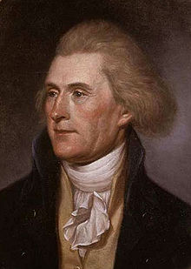
Jeffersonian Republic

Slide 5
“Revolution of 1800”
Significance
Jefferson called it a “Revolution”
A return to the “Spirit of 76” and true republican government
Revolutionary in that it was a peaceful transition of power from one party to the next
John Adams is the last Federalist president

Slide 6
12th Amendment (1804)
In response to Election of 1800
Electors must vote for one presidential candidate AND one vice president
Ensures that president and vice president will be from the SAME political party

Slide 7
Reversal of Federalist Policies
Pardoned editors convicted under Sedition Act
New naturalization law (1802) - return to 5 year requirement for citizenship
Repealed Hamilton’s excise taxes
Reduced the national debt
Reduced the standing army
Ended graduated property tax
Emphasized state’s rights
Encouraged development of agrarian nation
Appointed Democratic-Republicans to office

Slide 8
Kept Many Federalist Ideas
Retained most Federalist employees
Kept most of Hamilton’s financial plan
Funding at par
Assumption of state debts
Bank of the US
Protective tariff (raised later)

Slide 9
Judiciary Act 1801
Last ditch effort by Federalists
Created 16 new judge positions
“Midnight Judges”
Filled by Adams on his last day in office
Repealed in 1802

Slide 10
John Marshall
Most important Chief Justice in history
34 years on Supreme Court
Continued Federalist legacy long after the party died out
Decisions greatly increased the power of the federal government

Slide 11
Marbury v. Madison (1803)
Most important Supreme Court decision in US History
The Case:
“Midnight” judge William Marbury never received his commission.
The Decision:
Ruled that part of the Judiciary Act of 1789 that Marbury was basing his appeal on was unconstitutional by giving the Court the right to enforce appointments.
Gave power to the Supreme Court to review laws of Congress and determine their constitutionality = JUDICIAL REVIEW.

Slide 12
Important Court Cases
Fletcher v. Peck, 1810
McCulloch v. Maryland
Gibbons v. Ogden
Dartmouth College v. Woodward
Cohens v. Virginia

Slide 13
Impeachment of Samuel Chase
The Case:
Congressional Republicans wanted to remove Federalist judge Samuel Chase.
In 1804 House of Representatives brought impeachment charges against him
Senate failed to convict
Significance: No further attempts occurred to reshape the court by impeachment = reassured the independence of the judiciary and separation of powers in government!

Slide 14
Martin v. Hunter’s Lessee 1816
The Case:
Virginia sought to disregard Treaty of Paris (1783) and Jay’s Treaty provisions regarding confiscation of Loyalist property
The Decision:
Supreme Court rejected state claims that they were equally sovereign with the federal government
The Significance:
Upheld the Supremacy Clause of the Constitution and federal judicial supremacy over the states

Slide 15
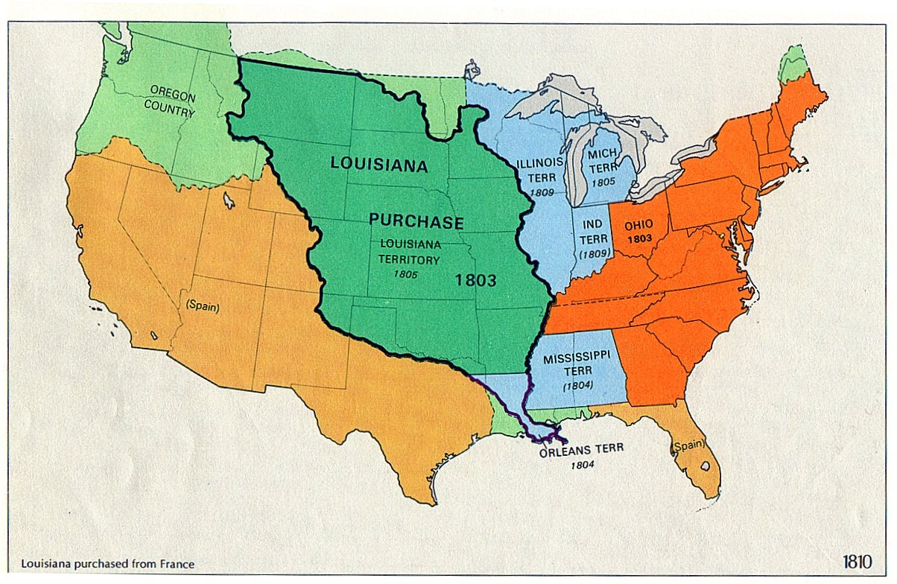
Louisiana Purchase

Slide 17
Federalist Opposition
Used “strict construction” - president did not have power to purchase Louisiana.
Why? It would cost too much and cause the U.S. debt to soar. IRONY!!!
Real reason: worried that new western lands would be loyal to the Republicans.

Slide 18
Problems with Britain & France
Napoleonic Wars
British Impressment
Chesapeake Leopard Affair

Slide 19
Embargo Act 1807
Forbade export of all good from the US to any destination!
Proved disastrous to the economy
In 1807 U.S. exports = $108 million ; in 1808 = $22 million
Inadvertently sparked American industrialization!
Why did it fail?

Slide 20
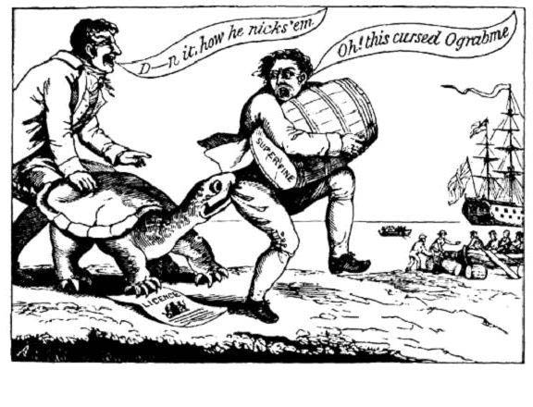
Federalist Opposition

Slide 21
Jefferson’s Legacy
Expansion
Non-aristocratic government created
Total defeat of the Federalists by 1816
Kept US out of war

Slide 22
Mnemonic Device
Jefferson was at the HELM
H - Hamilton’s Plan
E - Embargo Act
L - Louisiana Purchase
M - Marbury v Madison

Slide 23
James Madison’s Administration

Slide 24
Madison’s Presidency
Virginia Dynasty
Macon’s Bill No 2
War Hawks
Battle of Tippecanoe
Invasion of Canada

Slide 25
War of 1812
Why did US fight Britain when France had also assaulted American ships?

Slide 26
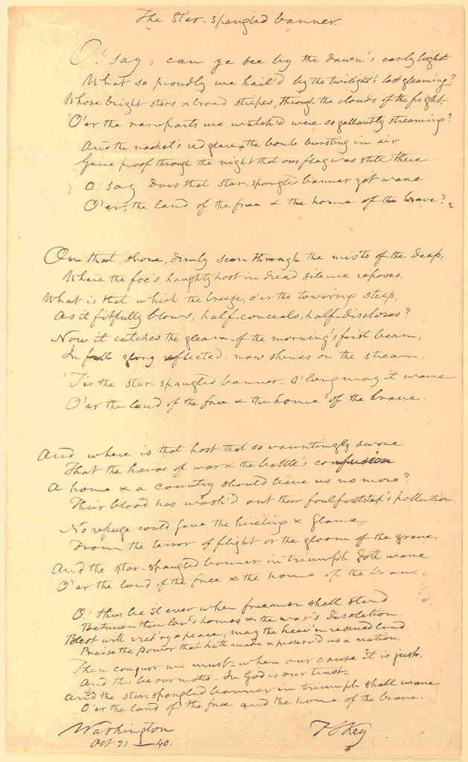
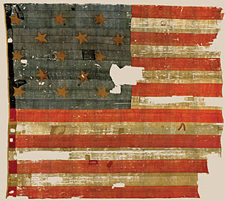

Slide 27
2014 British Tweet - Oops!

Slide 28
End of the War
Treaty of Ghent
Amerindians
Industry
Andrew Jackson
Battle of New Orleans

Slide 29
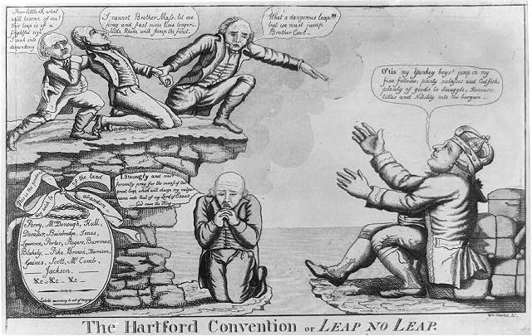
Federalist Opposition
Contemplating the possibility of secession over the War of 1812 (fueled in large part by economic interests of New England merchants), the Hartford Convention posed the possibility of disaster for the still young United States. England, represented by the figure John Bull on the right side, is shown in this political cartoon with arms open to accept New England back into its empire. William Charles, Jr., “The Hartford Convention or Leap No Leap.” Wikimedia, http://en.wikipedia.org/wiki/File:TheHartfordConventionOrLeapNoLeap.jpg.

Slide 30
Death of the Federalists
Hartford Convention
Recommended Amendments

Slide 31
Memory Aid
The War of 1812 can WHITEN your teeth
W = War Hawks
H = Hartford Convention 1814
I = Impressment
T = Treaty of Ghent, 1815
E = Embargo Act, 1807
N = New Orleans

Slide 32
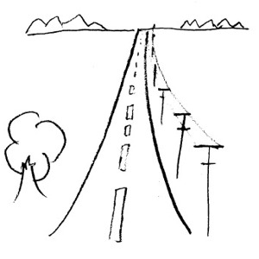
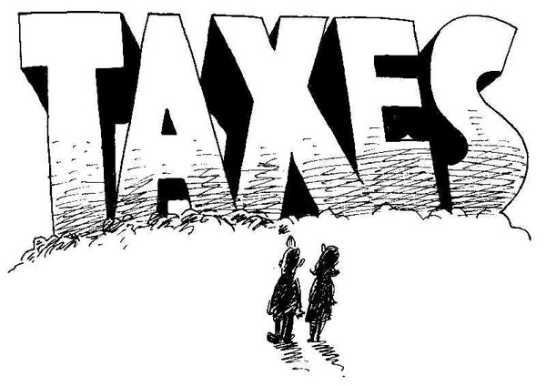
Henry Clay’s American System
B = Bank of the US
I = Internal Improvements
T = Tariff of 1816

Slide 33
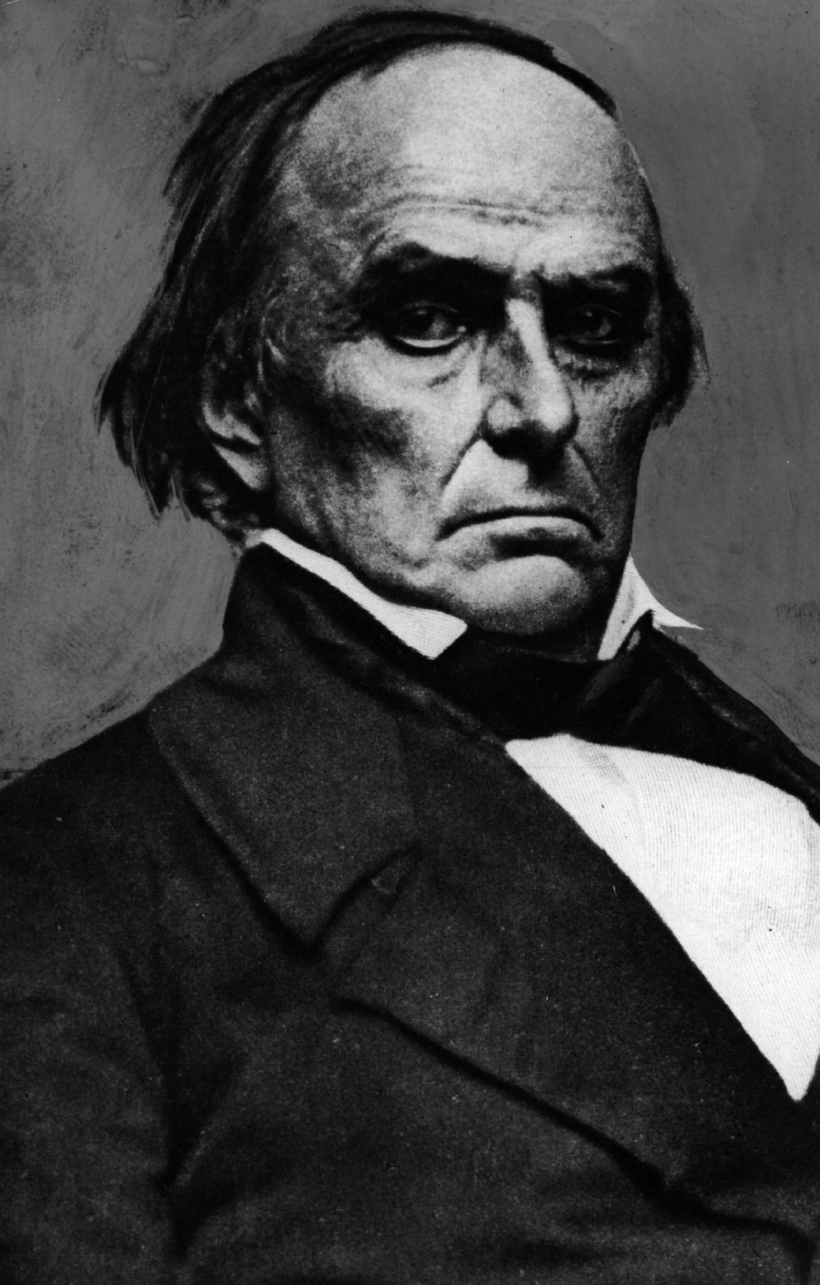
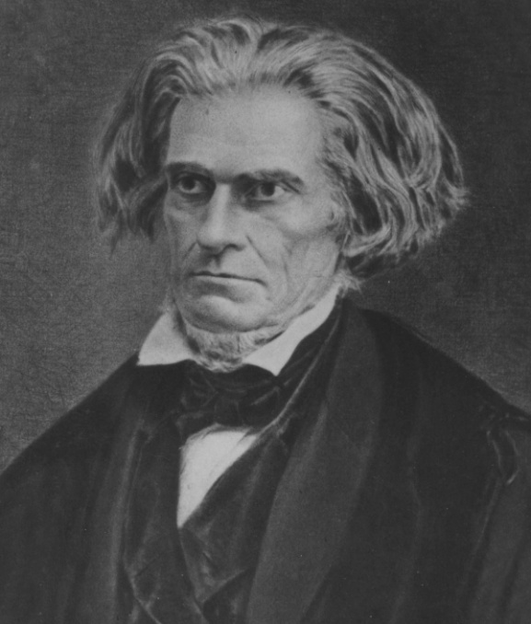
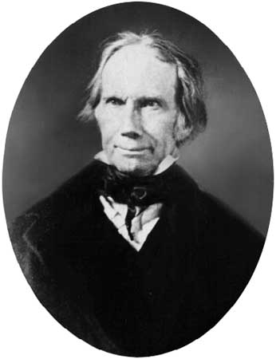
Tariff of 1816
Purpose: protect US manufacturing from British competition.
First protective tariff in US history.
20-25% duties on imports
Created sectional tension between 3 regions
North
opposed – feared it would damage shipping industry
Rep. by Daniel Webster (MA)
South
Originally supported, then opposed fearing it enriched New England at expense of South
Rep. by John C. Calhoun (SC)
West
In favor as it would fund needed roads and canals linking west to east
Rep by Henry Clay (KY)

Slide 34
Tariff of 1816
Historical Context
About the Tariff
1st protective tariff in US history
Effects
Sectionalism
North
South
West
Synthesis

Slide 35
The Era of Good Feelings
1817-1825

Slide 36
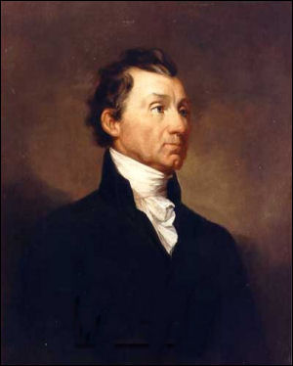
James Monroe
Continuation of “Virginia Dynasty” (4th)
Presidency dubbed the “Era of Good Feelings”
Only one party because the Federalists no longer exist

Slide 37
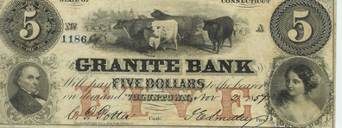
Panic of 1819
1st since 1790s and would reoccur every 20+ years (1837, 1857, 1873, 1893, 1907, 1929)
Causes
Overspeculation
Inflation
Negative Balance of Trade
“Wildcat Banks”

Slide 38
Tallmadge Amendment
MO asked to enter union in 1819
James Tallmadge introduced amendment on MO statehood
No more slaves could be brought to MO.
Gradual emancipation of children born to slave parents already there.
South viewed this as serious threat to sectional balance.

Slide 39
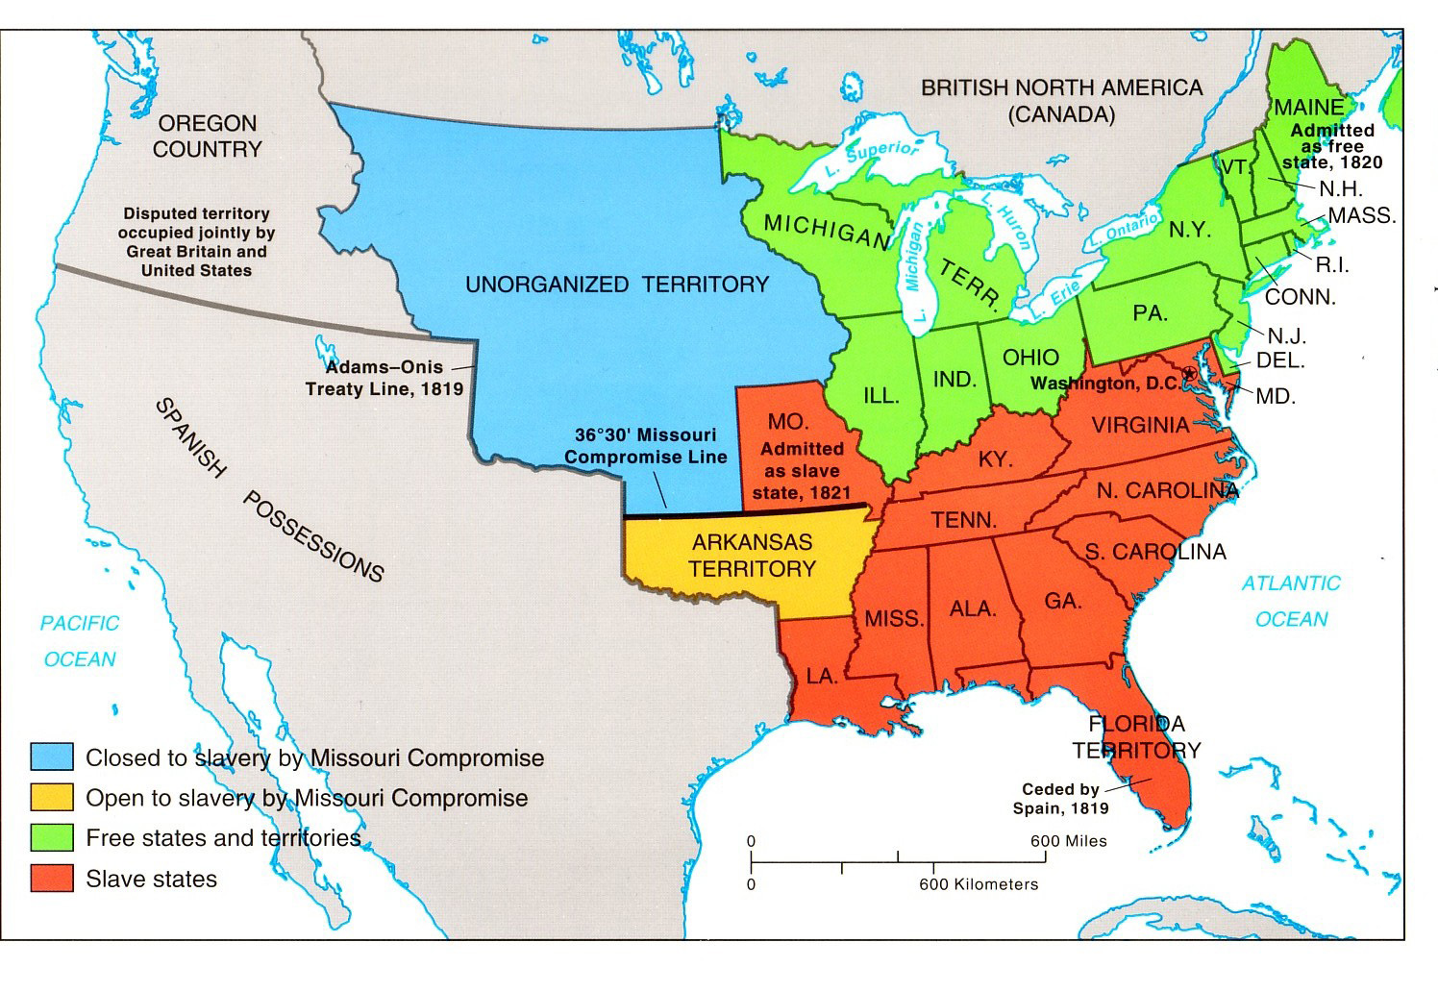
Missouri Compromise

Slide 40
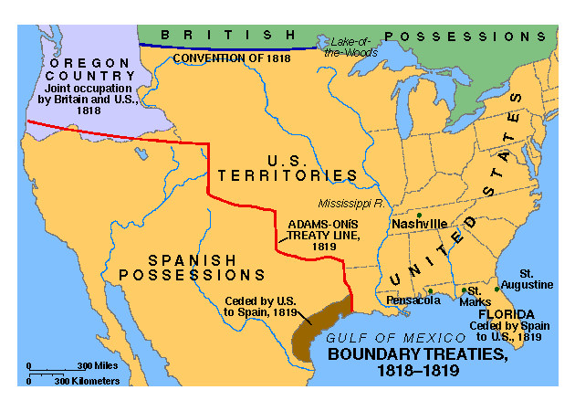
Foreign Policy
Rush Bagot Treaty
Treaty of 1818
Adams Onis Treaty

Slide 41
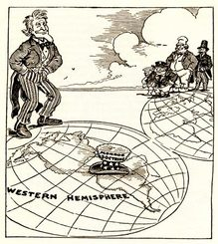
Monroe Doctrine
Historical Context
“No new colonies”
Synthesis
Theodore Roosevelt’s Corollary
20th Century

Slide 42
Growth of Nationalism
Victories of War of 1812
Death of Federalist Party
Decline in economic/political dependence on Europe
Westward Expansion
See themselves as Americans then state citizens

Slide 43
Was it the Era of Good Feelings?
One Party - Federalists Defeated
Nationalism
Panic of 1819
Missouri Compromise
Corrupt Bargain
American System
Boundary Disputes are Settled
Tariff of 1816
Sectionalism

Slide 44
Age of Jackson

Slide 45
Political
New Democracy
New Political Age
Election of 1824 - Corrupt Bargain
Election of 1828
President Jackson - Old Hickory
Spoils System
Kitchen Cabinet
Election of 1832
Election of 1836
Election of 1840

Slide 46
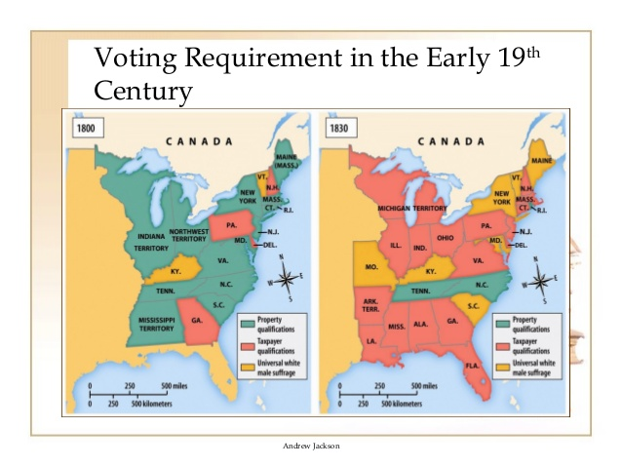
Expansion of Democracy

Slide 47
Economic
Tariff of 1824
Tariff of 1828 - Tariff of Abominations
Webster - Hayne Debate
Tariff of 1832
Tariff of 1833
Force Bill
Jacksonian Economic Policy
End of the Bank of the US
Pet Banks and the Specie Circular
General Incorporation Laws

Slide 48
Economics Continued
Charles River Bridge Decision
Maysville Road Veto
Panic of 1837
Treasury Bill of 1840 “Divorce Bill”

Slide 49
Social
Indian Removal Act 1830
Cherokee Nation v. Georgia 1831
Worcester v. Georgia 1832
Trail of Tears
Black Hawk War
Second Seminole War

Slide 50
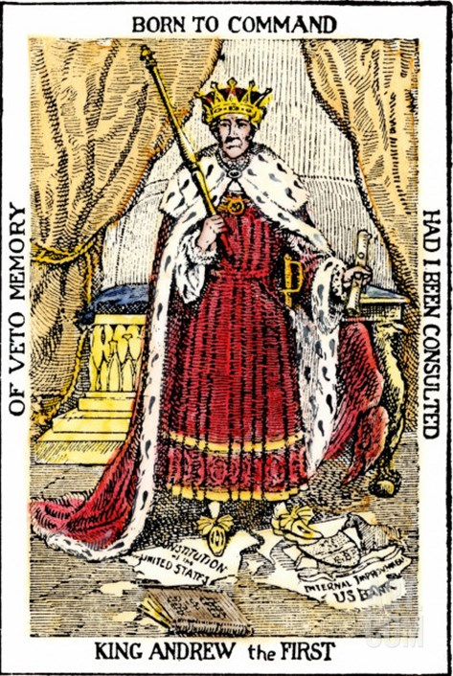

Slide 51
Mnemonic Device
“New KNICKSS”
New Democracy
Killing the Bank of the US
Nullification Crisis 1832
Indian Removal
Creation of two party system
Kitchen Cabinet
Spoils System
Sectionalism

Slide 52
Reform Movements

Slide 53
Second Great Awakening
75% of Americans attended church regularly
Liberal thinking challenged traditional views
Deism
Unitarianism
Revivalism - “camp meetings”
Peter Cartwright
Charles Grandison Finney
“Burned Over District”
Mormons
Impact

Slide 54
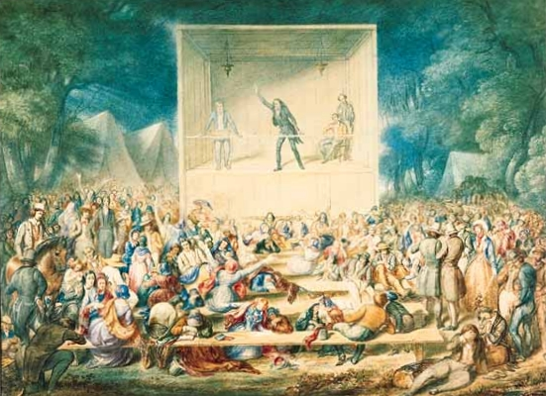
Camp Meeting

Slide 55
Utopian Communities
New Harmony
Brook Farm
Oneida Community
Shakers
Amana Community

Slide 56
Temperance
American Temperance Society
Maine Law of 1851
Neal S. Dow
Results

Slide 57
Women’s Rights
Impact of Industrial Revolution
Republican Motherhood
Cult of Domesticity
Elizabeth Cady Stanton
Lucretia Mott
Susan B. Anthony
Angelina and Sarah Grimke
Lucy Stone
Seneca Falls Convention
Gains for Women

Slide 58
Education
Horace Mann
Noah Webster
William H McGuffey
Higher Education

Slide 59
Other Reforms
Dorothea Dix
Prison Reforms

Slide 60
Changing American Family
Women increasingly challenged inferior status
Cult of Domesticity
Catherine Beecher
Changes in Family

Slide 61
Market Revolution

Slide 62
Demographic Changes
By 1860, 33 states
Population doubled every 25 years
13% were foreign born
43 cities with 20,000+ inhabitants

Slide 63
What was the Market Revolution?
1800-1840s
Gradual transformation:
People living in rural areas and working as farmers to living in cities,working in factories and buying goods.

Slide 64
Market Revolution Areas of Change
Industrial Revolution
Transportation Revolution
Change - Subsistence to Cash Crop Farming
Creation of national market economy
Regional Specialization
Immigration
Westward Movement
Growth of Cities

Slide 65
Memory Aids
1st Industrial Revolution (1814-1860) - TRIC - Textiles, Railroads, Iron, Coal
2nd Industrial Revolution (Post Civil War) - ROSE - Railroads, Oil, Steel, Electricity

Slide 66
Early Industrialization
In 1815, 65% of all U.S. clothing was made by women at home in the “putting out” system
By 1840, textile manufacturing grew, especially in New England, due to a series of new inventions
Notes:
*

Slide 67
Industrial Revolution
Inventions and Innovations
Samuel Slater - Spinning Jenny
Eli Whitney - Cotton Gin (1793), Interchangeable Parts
Elias Howe - Sewing Machine (improved by Isaac Singer)
Samuel Morse - Telegraph
Charles Goodyear - Vulcanized Rubber
28,000 patents in the 1850s compared to 306 in the 1790s!

Slide 68
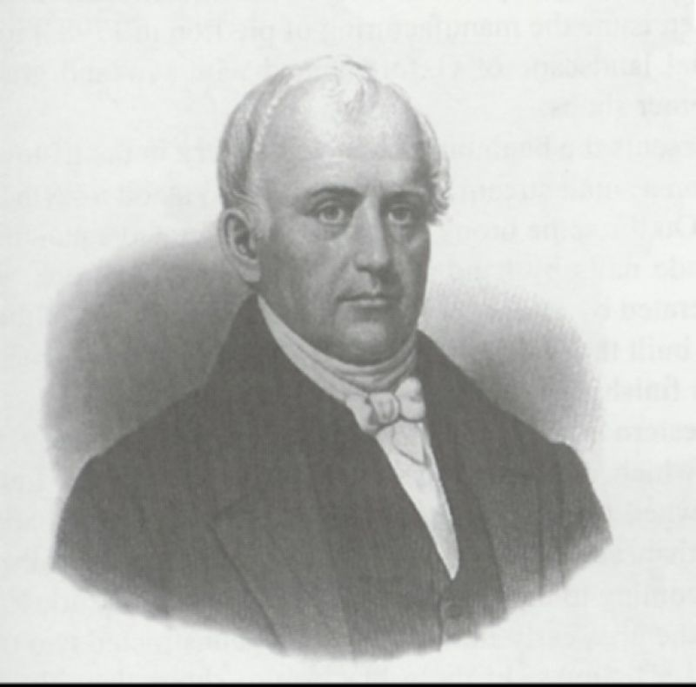
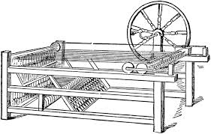
Samuel Slater (“Father of the Factory System”)
Spinning Jenny
Notes:
*

Slide 69
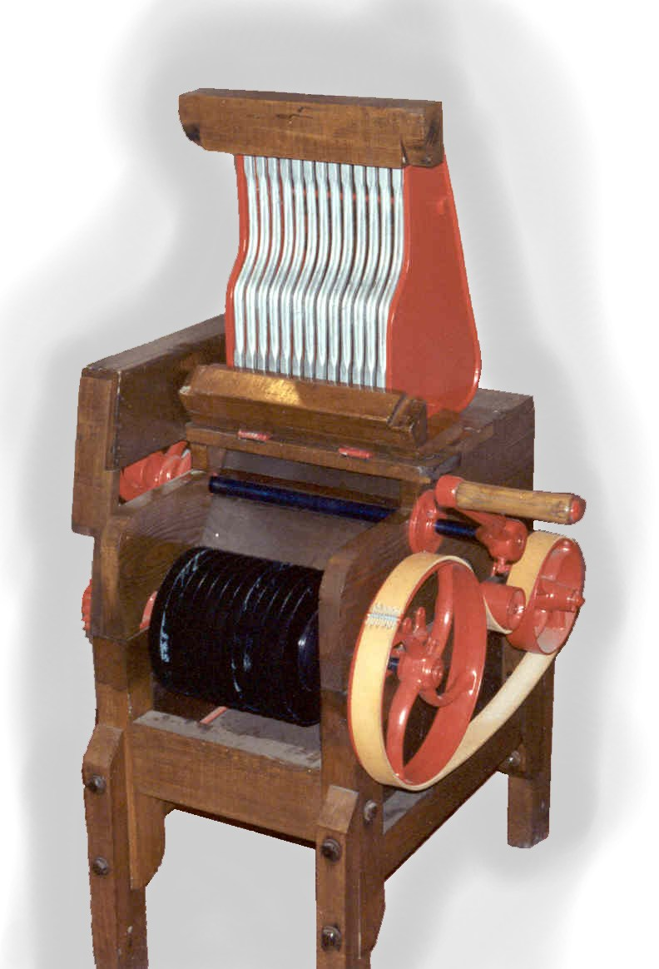
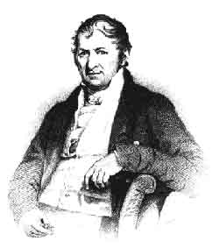
Eli Whitney’s Cotton Gin, 1793
Notes:
*

Slide 70
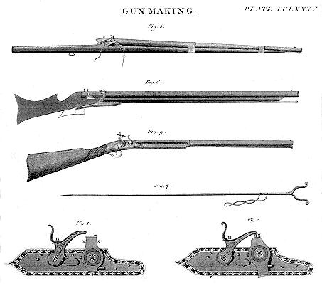
Eli Whitney’s Other Critical Invention
Introduced Interchangeable Rifle Parts

Slide 71
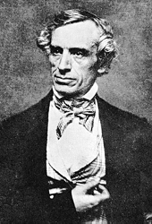
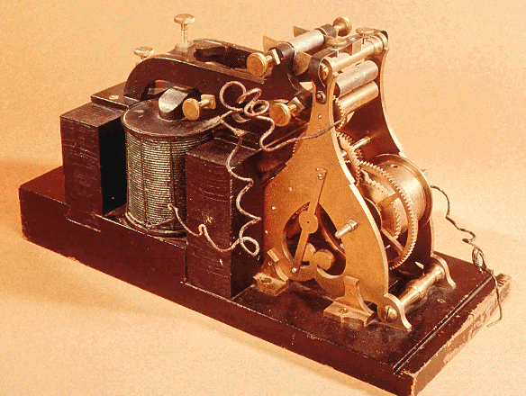
Samuel F. B. Morse
1840 – Telegraph
Notes:
*

Slide 72
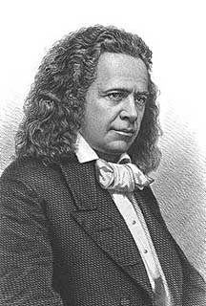
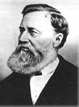
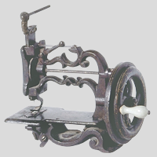
Elias Howe & Isaac Singer
1840s Sewing Machine
Notes:
*

Slide 73
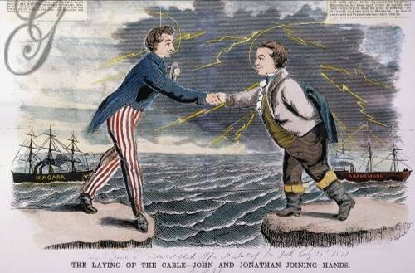
Cyrus Field’s Transatlantic Cable, 1858

Slide 74
Lowell System
Embargo Act (1807) decreased imports
1814 - Francis Cabot Lowell - 1st dual purpose textile plant in Waltham, MA
Significance - work moved from the home to the factory
1823 new plant built in Lowell, MA
Lowell Girls

Slide 75
The Lowell/Waltham System: First Dual-Purpose Textile Plant
Francis Cabot Lowell’s town - 1814
Notes:
*

Slide 77
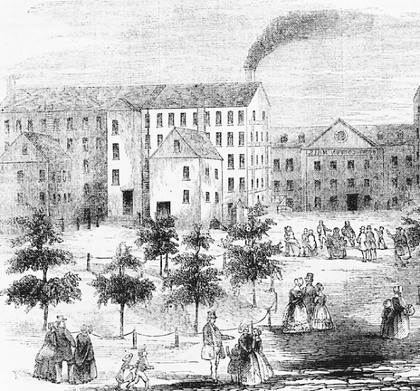
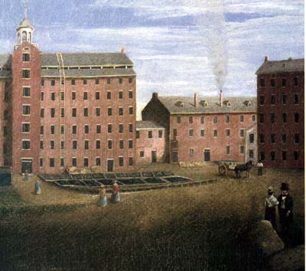
Lowell Mill
Notes:
*

Slide 78
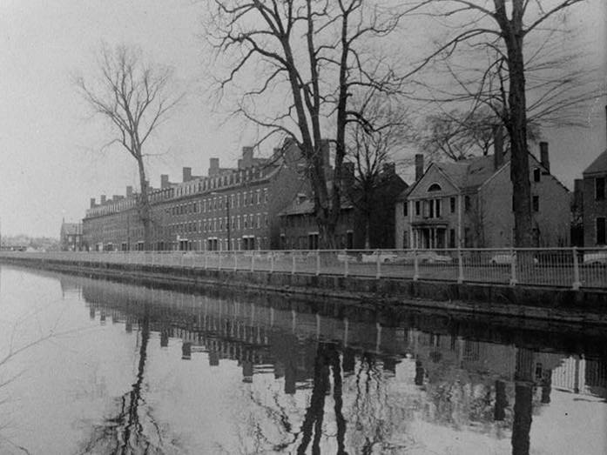
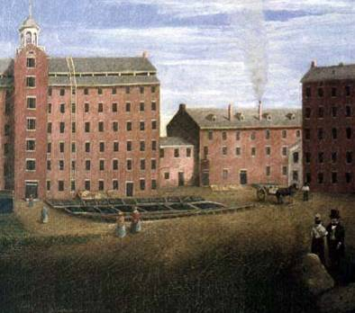
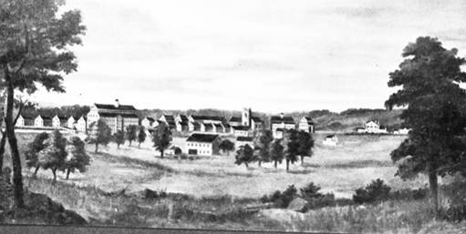
Lowell Boarding Houses
The Lowell System: The 1st Dual-Purpose Textile Plant
Francis Cabot Lowell’s town - 1814

Slide 79
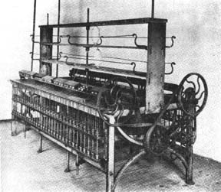
Early Textile Loom
Notes:
*

Slide 80
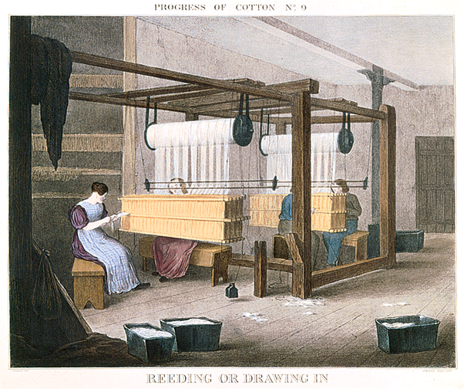
Ch. 9, Image 17
Notes:
Women at work tending machines in the Lowell textile mills.
Give Me Liberty!: An American History, 2nd Edition
Copyright © 2007 W.W. Norton & Company

Slide 81
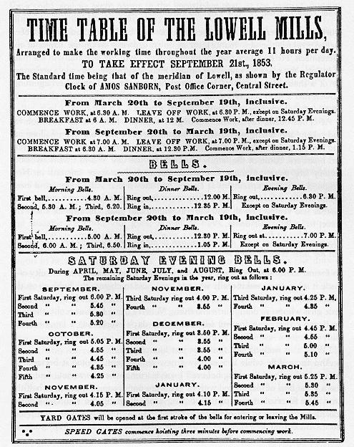
Lowell Mills Time Table
Notes:
*

Slide 82
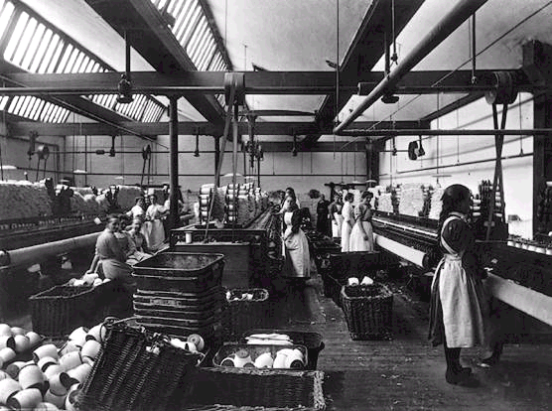
Irish Immigrant Girls at Lowell
Notes:
*

Slide 83
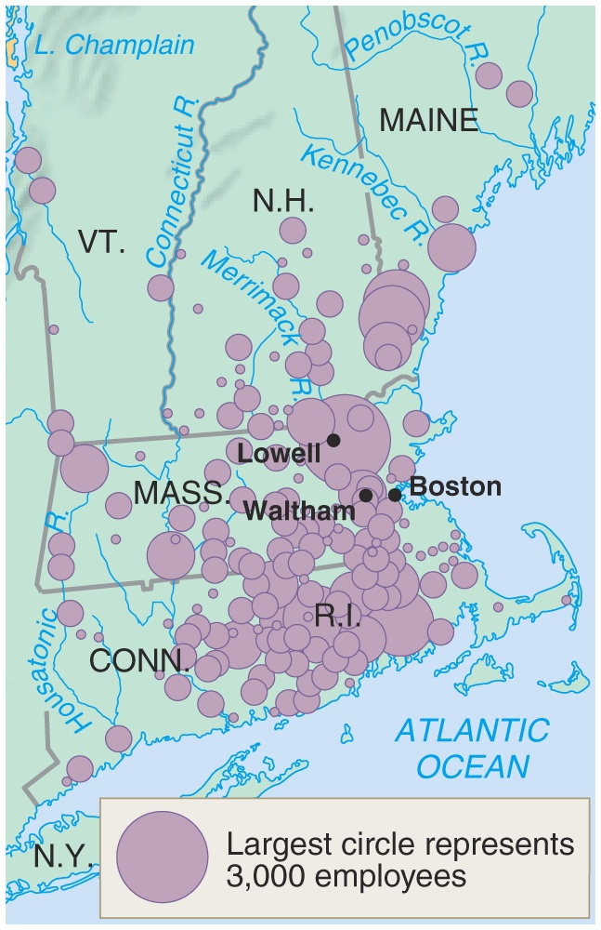
New England Textile Centers: 1830s
Notes:
*

Slide 84
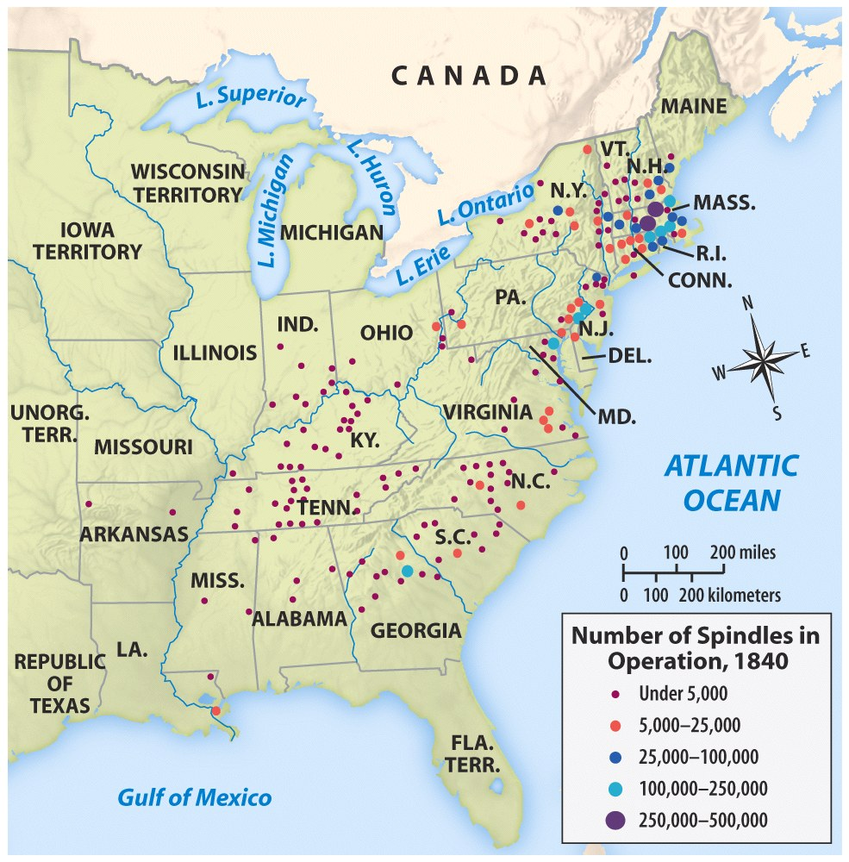
New England Dominance in Textiles
Notes:
*

Slide 85
Why Was New England the Center?
Why Not the South?
Rocky soil
Labor
Shipping
Rivers
Slavery
Poor Consumers

Slide 86
By 1850, industrial output exceeded agricultural output!

Slide 87
Northern Workers
Transformed working conditions
Women and children
Gains for workers
Commonwealth v. Hunt

Slide 88
Western Farmers
Breadbasket
Inventions
John Deere - steel plow
Cyrus McCormick - mechanical reaper
Change from subsistence to cash crop

Slide 89
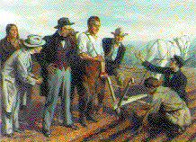
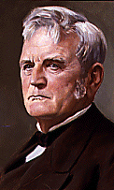
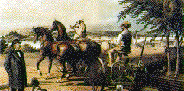
John Deere & the Steel Plow (1837)
Notes:
*

Slide 90
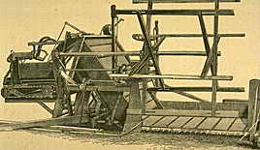
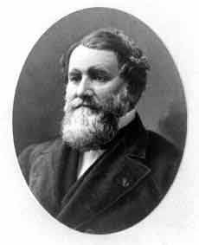
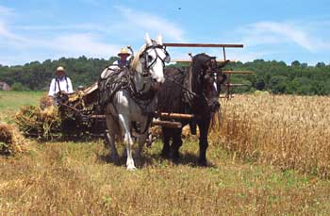
Cyrus McCormick & the Mechanical Reaper: 1831
Notes:
*

Slide 91
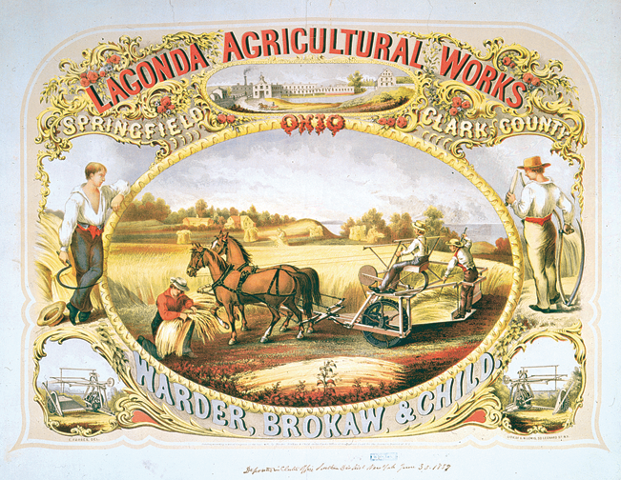
Ch. 9, Image 12
Notes:
Lagonda Agricultural Works, a color lithograph from 1859 advertising an Ohio manufacturer of agricultural machinery, in this case a horse-drawn reaper.
Give Me Liberty!: An American History, 2nd Edition
Copyright © 2007 W.W. Norton & Company

Slide 92
Transportation Revolution

Slide 93
Prime Motive: desire of East to tap the resources of the West
Significance:
National market economy
Regional specialization
Westward Movement

Slide 94
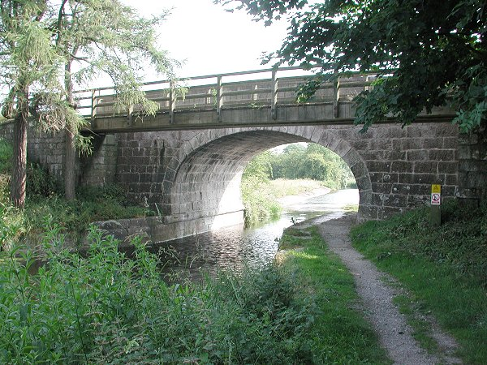
First Turnpike- 1790 Lancaster, PA
By 1832, nearly 2400 mi. of road connected most major cities.
Notes:
*

Slide 95
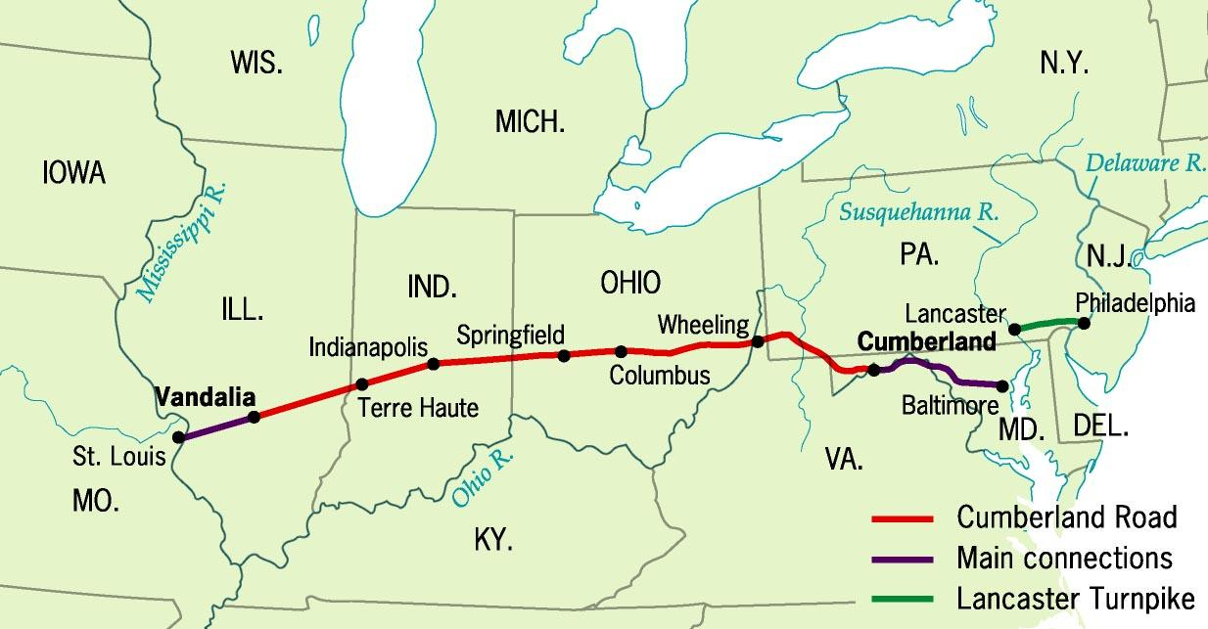
Cumberland (National Road), 1811
Notes:
*

Slide 96
Conestogas - Covered Wagons

Slide 97
Robert Fulton & the Steamboat
1807: The Clermont
Notes:
*

Slide 98
Robert Fulton’ s Steamboat
The Clermont

Slide 99
Notes:
*

Slide 100
Principal Canals in 1840
Notes:
*

Slide 101
Erie Canal System
Notes:
*

Slide 102
Erie Canal “Clinton’s Big Ditch”
363 miles
Completed in 1825
Links East Coast to the Great Lakes and trade in the Northwest
Funded entirely by New York State
$7 million

Slide 103
Erie Canal, 1820s
Begun in 1817; completed in 1825
Notes:
*

Slide 104
Notes:
*

Slide 105
The Railroad Revolution, 1850s
Notes:
*

Slide 106
Ch. 9, Image 8
An 1827 engraving designed to show the feasibility of railroads driven by steam powered locomotives, and dedicated to the president of the Baltimore and Ohio Railroad, which began construction in the following year. The engraver placed passengers as far from the locomotive as possible to ensure their safety in case of an explosion.
Give Me Liberty!: An American History, 2nd Edition
Copyright © 2007 W.W. Norton & Company
Notes:
An 1827 engraving designed to show the feasibility of railroads driven by steam powered locomotives, and dedicated to the president of the Baltimore and Ohio Railroad, which began construction in the following year. The engraver placed passengers as far from the locomotive as possible to ensure their safety in case of an explosion.
Give Me Liberty!: An American History, 2nd Edition
Copyright © 2007 W.W. Norton & Company

Slide 107
The “Iron Horse” Wins! (1830)
1830 → 13 miles of track built by Baltimore & Ohio RR By 1850 → 9000 mi. of RR track [1860 → 31,000 mi.]
Notes:
*

Slide 108
Railroad Expansion by 1860
The Expansion of Railroads by Region
Immigrant labor built railroads in the North
Slave labor built railroads in the South

Slide 110
Regional Specialization
EAST → Industrial
SOUTH → Cotton & Slavery
WEST → The Nation’s “Breadbasket”
Notes:
*

Slide 111
American Population Centers in 1860
Notes:
*

Slide 112
Results of Industrialization
Division of Labor
Growth of Cities
Increased gap between rich and poor
Sectionalism

