Slide 1
APUSH Period 3
1754-1800

Slide 2
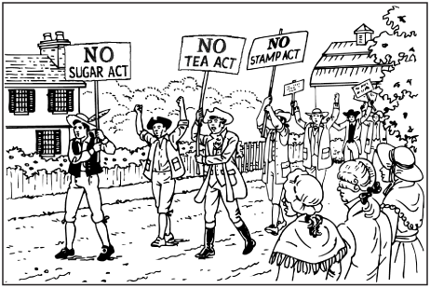
Road to Revolution

Slide 3
The Ratification Debate

Slide 4
The Debate
Federalist Papers:
Written by Federalists Hamilton, Madison, and Jay
Essays explaining and supporting ratification
Published first in leading newspapers, later in book form
Similar to the writers of The Federalist, some wrote urging rejection of the Constitution:
Letters From the Federal Farmer (Lee and Smith)
Observations on the New Constitution (Warren)
“Objections to This Constitution of Government” (Mason)

Slide 5
Federalist #84
…I go further, and affirm that bills of rights, in the sense and to the extent in which they are contended for, are not only unnecessary in the proposed Constitution, but would even be dangerous. They would contain various exceptions to powers not granted; and, on this very account, would afford a colorable pretext to claim more than were granted. For why declare that things shall not be done which there is no power to do? Why, for instance, should it be said that the liberty of the press shall not be restrained, when no power is given by which restrictions may be imposed?

Slide 6
Objections to this Constitution of Government
There is no Declaration of Rights, and the laws of the general government being paramount to the laws and constitutions of the several States, the Declarations of Rights in the separate States are no security. Nor are the people secured even in the enjoyment of the benefits of the common law…
This government will set out a moderate aristocracy: it is at present impossible to foresee whether it will, in its operation, produce a monarchy, or a corrupt, tyrannical aristocracy; it will most probably vibrate some years between the two, and then terminate in the one or the other…
George Mason

Slide 7
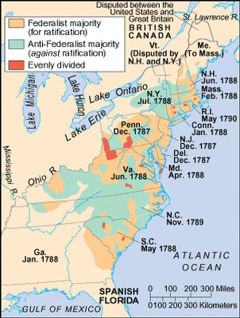

Slide 8
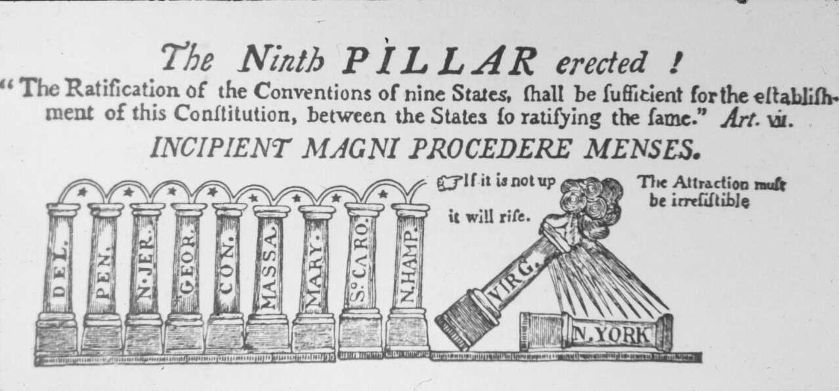
Virginia
Crucial to the legitimacy of the new government
Henry and Mason led the Anti-Federalists
Washington and Madison led the Federalists
Federalists won after proposing 20 amendments that the legislature would consider after ratification

Slide 9
New York
Anti-Federalists believed NY too large to cede authority to a central government
Hamilton’s influence and The Federalist swayed some Anti-Federalists’ opinion
Virginia’s ratification tipped the balance in NY
NC and RI ratified later

Slide 10
Bill of Rights

Slide 11
The Bill of Rights
I – RAPPS (Religion, Assembly, Press, Petition, Speech)
II – right to bear arms
III – no quartering troops during peacetime
IV – no unlawful search and seizure
V – rights of accused persons
VI – right to an attorney and trial by jury
VII – civil suits over $20 get jury trial
VIII – no cruel and unusual punishment or excessive bail
IX – citizens have more rights than are listed here
X – reserved rights of the states

Slide 12
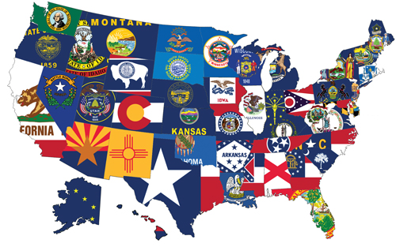
Tenth Amendment
The powers not delegated to the United States by the Constitution, nor prohibited by it to the states, are reserved to the states respectively, or to the people.

Slide 13
Washington’s Administration

Slide 14
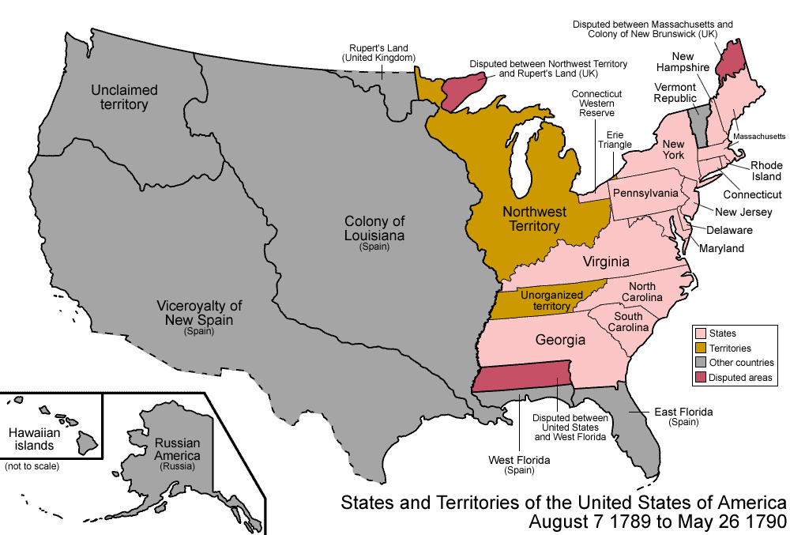

Slide 15
America in the 1790s
Population nearly 4 million
doubling every 25 years
90% of Americans lived on farms
Public debt large ($52 million) – revenue low, worthless paper $
Threats from GB and Spain threatened fragile unity of US

Slide 16
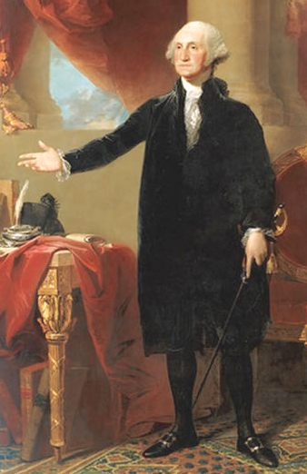
Washington’s Presidency
Election
Unanimously elected President by Electoral College in 1789
Took oath of office on April 30, 1789 in temporary capital of NYC.
John Adams had 2nd most votes and elected VP.

Slide 17
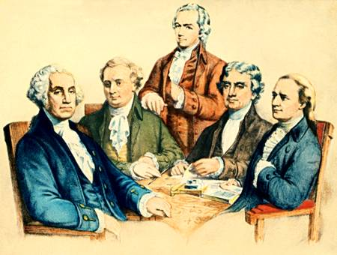
The Cabinet
Constitution does not provide for this.
Only 3 department positions created with appointments
Cabinet shaped by ideological feud between Jefferson & Hamilton
State – Thomas Jefferson
Treasury – A. Hamilton
War – Henry Knox
Attorney General – Edmund Jennings Randolph (after passage of Judiciary Act of 1789)

Slide 18
Hamilton vs. Jefferson
Strong national government
Rich,well educated should rule
Raise voting qualifications
Loose interpretation of Constitution
Balanced economy
National debt is good
National bank
Weak national government
Faith in the common people, especially farmers
Lower voting qualifications
Strict interpretation of the Constitution
Economy based on agriculture
Pay off the national debt
Opposed a national bank

Slide 19
Judiciary Act 1789
Organized the Supreme Court with a Chief Justice (John Jay) and five associates.
Organized federal district and circuit courts.
Established the office of the Attorney General.

Slide 20
Hamilton’s Financial Plan
Report on Public Credit (1790)
Plan to shape fiscal policies of admin to favor wealthier groups.
In return wealthy would loan money to gov’t
Prosperity would trickle down to the masses
Report on Manufactures (1791)
Advocated promotion of factory system
Basis of his tariff plan to protect American manufacturers

Slide 21
Hamilton’s Plan (“BE FAT”)
Bank
Components
Treasury would place surplus revenue here
Gov’t would be major stockholder, but bank would be private institution
Government would print paper money to provide a stable national currency

Slide 22
Opposition to the Bank
Jefferson and Madison felt states’ rights would be jeopardized by huge central bank.
Moneyed interests would take precedence over farmers
State banks would not be able to compete.
“Strict Constructionism” – Bank NOT within power of Congress to create
Hamilton’s Counter Argument
“Loose Constructionism” – powers not delegated to the national gov’t in Constitution are not prohibited by virtue of necessary and proper (elastic) clause. Concept of “implied powers.”
Washington signed bank measure into law Feb. 1791

Slide 23
Hamilton’s Plan Continued
Excise Taxes
In 1791 – Congress passed a $.07/gal tax on whiskey
Backcountry distillers most affected
Poor roads hurt profits
Whiskey often used as currency because so much
Funding at Par
Bonds had depreciated 10-15 cents
Plan to pay back gov’t debt to bondholders at face value plus interest
Purpose to bolster national credit

Slide 24
Hamilton’s Plan Continued
Assumption of State Debts
Motive: make the states obligated to the federal government
Hamilton thought the national debt was a blessing
States with large debts favored (MA); states with little to no debt did not (VA) - Became a north v. south issue
Compromise: north got assumption of debts while south got national capital moved to District of Columbia
Tariffs
Revenue Act of 1789 - 8% tariff on imports
Source of revenue but also aimed at protecting new US industries.

Slide 25
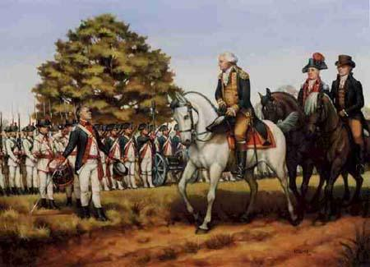
Whiskey Rebellion
Southwest Pennsylvania backcountry hit hard by excise tax
“Whiskey Boys” torched bldgs, tarred and feathered tax collectors, talked of “secession”
Washington summoned militia of several states (13,000) – escorted by Washington and Hamilton themselves
Significance: First display of fed’l gov’t “ensuring domestic tranquility”
Jeffersonians condemned action as a “brutal display of force” and gained more followers.

Slide 26
Amerindians in Old Northwest
Iroquois forced onto reservations
Chief Little Turtle led the Western Confederacy in opposition to westward expansion
Battle of Fallen Timbers (1794) - Forced to abandon British allies
Treaty of Greenville (1795) - Cleared ⅔ of Ohio & Indiana of tribes
Eastern Woodlands tribes forced west

Slide 27
Political Parties

Slide 28
Birth of Two-Party System
Founding Fathers feared of “factions” as going against spirit of national unity.
Madison’s Federalist #10 advised that factions cannot be prevented but they could be controlled
Frequent elections and separation of powers
Majority rule, but minority rights

Slide 29
FEDERALISTS
NOT the same as the “federalists” who supported the Constitution in 1780s - although some views in common
Believed in gov’t run by the elite
Rich had more time to study problems of governing
Distrusted the common people
Feared rule by “mobocracy”
Believed democracy too important to be left to the people.
Fed’l gov’t should encourage business, not interfere with it.
Dominated by merchants, manufacturers and shippers
Most lived on eastern seaboard where commerce flourished.
Pro-British in Foreign Policy
Trade with Great Britain was key to Hamilton’s plan

Slide 30
DEMOCRATIC REPUBLICANS
Advocated for rule of the people
Should be literate, but believed that “masses” could be taught
Appealed to middle-class (farmers, laborers, artisans, small shopkeepers) - Strong in South & Southwest
Government that governed best, governed least
Bulk of power should be retained by states.
Limit federal power through strict interpretation of Constitution.
National debt was a curse that should be paid off ASAP
Believed in freedom of speech
Basically pro-French

Slide 31
Foreign Policy

Slide 32
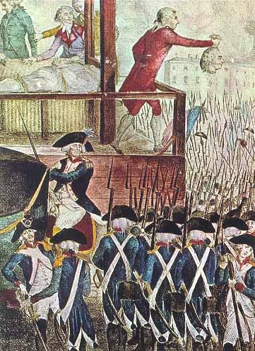
First Test: French Revolution
French declared themselves a “republic” and originally Americans supported them, but violence changed public opinion
Jeffersonians still support France
Hamiltonians want to stay neutral
US still obligated under Franco-American Alliance of 1778

Slide 33
Washington’s Neutrality Proclamation (1793)
US would be neutral
Warned US citizens to be impartial to both sides.
Jefferson furious – Washington did not consult Congress
Hamilton supported it.
Citizen Genet
French diplomat in US who felt Neutrality Proclamation not a true reflection of US feelings towards France
Went to people directly to ask for money and supplies for war cause
George Washington booted him out of country.

Slide 34
Second Test: Problems with Britain
Great Britain was a thorn in US side
constantly harassing US frontier settlers
Seized 300 US ships and impressed (stole) US sailors.
Remained in posts in violation of 1783 peace treaty
Sold firearms and alcohol to Natives who attacked US settlers.
Federalists did NOT want war (75% of import duties from British trade)
Jeffersonians wanted embargo

Slide 35
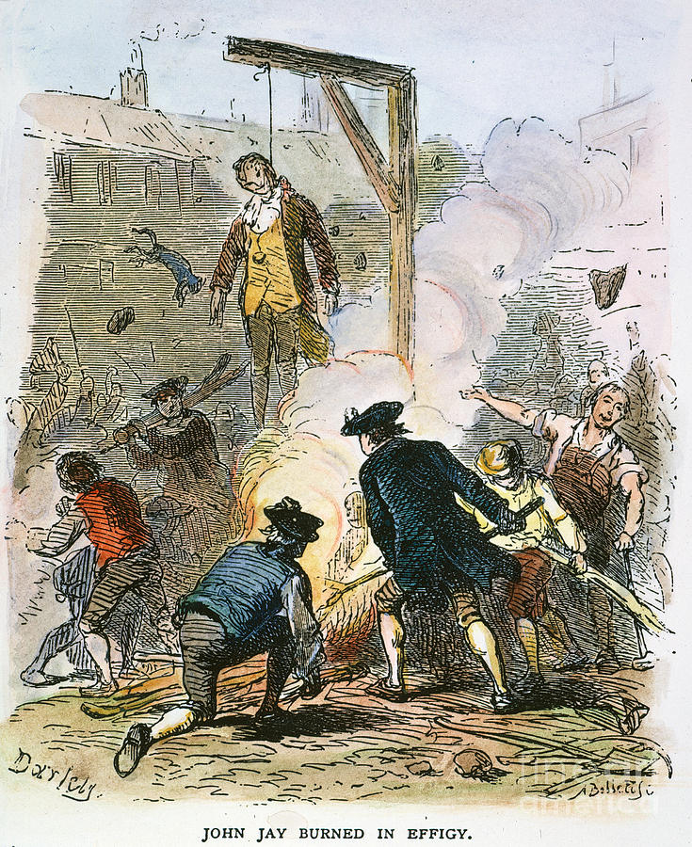
Jay’s Treaty
Washington sent Jay to negotiate a treaty in 1794
Provisions
GB renewed pledge to leave posts
GB would pay for recent seizures of ships, sailors
GB did not guarantee they would not do it in the future though
AND US forced to pay PRE-Revolution debts owed to GB
Jeffersonian outrage resulted in creation of Democratic Republican Party

Slide 36
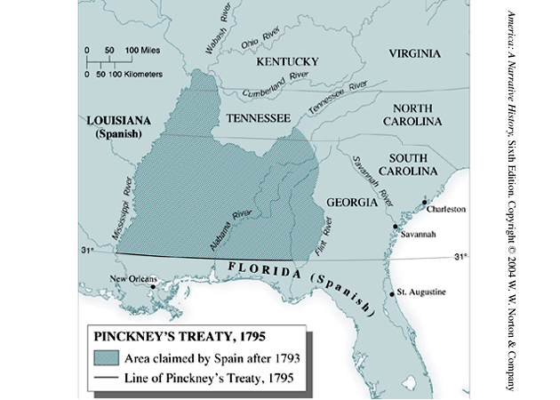
Pinckney Treaty
Spain worried about Anglo-American alliance – ready to give up some rights in North America
Granted US rights to navigate Mississippi and port of New Orleans
Yielded large tract of land north of Florida (north of 31st parallel)

Slide 37
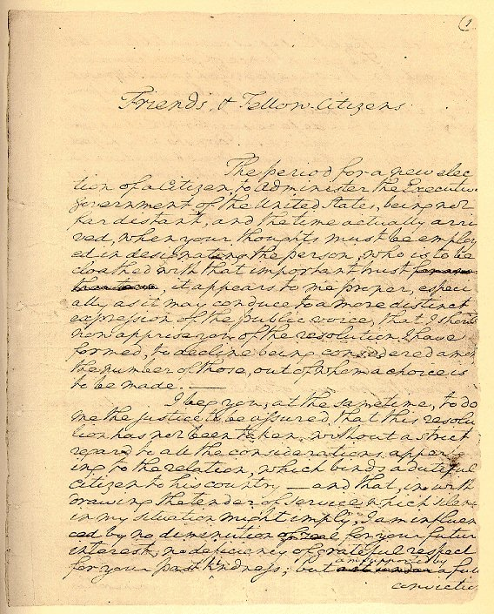
Washington’s Farewell Address
Historical Context
Exhausted physically and tired of verbal abuse from Jefferson for becoming partisan
Letter to the People
Warned of evils of political parties
Warned of entangling alliances (like treaty with France)
Isolationism became dominant foreign policy for next 100 yrs.

Slide 38
Washington’s Precedents
Cabinet of advisors that were regularly consulted
Right to choose cabinet
Two Term Maximum
Outside appointment of a Chief Justice to the Supreme Court

Slide 39
Adam’s Presidency

Slide 40
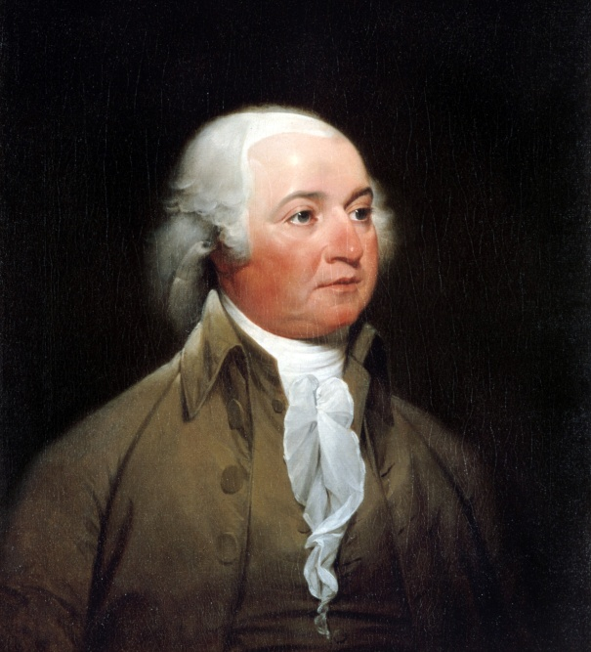
John Adams’ Presidency
Election
1796 - Defeats Thomas Jefferson 71 -66 in Electoral College
Jefferson becomes VP
Foreign Flare-Ups
France
Saw Jay’s Treaty as a violation of 1778 Franco-American Treaty
Seized 300 merchant vessels by mid-1797
Refused to receive America’s new envoy

Slide 41
XYZ Affair
John Adams sent delegation to France to work it out
Approached by 3 French agents (“X, Y and Z”) who demanded loan and bribe of 250,000 to talk to French foreign minister Talleyrand.
“Millions for defense, but not one cent for tribute (bribes)”
Negotiations broke down
Undeclared “Quasi War” with France 1798-1800
Navy Department created - US expanded its 3 ship Navy
US Marine Corps established
Embargo with France imposed (no trade)
Mostly fought in West Indies

Slide 42
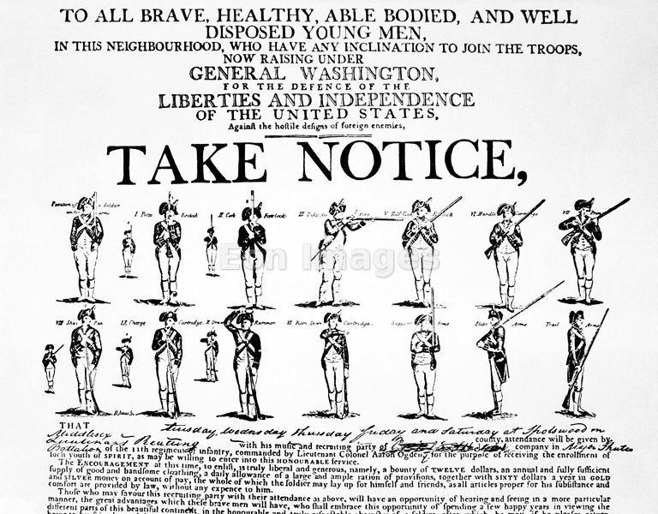
Convention of 1800
John Adams sent new envoy to France in 1800
Napoleon accepted – more bent on European conquest, not war with US
Improved Relations made Louisiana Purchase possible 3 years later.
22 year alliance between US and France dissolved.

Slide 43
Alien and Sedition Acts (1798)
Oppressive laws designed to reduce power of Jeffersonians and silence anti-war opposition
Alien Act
Attack on pro-Jeffersonian “aliens”
Raised residency requirements for US citizenship from 5 yrs to 14 yrs.
President could deport “dangerous” foreigners.
Sedition Act
Anyone who impeded policies of the gov’t or falsely criticized its officials would get heavy fine and imprisonment.
Direct violation of 1st Amendment
Expired day before Adams left office.

Slide 44
Virginia and Kentucky Resolutions (1798)
Democratic Republicans felt Alien and Sedition Acts were unconstitutional
Jefferson and Madison secretly penned two resolutions that asserted that states have the right to nullify unconstitutional laws passed by Congress.
Federalists retorted that the people, not states created Constitution and that the Supreme Court and not states determined the constitutionality of laws.
Nullification - belief that the states were the final judges of whether a federal law was constitutional
No other states but VA and KY adopted resolutions, but southern states would use this later in 19th century to support nullification and secession.

Slide 45
Revolution of 1800
Rematch Adams (President) vs. Jefferson (Vice President)
Jefferson and Burr tie for electoral votes
Significance: Peaceful and orderly transfer of power

