Slide 1
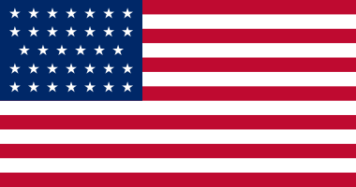
Legend
Black line – border between Confederacy & Union
Black dot – capitals (Washington & Richmond)
Red Dot & Name – Confederate battle victory
Blue Dot & Name – Union battle victory
Blue line – Union blockade
Grey shading – Confederate states
Blue shading – Union states
Union
Confederacy

