Slide 1
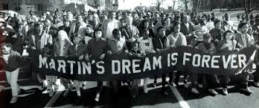
Civil Rights Movement
1950s-1960s….mission accomplished???

Slide 2
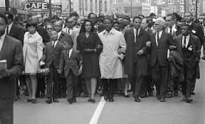
Civil Rights…What are civil rights?
The rights of individuals to receive equal treatment under the law

Slide 3
Reconstruction era promises unfulfilled
13th Amendment-did it end slavery?
14th Amendment-did it secure due process and equal protection under the law?
15th Amendment-did it secure the right to vote for African-Americans and other minorities?

Slide 4
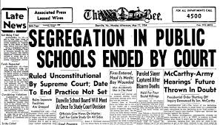
The goals of civil rights activists
Combat racial discrimination
End segregation
Desegregate schools and public facilities
3. Secure the right to vote

Slide 5
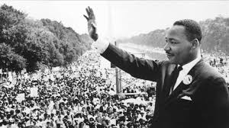
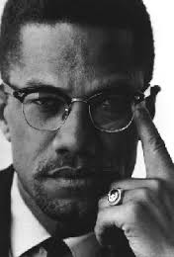
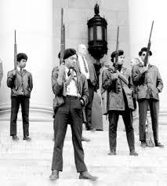
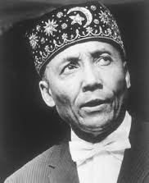
Civil Rights groups/Leaders
Martin Luther King
Southern Christian Leadership Conference
Malcolm X
Black Panther Party
Nation of Islam

Slide 6
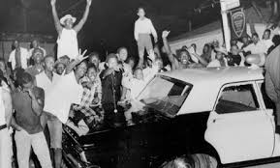
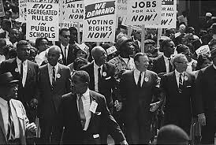
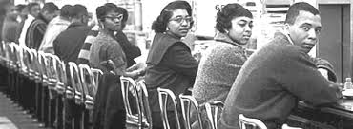
Strategies
Legal challenges-legislation
Non-violent protests
Direct Action
Sit-ins
Boycotts
Riots
marches

Slide 7
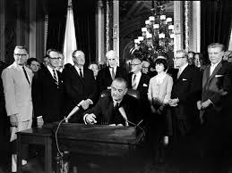
Major civil rights legislation
Brown vs. Board of education of Topeka Kansas 1954 -Supreme Court-ended segregation in public schools
Civil Rights Act of 1964-Congress, ended discrimination based on race, religion, national origin and gender
Voting Rights Act of 1965-Congress, President-eliminated literacy tests and poll taxes and other factors that kept Blacks from voting.

Slide 8
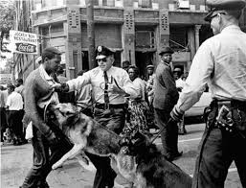
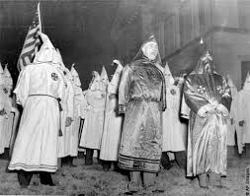
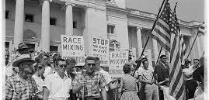
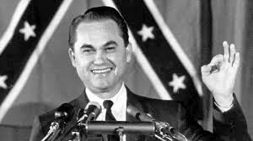
Resistance

Slide 9
And Now John Greene
https://www.youtube.com/watch?v=S64zRnnn4Po
(1950s)
https://www.youtube.com/watch?v=lkXFb1sMa38\
(1960s)

Slide 10
What are the civil rights issues of today?
In groups, come up with one civil rights issue that must be addressed today. 10 mins, share
What is the issue?
Why is it an issue?
What strategies should be used to address that issue?
What resistance do you anticipate you will be up against?

Slide 11
Issues today
Gay Rights
Health care as a right
Equal pay for women
Reproductive rights
Voted ID Laws
Education Inequality
Criminal justice reform

Slide 12
Project-Activist era presentations
You and a group will be creating a presentation around a group of activists from a specific area. You need to include the following information:
Leaders (Names and relevant information)
Include a quote from one of the leaders you find regarding their work in civil rights
Ideals (What did they want to accomplish?)
Goals (How were they going to accomplish those ideals?)
Accomplishments (What were they able to accomplish?)
Confrontations with the Man (Were there any instances of trouble with the police etc.?)
You can use any method of electronic presentation software (google slides, PowerPoint, Prezi, etc.) to present the information to the class.
Presentations will be no longer than 5 minutes
Presentations start Wednesday, April 20, 2016
You will be assigned a group to research from the following:
Chicano Movement Counterculture
American Indian Movement
LGBTQ
Women’s Movement
Student Movement/New Left
Environmental Movement

