Slide 1
APUSH Period 2
1607-1754

Slide 2
Key Concept 2.1
Europeans developed a variety of colonization and migration patterns, influenced by different imperial goals, cultures, and the varied North American environments where they settled, and they competed with each other and American Indians for resources.

Slide 3
Different European Powers
Spanish, French, Dutch and English Compared

Slide 4
Sub Concept I
Spanish, French, Dutch, and British colonizers had different economic and imperial goals involving land and labor that shaped the social and political development of their colonies as well as their relationships with native populations.

Slide 5
Directions: Using your prior knowledge, new knowledge gained and the additional facts provided in the colonization chart, complete the Venn diagram by filling is as many characteristics and facts for each colonizer. Then proceed to the questions.
French
French
1. Are there more similarities or differences?
2. To what extent are they similar or different?
3. Why? (list & explain three reasons to support your answer)
1.
2.
3.
4. Dutch colonists were also significant in North America. Explain the extent to which they were similar or different from the other three colonizers.
Spanish
English

Slide 6
Comparing Colonies
SPANISH
FRENCH & DUTCH
Funded by crown
Very direct control
Strong Catholic missionary impulse
More complex socio-political system (race based hierarchy where intermingling of races common)
Relatively few women over to colonize
Maintained a much looser hold on their colonies
Few Europeans came over
Used trade alliances and intermarriage with American Indians to acquire furs, etc. for export.
French sent Jesuit missionaries

Slide 7
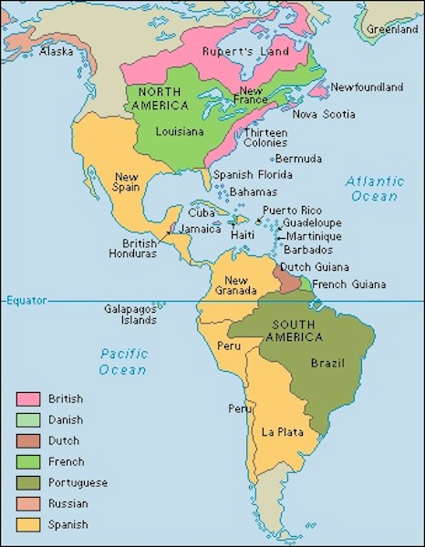
Comparing Colonization
BRITISH
Joint Stock Companies raised funds & were granted charters (later the crown takes over more directly)
Economic development more independent from Mother Country
More variance in background, motivation, etc. of colonists
Little intermixing with native population- very rigid racial hierarchy
Relatively more women over, as aim was to acquire land and populate colonies rather than simply turn a profit

Slide 8
Sub Concept II
In the 17th century, early British colonies developed along the Atlantic coast, with regional differences that reflected various environmental, economic, cultural, and demographic factors.

Slide 9
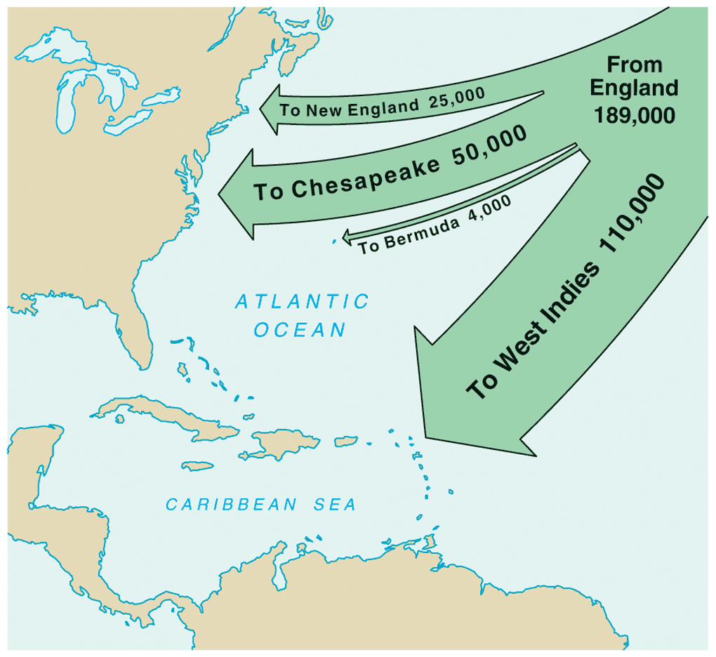
English Migration, 1610-1660
Notes:
Pojer

Slide 10
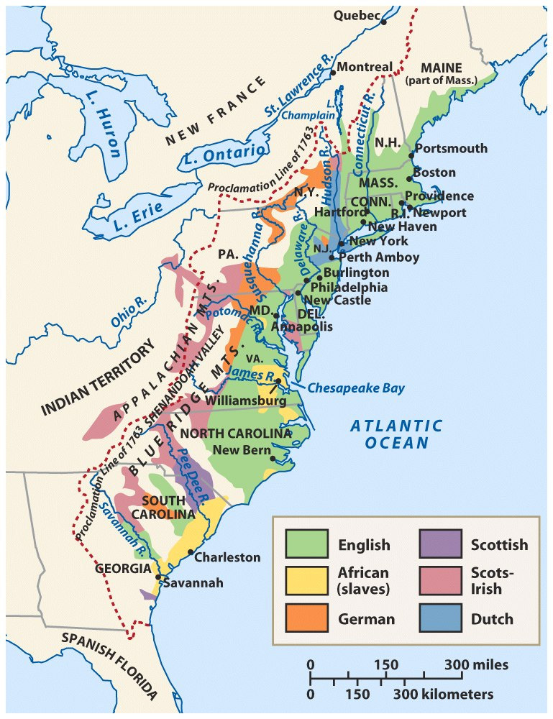
Population: Ethnic & Racial Diversity
Notes:
Roark, American Promise 3e from http://www.bedfordstmartins.com/mapcentral

Slide 11
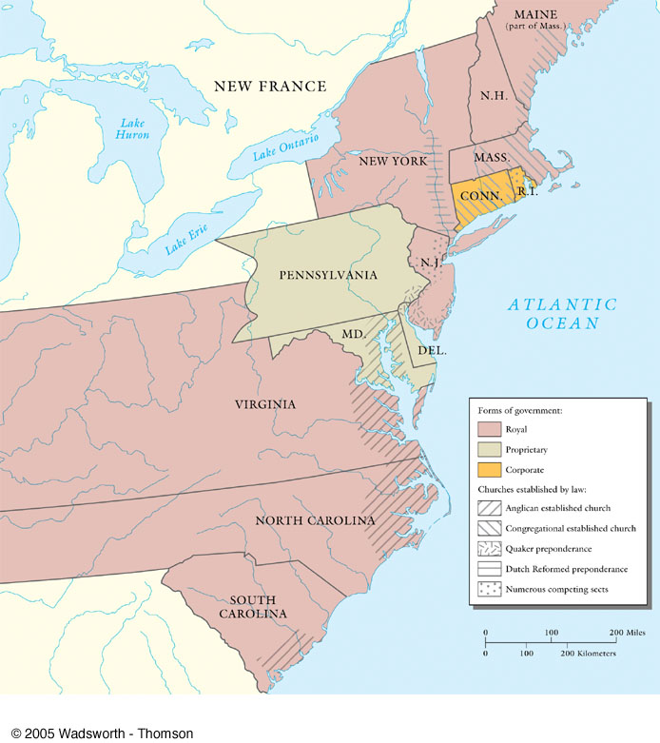
Government and religion in the British Colonies, 1720

Slide 12
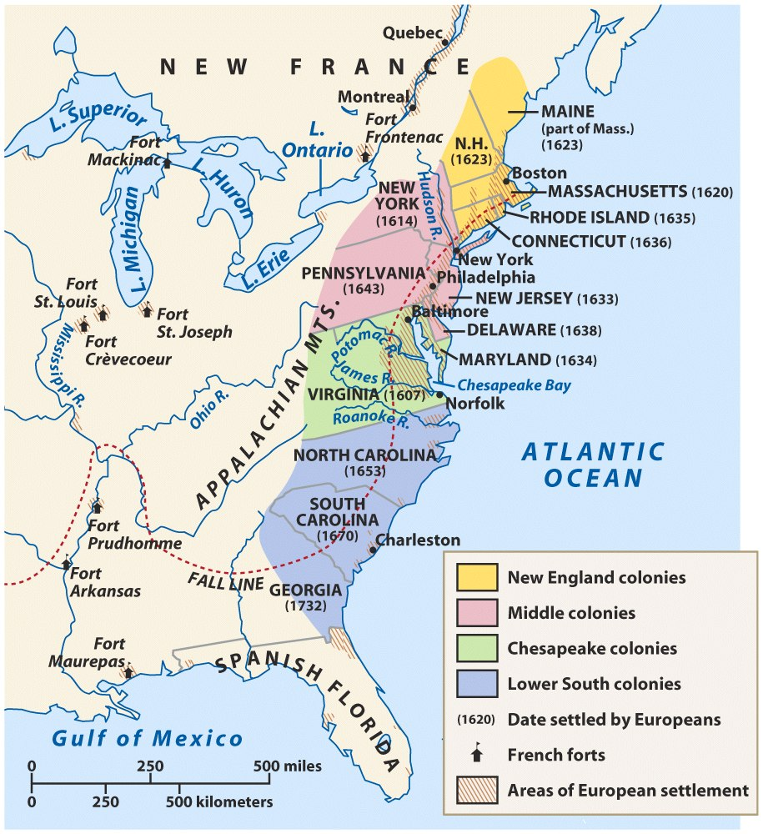
American Colonies at the End of the Seventeenth Century
Notes:
Roark, American Promise 3e from http://www.bedfordstmartins.com/mapcentral

Slide 13
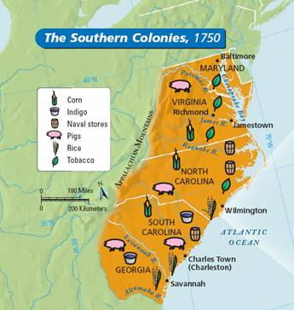
Southern Colonies General
Plantation economy
Slavery
Aristocracy & social structure
Sparsely populated
Religious toleration
Expansion

Slide 14
The Chesapeake
Virginia and Maryland

Slide 15
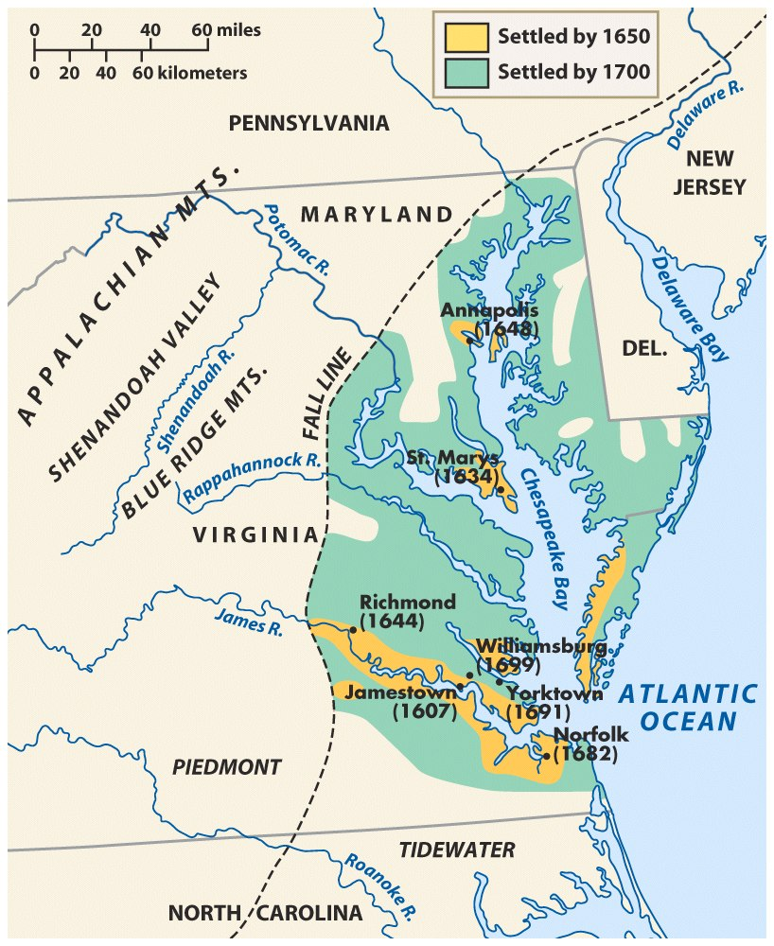
The Chesapeake Colonies in the Seventeenth Century
Notes:
Roark, American Promise 3e from http://www.bedfordstmartins.com/mapcentral

Slide 16
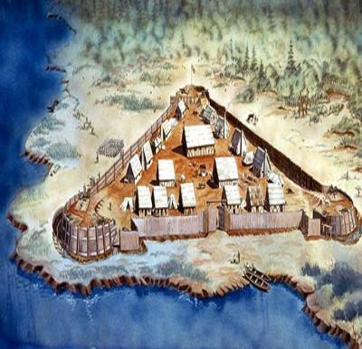
Settlement of Virginia
Jamestown 1607
Virginia Company
“Starving Time”
John Smith
Pocahontas
Mini DBQ: Why did so many colonists die???
Notes:
Pojer

Slide 17
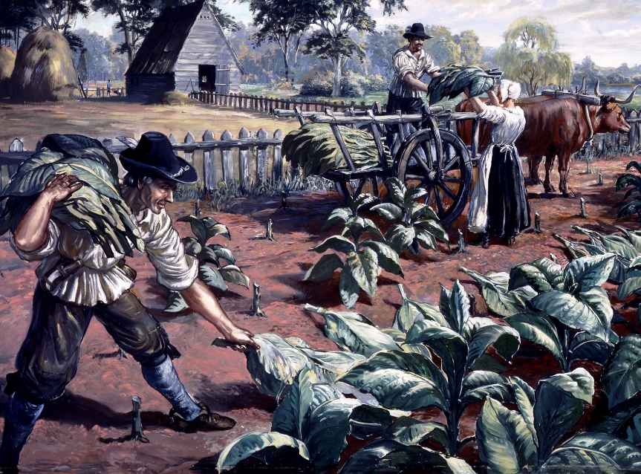
John Rolfe and Tobacco
John Rolfe and Tobacco

Slide 18
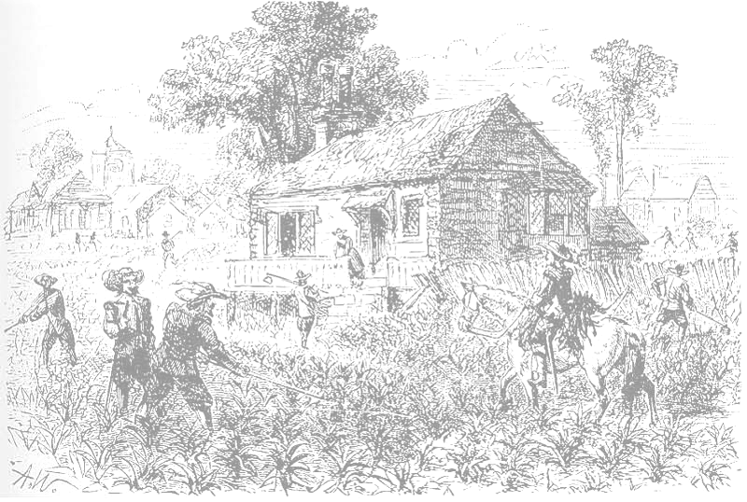
Early Colonial Tobacco
1618 — Virginia produces 20,000 pounds of tobacco.
1622 — Despite losing nearly one-third of its colonists in an Indian attack, Virginia produces 60,000 pounds of tobacco.
1627 — Virginia produces 500,000 pounds of tobacco.
1629 — Virginia produces 1,500,000 pounds of tobacco.
Notes:
Pojer; background - http://www.wadsworth.com/history_d/special_features/image_bank_US/1517_1705.html

Slide 19
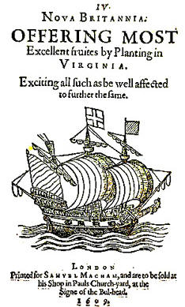
How to Attract Colonists?
Headright System
Indentured Servitude

Slide 20
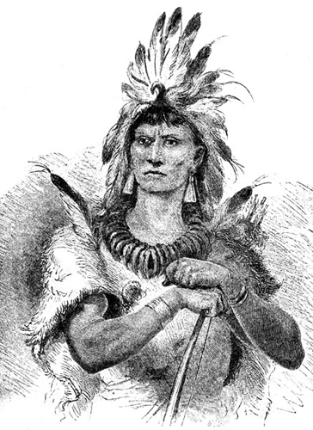
Colony Grows
Leads to conflict with Native Americans….
Anglo Powhatan Wars

Slide 21
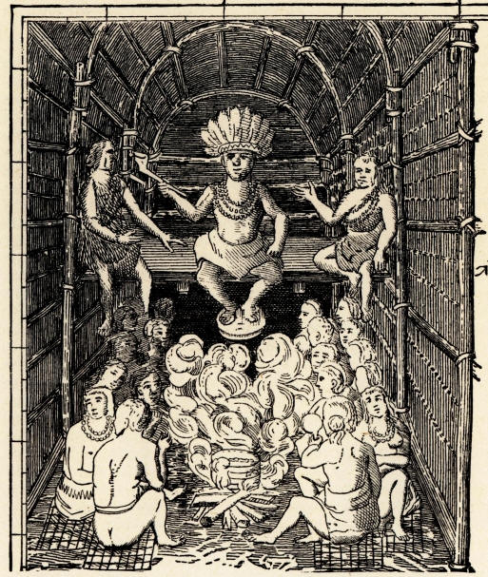
Powhatan
Father of Pocahontas…
His Indian Confederacy falls to the Three “D”s
Disease
Disorganization
Disposability

Slide 22
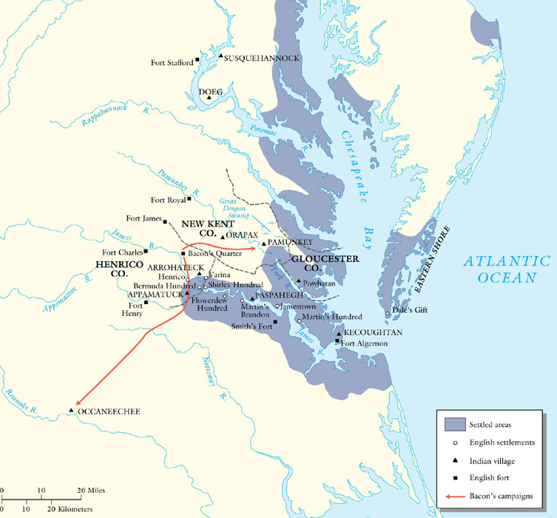
Social Unrest in the Chesapeake
Bacon’s rebellion
– causes
Backcountry settlement and Protection
Power of “eastern” elites and Taxation
significance
Bacon’s rebellion in Virginia, 1676
Notes:
http://www.wadsworth.com/history_d/special_features/image_bank_US/1642_1715_maps.html

Slide 23
Significance of Bacon’s Rebellion
First large rebellion in colonies (political & social)
Social/political conflict: “eastern” elites vs. backcountry
Catalyst in transition from indentured servitude to slavery

Slide 24
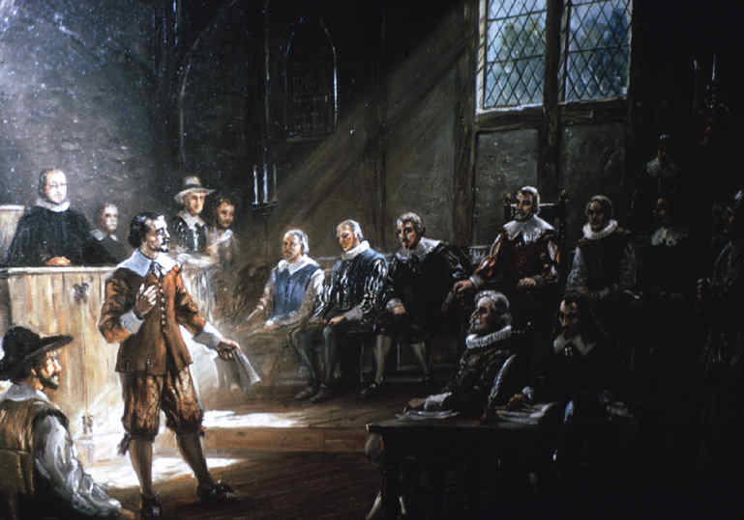
House of Burgesses
Representative Democracy

Slide 25
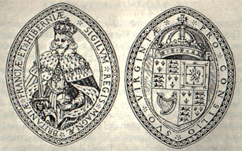
Revoked!!!

Slide 26
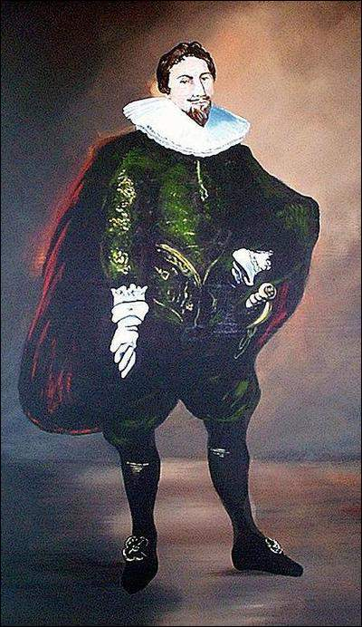
Maryland
Lord Baltimore
Refuge for English Catholics...
Tobacco Cultivation
Act of Toleration (1649)
Granted toleration to all Christians
Jews & Atheists get death penalty

Slide 27
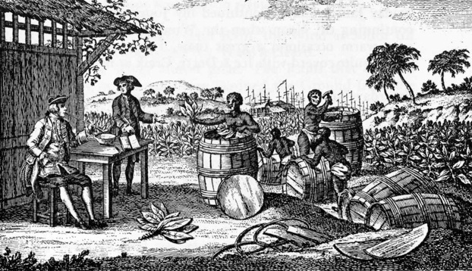
Life in the Chesapeake

Slide 28
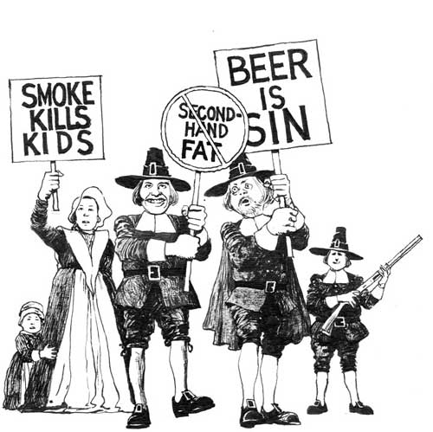
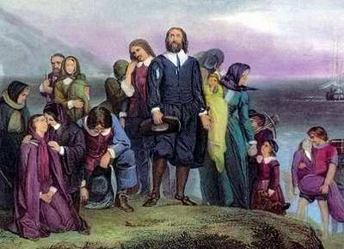
Good Morning Class!! Please get your Period Two Primary Source Packet Ready & Handy under your desk

Slide 29
Examining Passenger Lists
Today you will examine passenger lists from the 17th century in order to get a sense about who settled in the New World, why they came to the colonies and where they settled.
Get in groups, roles will be assigned

Slide 30
Ship Lists
Analyze the two ships lists in your document packet and complete the following: (recorder should copy this down)
 | To Virginia | To New England
Total Passengers
How many males/females?
Number of Married Passengers
Number of Passengers traveling with at least one family member
1.Describe the “typical” English immigrant to the New World in terms of gender, age, and
Marital status on each of the ships. How does this differ on the two ships?
2. What can you tell about the social background and wealth of the average passenger
On each of the ships? Does one of the ships have richer passengers? What do you predict the
Passengers on the America will do when they arrive in Virginia?

Slide 31
Whole Class Discussion
What are the biggest differences between the two ships?
What does this information tell you about the differences between New England and Virginia in the 1630s?

Slide 32
Southern Colonies
The Carolinas and Georgia

Slide 33
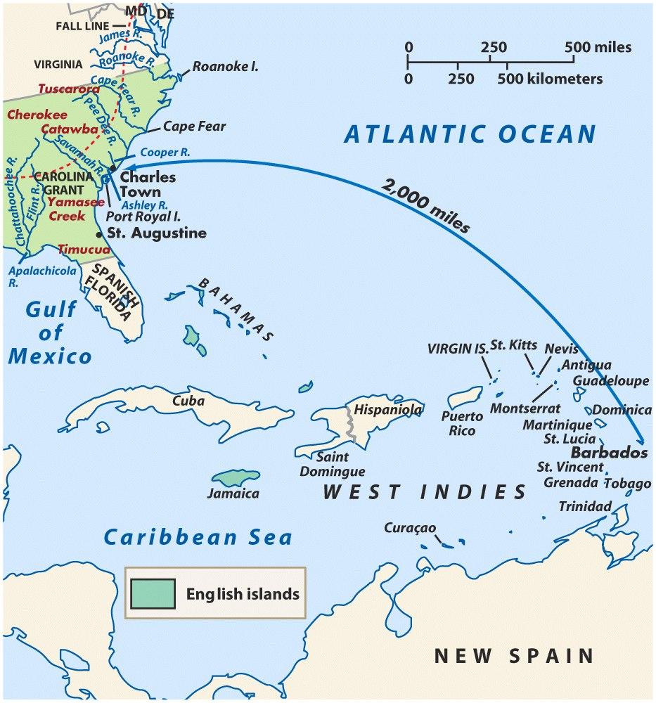
Deep South
The West Indies and Carolina in the Seventeenth Century
Carolina (1682)
Georgia (1738)
rice
indigo
Rice
Indigo
Notes:
Roark, American Promise 3e from http://www.bedfordstmartins.com/mapcentral

Slide 34
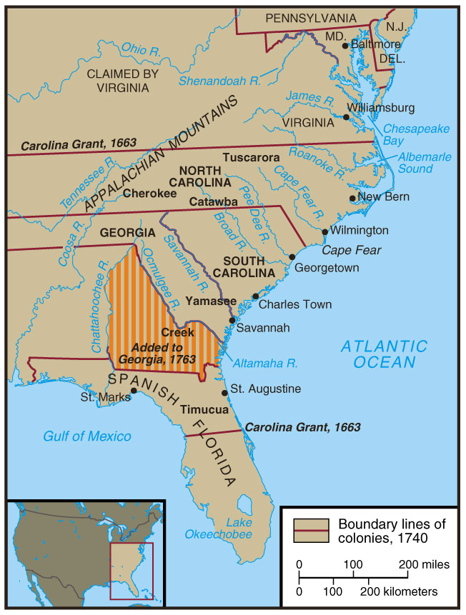
The Carolinas and Georgia
Notes:
Divine, America Past & Present 7e

Slide 35
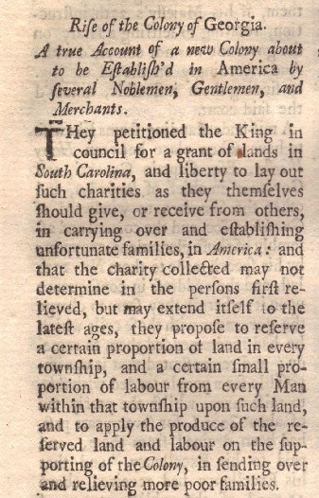
Georgia
James Oglethorpe
Serve as a buffer to Spanish in FL
Haven for imprisoned debtors
Religious Toleration (except Catholics)

Slide 36
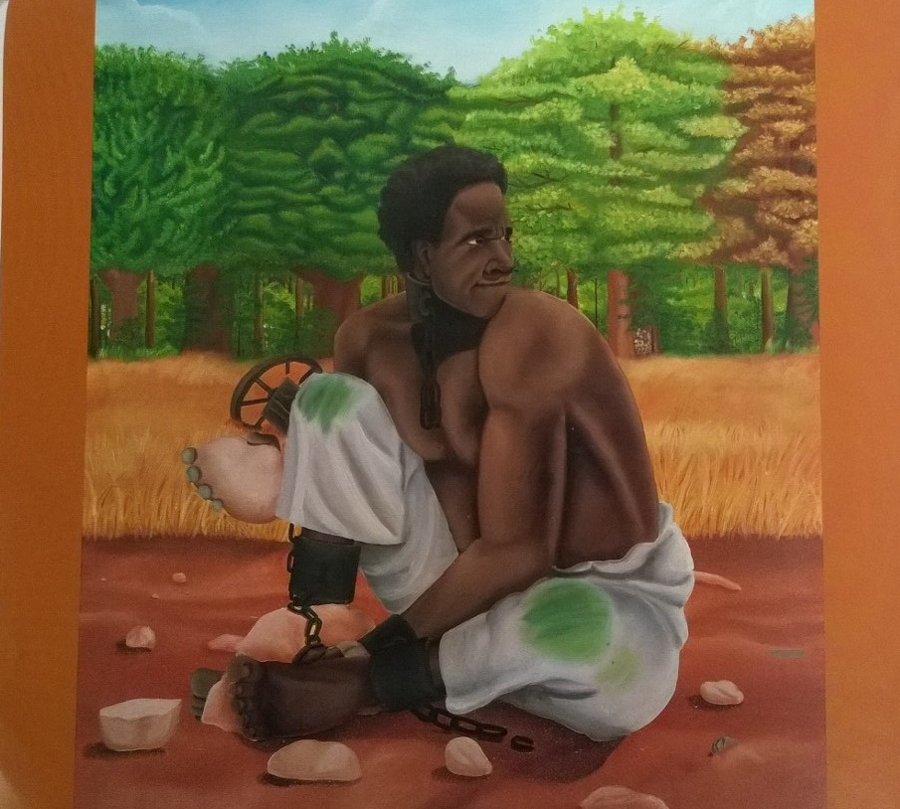
Slavery in the American Colonies
S

Slide 37
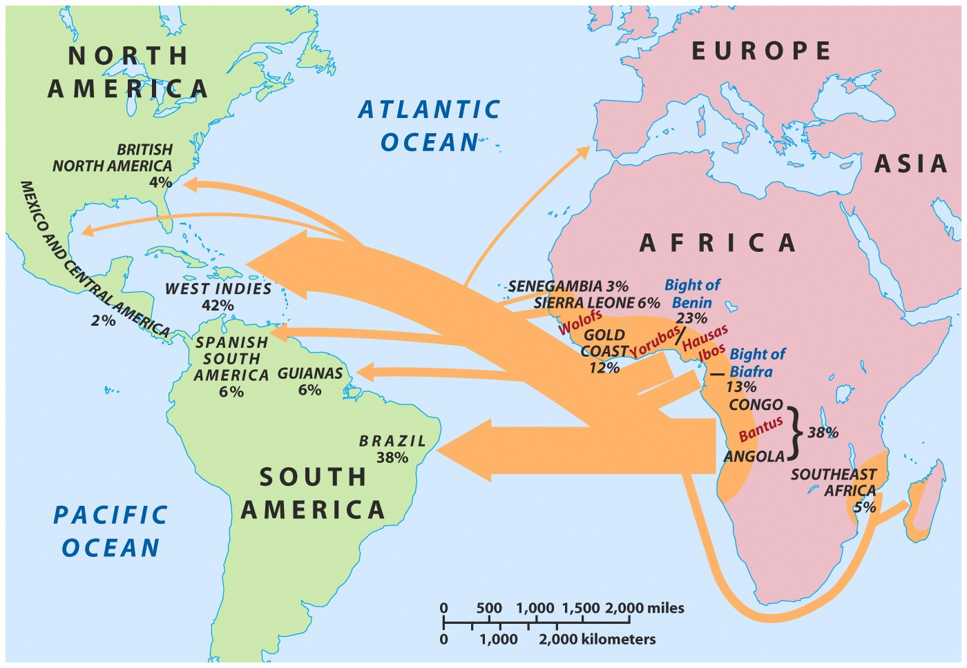
The Atlantic Slave Trade
“middle passage”
Notes:
Roark, American Promise 3e from http://www.bedfordstmartins.com/mapcentral

Slide 38
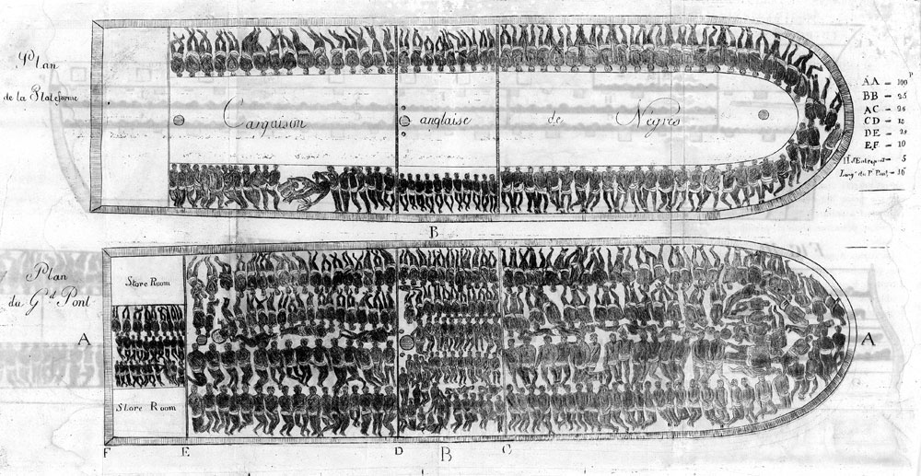
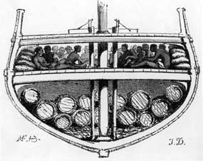
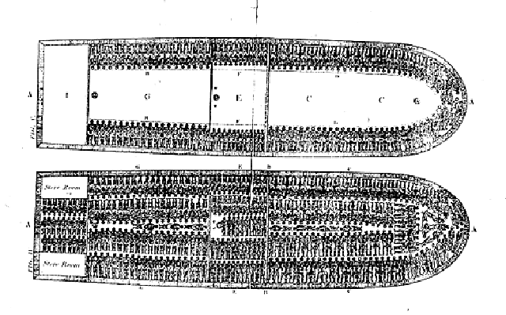

Slide 39
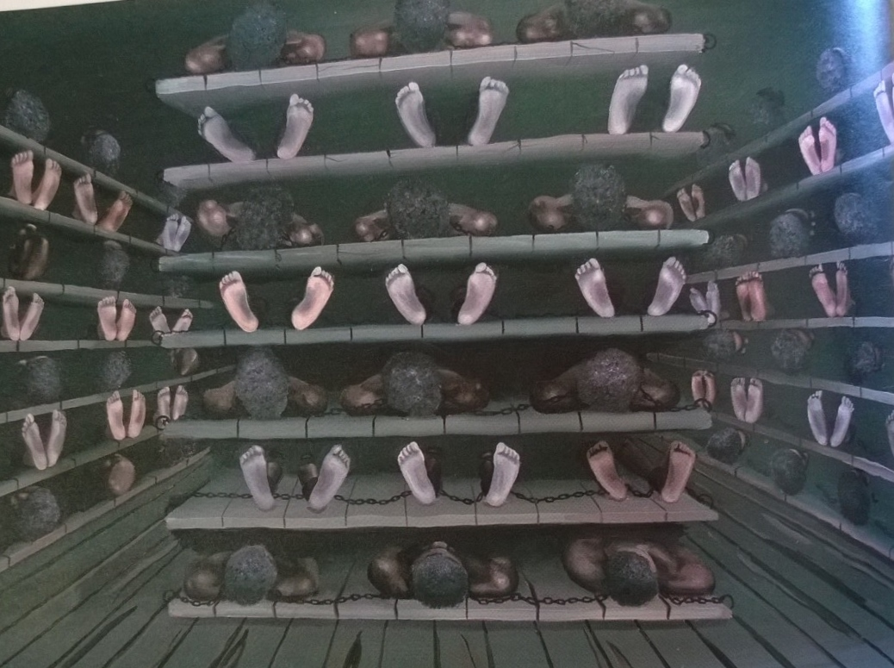

Slide 40
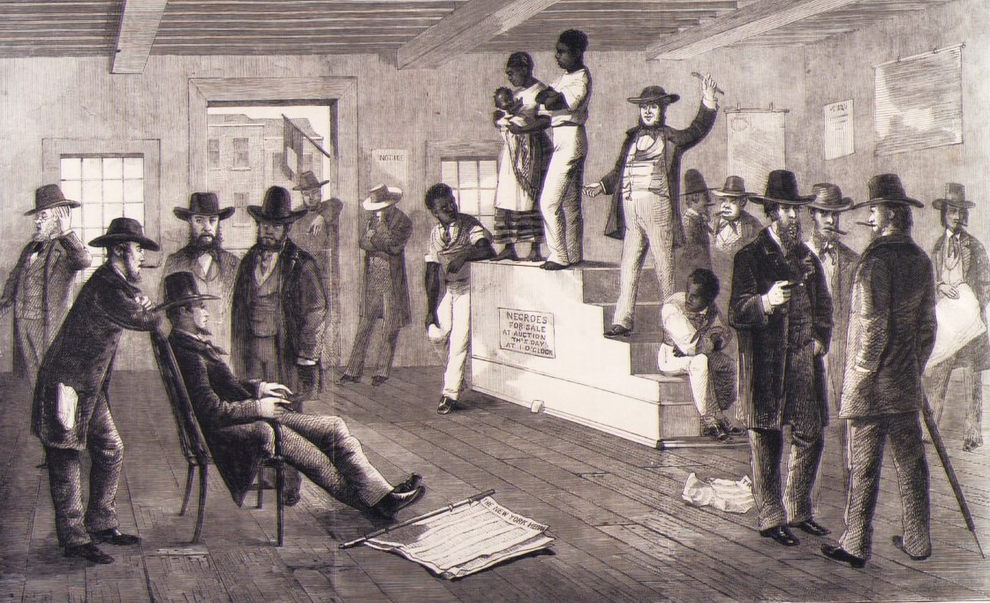
Slave Auctions

Slide 41
Reasons for Slavery
Decrease in indentured servants
English economy - rising wages
Increase in availability of slaves
End of Royal African company monopoly
Decrease in price
Fears of growing number of landless freemen
Available supply from Caribbean

Slide 42
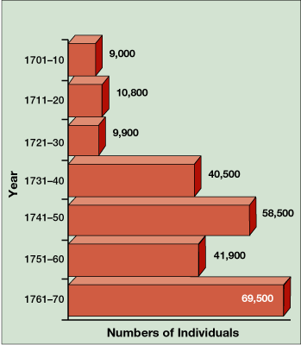
Estimated Number of Africans Imported to British North America, 1701–1775
Notes:
Faragher, Out of Many, 3rd Ed.; http://wps.prenhall.com/hss_faragher_outofmany_ap/

Slide 43
Statistics
By 1750 - 46% of Virginia’s Population
In South Carolina slaves outnumbered whites 2 to 1.
Slaves only 5% of Northern colonies population (2% in Massachusetts)
Until 1750, 25% of all slaves who arrive in America die within 1st year.

Slide 44
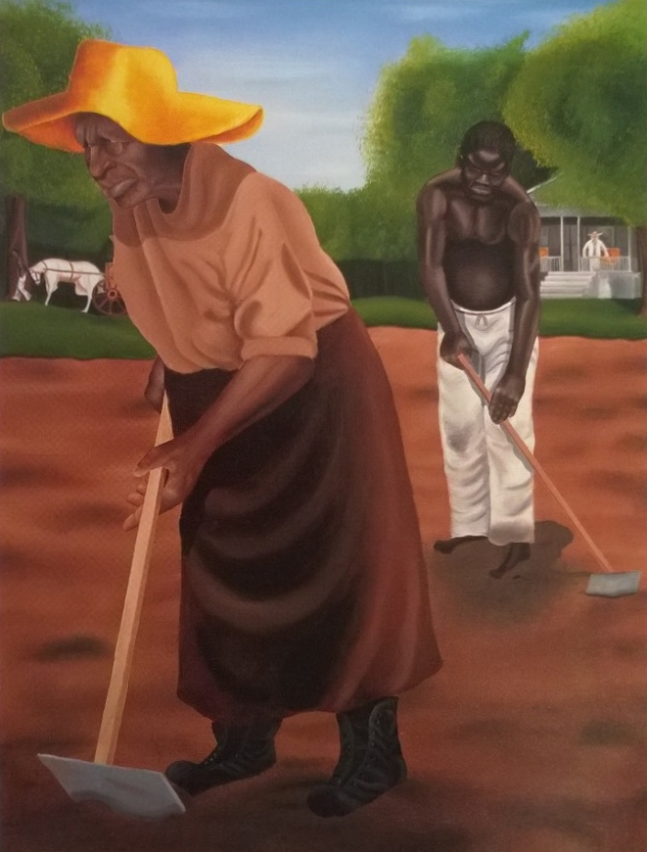
Slave Codes
Property for Life
Illegal to teach literacy
Conversion didn’t mean freedom
Designed to control slave population.

Slide 45
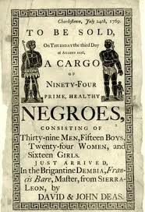
Slavery and Racism
Very little intermarriage in British colonies
Caste System
Mulattos were still slaves

Slide 46
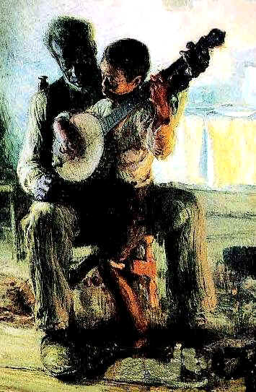
Slave Life
Harshest in lower South
Tobacco-growing was less deadly
Family life possible by 1720
Mix of American and African culture
Religion
Music
Oral Traditions
Family

Slide 47
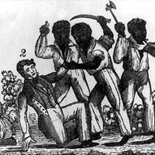
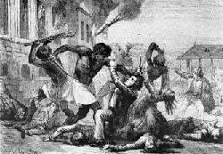
Stono Rebellion
Largest slave revolt in 13 colonies
Spain offered freedom in Florida
1739 - SC slaves tried to march to Florida
Militia stopped them after 25 whites died
SIGNIFICANCE: Slave system more strict!

Slide 48
Negro Act 1740
Can’t import slaves directly from Africa into South Carolina
Militia patrol to prevent slaves from gathering
Harsh treatment of slaves meant fines for owners
No slaves could gather in groups, nor could they grown their own food, learn to read or work for money

Slide 49
Southern Society - 18th c.
Plantation Owners
Small Farmers
Landless Whites
Indentured Servants
Slaves

Slide 50
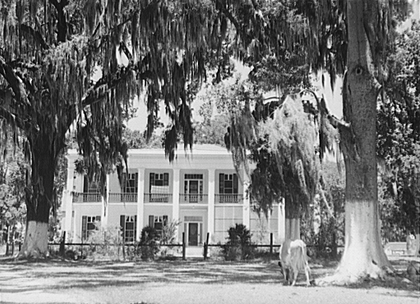
Underdeveloped
Few cities
Life revolved around plantations
Poor transportation

Slide 51
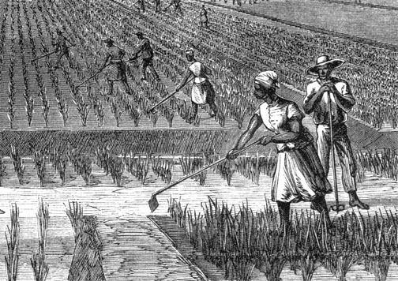
Why did Southern colonies differ from New England?
Demand for labor
Few women
Slaves from Africa

Slide 52
New England
Massachusetts, Connecticut, Rhode Island

Slide 53
Protestantism in America
Martin Luther, John Calvin and the Puritans

Slide 54
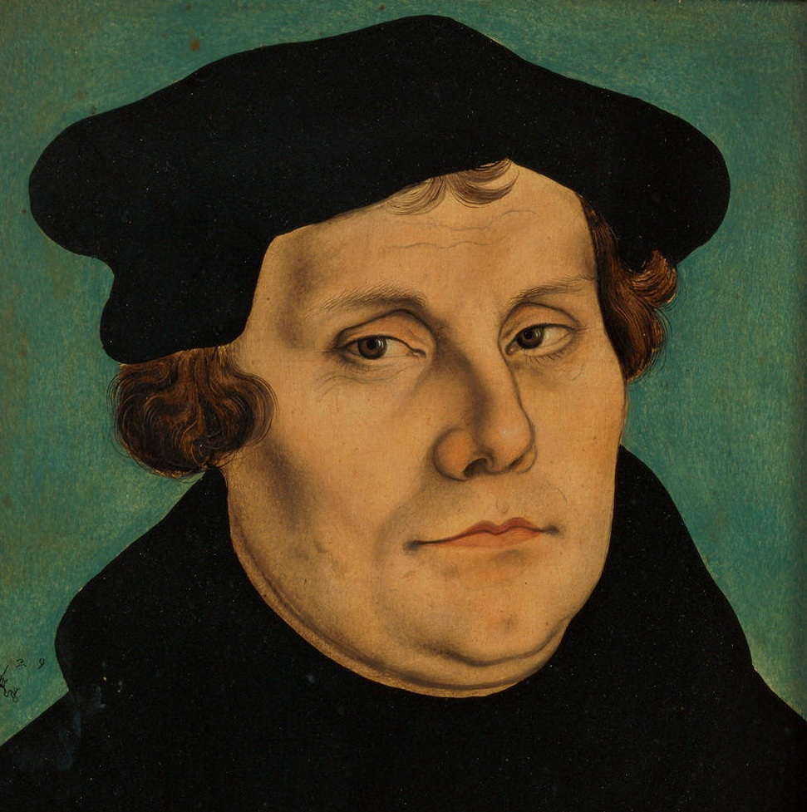
Martin Luther
Challenges the teachings of the Catholic Church
Three Philosophical Ideas:
1) Faith Alone
2) Scripture Alone
3) Priesthood of All Believers

Slide 55
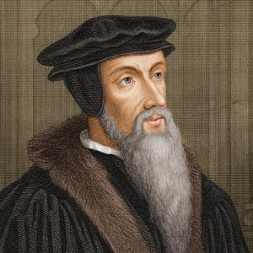
John Calvin
Expanded on Luther’s views to create Calvinism
Sovereignty of God
Election
Predestination
Total Depravity

Slide 56
Protestant Reformation
Conflicts in Europe between Popes and Kings
Elizabeth creates the Church of England (Anglican Church) - Catholic in practice, but Protestant in theology
Two responses to Church of England
Separatists - Church is too corrupt! Break away!
Puritans - Reform from within and get rid of Catholic elements!

Slide 57
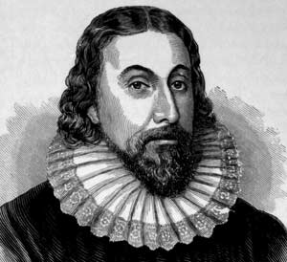
John Winthrop
Governor of Massachusetts Bay Colony
"We shall be as a city upon a hill, the eyes of all people are upon us."
Colony would be a beacon for the rest of Europe, "A Modell of Christian Charity," in his words.

Slide 58
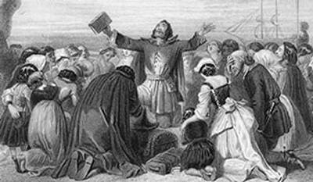
Puritan Calvinist Theology
Visible Sainthood
Societal Covenant
Half Way Covenant

Slide 59
Puritan Paradoxes
A paradox is something that appears to be contradicting itself.
1. Puritans want a bible based Protestant society, but also want to uphold their correct way of reading scripture.
2. Puritans come to escape persecution, but don’t allow religious freedom to others.

Slide 60
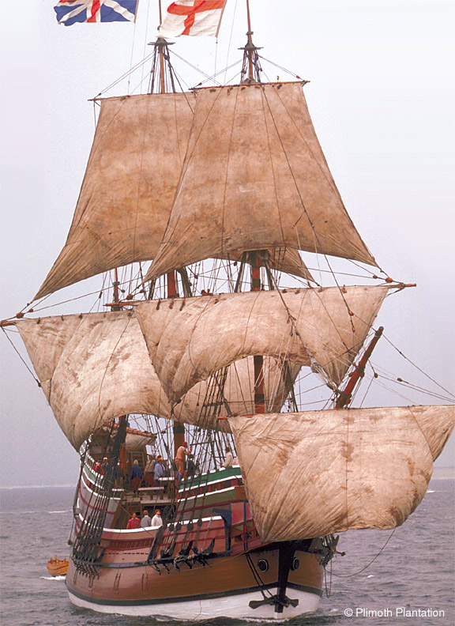
Plymouth
Separatists - aka “Pilgrims”
Led by Rev. John Robinson
Mayflower Compact
Relations with Amerindians
Squanto & Wampanoags
Thanksgiving - 1621
Success
Mayflower II

Slide 61
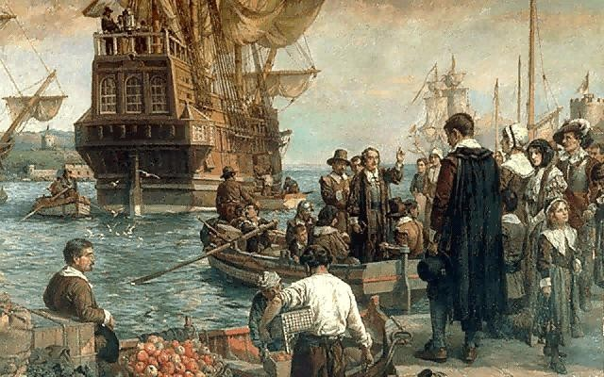
Massachusetts Bay - 1629
Non-Separatist Puritans
Cambridge Agreement
Great Migration (1630s)
Religion & Politics
“Democracy” or “Theocracy”?
Church Leadership
John Cotton
Cambridge Platform

Slide 62
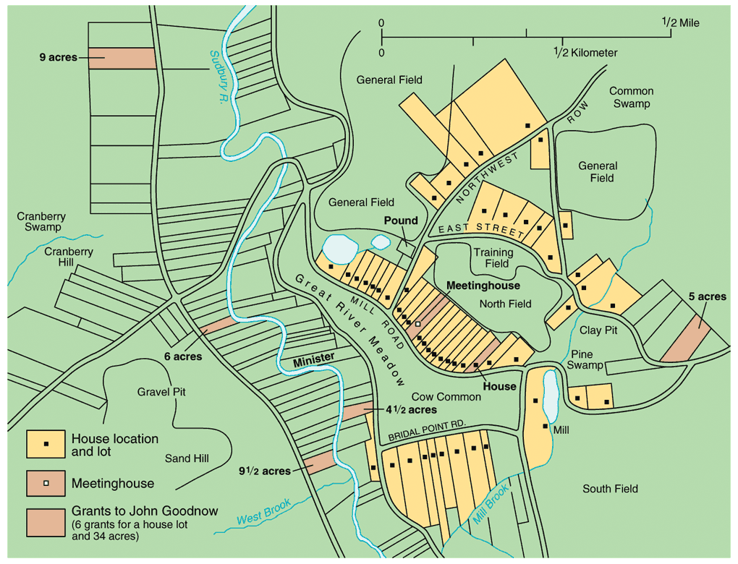
Education in New England
Law of 1642
“Old Deluder Satan” Act (1647)
Compulsory education
Harvard College (1636)
Oldest institution of higher learning in US
Land Division in Sudbury, MA: 1639-1656
Notes:
Pojer

Slide 63
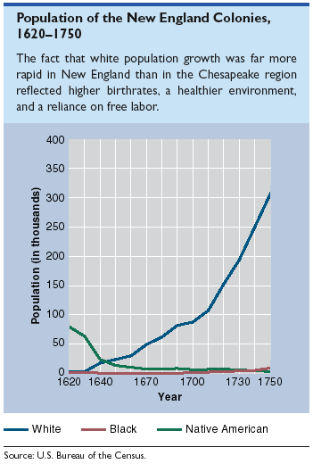
Population of the New England Colonies
Notes:
Pojer

Slide 64
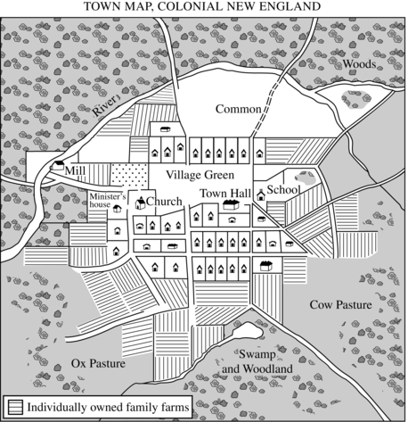

Slide 65
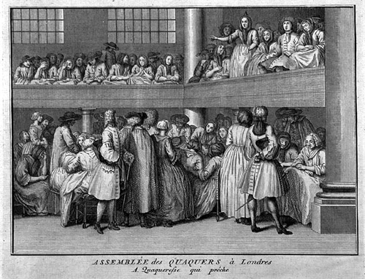
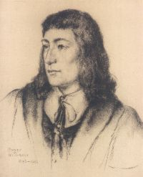
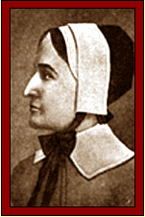
Puritan “Rebels” & Dissenters
Quakers
Roger Williams
“liberty of conscience”
Anne Hutchinson
“antinomianism”
Notes:
Pojer

Slide 66
Decline of Puritanism
Lost religious zeal
Decrease in conversions
Jeremiads
Half Way Covenant, 1662
Baptism for All
Salem Witch Trials, 1692

Slide 67
Rhode Island (1644)
Founded by Roger Williams
Complete religious freedom
Simple manhood suffrage (voting)
Most individualistic and independent population in the colonies

Slide 68
Connecticut (1636)
Founded by Thomas Hooker
Hartford, 1636
New Haven, 1638
Fundamental Orders, 1639

Slide 69
Maine & New Hampshire
Maine - absorbed by MBC in 1677
New Hampshire, 1679 - had been absorbed by MBC in 1641

Slide 70
New England Colonies, 1650
Notes:
Divine, America Past & Present 7e

Slide 71
Relations with Amerindians
Pequot War (1636-1637)
New England Confederation, 1643
King Philip’s War, 1675

Slide 72
King Philip’s War, 1675 – 1676)

Slide 73
Dominion of New England
Established 1686
Mercantilism
Navigation Laws
Impact of the Glorious Revolution

Slide 74
Economy of New England
Impacted by geography and demographics
Less ethnic diversity
Protestant Work Ethic

Slide 75
New England Society
Puritan contributions to American character:
Democracy
Perfectionism
Protestant Work Ethic
Education
Harvard
College of William & Mary
Tightly knit society
Family Life

Slide 76
Middle Colonies
New York, Pennsylvania, Delaware, New Jersey

Slide 77
Middle Colonies, 1685
Notes:
Divine, America Past & Present 7e

Slide 78
The Middle Colonies
Pennsylvania
*Estb 1681 by William Penn
“Holy Experiment”
Dutch New Amsterdam
*purchased from Indians
*absorbed Swedish settlements
*Company Town
Quaker Characteristics
-dissenting group in England
-Egalitarian, pacifist, tolerant
-’Friends’
Immigration
-Many ethnic & religious groups came; esp. Germans & Scotch-Irish
-Prosperous & Diverse
English gain New York;
*1664- Taken w/out a fight
*Dutch Influence continued *Slaves= 1/5th of NYC
Delaware
Dutch→ Swedes→ English
*separate from PA in 1704
New Jersey
*Duke of York gives to 2 royal proprietors 1664
*Became Royal Colony in 1702

Slide 79
Characteristics
Excellent land for farming
Three rivers - Susquehanna, Delaware & Hudson
Less aristocratic
Fewer industries than New England, but more than the South
Ethnically mixed population
Religious tolerance
Urban

Slide 80
New York
Henry Hudson
New Netherlands (1623)
– Peter Minuit
– Manhattan
New Amsterdam
– Patroonships
New York (1664)

Slide 81
New York (Continued)
New York Charter of Liberties, 1683
Leisler’s Rebellion, 1691

Slide 82
Beaver Wars
New Netherlands & Iroquois
New France & Huron

Slide 83
Pennsylvania
Quakers
William Penn
Holy Experiment
Characteristics
Royal Land Grant to Penn
Notes:
http://www.wadsworth.com/history_d/special_features/image_bank_US/1517_1705.html

Slide 84
New Jersey & Delaware
New Jersey, 1702
Delaware, 1703

Slide 85
Colonial Lifestyle
About 80% of colonists were farmers!
Compared to Europeans, American colonists had a higher standard of living.
Land was cheap
Wages were 3x that of Europe

Slide 86
Similarities Among Colonies
Mostly English
Possessed British freedoms
Self-government
Religious toleration (in most cases)
Educational opportunities
Economic opportunities
Unique from the British monarchy in character

Slide 87
Enlightenment
A Revolution in Thought

Slide 88
Understanding the Enlightenment
Classical Liberalism
Liberty
Equality
Human Dignity
Science, Progress, Rationality
Representative Government
Important Thinkers
John Locke
Baron de Montesquieu
Adam Smith
Deism

Slide 89
A Tale of Two Men
Benjamin Franklin:
Philip Vickers Fithian:

Slide 90
What was the Enlightenment?
Self improvement
Employing reason
“Citizen of the World”
Historical view - progress

Slide 91
Enlightenment & Religion
The Jefferson Bible

Slide 92
Enlightenment & Education

Slide 93
Enlightenment & Science

Slide 94
Enlightenment & Politics

Slide 95
The Great Awakening
Religious Revival in the 1730s

Slide 96
Religion in the Early 1700s
Limited church membership
Religious dissenters in established churches
Major Religious Groups:
Anglican Church
Congregational Church
Presbyterian Church
Quakers
Jews

Slide 97
Overview of Great Awakening
1st Mass Social Movement in America
Two issues:
Crisis within the ministry
Crisis between clergy and the laity
Reaction to the elaborate theological doctrines and emotional stagnation
Arminianism - Directly challenged Calvinism’s predestination saying that man was not helpless in achieving salvation

Slide 98
Jonathan Edwards
Credited with starting the Great Awakening
Most influential theological writer and thinker of the movement
Believed in dependence on God’s grace
Emphasized eternal damnation

Slide 99
George Whitefield
Field preaching
Highly emotional sermons

Slide 100
Old Lights vs. New Lights
Old Lights: orthodox and liberal clergymen deeply skeptical of emotionalism and the theatrics of the revivalists
New Lights: supported the Awakening for revitalizing American religion; used emotionalism to move followers

Slide 101
Significance of the Great Awakening
Split denominations thus increasing the competitiveness of American churches
Converted many thousands of people
Undermined the powerful older clergy
Encouraged a new wave of missionary work among Amerindians and slaves
Founding of “new light” colleges

Slide 102
Enlightenment and Great Awakening
Natural right to choose own faith
Greatest impact on elites who will protect religious liberty
Rights of dissenters to worship without state interference
Evangelicals and enlightened liberals would write religious liberty into law

Slide 103
Religion: Diversity
Tolerance?
Great Awakening
George Whitefield
Religious Diversity in 1750
Notes:
Henretta, America’s History 5e from http://www.bedfordstmartins.com/mapcentral

Slide 104
The Atlantic World

Slide 105
The Rise of the American Merchant, 1750
Notes:
Henretta, America’s History 5e from http://www.bedfordstmartins.com/mapcentral

Slide 106
Salutary Neglect

Slide 107
Navigation Laws
1651, first Navigation Act passed prevented Dutch trading with America
1660, England banned colonial trade with any other country except England
1663, all goods shipped from Europe had to go through England for tax purposes
1673, England imposed taxes on coastal trade among the colonies

Slide 108
Wool Act, 1699: forbade exportation of colonial wool or products and imposed tax on wool products imported to colonies
Molasses Act, 1733: Britain wanted to stop colonial trade with West Indies
The Iron Act, 1750: further restrictions on colonial metal production

Slide 109
Zenger Trial
John Peter Zenger - NY Printer
1733 - accused of libel (criticizing the government)
Found not guilty
Significance: Newspaper publishers felt more free to print honest views

Slide 110
Credits
Mr. Long
Anderson High School
Cincinnati, Ohio
Sue Pojer
Mr. Gouge
Daniel Boone High School, TN

