Slide 1
APUSH Period 1
1491-1607

Slide 2
Key Concept 1.1
As native populations migrated and settled across the vast expanse of North America over time, they developed distinct and increasingly complex societies by adapting to and transforming their diverse environments.

Slide 3
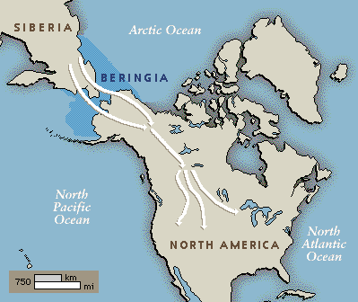
Land Bridge Theory

Slide 4
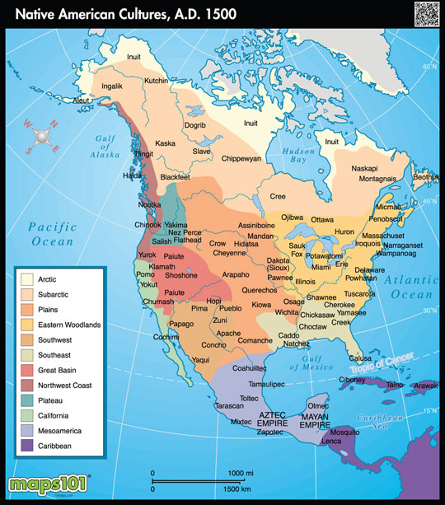

Slide 5
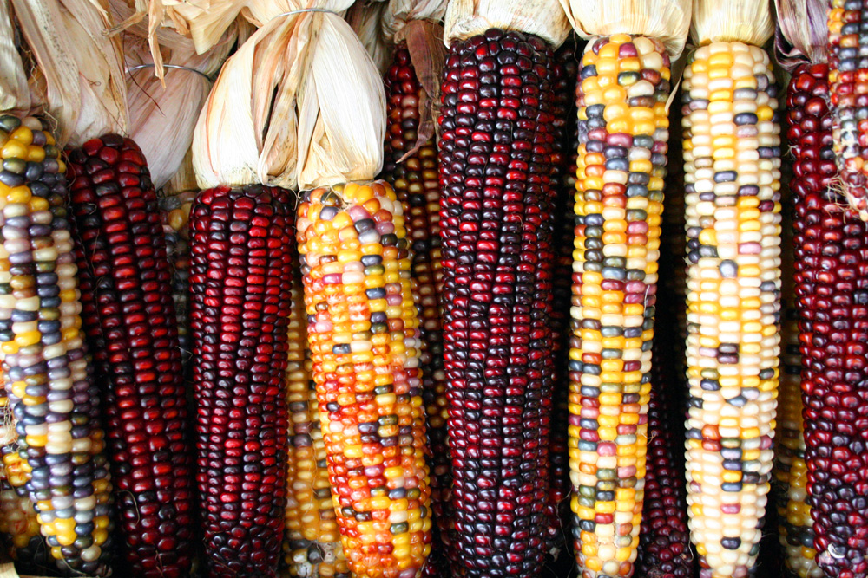
Maize

Slide 6
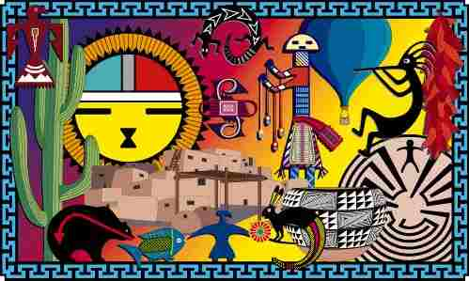
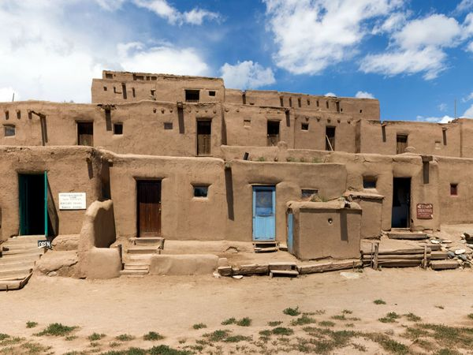
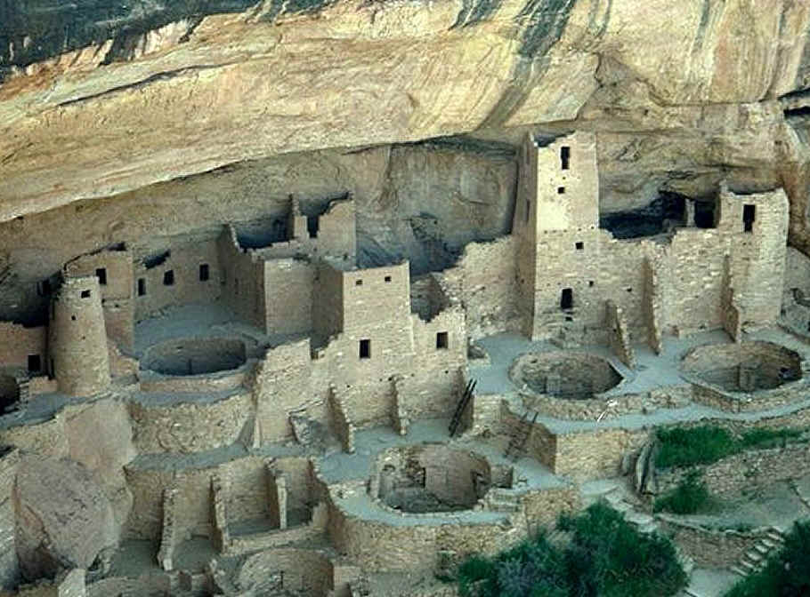
Southwest
Climate - Arid, Drought Prone
Irrigation, Maize Cultivation
Economic Development
Housing - terrace, multistory
Large towns - religious centers
Pueblo (Taos, NM)
Anasazi

Slide 7
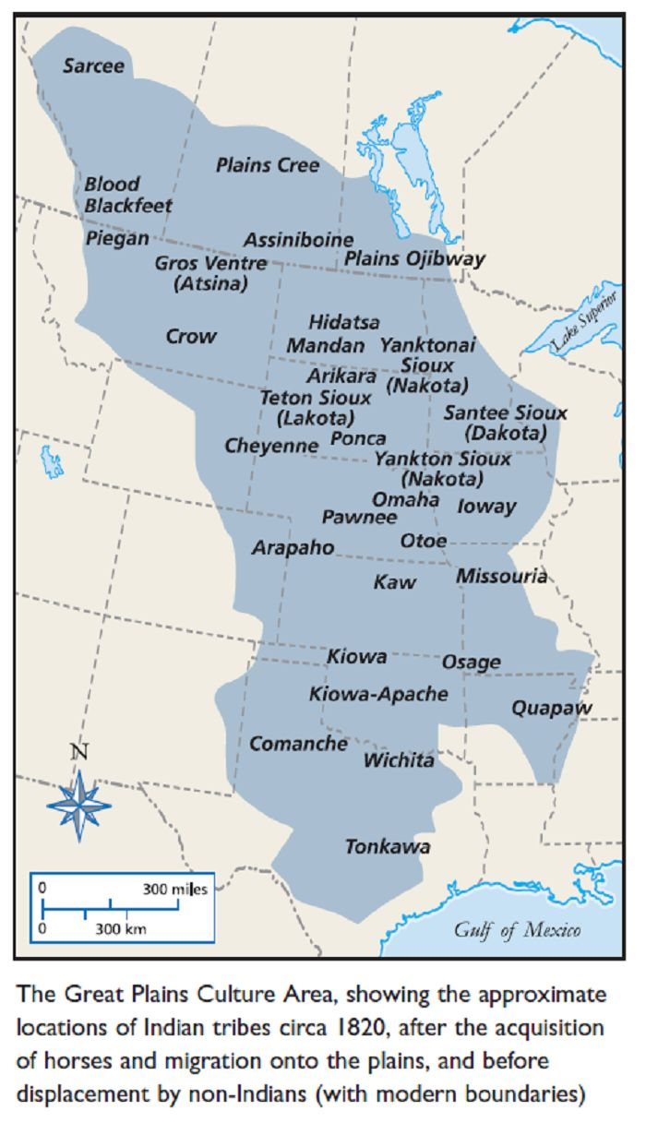
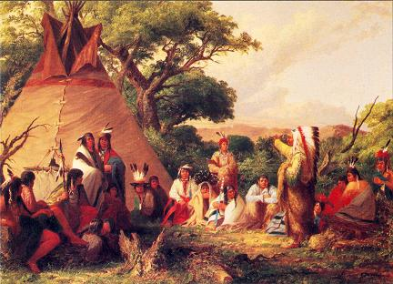
Great Plains
Scarce natural resources = nomadic
Bison
Tepees

Slide 8
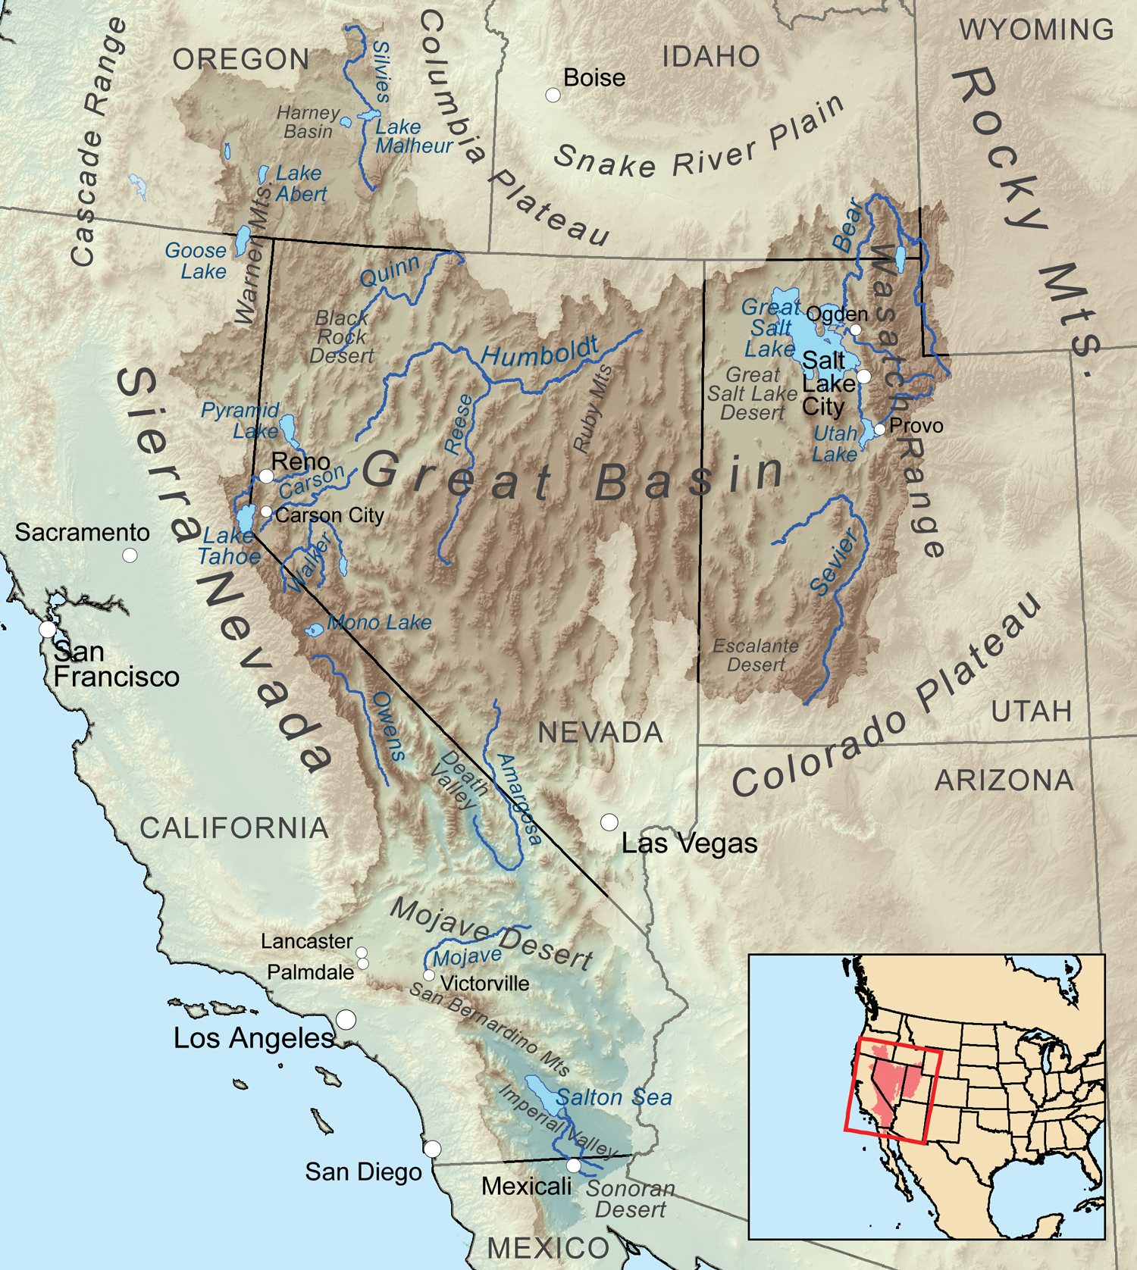
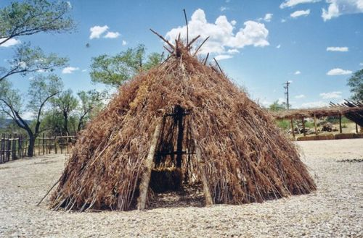
Great Basin
Some complex societies: Utes, Shoshones
Wikiups

Slide 9
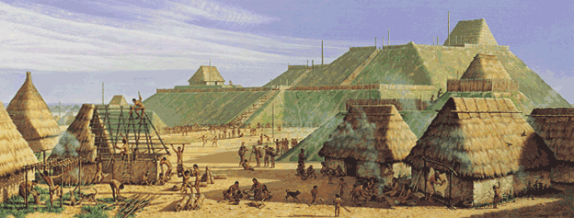
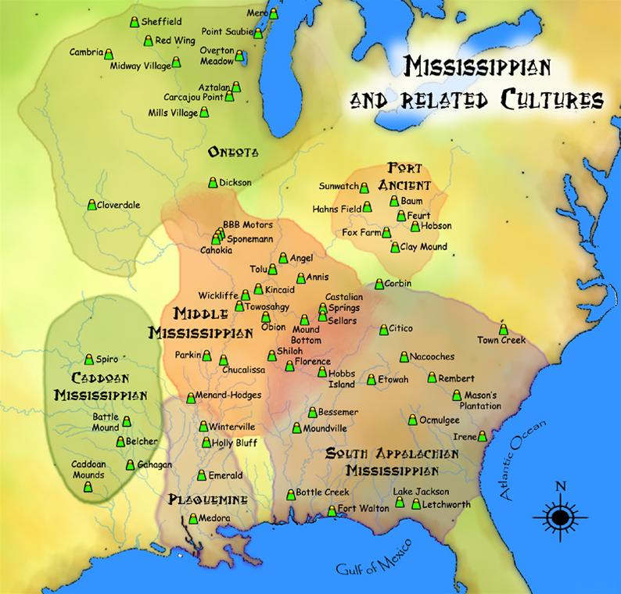
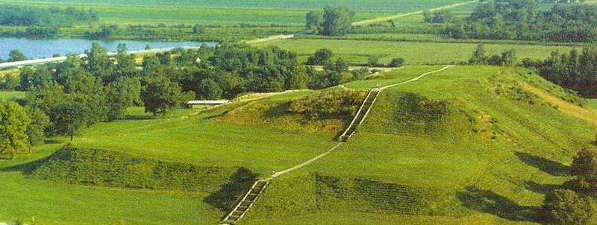
Mississippi River Valley
Sophisticated government structure
Iron tools, woven fabrics
Trade
Cahokia - largest city north of Mexico

Slide 10
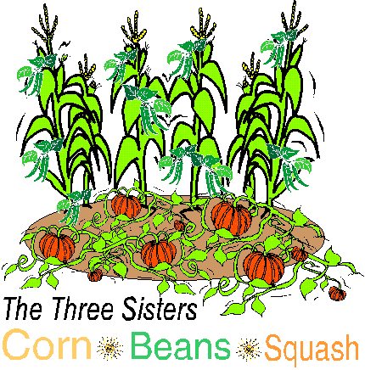
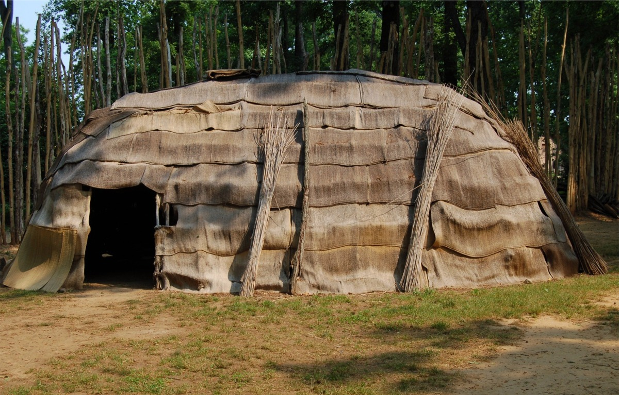
Eastern Woodlands
Diverse, complex societies
Algonquin used waterways,
Men hunt, women gather/farm
Most matrilineal and matrilocal
Extensive trade
Most abundant food resources
Semi-sedentary
Iroquois Confederacy
Mix of agriculture/hunting
Longhouse

Slide 11
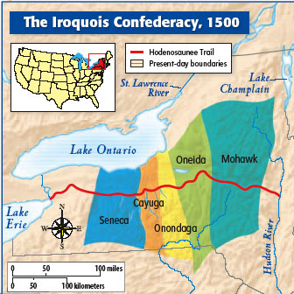
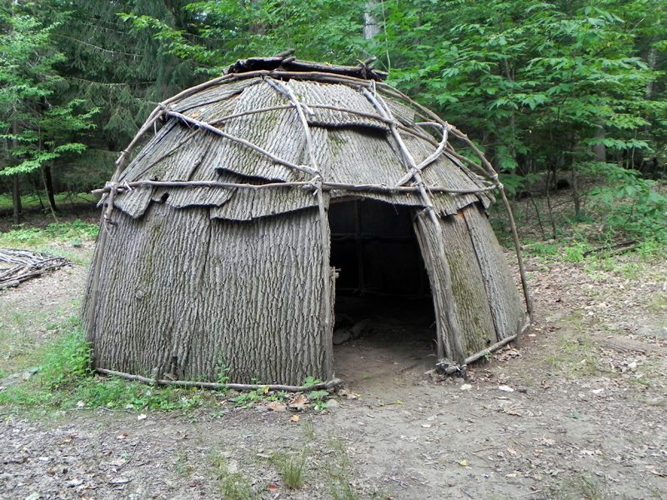
Eastern Woodlands
Wigwam
Algonquin used waterways,
Permanent settlements
Wigwams - portable homes

Slide 12
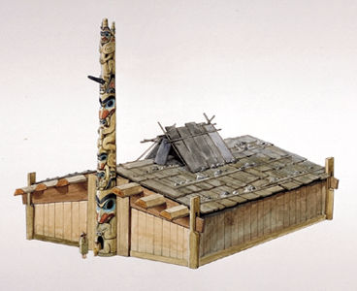
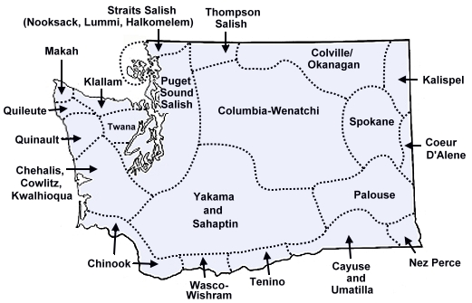
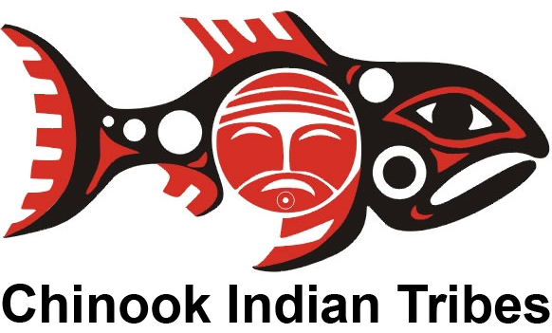
Northwest
Defined social hierarchies
Fish, elk, deer, roots, shellfish
skilled traders
longhouses of cedar and bark
clothing of grass and fur
Bow & arrow, clubs, spears

Slide 13
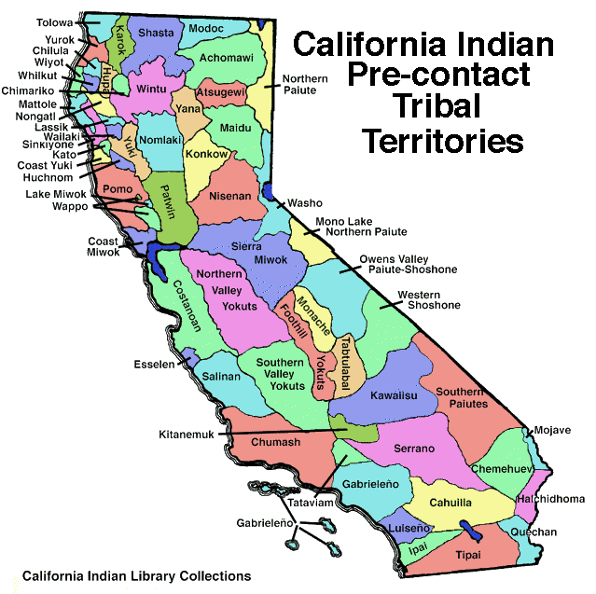
California
Six distinct regions
Colorado River - subsistence farming
Southern - complex chiefdoms
Great Basin area
Central - hunting
Northwest - woodworking
Northeast
Different environments
Desert
Mountains
Coastal

Slide 14
Review
Location | Economy | Society | Example | Notes
Southwest | Farming (Maize) | Towns & Large Multistory Buildings | Pueblo, Anasazi | Developed Irrigation, Arid Desert Climate, Drought
Northwest | Fishing, Elk Hunting, Whaling | Isolated, Permanent Villages | Chinook | Oceans, Rivers, Abundant Resources
California | Mixed: Hunt/Gather, fishing, farming | Varied depending on location |  | Mixed: coast, desert, forest
Plains | Hunt/Gather | Few Permanent Settlements, Nomadic | Sioux | Very Few Natural Resources
Middle | Farming | Ceremonial Mounds, Villages | Cahokia | Abundant Resources
Northeast | Trade, Fishing, Farming (Three Sisters) | Cities as Political & Trade Centers, Matrilineal | Iroquois, Algonquin | Many Resources Including Water Sources

Slide 15
Review Question
Briefly explain the role that geography played in shaping three specific Amerindian tribal regions.
Respond in a form of a paragraph with your group. You must include examples of at least two tribes and how those two tribes compare.

Slide 16
Key Concept 1.2
Contact among Europeans, Native Americans, and Africans resulted in the Columbian Exchange and significant social, cultural, and political changes on both sides of the Atlantic Ocean.

Slide 17
Today’s Class 8/22/17
Essential Question: What do varying accounts say about who Columbus really was?
Agenda
Lecture
Primary Source Analysis
Syllabus

Slide 18
Essential Question
What social, economic and cultural changes occurred as a result of European colonization?

Slide 19
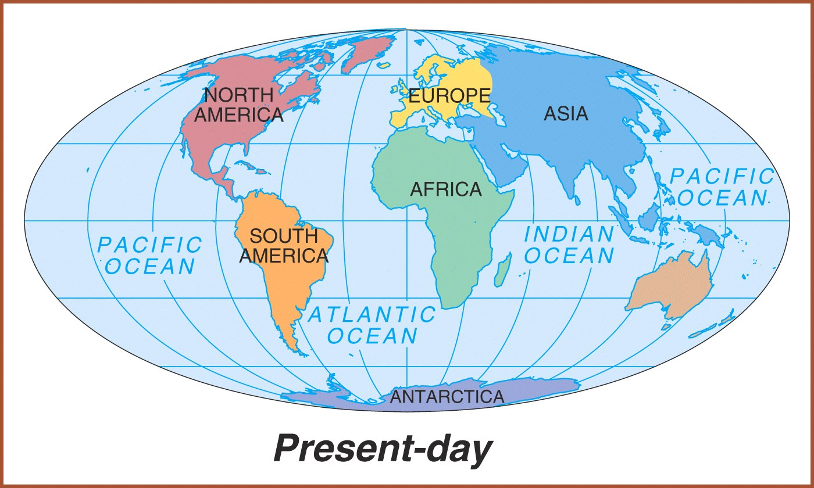
NEW WORLD
OLD WORLD

Slide 20
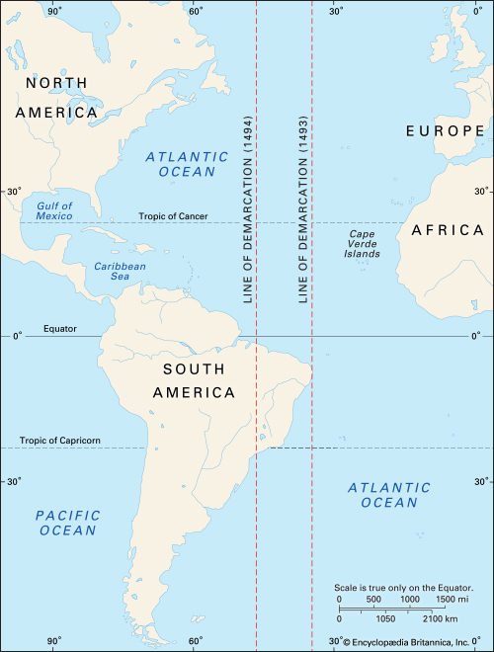
European Expansion
Historical Context
Protestant Reformation
Renaissance
England, France, Portugal & Spain
Causes:
Gold
Mercantilism
God
Glory

Slide 21
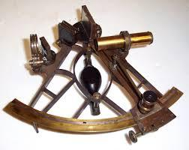
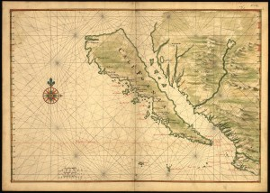
European Empire Building
Effects:
Population growth
Development of capitalism
Increased trade
Improvements in technology
Cartography
Mapped wind patterns
Map of California shown as an island, circa 1650, by Joan Vinckeboons; Library of Congress, G3291.S12 coll .H3 Vault: Harr vol. 2, map. 10

Slide 23
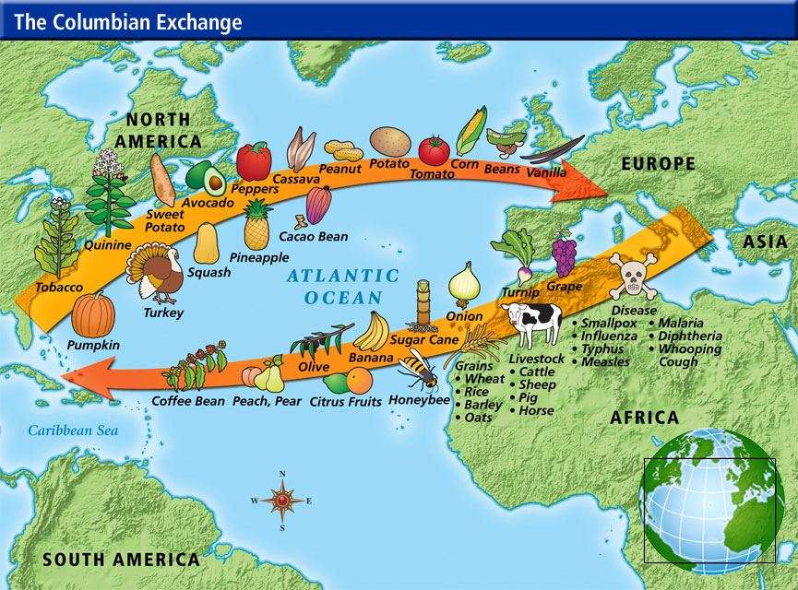

Slide 24
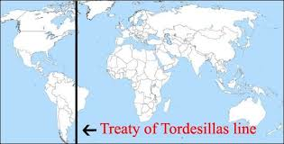
Treaty of Tordesillas (1494)
After Columbus’ return to Europe, Spain and Portugal sought to resolve future territory disputes in the New World through a treaty.
Spain was granted a large amount of territory in the Americas, and Portugal was given all of Africa.
Notes:
Ended here on 8/23

Slide 25
Treaty of Tordesillas (1494)
Notes:
Key Concepts 1.2.I.A, 1.2.I.C

Slide 26
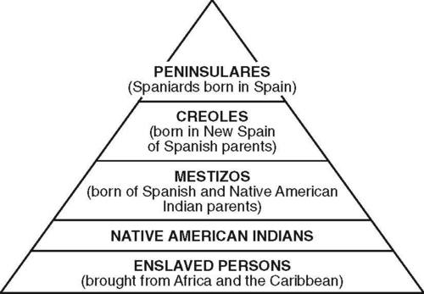
Demographic and Social Changes
Crops & Livestock
Deadly epidemics
Mixed populations (mestizo, mullato, zambo)
Caste system
Encomienda System
Natives were given to Colonists in
Exchange Christianizing them.
Repartimento System
Forced labor

Slide 27
The Colonial Class System
Peninsulares
(Spanish born Spaniard)
Creoles (Colonial born Spainard)
Mestizos (Spanish and Indian)
Mulattos (Spanish and black)
Native Indians
Black Slaves
Notes:
Mestizo: people of mixed Indian and European heritage
– Mulatto: people of mixed white and black ancestry

Slide 28
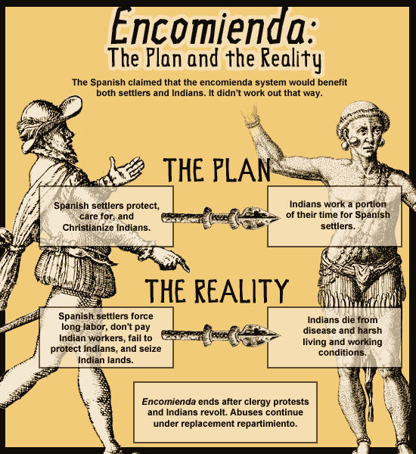
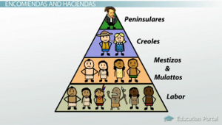
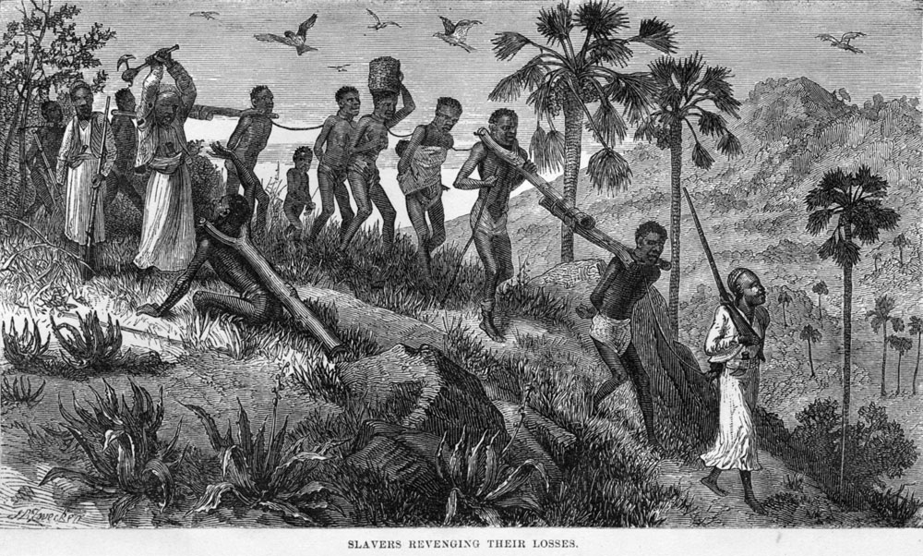
Spanish & Portuguese

Slide 29
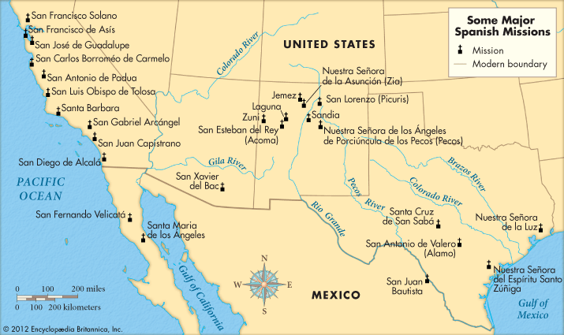
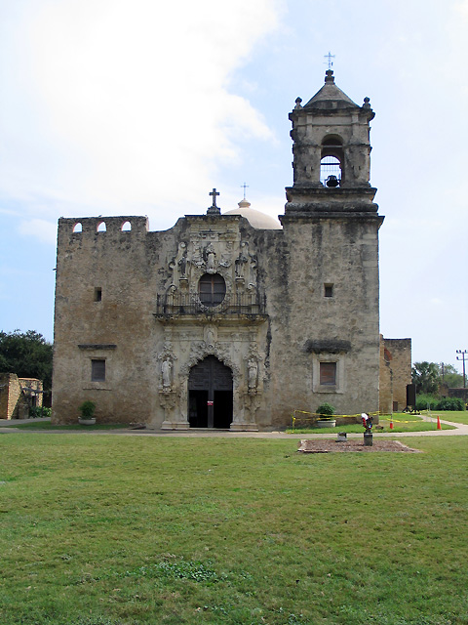
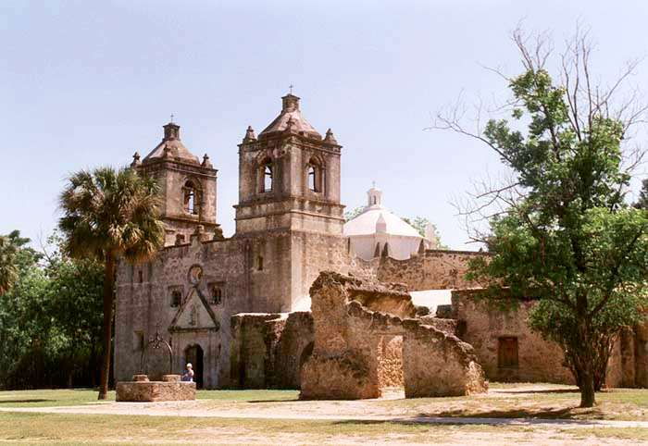
Spanish Mission System

Slide 30
Amerindian and African Views
Amerindian Resistance
Battle of Acoma, 1599
Pueblo Revolt/Pope’s Rebellion, 1680
African Cultural Preservation - Syncretism
Caribbean/Brazil - Maroon Communities
Notes:
hybridization or amalgamation of two or more cultural traditions.
Maroons were Africans who had escaped from slavery in the Americas and formed independent settlements.

Slide 31
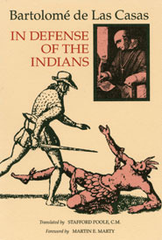
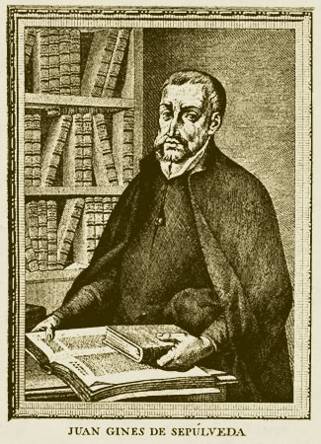
Valladolid Debate (1550-1)
What is the criteria for waging war against Natives?
Bartolome de Las Casas
Juan de Sepulveda
Black Legend Historiography
Notes:
Valladolid debate (1550–1551) was the first moral debate in European history to discuss the rights and treatment of a colonized people by colonizers.

