Slide 1
Articles of Confederation & Shay’s Rebellion
Building a New Nation
The Struggle is Real
Notes:
Shaky Start Towards a Union
Americans struggled with creating & operating a central government.
At this time, “America” was more of an idea than a nation.
– Espoused “natural rights” & regarded authority figures with suspicion
– Common purpose (independence) among factions is now gone – how to agree & move forward?
• Urban & rural, wealthy & poor, north & south, slave & free all have to fashion new government TOGETHER.
– BUT the new Patriot upper class would steer the new nation.
• Leaders like George Washington, James Madison, John Adams, Thomas Jefferson, and Alexander Hamilton

Slide 2
Good Morning Students
Please pick up handout by the entrance.

Slide 3
EQ:
What were the strengths and weaknesses of the Articles of Confederation (AOC)? How did Shay’s Rebellion expose those weaknesses?
Agenda
Overview of AOC
Primary Source Analysis-Shay’s Rebellion
Pass back papers

Slide 4
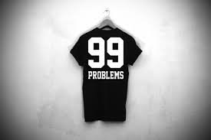
TPS
List at least 5 tasks/problems the new independent states & Patriots will have to deal with.

Slide 5
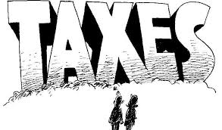
Problems at the end of the AR
Fear of a strong central government
Inflation (high prices of goods)
To tax or not to tax?

Slide 6
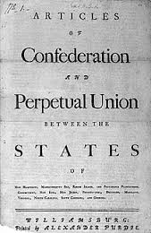
Creating a Confederation
Second Continental Congress sought to provide some form of a central government to unite colonies
The product was known as the Articles of Confederation
All 13 colonies approved 7 months before Yorktown

Slide 7
Weaknesses
1. The federal government could not tax
2. States did not have to follow federal laws
3. States had their own laws and did not have to follow other state laws.
4. No executive branch or national court system.
5. Any amendment required all 13 states’ approval.
WHY ARE THESE WEAKNESSES???

Slide 8
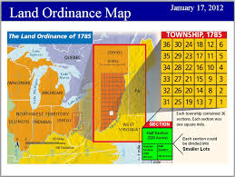
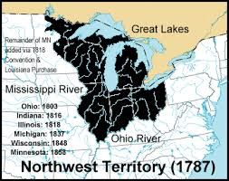
Strengths
Land Ordinance of 1785
Establish plan for dividing new territory west of Appalachian mountains
Each township required to set 1 square mile for the purpose of building schools & providing education
Northwest Ordinance of 1787
Outlined the process for how territories of the U.S. would be admitted as states
outlawed slavery in the Northwest territory

Slide 9
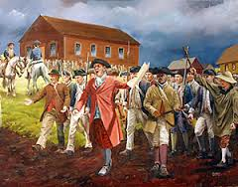
The weaknesses in the AOC became evident with Shay’s Rebellion (1786)
In groups read A Proclamation of Shaysite Grievances (1786) and answer the questions and then read George Washington’s Response on the back and answer the questions.

