Slide 1
Second Wave Feminism

Slide 2
We teach girls to shrink themselves To make themselves smaller We say to girls "You can have ambition But not too much You should aim to be successful But not too successful Otherwise you will threaten the man" Because I am female I am expected to aspire to marriage I am expected to make my life choices Always keeping in mind that Marriage is the most important Now marriage can be a source of eJoy and love and mutual support But why do we teach girls to aspire to marriage And we don't teach boys the same? We raise girls to treat each other as competitors Not for jobs or for accomplishments Which I think can be a good thing But for the attention of men We teach girls that they cannot be sexual beings In the way that boys are Feminist: the person who believes in the social Political, and economic equality of the sexes
To what extent is this passage true?

Slide 3
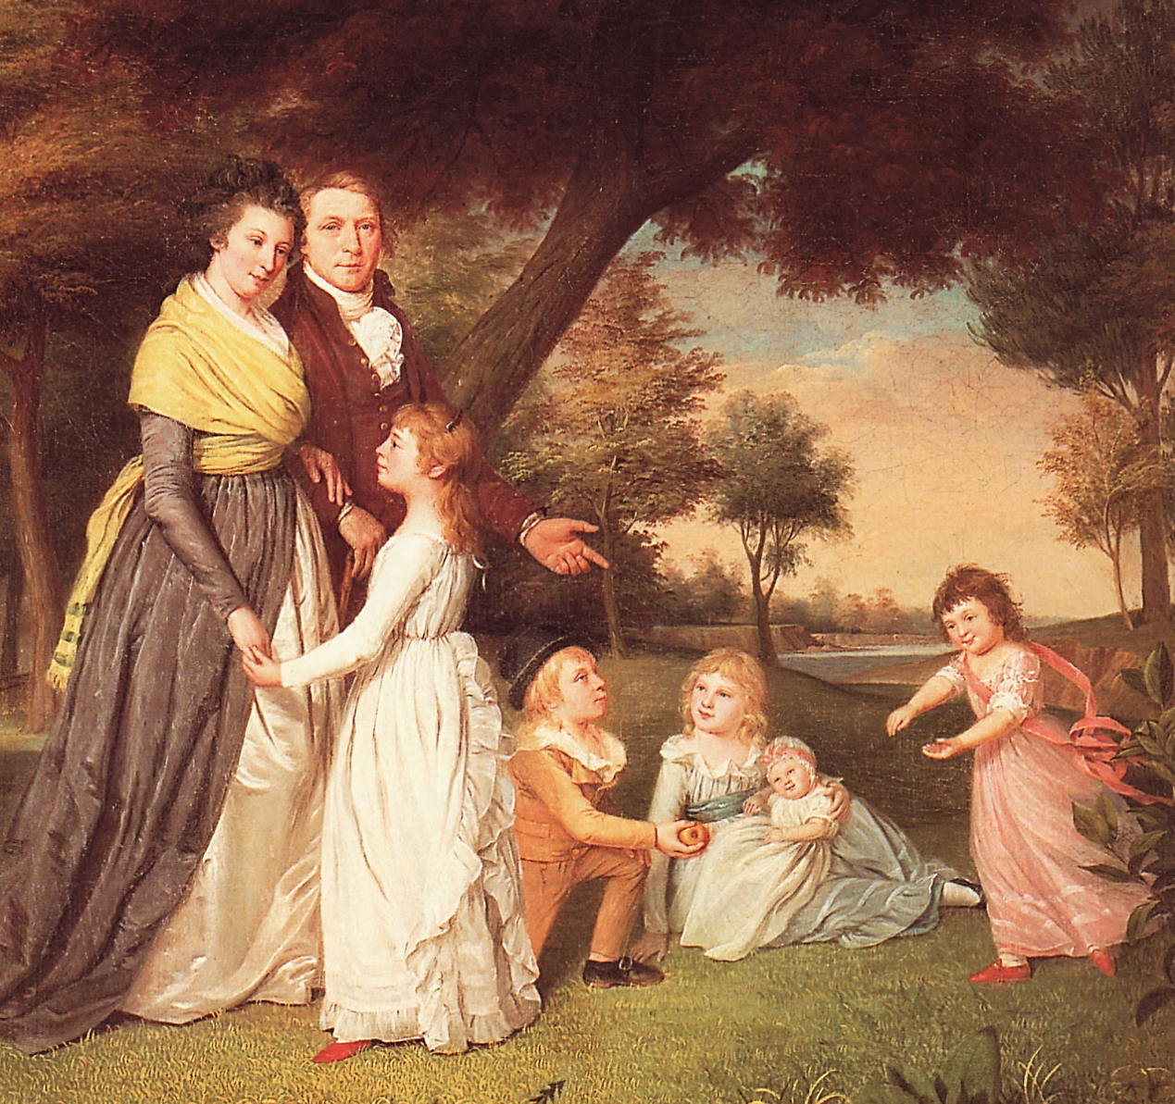
Republican Motherhood
Duty of mothers to teach their sons political ideals & citizenship
“Civic virtue”

Slide 4
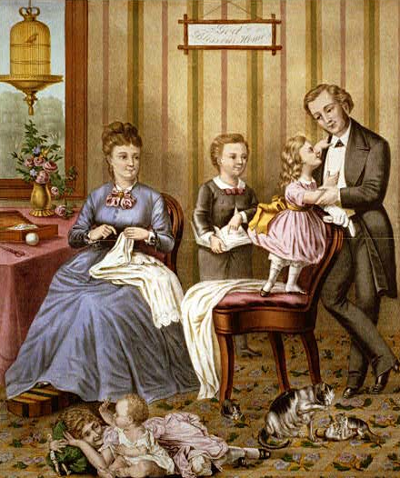
Cult of Domesticity
Home is a “haven in a heartless world”
Home is the woman’s “sphere”
Piety
Purity
Domesticity
Submissiveness
Women play a “civilizing” role on husbands

Slide 5
Review of First Wave Feminism 1848-1920

Slide 6
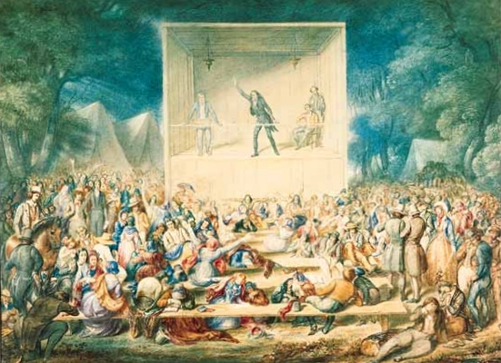
2nd Great Awakening

Slide 7
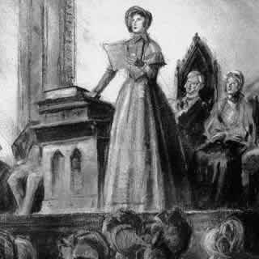
Seneca Falls Declaration of Sentiments, 1848
Organized by Lucretia Mott & Elizabeth Cady Stanton
Modeled on Declaration of Independence
“All men and women are created equal”
List of grievances against patriarchal society

Slide 8
Women in 19th Century Reform Movements
Abolition
Education
Temperance
Asylums & Prisons
Suffrage

Slide 9
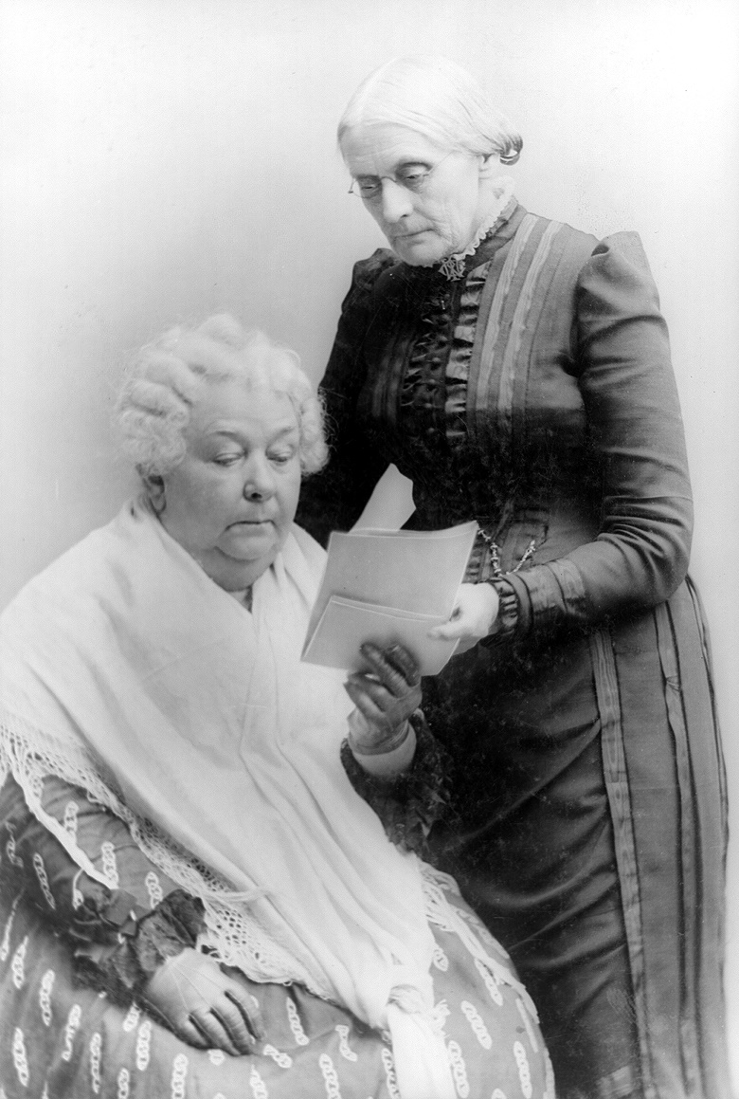
19th Century Leaders
Lucretia Mott & Elizabeth Cady Stanton
Seneca Falls Convention
Catharine Beecher & Elizabeth Blackwell
Education
Dorothea Dix
Prisons & mental health
Sojourner Truth & Harriet Beecher Stowe
Abolitionism
Susan B. Anthony, Victoria Woodhull
Suffrage & property rights

Slide 10
Women in Progressive Reform Movements
Muckraking
Immigration
Temperance
Labor rights
Suffrage

Slide 11
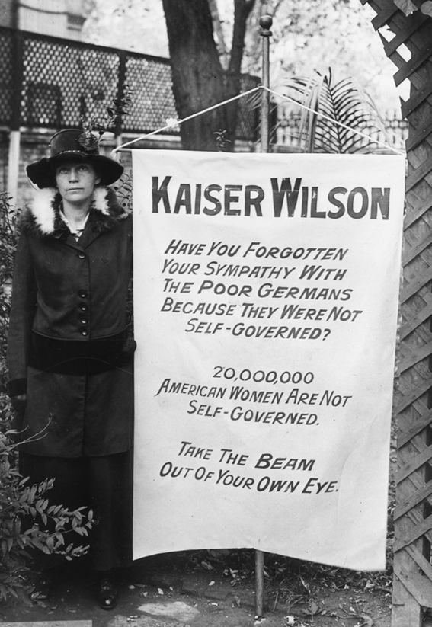
Progressive Era Leaders
Mary Elizabeth Lease
Populism
Ida Tarbell & Nellie Bly
Muckraking
Florence Kelly
Workplace reform & labor unions
Jane Addams
Immigration
Carrie Nation
Temperance
Carrie Catt & Alice Paul
Women’s suffrage

Slide 12
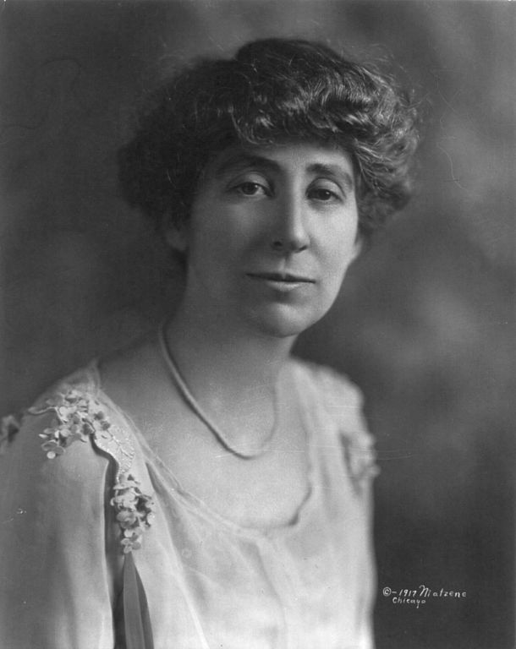
Jeanette Rankin
First woman elected to Congress (D-Montana) in 1916
Progressive
Pacifist

Slide 13
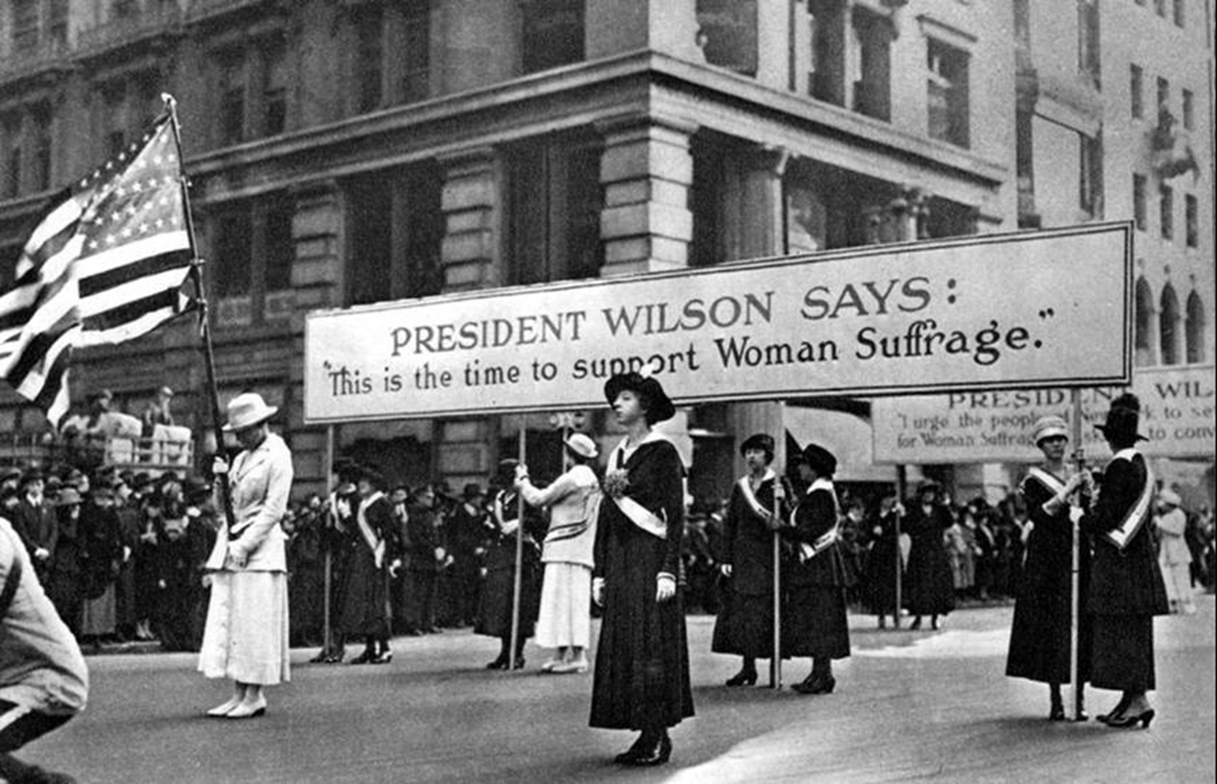
19th Amendment, 1920-End of first wave

Slide 14
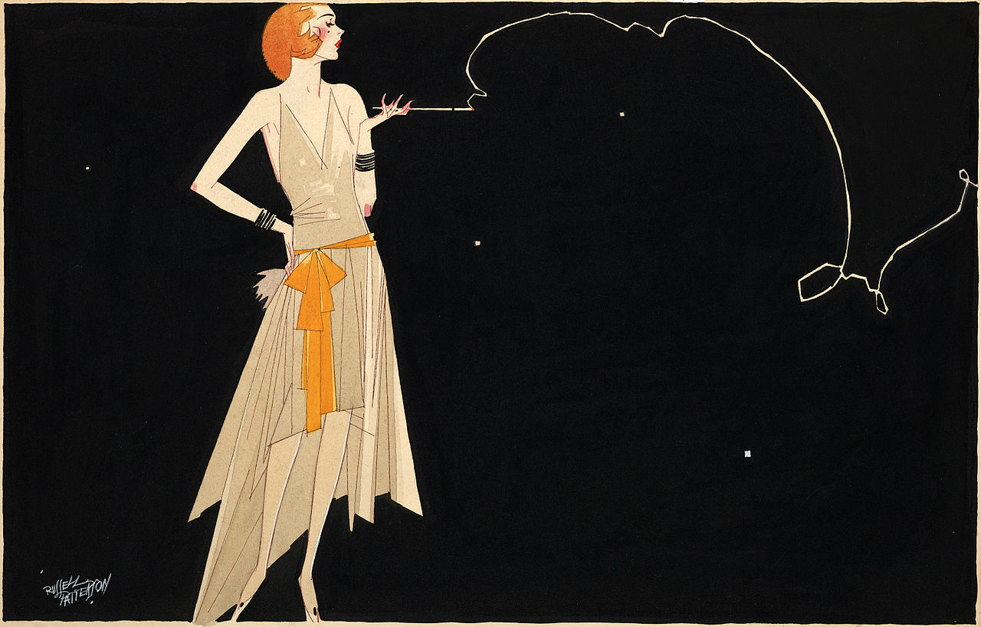
1920s Flapper Girls

Slide 15
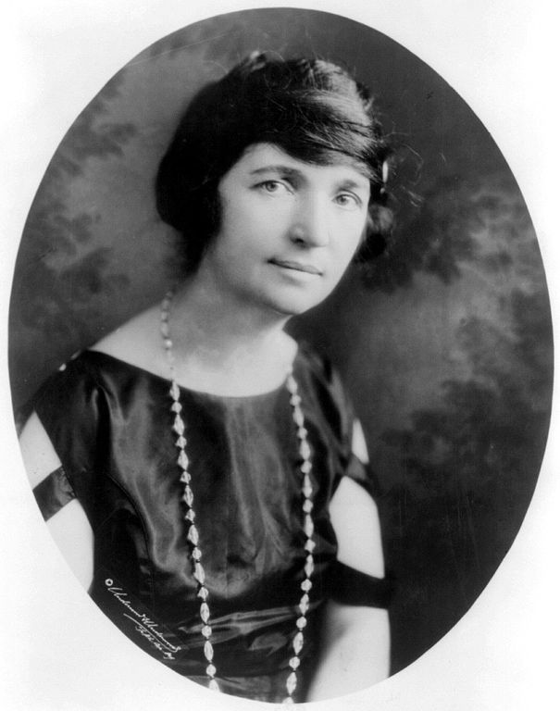
Margaret Sanger
Advocate of contraception & family planning
Founder of Planned Parenthood

Slide 16
Review of Women in the Thirties, Forties & Fifties

Slide 17
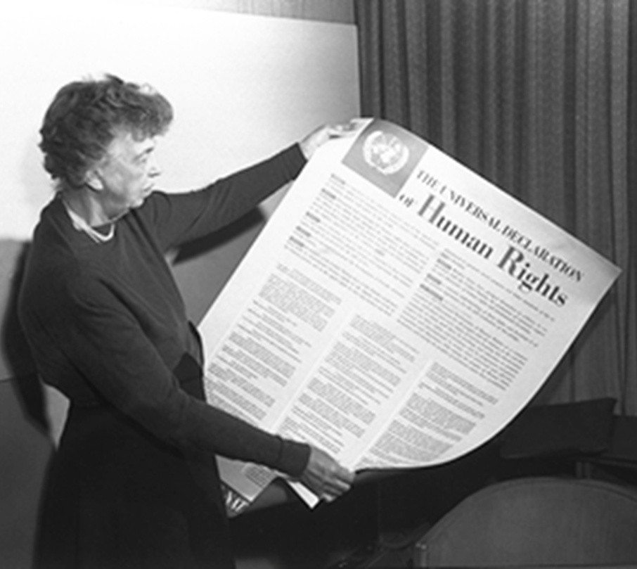
Eleanor Roosevelt
FDR’s wife
First politically-active First Lady

Slide 18
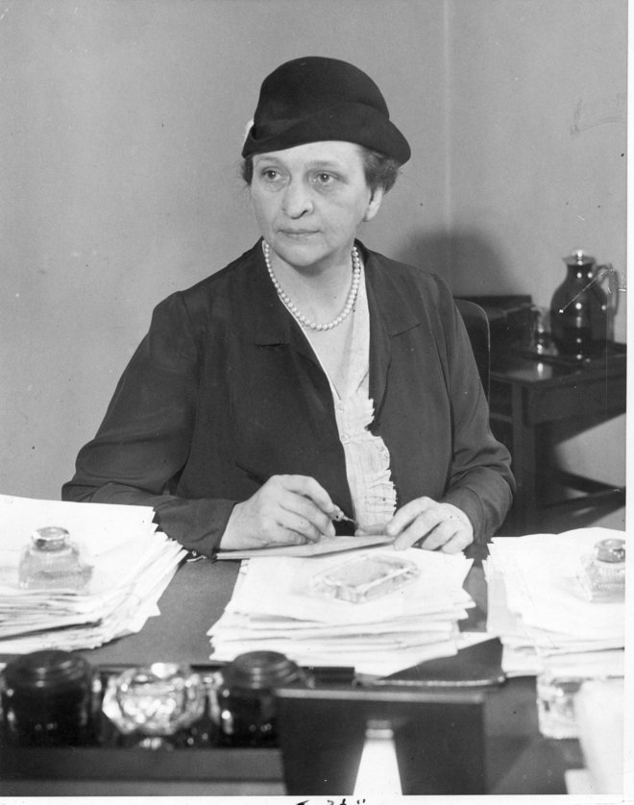
Frances Perkins
FDR’s Secretary of Labor
First female cabinet member

Slide 19
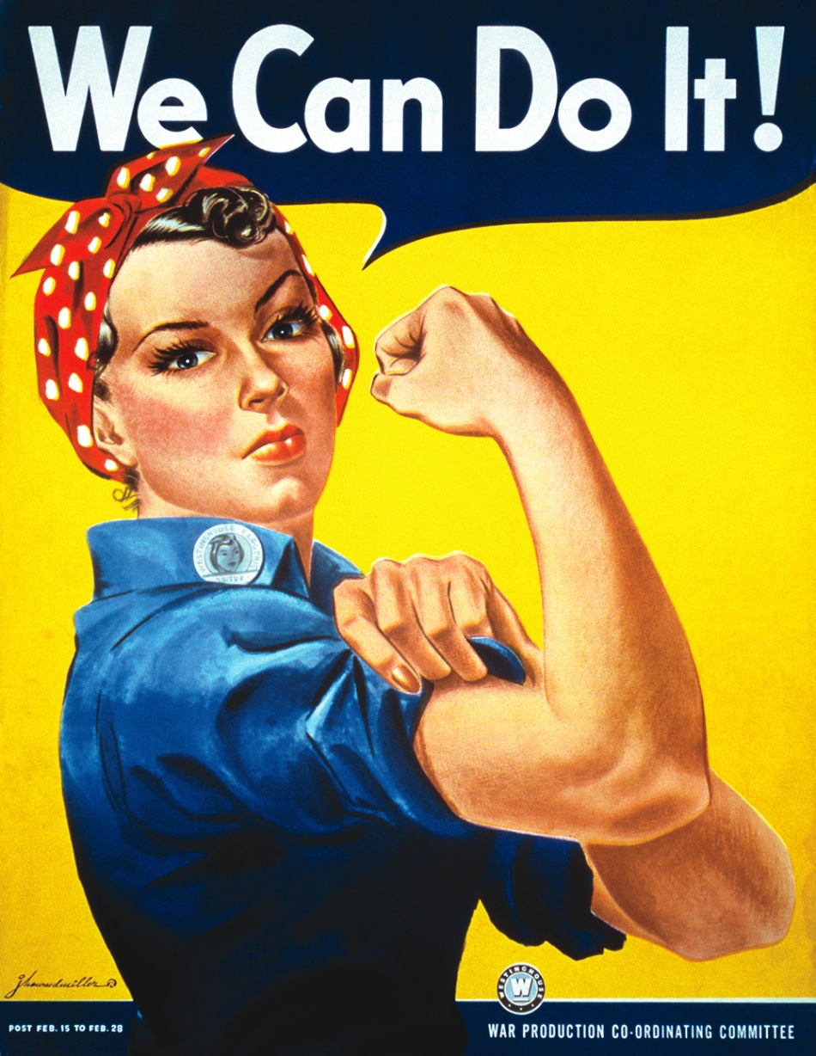
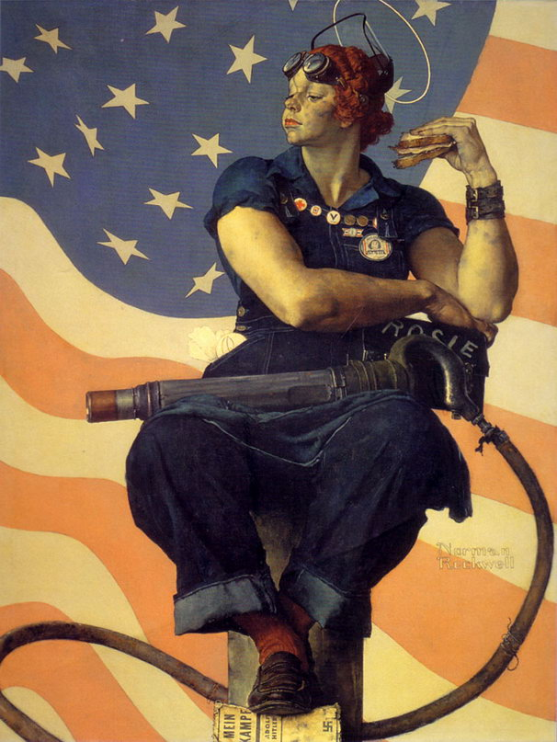
Rosie the Riveter

Slide 20
“Pink Collar” Jobs

Slide 21
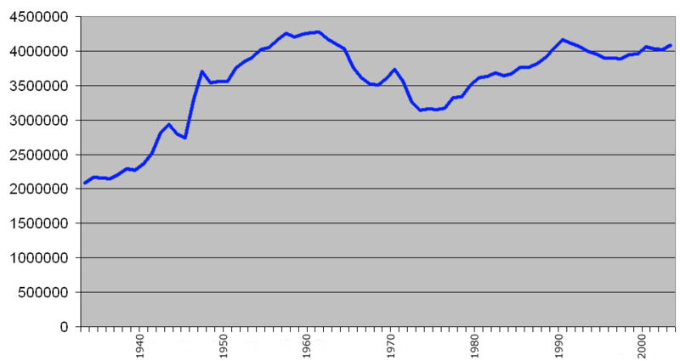
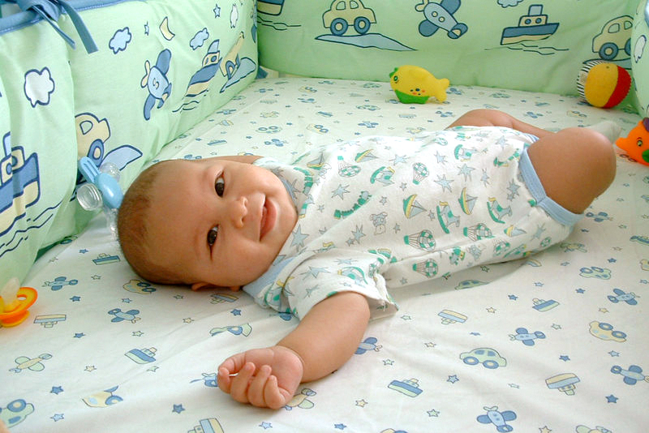
Baby Boom
Births in the United States

Slide 22
Post-WWII Housewives

Slide 23
The Second Wave Begins 1960s

Slide 24
Origins of 2nd Wave Feminist Movement
First Wave Feminist Movement: 1840s -1920s Culmination with 19th Amendment; mostly focused on suffrage; liberal, upper/middle class, white
Multiple Sources:
New Left Organizations: female activists challenge sexism in organizations; follow older female leaders; demand respect and authority from male counter parts (interracial)
Middle Class Culture: books and magazines published discussed women’s position and condition (The Feminine Mystique) – created awakening in middle class white women
Anti Poverty Campaigns: women in poor communities organized to improve conditions – demanded more authority in these communities

Slide 25
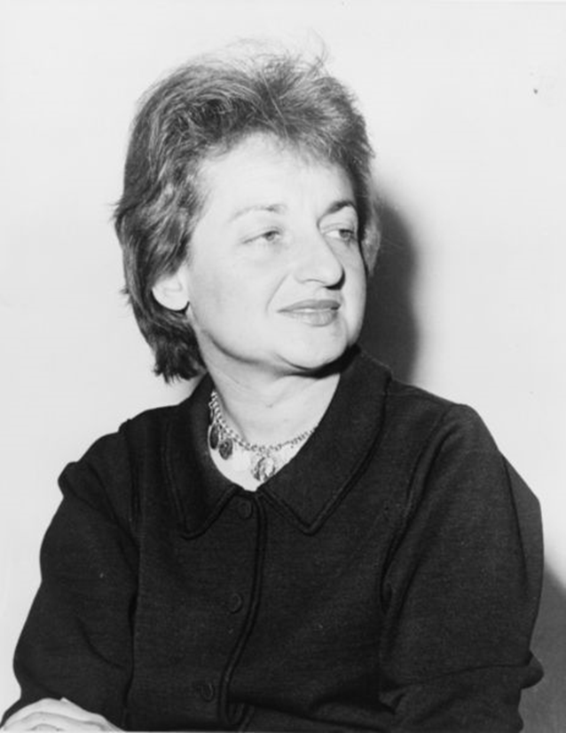
Betty Friedan
Author of The Feminine Mystique, 1963
Founder of the National Organization for Women (NOW), 1966

Slide 26
The Feminine Mystique
Women’s search for purpose independent of household & family obligations
Identity
Education
Career
Beginning of 1960s women’s movement

Slide 27
National Organization for Women
“NOW”
Focus & goals
Workplace equality
Stop violence against women
Reproductive rights

Slide 28
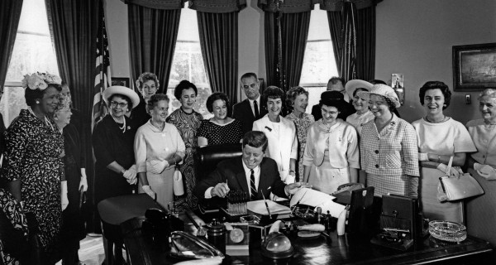
Equal Pay Act, 1963

Slide 29
Civil Rights Act of 1964
Outlawed discrimination based on “race, color, religion, sex, or national origin” by government & public accommodations

Slide 30
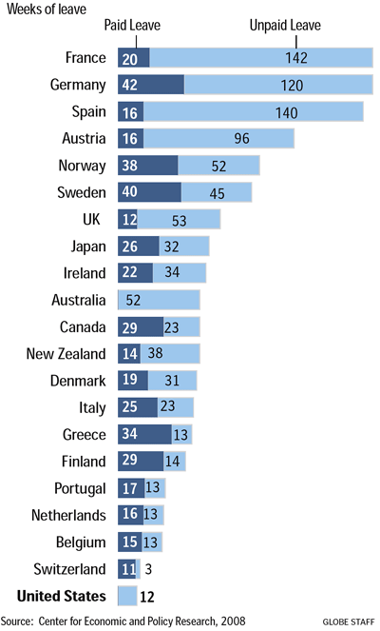
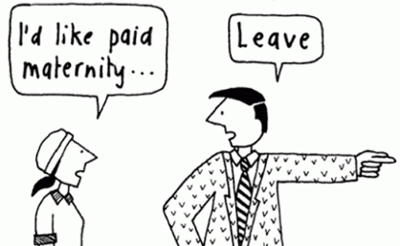
Maternity Leave?

Slide 31
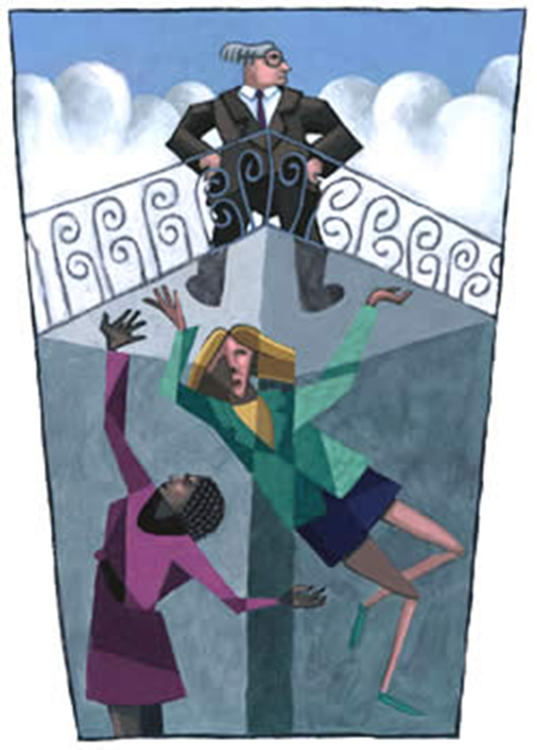
Glass Ceiling
Barrier to women entering top management positions?
“Good old boys club”?

Slide 32
Sexual Harassment

Slide 33
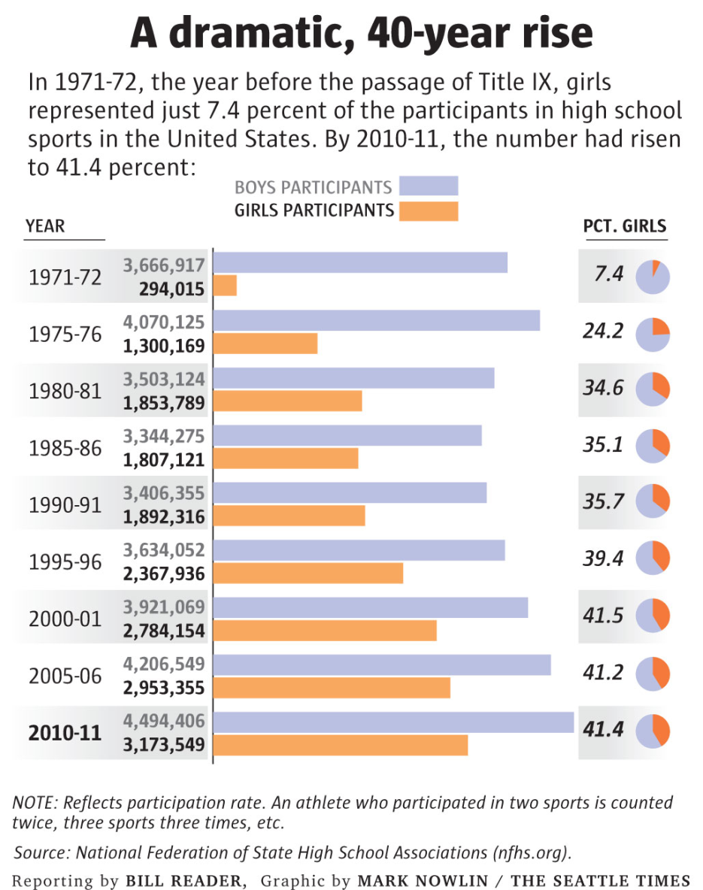
Title IX, 1972
Requires equal educational opportunities for females
Major expansion of girls’ athletics programs in public schools

Slide 34
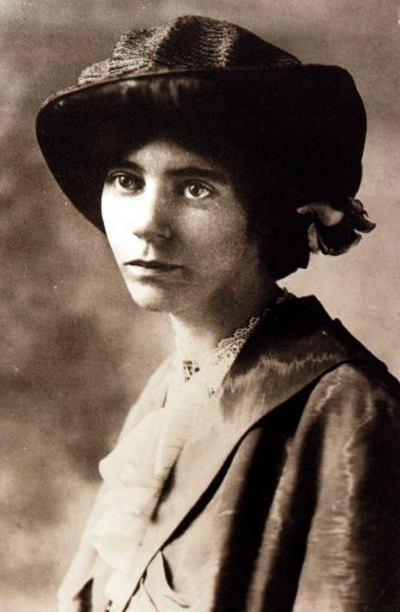
Equal Rights Amendment
Drafted by Alice Paul in 1923
Campaign for ratification in 1970s
Ratification failed by its 1982 deadline
“Equality of rights under the law shall not be denied or abridged by the United States or by any State on account of sex.”

Slide 35
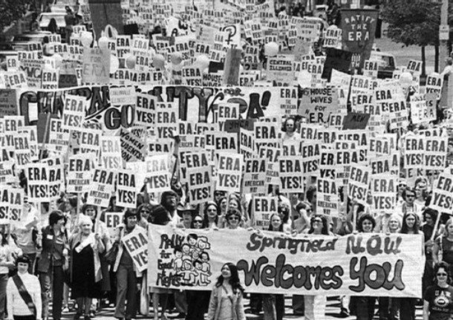
ERA Ratification Movement

Slide 36
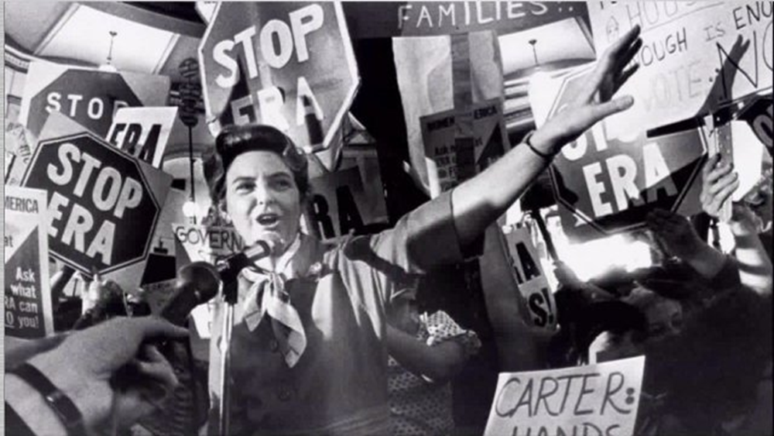
Stop ERA Movement

Slide 37
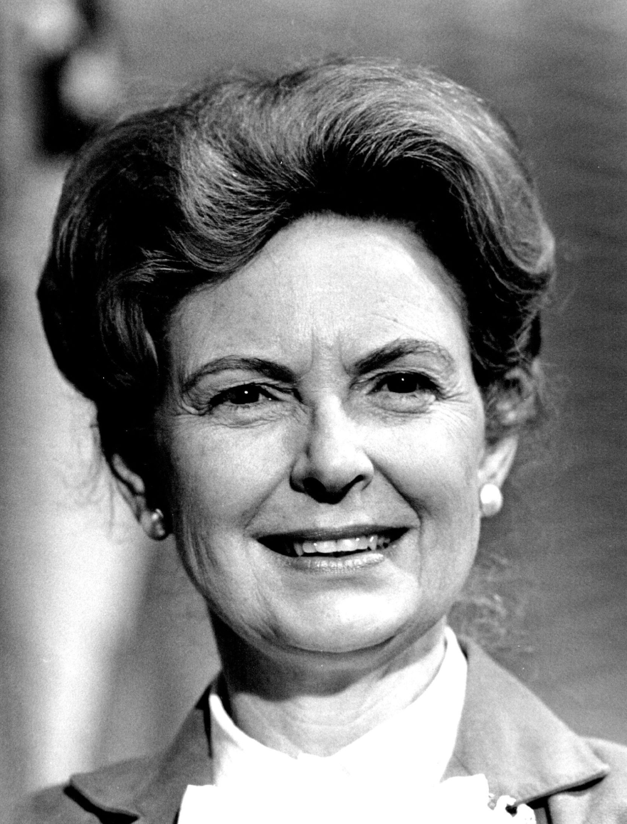
Stop ERA Movement
Led by Phyllis Schlafly
Criticisms of ERA
Unnecessary
Would force women into the military draft
Would end special preferences for women under the law (alimony, child custody, etc.)
Would force integration of single-sex facilities
Would upset “traditional” family roles

Slide 40
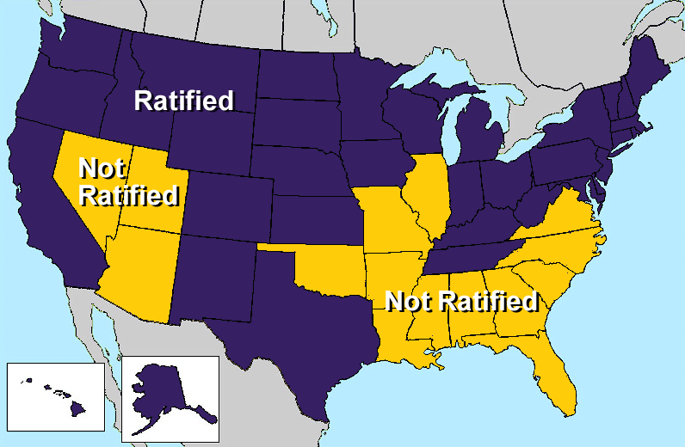
ERA Ratification Fails

Slide 41
ERA: Drafting of Women?

Slide 42
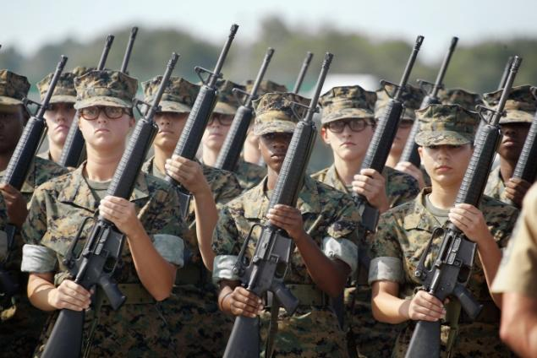
Integration into Combat Roles, 2013

Slide 43
Controversies Over Marriage, Sexuality & Reproductive Rights

Slide 44
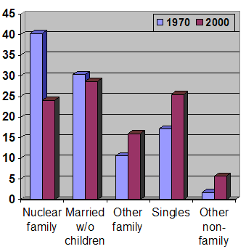
Decline the Nuclear Family

Slide 45
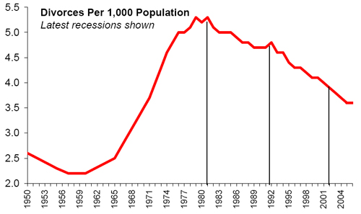
Annual Divorce Rates

Slide 46
Sexual Violence Prevention

Slide 47
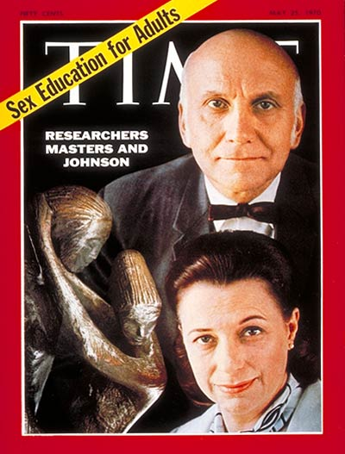
Sexual Revolution

Slide 48
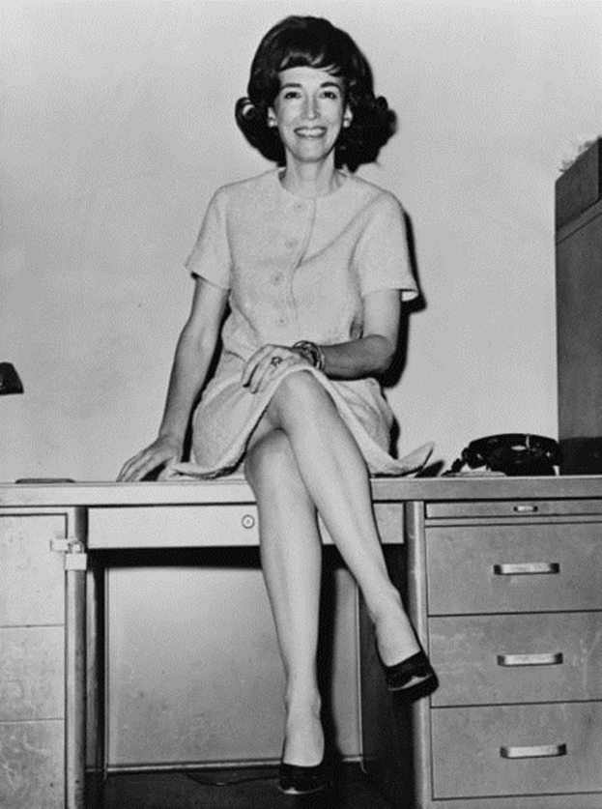
Helen Gurley Brown
Sex and the Single Girl, 1965
Relationship advice
Career and financial advice
Editor of Cosmopolitan for 32 years

Slide 49
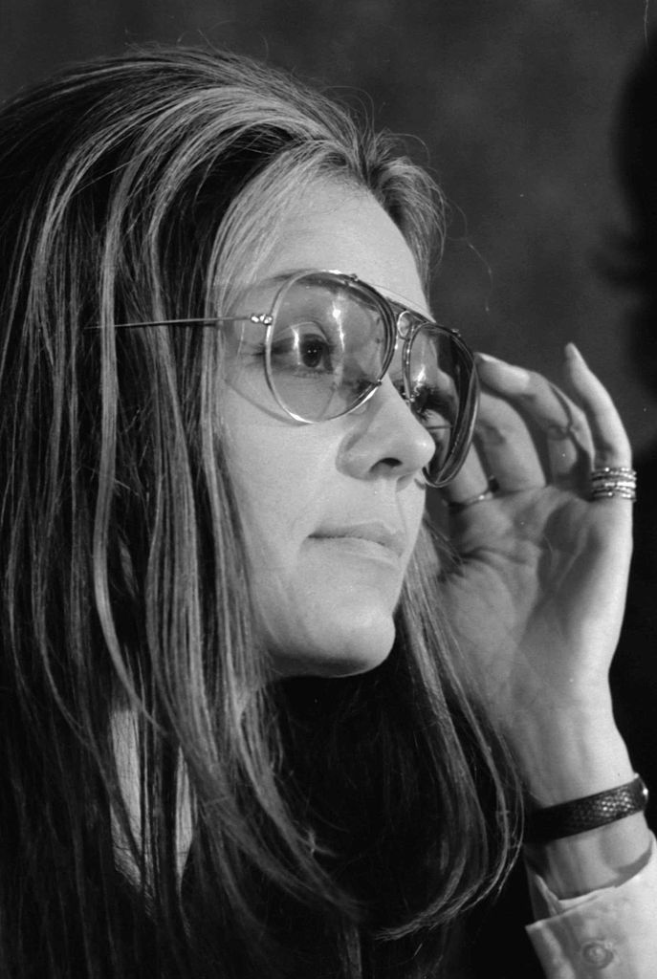
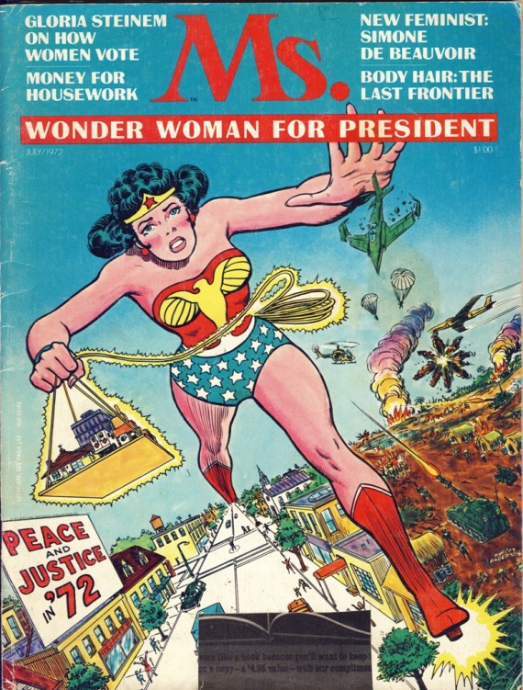
Gloria Steinem
Founder of Ms. Magazine
“A woman needs a man like a fish needs a bicycle”

Slide 50
Birth Control Pill
Became widely available in 1960s

Slide 51
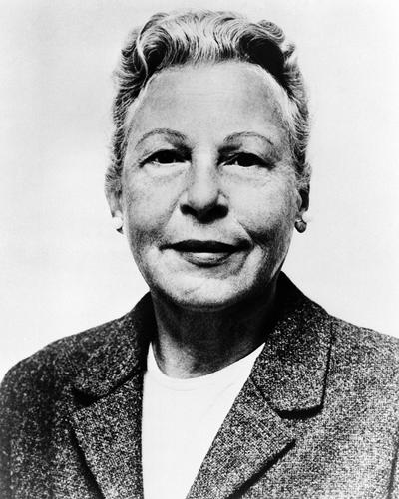
Griswold v. Connecticut, 1965
Estelle Griswold
director of a Planned Parenthood clinic
distributed contraceptives to married couples, which violated Connecticut law
Supreme Court decision
Overturned the ban on marital contraceptive use
Established right to privacy

Slide 52
Griswold Rationale: “Penumbras & Emanations of Privacy”
Privacy
1st Amendment
2nd Amendment
4th Amendment
9th Amendment

Slide 53
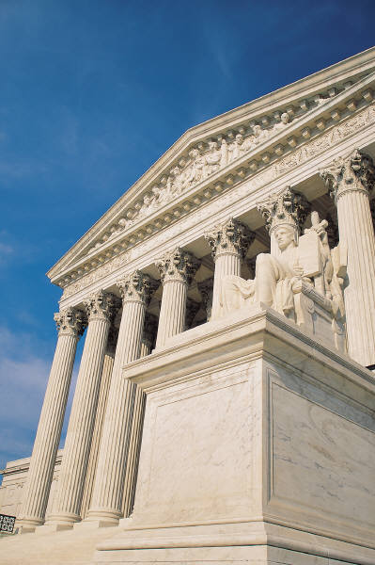
Roe v. Wade, 1973
Legalized abortion
Right to privacy
Trimesters
First trimester: decision of woman & doctor
Second trimester: states may regulate
Third trimester: states may ban abortions
Ongoing political controversy

Slide 54
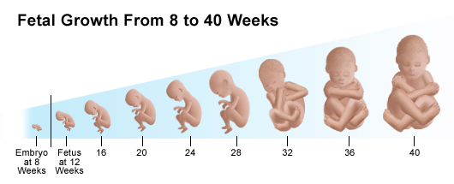
Fetal Development

Slide 55
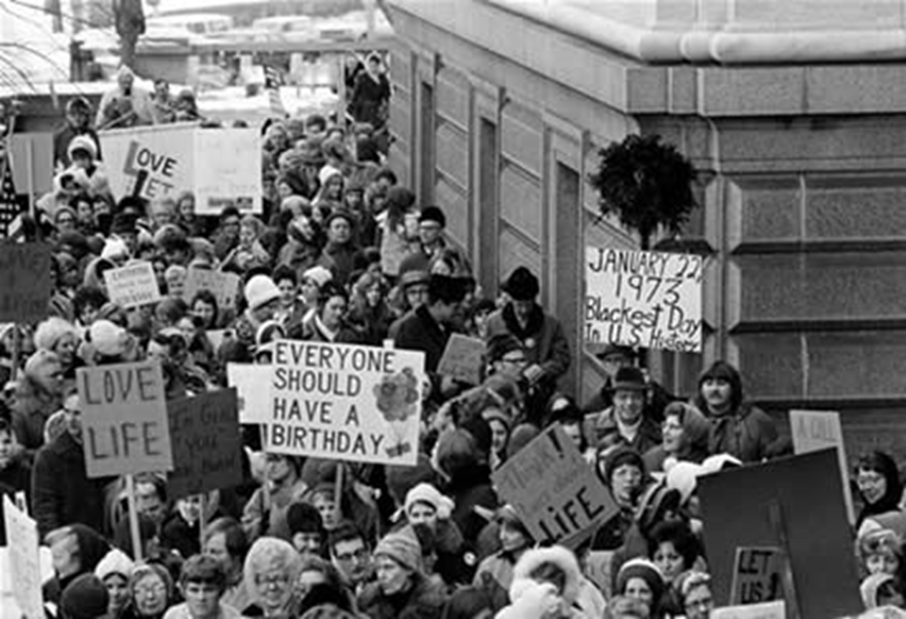
“Pro-Life”

Slide 56
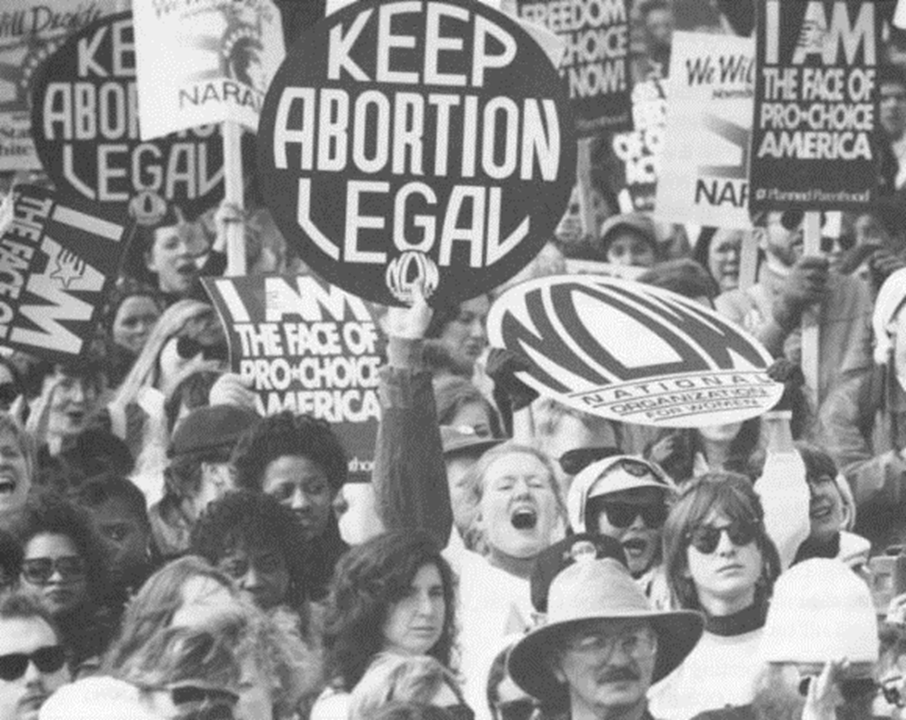
“Pro-Choice”

Slide 57
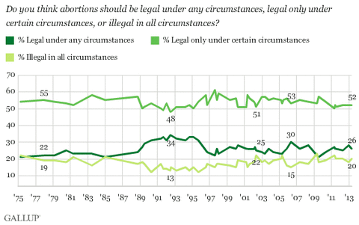
Public Opinion

Slide 58
Access to Abortion Providers?

Slide 59
Leading Ladies

Slide 60
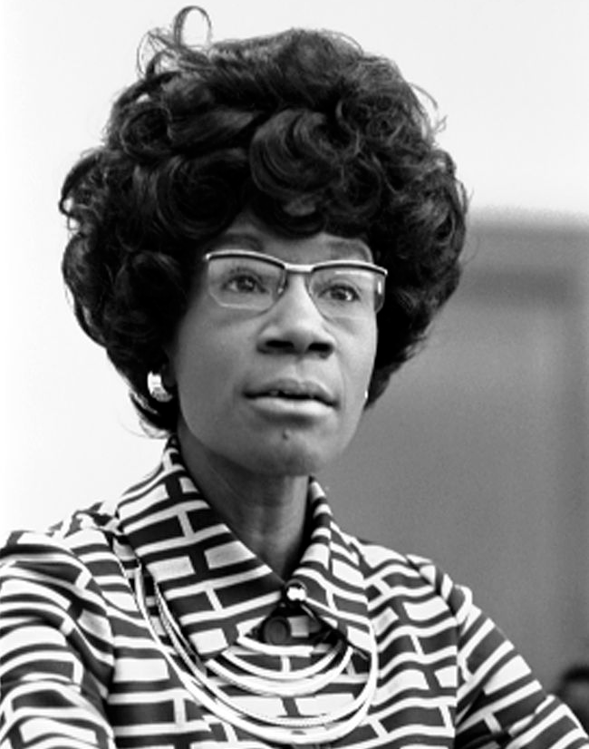
Shirley Chisholm
First African American woman (D-New York) elected to Congress, 1968

Slide 61
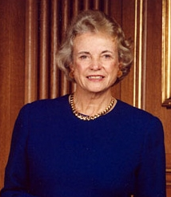
Sandra Day O’Connor
First woman on Supreme Court, 1981
Appointed by Ronald Reagan
Became swing vote in key cases in favor of abortion

Slide 62
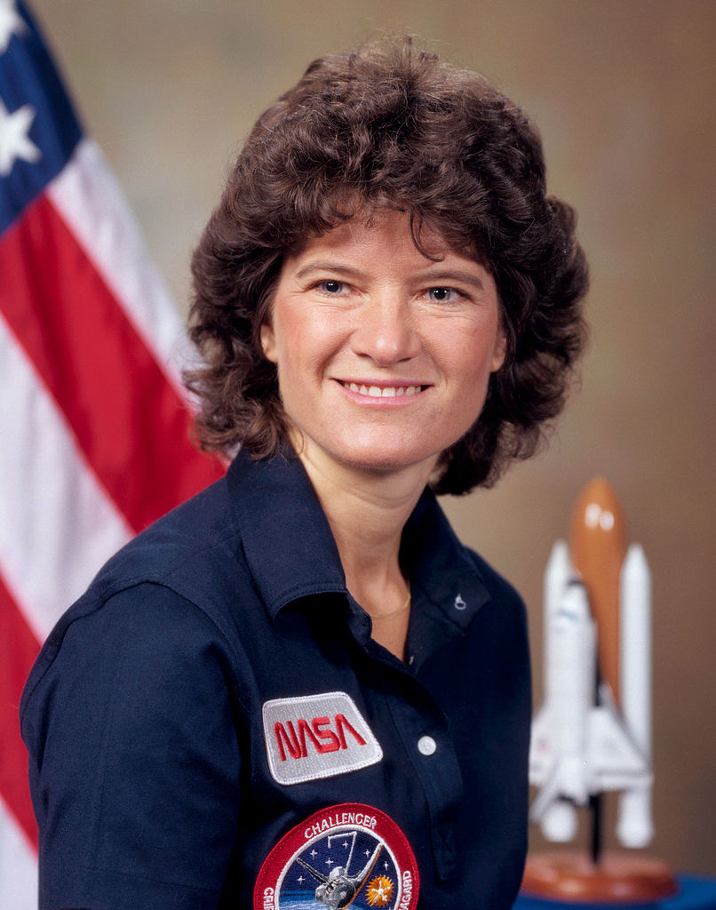
Sally Ride
First woman in space, 1983

Slide 63
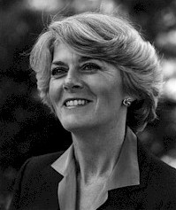
Geraldine Ferraro
First female vice presidential nominee for a major party
Running mate of Walter Mondale in 1984

Slide 64
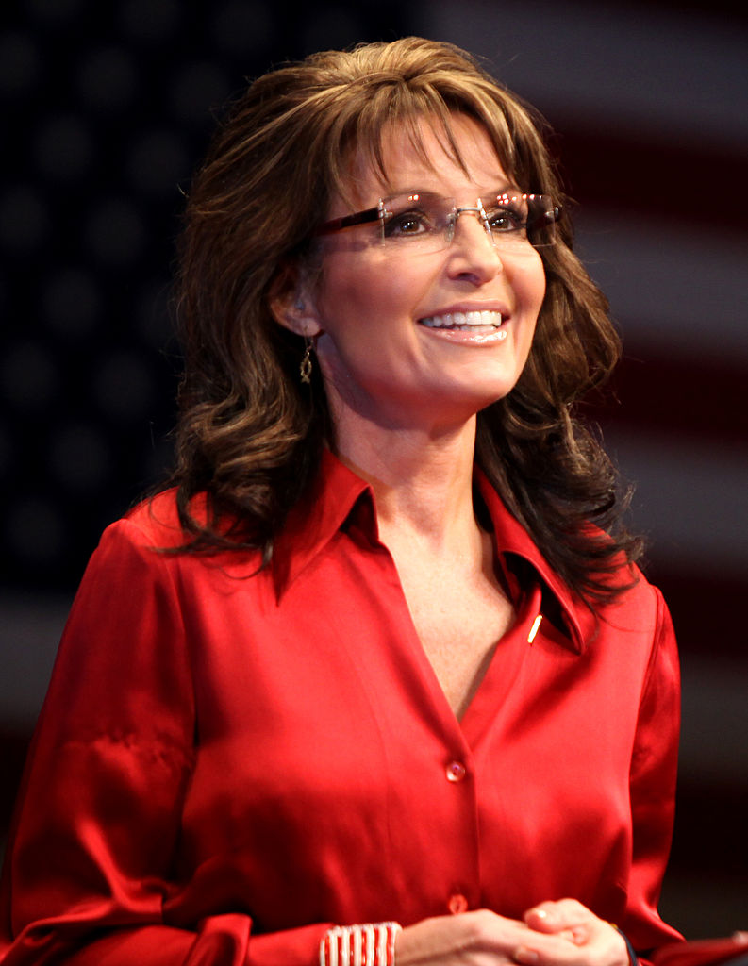
Sarah Palin
Alaska governor
Second female vice presidential nominee
Running mate of John McCain, 2008

Slide 65
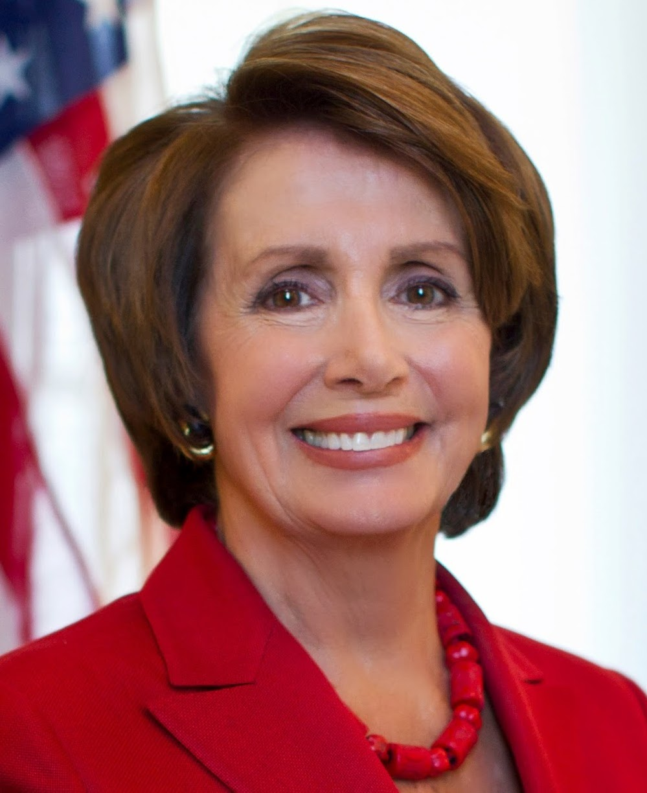
Nancy Pelosi
First female Speaker of the House, 2009

Slide 66
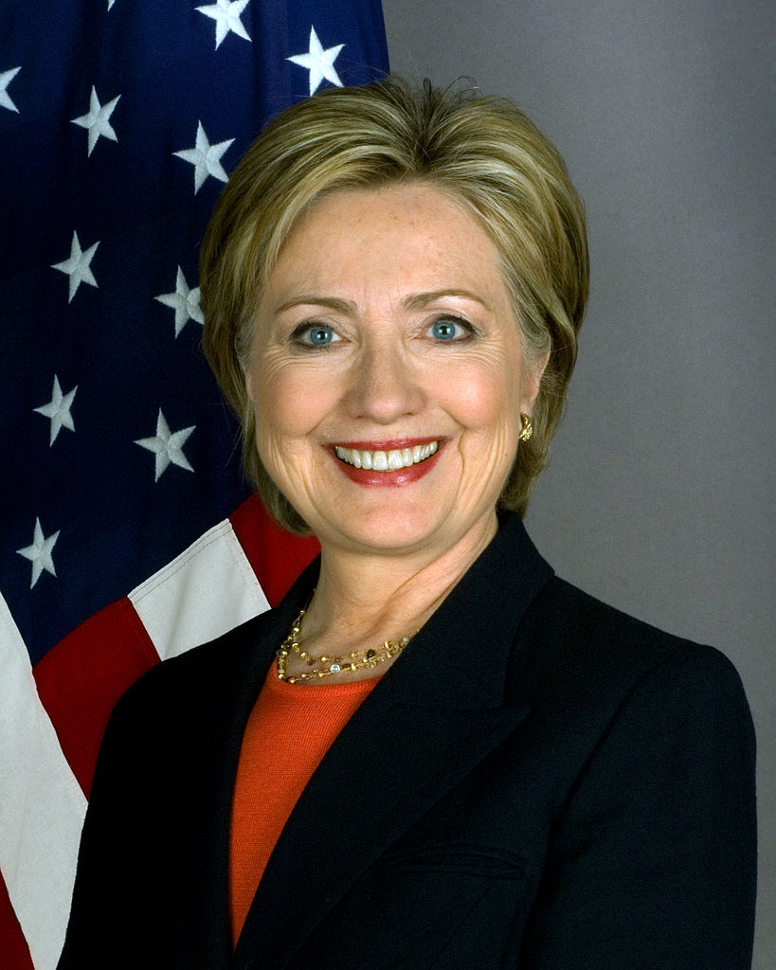
Hillary Clinton
Politically active First Lady
U.S. Senator for New York
Secretary of State
Democratic nominee in 2016 presidential election

Slide 67
Go to Website and open up Betty Frieden’s the Feminine Mystique and Phyllis Schlafly and the ERA

Slide 68
1. Compare and Contrast Betty Friedan’s Feminine Mystique and Phyllis Schlafly views on Feminism. 2. What trends amongst the Women’s movement will change? What struggles/challenges will continue into the future?

