Slide 1
20th Century Social Movements Native Americans & Hispanics

Slide 2
Native Americans

Slide 3
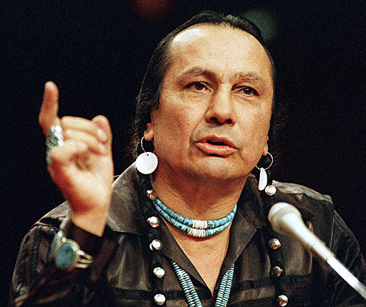
Major Issues
Sovereignty over Indian land
Preservation of other treaty rights
Quality of life
Cultural identity
Environmentalism & exploitation of natural resources

Slide 4
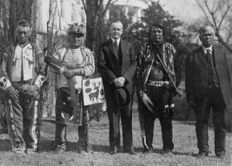
Indian Citizenship Act, 1924
Full citizenship
Equal protection
Suffrage

Slide 5
Indian Reorganization Act, 1934
“Indian New Deal”
Greater tribal sovereignty over local laws, education, land ownership, etc.
termination of government control
self-determination/ autonomy

Slide 6
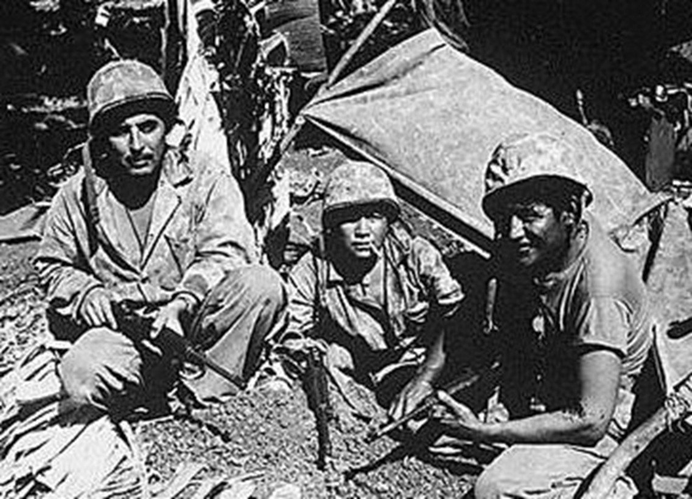
Codetalkers
“Windtalkers”
Native American signals operators in World War II
Axis Powers found codes to be unbreakable

Slide 7
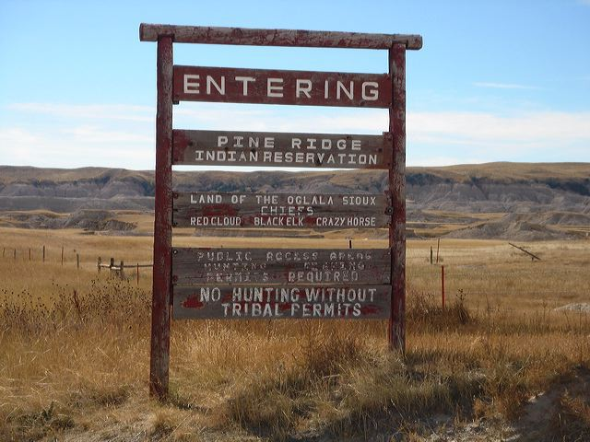
Indian Reservations

Slide 8
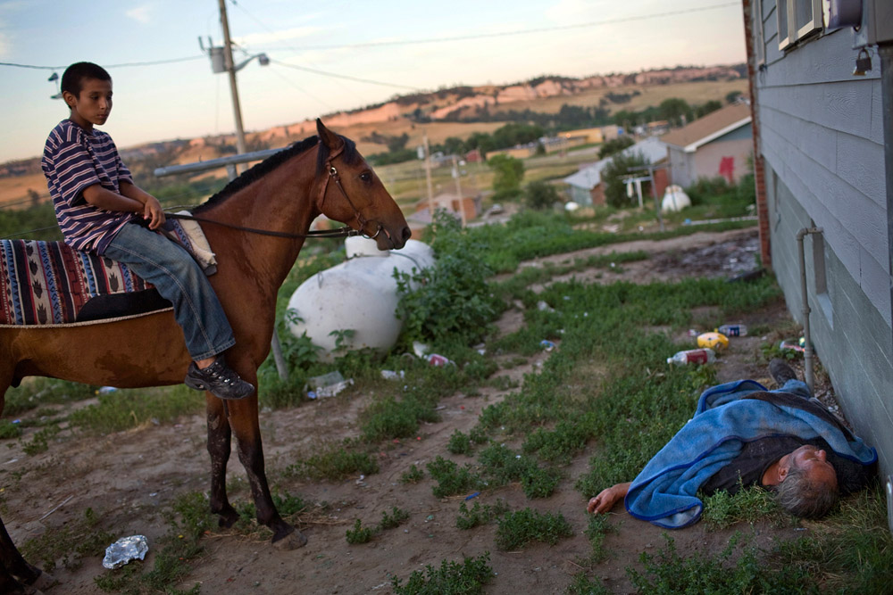
Quality of Life

Slide 9
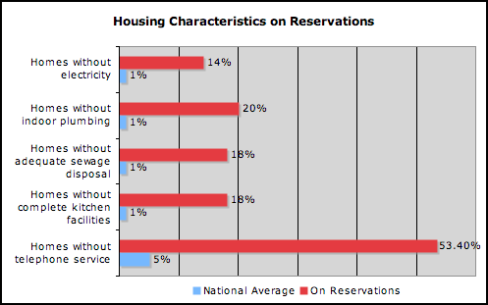
Quality of Life

Slide 10
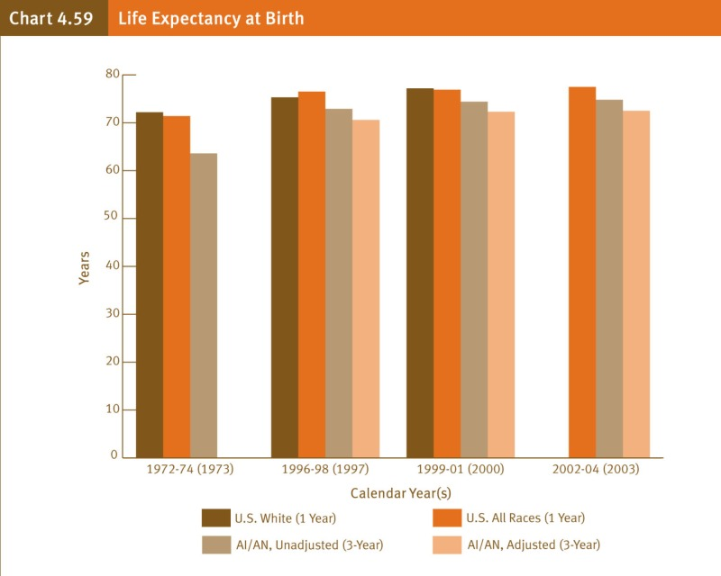
Quality of Life

Slide 11
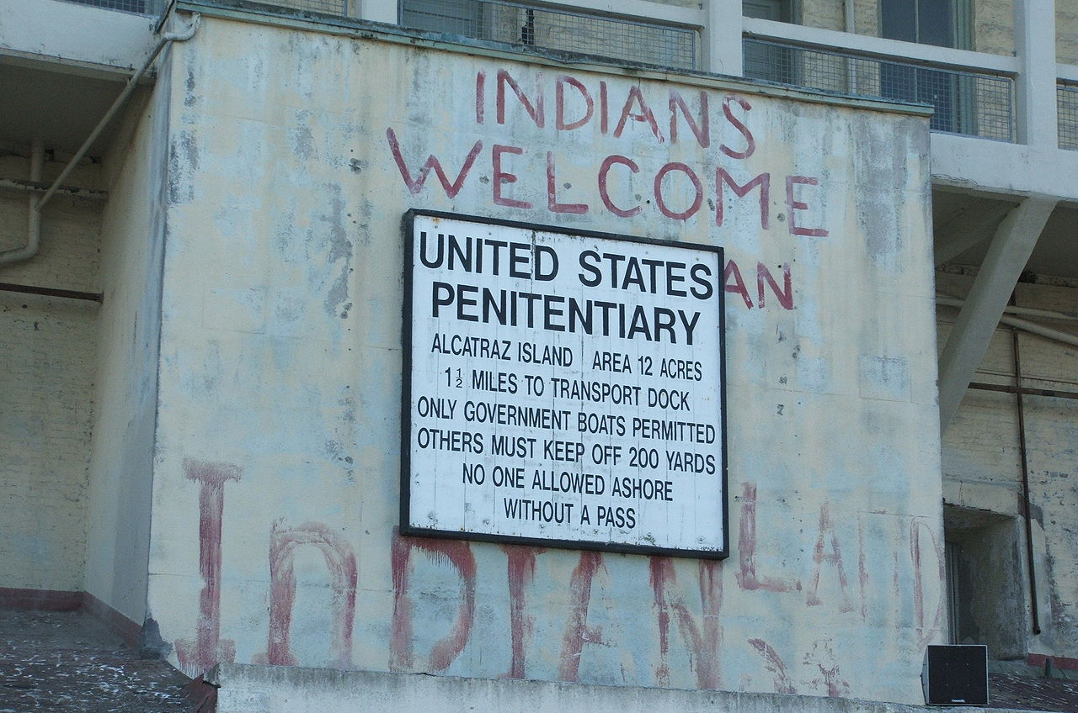
Occupation of Alcatraz, 1969-1971

Slide 12
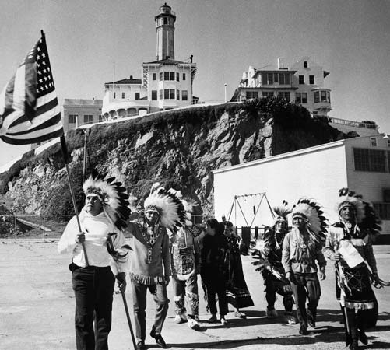
Occupation of Alcatraz, 1969-1971
Act of political theater
Drew attention to poor quality of life on reservations

Slide 13
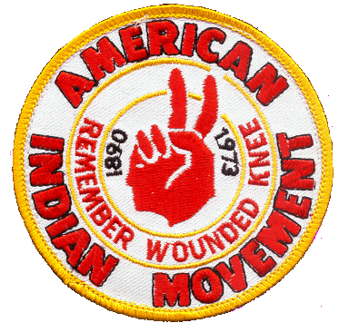
American Indian Movement (AIM)
Combination of urban Indians & Indians on reservations
Militant organization
Confrontations with federal government & law enforcement
BIA
FBI

Slide 14
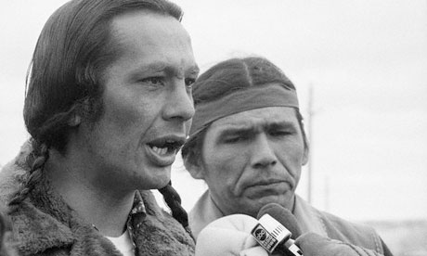
Russell Means & Dennis Banks

Slide 15
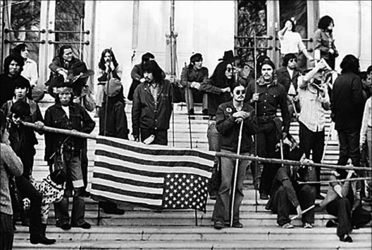
Takeover of Bureau of Indian Affairs (BIA) Office, 1972

Slide 16
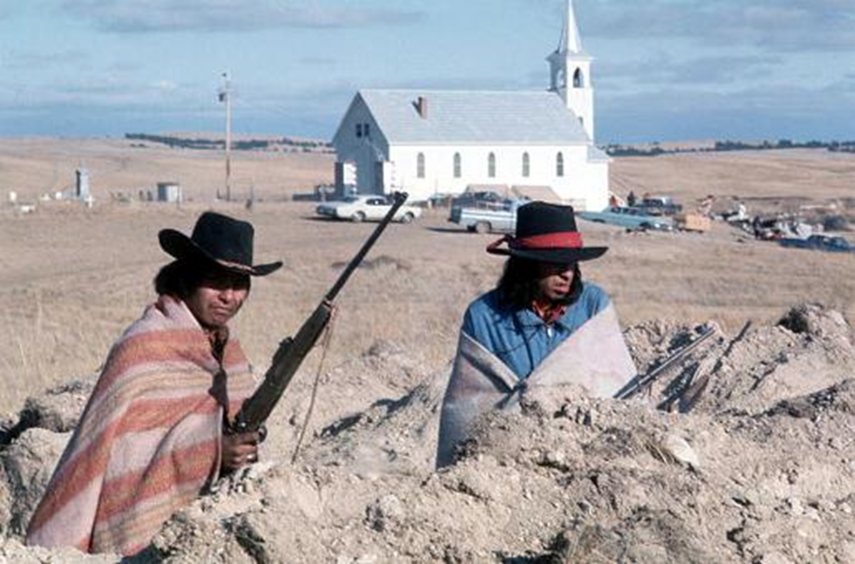
Wounded Knee Standoff Against the FBI, 1973

Slide 17
Urban Indians

Slide 18
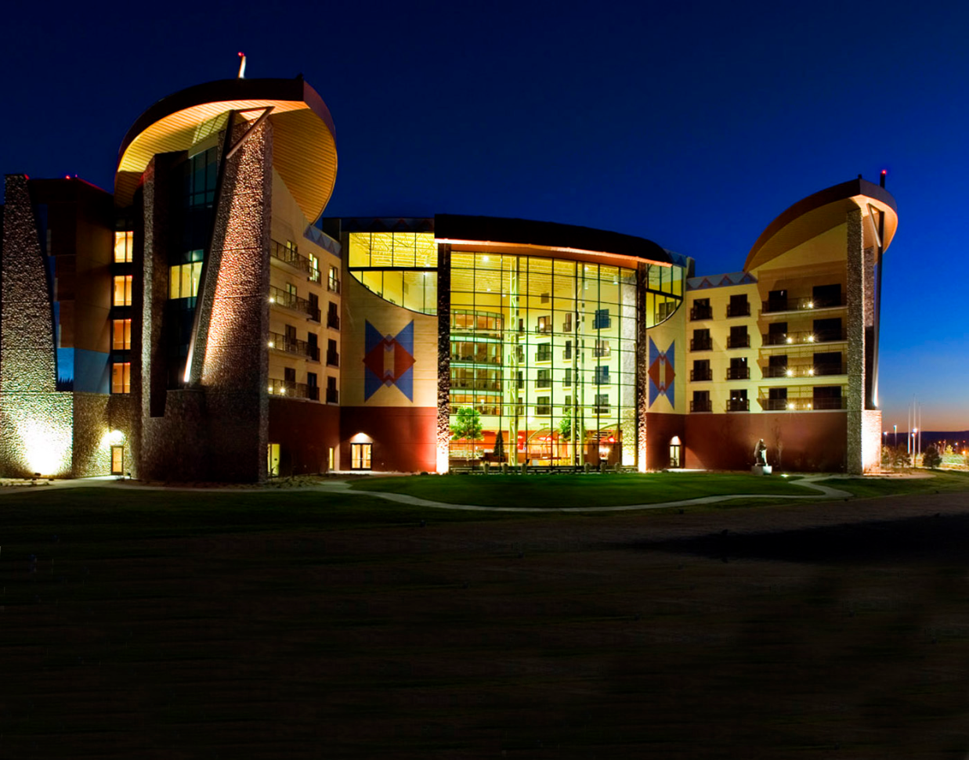
Indian Gaming
Sovereignty grants some exemptions from state & federal gambling laws
Controversy: positive vs. negative impact of casinos on native communities

Slide 19
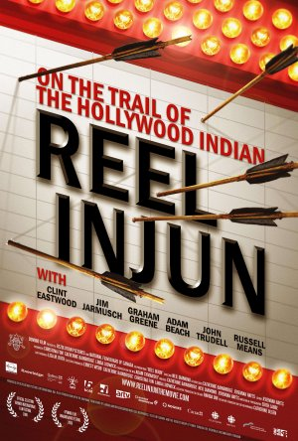
Media Depictions of Native Americans
Casting of white actors vs. indigenous actors
Historical accuracy vs. inaccuracy
Archetypes as heroes vs. villains
Murderous “savages”?
Noble, innocent victims?
Recently… more nuanced, complex portrayals

Slide 20
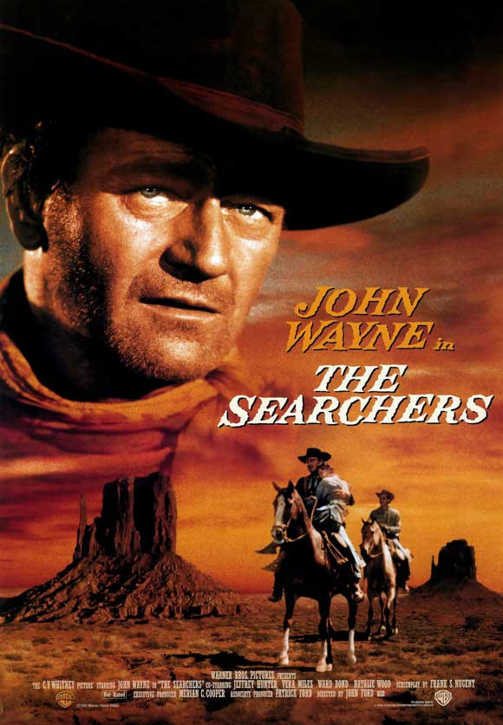
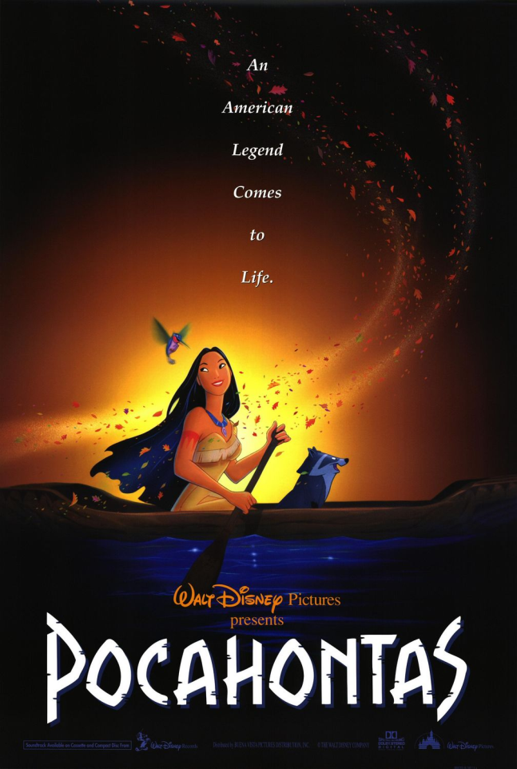
Media Depictions of Native Americans

Slide 21
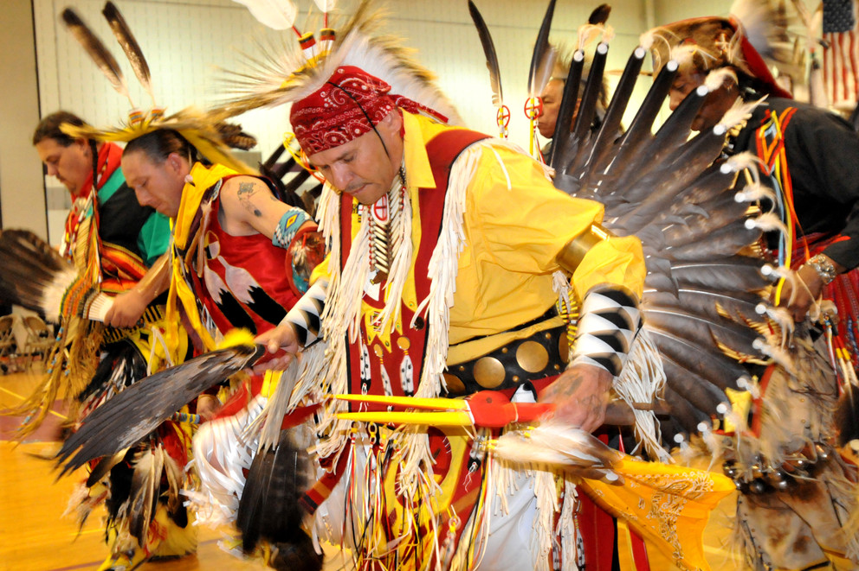
Pow Wows
Regional cultural gatherings
Music, dance, arts, crafts, food

Slide 22
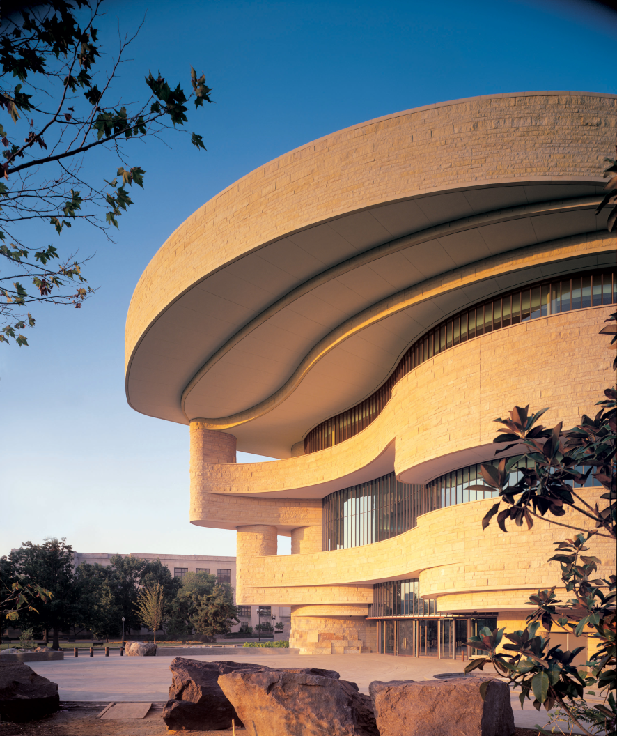
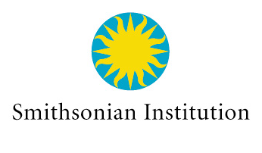
National Museum of the American Indian
Opened in 2004
National Mall in Washington, D.C.
Historical exhibits
Cultural events

Slide 23
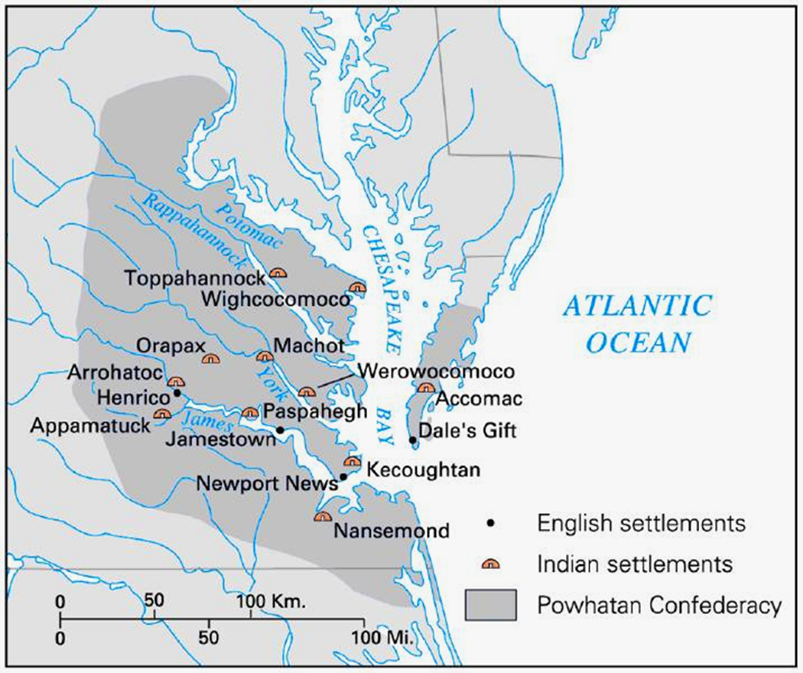
Virginia’s Powhatan Confederacy, 1620

Slide 24
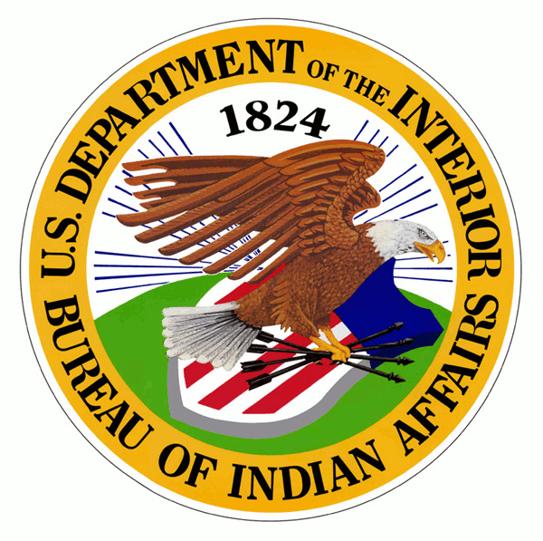
Federal Recognition of Tribes
As of 2014, Virginia still has no tribes currently recognized by the federal government!
Key to tribal sovereignty

Slide 25
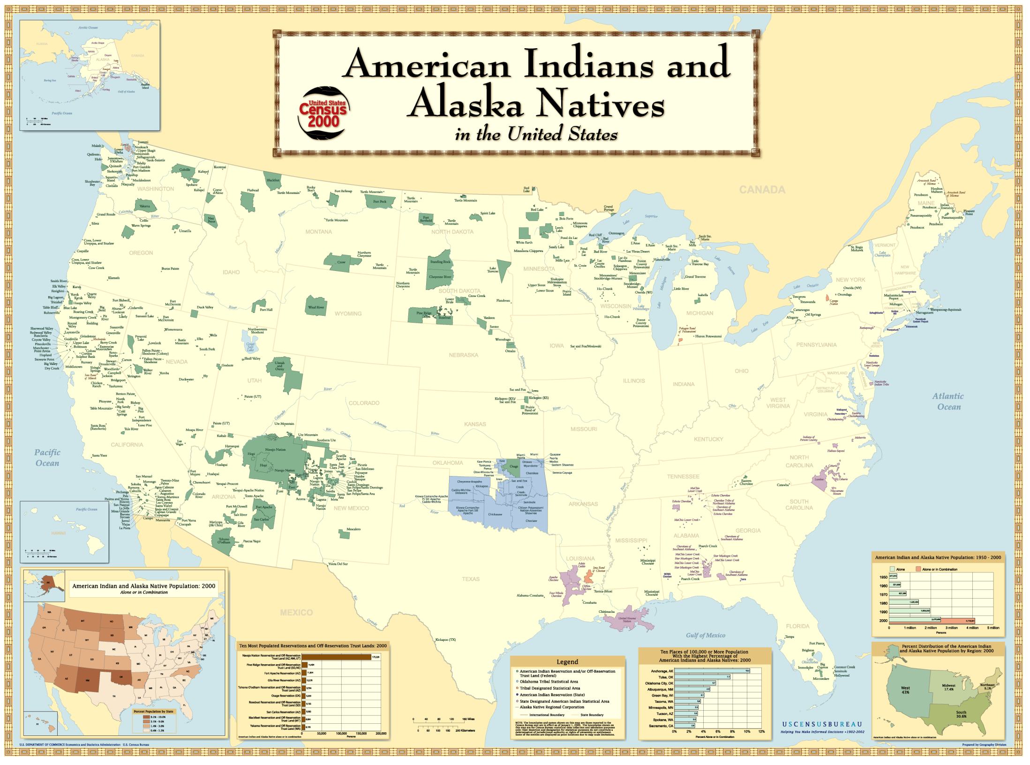

Slide 26
Hispanics

Slide 27
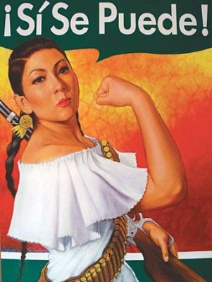
Major Issues
Labor justice
Immigration, citizenship & amnesty
Education
Language
Increasing demographic presence

Slide 28
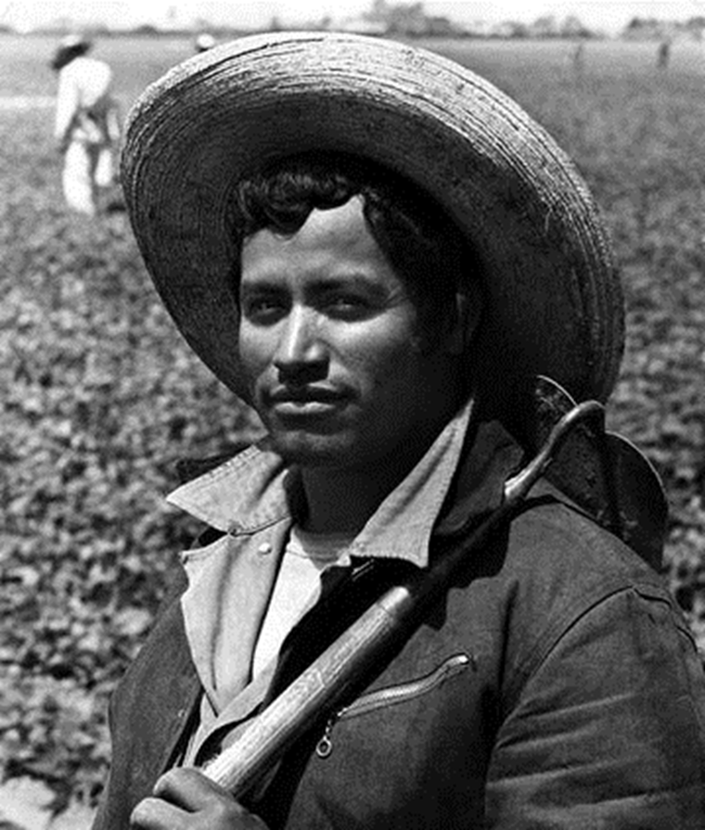
Bracero Program
1942-1964
Shortage of agricultural labor during the World War II
Encouraged Mexican guest workers to come to the U.S.

Slide 29
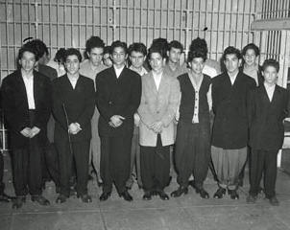
Zoot Suit Riots
1943
Violence between white sailors & Mexican-American youths

Slide 30
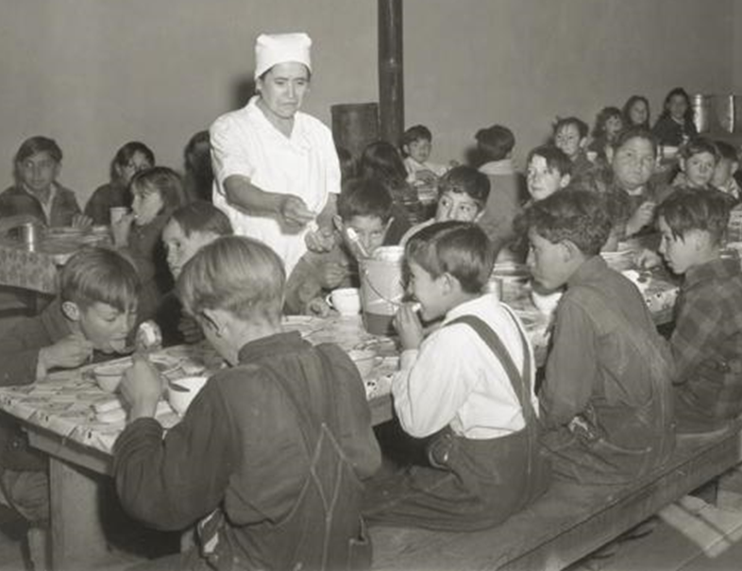
Mendez v. Westminster, 1947
Integration of Mexican-American students into public schools
Precedent for Brown v. Board, 1954

Slide 31
“Operation Wetback”
1954
Increased border security & deportations

Slide 32
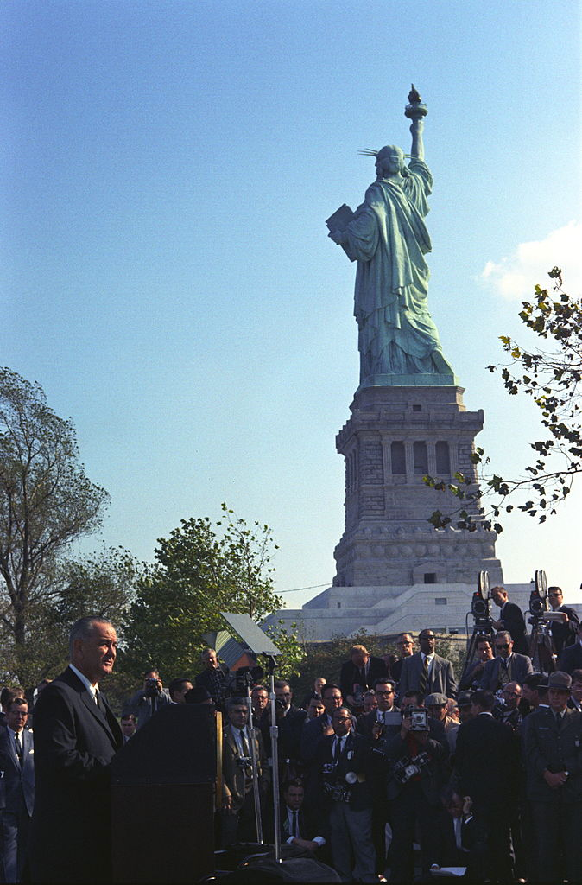
Immigration & Nationality Act, 1965
Ended national origins quota system
New immigration admissions criteria based on skills & ties to relatives inside the U.S.
Part of LBJ’s “Great Society”

Slide 33
United Farm Workers
Labor union & political advocacy group for migrant farmers
Led by Cesar Chavez
Campaigns
Strikes
Public boycotts of unfair employers

Slide 34
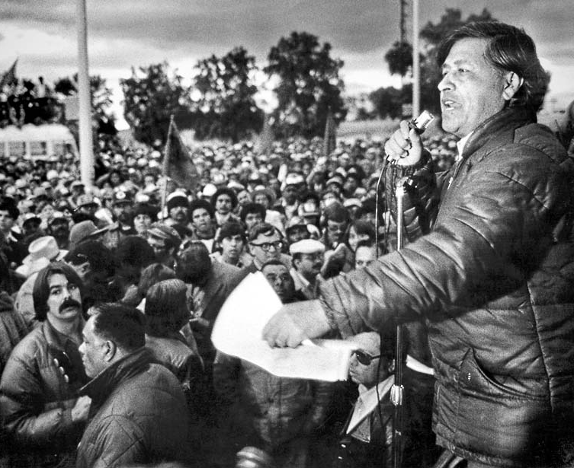
Cesar Chavez
Non-violent organizing
Inspired by Martin Luther King & African American civil rights struggle

Slide 35
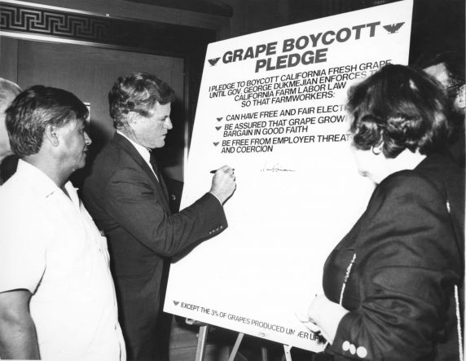
UFW Boycotts
Inspired by Montgomery Bus Boycotts

Slide 36
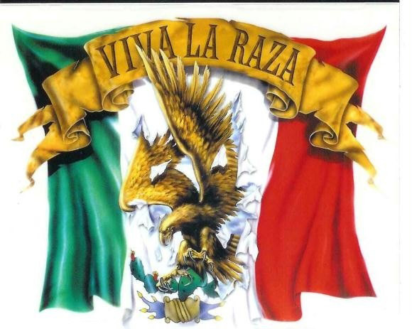
“La Raza Cosmica”

Slide 37
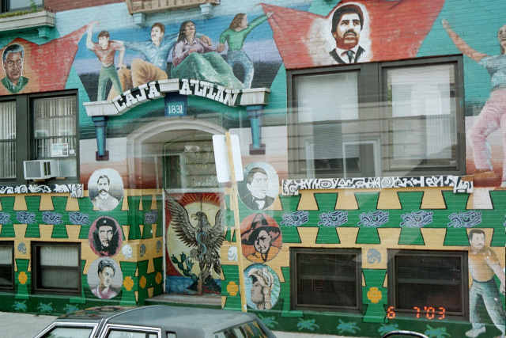
Chicano Pride

Slide 38
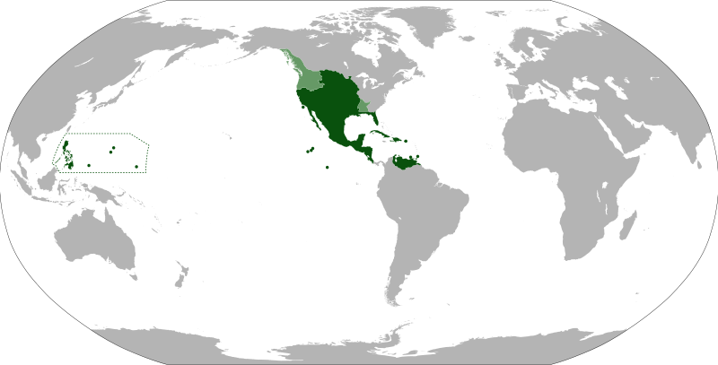
Old “New Spain”

Slide 39
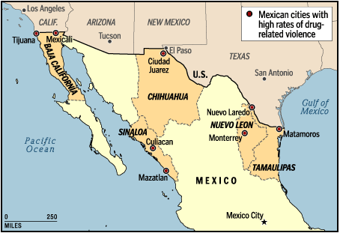
U.S.-Mexico Border & the Drug War

Slide 40
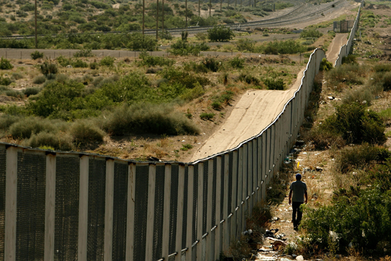
Border Fence

Slide 41
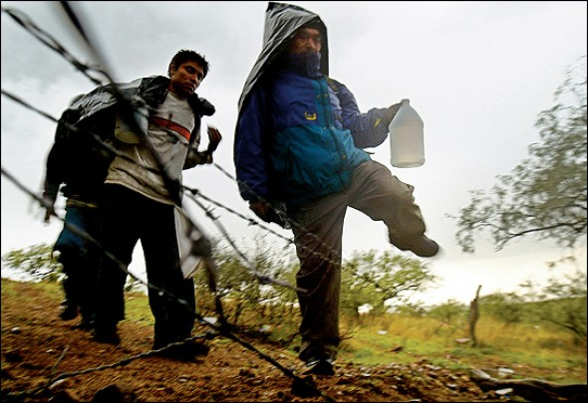
Dangerous Crossing

Slide 42
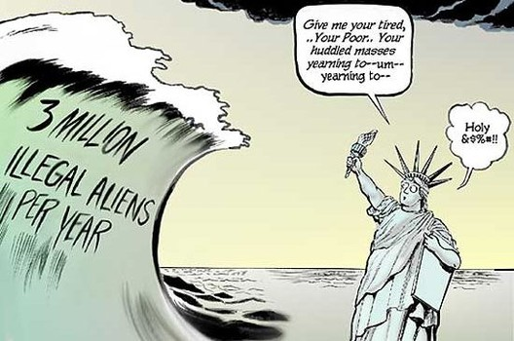
“Undocumented” Workers

Slide 43
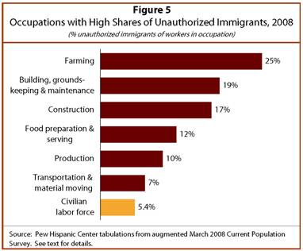
Employment of Undocumented Workers

Slide 44
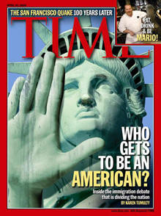
Naturalization, Citizenship & Amnesty
Immigration Reform & Control Act (IRCA) of 1986
Amnesty for 3 million undocumented immigrants
Signed by Ronald Reagan
Dream Act
Path to citizenship for undocumented youth
Estimated 13 million illegal immigrants in 2014

Slide 45
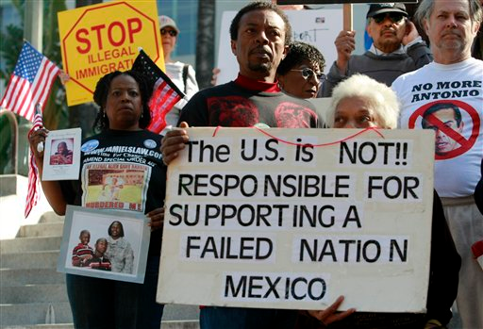
Opposition to Amnesty

Slide 46
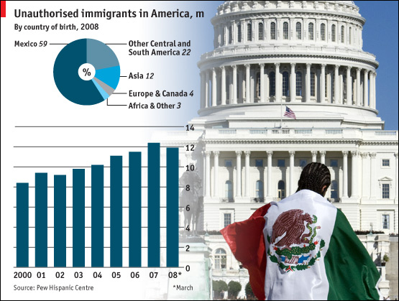
Illegal Immigrants Leaving the U.S.?

Slide 47
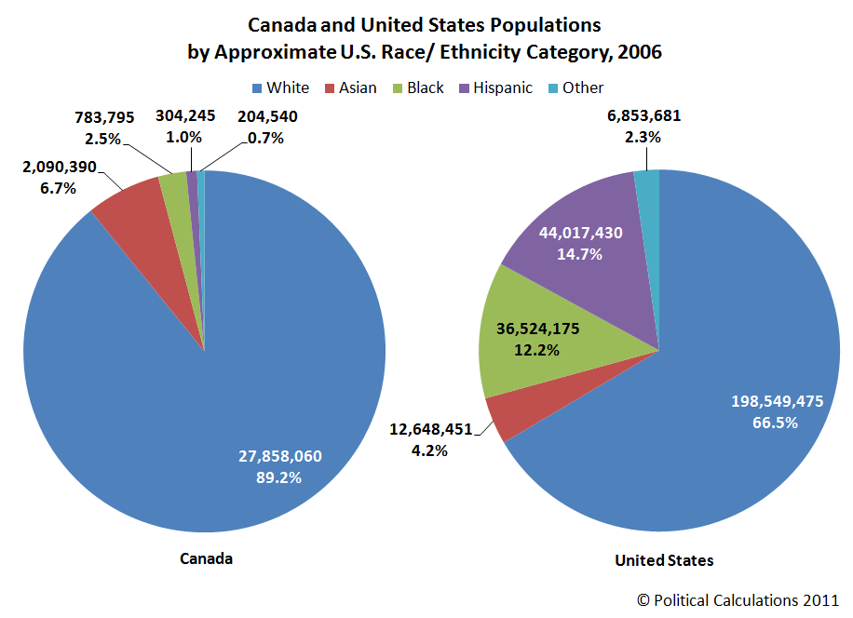
Hispanic Population Surpasses African American Population

Slide 48
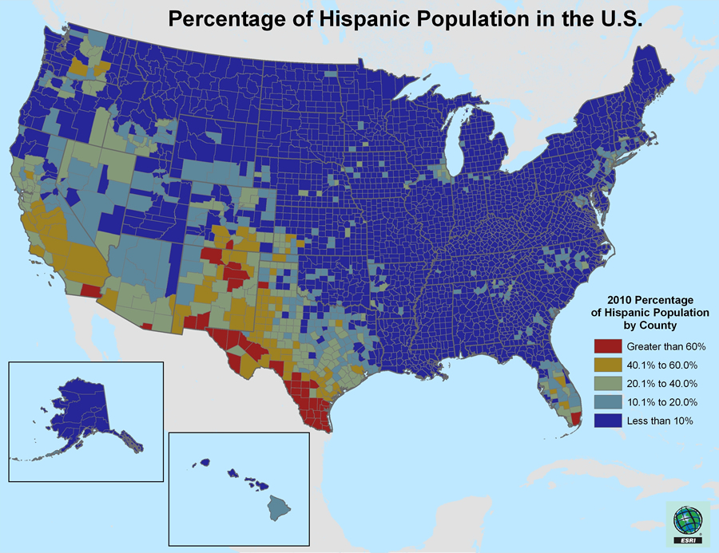
Hispanic Communities

Slide 49
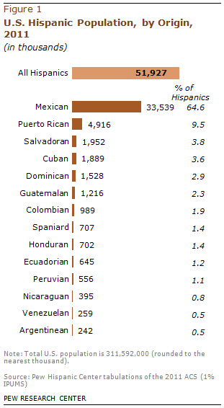
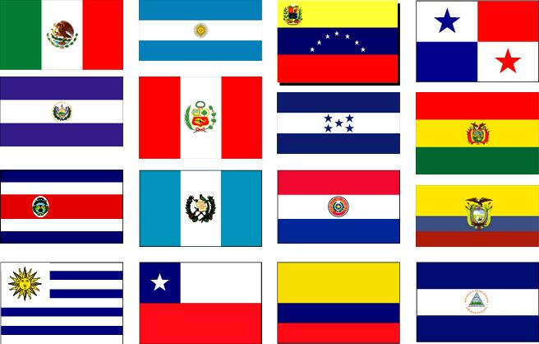
Diversity within Hispanic Community

Slide 50
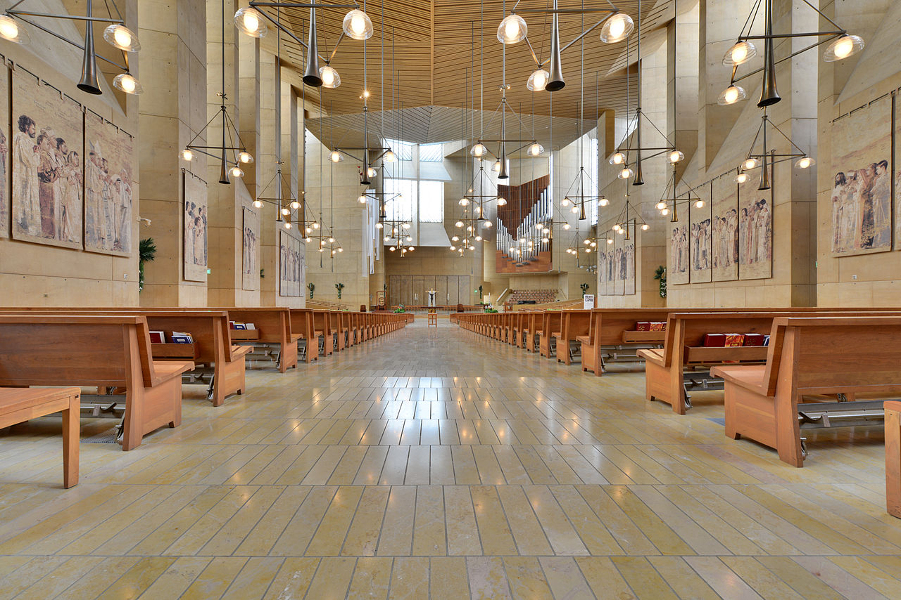
Catholicism

Slide 51
Educational Issues
Special programs
English as a Second Language (ESL)
English Language Learners (ELL)
Bilingual education controversies

Slide 52
News & Entertainment
Spanish language programming
4th largest network in U.S.

Slide 53
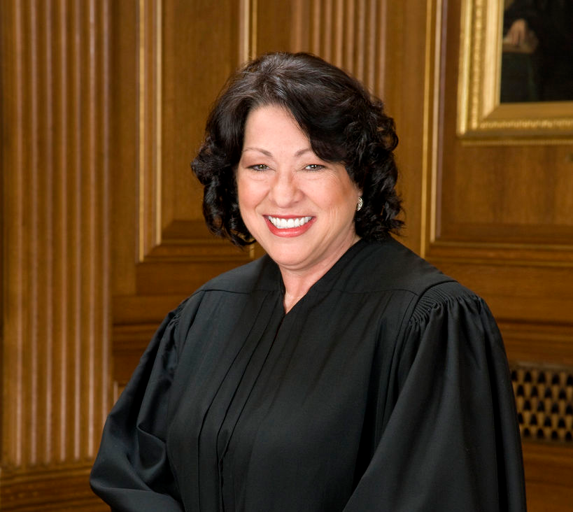
Sonia Sotomayor
First Hispanic Supreme Court justice
Appointed by Barack Obama

