Slide 1

Environmentalism
& Consumer Protection

Slide 2
Part One
Environmental Issues from Previous Units

Slide 3
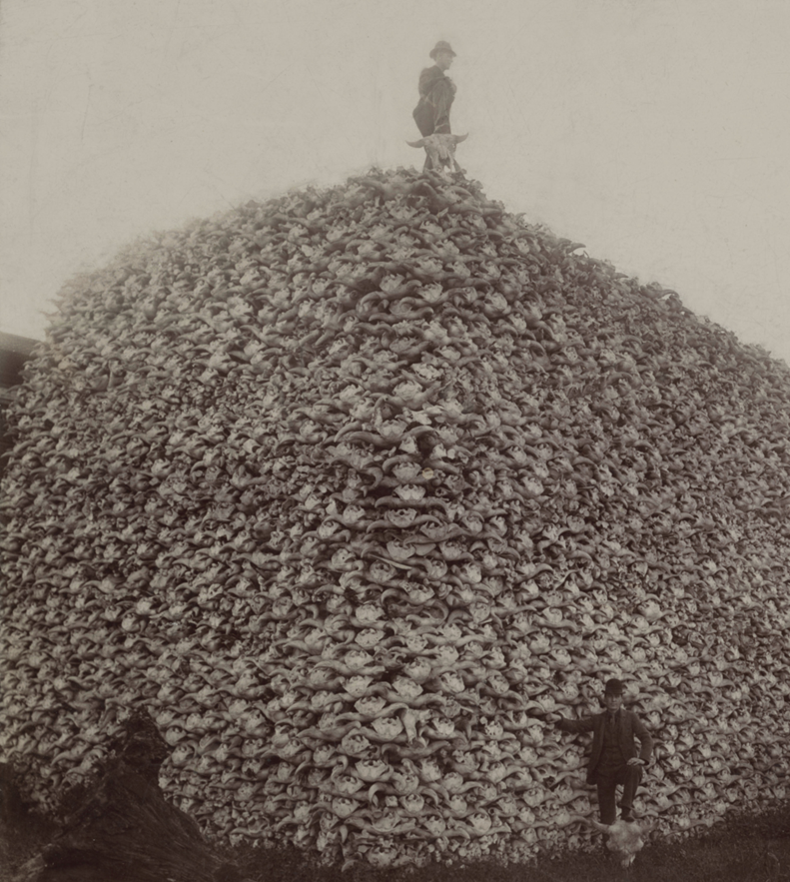
Near-Extinction of Buffalo
Settlers, railroads & U.S. army sought to deny Plains Indians their primary source of food
Effort to force Indians onto reservations

Slide 4
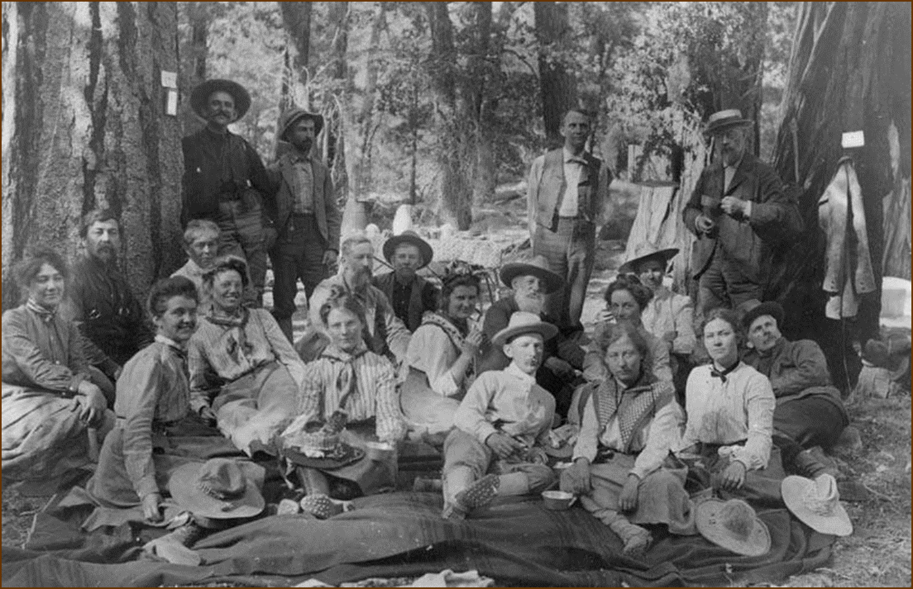
Sierra Club

Slide 5
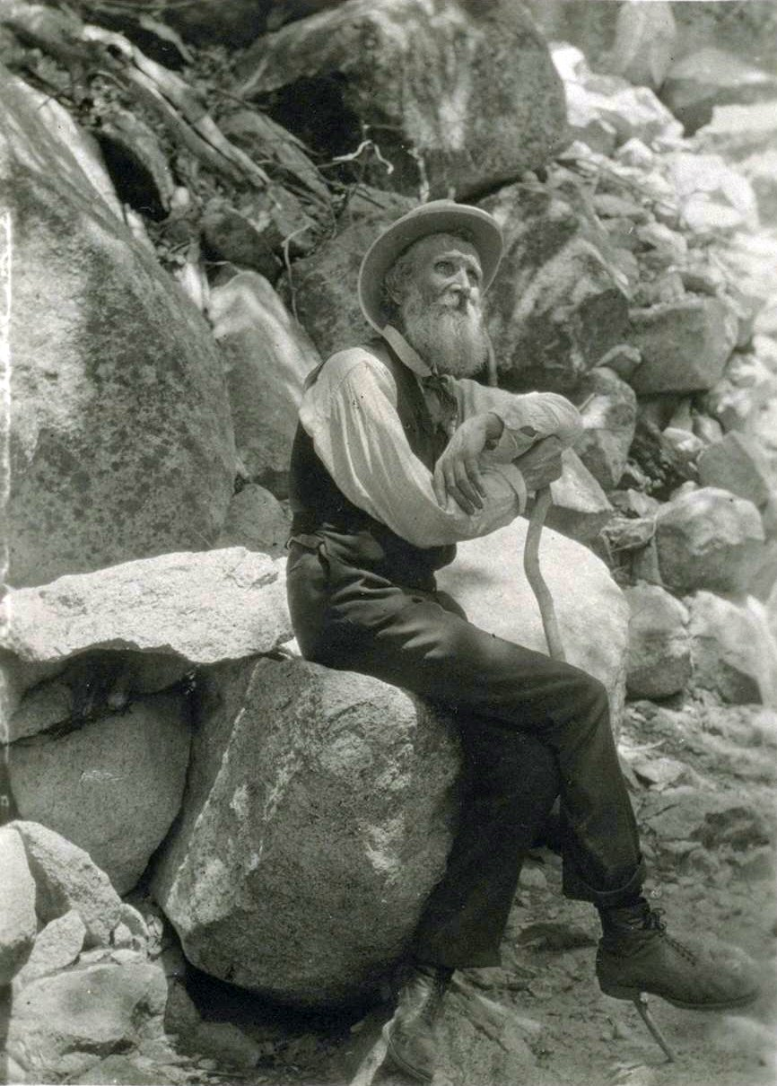
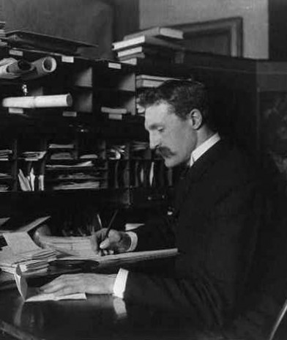
The Conservation Debate
John Muir
Pure preservation
Gifford Pinchot
Managed use

Slide 6
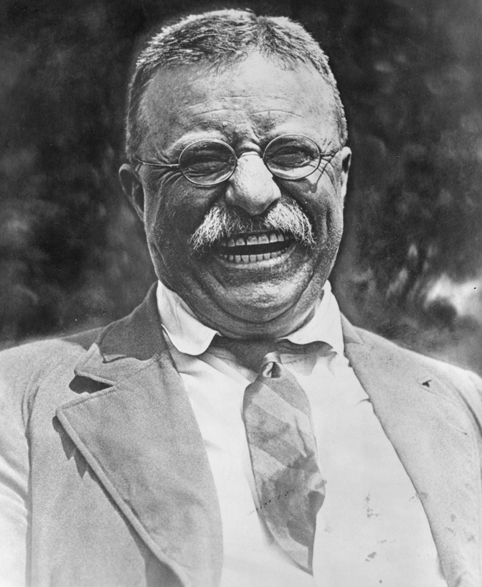
Theodore Roosevelt
Hunter & outdoorsman
First “environmentalist” president

Slide 7
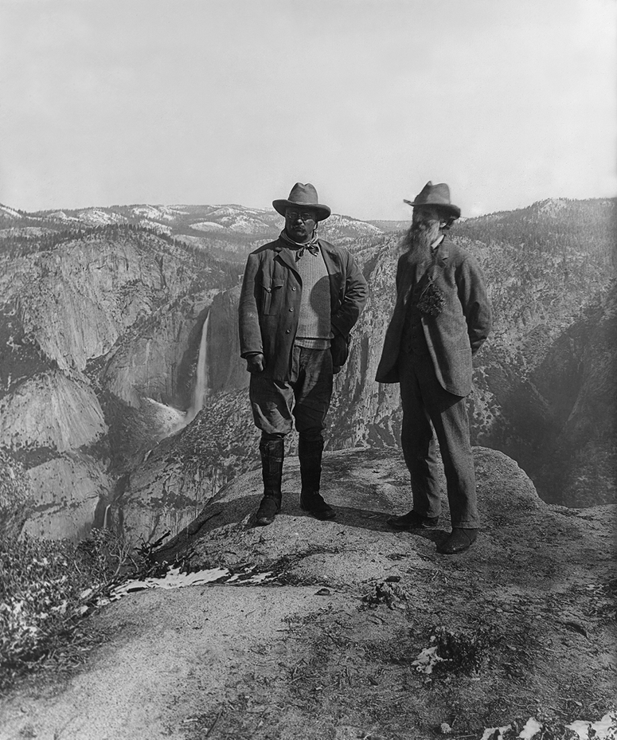
Conservation Under T.R.
T.R. supported Pinchot’s “managed use”
Newlands Reclamation Act
Irrigation & flood control
U.S. Forest Service
New national parks
Theodore Roosevelt with John Muir at Yosemite

Slide 8
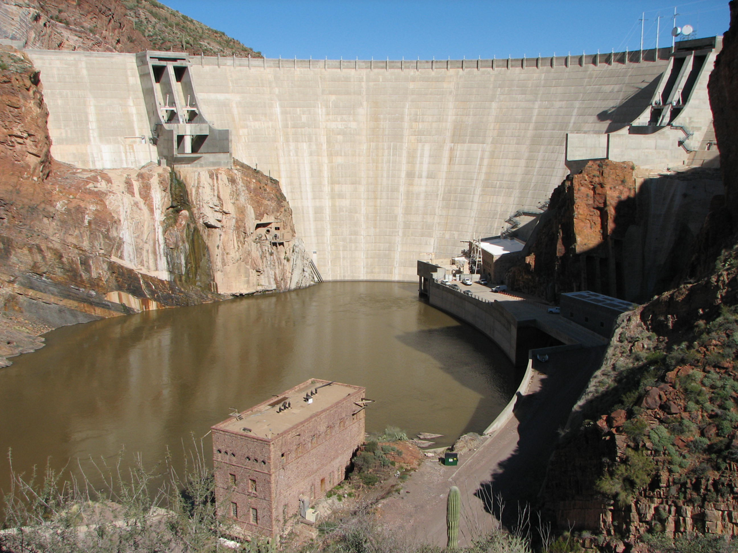
Reclamation: Roosevelt Dam

Slide 9
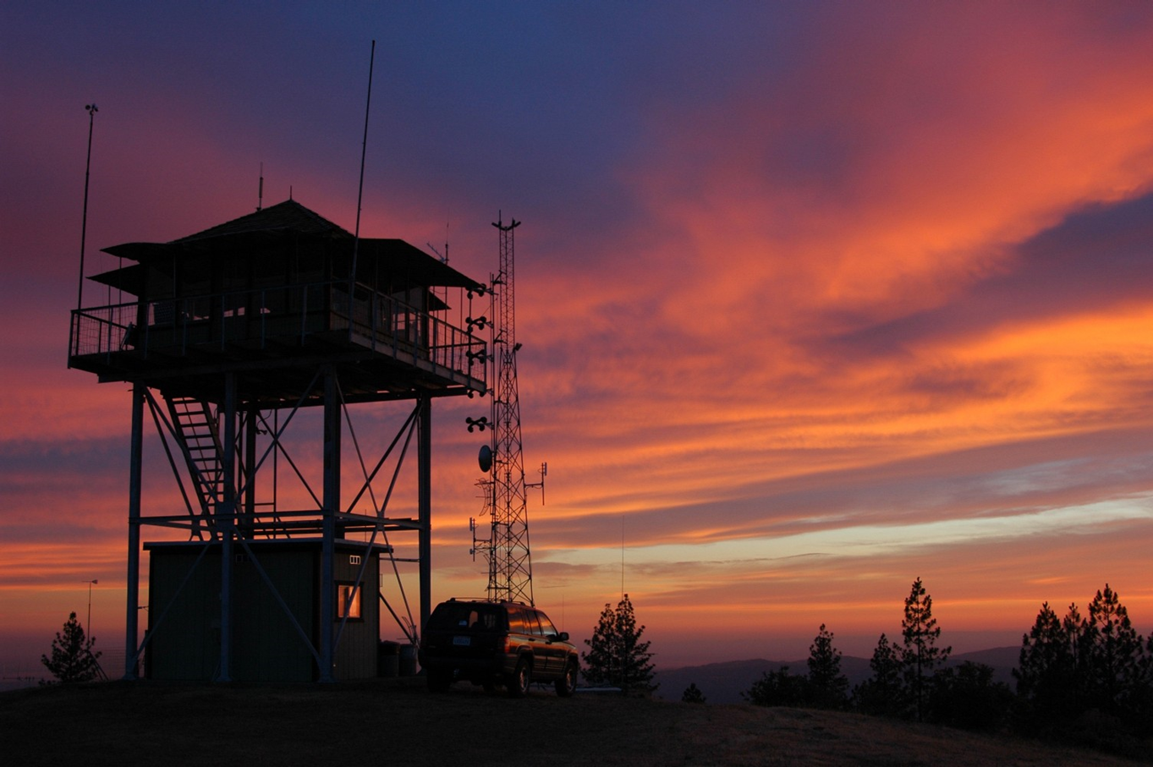
Management: U.S. Forest Service

Slide 10
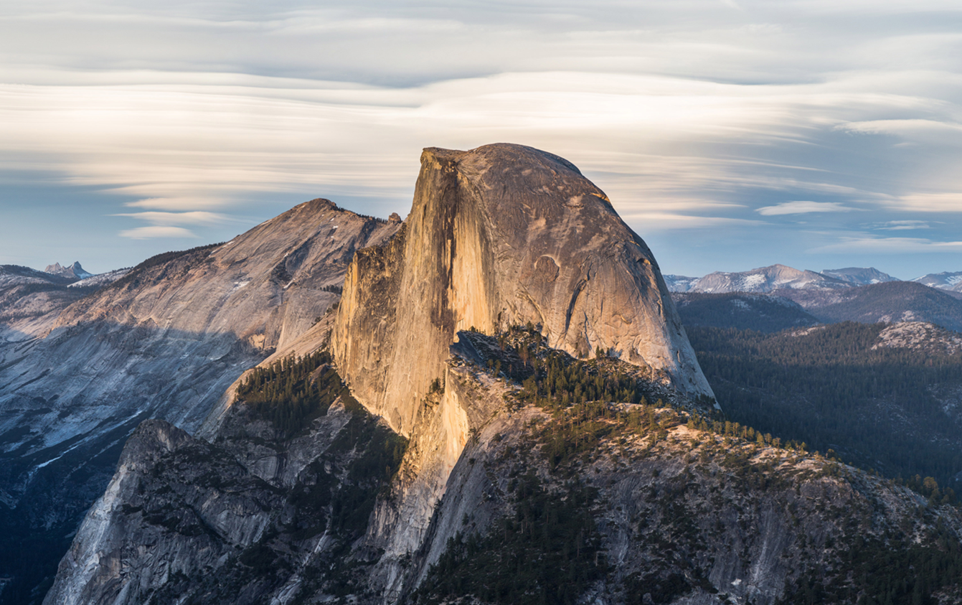
Preservation: National Park System

Slide 11
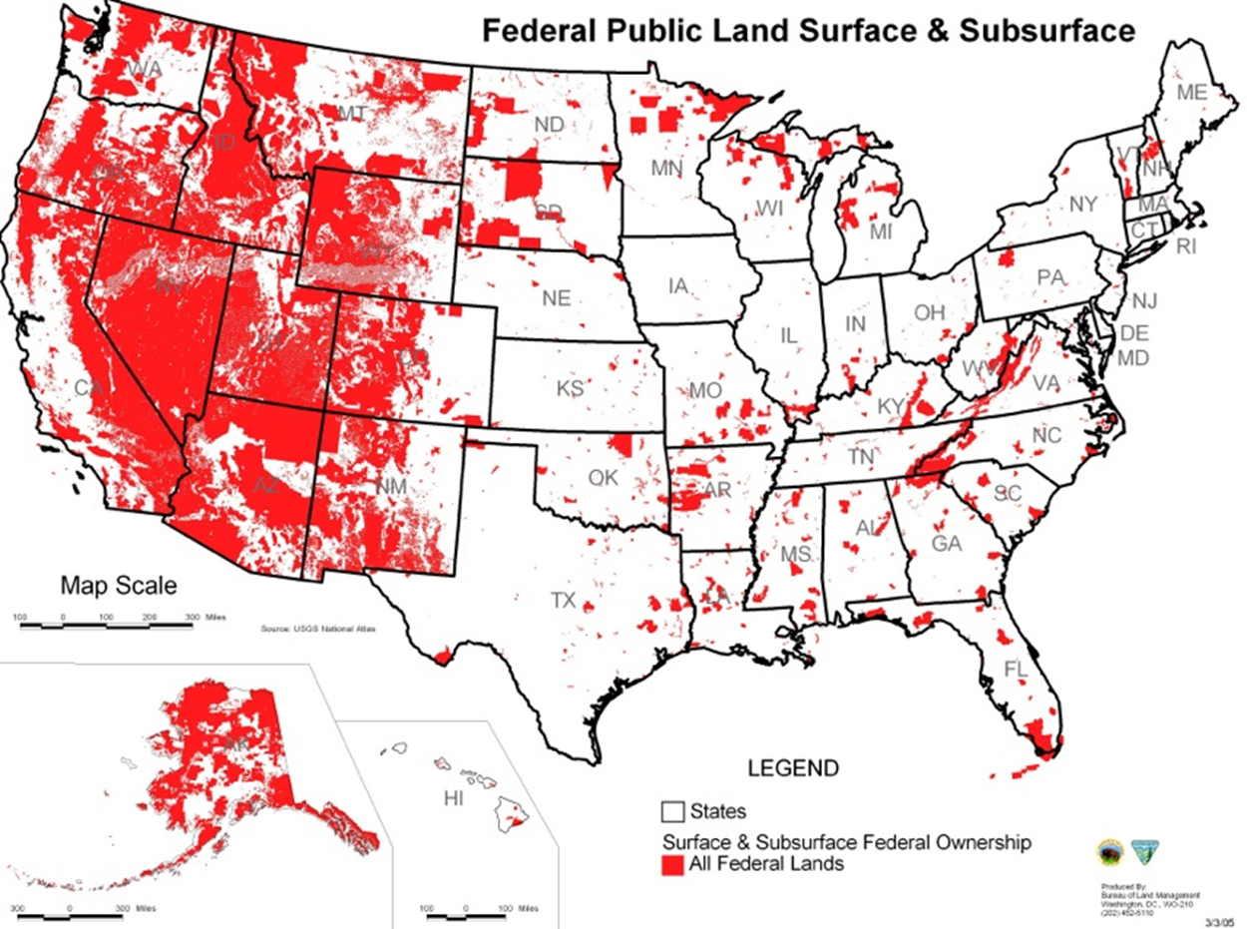
Federally-Owned Land

Slide 12
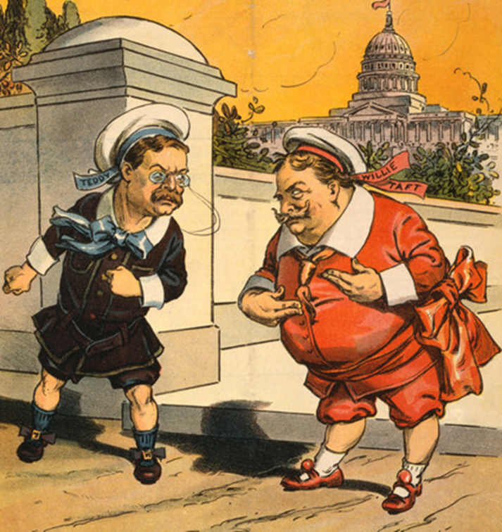
Ballinger-Pinchot Affair
Conservation policy controversy
  Gifford Pinchot
    Appointed by Roosevelt
    Fired by Taft
  Richard Ballinger
    Appointed by Taft
Growing split in Republican Party
  Taft vs. Roosevelt

Slide 13
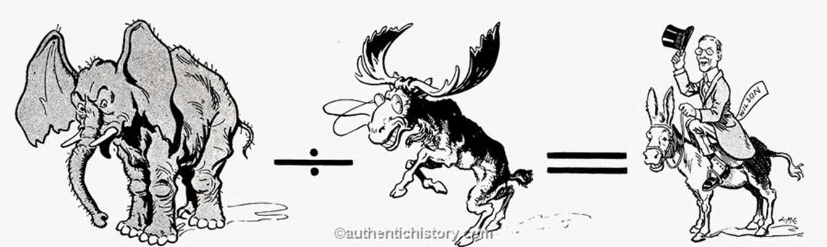
Taft & Roosevelt Split the Vote in 1912

Slide 14
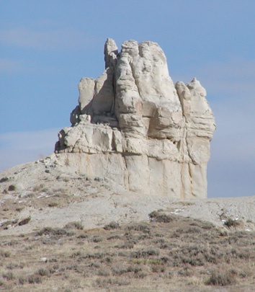
Teapot Dome Scandal
Secretary of Interior Albert Fall accepted bribes for the right to drill for oil on public land
Major scandal for the business-friendly Harding administration

Slide 15

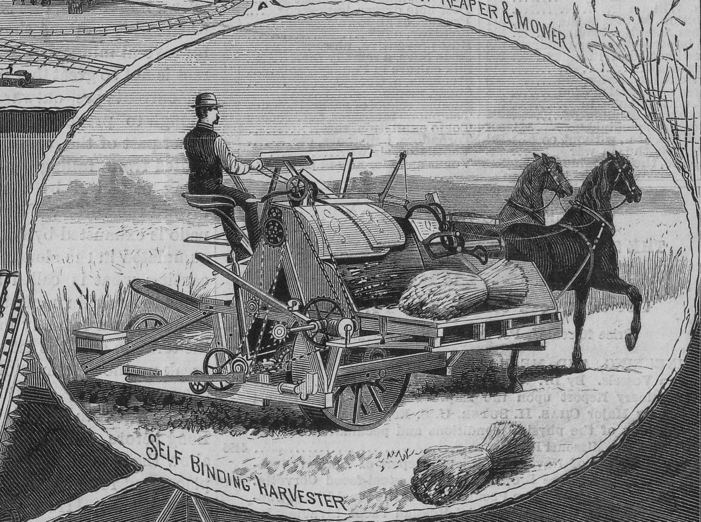
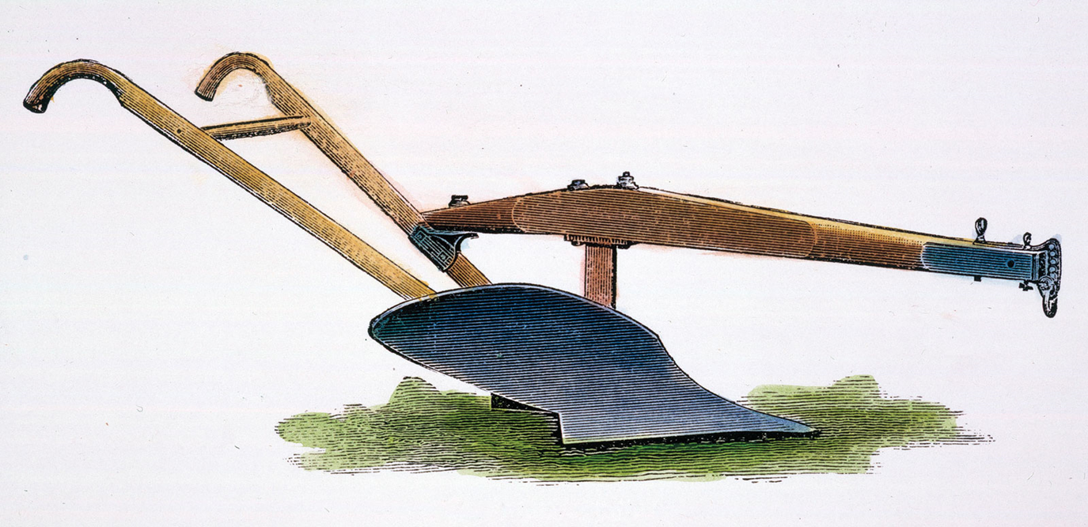
The Farm Becomes a Factory

Slide 16
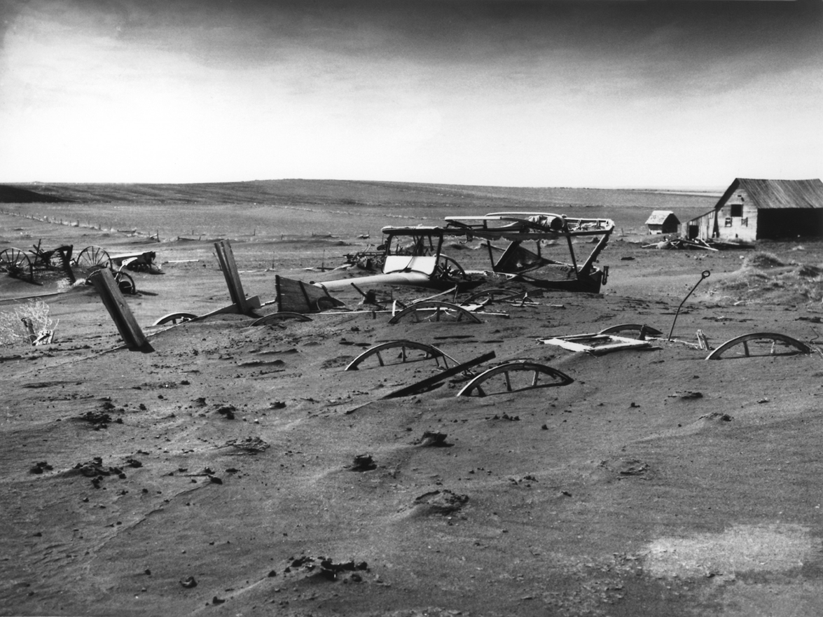
Dust Bowl of the 1930s

Slide 17
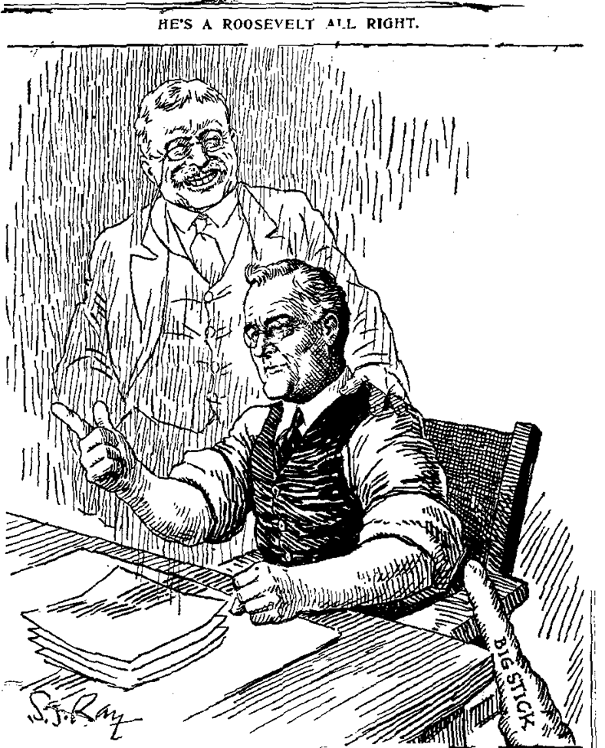
Franklin Roosevelt
New Deal programs addressed some conservation issues
  Erosion & flood control
  Planting of trees
  Building dams
  Farmer education
  More parks, trails & fire breaks

Slide 18


Civilian Conservation Corps (CCC)

Slide 19
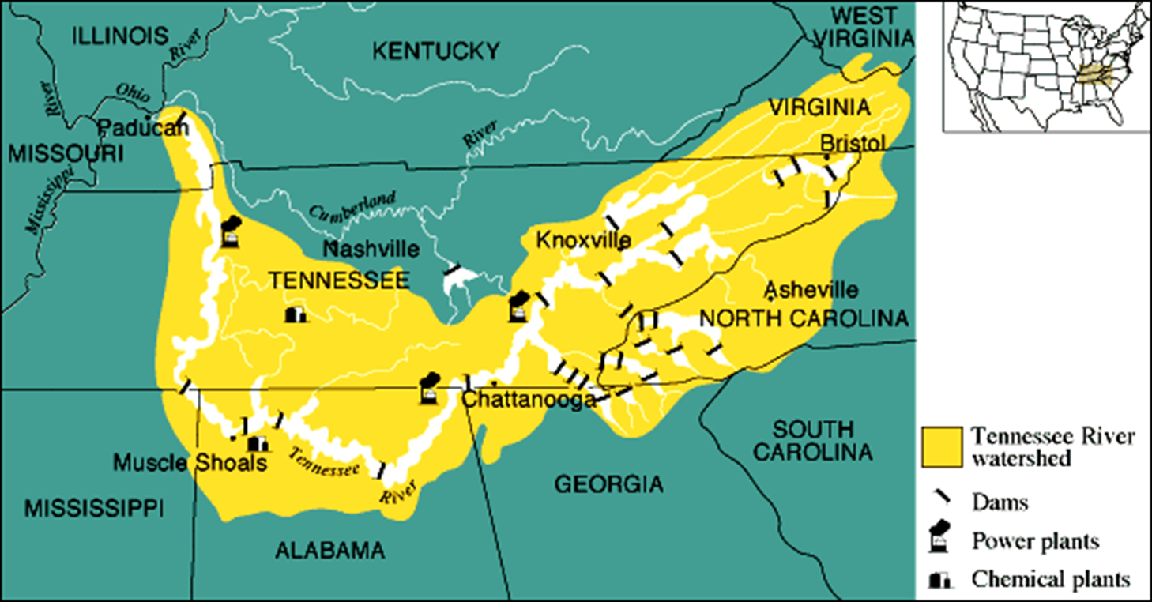
Tennessee Valley Authority (TVA)

Slide 20
Part Two
The Modern Environmental Movement

Slide 21
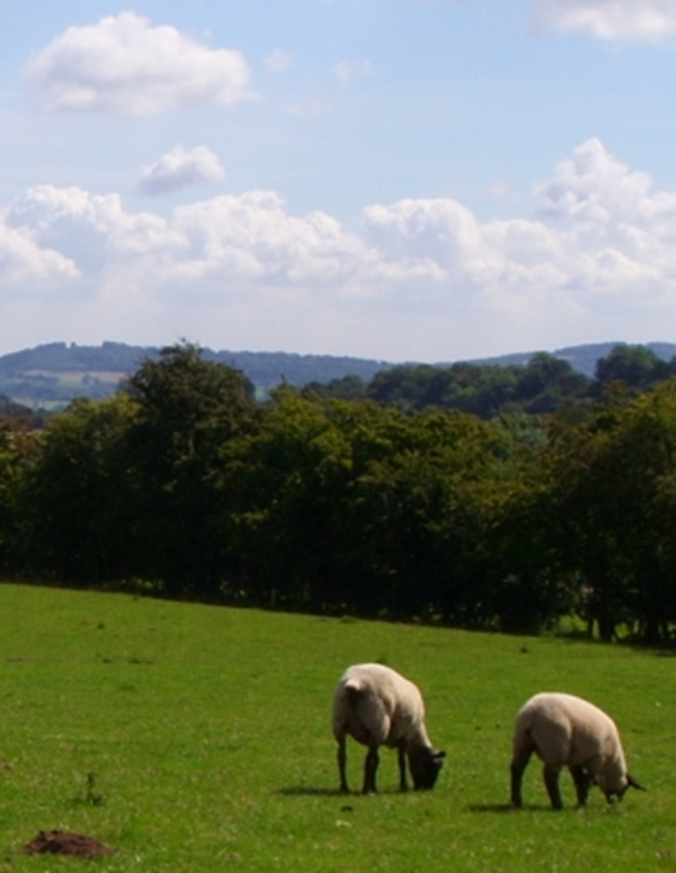
Tragedy of the Commons
Selfish “bad actors” can ruin shared resources
Examples
  Town common pasture can be devoured by a single owner’s sheep
  River’s entire water supply can be contaminated by a single factory’s toxic dumping

Slide 22
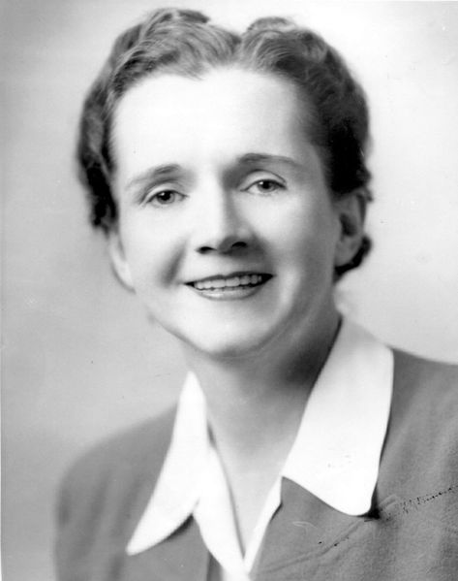
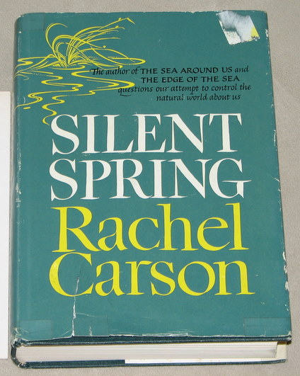
Rachel Carson
Silent Spring, 1962
Drew attention to negative effects of pesticides
DDT was banned
Beginning of modern environmental movement

Slide 23
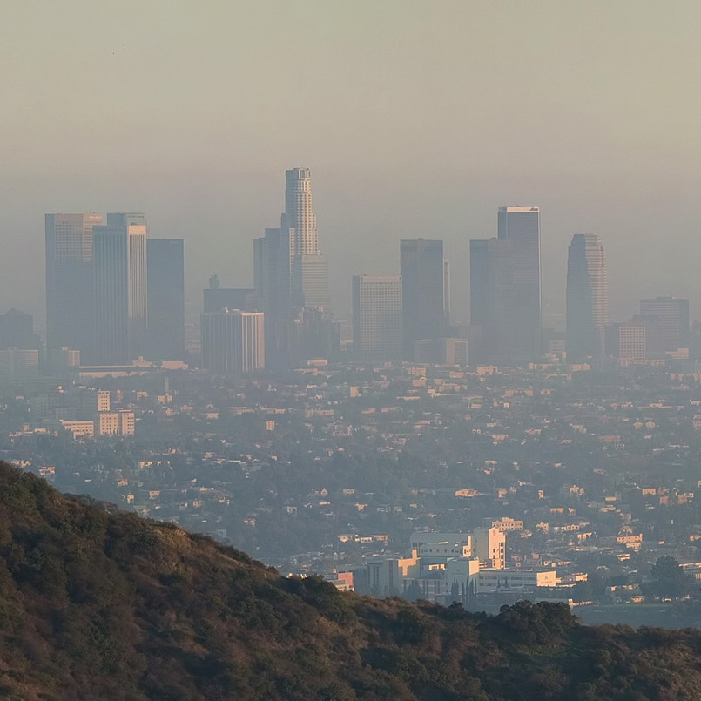
Clean Air Act, 1963
Established emissions standards
Addressed problem of urban “smog”
Signed by Lyndon Johnson

Slide 24

Earth Day
First celebrated in April 1970
Pressured federal government to pass environmental legislation

Slide 25
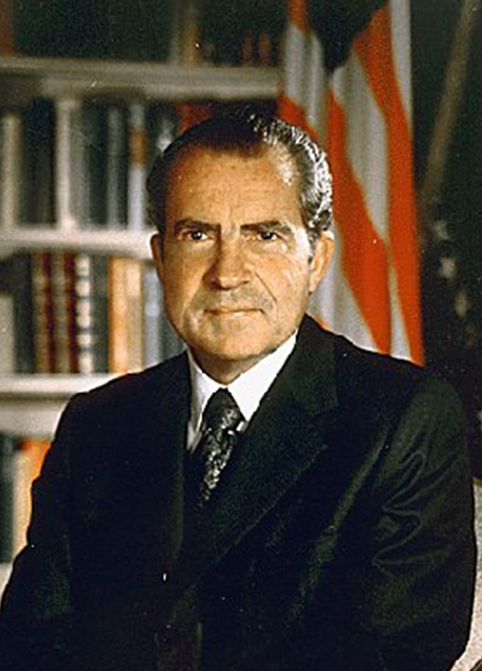
Richard Nixon, Environmentalist?
Clean Air Act of 1970
Vetoed Clean Water Act of 1972
Occupational Safety & Health Administration (OSHA)
Environmental Protection Agency (EPA)
Endangered Species Act of 1973

Slide 26
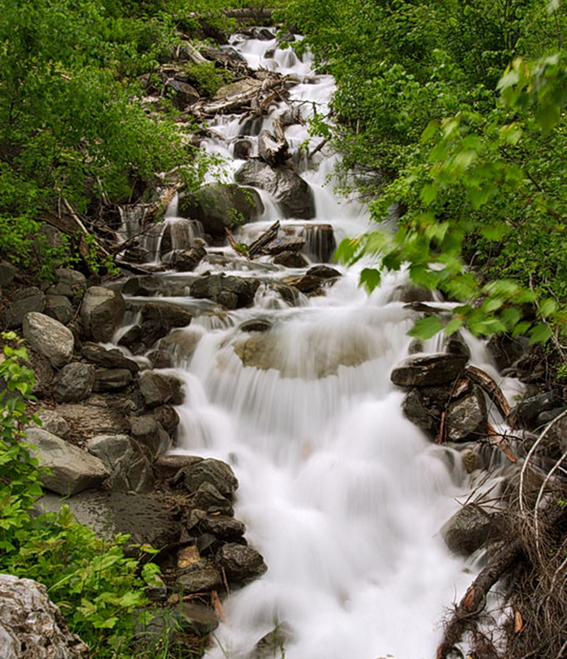
Clean Water Act, 1972
Testing of water quality
Required construction of sewage treatment plants
Nixon objected to the large amount of funding required, but his veto was overridden

Slide 27
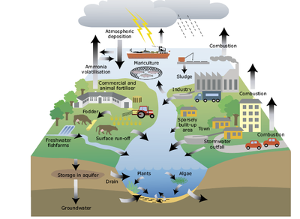
Sources of Pollution

Slide 28
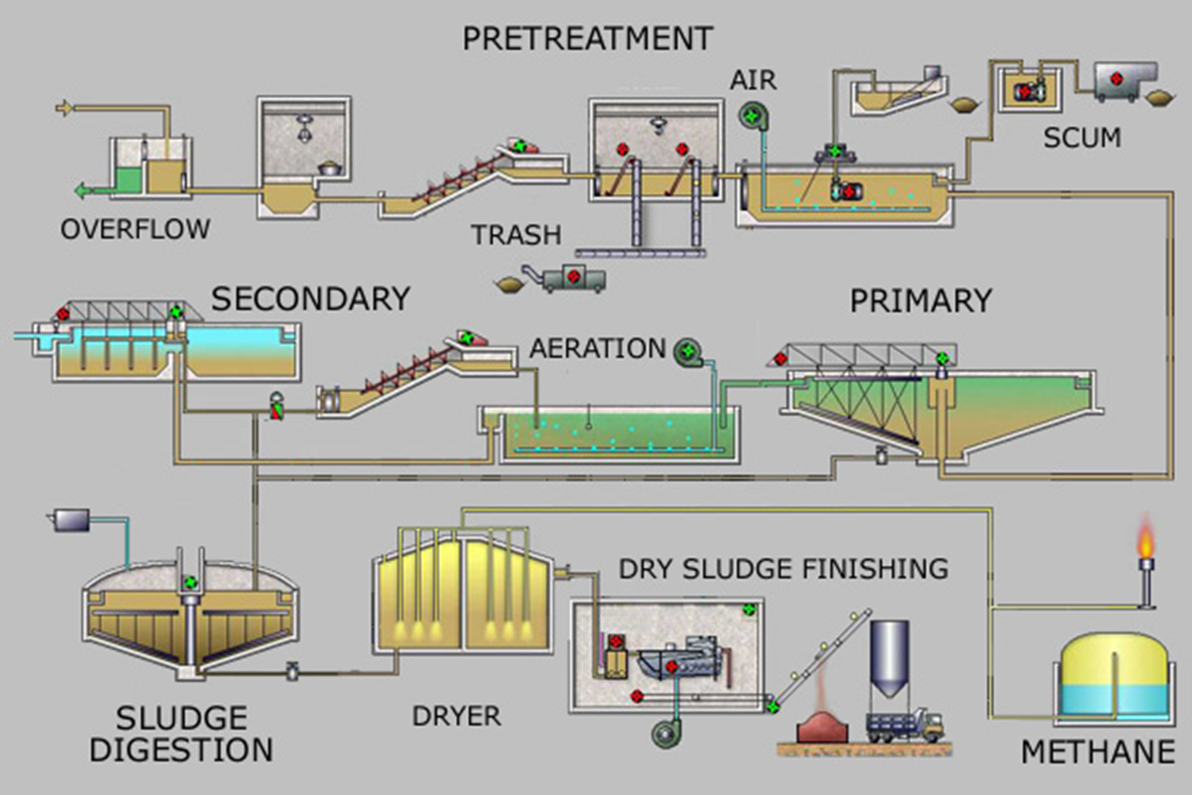
Sewage Treatment

Slide 29


Environmental Protection Agency
Established in 1970
Signed into law by Richard Nixon

Slide 30
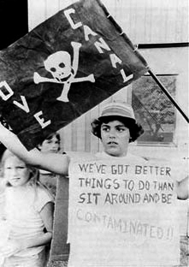
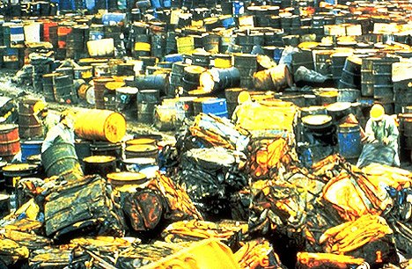
Environmental “Superfund,” 1980
Federal funds to clean up toxic waste
  Love Canal in New York
  “Valley of the Drums” in Kentucky

Slide 31


Endangered Species Act

Slide 32

Bald Eagle Population Recovery
Factors threatening bald eagle
  Loss of habitat
  DDT damage to egg shells
  Hunting
Protected by Endangered Species Act
Population rebounded by 1990s

Slide 33
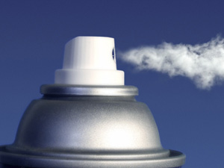
Ozone Layer Depletion
Could lead to higher rates of cancer
Caused by chlorofluorocarbons (CFCs) contained in aerosol spray cans
CFCs were banned
Ozone layer is expected to recover by 2050

Slide 34
Part Three
The Problem with Fossil Fuels…

Slide 35

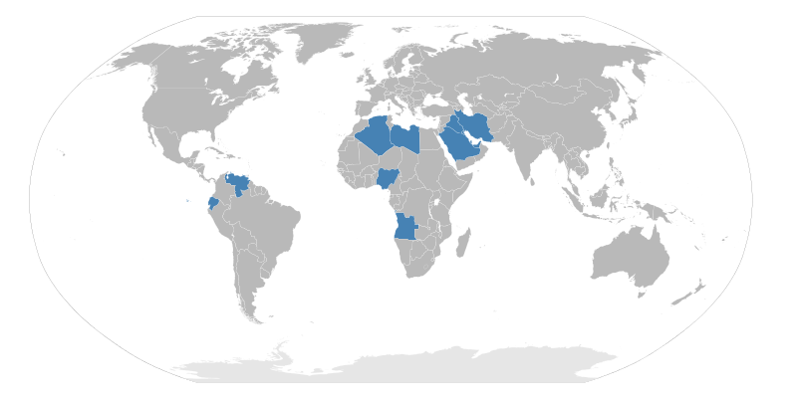
1970s OPEC Embargoes
Economic retaliation against U.S. policy in the Middle East
  1973: Reaction to U.S. support for Israel during Yom Kippur War
  1979: Pressure against U.S. during the Iranian Revolution

Slide 36
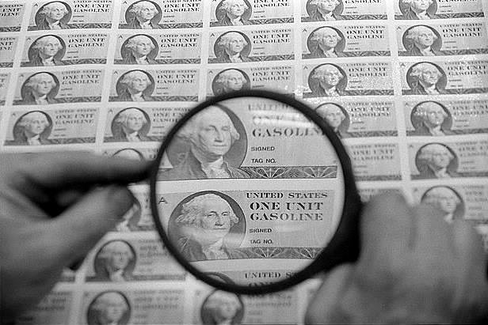
1970s Oil Rationing

Slide 37
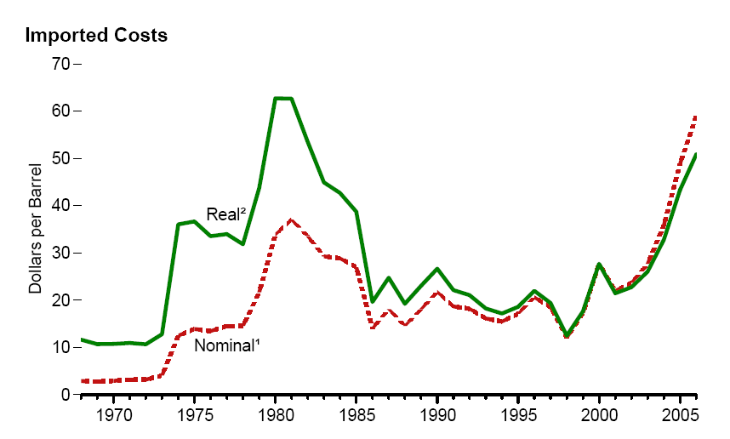
1970s Oil Prices

Slide 38
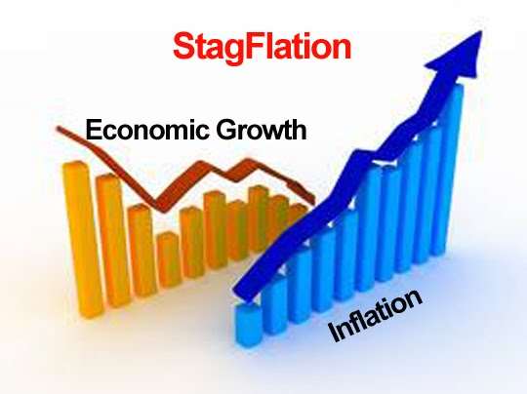
Oil Price Increase Causes “Stagflation”

Slide 39
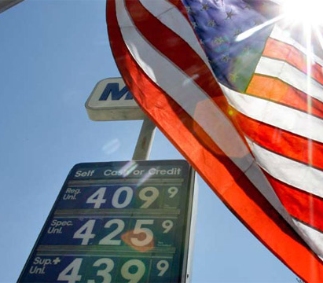
“Energy Independence”
Reducing American dependence on foreign oil
  More domestic fossil fuel production (ex: fracking)
  Alternative energy sources
Limited effectiveness

Slide 40
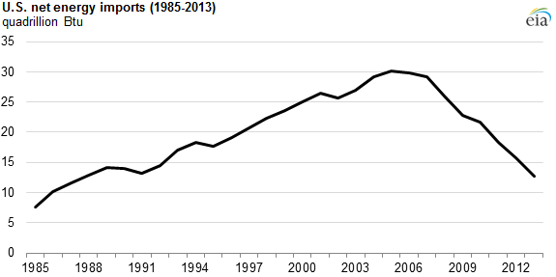
“Energy Independence”

Slide 41
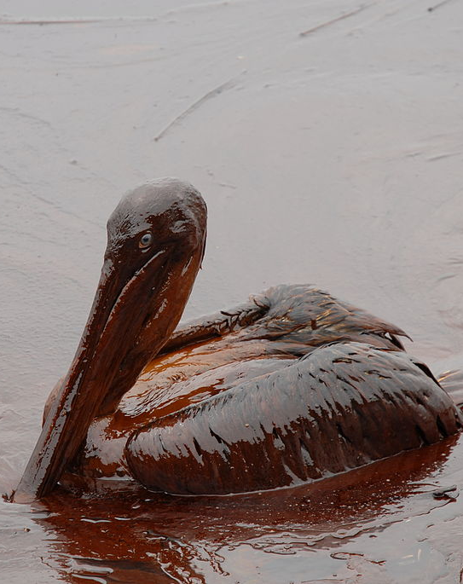
Major Oil Spills
Serious damage to local ecosystems and economies
  Exxon-Valdez, coast of Alaska, 1989
  Iraqi destruction of Kuwaiti oil fields, 1991
  Deepwater Horizon, Gulf of Mexico, 2011

Slide 42
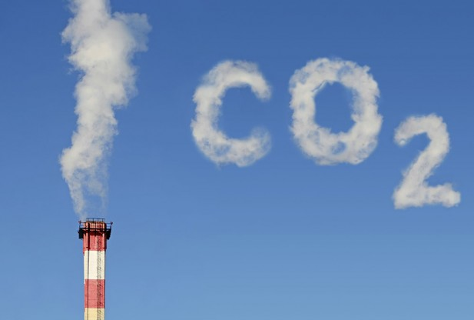
Greenhouse Gases

Slide 43
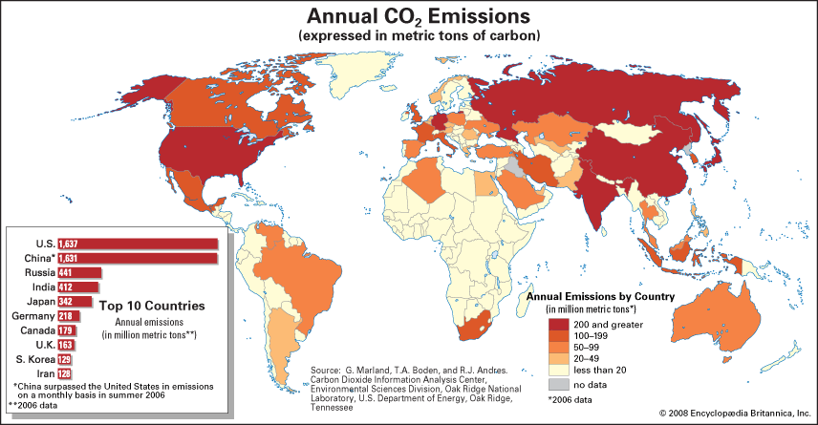
Developed vs. Developing Countries

Slide 44
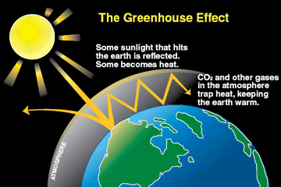
Greenhouse Effect

Slide 45
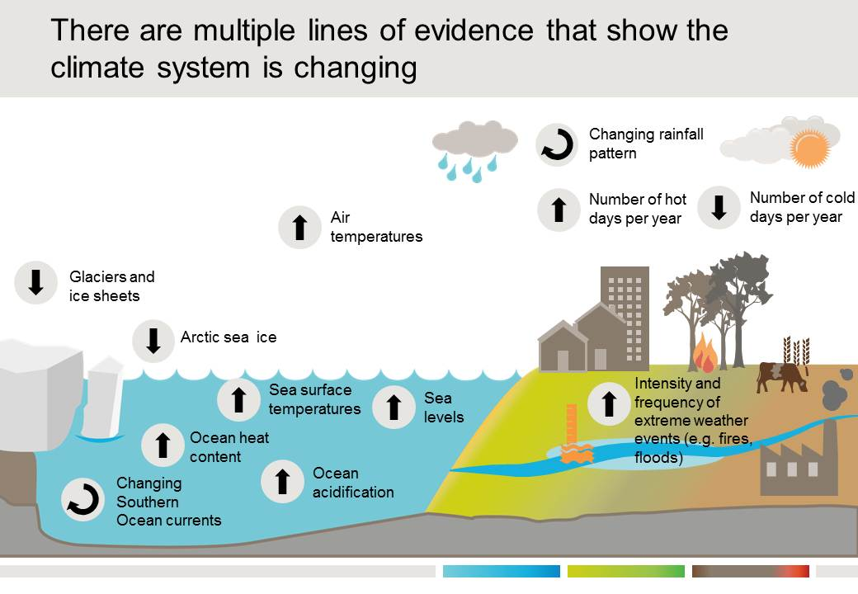
Climate Change/Global Warming

Slide 46
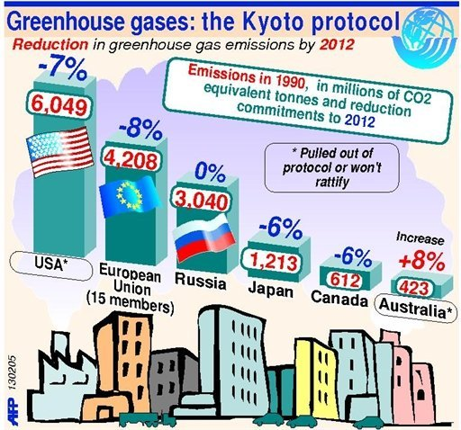
Addressing Climate Change
Government initiatives
  Carbon tax
  Alternative energy
  Energy efficiency
  Reforestation
International agreements
  Kyoto Protocol placed responsibility for carbon reduction on already-developed countries

Slide 47
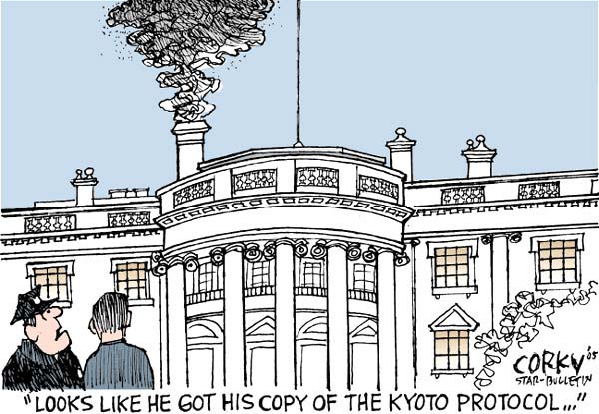
U.S. Rejection of Kyoto Protocols

Slide 48
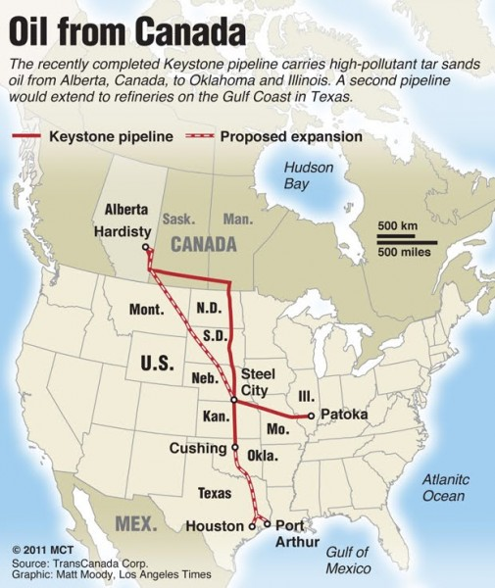
North American Oil Production
Environmental concerns vs. potential economic benefits
  Arctic National Wildlife Refuge (ANWR) oil reserves
  Keystone XL Pipeline controversy

Slide 49
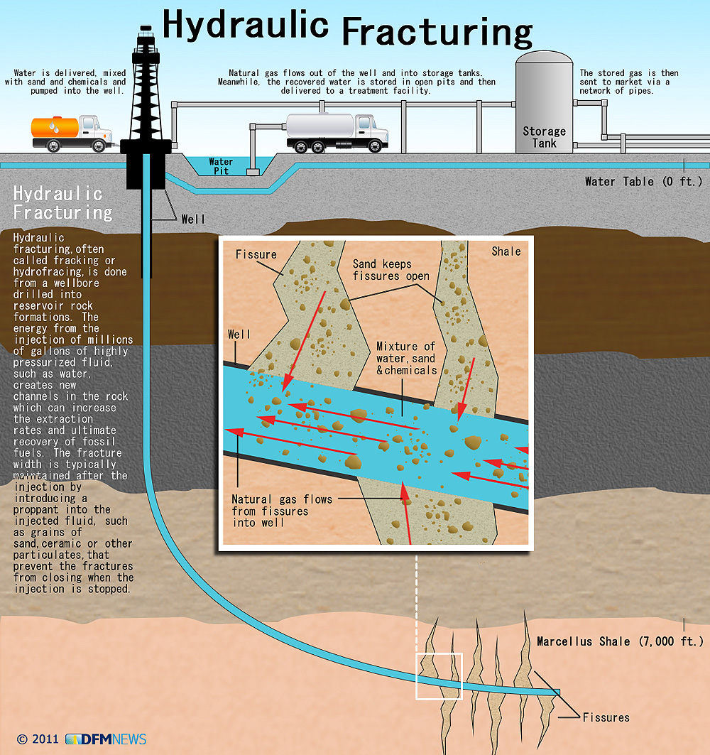
“Fracking”
Hydraulic fracturing of bedrock to recover deeply-buried sources of energy
Vast new supplies of untapped fossil fuels have become available

Slide 50
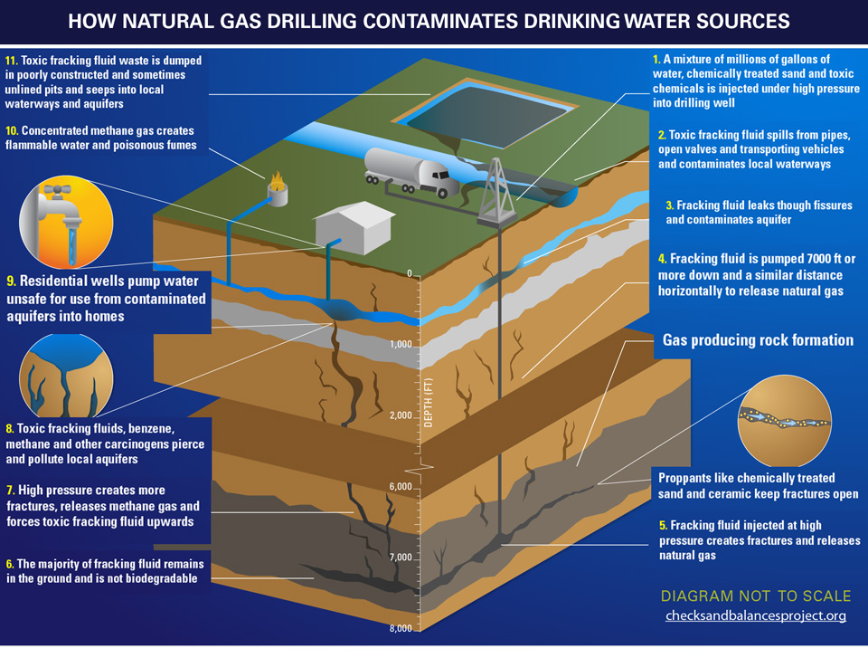
Dangers of Fracking

Slide 51
Part Four
Nuclear Energy

Slide 52
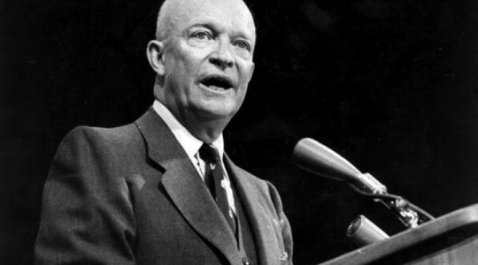
Nuclear Power
President Dwight Eisenhower
  “Atoms for Peace”
Lewis Strauss, head of U.S. Atomic Energy Commission
  “Our children will enjoy in their homes electrical energy too cheap to meter.”

Slide 53
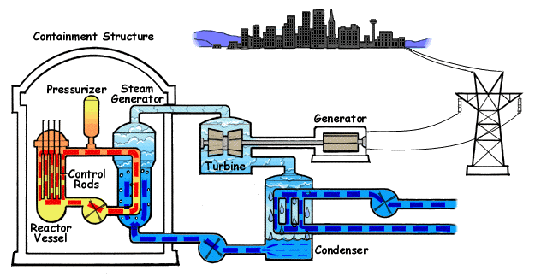
Nuclear Reactor & Steam Turbine

Slide 54
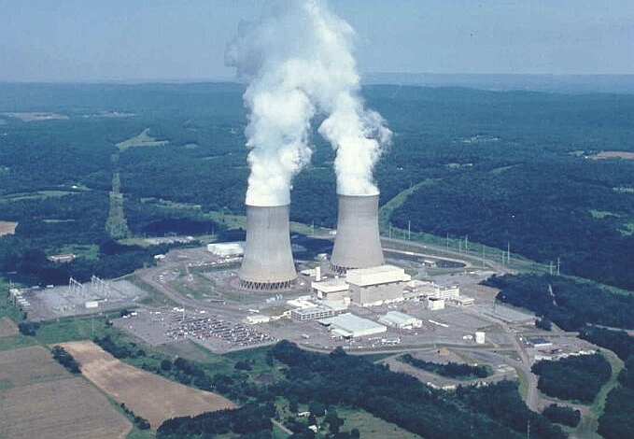
“Zero Pollution” from Nuclear Energy

Slide 55
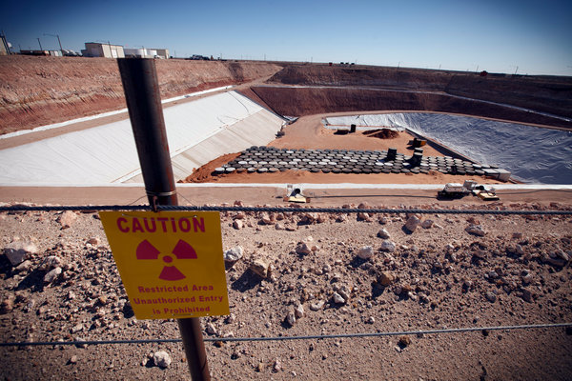
Nuclear Waste Disposal

Slide 56
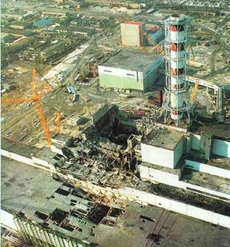
Nuclear Accidents
Three Mile Island, Pennsylvania, 1979
Chernobyl, Ukraine, 1986
Fukushima Daiichi, Japan, 2011

Slide 57

Three Mile Island, 1979
Partial meltdown
Negligible dose of radiation into local area (equivalent to a single x-ray exam)
President Carter reorganized the Nuclear Regulatory Commission (NRC)

Slide 58

“No Nukes” Movement
Reaction to Three Mile Island & fear of nuclear war
No new nuclear power plants have been built in the U.S. since 1977

Slide 59

Nuclear Power Plants in the U.S.

Slide 60

Chernobyl, 1986
Complete meltdown
Major health impact on local civilians and wildlife
City of Pripyat was evacuated and became an “exclusion zone”

Slide 61

Fukushima Daiichi, 2011
Tsunami flooded the station, crippling reactor controls
Radiation leak was equivalent to 10%-30% of Chernobyl levels

Slide 62


Slide 63
Part Five
Alternative Energy

Slide 64

Solar Power

Slide 65

Wind Power

Slide 66

Hydroelectric Power

Slide 67

Geothermal Power

Slide 68

Biofuel

Slide 69

Energy Consumption Over Time
Despite recent availability of alternative sources, cheap fossil fuels have continued to dominate energy consumption

Slide 70
Part Six
Consumer Protection

Slide 71

“Muckraking”

Slide 72

Upton Sinclair
The Jungle, 1906
Pure Food & Drug Act, 1906
Meat Inspection Act, 1906
Eventual creation of Food & Drug Administration (FDA)

Slide 73

U.S. Surgeon General
Report on Smoking & Health, 1964
  Implicated smoking in cancer and heart disease deaths
  Led to warning labels on cigarette packs & government-funded anti-smoking campaigns

Slide 74


Smoking Rates

Slide 75

Ralph Nader
Unsafe at Any Speed, 1965
Led to automobile reforms
  Seatbelts
  Safety design
  Fuel efficiency
“Nader’s Raiders” investigated other consumer safety & environmental issues

Slide 76


Consumer Awareness

Slide 77




Nader & the 2000 Election
Gore campaign accused Nader & the Green Party of spoiling the election in favor of Bush

Slide 78

The End!

