Slide 1

LGBT
History of the United States
AN
Mr. Johnson – APUSH
Hopewell High School

Slide 2

Introduction
L – Lesbian
G – Gay
B – Bisexual
T – Transgender
“Queer”

Slide 3
19th Century America

Slide 4
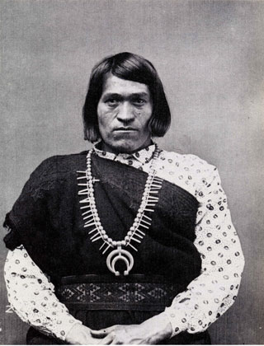
Native American Culture
“Two-Spirit” people
      Manifestation of both male & female “spirits”
Documented in 130+ tribes
Role
      Healer, storyteller, prophet
“Third gender”
      Not considered male or female
      Not considered homosexual or heterosexual

Slide 5
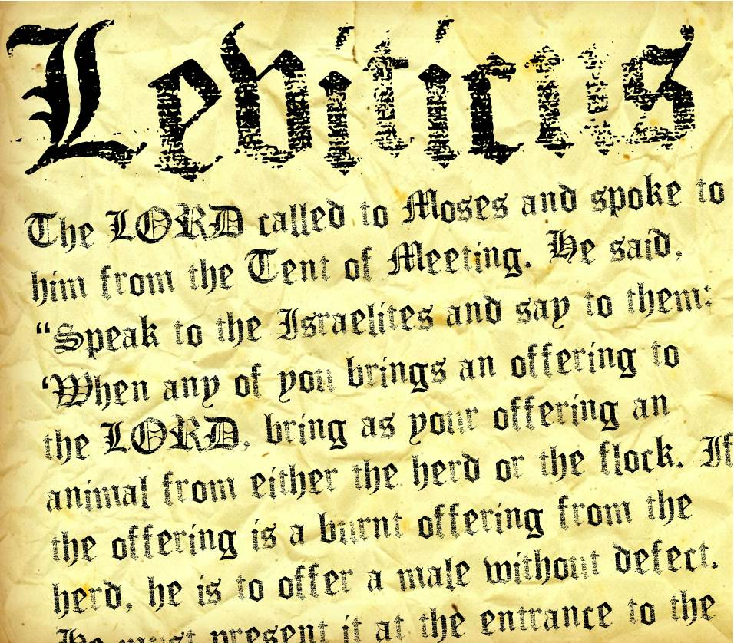
19th Century Laws
Judeo-Christian tradition
      Old Testament prohibitions against homosexuality
Strict sodomy laws
      “Crime against nature”
      Long prison sentences
      Hard labor
      Even death penalty

Slide 6

19th Century Same-Sex Relationships?
Uncertainty…
      Social stigma kept behavior hidden
      Lack of clear records
Modern misinterpretation of heterosexual behavior?
      “Co-sleeping”
      “Romantic friendships”
      “Boston marriages”

Slide 7
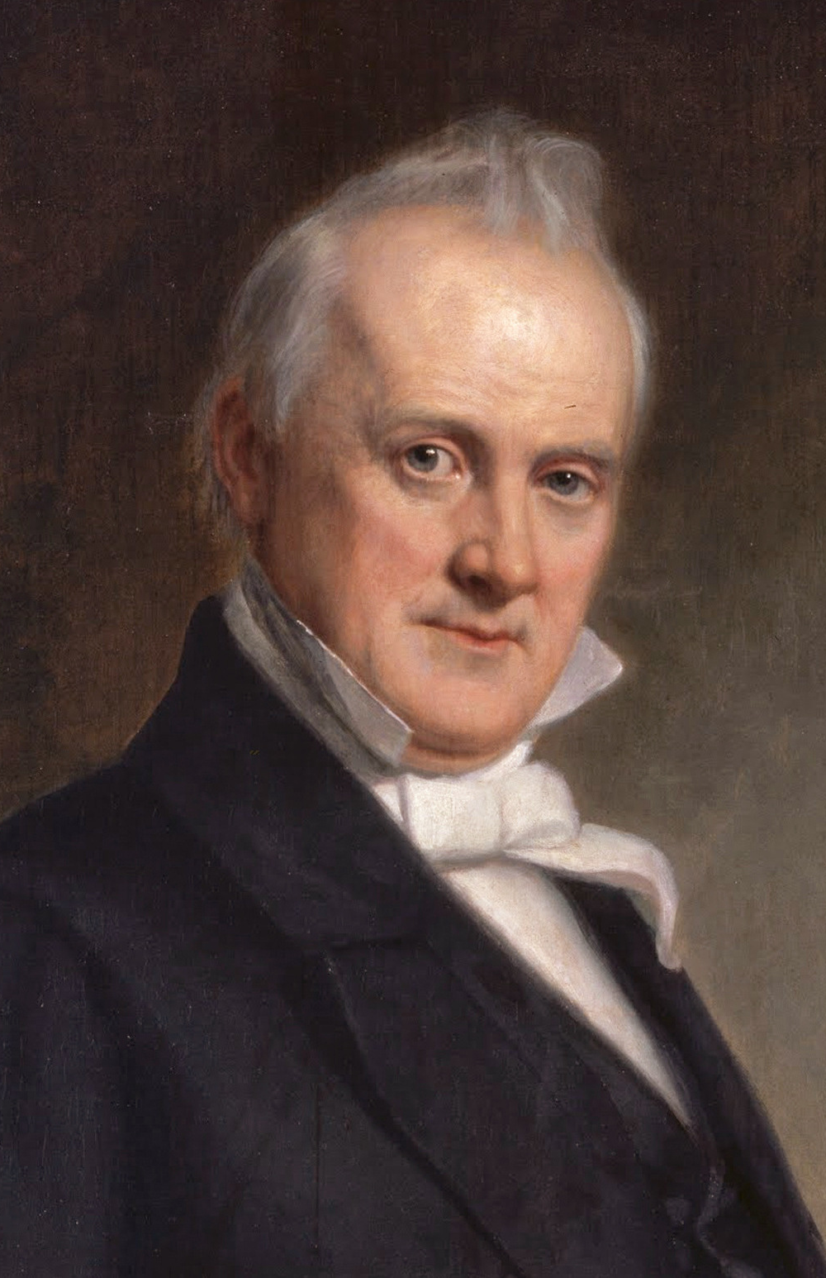
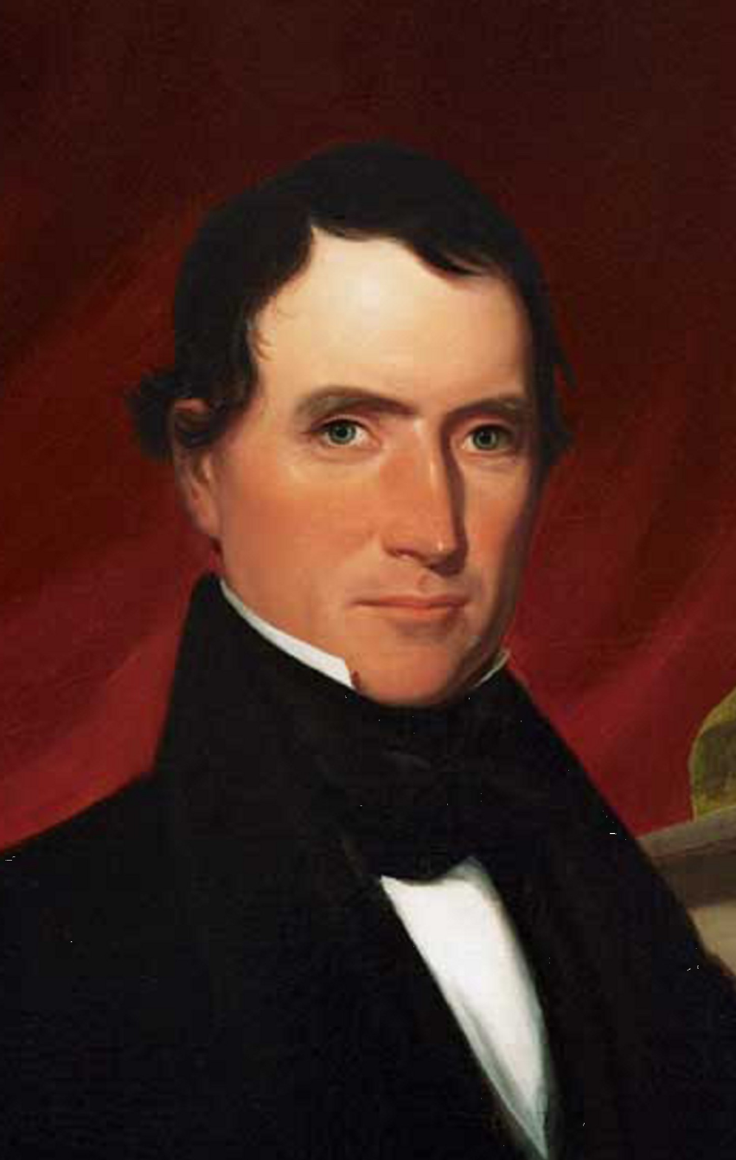
James Buchanan & Rufus King

Slide 8
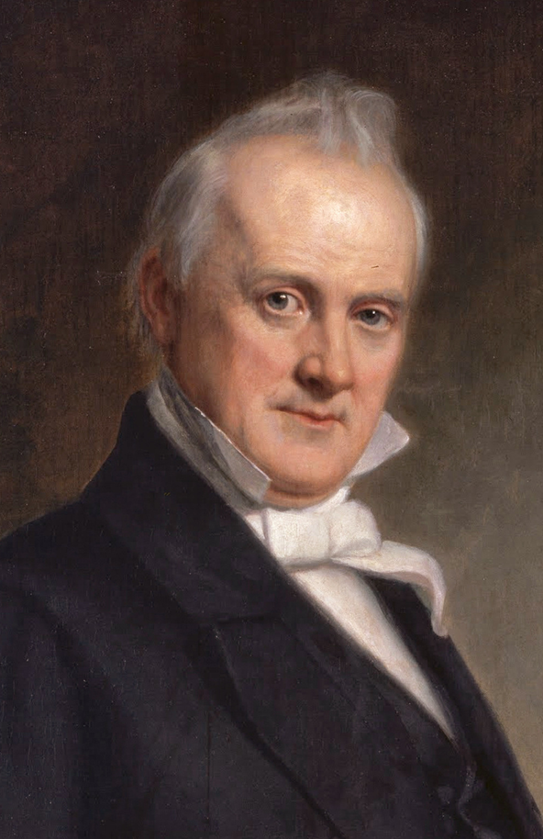
Our First Gay President?
James Buchanan
Never married
Relationship with W. Rufus King
      Lived together for 13 years
      Adopted each other’s effeminate mannerisms
      Quotes from contemporaries:
        “Miss Nancy & Aunt Fancy”
        “Something unhealthy in the president's attitude”

Slide 9
Buchanan on King’s Departure, 1844
"I am now solitary and alone… I have gone a wooing to several gentlemen, but have not succeeded with any one of them. I feel that it is not good for man to be alone, and [I] should not be astonished to find myself married to some old maid who can nurse me when I am sick, provide good dinners for me when I am well, and not expect from me any very ardent or romantic affection.”

Slide 10
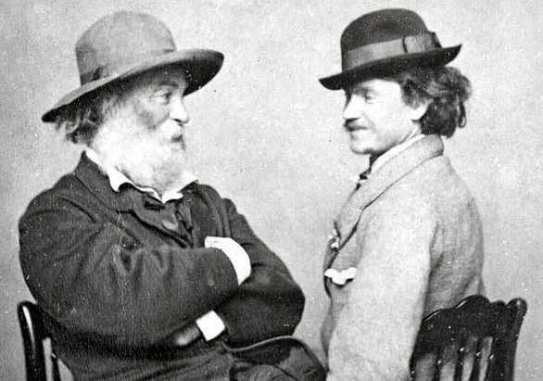
Walt Whitman & Peter Doyle

Slide 11
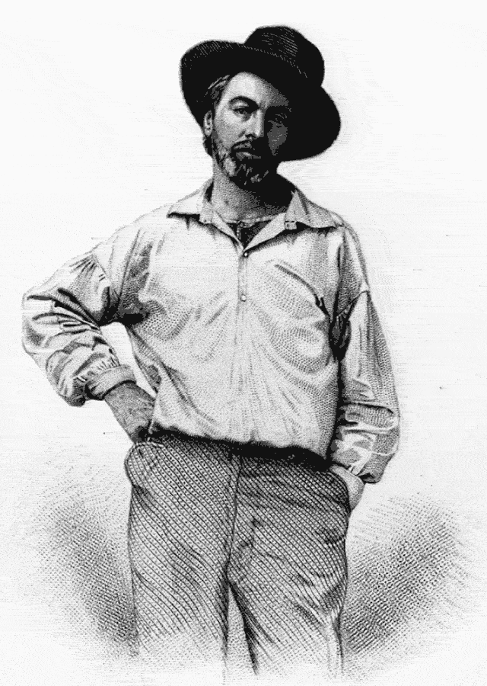
Walt Whitman
Transcendentalist poet
Leaves of Grass, 1855 (1st ed.)
      Continuously revised until his death in 1892
      Criticized and censored for its sexual content

Slide 12
“I sing the Body Electric,” 1855
by Walt Whitman
I sing the body electric,
The armies of those I love engirth me and I engirth them,
They will not let me off till I go with them, respond to them,
And discorrupt them, and charge them full with the charge of the soul.

Slide 13
“I sing the Body Electric,” 1855
Was it doubted that those who corrupt their own bodies conceal themselves?
And if those who defile the living are as bad as they who defile the dead?
And if the body does not do fully as much as the soul?
And if the body were not the soul, what is the soul?...

Slide 14
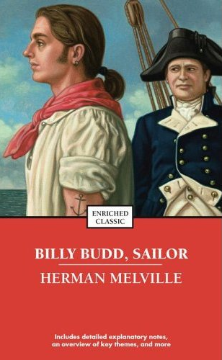
Herman Melville’s Billy Budd
Impressment of young sailor
He later murders the ship’s captain

Slide 15
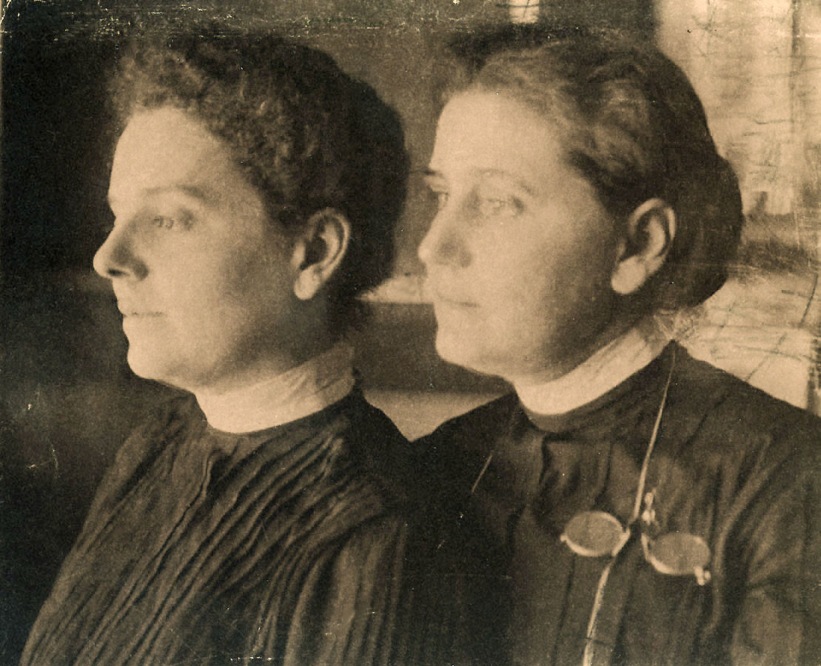
Gilded Age “Boston Marriages”
Single women living together
      Economic partnership
      Friendship
      Romance?
Jane Addams of Hull House & Mary Roze Smith

Slide 16
Early 20th Century

Slide 17
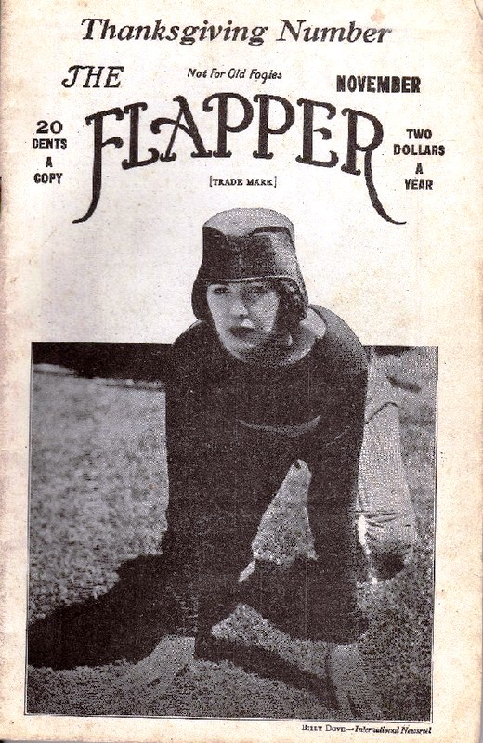
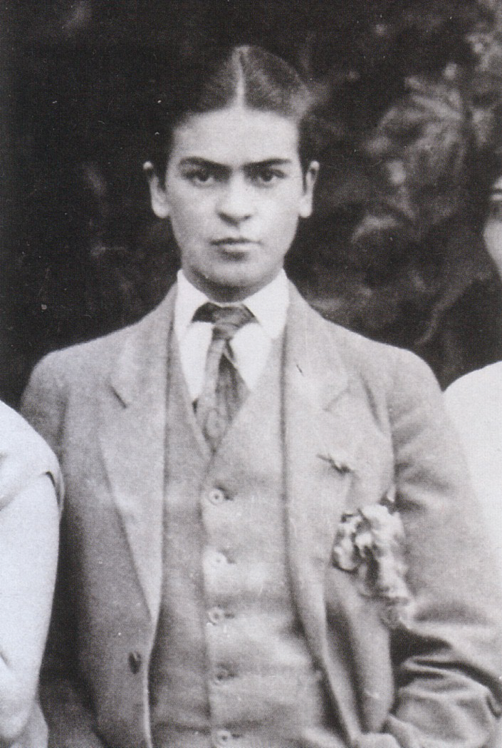
The Roaring Twenties
Breaking of traditional gender barriers
Flappers
Male drag

Slide 18

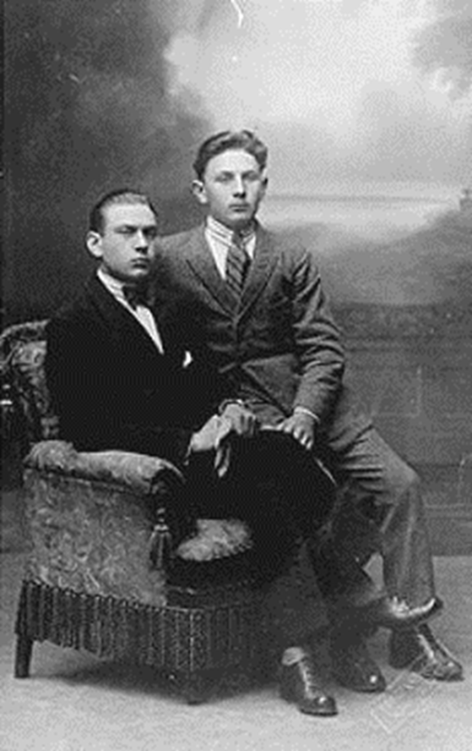
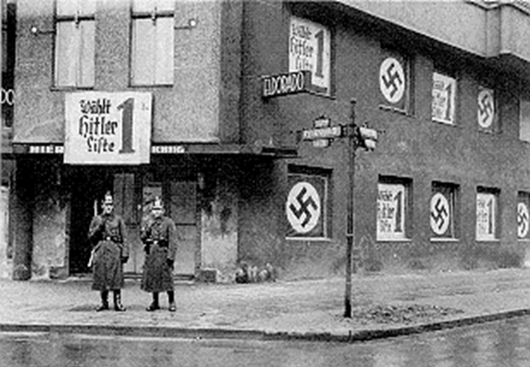
Nazi Germany

Slide 19
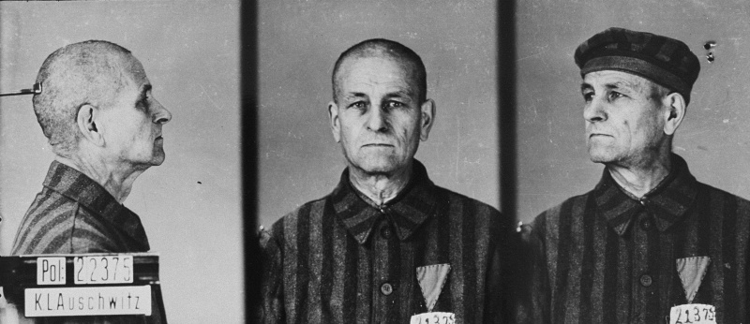
The Holocaust

Slide 20
1950s-1960s: Coming Out

Slide 21
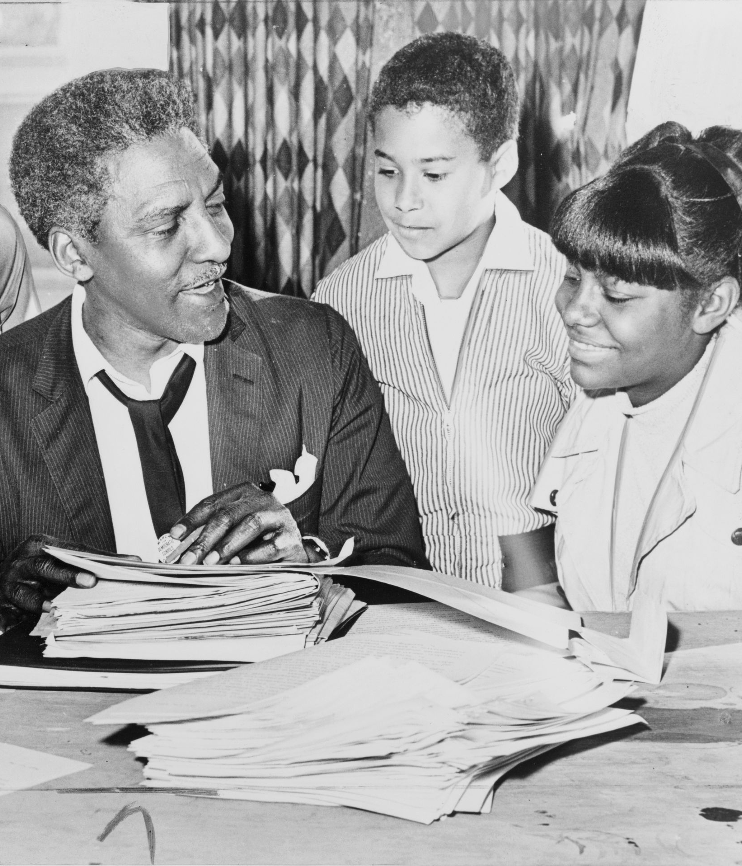
Bayard Rustin
Prolific civil rights organizer
      Freedom Rides
      Southern Christian Leadership Conference (SCLC)
      1963 March on Washington
Sexual orientation and past ties to Communist Party limited his public role

Slide 22
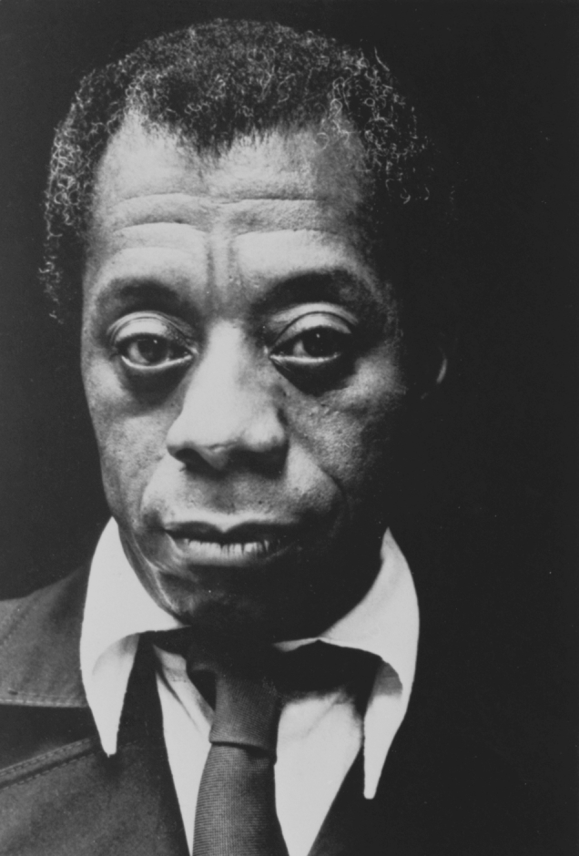

James Baldwin
Go Tell It on the Mountain, 1953
Giovanni’s Room, 1956

Slide 23
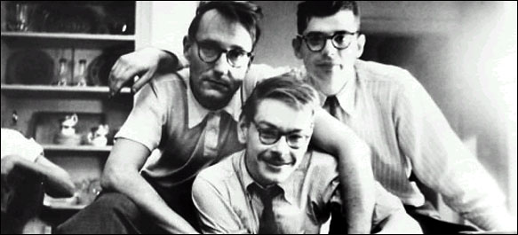
Beats: Burroughs, Solomon & Ginsberg

Slide 24
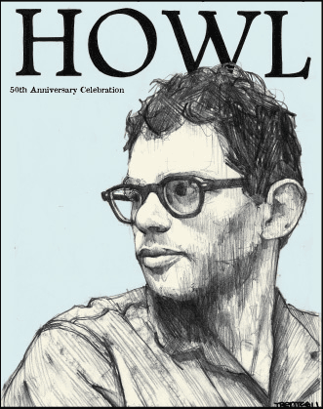
Howl by Allen Ginsberg, 1955
For Carl Solomon
I saw the best minds of my generation destroyed by madness, starving hysterical naked,
dragging themselves through the negro streets at dawn looking for an angry fix,…

Slide 25
Howl by Allen Ginsberg, 1955
angelheaded hipsters burning for the ancient heavenly connection to the starry dynamo in the machinery of night,
who poverty and tatters and hollow-eyed and high sat up smoking in the supernatural darkness of cold-water flats floating across the tops of cities contemplating jazz…

Slide 26
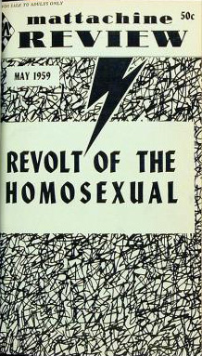
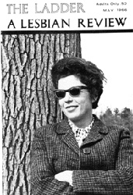
Homophile Movement

Slide 27
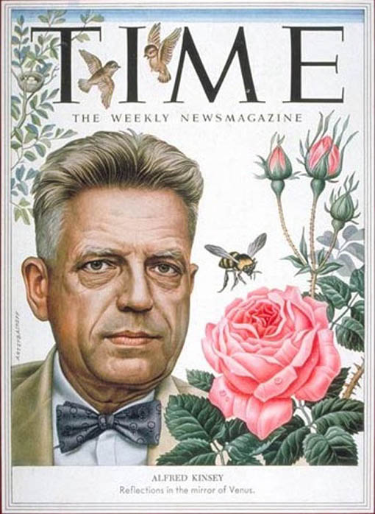
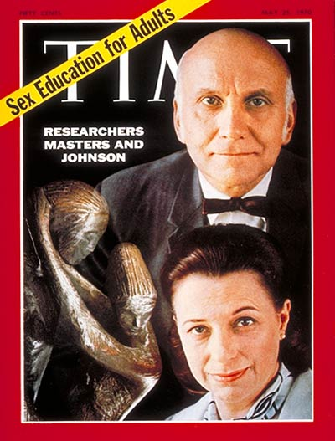
Sexual Revolution

Slide 28
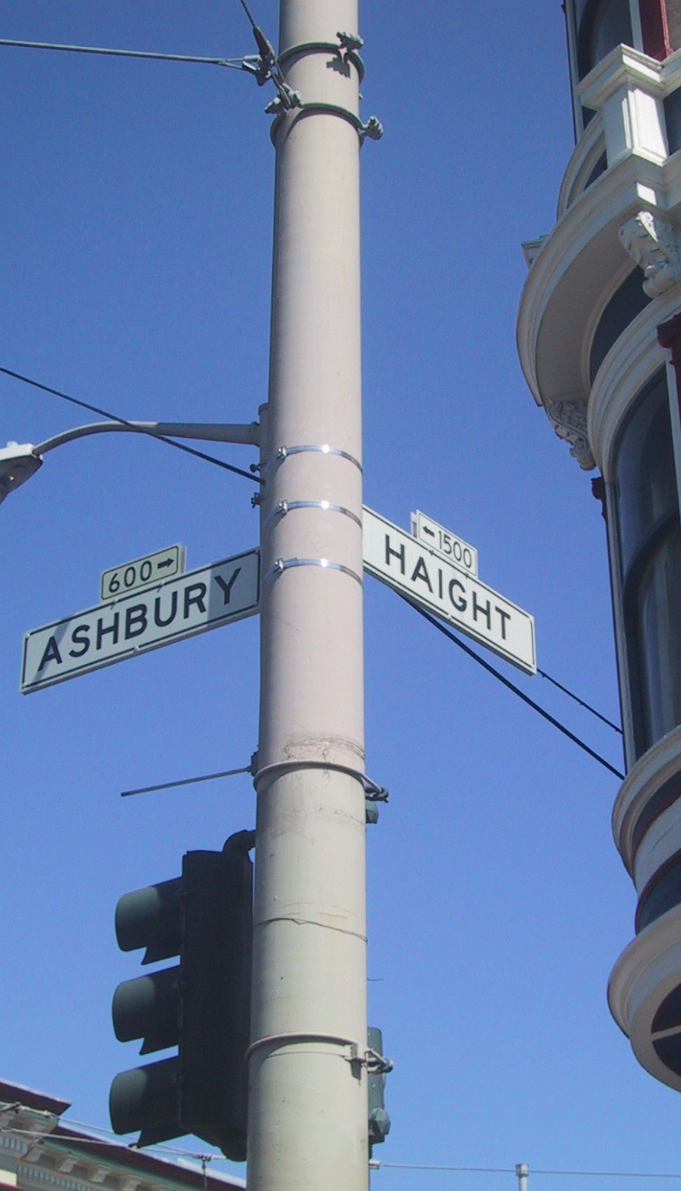
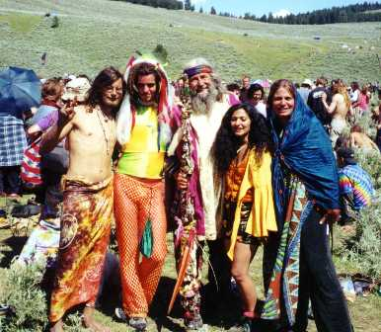
Hippies

Slide 29
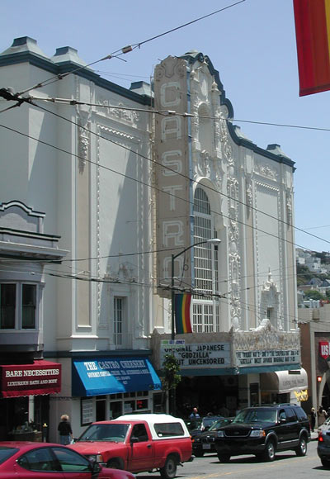
Urban Gay Districts
The Castro, San Francisco
Greenwich Village, NYC
Boystown, Chicago
Dupont Circle, Washington, DC
Hillcrest, San Diego
West Hollywood, Los Angeles

Slide 30
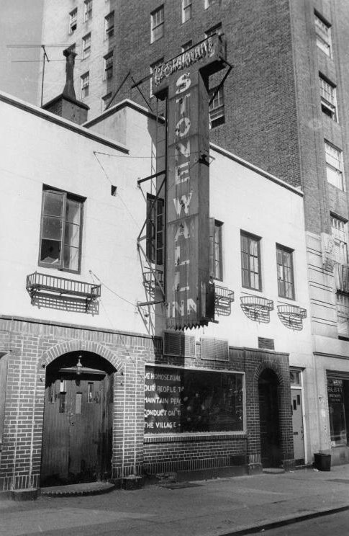
Stonewall Riots
New York City, 1969
Police clash with patrons of gay bar
Riots continued for 5 days
Birth of modern gay rights movement
“Gay Liberation”

Slide 31
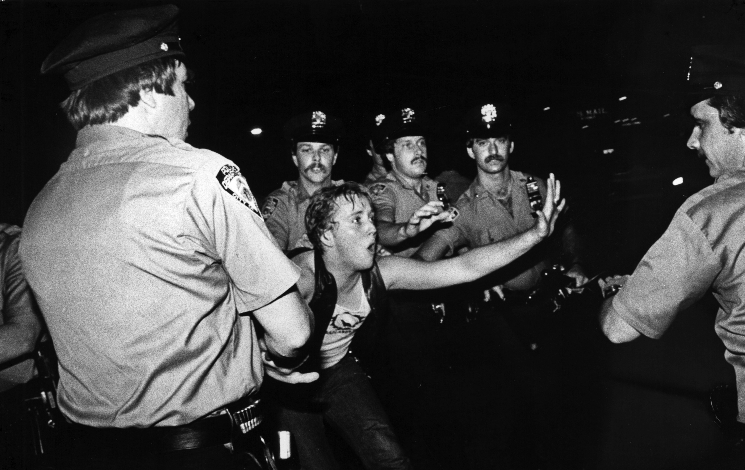
Stonewall Riots

Slide 32
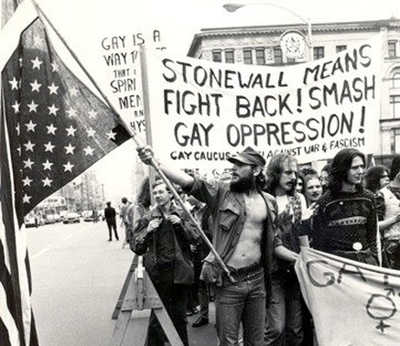
Stonewall Sparks a Movement

Slide 33
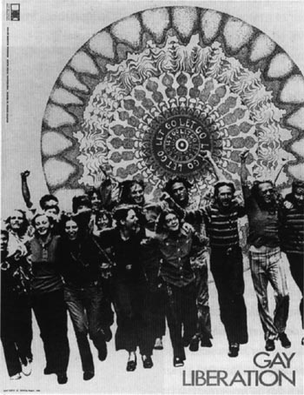

Gay Liberation Movement

Slide 34
1970s-1990s:
Tribulations

Slide 35

American Psychiatric Association
Removed homosexuality from list of psychological disorders in the Diagnostic & Statistical Manual (DSM-II) in 1973

Slide 36
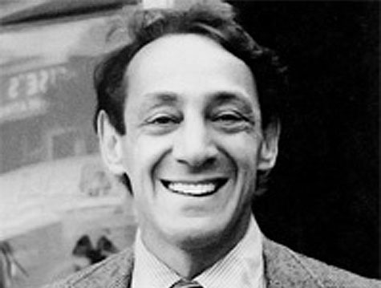
Harvey Milk
San Francisco City Supervisor, 1977
One of the first openly gay elected officials in U.S.
Elected with strong support from the Castro district
Assassinated in 1978

Slide 37
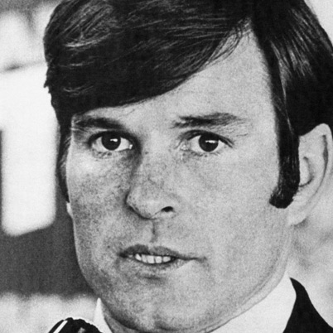
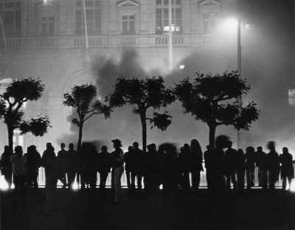
“Twinkie Defense” & White Night Riots

Slide 38

AIDS Pandemic
“Gay cancer”
“Gay Related Immune Deficiency” (GRID)
HIV/AIDS
      Human Immunodeficiency Virus
      Acquired Immune Deficiency Syndrome

Slide 39

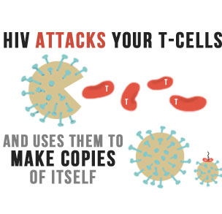
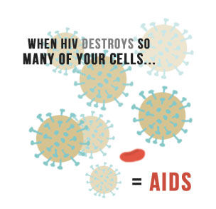
AIDS Pandemic

Slide 40
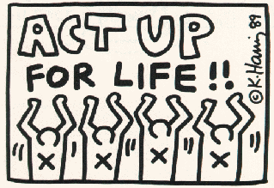
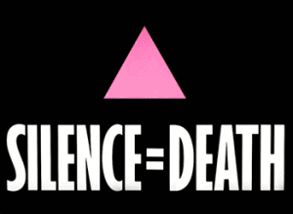
ACT Up

Slide 41
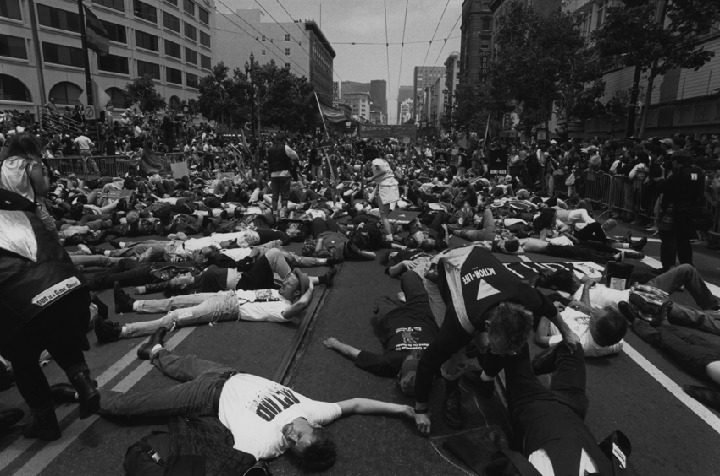
ACT Up “Die-In”

Slide 42
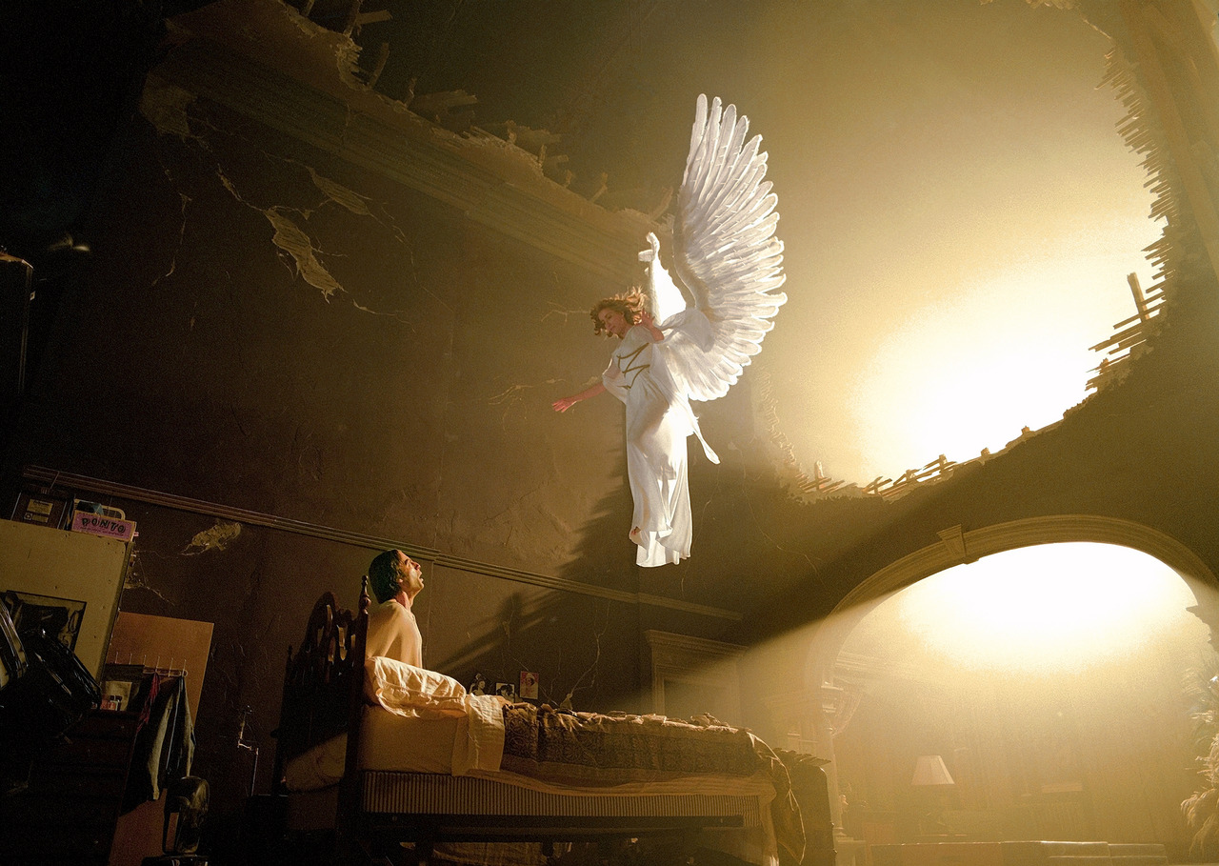
Tony Kushner’s Angels in America

Slide 43
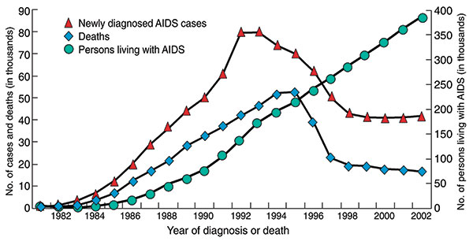
AIDS Deaths Decline

Slide 44
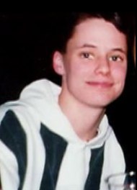
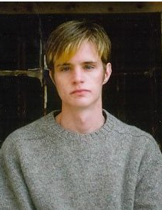
Brandon Teena & Matthew Shepard

Slide 45
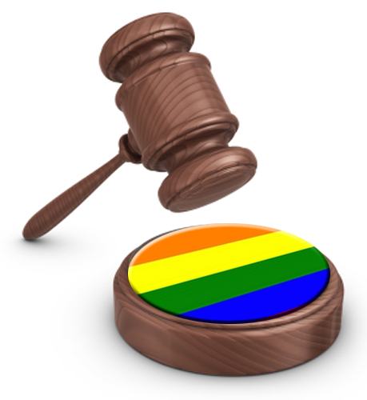
Hate Crimes Laws
31 states include sexual orientation protections in their hate crimes statutes

Slide 46
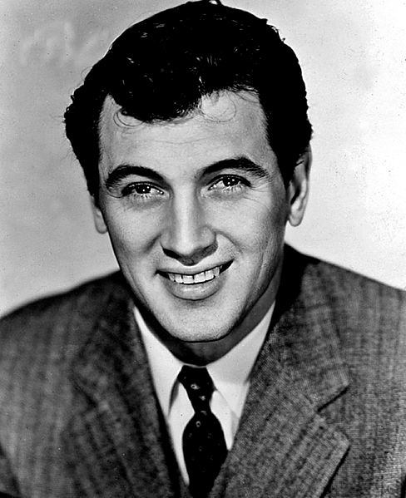

Entertainment Industry

Slide 47
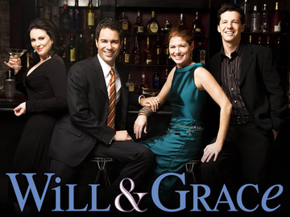
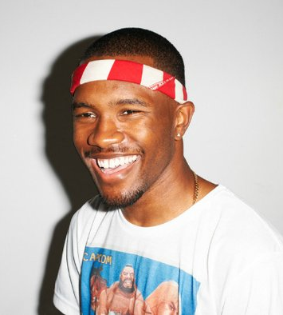
Entertainment Industry

Slide 48
Conservative Opposition

Slide 49
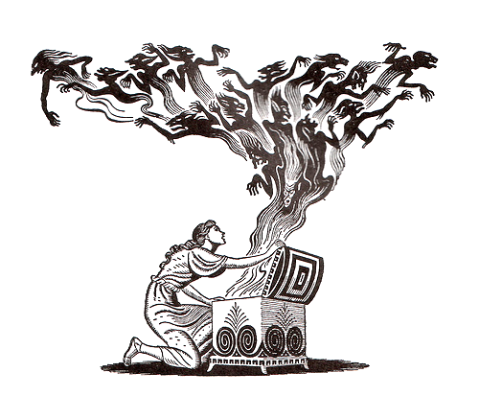
Opening Pandora’s box?
Bestiality
Polygamy
Pedophilia

Slide 50
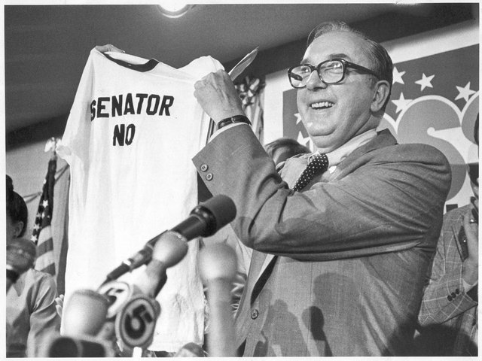
Jesse Helms
Opposed federal AIDS research
Opposed confirmation of federal LGBT officials
Opposed National Endowment for the Arts for its sponsorship of gay photographer

Slide 51
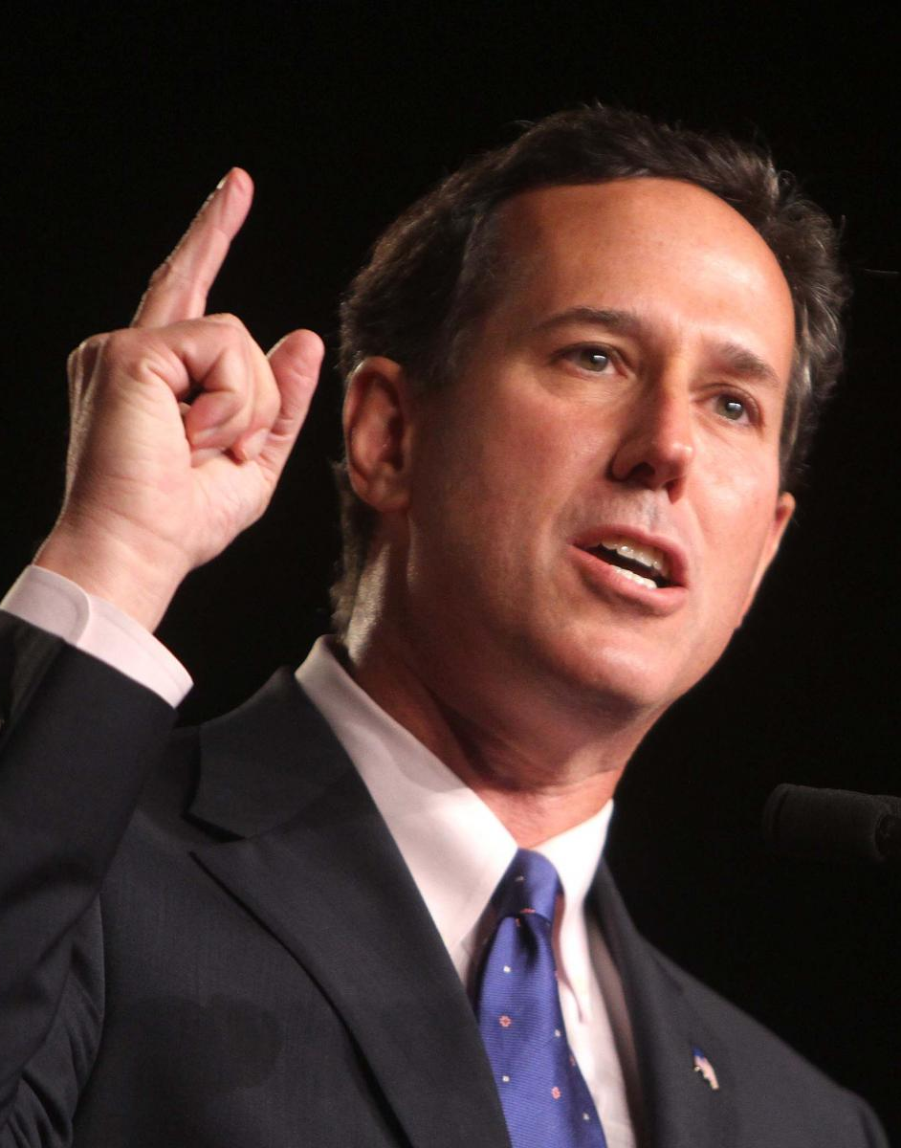
Rick Santorum
Pennsylvania Senator
Supporter of the “Federal Marriage Amendment”
Placed 2nd behind Mitt Romney in 2012 Republican presidential race

Slide 52



Organizations
Southern Baptist Convention

Slide 53
1990s-2000s: Legal Limbo

Slide 54
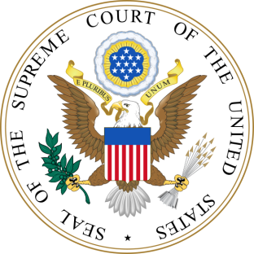
Bowers v. Hardwick, 1986
Upheld Georgia sodomy law
Justice Burger:
      “To hold that the act of homosexual sodomy is somehow protected as a fundamental right would be to cast aside millennia of moral teaching.”

Slide 55
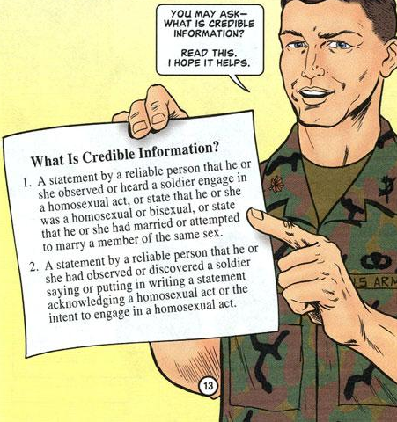
Don’t Ask, Don’t Tell (DADT), 1993
Intermediate step
    Gays & lesbians could serve, but only if they were “closeted”
    Could be discharged if “credible information” emerges
Signed by Bill Clinton
Criticized by both sides

Slide 56

Defense of Marriage Act (DOMA), 1996
Defense of “traditional” marriage
      Denied federal recognition of same-sex marriage
      Allowed states to ignore same-sex marriages performed in other states
Passed by supermajorities in Congress
Signed by Bill Clinton

Slide 57

Boy Scouts v. Dale, 2000
Dale was an openly gay Scout
Freedom of association
      BSA’s freedom to choose its members?
      Dale’s freedom to retain BSA membership?
S.C. ruled against Dale

Slide 58

Lawrence v. Texas, 2003
Overturned state sodomy laws
Reversed decision in Bowers v. Hardwick
Justice Kennedy:
      “The petitioners are entitled to respect for their private lives… Bowers was not correct when it was decided, and it is not correct today.”

Slide 59

Recent Bans on Same-Sex Marraige
Arizona constitutional amendment, 2008
Florida constitutional amendment, 2008
North Carolina constitutional amendment, 2012

Slide 60
2010s:
The Tidal Wave of Change?

Slide 61

2010: Repeal of Don’t Ask, Don’t Tell
Allows gays and lesbians to serve openly in the military
Signed by President Obama

Slide 62

2012: Obama “Evolves”

Slide 63

Boy Scouts of America, 2013
BSA lifts ban on gay youth, but maintains ban on gay leaders
Some conservative host churches withdraw support from BSA

Slide 64

US v. Windsor, 2013
Overturned portion of Defense of Marriage Act (DOMA)
Language indicates that remainder of DOMA may be overturned in future

Slide 65

Virginia Under Terry McAuliffe, 2014
Refused to defend state laws against same-sex marriage

Slide 66

The Patchwork of State Laws
Click here:

