Slide 1
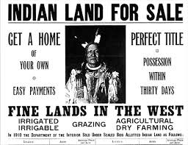
Closing of the Frontier

Slide 2
Essential Questions
What impact did the completion of the transcontinental railroad, increasing westward migration of settlers, and government policy have on American Indians in the West?
How did westward migration, new systems of farming and transportation, and economic instability, lead to political tension and social conflict?

Slide 3
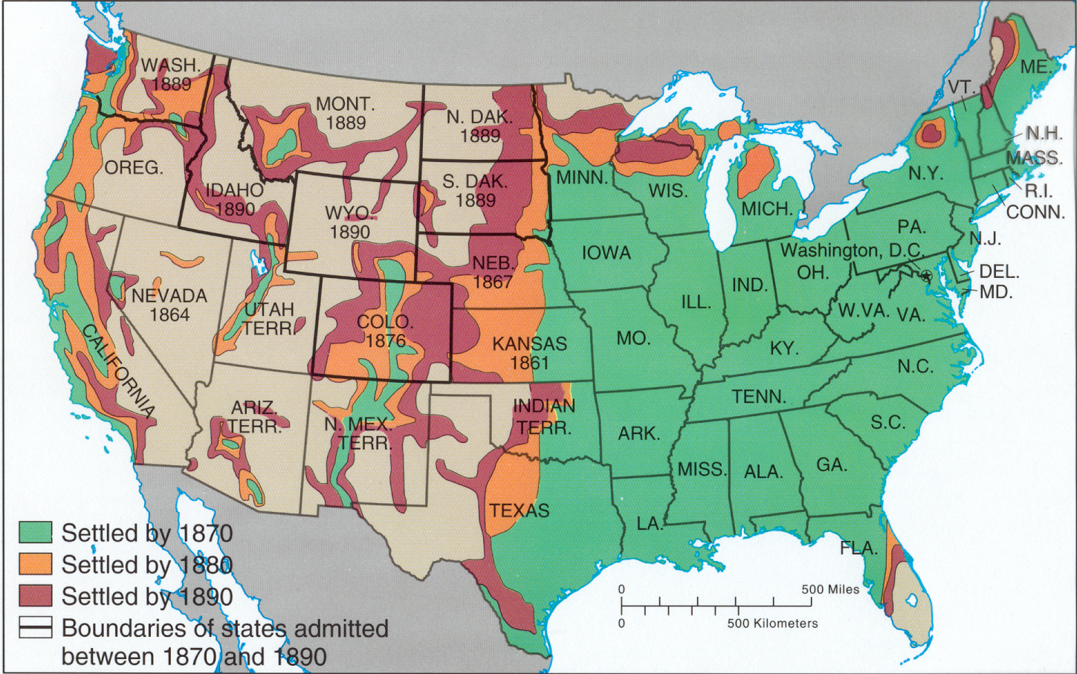
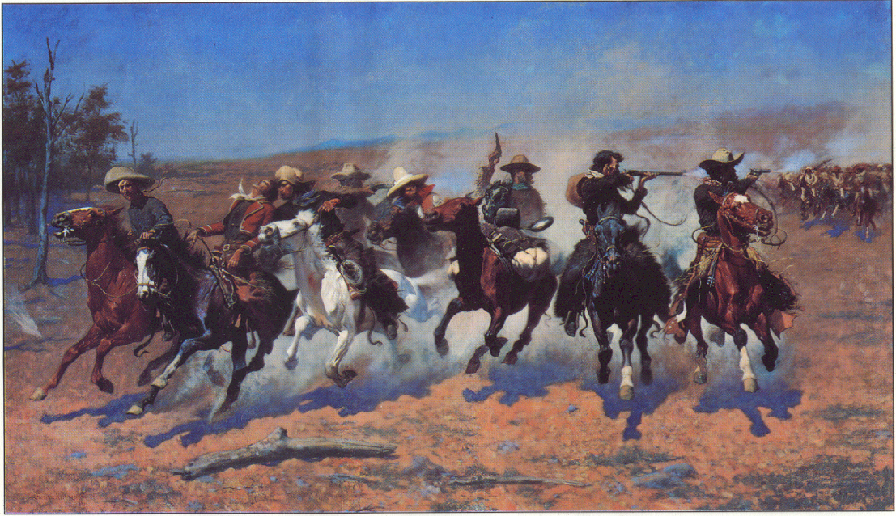
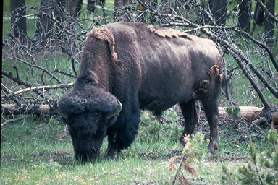
The West: Settlement of Frontier
Before 1860 West of Mississippi known as “Great American Desert”
Great Plains: grasslands, less than 15 inches of rain/yr.
Harsh winters & hot dry summers
15 million bison
250,000 American Indians
By 1900: frontier largely was gone along with bison, & open Indian land replaced by ranches & farms, railroads & new boomtowns.

Slide 4
http://www.slate.com/blogs/the_vault/2014/06/17/interactive_map_loss_of_indian_land.html

Slide 5
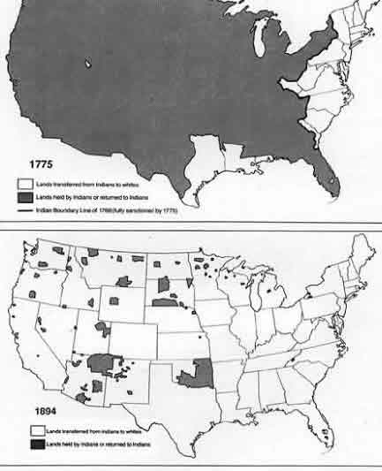
Native American land
1775
1894

Slide 6
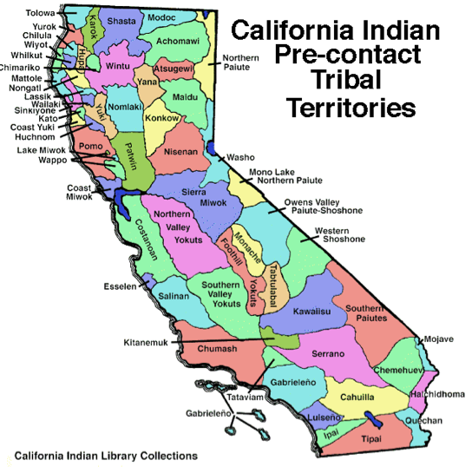

Slide 7
Copy This
Essays:
American Indians and the Transcontinental Railroad
Born Modern: An Overview of the West
Financing the Transcontinental Railroad
Transcontinental Railroad
Native Americans & the West
Westward Migration
Government Policy
Directions: As you read the essays, make note of how the Transcontinental Railroad, Westward Migration and government policy affected the West and Native Americans living in the West. We will discuss.

Slide 8
Federal Policies that Encouraged Movement
Homestead Act of 1862: 160 acres free if worked for 5 years & railroad grants & land speculators – 500,000 families settled in West 1860s-1900
Morrill Act (1862) – gave federal lands to states to build agricultural colleges for education & research
  A&M = Agricultural & Mechanical universities
  Helped research & develop new grain strains & farming techniques for arid Midwest soil

Slide 9
Federal Policies that Encouraged Movement
Oklahoma Land Giveaway (1889) – gov’t offered unclaimed land in Indian Territory (OK) to settlers
“Sooners” – settlers who moved in before they were allowed
“Boomers” – settlers who moved in at the sound of the cannon, signaling the start
Land grants to railroad companies – worth $500+ million (billions today)
` Companies granted more land for building in territories
than states
Transcontinental Railroad – started by Pres. Lincoln in 1862, completed in 1869, linked east & west coasts by rail HUGE impact on interconnectedness of U.S.

Slide 10

Far & Away Oklahoma Land Rush Scene

Slide 11
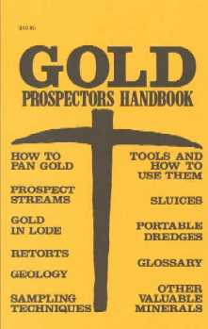
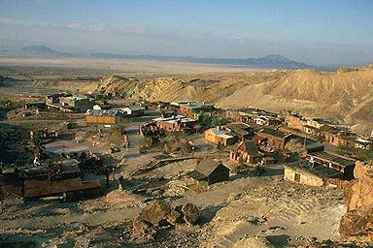
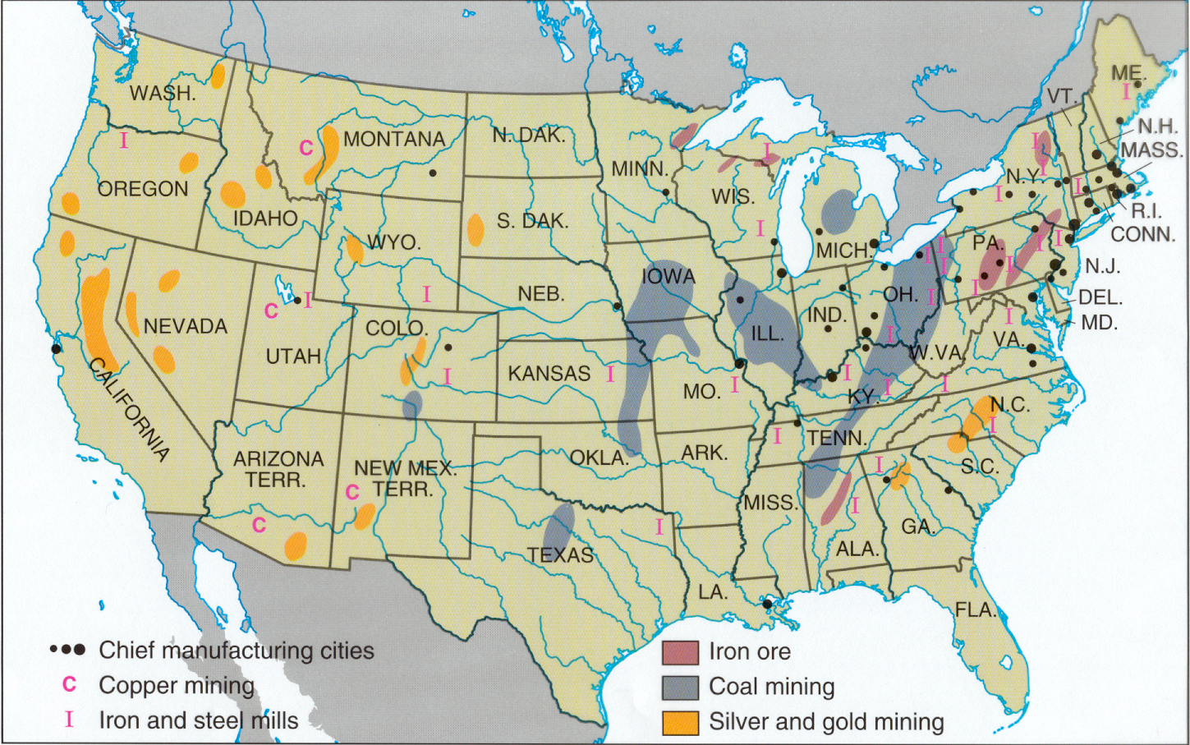
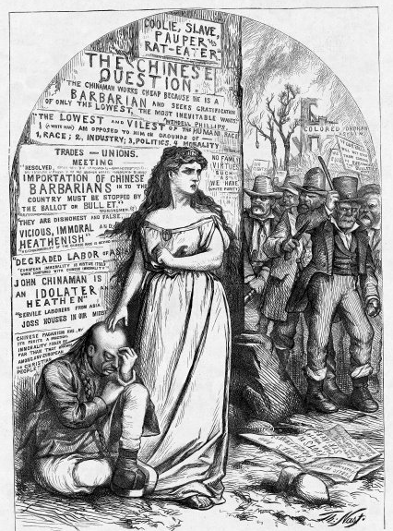
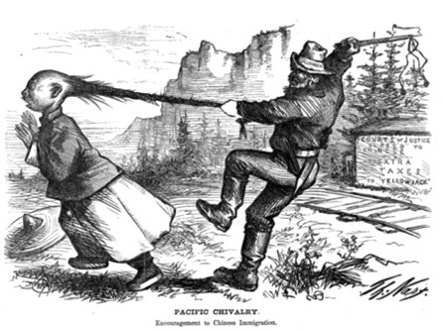
Mining Frontier
Pike’s Peak, CO Gold Rush 1859 100,000 miners – Denver
Comstock Lode – mines in NV 1859 $340 million in gold & silver (NV became a state in 1864)
Followed similar pattern as CA Gold Rush – individuals replaced by large corporate operations
Significant conflict with American Indians
Many “boomtowns” turned into “ghost towns”
Mining companies hired experienced miners from around world 1/3 from China - nativism
CA: anti-Chinese sentiment rose Miner’s Tax of $20 to all foreign miners, “Anti-Coolie Clubs”
Chinese Exclusion Act of 1882: political pressure from West banned immigration to US by Chinese laborers

Slide 12
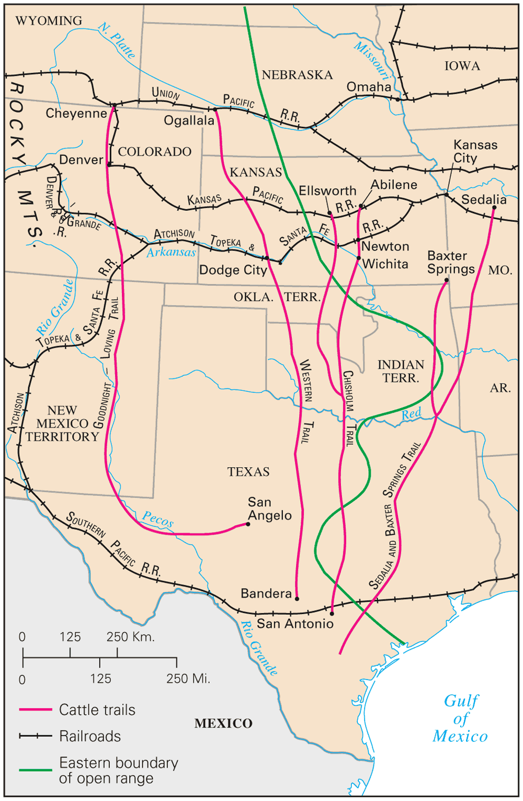
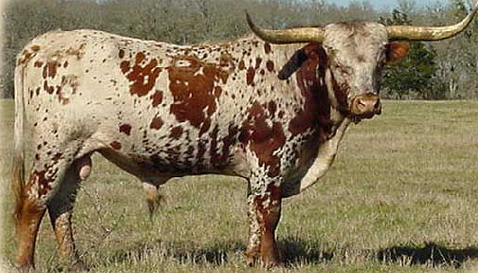
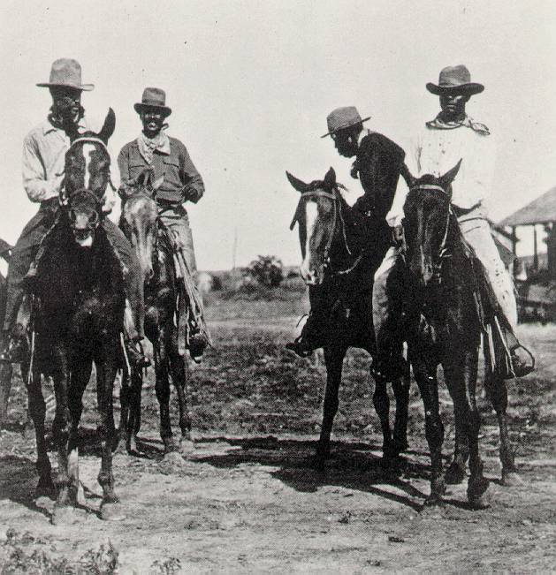
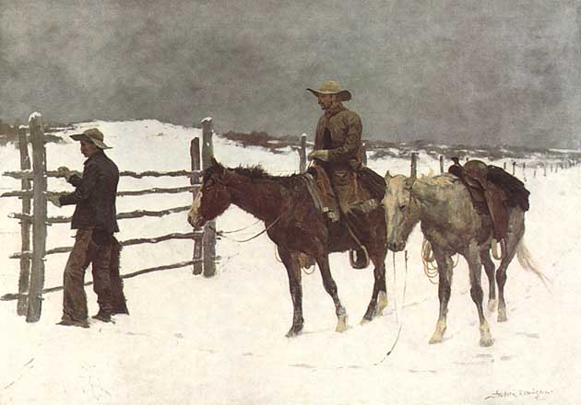
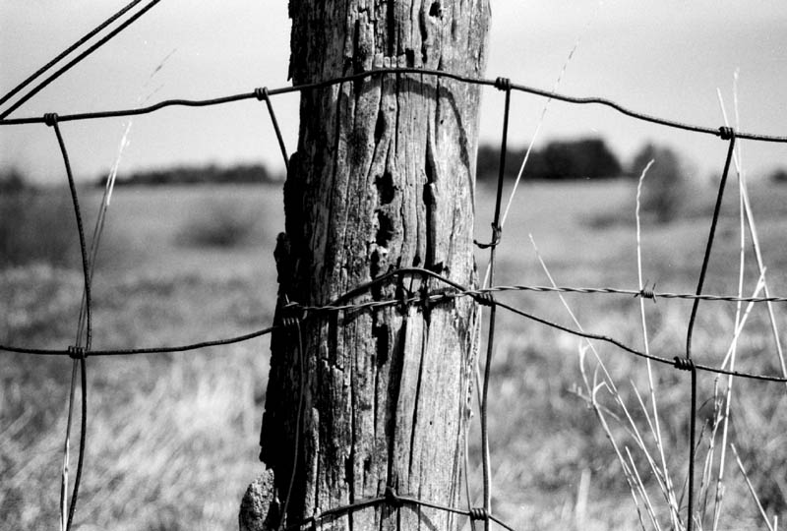
The Cattle Frontier
5 million “Texas” longhorn cattle herded by vaqueros & cowboys along cattle trails like Chisholm & Goodnight-Loving to railroad lines in Kansas to ship to East demand for beef
Cowboys were poorly paid – many were black, Mexicans – even some were Indians & women
1885-1886 combined overgrazing, blizzards, and drought killed off 90% of the cattle & arrival of homesteaders using barbed wire fencing
Replaced by large corporate ranches

Slide 13
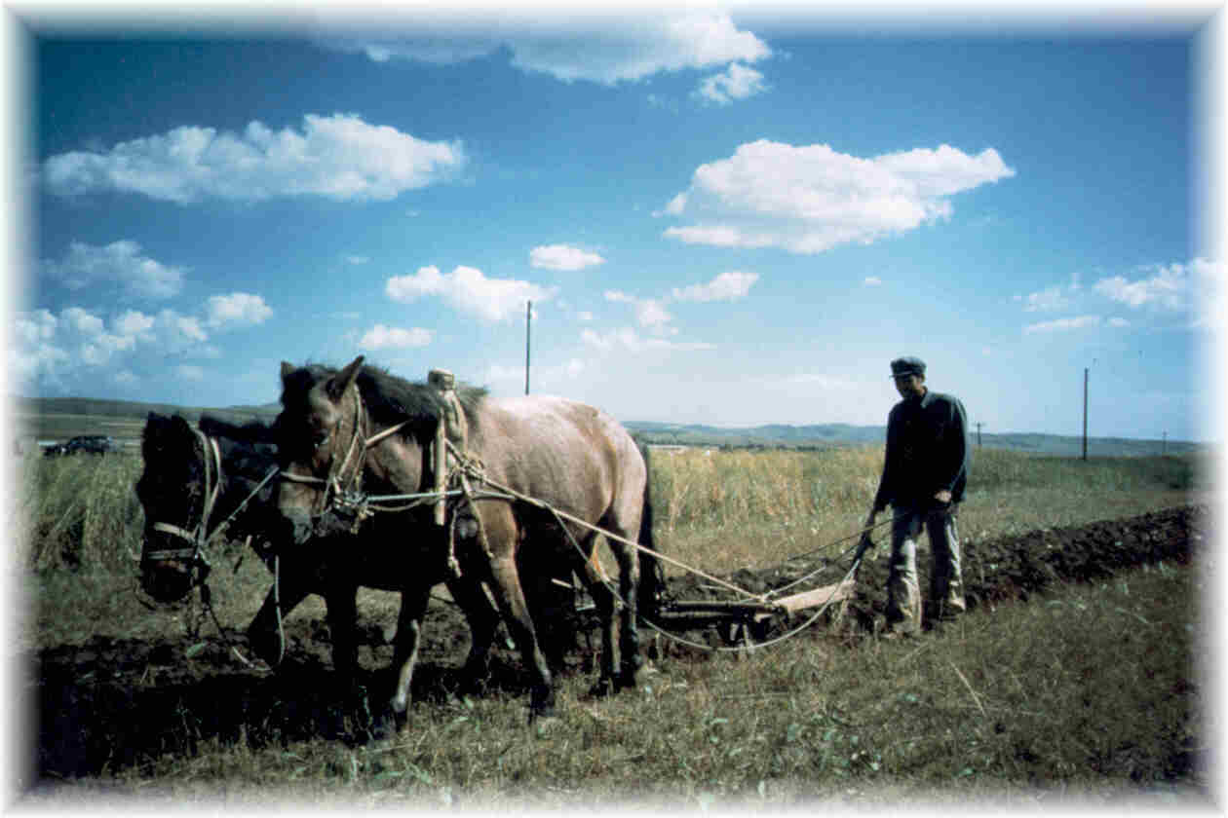
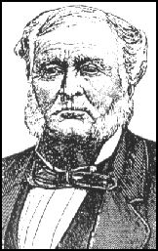
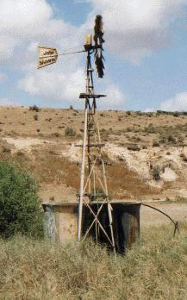
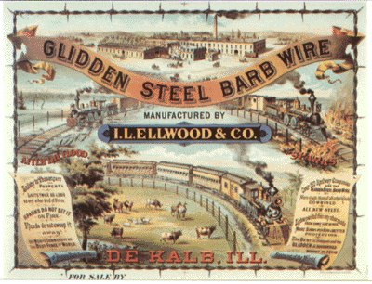
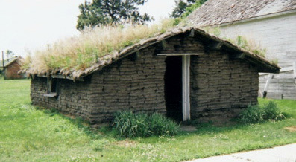
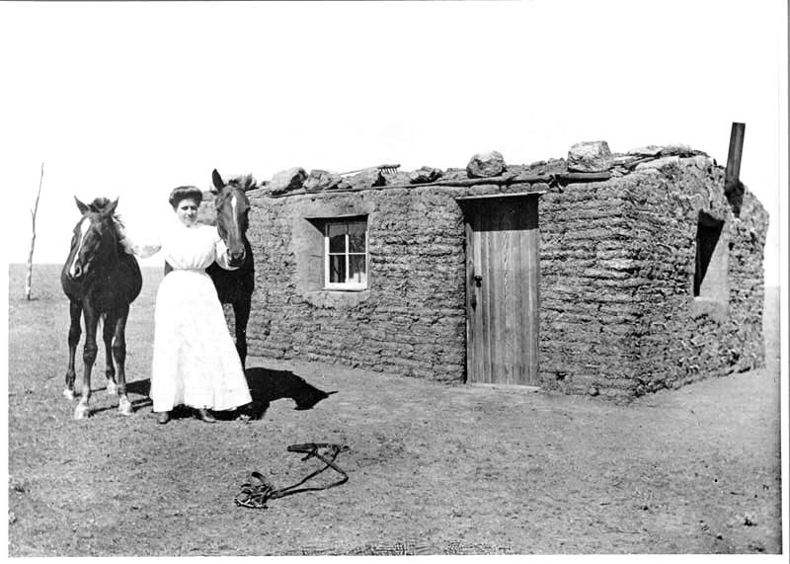
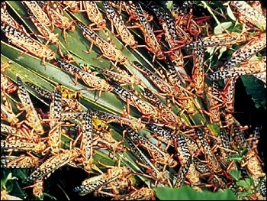
The Farming Frontier
Homestead Act of 1862: 160 acres free if worked for 5 years & railroad grants & land speculators – 500,000 families settled in West 1860s-1900
Problems: lack of wood & water, extreme weather, locusts, isolation
Solutions: Joseph Glidden’s invention of barbed wire, windmills with water pumps, “soddies”, dry farming & deep plow & Russian wheat & irrigation techniques
Due to difficulties, rising costs of machinery & falling crop prices caused 2/3 of Homesteads to fail in Great Plains by 1900

Slide 14
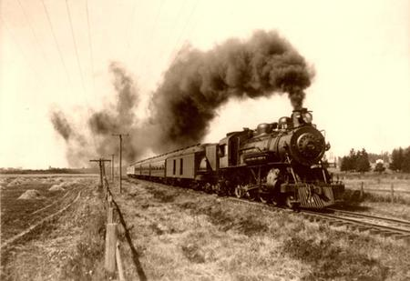
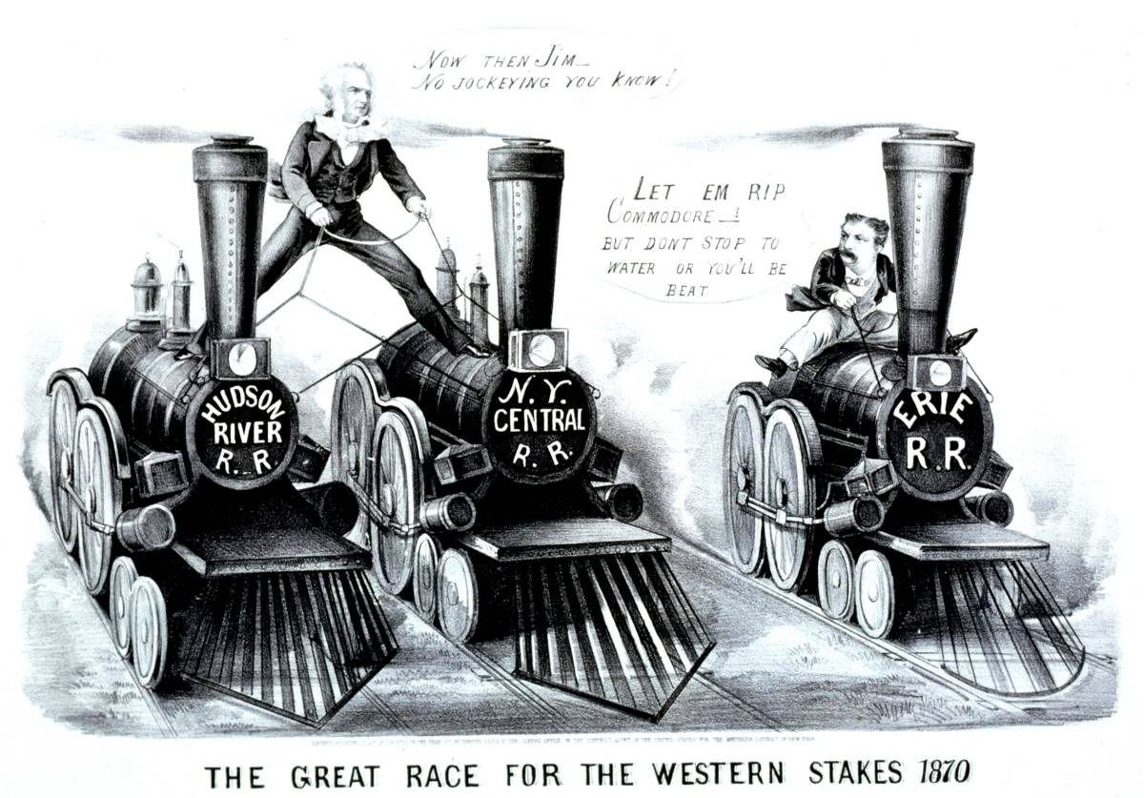
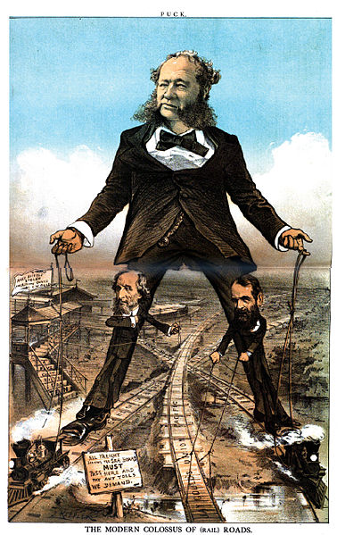
Railroads
Railroads expanded from 35,000 miles in 1865 to 193,000 miles in 1900
Effects: expanded national markets, encouraged mass production, mass consumption, specialization, American Railroad Association time zones (1883), investment in railroad co.s led to modern stockholder corporation & high finance.
Eastern Trunk Lines: (major routes between large cities)
  Commodore Vanderbilt NY Central Railroad (1867) connected NYC to Chicago, B & O RR, & Pennsylvania RR
Western Railroads:
  Federal Land Grants: 170 million acres to 80 railroad companies, some corruption like Credit Mobilier Scandal
  Transcontinental Railroad: Union Pacific (UP) built west from Omaha, Central Pacific (CP) built east from Sacramento, 6,000 Chinese employed. Completed at Promontory Point, UT in 1869
Competition & Consolidation:
  Overtime railroads formed pools & used rate fixing schemes to survive
  Panic of 1893 many in bankruptcy – consolidated control under banker J.P. Morgan regional monopolies
  By 1900 7 giant companies controlled 2/3 of railroads
  Criticism led to reforms: Interstate Commerce Act of 1886 (ICC)

Slide 15
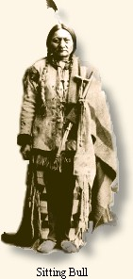
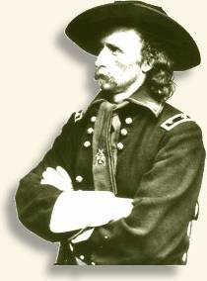
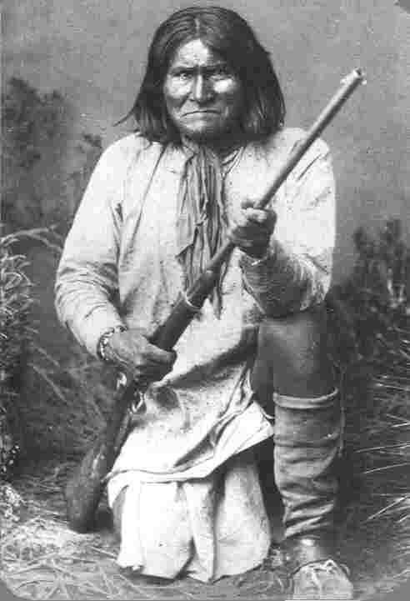
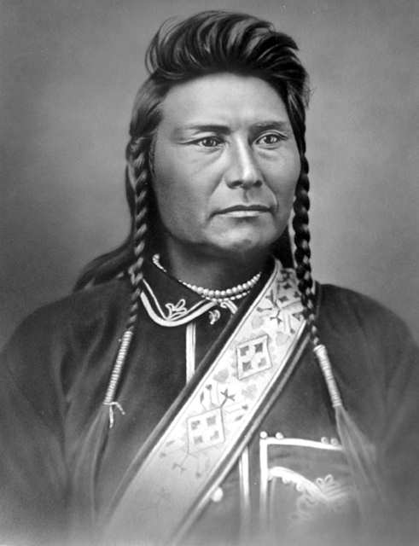
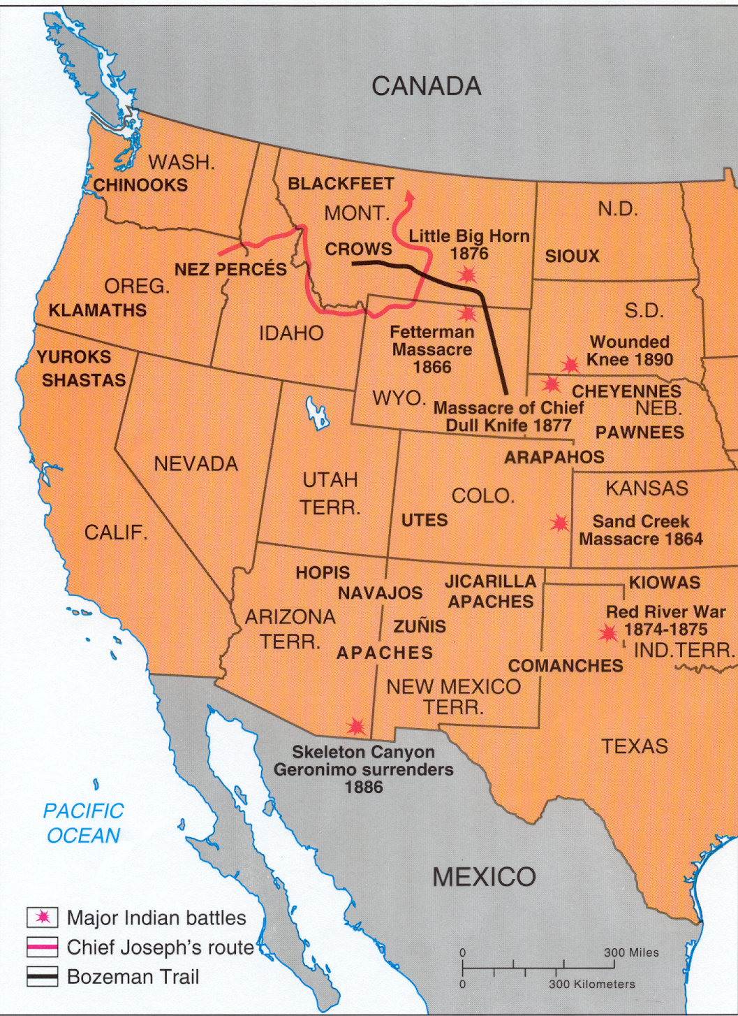
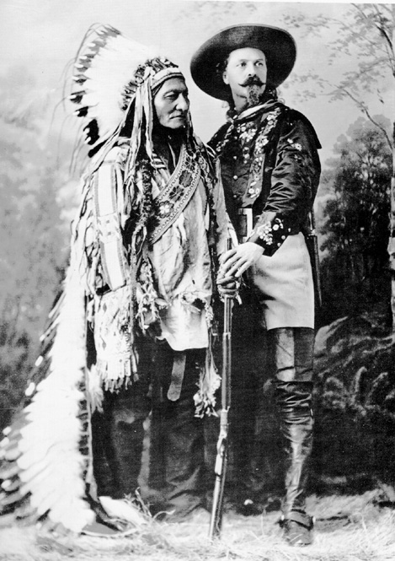
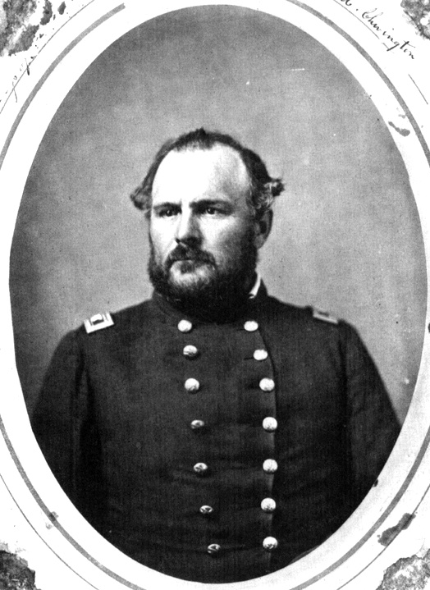
American Indians in the West
2/3 of American Indian tribes in the West were nomadic hunters: Lakota (Sioux), Blackfoot, Cheyenne, Crow & Comanche –hunted buffalo, Apache & Navajo in SW
Reservation Policy: 1851 Treaty of Fort Laramie assigned tribes large reservations – but many tribes refused
Other Tribes reluctantly relocated to “Indian Territory”
Bureau of Indian Affairs was put in charge of reservations
Indians Wars:
  increased settlement in 1860s led to increasing bloodshed including Sand Creek Massacre -2nd Treaty of Fort Laramie – smaller reservations in 1868
  Indian Appropriation Act of 1871 – tribes no longer viewed as Independent Nations nullified all previous treaties
  Gold rush in Black Hills of SD led to Sioux War – Battle of Little Bighorn – defeat of Colonel George Custer by Crazy Horse & Sitting Bull in 1876
  Chief Joseph’s attempt to lead Nez Perce to Canada failed in 1877

Slide 16
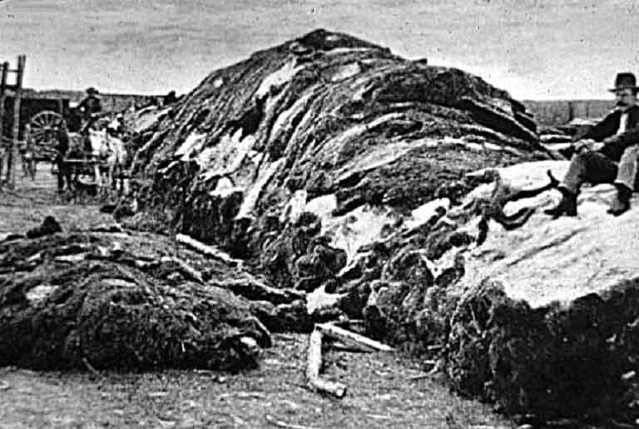
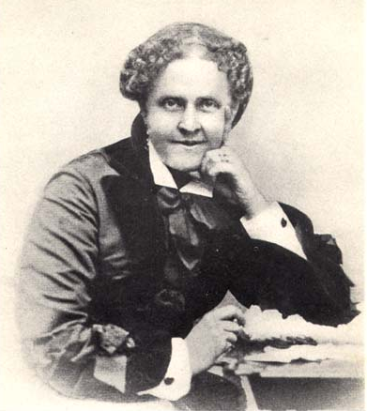
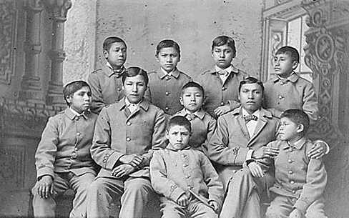
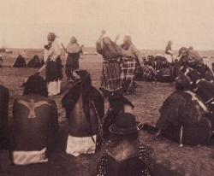
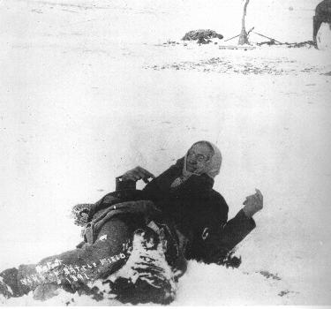
American Indians in the West
Buffalo nearly extinct by early 1880s
Assimilationists: Helen Hunt Jackson’s A Century of Dishonor (1881) sympathy but support for ending Indian culture Christianity and assimilation through boarding schools like Carlisle School in PA
Dawes Severalty Act (1887) break up tribal organizations and land into 160 acre plots that could become their own if worked for 25 years and they adopted “civilized life”
  47 million acres split amongst American Indians
  90 million acres of best former tribal land sold to white settlers or seized by government
  Failed policy – remaining 200,000 American Indians by 1900 mostly were malnourished and impoverished
Ghost Dance & Wounded Knee Massacre – end of resistance 1890
What happened to the sacred Black Hills?

Slide 17
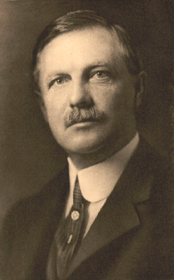
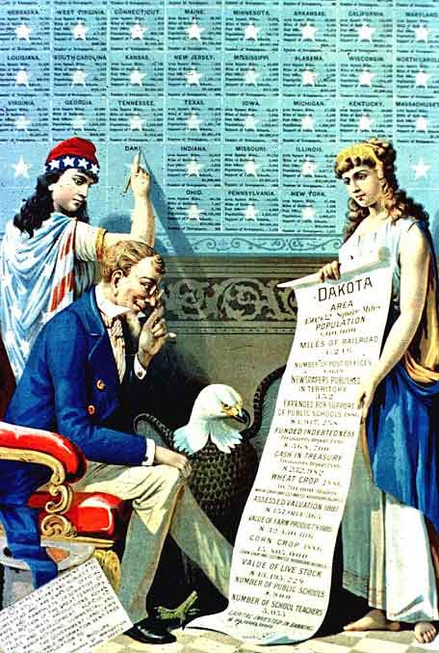
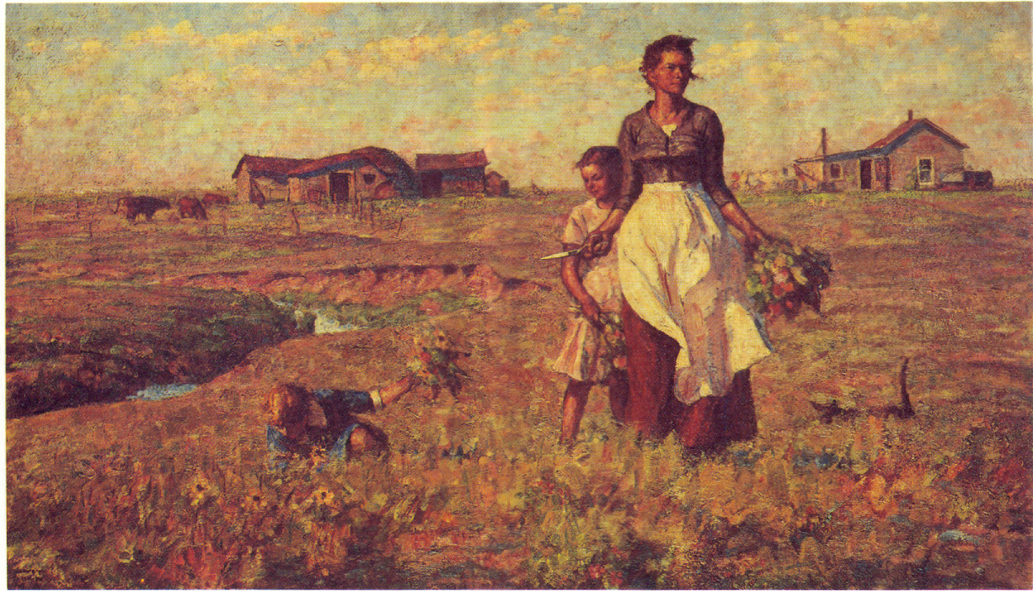
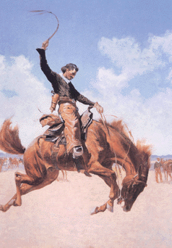
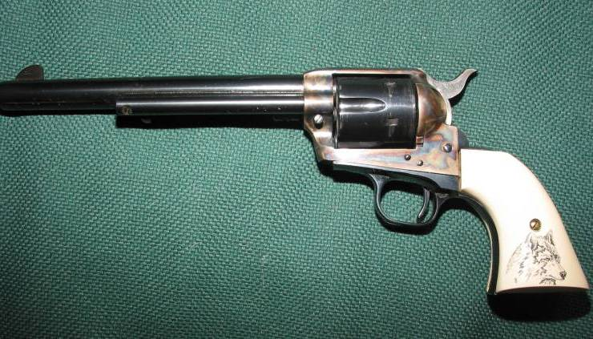
Closing of the Frontier
After Oklahoma Territory great land rush in 1889 the frontier was “closed”
Turner’s Frontier Thesis: Frederick Jackson Turner’s 1893 essay “The Significance of the Frontier in American History” – argued that West had been a equalizer and a force for democracy, with “closing” he feared US condemned to follow Europe

Slide 18
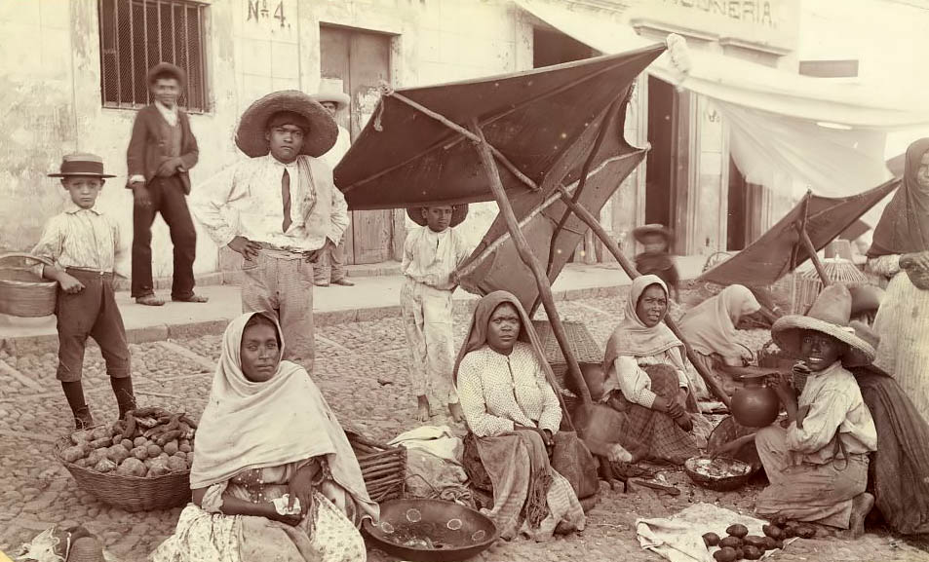
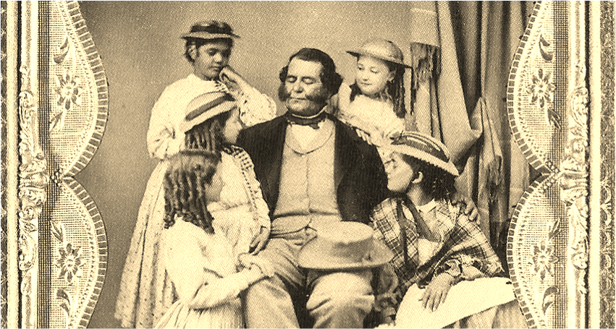
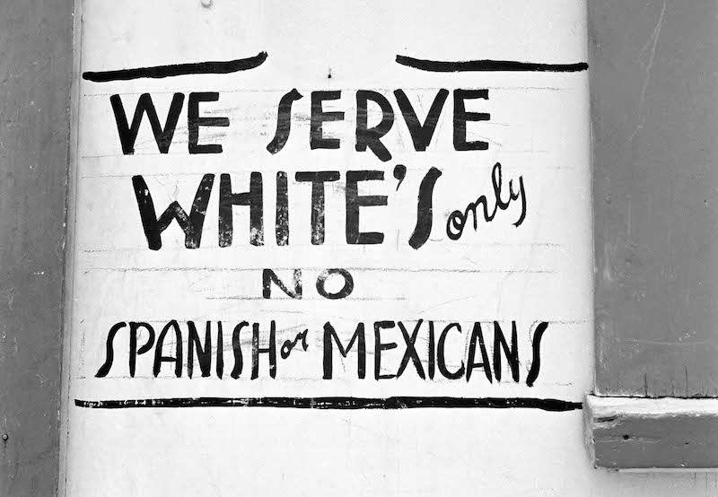
Latinos in Southwest
Latino Southwest: despite promises of citizenship and land rights, Californios lost most land claims by 1900 but maintained cultural traditions
Mexico border open until 1917 & many migrant workers throughout SW

Slide 19
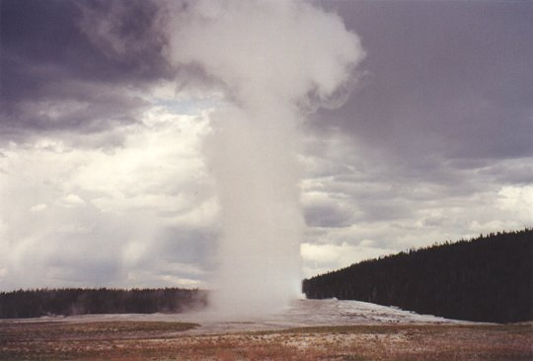
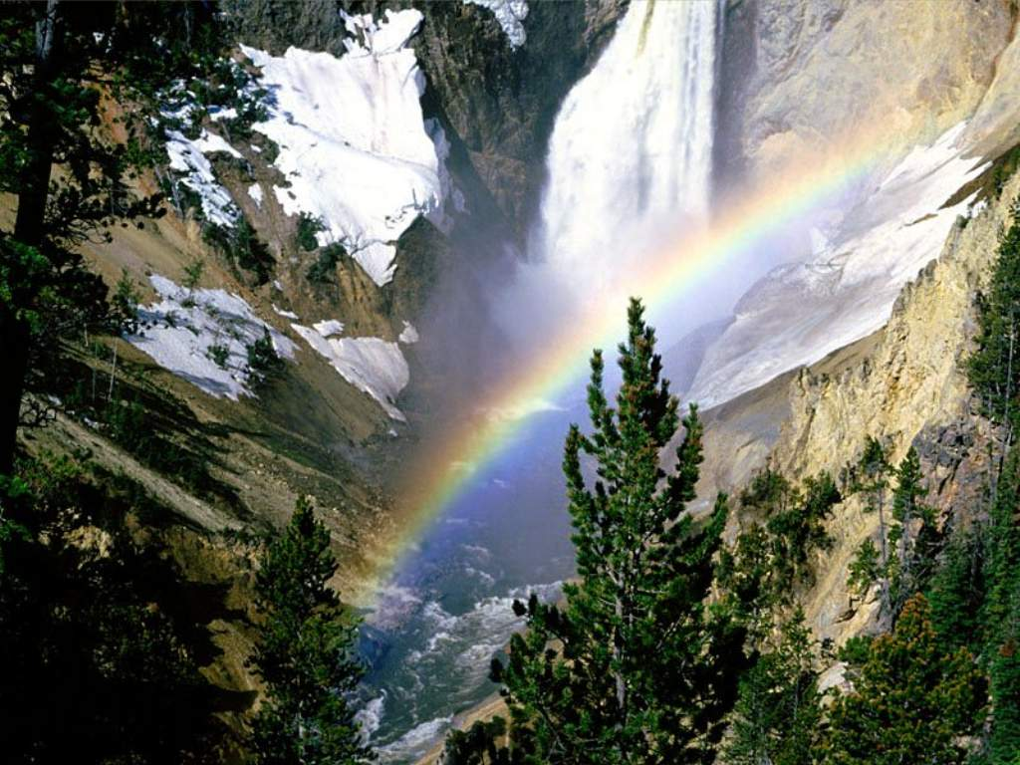
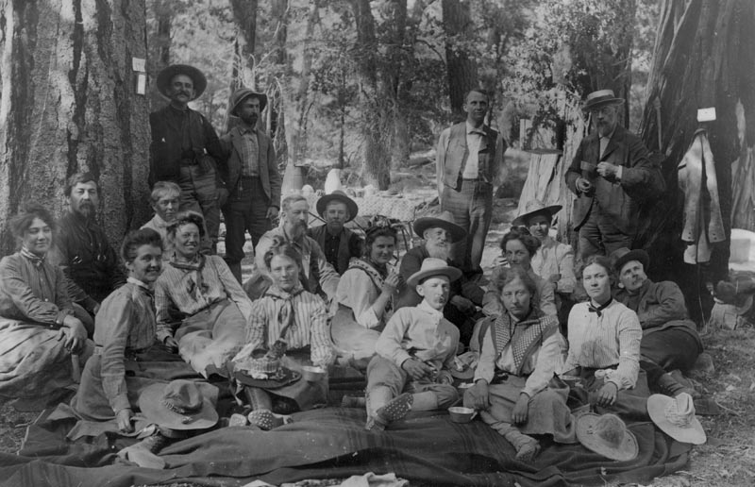
Conservation
Conservation Movement: rise of concerns over deforestation
Yellowstone 1st National Park in 1872
Carl Shurz Sec. of Interior in 1880s pushed for creation of forest reserves
Presidents Cleveland & Harrison reserved 33 million acres of national timber
Forest Reserve Act of 1891 & Forest Management Act of 1897
Preservationists vs. Conservationists
John Muir founds Sierra Club in 1892,
Arbor Day & Audubon Society – growing movement by 1900

Slide 20
STOP HERE FOR WESTWARD EXPANSION

Slide 21
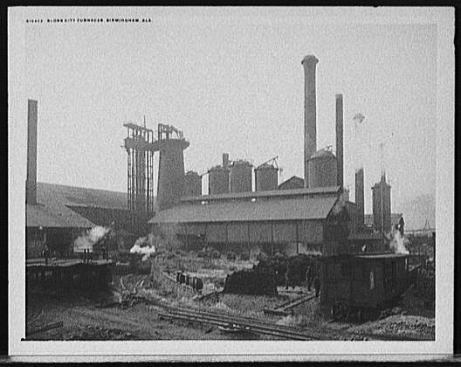




The New South
Henry Grady editor of Atlanta Constitution promoted New South - modernism & self-sufficiency, diversity & laissez-faire capitalism
Birmingham, AL became a leading steel producer
Richmond center of tobacco industry
Georgia, NC & SC took over New England as center of the textile industry
By 1900 400 cotton mills employed 100,000 white workers
Expansion of Southern railroad network
Despite growth South remained poorest in nation
Causes of southern poverty:
  South’s late start at industrialization
  Poorly educated workforce
  Reliance on system of subsistence sharecropping

Slide 22





Southern Agriculture
1870-1900 doubled cotton acreage – glut in cotton market over 50% drop in prices
Per capita income declined for Southern farmers
By 1900 more than ½ of white & ¾ of black farmers were sharecroppers
George Washington Carver worked to diversify – peanuts, sweet potatoes, soybeans
1890 Farmers’ Southern Alliance grew to 1 million members & Colored Farmers National Alliance had 250,000 members pushed for political reforms to help but failure to unite races weakened movement

