Slide 1
APUSH Review: Manifest Destiny
Everything You Need To Know About Manifest Destiny To Succeed In APUSH

Slide 2
EQ: Evaluate the extent to which western expansion contributed to maintaining continuity as well as fostered change with regard to growing sectional tensions between the North and South in the U.S from 1800-1850.

Slide 3
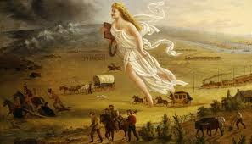
Manifest Destiny: An Intro
What is it?
Belief that it was America’s “God-Given” right to expand from coast to coast
Term that was created by John O’Sullivan
The South generally favored westward expansion
More land and spread slavery
When time period is associated with it?
1840s and 1850s
Although it has roots in the LA Purchase and Indian Removal Act
Key Associations:
Oregon
Texas
Mexican-American War

Slide 4
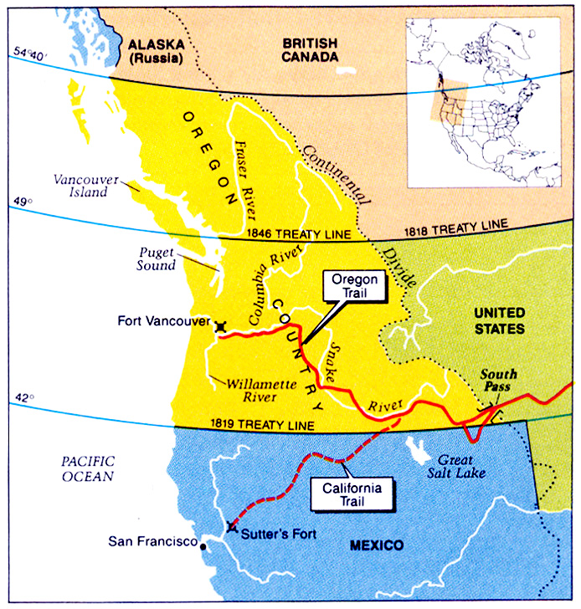
Oregon
At one time, four countries claimed Oregon:
Spain
Britain
Russia
US
The boundary was not settled between US and Great Britain
Polk campaigned on “54°40’ or Fight” during the 1844 election. Other issues in the 1844 election included:
Texas annexation and slavery in the new territories
Eventually, the two sides settle on the 49th parallel

Slide 5
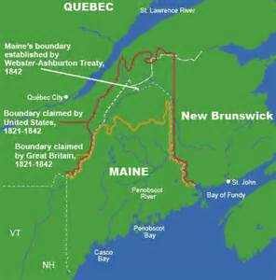
Boundary Dispute in Maine
Maine vs. New Brunswick
Aroostook War (1838-39)
Canadians vs. American Lumberjacks
Webster-Ashburton Treaty if 1842

Slide 6
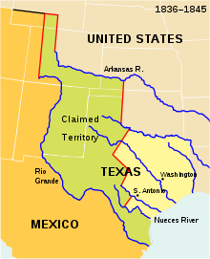
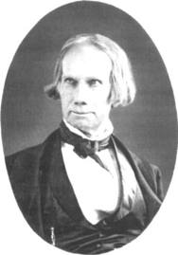
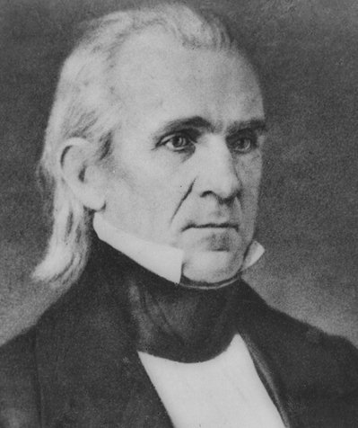
Texas
I flip-flopped on the annexation of Texas
I advocated the annexation of Texas…
In 1836, Texas declared independence from Mexico
1844 presidential campaign focused on the issue of Texas
In 1845, Texas is annexed via a joint resolution
Southerners favored the admission as a way to expand slavery
The boundary was not settled by both US and Mexico
U.S. sets boundary on the Rio Grande while Mexico on the Nueces RIver
Helps lead to the…….

Slide 7
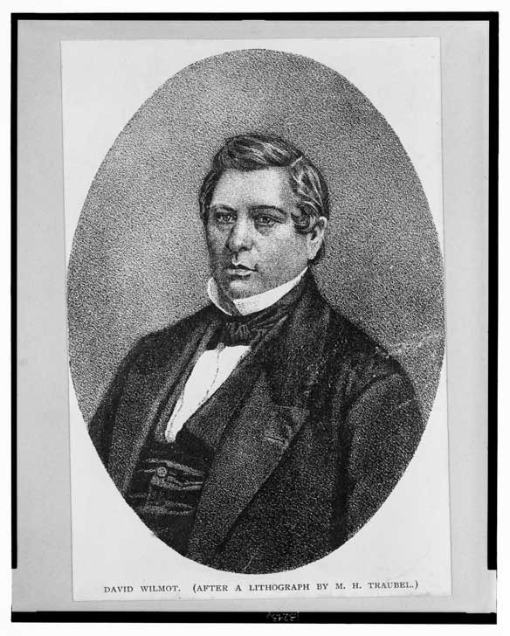
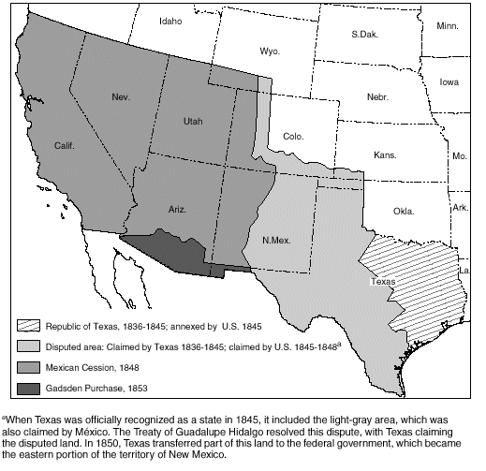
Mexican-American War
Polk sends Slidell
1. Buy California & New Mexico for $25 million-→ insulting to Mexico
2. Settle disputed border
Causes:
Texas boundary: Rio Grande vs. Nueces
“American blood on American soil”-→ Zachary Taylor’s army attacked
Lincoln’s “Spot Resolutions”
Treaty of Guadalupe Hidalgo
1. Mexico recognizes Rio Grande as southern border of Texas
2. U.S. takes CA and NM. U.S. pays $15 million to settle American claims against Mexico
Effects:
US gains Mexican Cession
Land increases by 1/3
US now expands from Atlantic to the Pacific
Debate over slavery would be #1 topic until the Civil War
Wilmot Proviso – wanted to keep slavery out of Mexican Cession Passed House, not Senate
Compromise of 1850

Slide 8
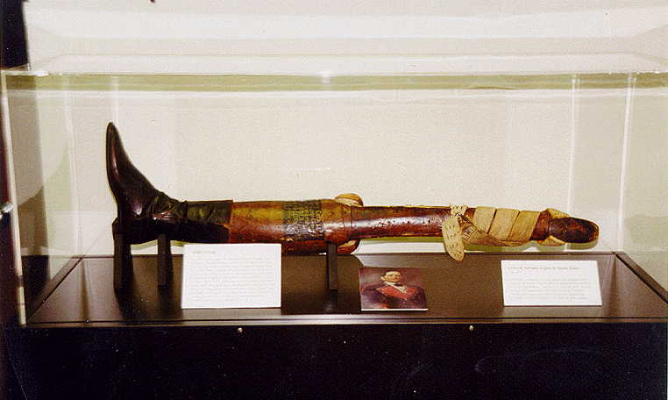

Slide 9
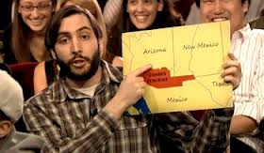
Gadsden Purchase
Watch Jimmy Fallon’s skit on the Gadsden Purchase.

Slide 11
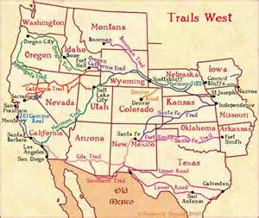
Overland Trails
Oregon Trails
Mormon Trails
Santa Fe Trails
California Trail

Slide 12
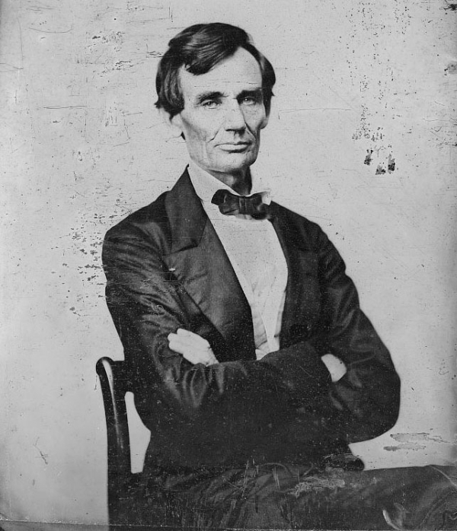
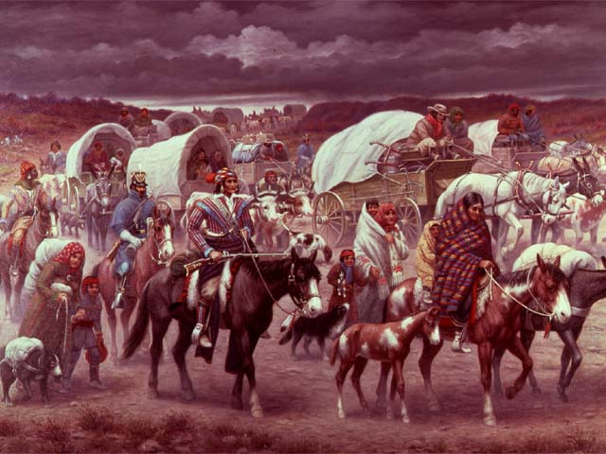
Impacts of Manifest Destiny
Native Americans:
They continually lost land and were pushed further and further west
Eventually, they were forced on reservations
Slavery:
Manifest destiny thrust the issue of slavery into the national spotlight
Debate over whether new land should be slave or free
Politics
Wilmot Proviso-no slavery in the Mexican Cession
Does not pass but infuriates the South
Republican Party:
One of the platforms was to keep slavery from expanding

