Slide 1
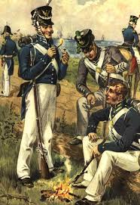
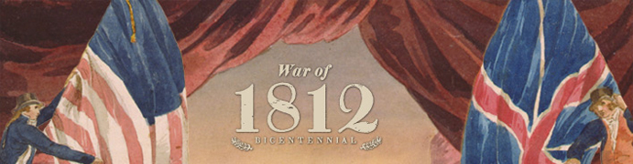
Madison & War or 1812
Crash Course #11

Slide 2
Essential Questions
What were the causes and effects of the War of 1812?

Slide 3
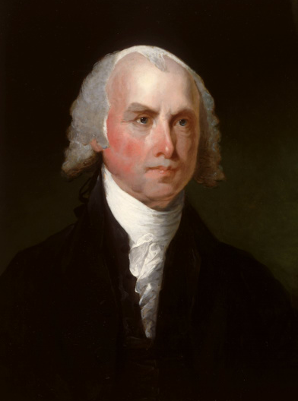
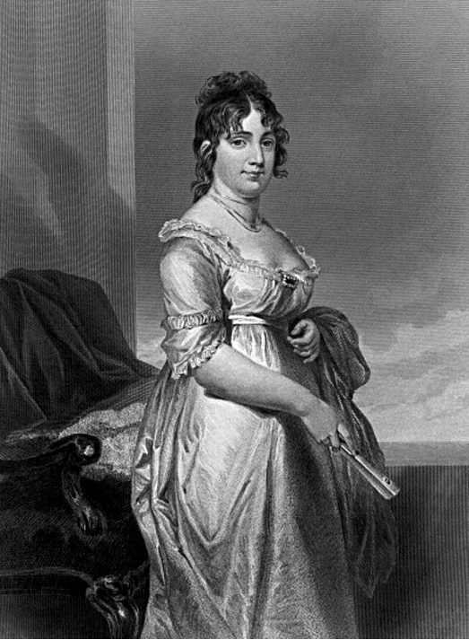
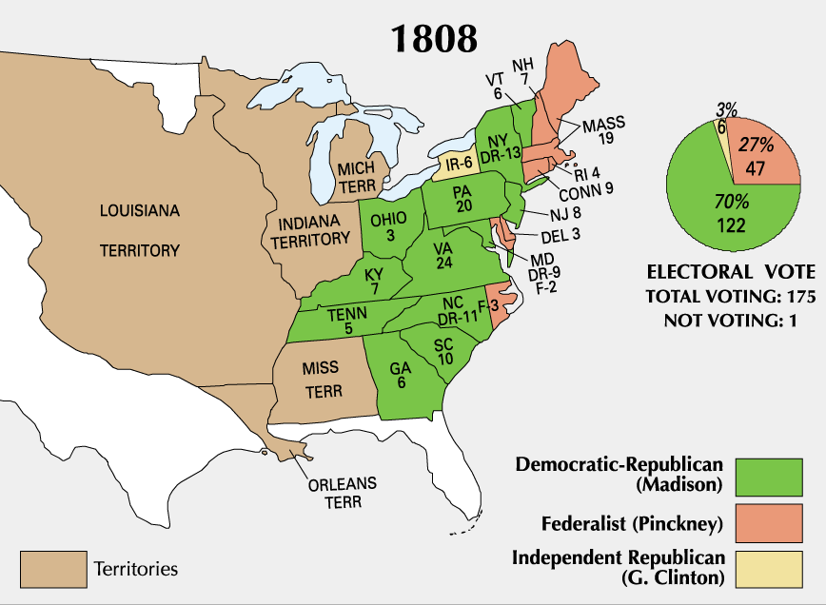
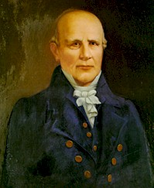
Madison’s Presidency 1809-1817★
1808 Election Madison defeats Charles Pinkney, but Federalists gained seats in Congress due to Embargo Act
Nonintercourse Act of 1809 – replaced Embargo, trade w/ all except Britain & France
Macon’s Bill No. 2 (1810) Nathanial Macon’s bill restored trade with both, if either respected neutral rights they would embargo opponent
Napoleon accepted, so Madison announced embargo against Britain, but Napoleon seized ships anyway
Nathaniel Macon
Dolly Madison

Slide 4
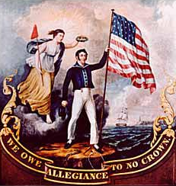
War of 1812 - Causes★
British impressment & violations of neutral rights due to ongoing conflict between Britain & France
Frontier Pressures – British provided limited aid to Tecumseh & The Prophet (Shawnee Tribe) formed Pan-Indian Confederation
  Defeated at Battle of Tippecanoe in 1811 by Indiana Territory Governor Gen. William Henry Harrison- but Britain blamed
Election of “War Hawks” in Congress in 1810 – young Dem-Republicans headed by Henry Clay & John C. Calhoun – defend American honor, gain Canada, eliminate Indian problem

Slide 5
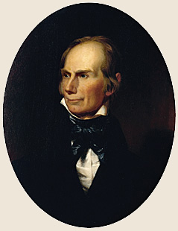
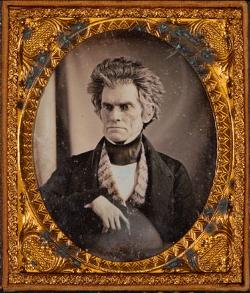
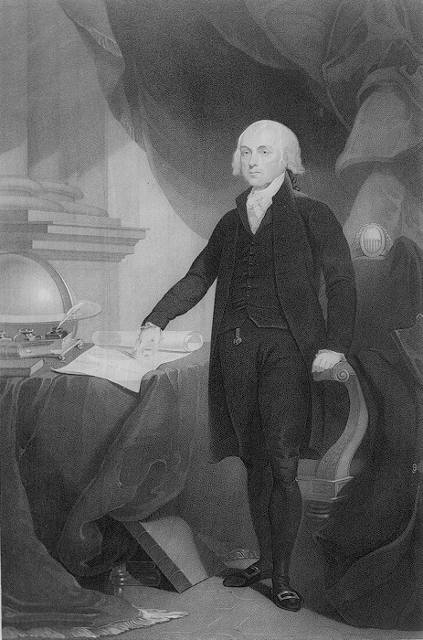
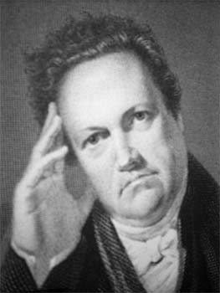
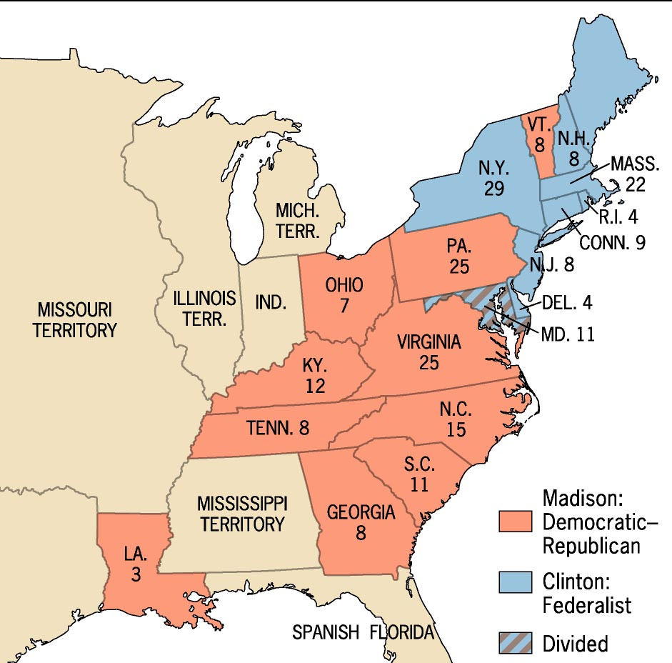
“Mr. Madison’s War” & 1812 Election
“I verily believe that the militia of Kentucky are
alone competent to place Canada at your feet”
- Clay to Madison
“We must show the World that we have not only
inherited the liberty which our Fathers gave us, but
also the will and power to maintain it.”
- Calhoun
War declared June 1812 - Narrowest margin in US History 79-49 House, 19-13 in the Senate
Irony: Britain had just voted to end naval blockade
Divided nation: NY, NJ & most of New England opposed the war – NE Merchants, Federalists, & “Quids” – Old Dem-Reps who favored limited power & peace
1812 election Madison narrowly defeats De Witt Clinton (anti-war)
Clinton

Slide 6
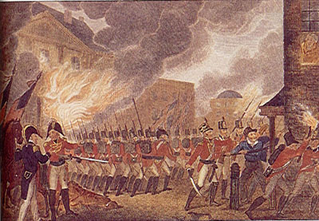
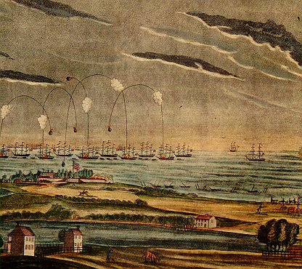
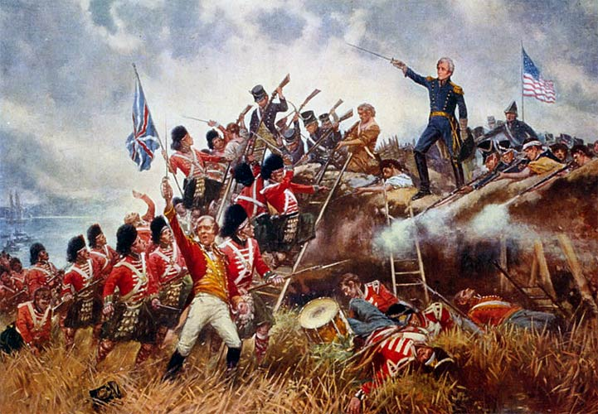
War of 1812- Defeat & Victory
Strategy: 1. Take Canada 2. Hope Napoleon keeps British occupied
Invasion of Canada – fails on all fronts, but burned York (Toronto) in 1813
Naval Battles: a few surprising victories U.S.S. Constitution “Old Ironsides” in Atlantic & Captain Oliver Hazard Perry victory of Lake Erie 1813 “We have met the enemy & they are ours.”
Tecumseh killed at Battle of Thames River
Chesapeake Campaign: Napoleon defeated in 1814 – British attacked and burned Washington D.C., but Baltimore is saved by defense at Fort McHenry “Rockets red glare…” – Francis Scott Key
Southern Campaign: Andrew Jackson Battle of Horseshoe Bend – defeat Creeks, Battle of New Orleans Jan. 1815 biggest defeat of British, but after war is over
Treaty of Ghent: John Q. Adams “Status quo antebellum” Dec. 1814 no concessions on either side

Slide 7
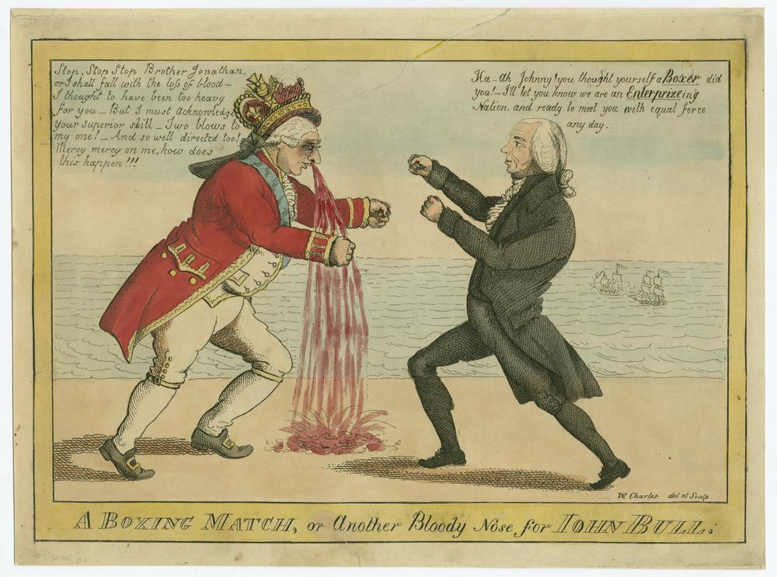
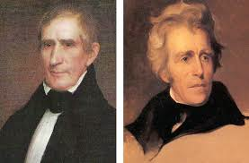
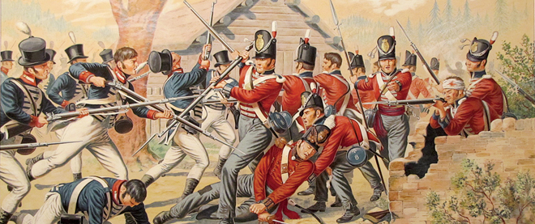
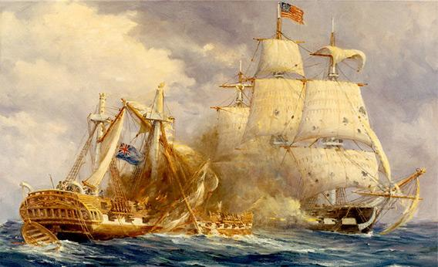
Results of War of 1812★
US gained respect from other nations
Accepted British control of Canada & general improved relationship with England
Downfall of Federalist Party: Hartford Convention of 1814 – discussed secession (rejected), 2/3 vote for future wars
End of hope for an Indian Confederacy east of the Mississippi – Go West!
Embargo & blockade had caused American industrial self-sufficiency
Andrew Jackson & William Henry Harrison war heroes.
Rise of Nationalism & “Era of Good Feelings” during the Monroe Presidency.

Slide 8
War of 1812 Spat Chat
Henry Clay-Congressman from Kentucky, War Hawk
King George III-King of England
James Madison-4th President of the U.S. 1809-1817
Tecumseh-leader of the Shawnee Tribe. Sided wit the British during the War of 1812
Jessica Simpson

