Slide 1
Jefferson Era
Crash Course: #10

Slide 2
Essential Questions
What were the key issues in the early 1800s that caused divide and debate between the national political parties?
After the Louisiana Purchase, how did the US government attempt to influence and control North America and the Western Hemisphere, including examples of exploration, military efforts, American Indian removal, and diplomacy?

Slide 3
TPS: What do you already know about Thomas Jefferson???

Slide 4
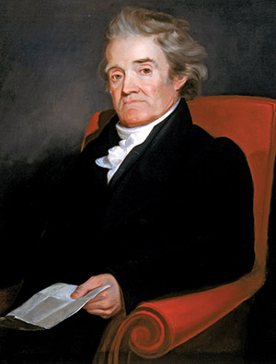
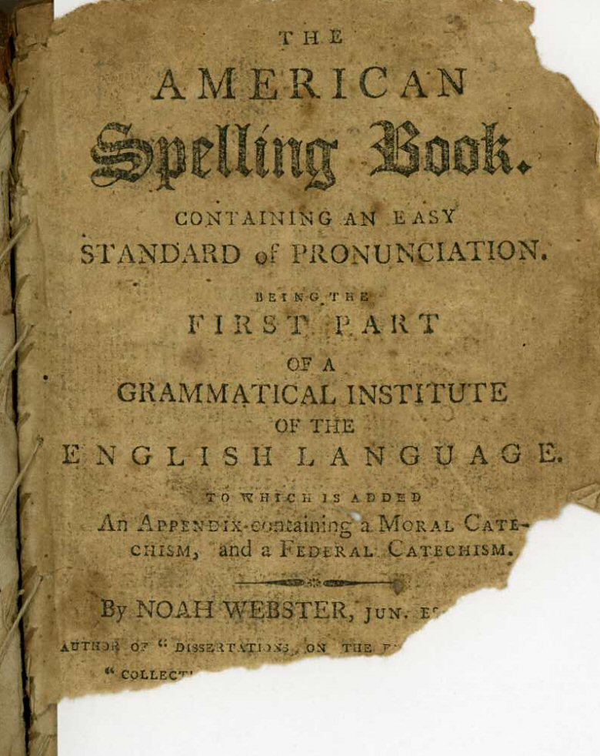
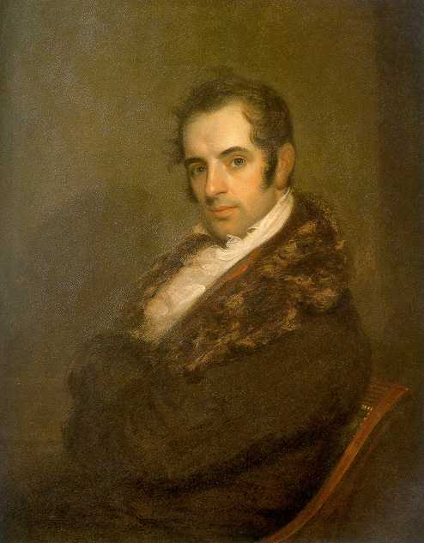
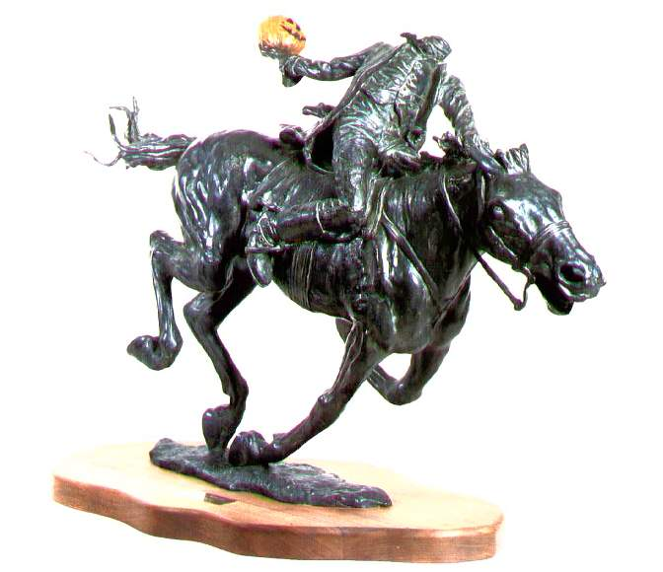
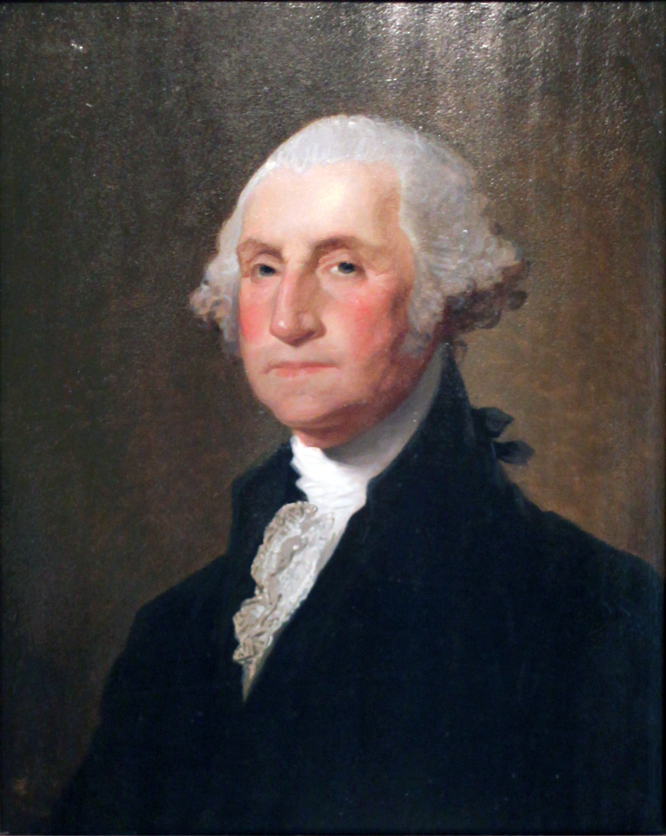
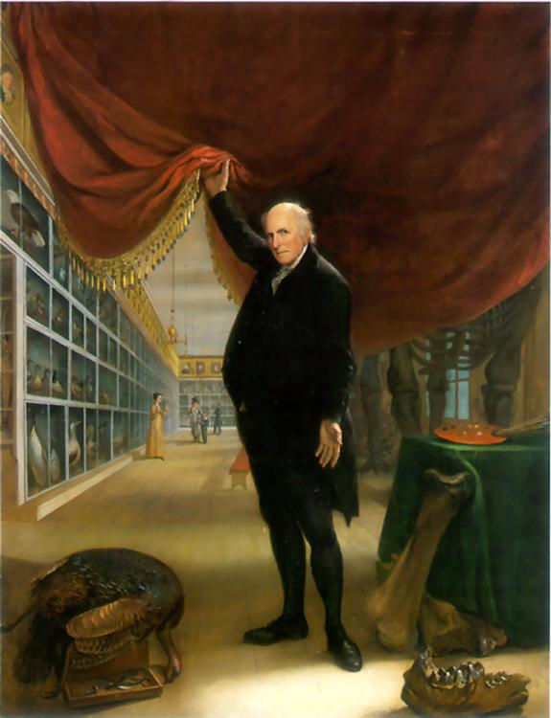
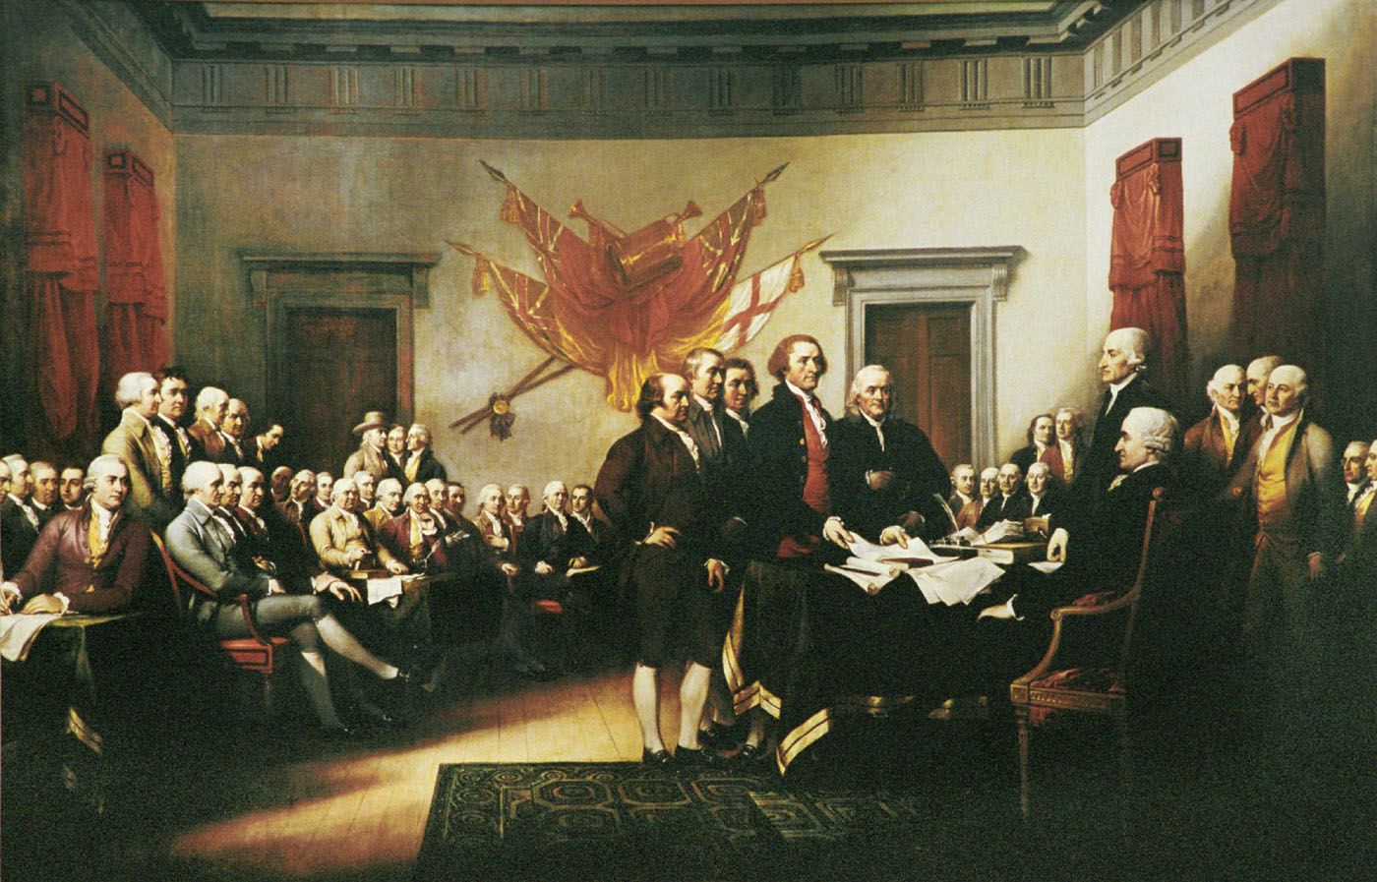
Cultural Nationalism
Noah Webster’s American Spelling Book & dictionary
Expanded public education: “virtuous citizen”
Patriotism: Parson Weems G.W. bio
Emerging American Literature: Washington Irving
Patriotic paintings of Gilbert Stuart, Charles Wilson Peale & John Trumbull
Stuart
Peale
Trumbull

Slide 5
Get your primary source packet…
Read Jefferson’s first inaugural and identify the following:
Intended Audience
Purpose

Slide 6
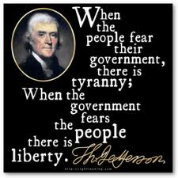
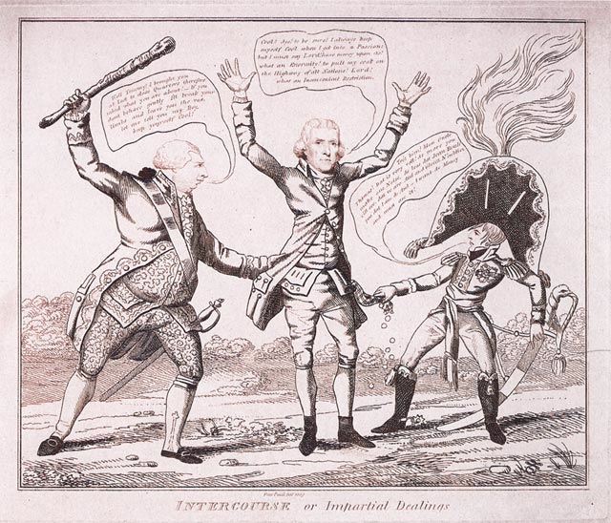
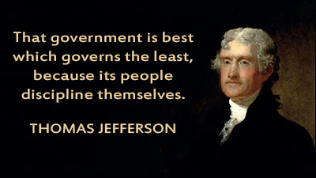
Jeffersonian Democracy
“We are Federalists, we are all Republicans.” (1801) - 1st Inaugural Address
“Common Man” - Changed the pomp and circumstance of the White House
Limited the role of Federal Government
Repealed the Sedition Act, Judiciary Act of 1801
Abolished all internal taxes including Whiskey Tax (customs duties and tariffs only source of revenue)
Reduced government spending: cut debt nearly in half
Reduced size of army from 4,000 to 2,500 men, and Navy from 25 ships to 7 (but established West Point)
Partisan: all key appointees were Democratic-Republicans – “patronage”

Slide 7
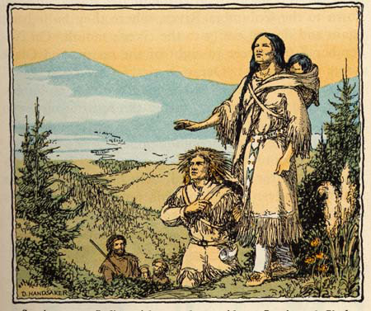
Louisiana Purchase
1800 Napoleon pressured Spain to return Louisiana to France
Livingston & Monroe sent to negotiate the purchase of New Orleans for $10 million
Surprise - Napoleon offers all of Louisiana Territory for $15 Million- why?
Constitutional & ideological dilemma for TJ?
How did it forward Jefferson’s vision of America?
Lewis & Clark Expedition – “Corps of Discovery” 1804-1806 to Oregon coast, Sacajawea
Toussant
L’Overture
Robert Livingston
James Monroe
Notes:
Effects of both?

Slide 8
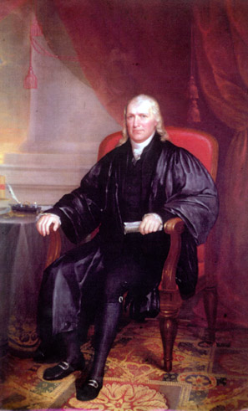
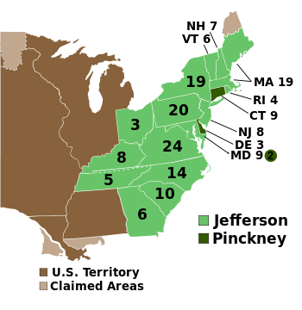
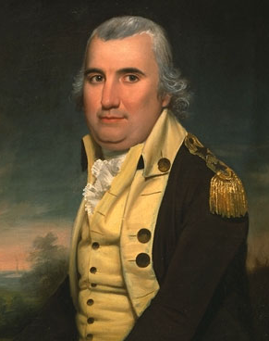
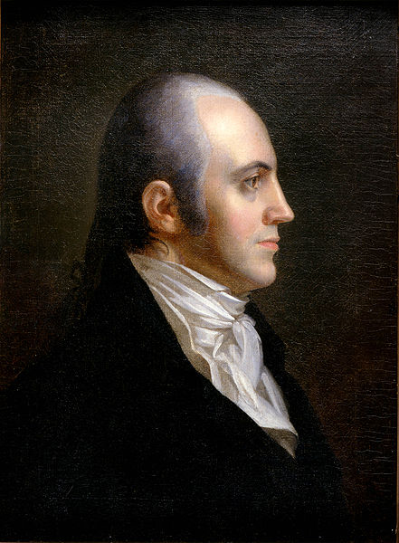
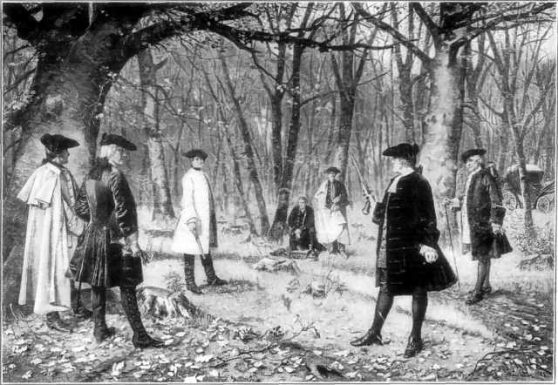
Supreme Court & Reelection
John Adams “Midnight Appointments” – Federalists retain control of courts
John Marshall (Jefferson’s cousin) appointed by Adams as Chief Justice (1801-1835) strengthen power of federal government
Marbury v. Madison (1803) John Marshall’s ruling sets important precedent
Judicial Review - Supreme Court’s role in deciding on Constitutionality of laws
Jefferson’s impeachment campaign – Justice Samuel Chase impeachment trial 1804 fails
1804 Election Jefferson easily defeats Fed. Charles Pinkney
Aaron Burr
  1804 Jefferson replaces him with George Clinton (NY) as V.P.
  1804 runs for NY Governor as part of Federalist Conspiracy “Essex Junto”
  Duel with Hamilton 1804
  1806 Mexico Conspiracy & Trial for Treason, Marshall acquits him
Burr-Hamilton Duel
Aaron Burr

Slide 9
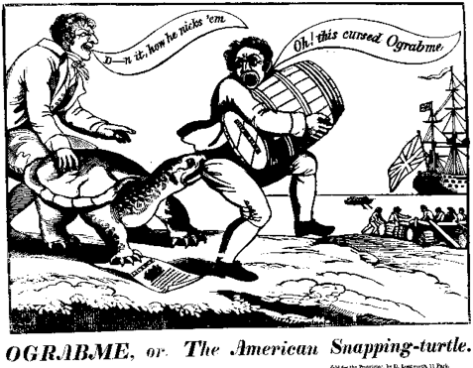
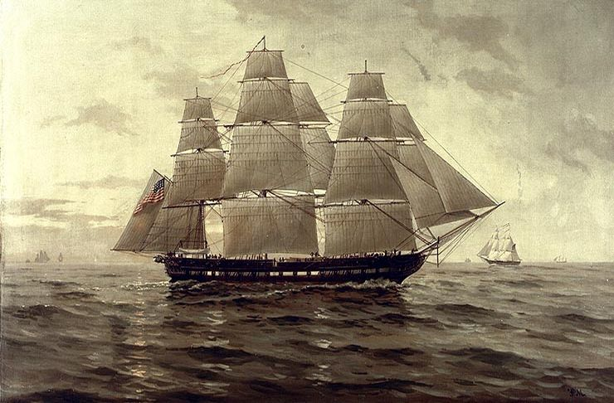
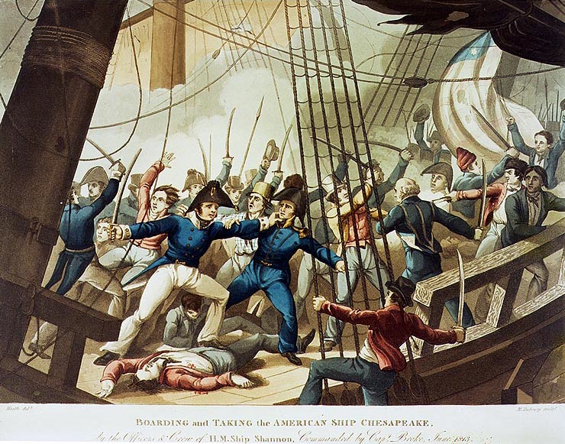
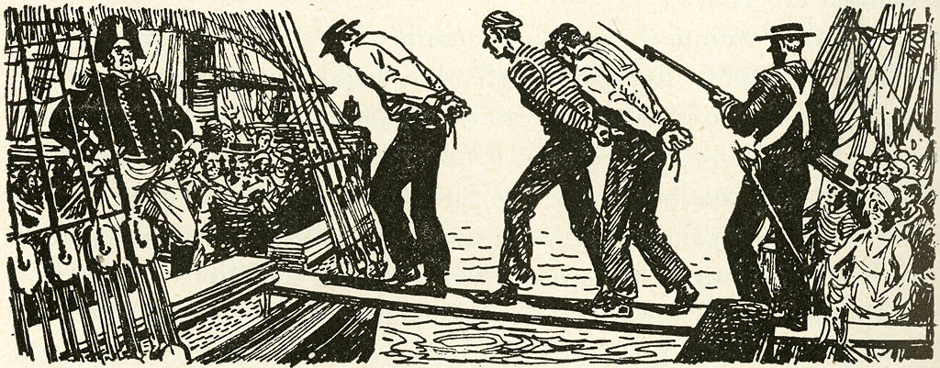
Foreign Policy Challenges
Barbary Pirates War (1801-1805) TJ refused to pay tribute to Pasha of Tripoli – sent naval fleet – reduction of $
Threats to Neutrality – British impressment of American sailors
Chesapeake-Leopard Affair (1807) 3 Americans killed, others impressed of coast of VA, caused “war fever” and anti-British sentiment
Embargo Act (1807) forbade American ships to sail to any foreign port to pressure Britain to respect neutral rights, backfired
  Devastated American economy as exports dropped 80%
  New England considers secession
  TJ calls for its repeal last days in office 1809

Slide 10
TJ Says Goodbye
"I have retired from the
hated occupations of politics and
returned to the bosom of my family,
my farm, and my books."
- Thomas Jefferson 1809

Slide 11
Thomas Jefferson Caricature
Directions: Add quotes and symbols that describe the Jefferson Presidency 1801-1809
Color/neatness is a must!

