Slide 1
Seven Years’ War or French & Indian War
1754-1763
Crash Course #5 The Seven Years War & Great Awakening

Slide 2
Essential Questions:
What were the causes of conflict between British and France and American Indians culminating in the Seven Years’ War?
What were the positive and negative effects of the victorious results of the Seven Years’ War on the British?
What were the motivations and the effects of the Proclamation of 1763? What effects did the Seven Years’ War have on American Indian groups?

Slide 3
Essential Question
How did the French and Indian War change the relationship between the British and the Colonists?

Slide 4
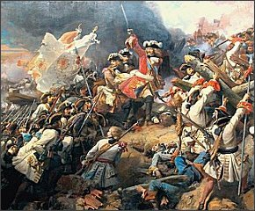
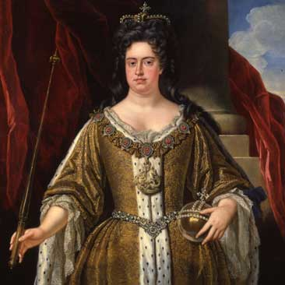
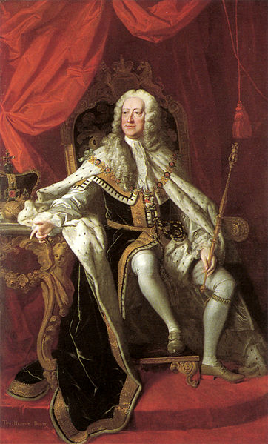
Early Wars for Empire
Sparked by competition for trade & territory in America between Britain, France, & Spain
King William’s War (1689-1697) & Queen Anne’s War (“War of Spanish Succession” 1702-1713) – failed attempts to take Quebec – Indians side w/ French, British gain Nova Scotia & trade in Spanish America including “asiento de negros”
King George’s War (1744-1748) British vs. France & Spain – limited territorial changes in Americas
New Englanders upset about return of territory to French
Queen Anne
1702-1707
King George II
1727-1760

Slide 5
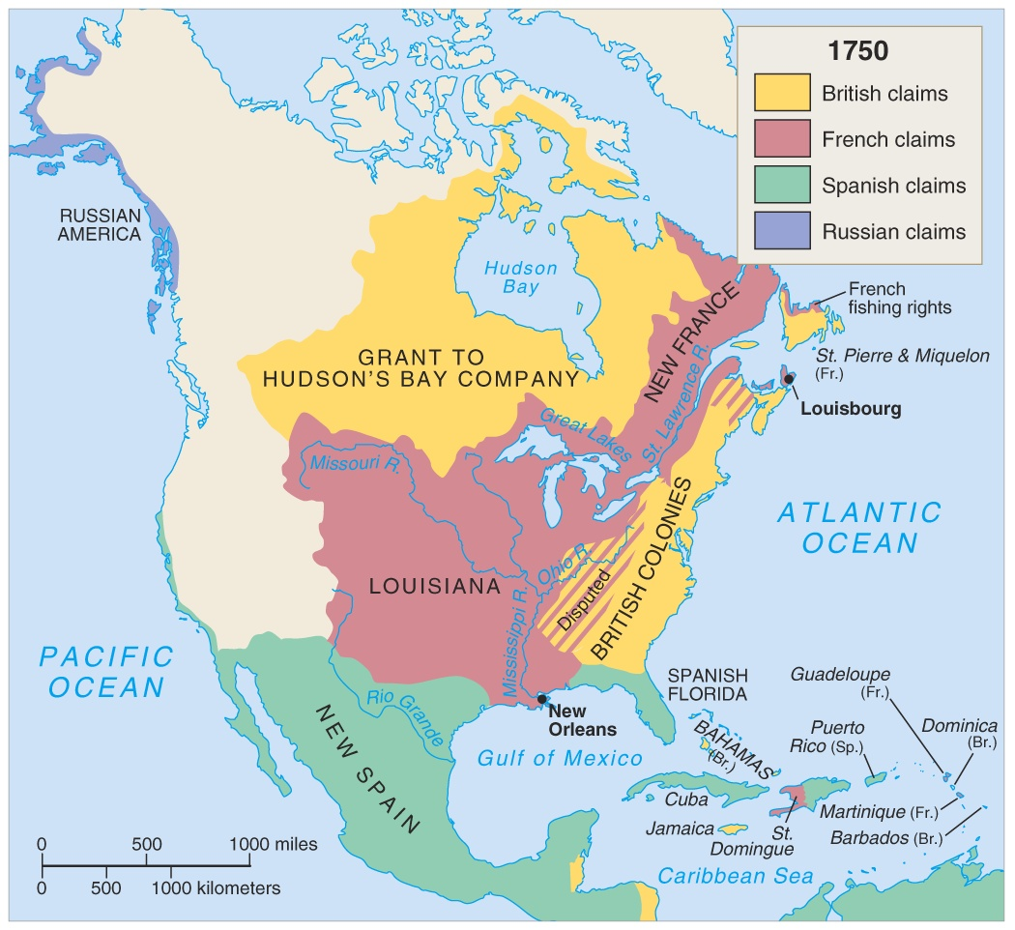
North America in 1750

Slide 6
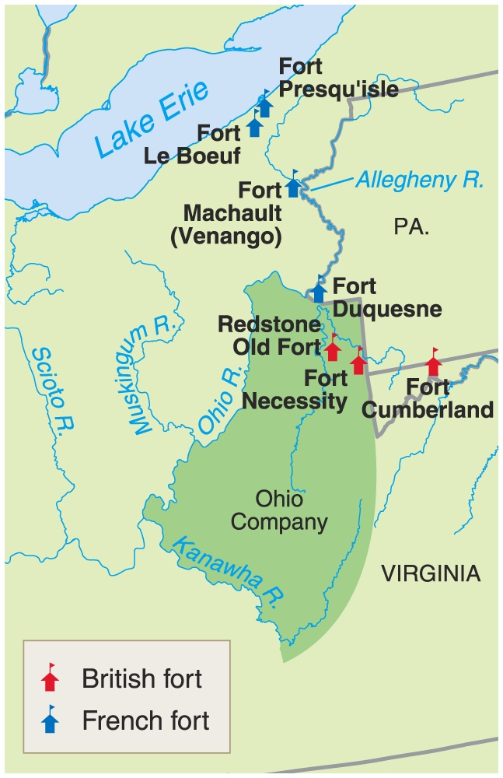
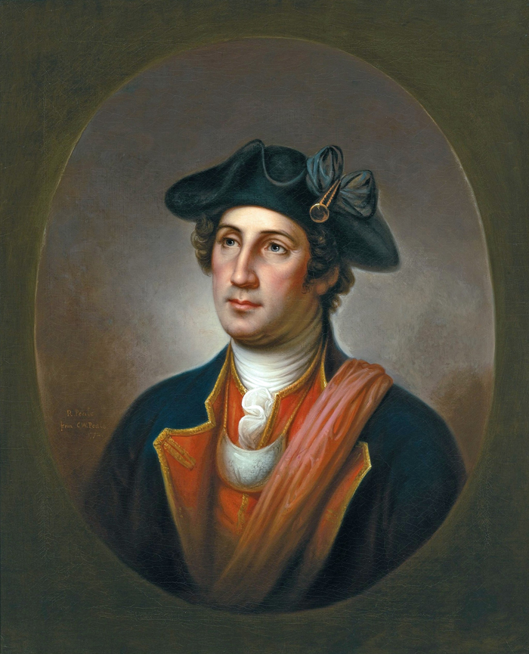
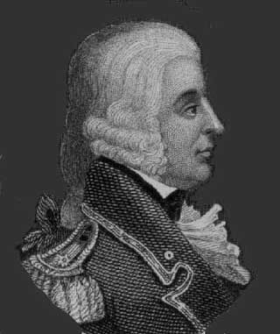
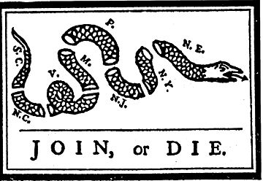
Seven Years’ War
Causes:
- Britain & France compete for empires
- French & English fur traders & English land speculators compete for Ohio Valley
- French fortify central frontier
- French and British sought alliances w/
Indians (French more successful)
Early Defeats (1754-1756):
  British failed attempt to capture Ft. Duquesne George Washington militia surrender 1754
  1755 General Braddock killed & British & colonial militia routed by French & Algonquin allies
  1756 failed attack on Quebec
Albany Plan of Union (1754) Ben Franklin attempted to create limited inter-colonial government to recruit troops & collect taxes for common defense – rejected
Why significant?

Slide 7
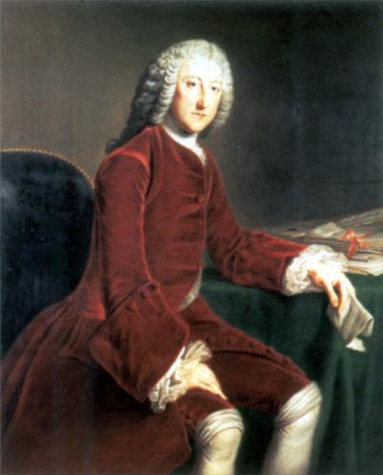
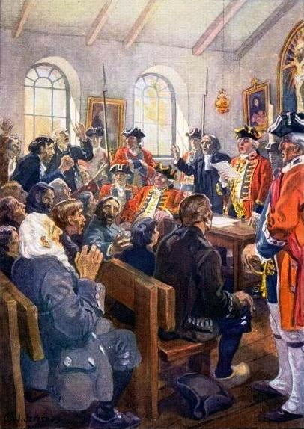
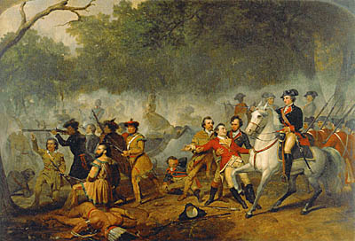
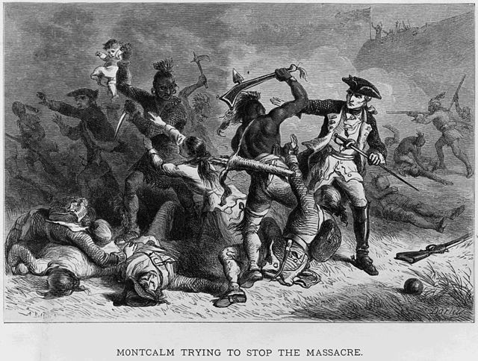
British Victory & Effects
Prime Minister William Pitt focus on conquering Canada – Quebec 1759 & Montreal 1760
Treaty of Paris 1763: Britain gains French Canada & Spanish Florida. France gives land west of Mississippi to Spain.
Immediate Effects:
  British gained supremacy over North America & dominate naval power
  France, Spain & American Indian allies no longer a threat to North American empire
  Transform relationship between Britain & its colonies
  British War Debt – reorganization of empire needed
British View: Colonists weak, poorly trained, undisciplined, some refused to contribute troops or money to war & unwilling & unable to defend frontier
Colonial View: proud of their military, not impressed by British troops & leadership & snobbishness. Gained valuable experience & connection.

Slide 8
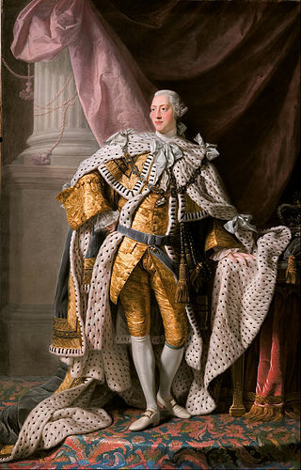
Reorganization of Empire
End of “salutary neglect” Britain take more direct & forceful control over colonies
Increased War Debt: British maintain a large force on frontier
King George III & Whigs in Parliament increased taxes on colonies
King George III –
1760-1820

Slide 9

Good Morning Mighty Arabs!!!
Please get out your Period Three Primary Source Packet

Slide 10
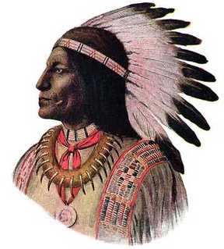
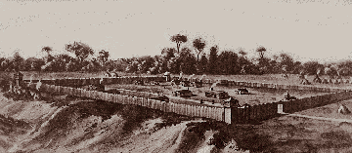
Pontiac’s Rebellion &
Proclamation of 1763
Pontiac’s Rebellion: 1763 Chief Pontiac forms alliance of Western tribes to resist western expansion – attack settlements in Ohio Valley & Great Lakes. British use regular troops to crush rebellion.
Proclamation of 1763: to stabilize western frontier banned colonial settlement west of Appalachians
Colonists respond with anger & defiance – thousands migrated west anyway
Paxton Boys - 1763 Scots-Irish vigilantes in W. PA attacked Indians – “Conestoga Massacre” slaughtered 20 Susquehannock peaceful tribe for “revenge” & marched on Philadelphia
Pontiac
Fort Detroit – Gifts from the British?

Slide 11
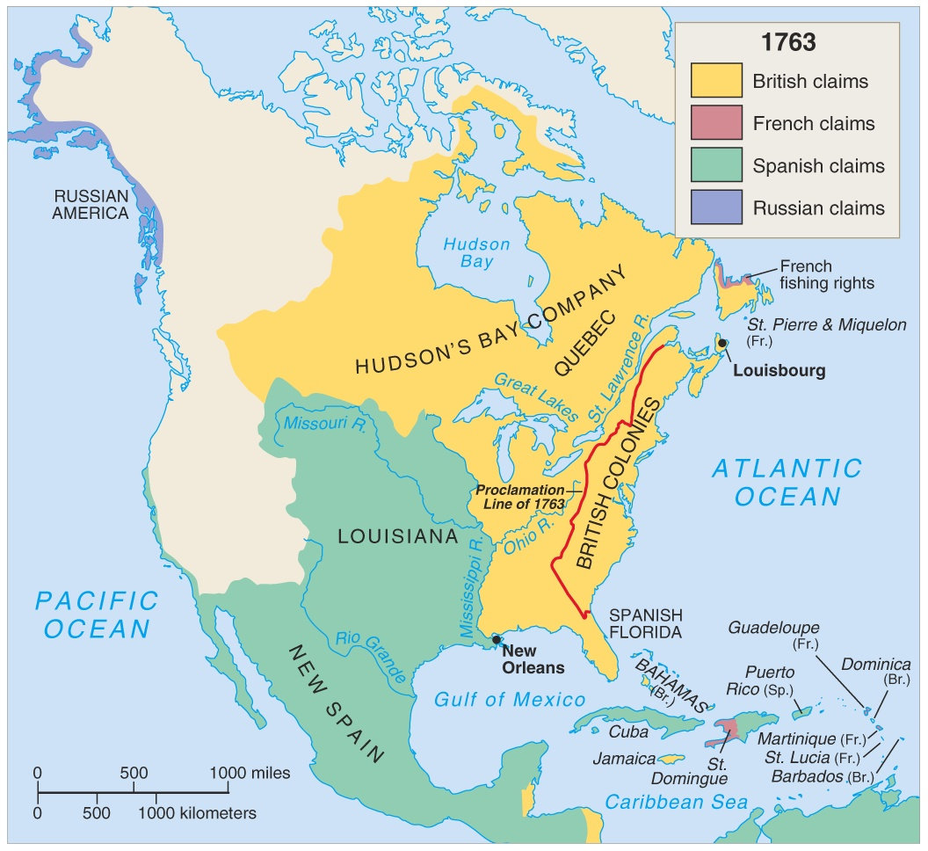
North America in 1763

Slide 12
Now Let’s Revisit Our Short Response.
At your assigned spots, draw this chart and fill it in with everything you know about these regions
Chesapeake | New England
Similarities

Slide 13
Boston Massacre Roles
Recorder 4
Time Keeper 2
Leader1
Presenter 3

