Slide 1
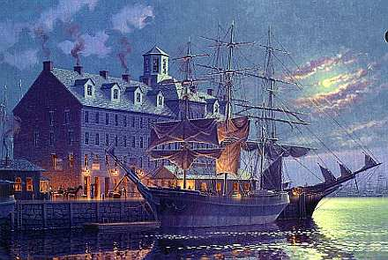
18th Century Colonial Life
Crash Course #4

Slide 2
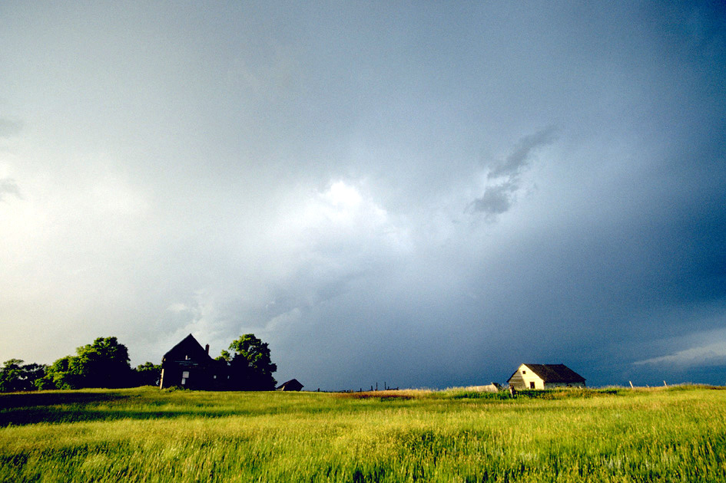
Essential Questions:
What were the causes and effects of the First Great Awakening?
What impact did the ideas of the Enlightenment have on the colonies?
(Copy above ^^)
What were the causes and to what extent had the British colonies become more “Anglicanized” in the 17th and early 18th Century?

Slide 3
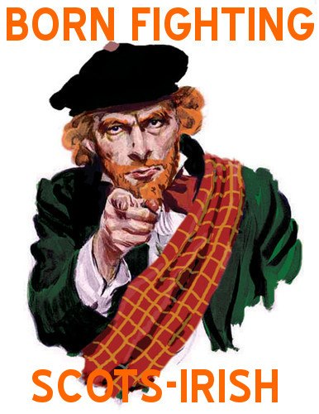
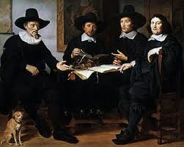
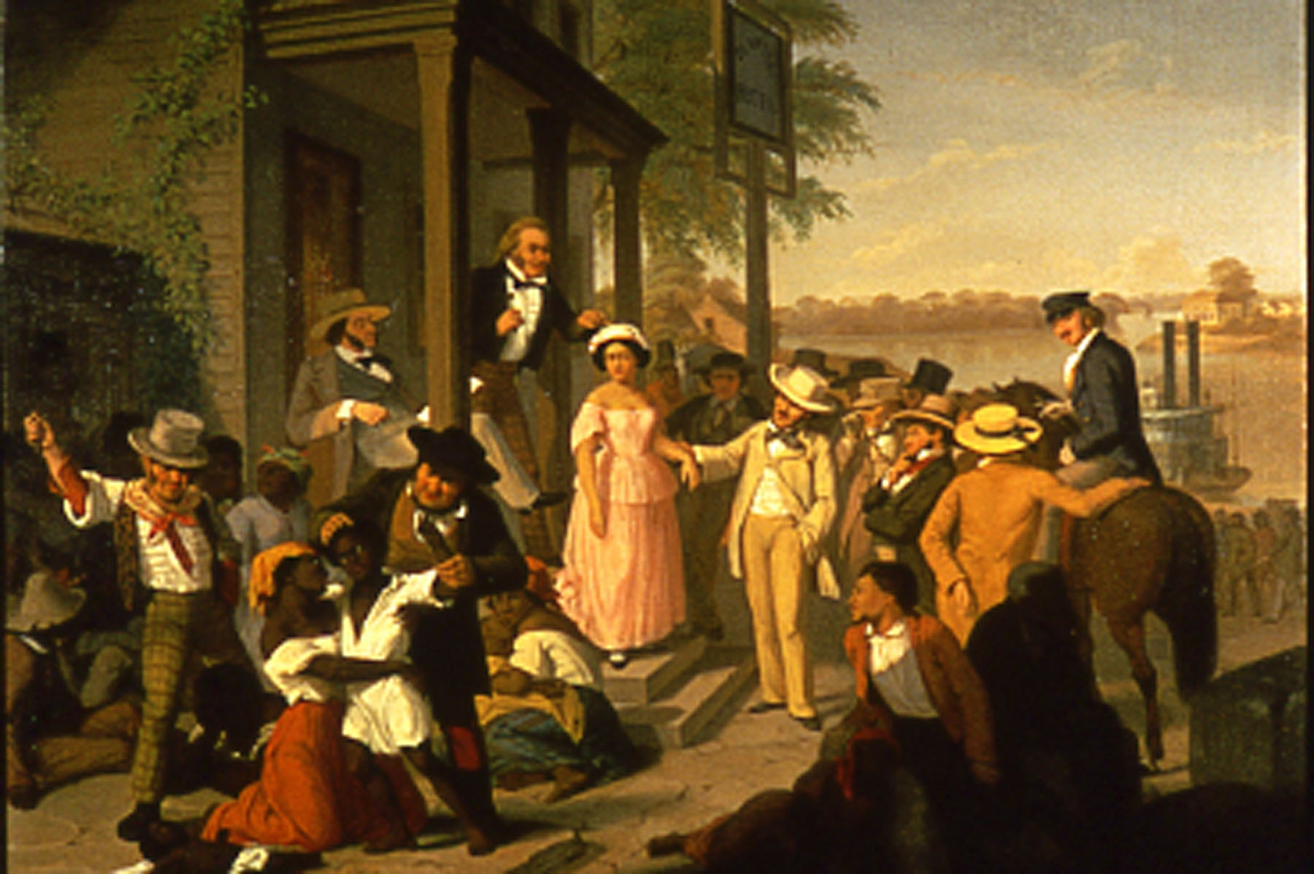
Population Growth
During 17th Century pop. grew and colonies became distinct from Europe
1701 English colonial pop. (incl. slaves): 250,000. By 1775: 2.5 million
Cause: immigration & high birthrate due to fertile land and abundant food supply
European Immigrants: escape religious persecution, war, economic opportunity, and land. Most settled in Middle Colonies & western frontier of VA & Carolinas
  English numbers decreased due to stability in England
  Germans: farms of W. PA “Pennsylvania Dutch”, language & customs 6% by 1775
  Scots-Irish (Scotch-Irish): N. Ireland – disrespect for English authority, frontier settlement – 7%
  Others: French Protestants (Huguenots), Dutch, Swedes – 5% by 1775
Africans: largest group of non-English, every colony had slaves, but much higher in South (90%) mostly in SC & GA, by 1775 African-Americans (slave & free) 20% of colonial pop.

Slide 4
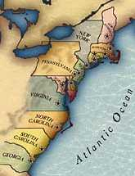
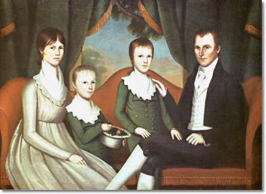
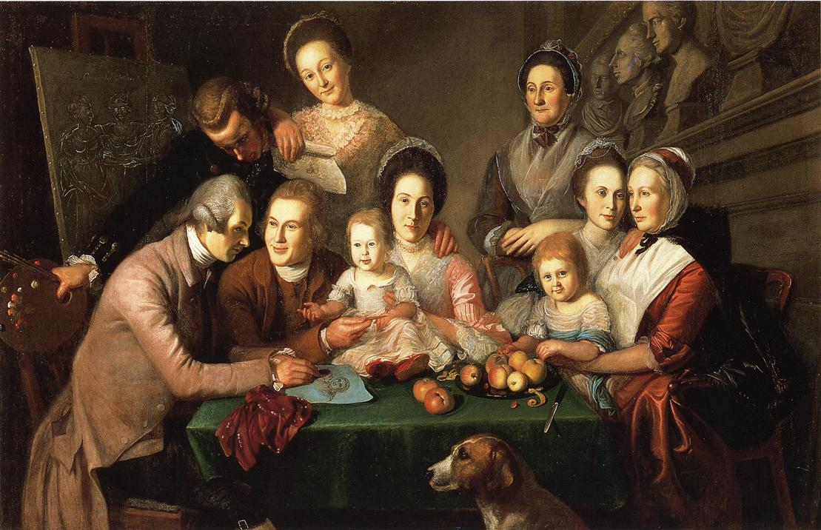
Colonial Society
Dominance of English culture
No hereditary aristocracy
  classes based on economic status
Social mobility
  only African-Americans couldn’t work their way up
Family at center of life
  Men: Landowners, political power, wealth, right to property, right to beat wife
  Women: Raised and educated children (8 on average) cooking, cleaning, making clothes, few rights
  Divorce legal but very rare
Over 90% of colonists lived on farms

Slide 5
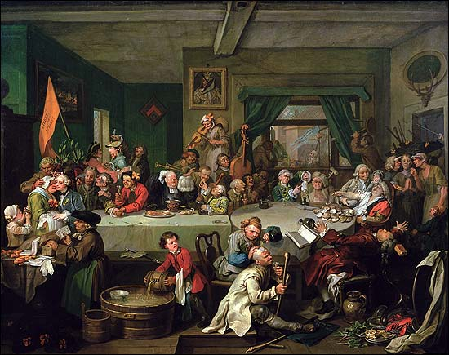
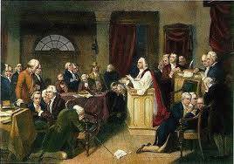
Political Structure
All colonies -bicameral legislatures (2 Houses)
Lower House Elected
  Voted on taxation (with representation)
Governors/Upper Houses chosen differently
  8 Royal colonies chosen by the crown
  3 Proprietary (MD, PA, DE) appointed by proprietors
  2 (CT, RI) had elected governors
Local Government most important to people
  New England: Town meetings – public vote
  South: Sheriff/county administrators
Voting: limited democracy
  Property owning white males – elite held power
  White women, poor white men, slaves, & free blacks could not vote
  Religious restrictions lifted by 1690s

Slide 6

Colonial Economy

Slide 7
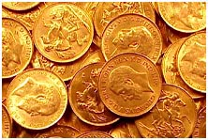
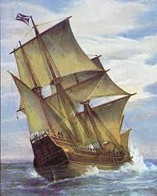
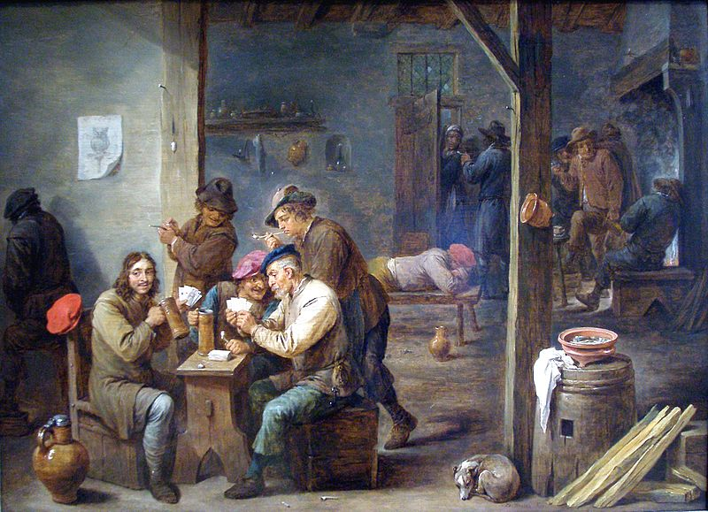
Money & Transportation
English restricted $ to control the colonial economy
Colonies growing fast, but limited to “hard” currency (specie = Gold and Silver coin)
Imports exceeded exports, tried to print paper money - Led to inflation
Parliament vetoed colonial laws such as printing own $, that could hurt English merchants
TRANSPORTATION:
Atlantic journey 3-4 weeks heading East, 5-6 weeks heading West
Water transportation easier than roads and trails
Major cities develop near major ports
  Boston, New York, Philadelphia, Charleston
Despite conditions, overland travel became more common into 1700s – postal routes developed
Roadside taverns become social centers for news and political discussions

Slide 8
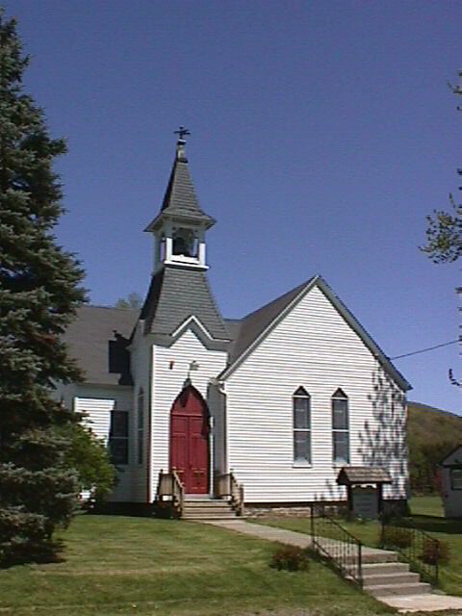
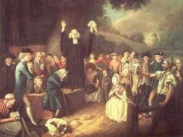
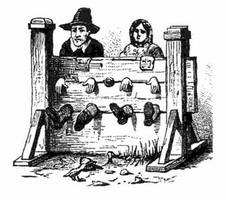
Colonial Religion
Pluralism – multiple religions BUT
Dominance of Protestant Religions
Jews, Catholics, & Quakers suffered discrimination
Some “established” religions
  supported by taxes (MA until 1830s) EVERYONE pays, regardless of faith
  Anglican Church (Church of England)- VA
  Congregational Church (Puritan) -MA, CT
Others:
  Catholics: Middle Colonies
  Jews: Boston, New York
  Presbyterians: New England
  Dutch Reformed: New York
  Lutherans, Mennonites, Quakers: Pennsylvania

Slide 9
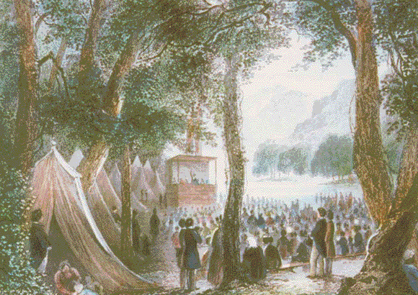
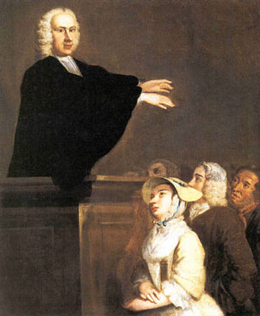
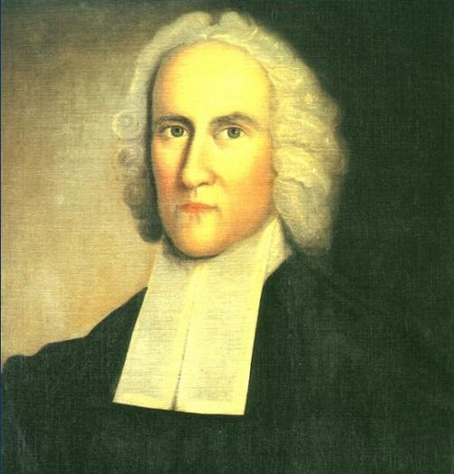
The Great Awakening
Religious revival sparked by introduction of Pietism (evangelical movement focused on individual’s personal relationship with God) by German immigrants
Strongest in the 1730s and 1740s
Jonathan Edwards of MA “Sinners in the Hands of An Angry God”
God is angry with sinfulness, express penitence or eternal damnation. You could be saved!
John and Charles Wesley: founders of Methodist church visited from England in 1730s
Expanded by George Whitefield
  all over colonies in barns, tents, fields
  audiences up to 10,000

Slide 10
Effects of the Great Awakening
RELIGION
Ministers lose authority among people who now study bible at home
New Lights (supporters):
  Baptists, Methodists
Old Lights - traditionalists - ministers needed to properly interpret The Bible
Causes diversity of sects & competition
New denominations
Salvation for ALL
POLITICS
Affects all classes and sections
First movement to unify colonists
Experience shared by all American colonists, regardless of origin
Changes how people view authority in general
Long-term leads to increased drive to expand democracy
(IMPORTANT ^^)

Slide 11
Participants in the Great Awakening came to realize that if they can select their own religion, they can also select their own government.

Slide 12
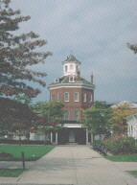
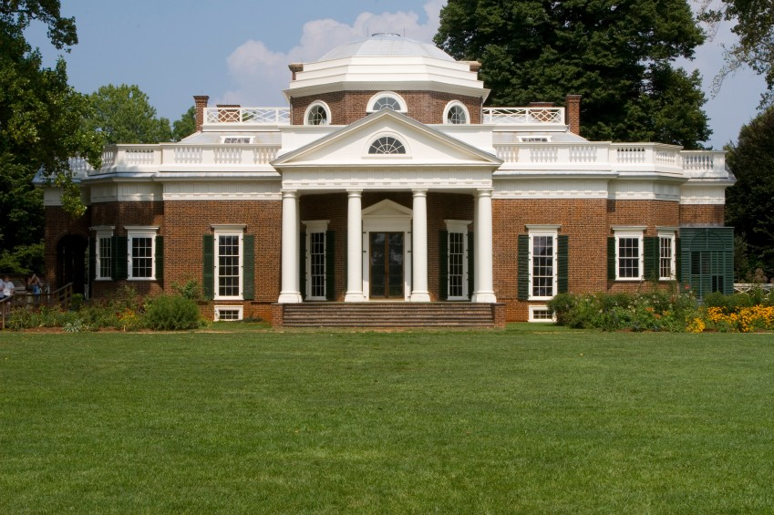
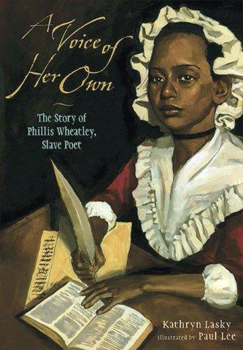
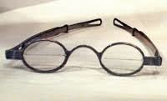
Colonial Culture
Architecture—Georgian style (1740-50s); brick or stucco, symmetry, center halls with fireplaces
  Public buildings, churches on seaboard; one-room log cabins on frontier
Art—portraits of families, Benjamin West & John Copley
Literature: mostly religious (Cotton Mather, J. Edwards); political essays (J. Adams, Otis, Dickenson, Paine, Jefferson) almanacs
  Phyllis Wheatley: former slave & poet
  Most successful: Ben Franklin, Poor Richard’s Almanac (1732-1757)
Science: mostly self-taught scholars Franklin’s work w/electricity, bifocals, & Franklin stove

Slide 13
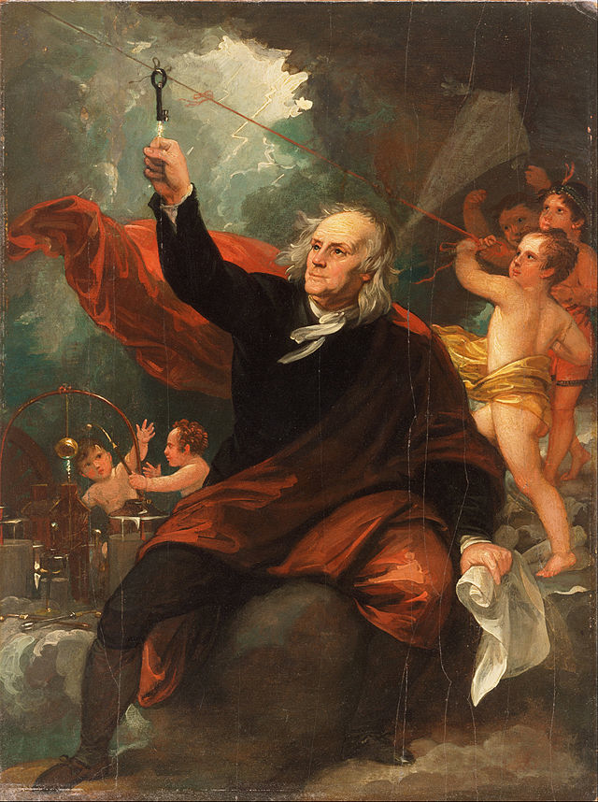
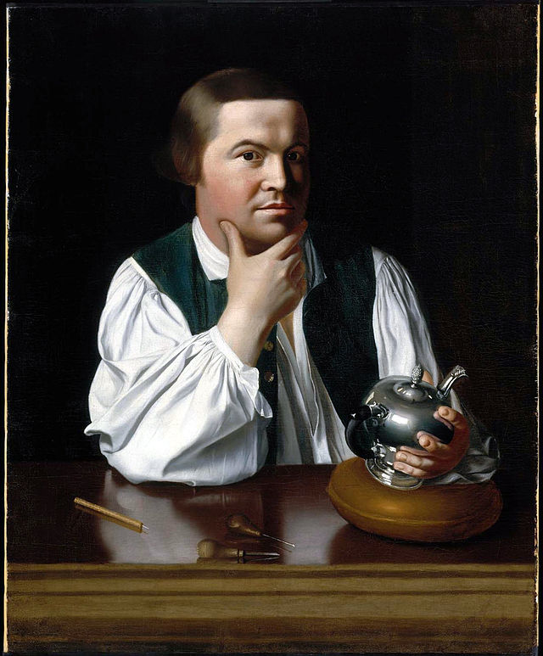
Art: Benjamin West & John Copley

Slide 14
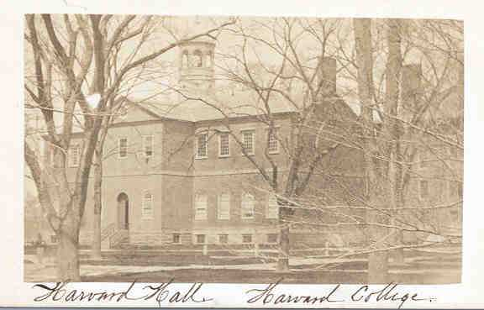

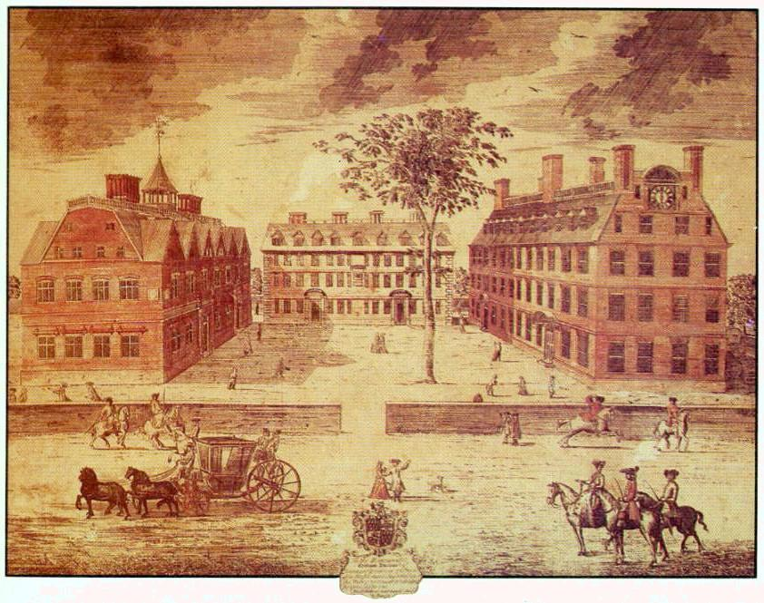
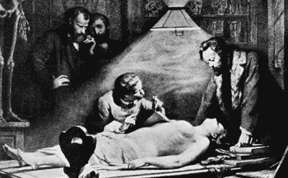
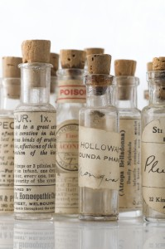
Education
Elementary Education:
  N.E. Puritans 1st tax supported public schools, MA law in 1647 requiring towns to build primary & grammar schools
  Middle Colonies: church-sponsored or private schools
  Southern: limited usually private tutors for wealthy
Higher Education: mostly religious sectarian
  Harvard, 1636—1st colonial college; trained candidates for ministry, College of William and Mary, 1694 (Anglican), Yale, 1701 (Congregational)
  Great Awakening influences creation of 5 new colleges in mid-1700s: College of New Jersey (Princeton), 1746 (Presbyterian), King’s College (Columbia), 1754 (Anglican), Rhode Island College (Brown), 1764 (Baptist), Queens College (Rutgers), 1766 (Dutch Reformed), Dartmouth College, 1769, (Congregational)
Ministers often highest education
Medicine: doctors lacked formal training: Franklin helped establish first medical college in Phil. In 1765
Lawyers: profession expanded in 1700s as legal conflict increased – formed a bar – revolution leaders: Adams, Henry

Slide 15
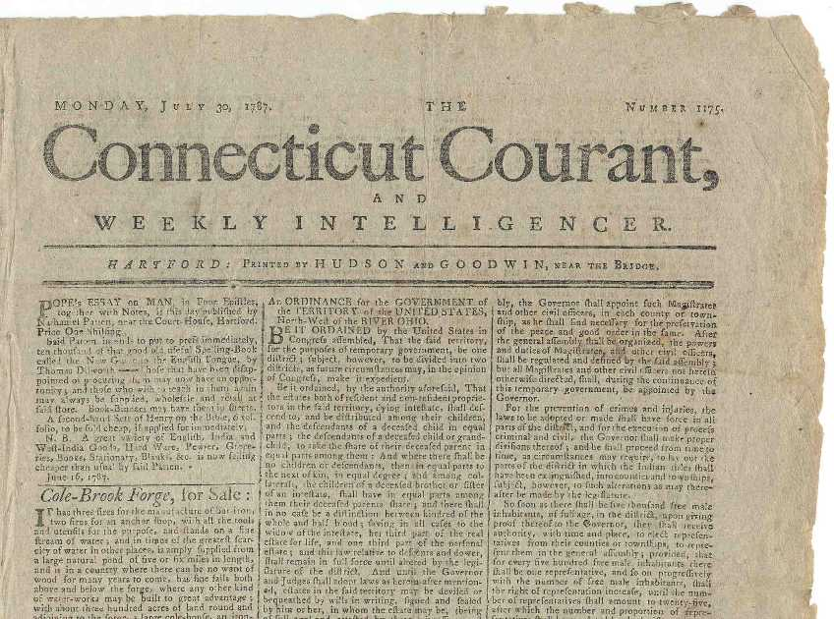
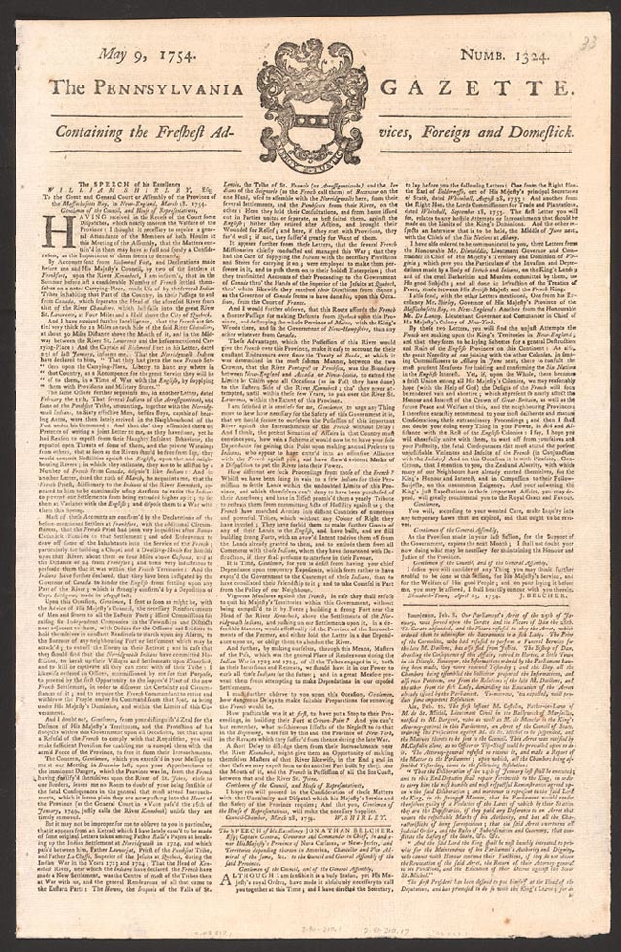
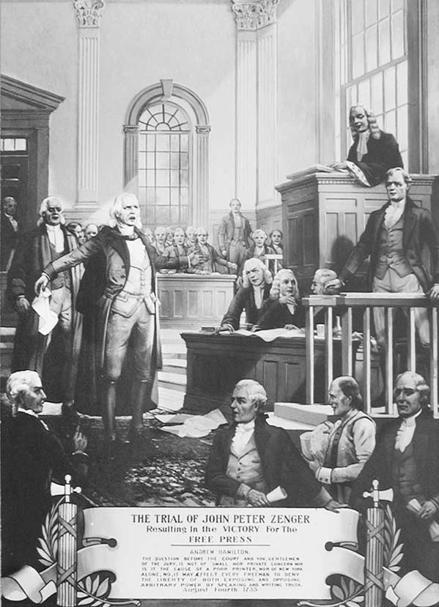
The Colonial Press
Primary means of communication in the colonies, along with postal service
1725—5 newspapers by 1776—40 newspapers
Typically included
  European news (1 month late)
  Ads for goods, services, return of runaway slaves
  Essays giving advice for better living
  Few illustrations
First cartoon in Philadelphia Gazette by editor Ben Franklin
Zenger Trial (1735) – John Peter Zenger NY publisher charged with libel against governor, jury found not guilty: led to more willingness to criticize public figures than England

Slide 16
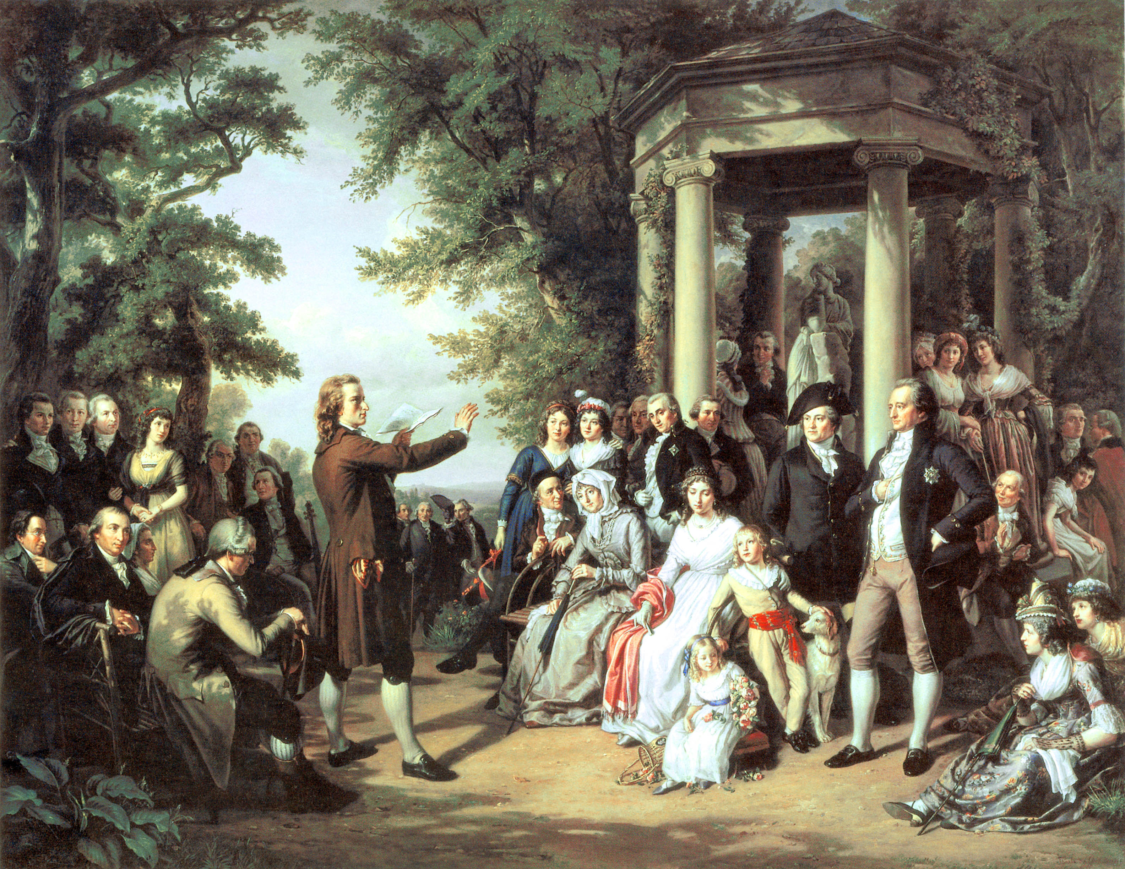
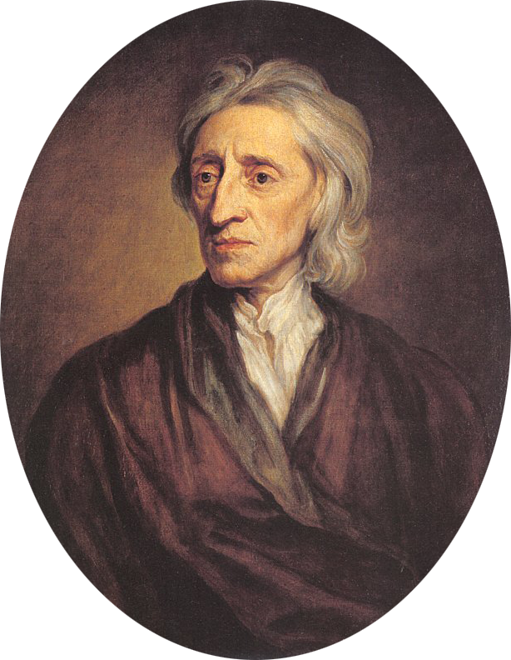
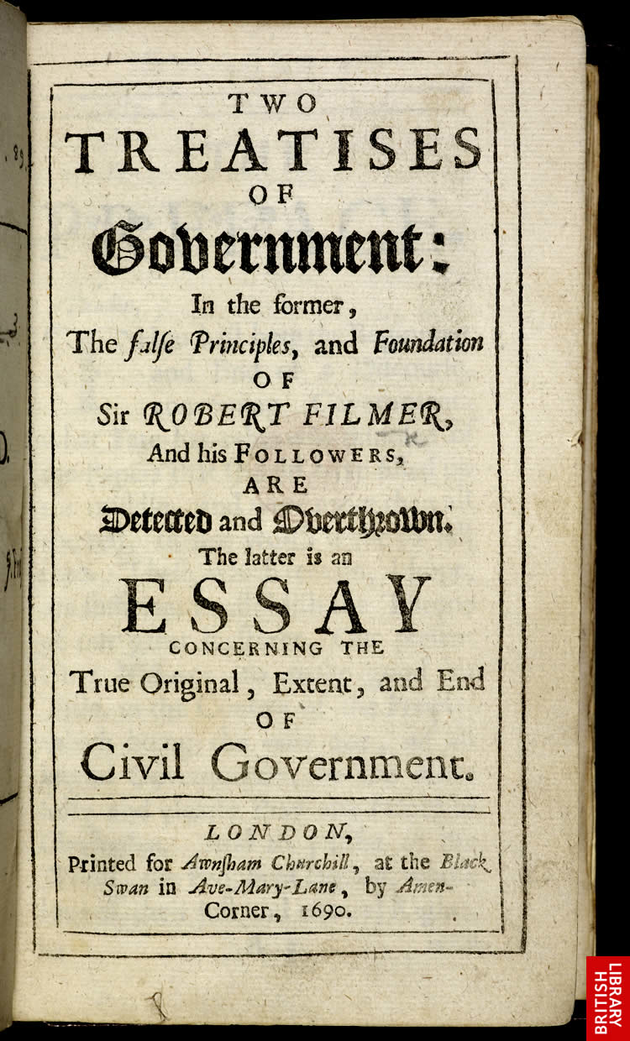
The Enlightenment
Human reason can solve humanity’s problems
John Locke’s Two Treatises of Government (1689): “natural laws” based on rights of the people – people as sovereign, thus people had right to revolt against government that violated their natural rights
Movement inspired many educated Americans
Rise of Deism (Franklin, Jefferson)

Slide 17
Assignment
As a group, How do you think the Enlightenment & The Great Awakening influenced the independence movement in the colonies?? Explain

