Slide 1
Restoration: Middle Colonies, the South & British West Indies
Mr. Owens

Slide 2
Essential Questions
What were the key characteristics of the middle colonies and why did they tend to be more diverse and tolerant?
Why did the southern Atlantic colonies and the British West Indies rely more heavily on slavery, and how did this contribute to unique cultural and religious development?

Slide 3
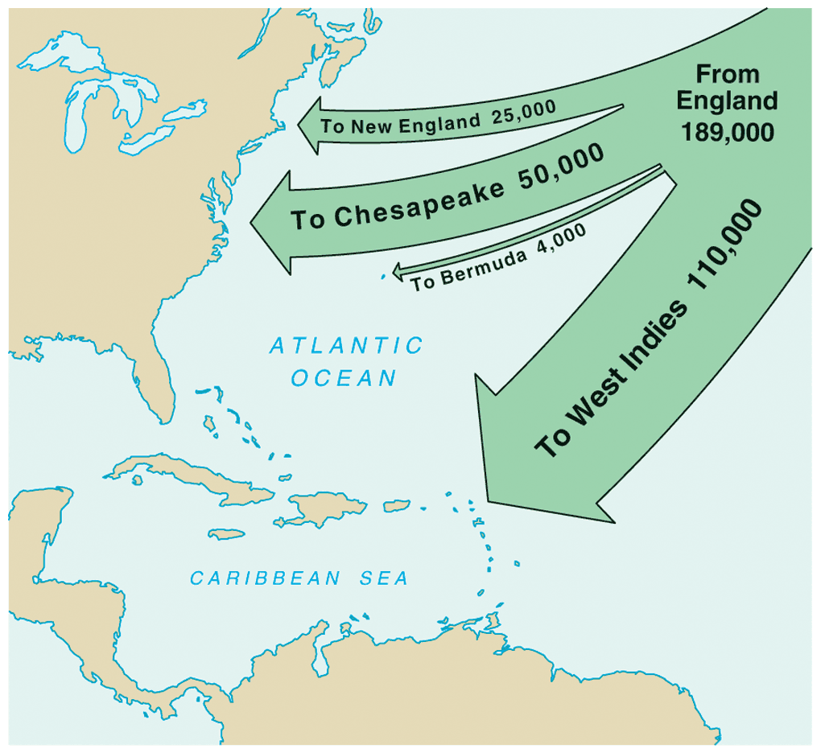
English Migration: 1610-1660

Slide 4
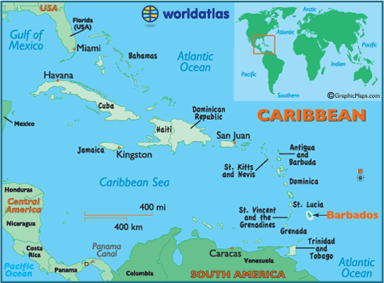
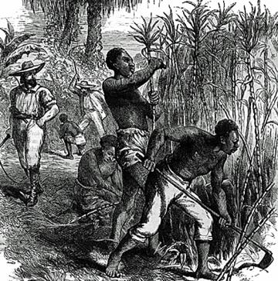
British West Indies
British colonies in the Caribbean: Antigua, St. Kitts, Jamaica, and Barbados
From 1640-1660 over 2/3 of English emigrants to the Americas settled in Barbados – aristocratic plantation owners dominated
Sugarcane plantations for sugar and rum: labor intensive African slaves, by late 17th Century 4x as many slaves as whites – harsh slave codes
Slave revolts and threats from Spanish, French, Dutch, and Portuguese caused many to settle on mainland colonies.

Slide 5
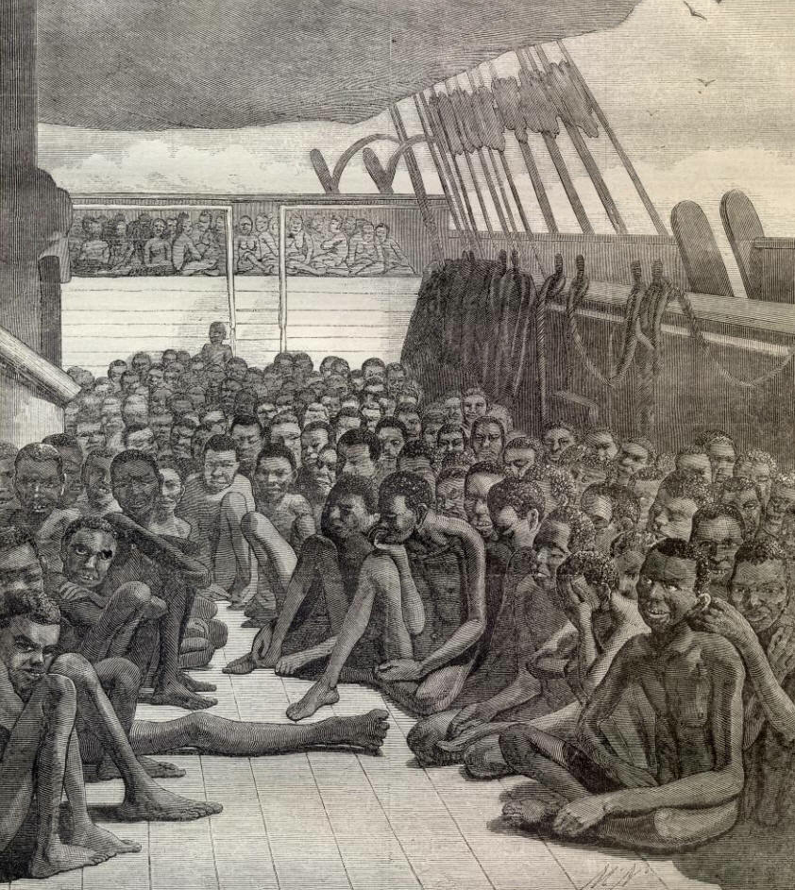
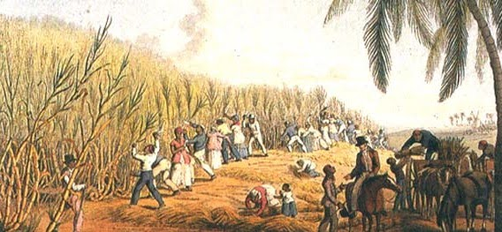
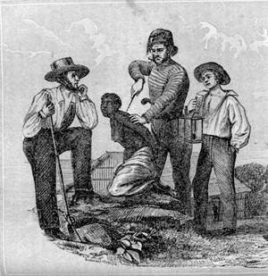
Barbados Isle inhabited by Slaves
And for one honest man ten thousand knaves
Religion to thee’s a Romantic story
Barbarity and ill-got wealth thy glory
All Sodom’s Sins are Centered in they heart
Death is thy look and Death in every part
Oh! Glorious Isle in Villainy Excel
Sin to the Height – thy fate is Hell”
- 1710 anonymous planter

Slide 6
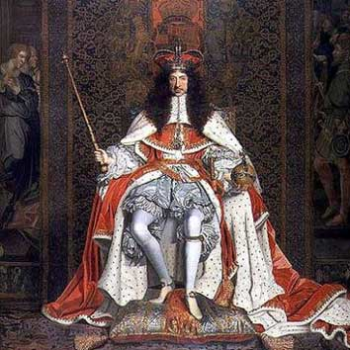
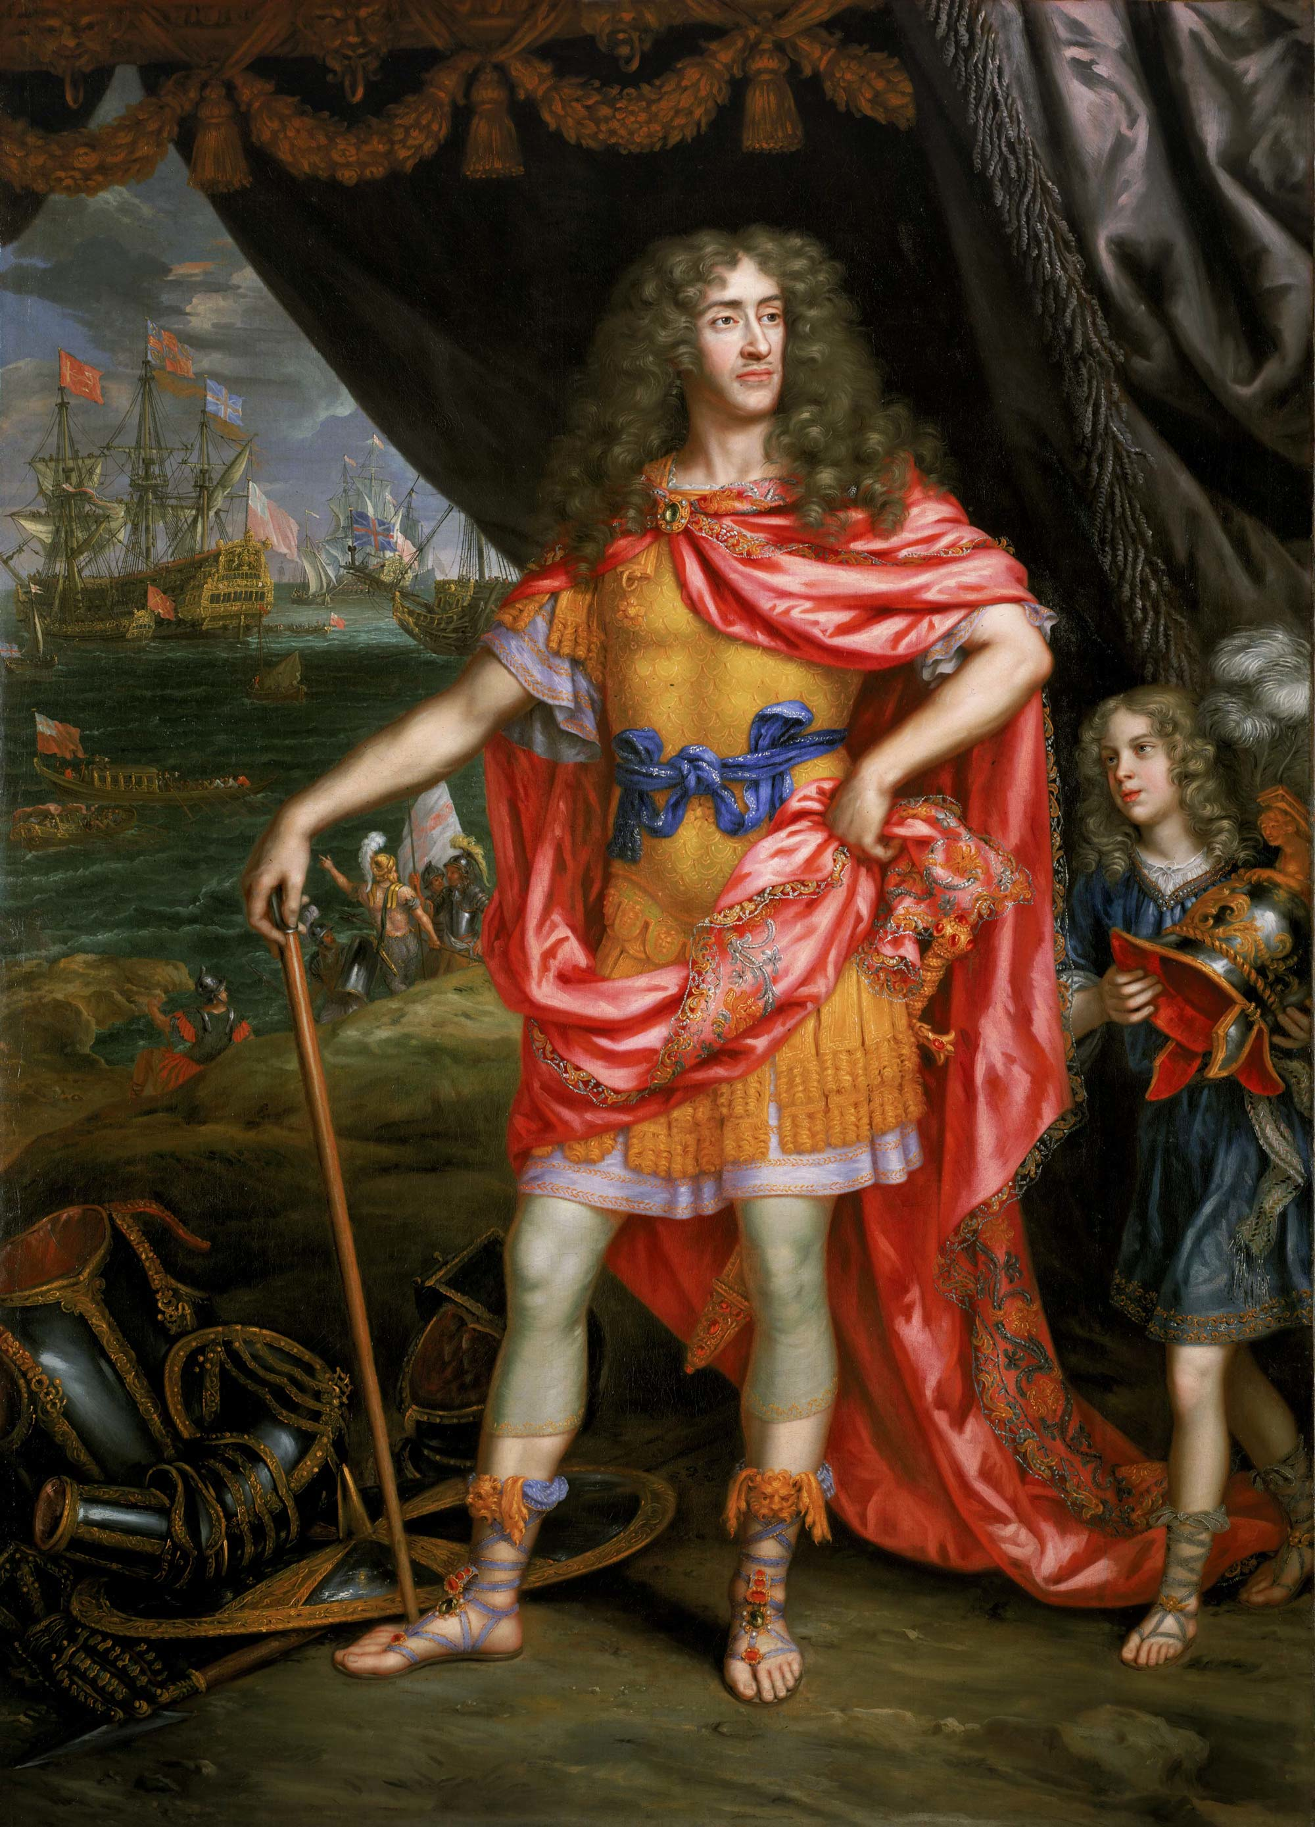
Restoration Colonies
Restoration Period: referring to the restoration of power of the English monarchy under Charles II in 1660 following brief period of Puritan rule under Oliver Cromwell
Restoration Colonies: Carolinas, NY, NJ, PA, DE
Charles II
James II
(then Duke of York)

Slide 7
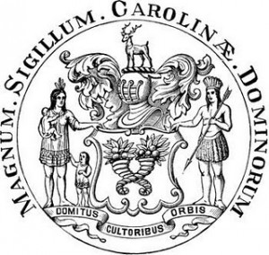
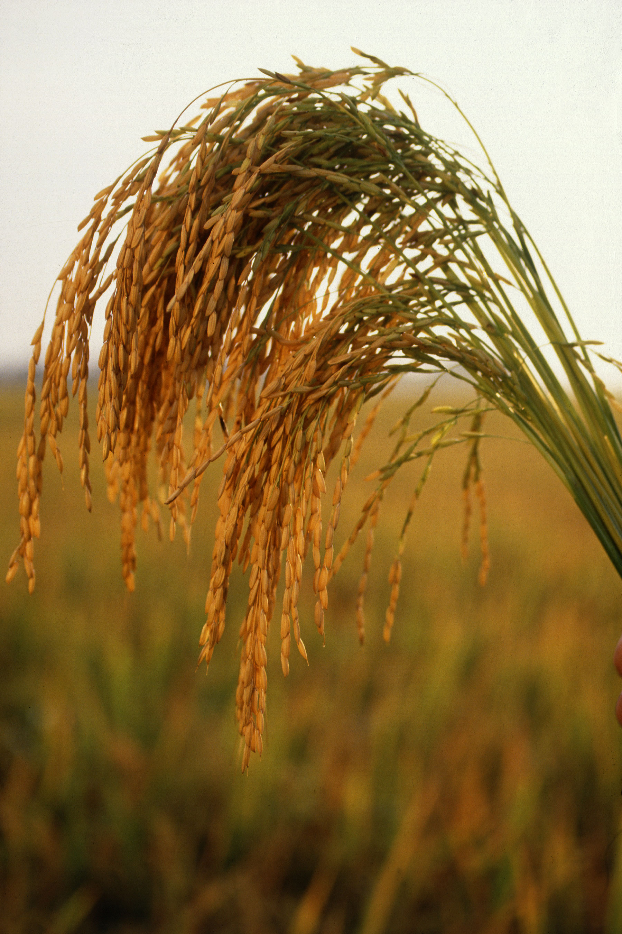
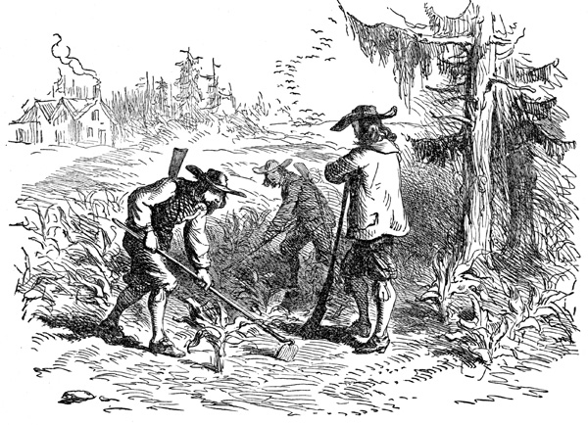
Carolinas
Charles II rewarded 8 nobles – lord proprietors of the Carolinas
1729 split into 2 royal colonies: North & South Carolina
South Carolina founded by large wealthy, plantations owners from Barbados – remains trading partner
Economy initially based on fur trade and supplying food for West Indies
By mid-18th Century dominated by Rice plantations and reliance on African slavery
By 1710 → black slaves were a majority in South Carolina 1st mainland colony.
North Carolina: mostly small tobacco farms, developed fewer plantations, and less reliance on slavery
By 18th Century more democratic and autonomous from Britain

Slide 8
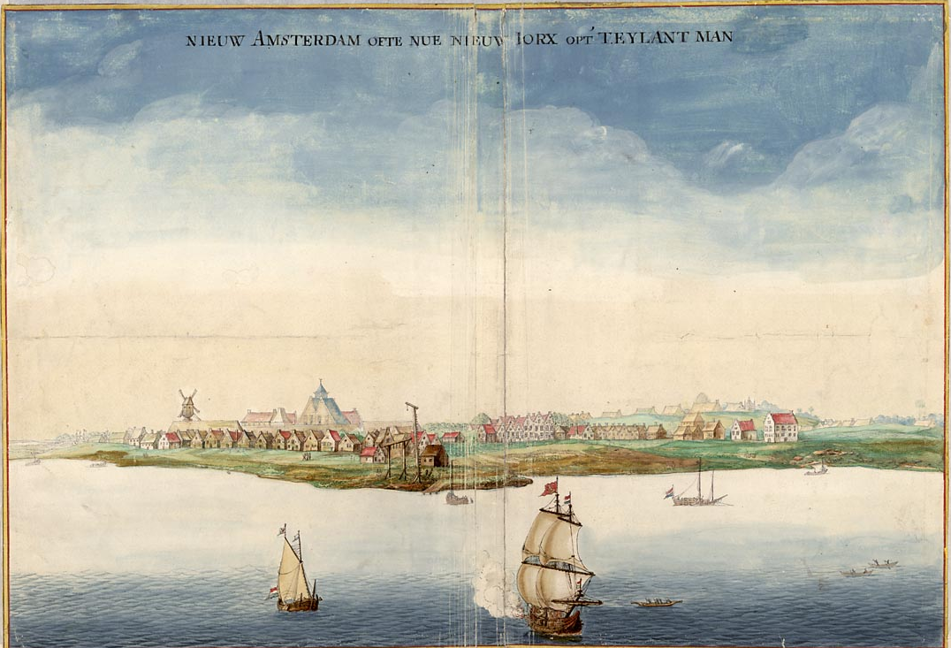
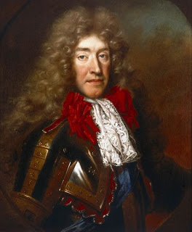
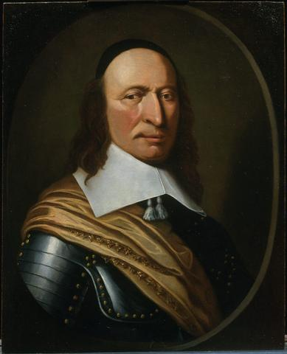
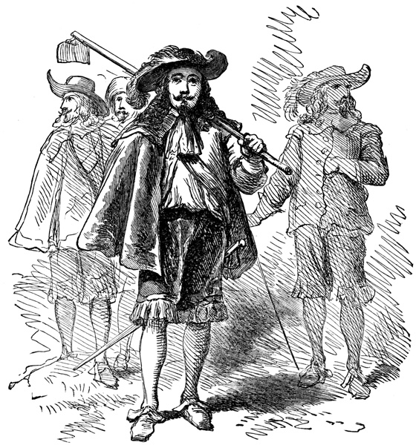
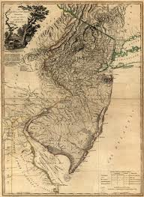
New York & NJ
Beaver Wars (1640s-1660)– Iroquois to dominate region & fur trade – partners with Dutch
1664 – Charles II grants brother Duke of York (James II) New Netherlands
James seized New Amsterdam – “New York” from governor Peter Stuyvesant – Dutch allowed freedom of worship and land if loyal to English crown, patroons retained land
James taxed people w/out an assembly
Protests led to 1683 to grant more civil rights, political rights, and a representative assembly
New York serves as an important harbor & center for trade
New Jersey: James spilt New York in 1664 – granting NJ to Lord John Berkeley & Sir George Carteret – offered generous land grants, religious freedom & an assembly
Eventually proprietary land sold to groups of Quakers
Became official Royal Colony on New Jersey in 1702
New York
Duke of York
Stuyvesant

Slide 9
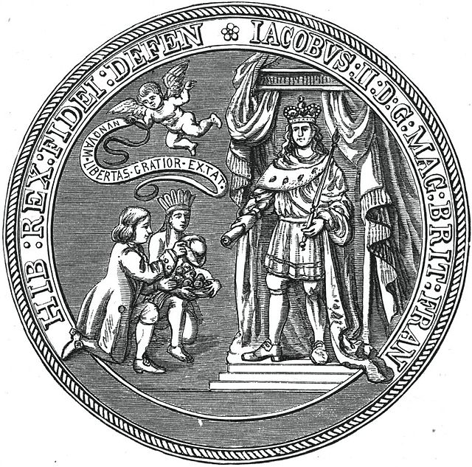
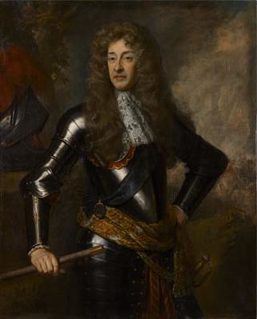
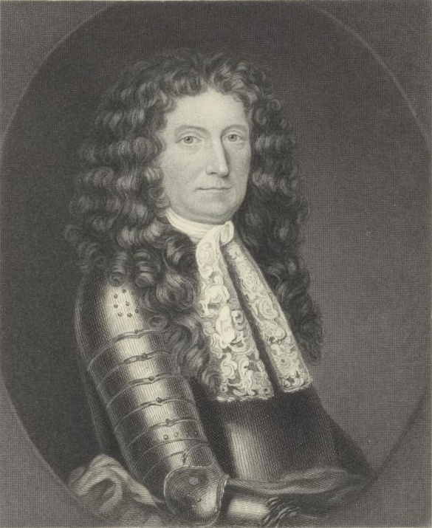
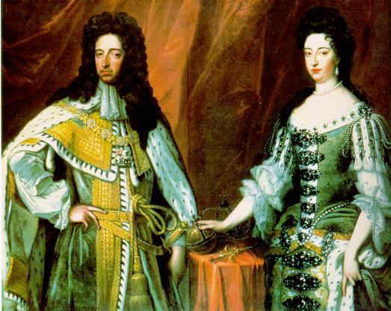
Dominion of New England
James II gained throne in 1685
Opposed colonial assemblies – wanted more direct royal control
1686 formed Dominion of New England (1686-1689) from N.E. colonies NY & NJ under rule of autocratic governor Sir Edmund Andros – became unpopular due to taxes, limiting assemblies, and revoking land titles
1688 Glorious Revolution – William & Mary ousted James, constitutional monarchy
1689 end of Dominion, individual charters returned
Navigation Acts remained but weakly enforced = “Salutary Neglect”
James II
Andros
William & Mary

Slide 10
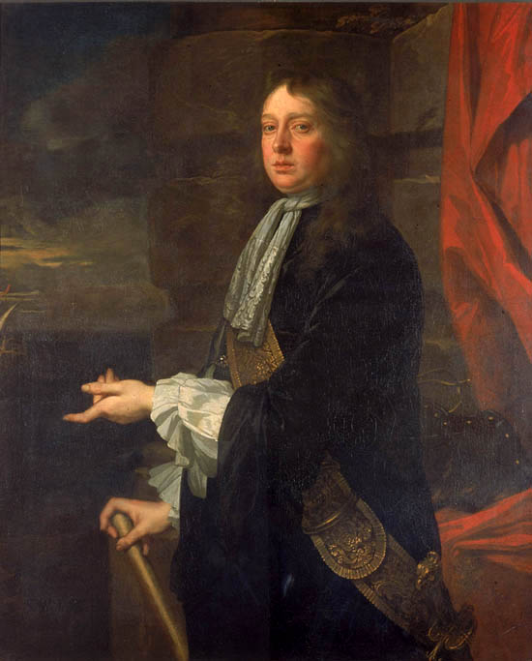
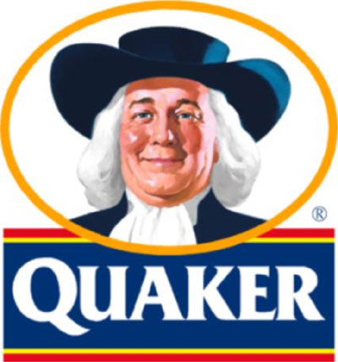
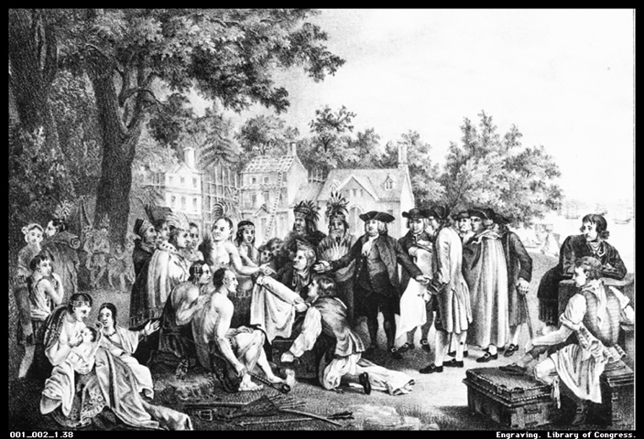
Pennsylvania & Delaware
Society of Friends “Quakers”: believed in equality of all men & women, nonviolence, resistance to military service, & religious authority in each person’s soul not Bible or church authority
Quakers were sometimes persecuted or jailed for beliefs
1681 William Penn (Quaker) proprietary grant to form Pennsylvania to pay off large royal debt to father
“The Holy Experiment” – religious refuge for Quakers & others and to amass personal profit
Frame of Government (1682-1683) representative assembly elected by landowners & written constitution
Charter of Liberties (1701) guaranteed freedom of worship for all and unrestricted immigration
Attempted to treat American Indians fairly
Delaware: in 1702 Penn granted 3 counties their own assembly – separate but shared same governor as PA until revolution.

Slide 11
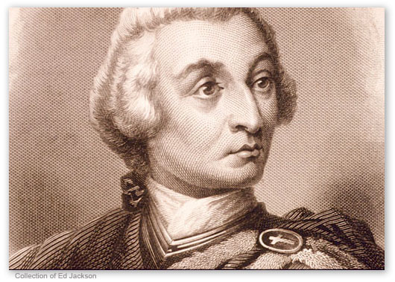
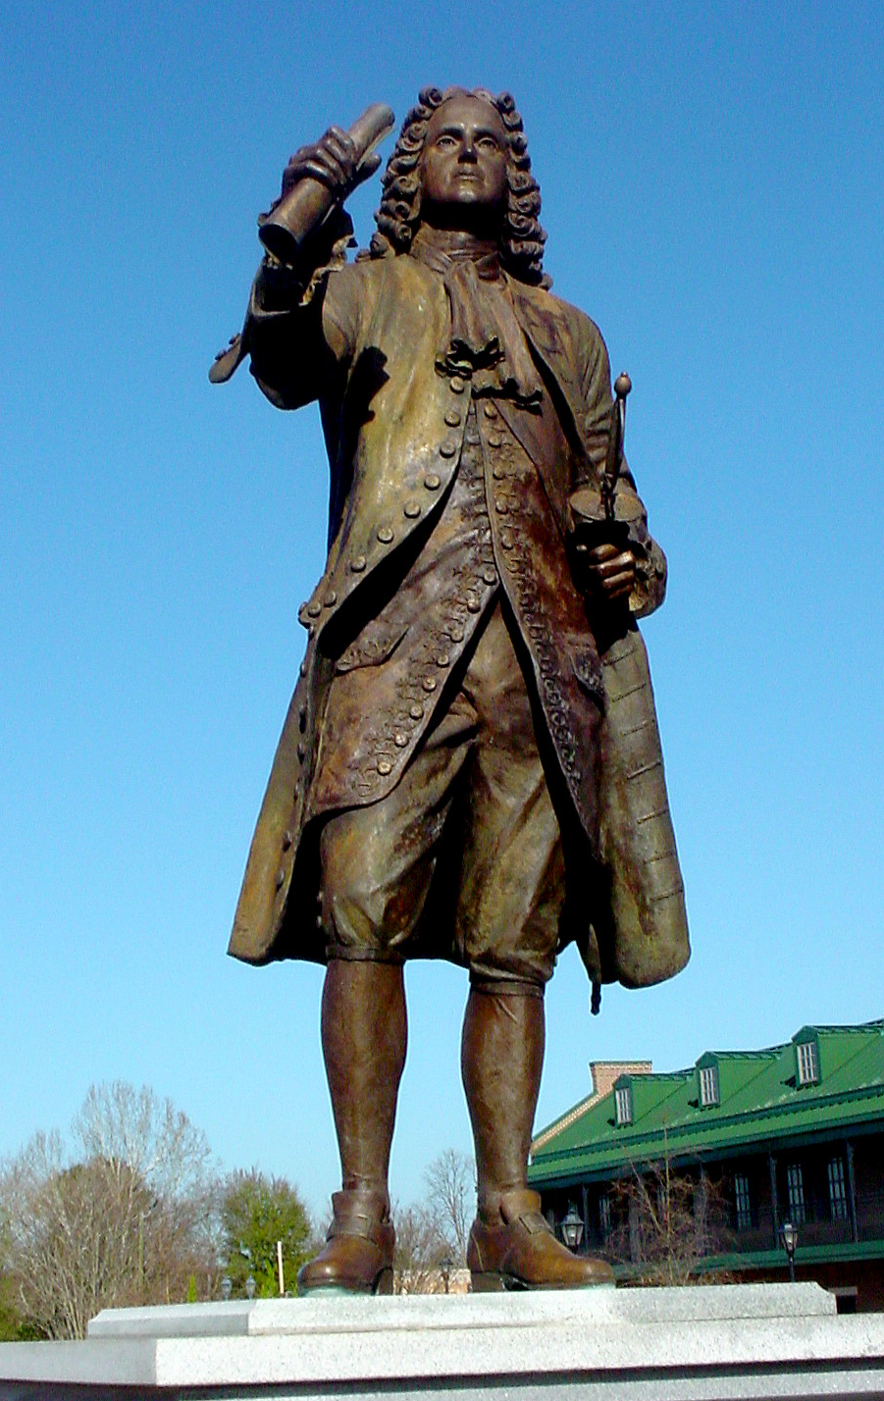
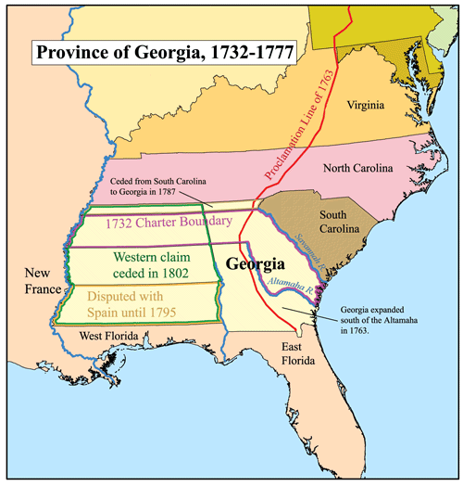
Georgia
Proprietary Charter in 1732 from King George II to James Oglethorpe.
Founded to 1. provide a buffer to Spanish settlement & 2. Haven for debtors
Founded Savannah in 1733
Strict regulations: no slavery, no rum, but isolated and under threat colony remained poor
Dissidents rebelled, motto: “Liberty & Property without restrictions!” – which “liberty”?
1752 became a royal colony and slowly adopted South Carolina style of slave plantation economy
King George II

