Slide 1
Early English Colonies
The Chesapeake
Crash Course #2

Slide 2
Good Morning Class
Bell Work
How was Spanish, English and French colonization similar? How was it different? (TPS)

Slide 3
Essential Questions:
What characteristics make up the Chesapeake colonies? Why did the vast majority of European immigrants to the Chesapeake come as indentured servants?

Slide 4
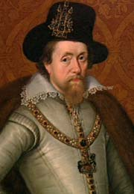
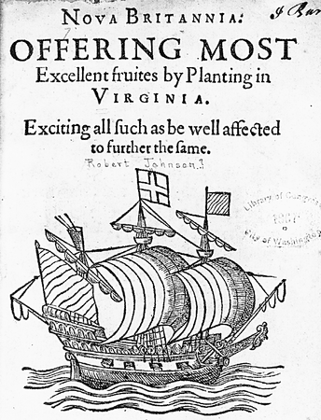
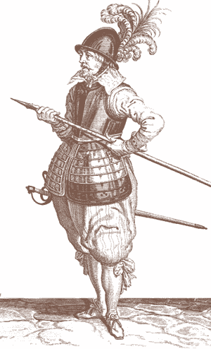
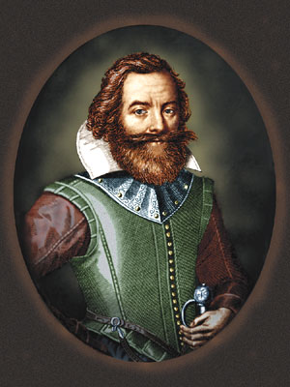
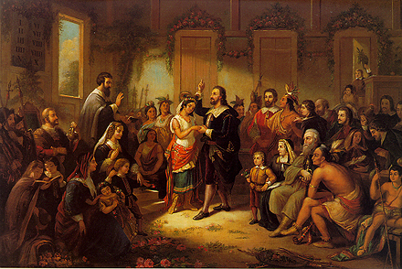

Jamestown & Virginia
1606 - James I issues a corporate charter to the Virginia Company a joint-stock company.
Jamestown founded 1607 swampy area along James River
Problems: malaria & dysentery, “gentlemen” didn’t want to work, searched for gold, “starving time”
Survived under leadership of John Smith &trade w/ Powhatan Confederacy
John Rolfe (married to Pocahontas) developed tobacco - cash crop
Virginia Company near bankrupt: charter revoked Virginia becomes first royal colony in 1624
James I
John Smith
John Rolfe

Slide 5
Take a moment to read Starving Time (1609) by John Smith and answer the following:
What does this passage say about the beginnings of the English efforts to colonize America?
What problems did the Jamestown colony face in its first year?
What sort of relationship did the English colonists have with the local Indians?

Slide 6
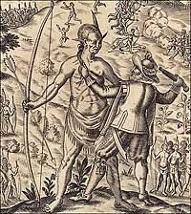
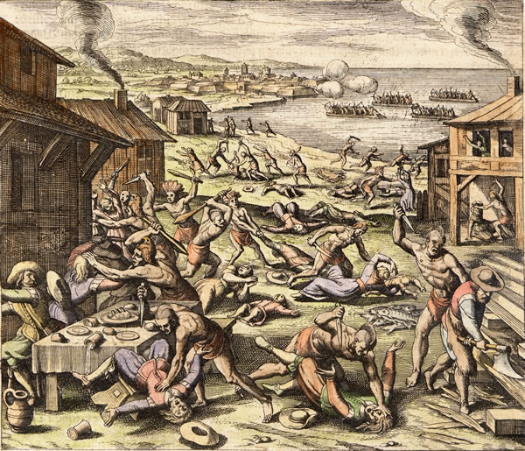

Indian Conflict
Growing immigration demand for land for settlement & tobacco
Opechancanough “He whose soul is white” (Powhattan’s younger brother & successor) resisted expansion & conversion attempts
1622 War: surprise attacks by 12 chiefdoms killing 347 colonists – 1623 “Peace” meeting killing all 250
Virginia Co. called for a “perpetual war” until Native Americans were eradicated.
1644-1646 → Second Anglo-Powhatan War
  Last effort of natives to defeat English, Indians defeated again.
Peace Treaty of 1646
  Removed the Powhattans from their original land.
  Formally separated Indian and English settlement areas

Slide 7
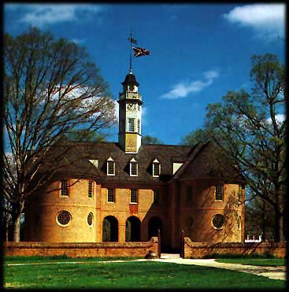
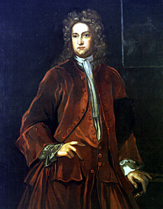
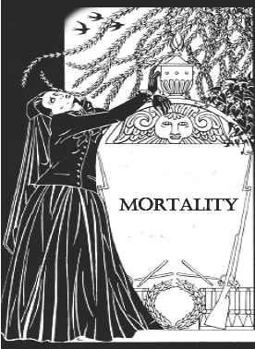
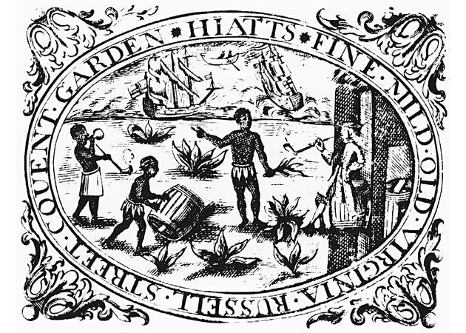
Early Government
House of Burgesses – first representative assembly founded in 1619
Only male property owners could vote
Women and landless men had few rights (widows were an exception). Slaves, indentured servants & Native Americans had nearly no rights at all.
Crown appointed governors acted as autocrats – Gov. William Berkeley (1641-1652 & 1660-1677)

Slide 8
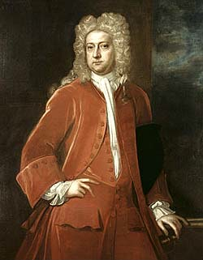
Gov. William Berkeley
“I thank God, there are no free schools nor printing in Virginia, and I hope we shall not have these for a hundred years; for learning has brought disobedience and heresy…into the world, and printing has divulged them, and libels against the best government. God keep us from both!” - 1671
Yes, he actually said that.

Slide 9
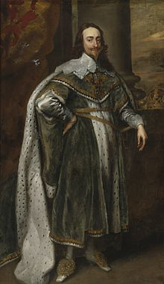
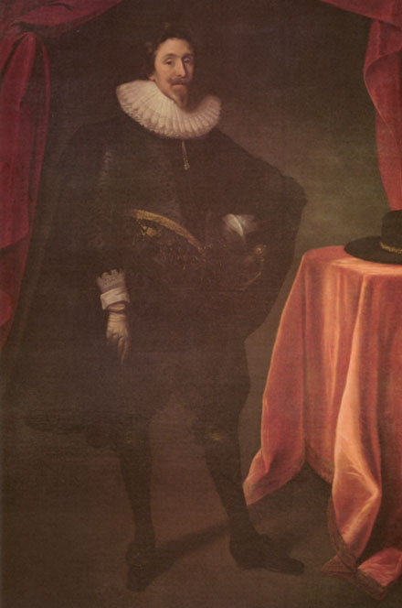
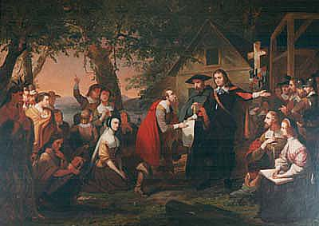
Maryland
1632 Charles I divides Virginia and grants east of Chesapeake to Catholic Lord Baltimore (George Calvert) – 1st proprietary colony
Cecil Calvert founds Maryland as a source of wealth (tobacco) & Catholic haven
Colony controlled by wealthy Catholic landholders, but soon outnumbered by Protestant settlers
Act of Toleration of 1649 religious freedom for a Christians, BUT death to all “who denied the divinity of Jesus Christ”
Protestant revolt in late 1600s – repealed Act of Toleration & Catholics were disenfranchised – Maryland more tolerant to variety of protestant sects than VA.
Huh?
Freedom of worship
for all! Death to all
Jews and Atheists!
Charles I
Lord Baltimore

Slide 10
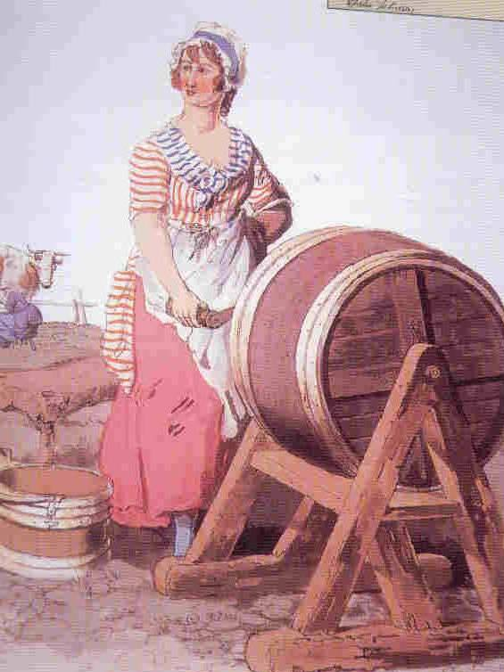
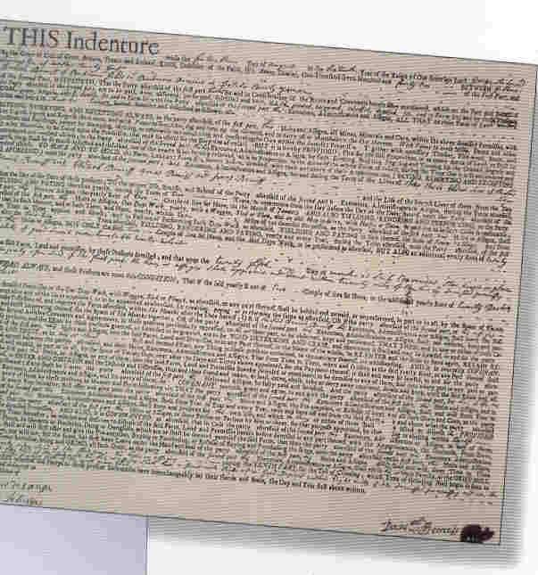
Indentured Servants & Slavery
Demand for land for tobacco led to labor shortages
Indentured servants: master or landowner paid passage. Signed 4-7 year contract then given “freedom dues” $ & land
Headright System: reward 50 acres for themselves & each immigrant whose passage they paid. Effects?
1619 – first Dutch shipment of Africans – indentured servants, no life bondage, children born free
By 1650 only 400 African laborers in Virginia
1660s House of Burgesses passed first slave race laws – children would remain “slaves”
Economic problems: 1660s tobacco overproduction drop in prices – growers tried to raise prices, London merchants raised price of exports to Virginia

Slide 11
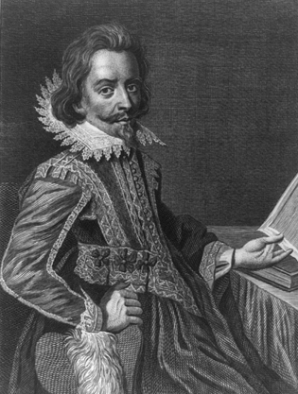
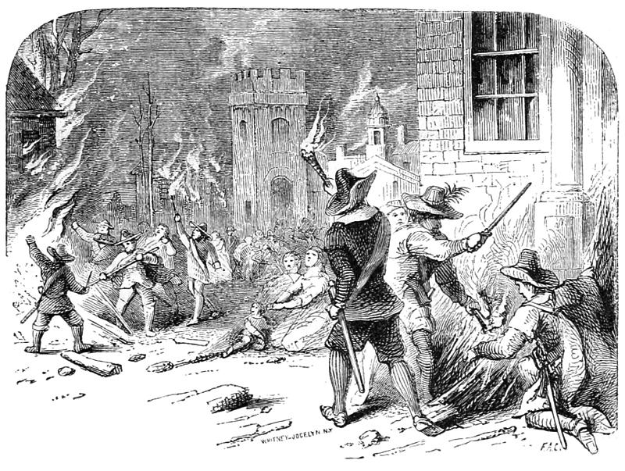
Bacon’s Rebellion: 1676
Gov. William Berkeley used dictatorial powers on behalf of elite
Nathaniel Bacon & western farmers wanted protection from Indians & tax relief
1,000 Rebels resented the large planter elite & his dictatorial rule.
Bacon: Kill “all Indians in general…they were all enemies”, massacre local villages
Berkeley accuses Bacon of treason, Bacon marches and burn Jamestown
Bacon’s “Manifesto” anti-elite – promised lower taxes and better land for freedmen
Bacon dies of dysentery….so it goes.
23 Executed – but Berkeley forced to liberalize
Nathaniel Bacon

Slide 12
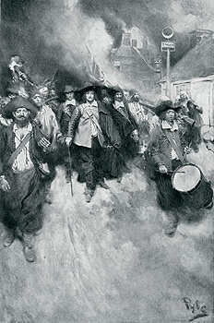
Effects of Bacon’s Rebellion
1. It exposed class conflict between planter elite and landless or poor farmers.
2. Early example of colonial resistance to Royal authority
3. Upper class planters searched for laborers less likely to rebel – eventually turn to more African Slaves
4. Berkeley removed – lower tax burden on poor

Slide 13
Bacon’s Manifesto
1. Read Bacon’s Manifesto
2. HIPP Bacon’s Manifesto
3. Respond to the following questions as a group:
  1. What problems (list at least 3) do Bacon & his fellow fronteirsmen face?
  2. Who does Bacon blame for their plight?
  3. What does Bacon wish to see changed in the colony?

